Slide 1
Using GOES-16 to track deep convection within a wider convective environment
William Jones, Max Heikenfeld , Matthew Christensen & Philip Stier
Climate Processes Group, University of Oxford
Email: william.jones@physics.ox.ac.uk

Slide 2
Objective and Motivation
How does the development and lifecycle of deep convective cores interact with feedbacks in changes in anvil properties?
Many of the atmospheric impacts of anvil clouds – including radiative forcing, tropospheric stability and surface heating – also impact the development of subsequent convection
Changes in individual convective cores need to be considered within changes to the wider environment
E.g. invigoration of DCCs may result in fewer cores developing, complicating the net impact
As these interactions can occur over large domains, satellite observations are vital for investigating these feedbacks
But, there are major challenges in using satellite observations to detect and track both convective cores and anvils over their entire lifetimes…

Slide 3
Novel tracking framework
Dynamical detection
e.g. Cb-TRAM (Zinner et al., 2008)
Geostationary satellites lack a direct definitive measure of convective cores unlike updraft velocity or radar reflectivity in models and cloud radars, respectively
We can attempt to use a proxy for this, such as cloud top cooling(e.g. Cb-TRAM, Zinner et al. 2008)
But, this is only visible for a short section of the DCC lifecycle, and does not detect the anvil cloud
Alternatively we can use a fixed threshold such as anvil temperature
But this is changeable depending on location and meteorology, and may bias investigations of cloud properties
By combining multiple existing techniques within a novel Lagrangian framework, we can overcome the problems with each individual technique
Cloud edge detection (Dim and Takamura, 2013)
“3-D” detection (Fiolleau and Roca, 2013)
Lagrangian framework
(optical flow)
Single step detection & tracking

Slide 4
(a)
Growing Cb
a. Detect developing cores by detecting regions of rapidly cooling, cold cloud tops
(b)
Semi-Lagrangian watershed algorithm
(c)
b. Detects extent of anvil clouds using their edges, without specifying a fixed threshold. Uses the difference of the lower and upper troposphere WV channels (6.2 and 7.3 μm)
c. Links detected cores to the development of the anvil cloud
d. Combining methods to detect the associated anvil cloud. Additional channels used to detect cirrus outflow region
Outflow region
Thick anvil

Slide 5
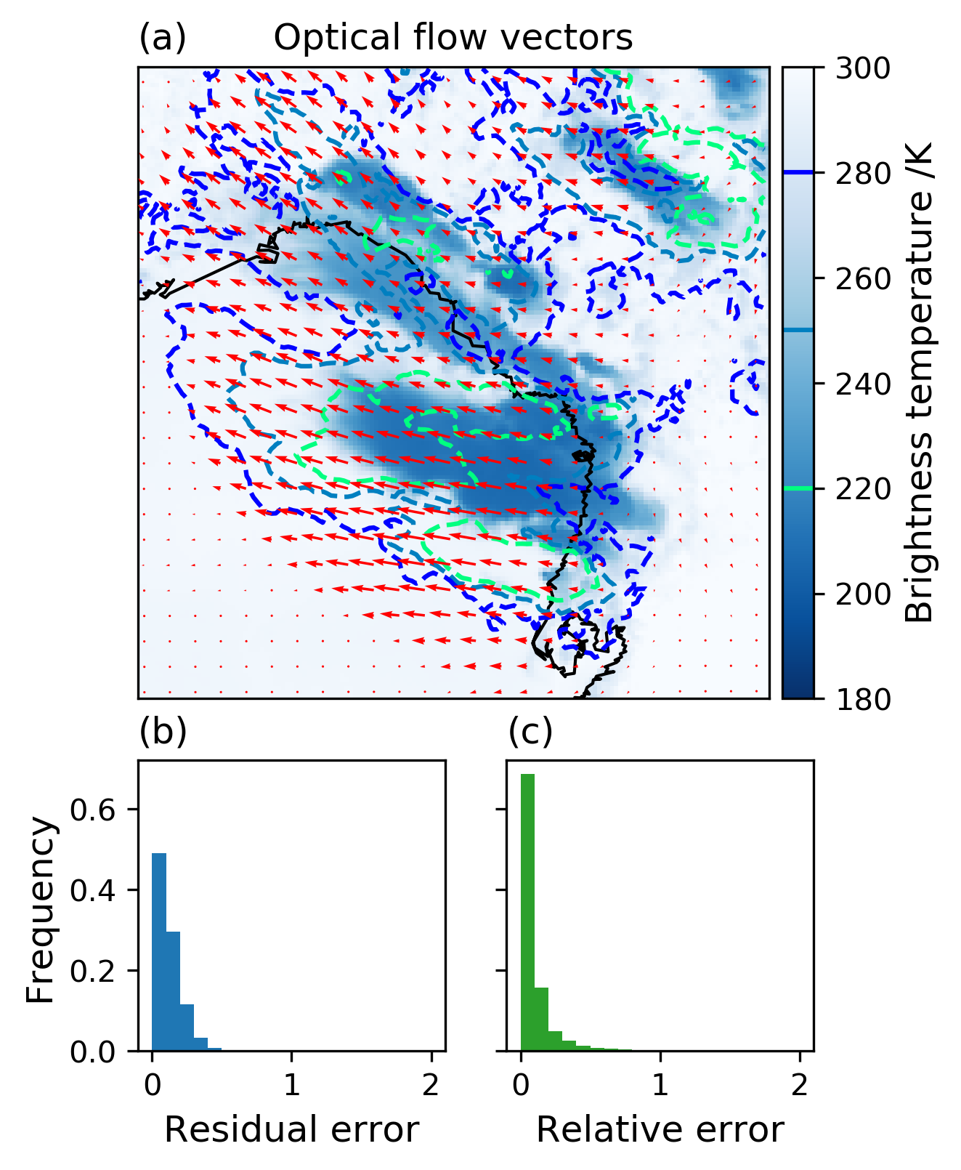
Optical Flow techniques
a. Optical flow vector example. The BT field one hour later is shown by the dashed contours. The red arrows are the calculated flow vectors
Optical flow algorithms estimate the apparent motion of objects in a sequence of images
Already used with geostationary satellite imagery for nowcasting and observing DCCs
Requires that the movement of objects between images is small
5 minute GOES-16 imagery meets this criteria
(b)
b. Relative error of optical flow vector magnitudes is low, generally less than 10%

Slide 6
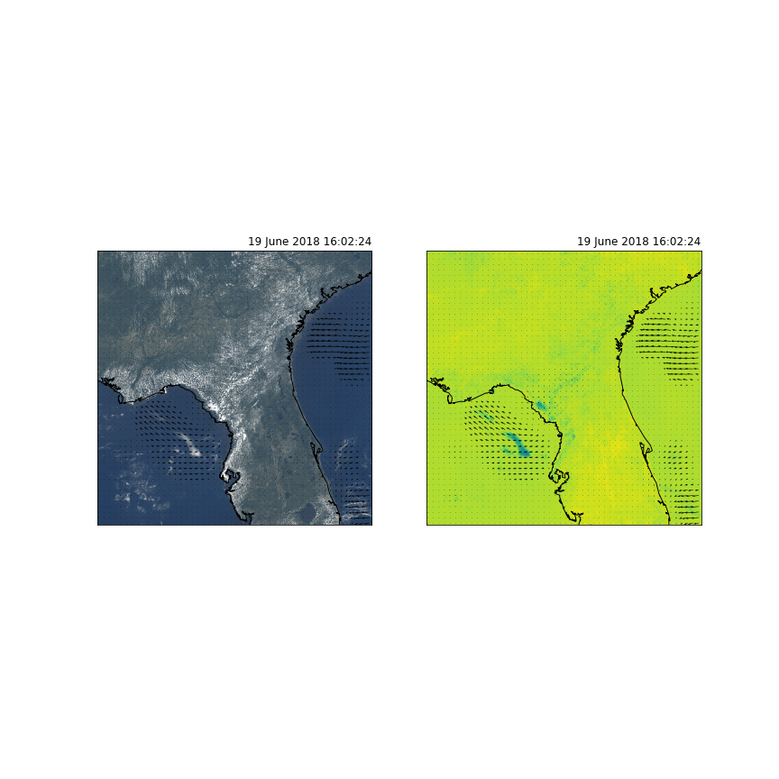
Summary of tracking technique
New tracking technique allows the detection of developing cores to be linked to the full lifetime of the anvil cloud, allowing the investigation of subsequent anvil cloud feedbacks
Will be incorporated into the tobac package
https://github.com/climate-processes/tobac
Now collaborating with the TINT package to build a common framework for DCC tracking with multiple data sources

Slide 7
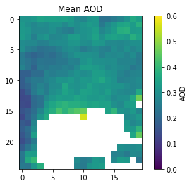
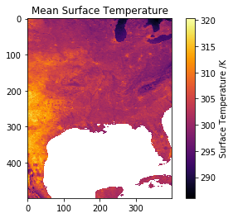
Investigating changes in lifecycle
250
200
150
100
50
0
A change in the time of convective initiation resulting in an anvil cloud of the same size and lifetime could result in a large change in SW forcing
Investigation of the relationship between AOD and time of first detection shows an earlier time for high AOD cases
No observed covariance with other properties such as surface temperature, CAPE and relative humidity
Could be due to invigoration, or be a feedback due to wet deposition and stabilisation from prior convection (e.g. Varble, 2018)
0:00 5:00 10:00 15:00 20:00
Local time of first detection

Slide 8
Conclusion
A novel Lagrangian tracking framework, combined with the capabilities of the newest geostationary satellite imagers, allows better observations of the entire lifecycle of deep convection
It is hoped that this will enable a better understanding of the lifecycle of deep convective clouds and the their interactions and feedbacks with the surrounding environment
A dataset of tracked convective storms over the continental US is being developed using GOES-16 data, providing almost 3 years of continuous observations across a large domain
Early studies have shown that difference in the lifecycle and behavior of anvil clouds can be distinguished in different environmental conditions
We will be investigating further the impacts of prior convection on the development of DCCs, in particular the impact of organized convection

