Slide 1
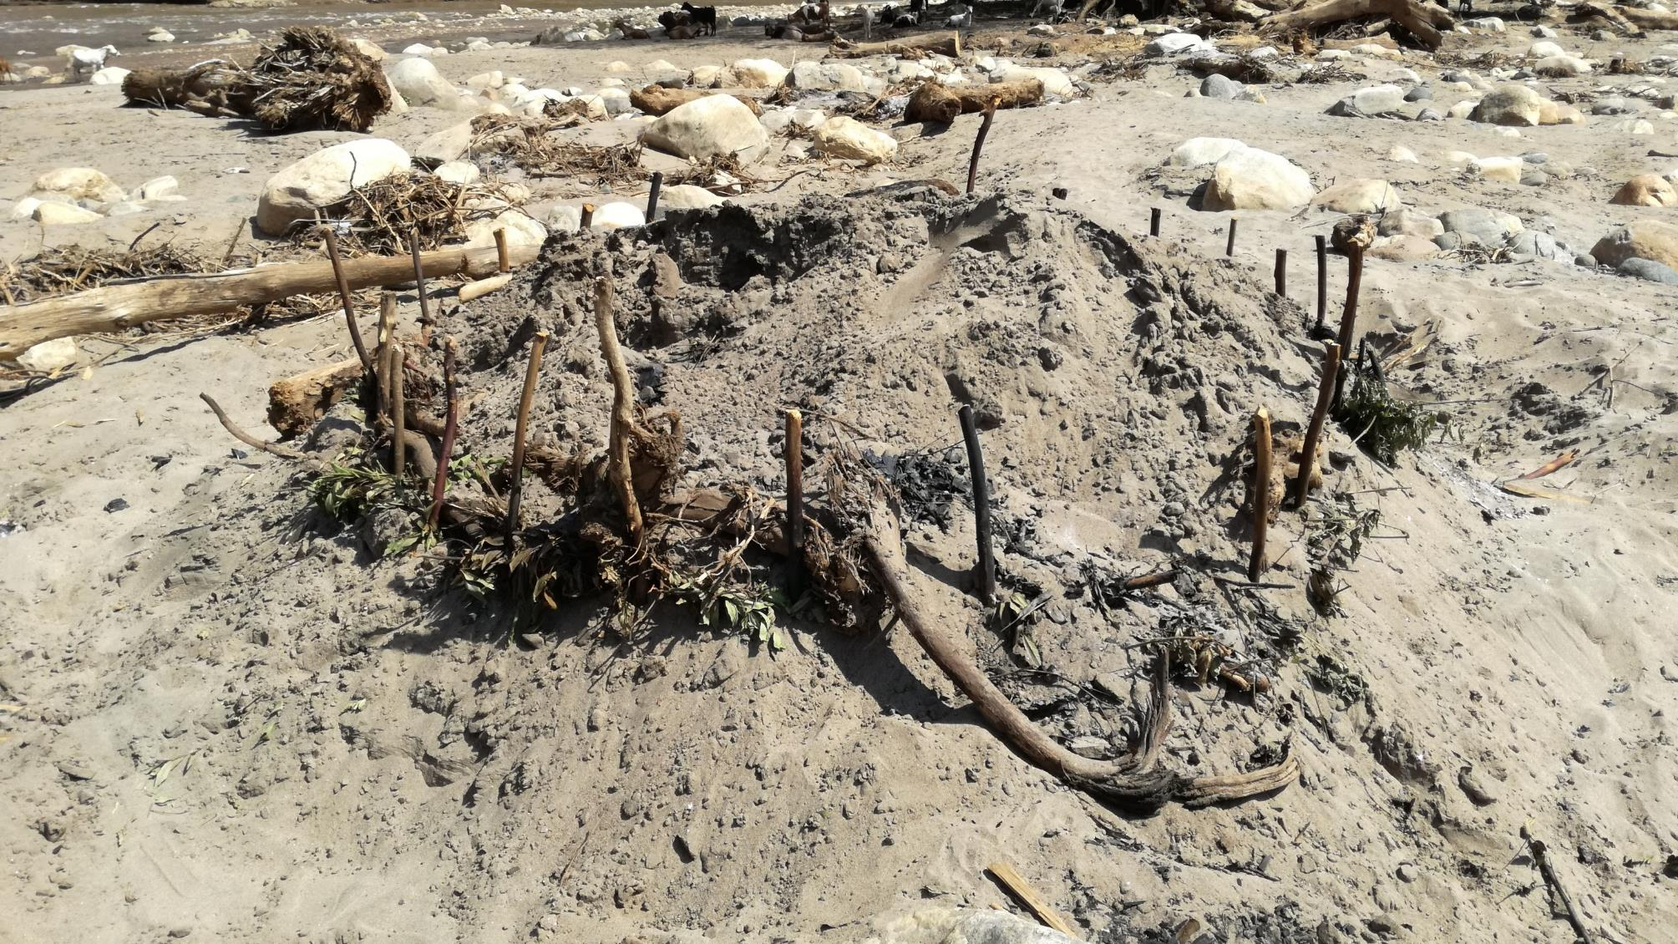
Producing charcoal in sub-Saharan drylands Central Pokot, Kenya 07.05.2020 Maike Petersen, Christoph Bergmann, Paul Roden, and Marcus Nüsser
© M. Petersen 2017

Slide 2
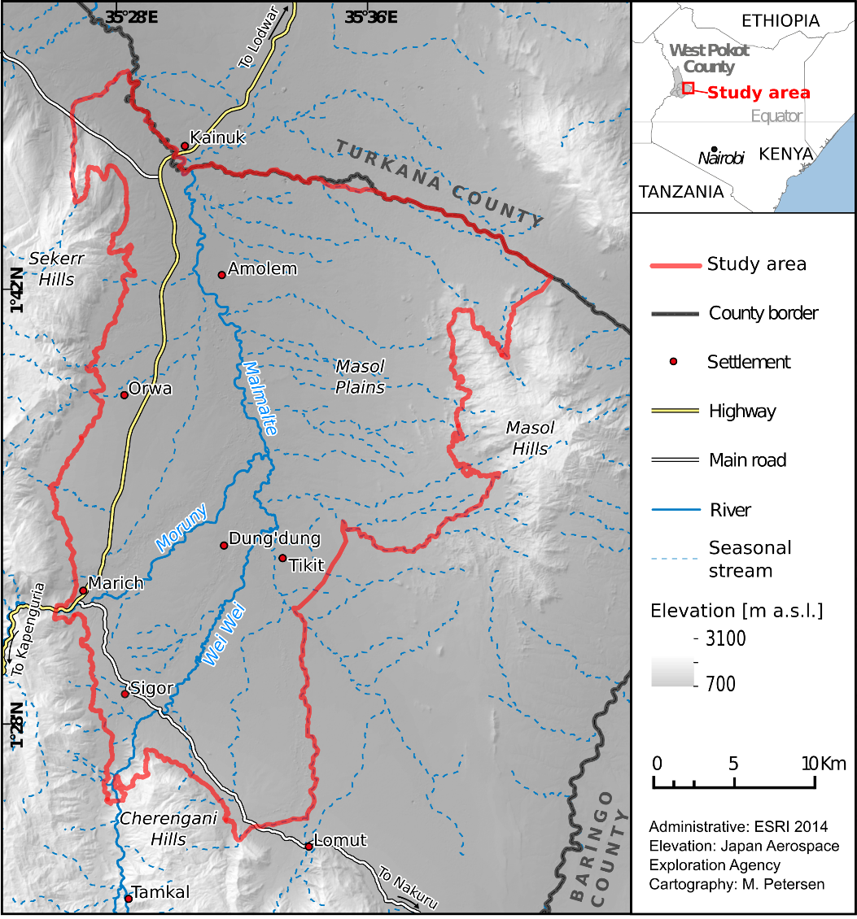
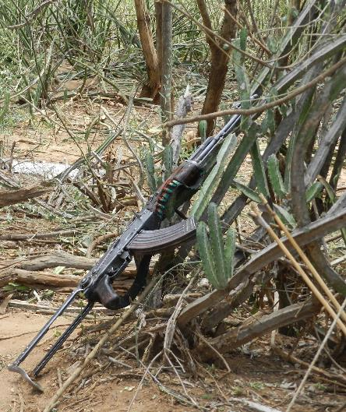
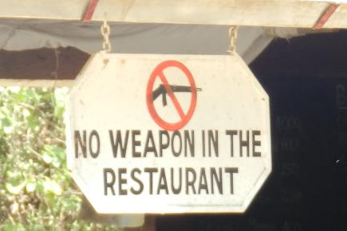
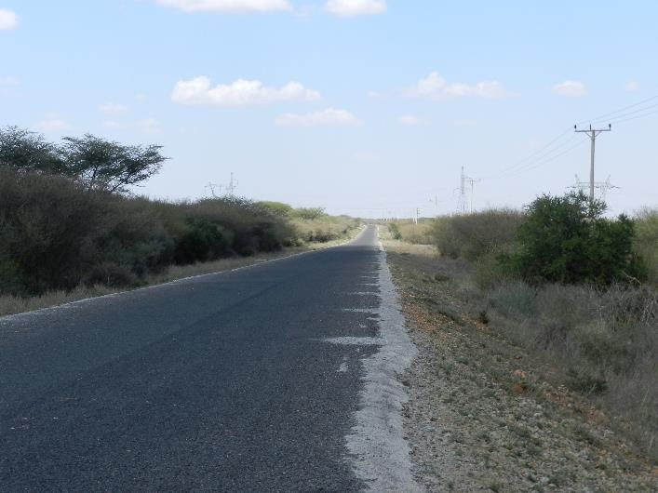
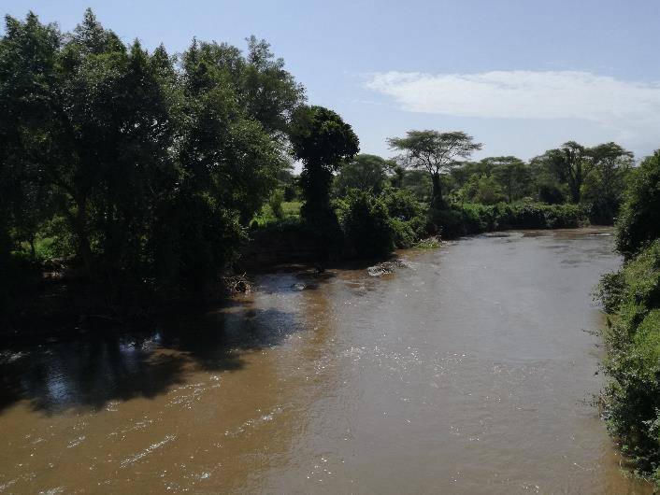
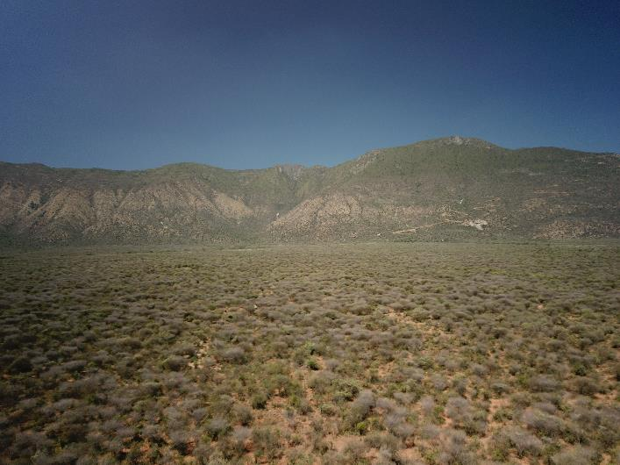
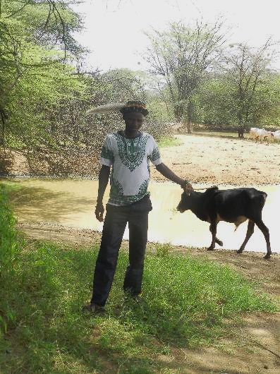
Case study
Pokot Central, Kenya
Population: 119,016​
Study area: ~ 705 km2​
​
​Semi-arid climate​
Border and transit region
Poor infrastructure​
High birth-rates​
High levels of illiteracy​
© M. Petersen 2020

Slide 3
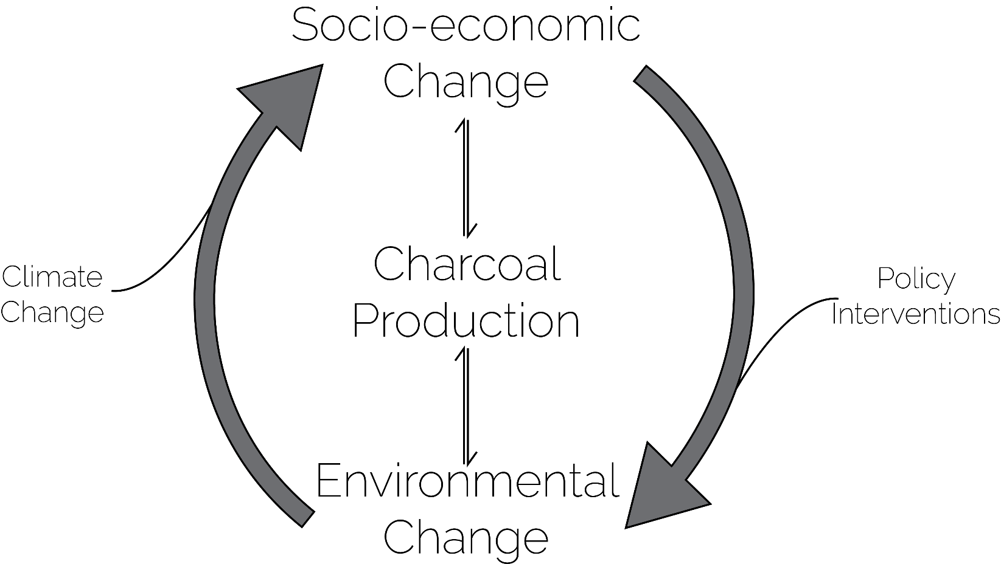
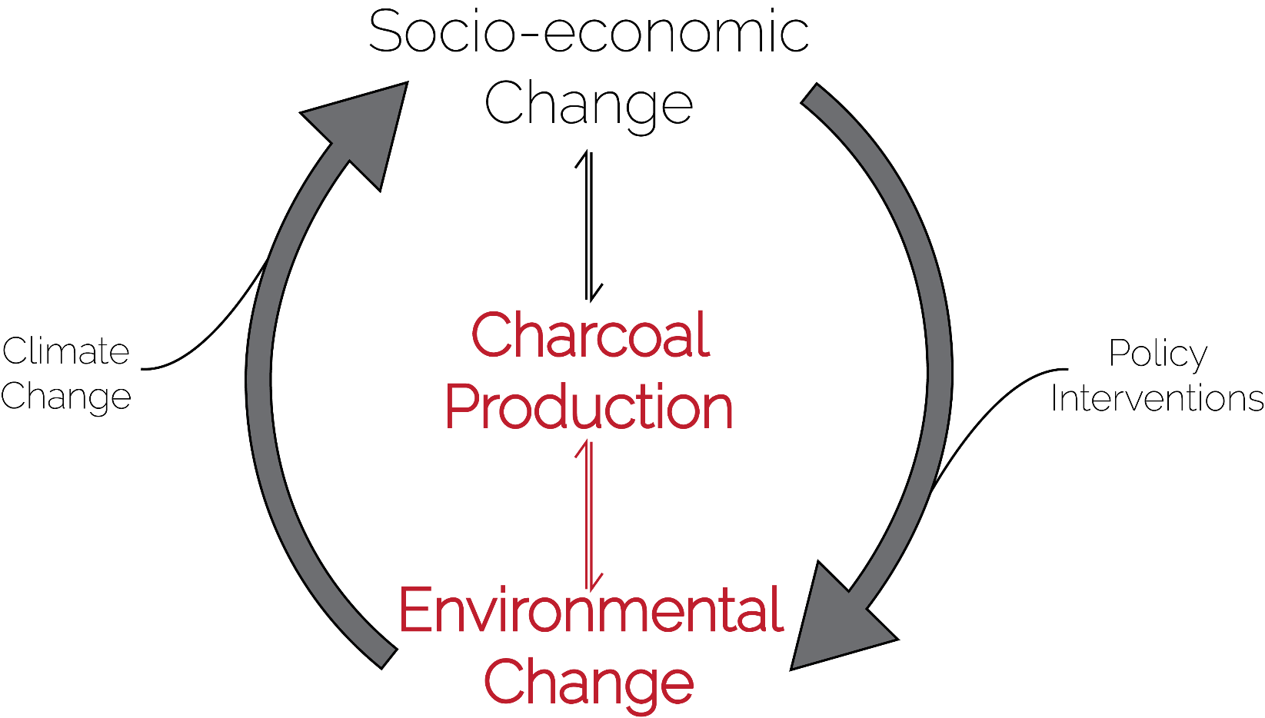
What are the human-environment interactions in the context of charcoal production?
© M. Petersen 2020

Slide 4
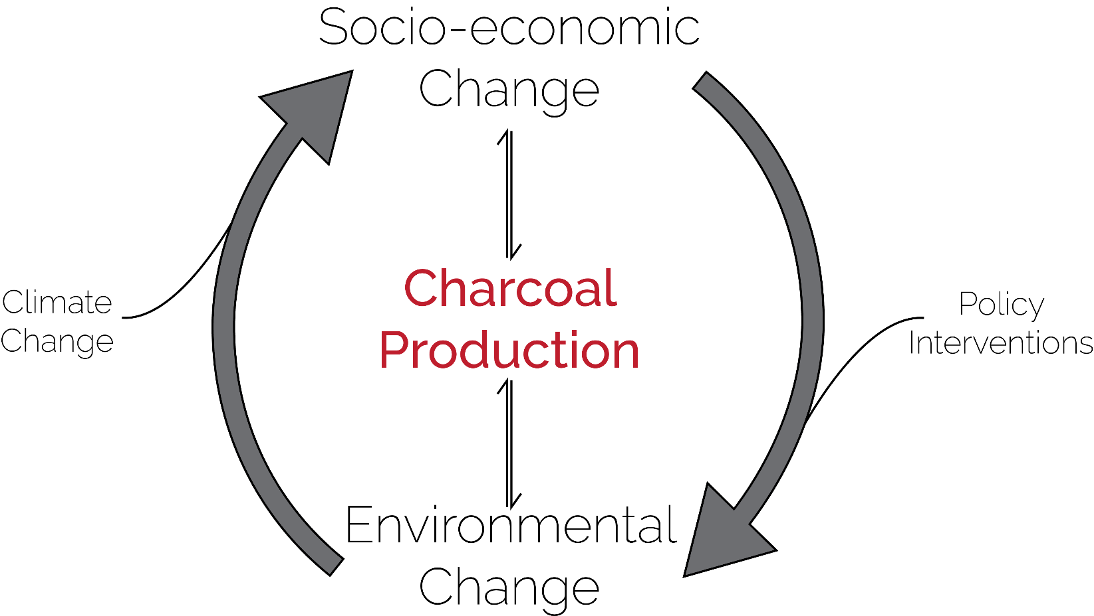
© M. Petersen 2020

Slide 5
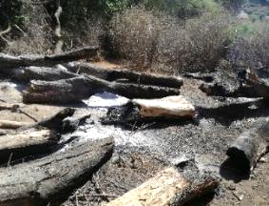
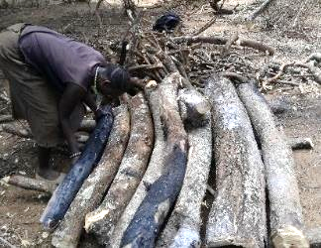
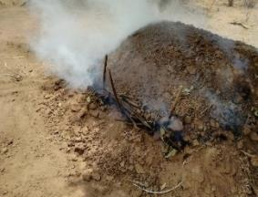
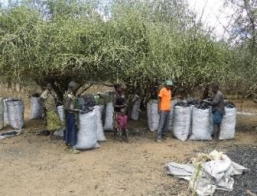
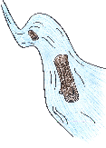
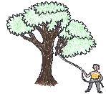
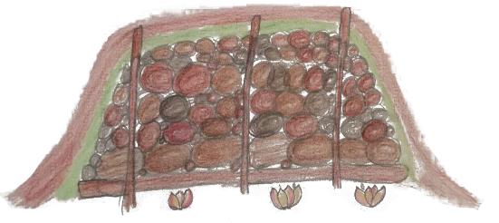
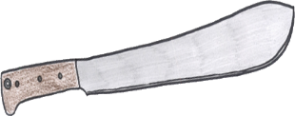
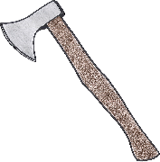
Collection of wood
2.8 days
Installation
1.7 days
Pyrolysis
3.5 days
Selling
6.0 days
Sealed with soil
Sticks for stabilization
Green leaves
Tightly piled wood
ø
11
11
3.4 m²
Logs to create hollow
53
Hollow for fire
82
159
max.
162
2
Average: 1¾ h
Minimum: 20 minutes
Maximum: 3 days
16 m²
126
Drawings © M. Olszok, multiple answers possible
Household survey 03/2017 and 03/2018 | n=169, Data and draft © M. Petersen

Slide 6
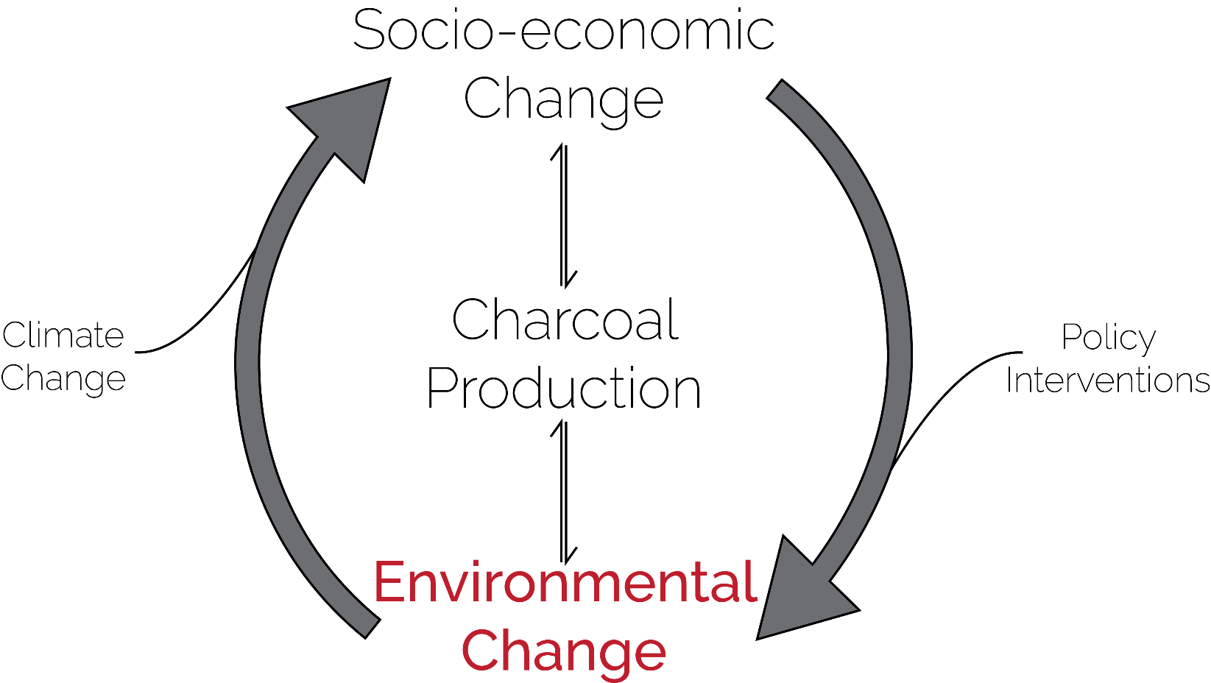
What long-term land use and land cover (LULC) change can be detected in a charcoal producing area?
© M. Petersen 2020

Slide 7
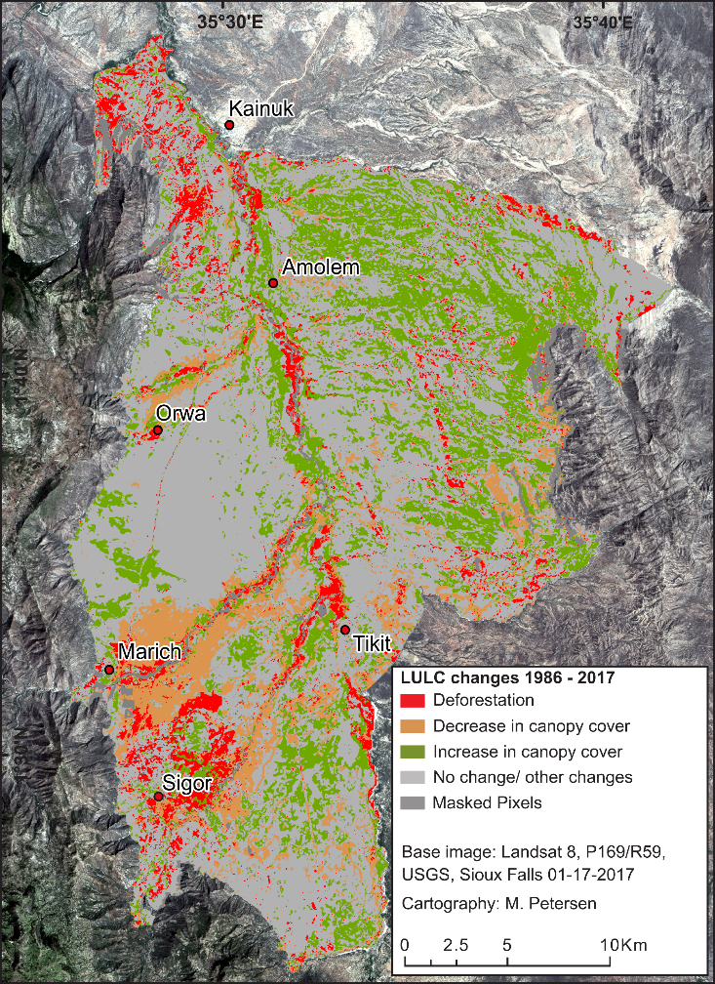
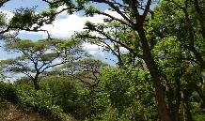
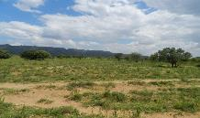
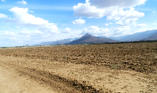
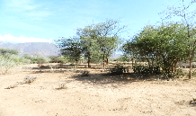
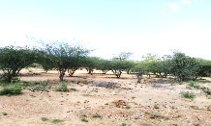
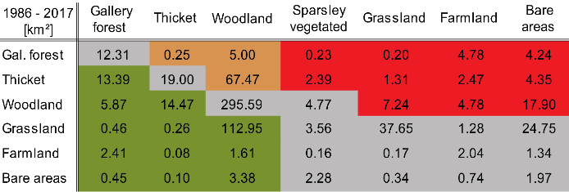
What long-term land use and land cover (LULC) change can be detected in a charcoal producing area?
Deforestation along rivers and around Sigor
Deforestation
Decrease of the vegetation cover in the vicinity of settlements
Increase in canopy cover
Decrease in canopy cover
Bush encroachment in the Masol Plains
© M. Petersen 2020

Slide 8
What long-term land use and land cover (LULC) change can be detected in a charcoal producing area?
Deforestation and decrease in canopy cover due to agricultural expansion and increased settlement
No major decrease in canopy cover at charcoal production hotspots
Increase in canopy cover (bush encroachment) in former pastures

Slide 9
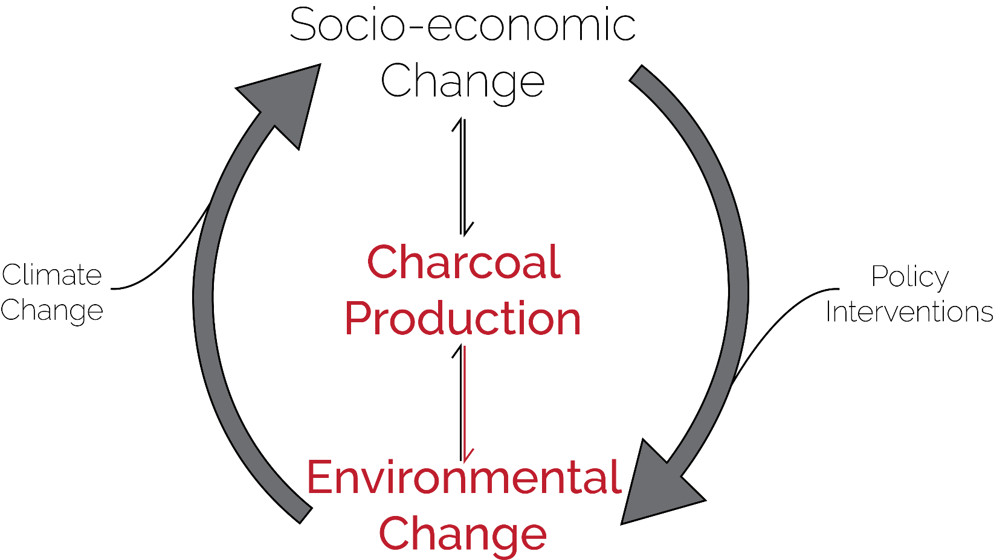
How does the production of charcoal affect the surrounding vegetation on a small scale?
© M. Petersen 2020

Slide 10
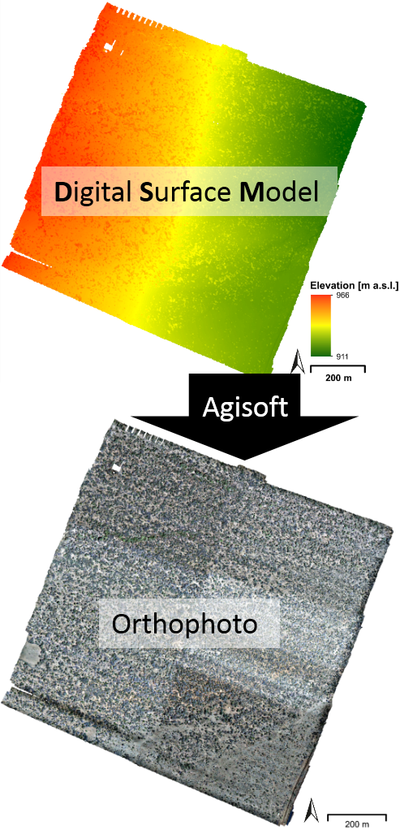
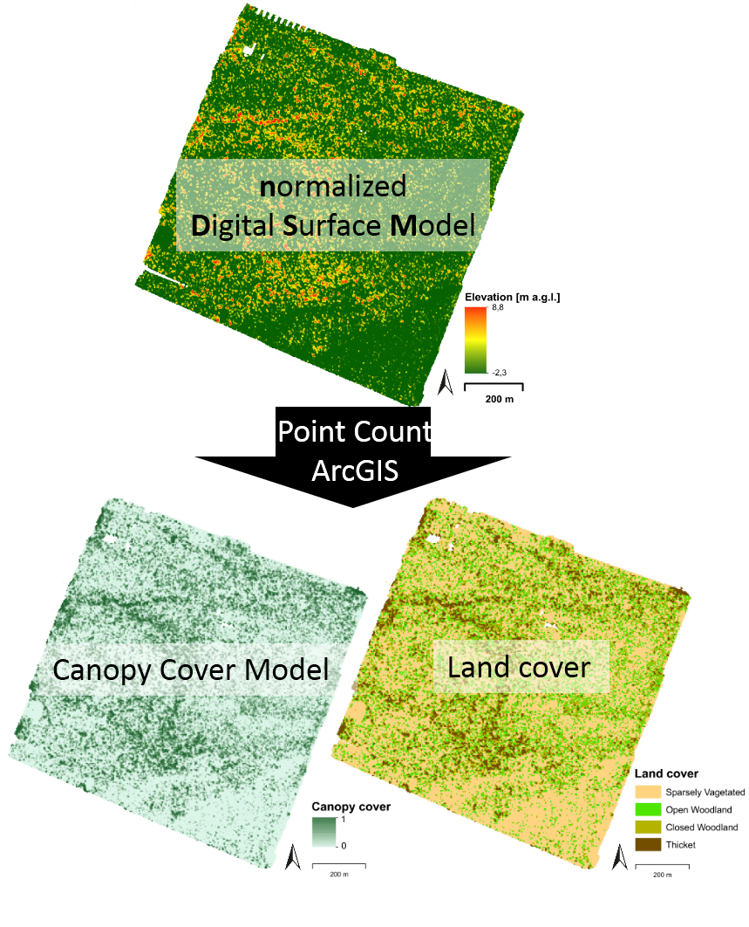
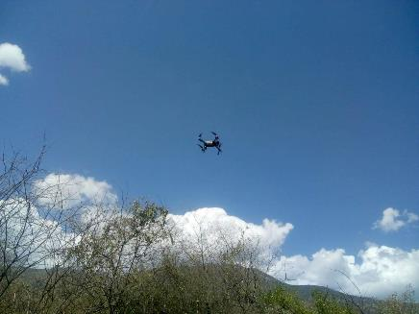
© M. Petersen 2020

Slide 11
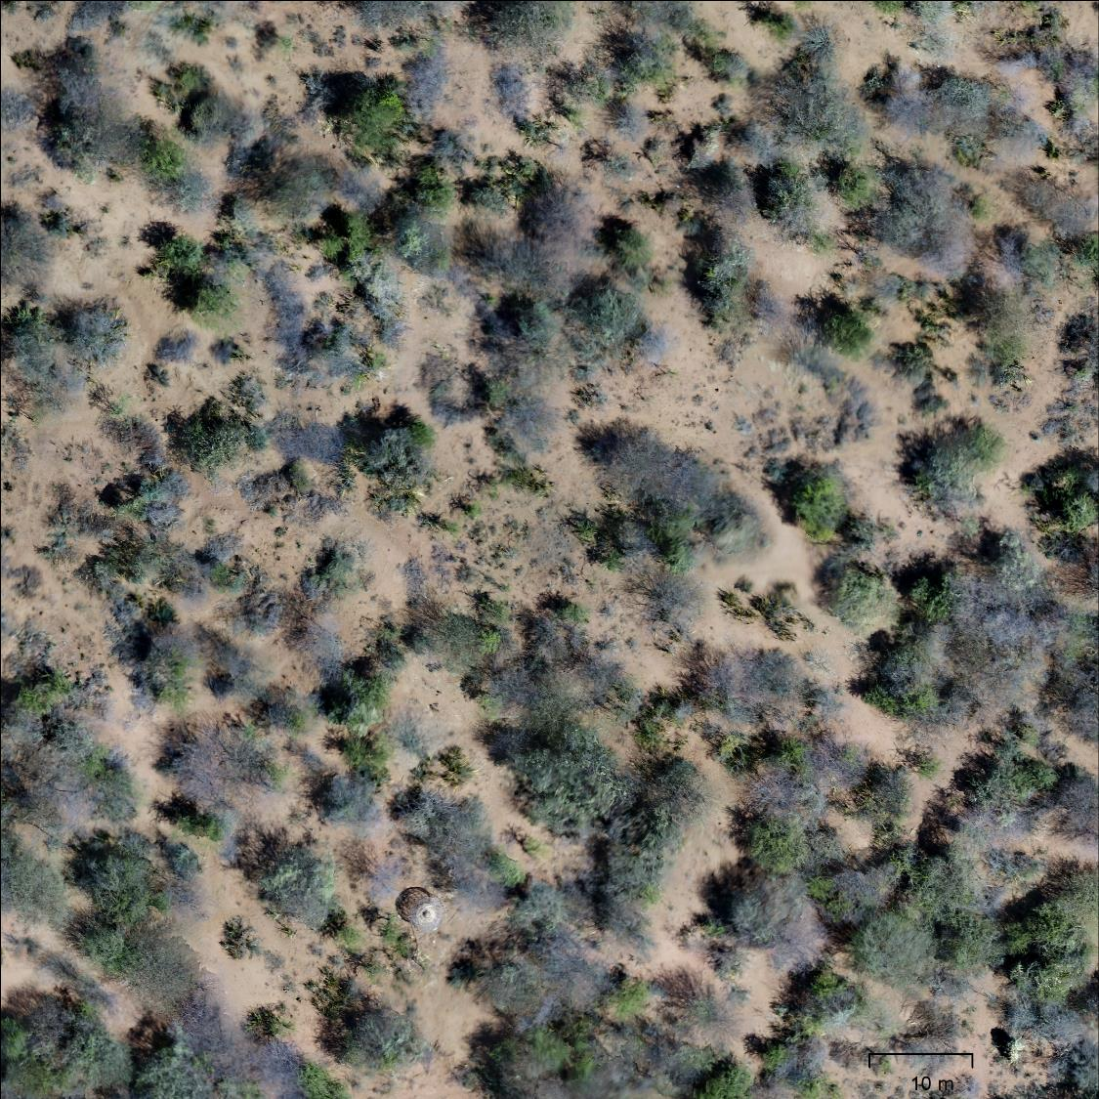
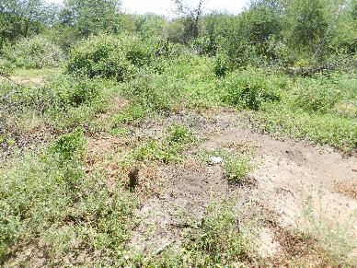
How does the canopy cover change with an increasing distance to the kiln burn mark?
© M. Petersen 2020
© M. Petersen 2020

Slide 12
Kiln burn mark plots
Canopy cover
Reference plots
n=67
n=24
Mean
n=27
Standard deviation
Canopy cover
n=14
Canopy cover
n=20
n=5
n=6
Distance to KBM
Distance to plot centre
© M. Petersen 2020

Slide 13
How does the production of charcoal affect the surrounding vegetation on a small scale?
No significant effects in sparsely vegetated and thicket plots
Small trend in open woodland plots
Small deviation in closed woodland plots
Slight effects only in immediate vicinity of kiln burn marks (15-20m)

Slide 14
How is the impact of charcoal production on the environment perceived by the local population?
© M. Petersen 2020

Slide 15
How is the impact of charcoal production on the environment perceived by the local population?
In your opinion, is charcoal production good or bad for the environment?
In your opinion, why is charcoal production bad for the environment?
Street survey 12/2018 and 01/2019 | n=, Data and draft © M. Petersen
© M. Petersen 2020

Slide 16
How is the impact of charcoal production on the environment perceived by the local population?
Charcoal production perceived as major deforestation driver
Agriculture is not seen as a driver of environmental change
Charcoal producers are understood to destroy the environment by producers and non-producers
But: Sympathy for producers
Charcoal production is an important income source for local population

Slide 17
None to small effects of charcoal production on environment found through remote sensing techniques
Less invasive production than in other producing regions
Banning it is not stopping it!
Investments needed to transform the charcoal sector
Potential for sustainable charcoal production in the area (Long-term studies required)

Slide 18
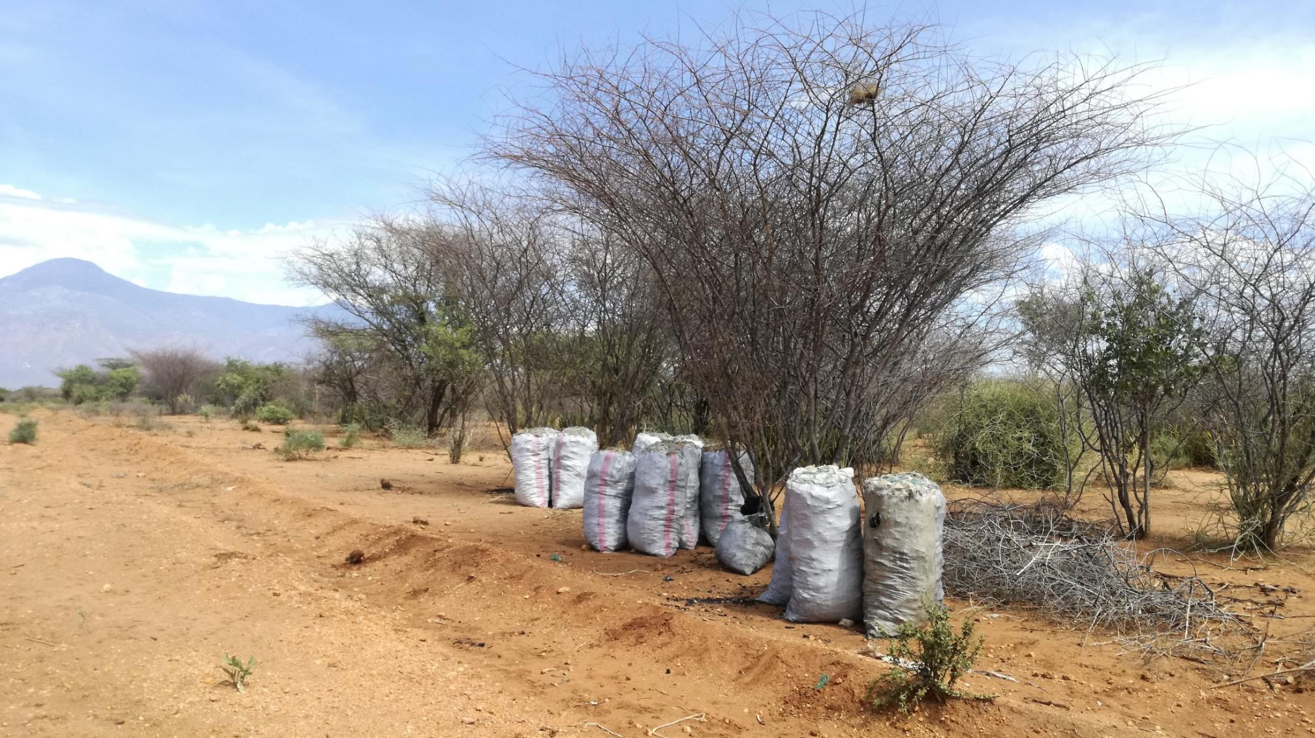
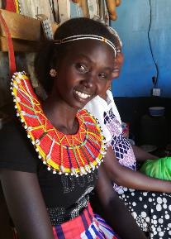
SORO NYO WOW
Uni Heidelberg
Marcus Nüsser
Christoph Bergmann
Paul Roden
Miriam Olszok
Uni Nairobi
Oliver Wasonga
Sharon Teyie
Fredrick Ochieng
Impossible without:
Dinah
Nancy
Jacob
M. Petersen 2017

