Slide 1
Large amplitude exospheric waves seen in MAVEN NGIMS data
Hayley N. Williamson, Robert E. Johnson, Ludivine Leclercq, Lucia Tian, and Meredith Elrod

Slide 2
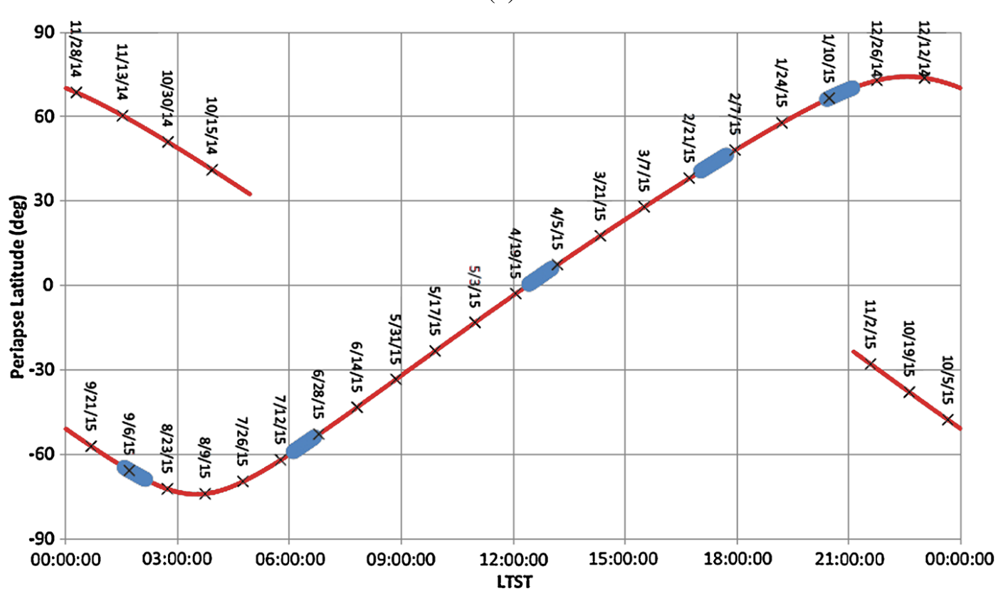
MAVEN Mission
Data used from the Mars Atmosphere and Volatile EvolutioN (MAVEN) spacecraft
Launched in 2013, orbiting Mars since late 2014
Orbit precesses so it covers all local times and latitudes
Primary instrument used is the Neutral Gas and Ion Mass Spectrometer (NGIMS)
Quadrupole mass spectrometer with a range of 2 -150 amu with 1 amu resolution
Jakosky et al. (2015)

Slide 3
Perturbations
Can high altitude, large amplitude perturbations affect the composition and energy of the upper atmosphere?
Criteria for a perturbation of interest:
Ar amplitude is $≥40\%$ of background profile
Only one peak has an amplitude $≥40\%$ of background profile
The peak occurs above the exobase, a column density of $5 × {10}^{18} atoms{/m}^{2}$
We find 252 examples out of 4259 orbits from February 2015 to November 2017

Slide 4
Example perturbation from orbit 2521 on January 16,2016, showing (a) number density versus altitude, (b) amplitude versus altitude, (c) number density versus column density, and (d) amplitude versus column density
Total atomic column density (atoms/m²)

Slide 5
Average profile
Fit the amplitude and density data vs column density with a 15th degree polynomial (to fit perturbations) between 10¹⁶ and 10¹⁹ atoms/m² column density
Can then average these standardized perturbation profiles
Create an average amplitude profile and O/CO₂ profile
Also average the CO₂ amplitude and O/CO₂ for all orbits without a perturbation for comparison

Slide 6
Average profiles, with (a) showing absolute value of amplitudes and (b) showing O/CO₂. The pink line indicates the exobase and the black dashed lines are the values for orbits without a perturbation.
Total atomic column density (atoms/m²)
Total atomic column density (atoms/m²)
Perturbations have peak amplitude at roughly the same column density for all 3 species
The O/CO₂ ratio is significantly different for perturbation orbits, indicating some sort of heating or cooling to change the composition

Slide 7
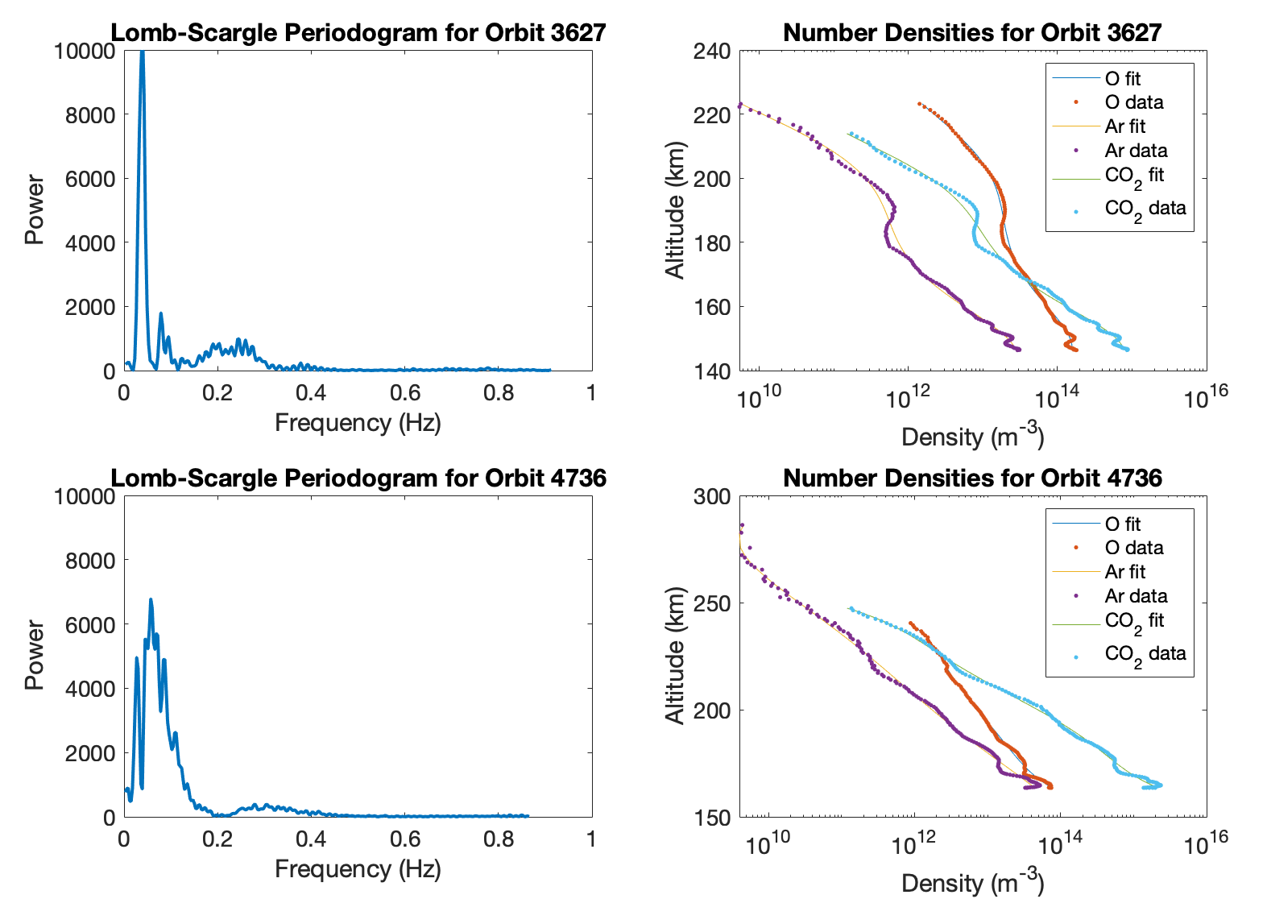
Wavelength
Need wave parameters to model/understand the perturbations
Cannot retrieve a frequency from the data because it is sampled in space, not time
Can use a Lomb-Scargle periodogram to retrieve a wavenumber
Use amplitude vs altitude profiles
All show a single dominant wavenumber peak
Second highest peak usually orders of magnitude lower in power
Average wavelength is 29.6 ± 9.5 km, consistent with thermospheric waves
With large perturbation
Wavelength
Wavenumber (1/km)
Without large perturbation
Wavenumber (1/km)

Slide 8
DSMC Model Comparison
Can’t find frequency directly, so we model perturbations of different frequencies and compare
1D DSMC model with Mars-like O and CO₂ atmosphere
Change number flux in bottom cell at 100 km altitude
Choose frequencies corresponding to gravity waves, evanescent (decaying) waves, and acoustic waves and compare resulting perturbations to the data
Best fit is an acoustic wave with frequencies slightly above the acoustic cutoff frequency
We see residual heating in O but not CO₂ for this wave, explaining the O/CO₂ increase seen in the data

Slide 9
Acoustic Wave - O
Residual heating

Slide 10
Conclusions
Perturbations dissipate at a consistent column density
Amplitudes, wavelengths, and local time dependence consistent with gravity waves
Perturbations change composition by increasing O/CO₂
Acoustic waves are the best fit due to preferential heating of O and shorter wavelength
Models (ours and Walterscheid et al. 2013) show temperature change of a few K
These waves do have a measurable effect on the exosphere

