Slide 1
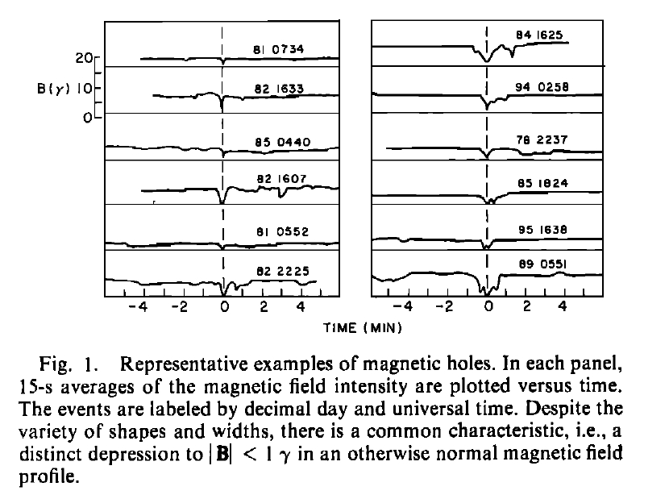
characteristics of magnetic holes
Martin Volwerk
Charlotte Goetz
Ferdinand Plaschke
Tomas Karlsson
Daniel Heyner
Brian Anderson
Martin Volwerk
Space Research Institute (IWF), Austrian Academy of Sciences (ÖAW)

Slide 2
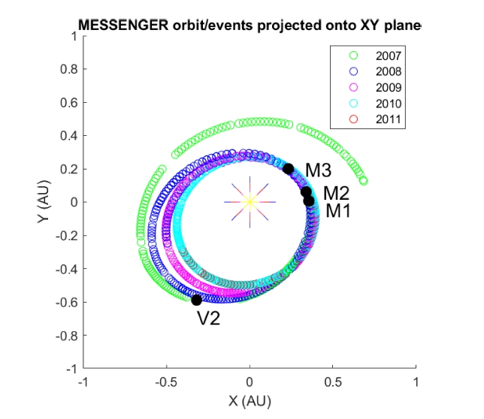
Goal of the study
Preparation for BepiColombo
To do science during the cruise phase
Possibility to use these compressional structures for magnetometer calibration
To study the development of magnetic holes through the inner solar system
Method: Use Messenger data
Messenger Magnetomer Data during cruise phase
starting from Earth (2005) and arriving at Mercury (2011)
Unfortunately the data before the first Venus flyby are unrecoverably perturbed
Start of study in 2007
1 second resolution data

Slide 3
Magnetic holes
What are MHs?
Turner et al. [1977]
Magnetic depressions with |B| < 1 nT in an average field of |B| ∼ 6 nT, in the form of discrete “holes” in the IMF.
Rotation of the background magnetic field is small from one side of the hole to the other
Assumed to be diamagnetic structures created by inhomogeneities in the solar wind plasma
Similarities to Mirror Mode structures
MHs mainly occur in high plasma-β solar wind
Related to mirror modes (MM)
Gary et al. [1993]
high-β plasmas
Temperature asymmetry T⊥ > T∥
Specifically, when R_{SK} > 1
$R_{SK}= \frac{T_{p,⊥}/T_{p,∥}}{1+1/β_{p,⊥}}$
and
$$β_{p,⊥}= \frac{n_{p}k_{B}T_{p,⊥}}{B^{2}/2μ_{0}}$$

Slide 4
Example linear magnetic hole
Two magnetic holes on 4 February 2008
Rotation; θ < 10
Depth: ΔB/B300 > 0.8.
(a) B field (blue), B₃₀₀ (red), and B₂ (green).
Panels (b)–(d) show the unfiltered Bx, By, and Bz.
Panel (e) shows the ΔB/B300

Slide 5
Occurrence rate
Searching for magnetic depressions
B₃₀₀: Background magnetic field - sliding window average over 300 s
B2: Data smoothed by a sliding window average over 2 s
From ΔB/B₃₀₀= (B₃₀₀- B₂)/B₃₀₀ the lowest depressions are determined separated by at least 300 s
The total magnetic field strength is B₃₀₀> 2 nT
The depth of the structure ΔB/B₃₀₀ > 0:5.

Slide 6
Linear magnetic holes: θ < 10°
2D histograms of the width and the depth of the LMHs
Overall the width does not change much, between 15 and 30 s
Magenta line shows max. occ. rate and cyan line observations by Sperveslage et al. [2000]
The depth range is slightly narrower further away from the Sun

Slide 7
Linear magnetic holes: θ < 10°
2D histogram of the width and depth of LMHs as a function of B
The width is rather narrow
Green is median, blue is upper and lower quartile
The depth is rather broad
Higher occurrence of greater depth for stronger B
Green line: exponential function D(B) = a exp{-b B} + c

Slide 8
Change in occurrence rate
The occurrence rate of LMHs decreases with increasing distance from the Sun
Three fits:
Constant number of LMHs, becomes diluted by R-1 Fit: N(R) = a Rb a = 8.6, b = 0.44, R2 = 0.74
Exponential decay of LMHs Fit: a exp{b R} a = 19, b = -1,0, R2 = 0.77
Linear drop off Fit: a + b R a = 18, b = -12, R2 = 0.77
Non are good solutions, and assumption that all LMHs are created at the Sun not realistic

Slide 9
conclusions & Future work
There is a clear behaviour of the Linear Magnetic Holes measured between Mercury and Mars
There is a slow decrease in occurrence rate from ~14% h⁻¹ to ~4% h⁻¹
There is a narrow range of widths ~4 - ~30 s over the whole distance.
If the LMHs show a Bohm-like diffusion (like mirror modes) then a constant creation, diffusion and (stochastic) decay needs to occur (between Mercury and Venus)
Therefore, more data need to be analyzed, e.g. BepiColombo cruise phase
Messenger did not have appropriate plasma data to fully study the LMHs
Future work:
Study LMHs with missions including good plasma data (e.g. MMS near Earth)
A dedicated ISSI team to study magnetic depressions in the solar system

