Slide 1
The characteristics and drivers of precipitation over the Serengeti-Mara region
Josephine Mahony, Ellen Dyer and Richard Washington

Slide 2
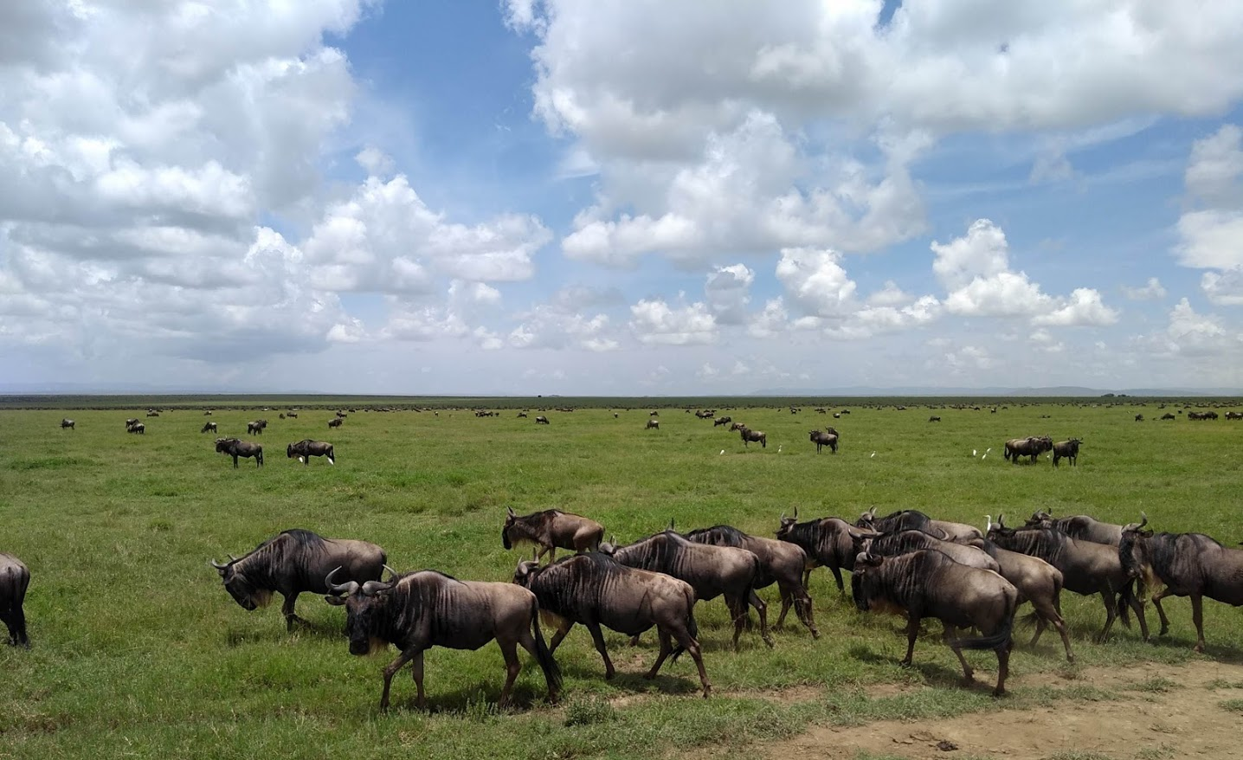
The Serengeti-Mara ecosystem
The Serengeti National Park is famous for the annual migration of approximately 1.2 million wildebeest

Slide 3
Migration drivers
Animals migrate around the ecosystem in a clockwise direction
Driven by a constant search for grass
Grass quality determined by soil chemistry and geology, with more nutrient rich soils present in the south
Grass availability determined by rainfall
Mean monthly position of the wildebeest migration available at: https://www.expertafrica.com/tanzania/info/serengeti-wildebeest-migration

Slide 4
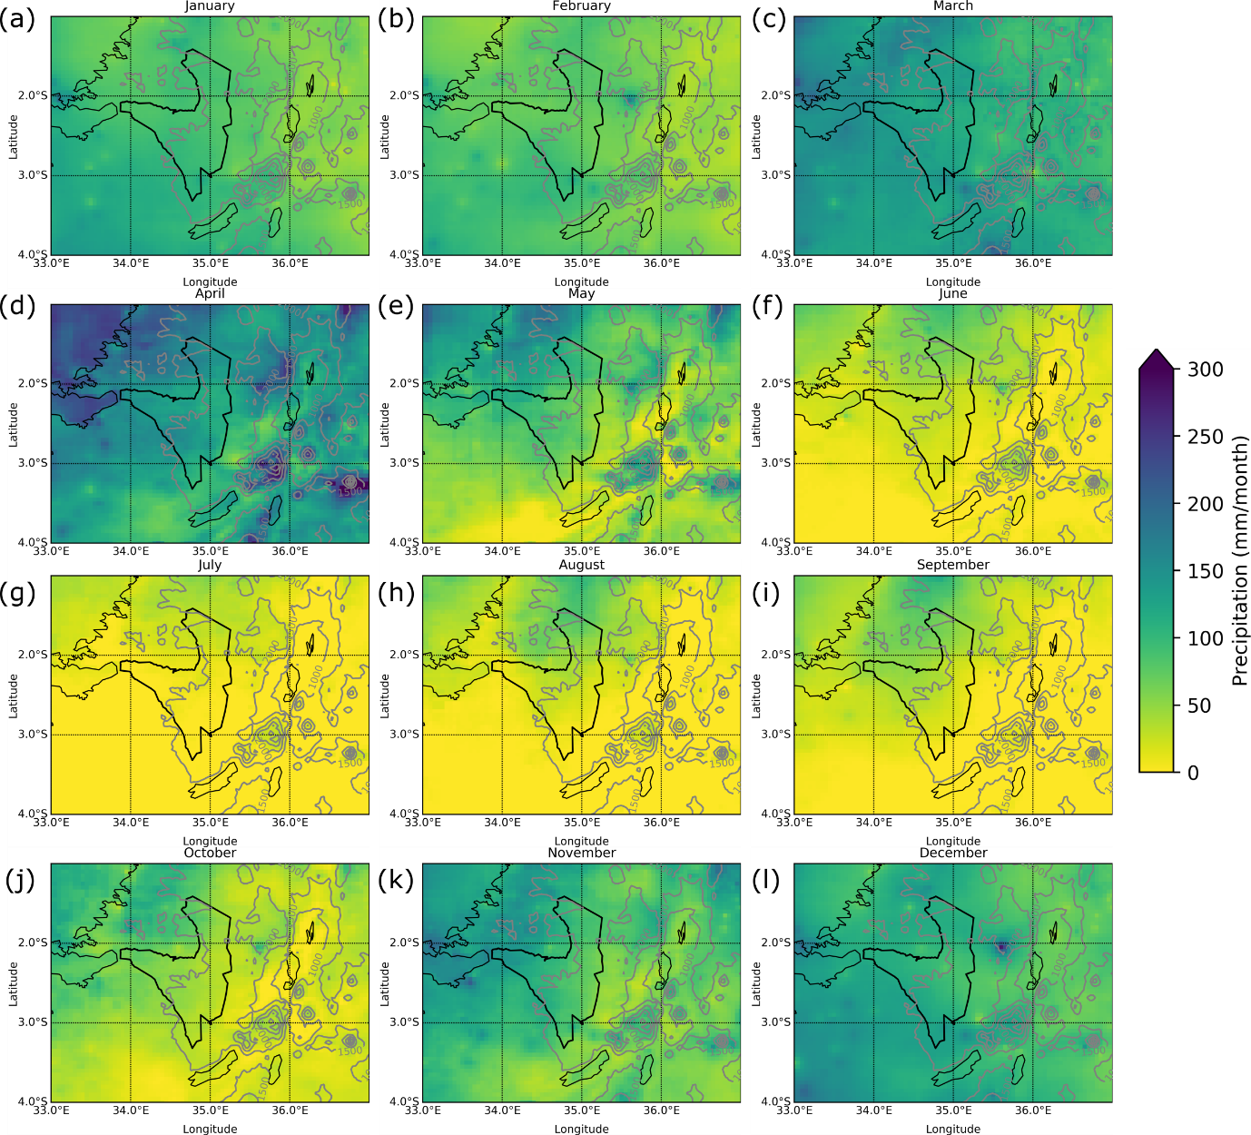
Regional Rainfall
Region receives typical annual cycle for tropical east Africa – wet seasons in March – May and October - December
There are still strongly heterogeneous patterns across the park, suggesting the influence of mesoscale systems
Topographic interactions apparent – more rain over highlands, less rain to the east of mountains
Also, a seasonally changing precipitation gradient runs across the park
Monthly climatological mean precipitation across the wider Serengeti domain. Monthly rainfall climatologies calculated from CHIRPS dataset (1987-2016) for each month, starting with January (a) and finishing with December (l). Gtopo30 topography data overlaid.

Slide 5
Rainfall gradient
The seasonally changing orientation of the rainfall gradient becomes clearer when colour bar is altered to reflect the range of values recorded in each month
Mean monthly rainfall (CHIRPS, 1980-2006)

Slide 6
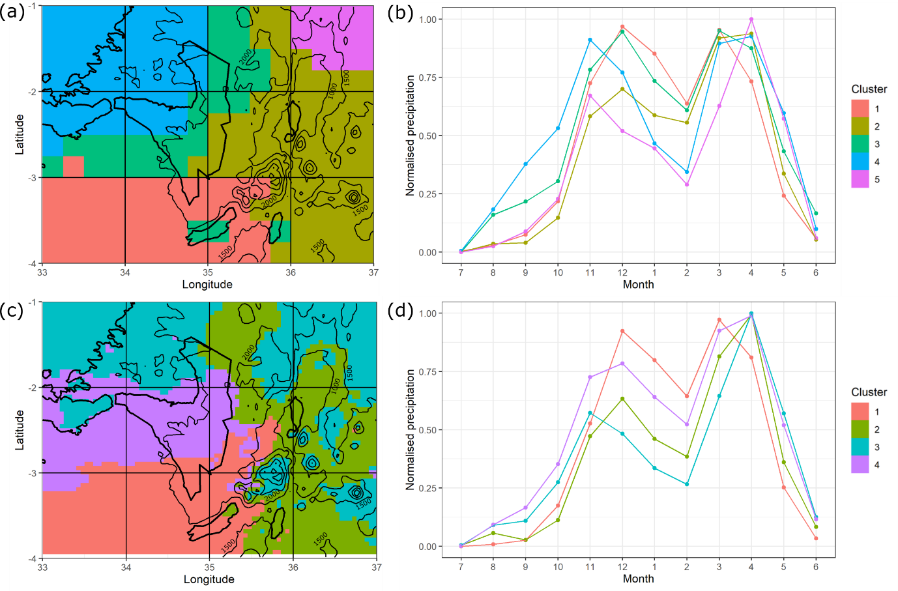
Cluster analysis
Spatially heterogeneous monthly rainfall patterns lead to distinctly different annual cycles across the region
Cluster analysis (Ward’s minimum variance method) identified distinct annual cycles in 5 parts of the region, with varying peak rainfall months and dry season rainfall totals.
Cluster analysis of normalised climatological annual cycles. For each spatial datapoint/location, the annual cycle of precipitation was clustered using hierarchical cluster analysis (Ward’s criterion). The spatial distribution of the resulting clusters is shown for the (a) TRMM (1998-2014); and (c) CHIRPS (1987-2016) precipitation datasets. The normalised annual cycles for the identified clusters are shown for (b) TRMM; and (d) CHIRPS.

Slide 7
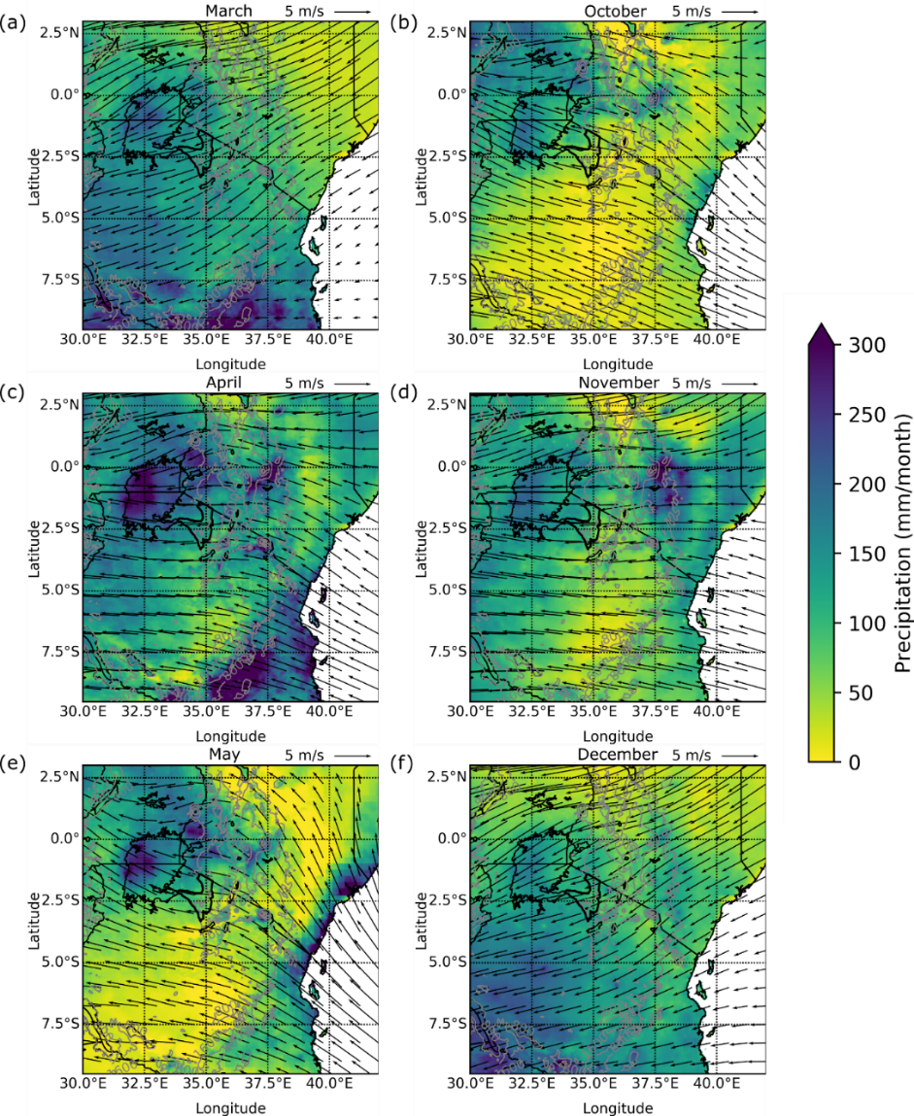
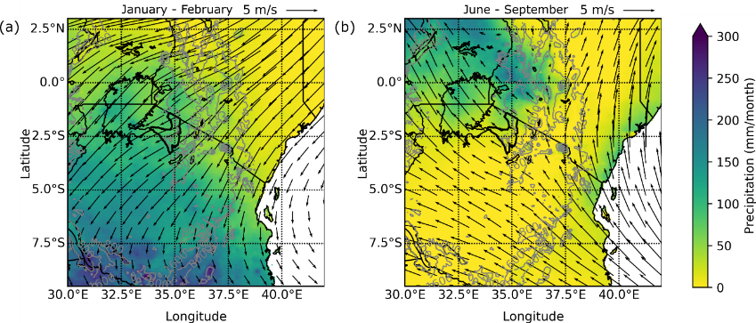
Dynamic Causes
Wet seasons
Mid-tropospheric winds explains the basic structure of the region’s annual rainfall cycle (wet seasons are associated with biannual passage of tropical rainfall belt)
But does not spatial heterogeneity observed over the Serengeti
Clear Lake Victoria plays a role
Dry seasons
Climatological precipitation and mid-tropospheric wind patterns during the East Africa wet seasons. Precipitation (CHIRPS, 1987-2016) and wind (ERA-I, 1986-2017) climatologies shown for (a) March; (b) October; (c) April; (d) November; (e) May; and (f) December. Gtopo30 data overlaid.
Climatological precipitation and mid-tropospheric wind patterns during the East Africa dry seasons. Precipitation (CHIRPS, 1987-2016) and wind (ERA-I, 1986-2017) climatologies shown for (a) January-February; and (b) June-September. Gtopo30 data overlaid.

Slide 8
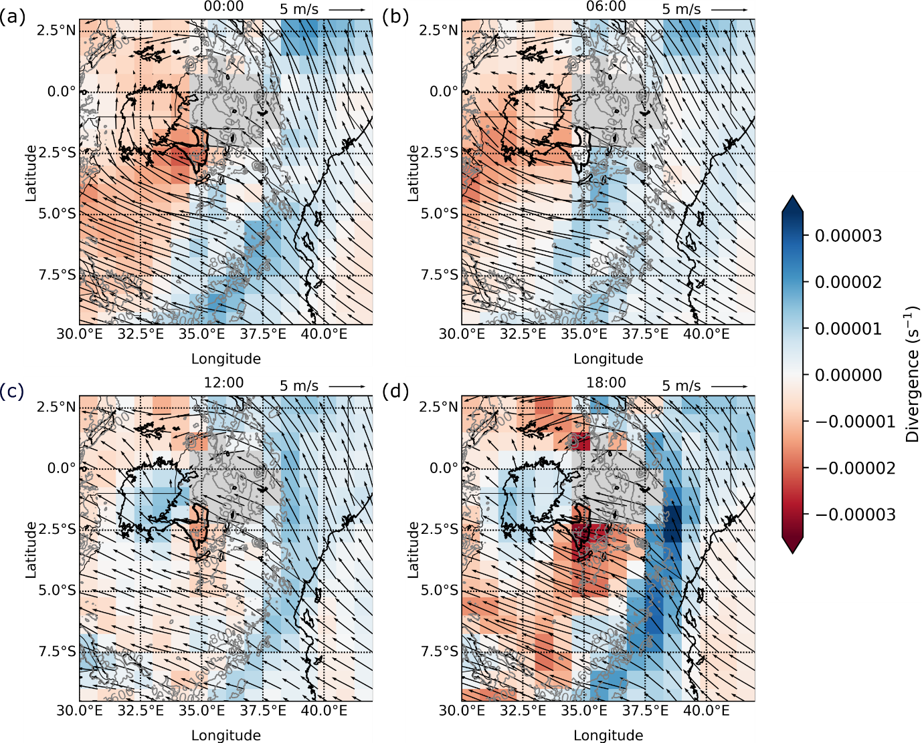
Lake Victoria land-lake breeze
The annual land-lake breeze over Lake Victoria is strong and often leads to converging winds over the Serengeti National Park
Mean annual (1987-2016) diurnal cycle of annually averaged lower tropospheric (825 hPa) wind (vectors) and divergence (shading) over East Africa for (a) midnight (00:00); (b) early morning (06:00); (c) midday (12:00); and (d) early evening (18:00). Gtopo30 data overlaid.

Slide 9
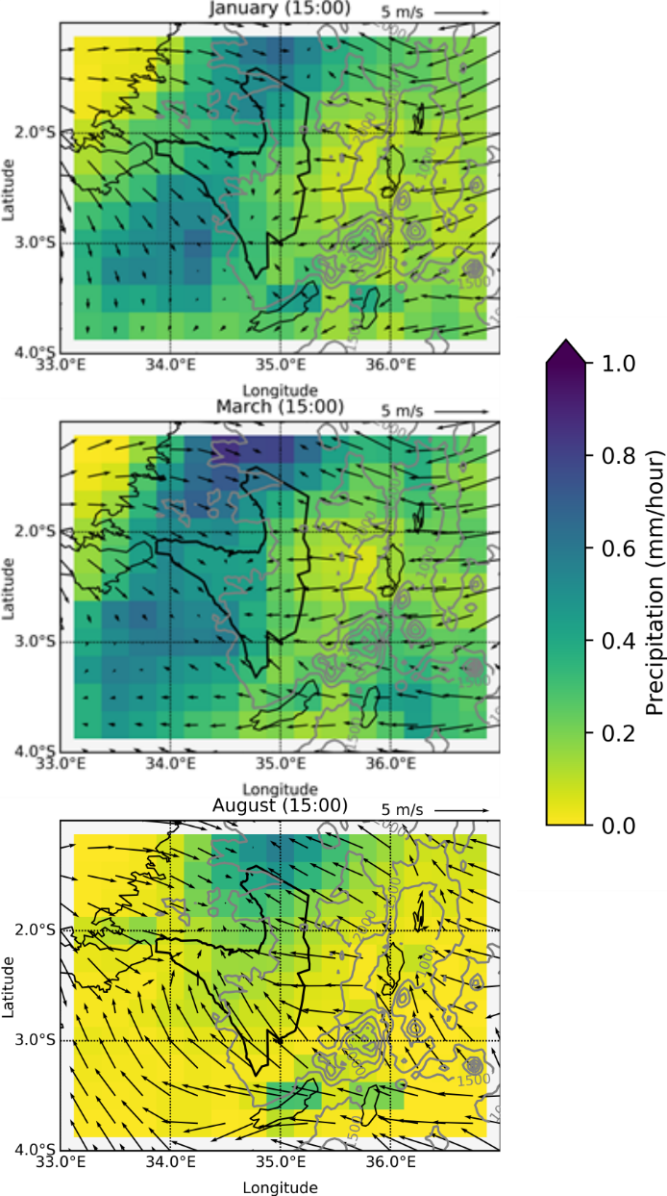
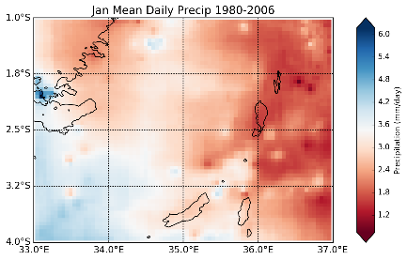
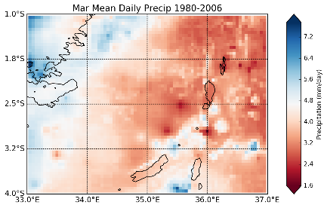
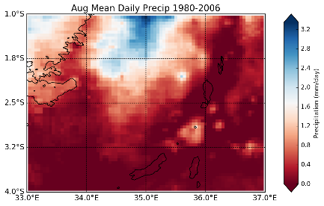
Hourly wind and rain
Mean hourly wind and rain (1500 UTC)
Mean monthly rain
Analysis of 1500 UTC wind and rainfall patterns in individual months, shows a match between hourly precipitation and lower tropospheric winds
But 1500 UTC atmospheric conditions don’t always match monthly precipitation gradients (e.g. January)
Hourly precipitation (TRMM 3B42; 1998-2014)
and surface winds (ERA5; 1987-2016).
CHIRPS (1980-2006)

Slide 10
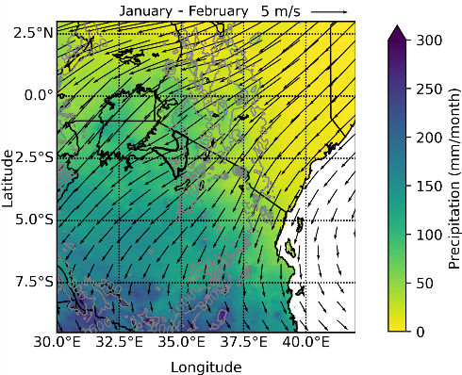
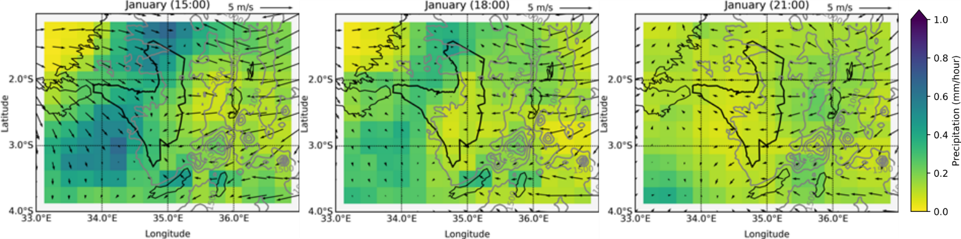
Afternoon Precipitation - January
Mean precipitation always heaviest to the west of the lake convergence line at 1500 UTC, then propagates in the direction of the prevailing mid-tropospheric winds as the day progresses
Mean mid-tropospheric wind and rain
Mean afternoon surface wind and rain
Mean monthly rain
Seasonal precipitation (CHIRPS, 1987-2016) and 700 hPa wind (ERA-Interim, 1986-2017)
Hourly precipitation (TRMM 3B42; 1998-2014) and surface winds (ERA5; 1987-2016).
CHIRPS (1980-2006)

Slide 11
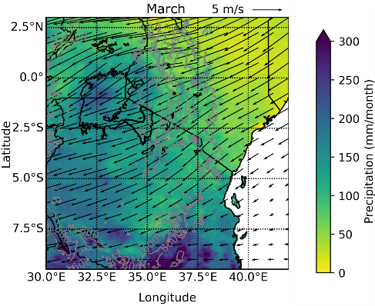
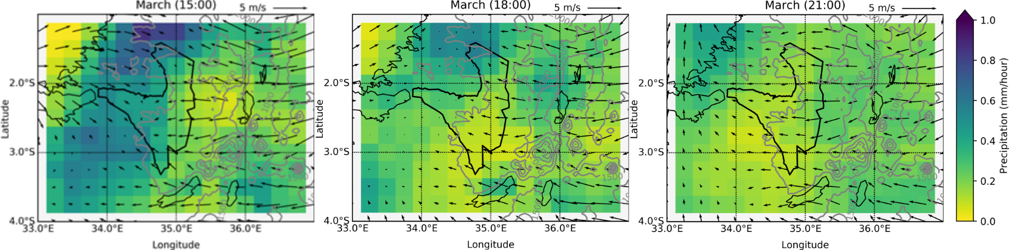
Afternoon Precipitation - March
Mean precipitation always heaviest to the west of the lake convergence line at 1500 UTC, then propagates in the direction of the prevailing mid-tropospheric winds as the day progresses
Mean mid-tropospheric wind and rain
Mean afternoon surface wind and rain
Mean monthly rain
March precipitation (CHIRPS, 1987-2016) and 700 hPa wind (ERA-Interim, 1986-2017)
Hourly precipitation (TRMM 3B42; 1998-2014) and surface winds (ERA5; 1987-2016).
CHIRPS (1980-2006)

Slide 12
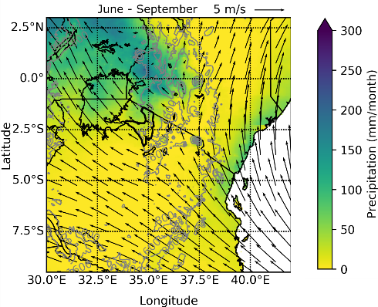
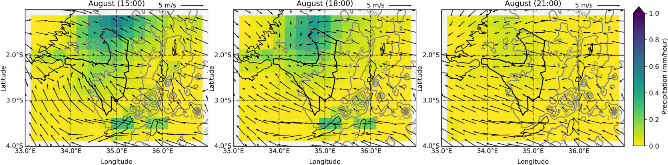
Afternoon Precipitation - August
Mean precipitation always heaviest to the west of the lake convergence line at 1500 UTC, then propagates in the direction of the prevailing mid-tropospheric winds as the day progresses
Mean mid-tropospheric wind and rain
Mean afternoon surface wind and rain
Mean monthly rain
Seasonal precipitation (CHIRPS, 1987-2016) and 700 hPa wind (ERA-Interim, 1986-2017)
Hourly precipitation (TRMM 3B42; 1998-2014) and surface winds (ERA5; 1987-2016).
CHIRPS (1980-2006)

Slide 13
Summary
Regional rainfall caused by a complex set of interactions between large-scale winds and atmospheric dynamics (tropical rainfall belt), topographic features (topographic rainfall and rain shadows) and a land-lake breeze.
Mean wind and rainfall patterns suggests storms form at the wind convergence line and are blown in the direction of the mid-tropospheric winds as the afternoon/evening progresses.
Moisture from Lake Victoria important to the majority of Serengeti National Park (previously it was considered to only affect the north)
Migration has adapted to unique regional precipitation conditions that may be affected by climate change
Work submitted to the International Journal of Climatology (April 2020)

