Slide 1
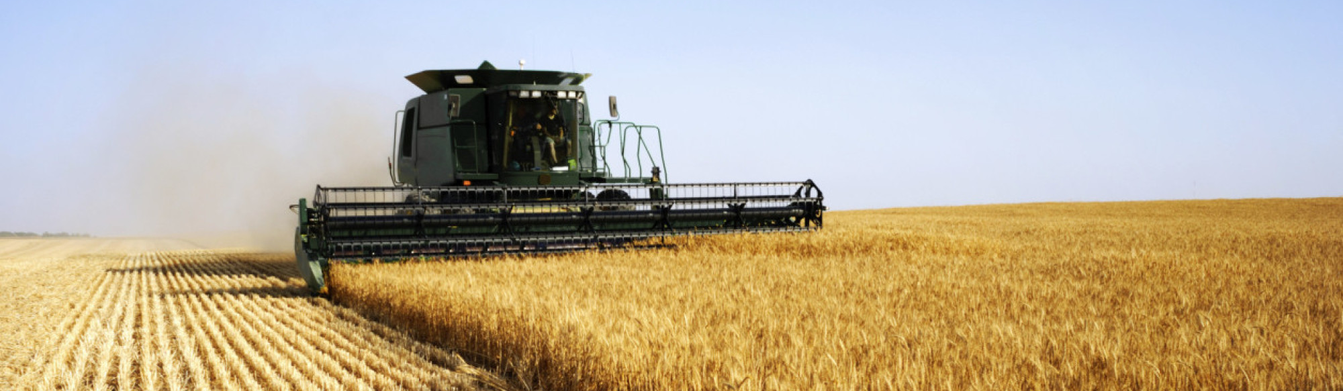
The impacts of climate change on the productivity of conservation agriculture
Yang Su
UMR-EcoSys INRAE/AgroParisTech
08/05/2020

Slide 2
What is conservation agriculture (CA)
CA is a resource-saving agriculture concept that aims to:
Achieve acceptable profits with sustained production levels
Conserving the environment
It has three principles:
Minimum soil disturbance (no tillage)
Permanent soil cover (crop residue retention or live mulch)
Species diversification (crop rotation and/or intercropping)

Slide 3
Evidences of environmental benefits from CA
It is believed that CA can bring a lot of environmental benefits comparing with conventional tillage (CT):
Reduce soil degradation and erosion
Improve soil quality
Reduce surface runoff
Increase carbon sequestration
Enhance biodiversity
Reduce fossil fuel usage
Etc.

Slide 4
Uncertain effect of CA on crop yields
Field experiments show that impact of CA on yield depends on local climate conditions, it varies a lot globally
Impact of climate change on the productive performance of CA vs CT system is unknown
Notes:
Here we address on the second topic, and try to evaluate the impact of climate change on CA vs CT system

Slide 5
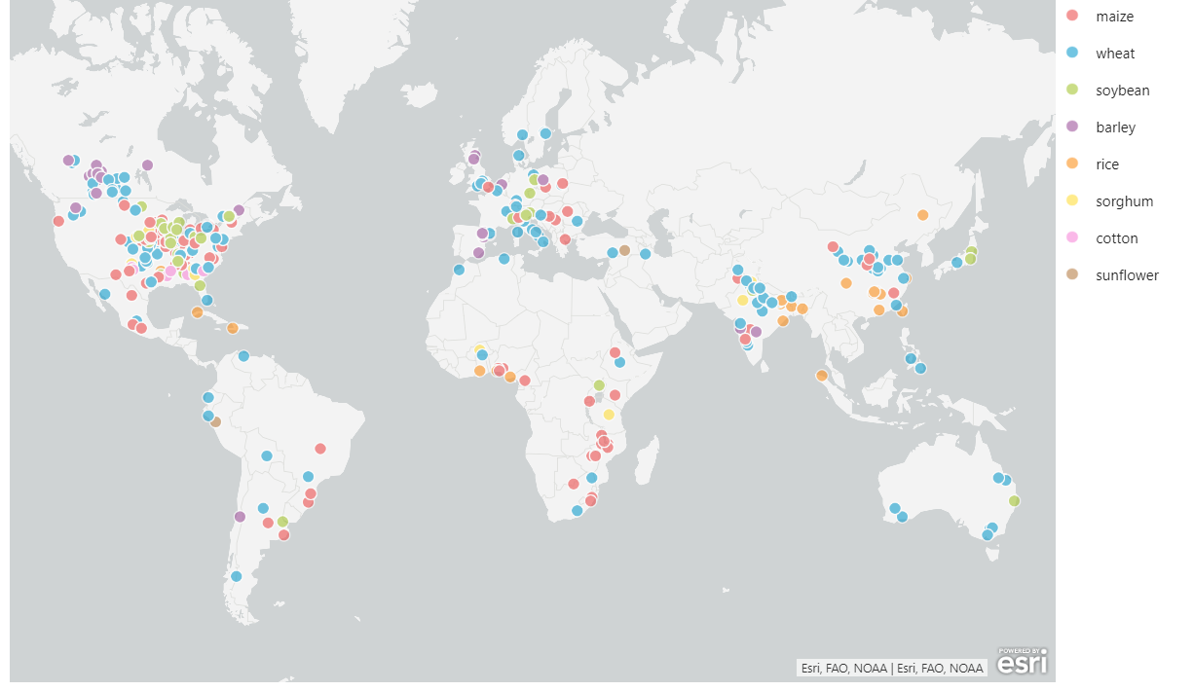
Dataset and model training
4071 paired experimental yield observations for CA and CT
8 crops and 52 countries.
Model: Machine learning model – random forest
Model inputs (11):
Crop type
Soil texture
Climatic variables in the growing season :
Precipitation balance (PB)
Average temperature (Tave)
Maximum/Minimum temperature (Tmax /Tmin)
Agricultural management:
Rotation
Residue management
Fertilization management
Weed and pest control
Irrigation
Model output: Probability of yield increase / gain from converting CT to CA
Local values of key climatic variables were collected for all experimental sites and used in the model training, which enables us the ability to do future projection
Notes:
We did a meta-analysis this year in February to update the database we built in 2018. the new database included the data from 422 papers, publication year range of these papers is from 1983 to 2020, while the experiment year range from 1980 to 2017 (the data in 2018 exists, but not included in this analysis due to the data availability of climatic data)

Slide 6
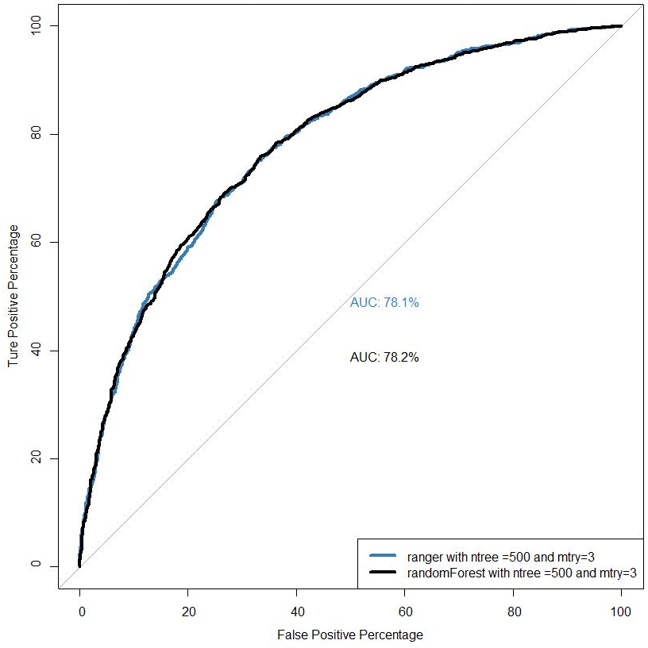
Model cross-validation
Method: Leave One Out Cross-Validation (LOOCV)
Criterion: Area Under the Receiver Operating Characteristics Curve (AUC - ROC Curve)
AUC – ROC Curve is a standard evaluation metrics for assessing model classification performance
When AUC is 78.2%, it means there is 78.2% chance that model will be able to distinguish between positive class (yield gain) and negative class (yield loss)

Slide 7
Model settings for global projection
Climatic model inputs | Setting | Resources
Total Evapotranspiration, Precipitation, average/maximum/minimum temperature in the growing season | 2 periods: Current: 2011-2020 mean climate condition Future : 2051-2060 mean climate condition 4 climate models: Gfdl-esm2m, Hadgem2-es, Ipsl-cm5a-lr, Miroc5 4 scenarios: rcp2.6, rcp4.5, rcp6.0, rcp8.5 | Data from ISIMIP2b project Download from: Lawrence Livermore National Laboratory

Slide 8
Model settings for global projection
Other model inputs | Setting | Resources
Crop types | Barley, maize, soybean, wheat, rice, sorghum, cotton, sunflower
Crop growing season | No changes for current and future | Crop calendar data University of Wisconsin-Madison
Soil texture | No changes for current and future | HWSD data provided by Tokyo University
Crop Irrigation | No changes for current and future | MIRCA2000 data from Goethe University
Field fertilization | Yes
Weed and pest control | Yes
Crop residue management | Residue retained
Crop rotation management | Crop rotated

Slide 9
CA productivity in current and future
Result example:
Climate model: Gfdl-esm2m
RCP Scenario: rcp4.5
Crop: wheat

Slide 10
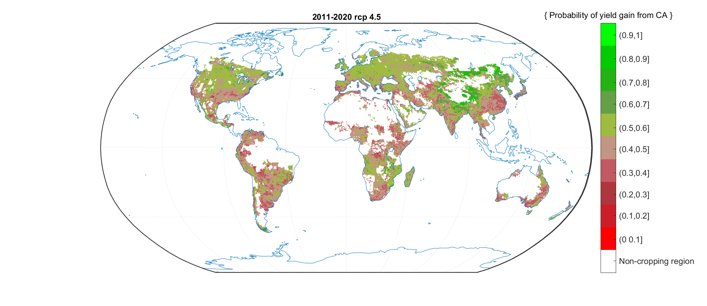
Probability of yield gain from CA in current condition
Probability of yield increase | Area ratio | Mean PB [mm] | Mean Tave [Deg.C]
Prob. > 0.6 High chance of yield gain | 0.0963 | -10.29 | 3.63
Prob. > 0.5 | 0.485 | 73.67 | 8.78
Prob. <= 0.5 | 0.515 | 91.66 | 16.89
Prob. <= 0.4 High chance of yield loss | 0.139 | 105.19 | 18.88
Promising regions for CA implementation: Mainly in Northern part of North America, Europe and Northern Asia
Non-favorable regions for CA implementation: Mainly in Southern part of North America, South America, Southern China
The mean PB and Tave in the regions with “high chance of yield gain” are lower than the regions with “high chance of yield loss”, indicates that CA has a better performance in dryer and cooler conditions

Slide 11
Comparison between productivity in current and future
Probability of yield gain | Area ratio RCP 4.5 | Area ratio RCP 4.5 future
Prob. > 0.6 | 0.0963 | 0.0828
Prob. > 0.5 | 0.485 | 0.446
Prob. <= 0.5 | 0.515 | 0.554
Prob. <= 0.4 | 0.139 | 0.147
In future, globally, the area with probability of yield gain > 0.5 will decrease ~ 4% in the future.
It indicates that, globally, the productive performance of CA for wheat will be lower in future than current condition

Slide 12
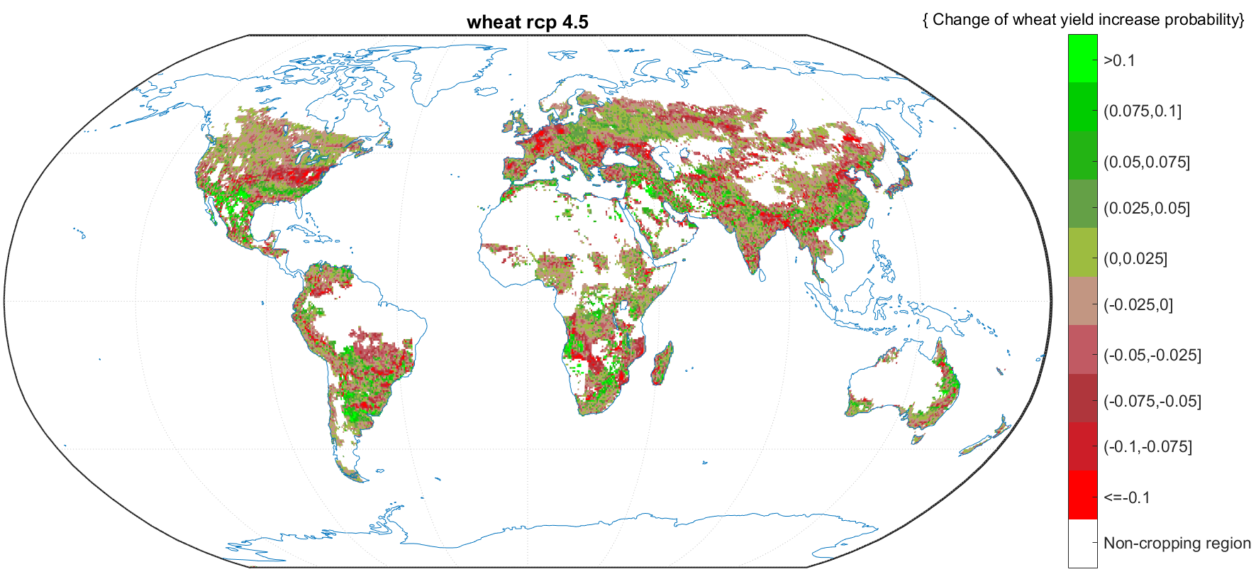
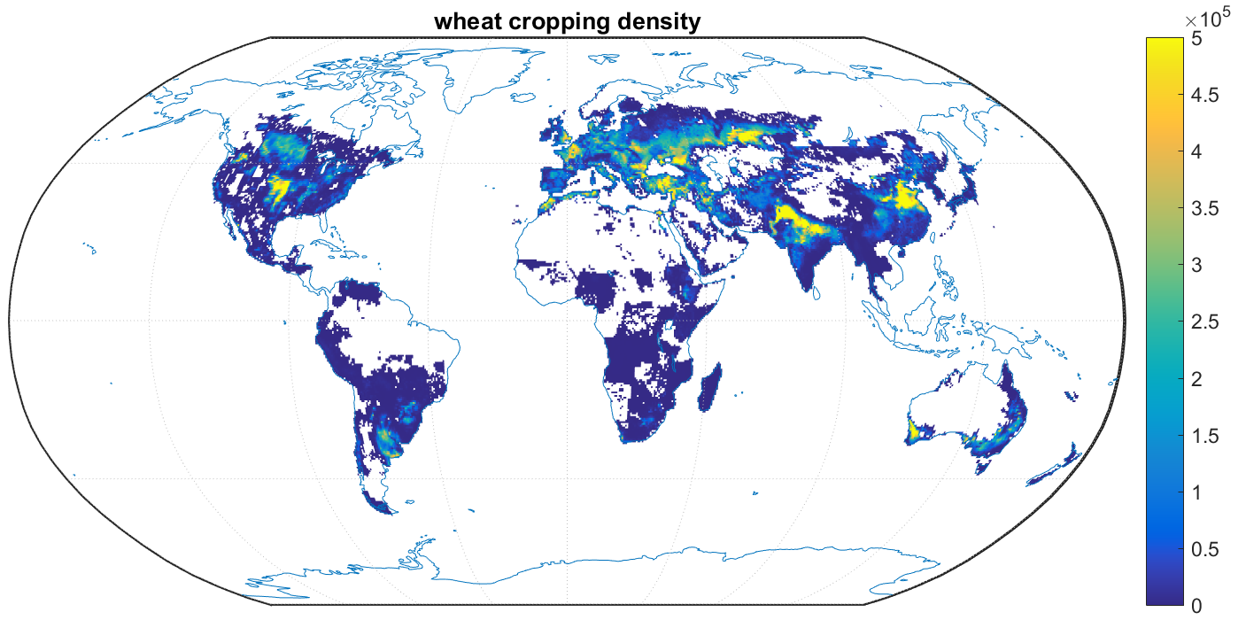
Where is the increase & decrease of probability of yield gain?
We mapped the difference of the probability of yield gain between current vs. future climates
In the main cropping regions of wheat in the US, Europe, and China, the probability of yield gain from CA will decrease in the future
In southern US, and Argentina, the probability of yield gain from CA will increase in the future

Slide 13
Differences between climate models & RCP scenarios

Slide 14
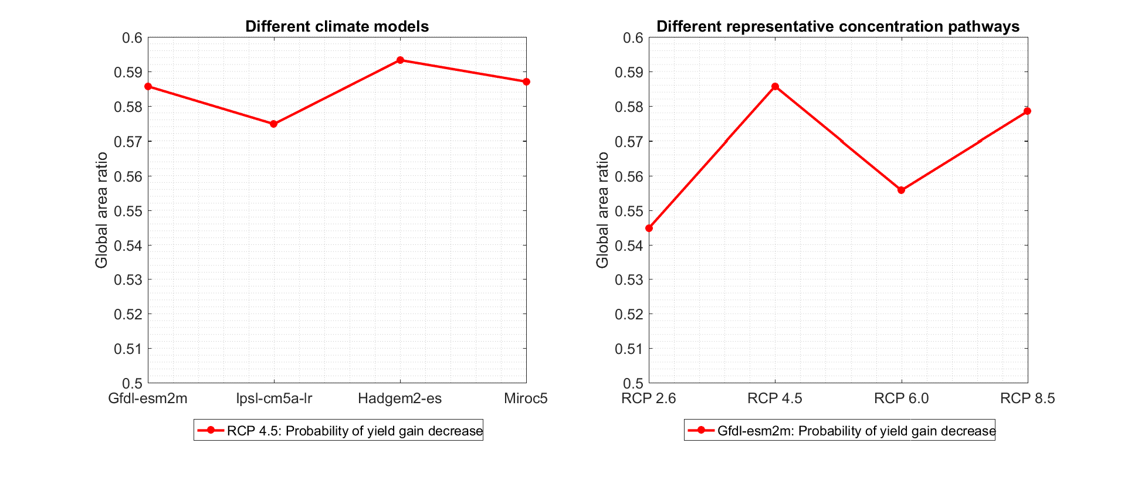
Differences between climate models and RCPs - wheat
We calculated the area ratio where the probability of yield gain is decreasing
Around 54 ~ 60% areas are expected to show a decrease on CA performance in the future.
The results are more sensitive to RCPs than to climate models, but they are in same magnitude.
RCP4.5 and RCP8.5 lead to a higher relative area than RCP2.6 and RCP6.0.

Slide 15
Conclusion
CA has a better performance in dryer and cooler conditions.
Globally, the area with probability of yield gain > 0.5 for wheat will decrease ~ 4% in the future.
In the main cropping regions of wheat in the US, Europe, and China, the probability of yield gain from CA will decrease in the future. While in southern US, and Argentina, the probability of yield gain from CA will increase in the future.
The results are more sensitive to RCPs than to climate models, but they are in same magnitude.

Slide 16
Thank you for your attention
Yang SU
yang.su@inra.fr

Slide 17
Additional materials

Slide 18
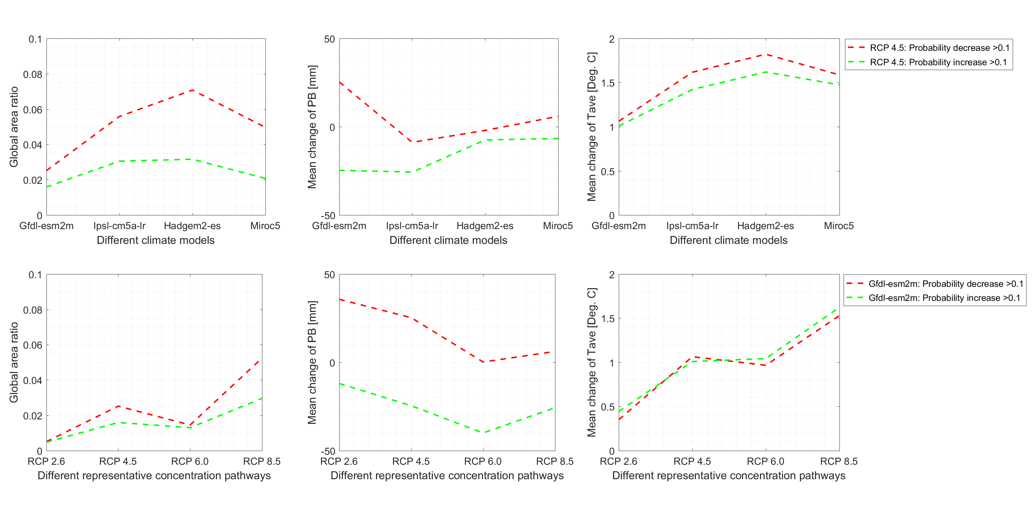
Differences between climate models and RCPs - wheat

Slide 19
Partial dependent plot
Partial dependent plot is a method that shows the marginal effect one or two features have on the predicted outcome of a machine learning model

Slide 20
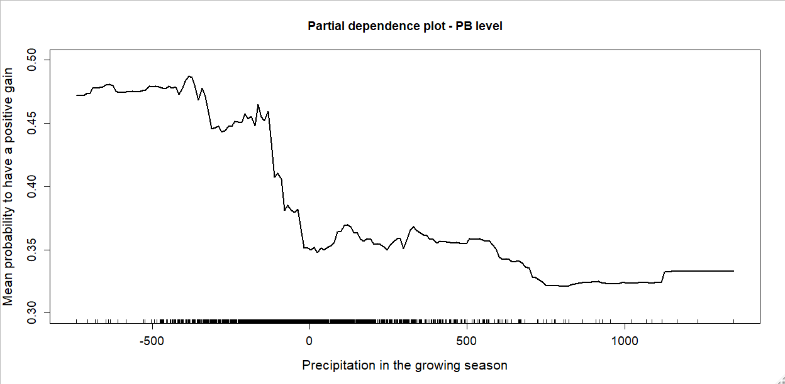
Partial dependence plot
Example: Y ~ (x1, x2, …. , x10), we want to study how x1 will affect the Y
Manually define 100 levels between maximum and minimum of x1
X1(level 1, level 2, …, level 100)
Average the results of prediction for each level
Y ( x1(level1) )
…
Y( x1(level100) )
For each level of x1, combine with other predictors (all possible combinations under the constrain: Tmin < Tave < Tmax)
x1(level 1) + (x2(1),…,x10(1))
x1(level 1) + (x2(2),…,x10(1))
…
x1(level 1) + (x2(n),…,x10(1))
…
x1(level 1) + (x2(1),…,x10(n))
…
x1(level 1) + (x2(n),…,x10(n))
…
x1(level 100) + (x2(n),…,x10(n))
Model
Plot Y and x1

Slide 21
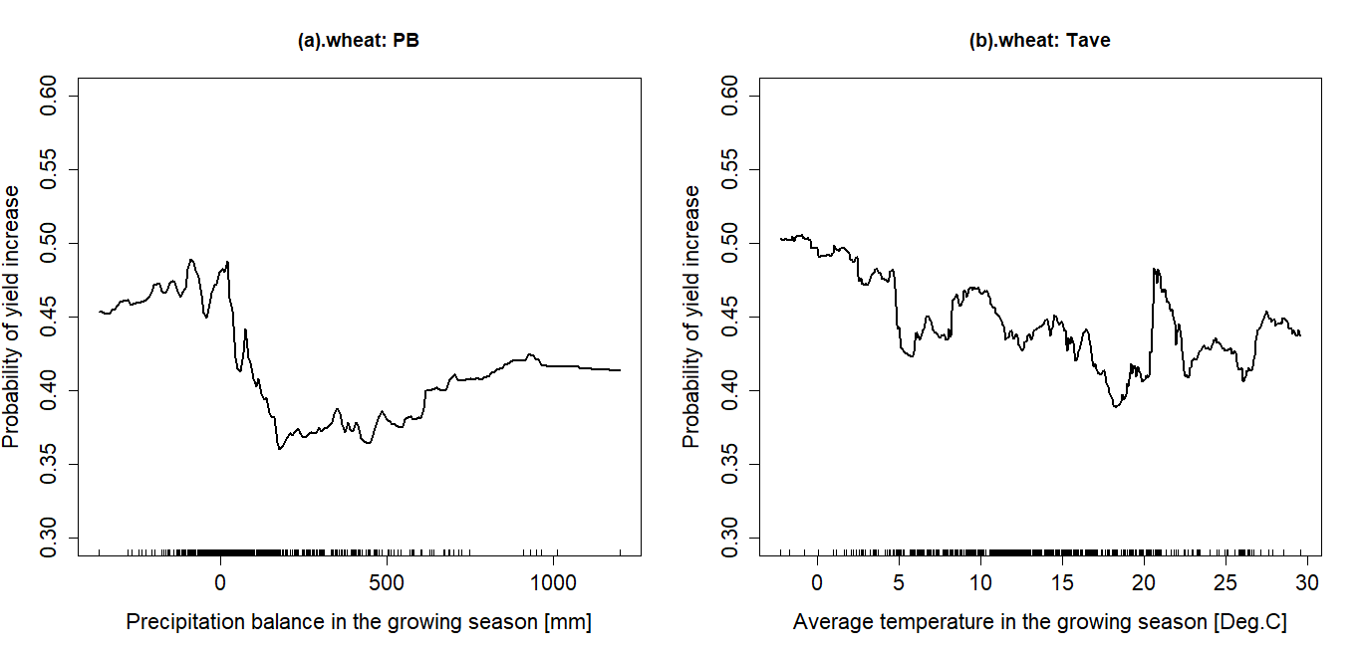
Partial dependent plot

Slide 22
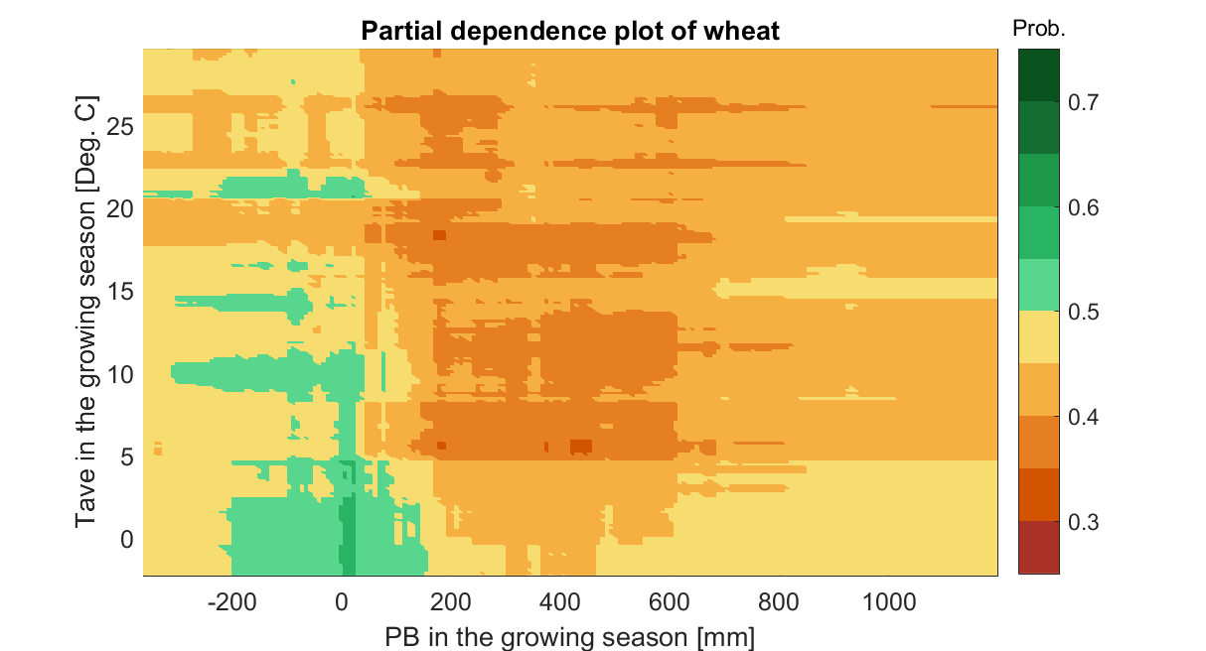
Partial dependent plot – 2d

