Slide 1
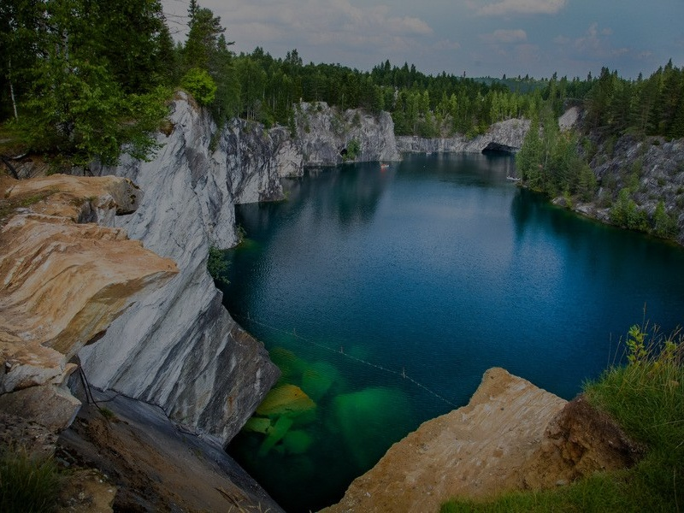
RUSKEALA UNDERGROUND LABORATORY FOR THE STUDY OF NATURAL WATERS (KARELIA, RUSSIA)
Galina S. Borodulina, Mikhail A. Levichev
Northern Water Problems Institute,
Karelian Research Centre of Russian Academy of Sciences,
Petrozavodsk, Russia
Notes:
1

Slide 2
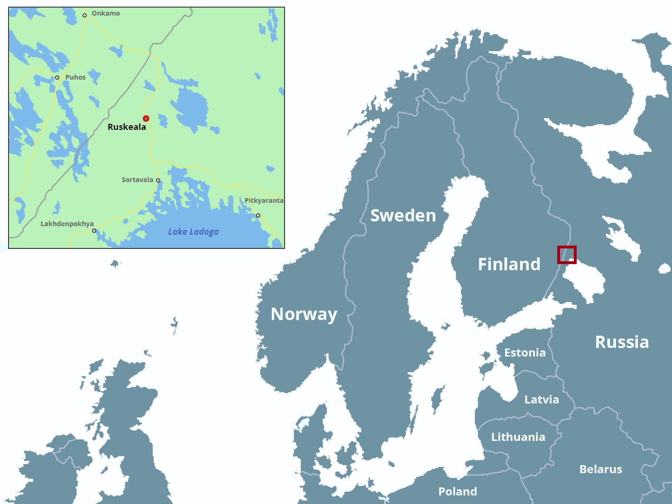

Slide 3
The Ruskeala underground space formed as a result of the extraction of marble. Carbonate rocks are connected to the metamorphosed sedimentary-volcanogenic formations of the Lower Proterozoic of the Fennoscandian Shield.
The Ruskeala marble has been known since the 18th century and was mined intermittently until the end of the last century.
Marble was used in the construction and decoration of St. Petersburg palaces and cathedrals.

Slide 4
The Ruskeala underground laboratory was organized jointly with the Karelian Research Center of the Russian Academy of Sciences and the Kolmas Karelia company as an experimental innovative structure for the study of underground space.
KarRC RAS is a partner of the Baltic See Undeground Innovation Network (BSUIN) project of the Interreg Baltic Sea Program

Slide 5
Currently mine workings (quarries, tunnels, caves) are filled (partially or completely) with groundwater.
The Ruskeala Park is a good example of a careful attitude to the monument of industrial heritage when it is successfully used in the field of tourism.
But there is still insufficient knowledge about the hydrogeological conditions of the area and water quality

Slide 6
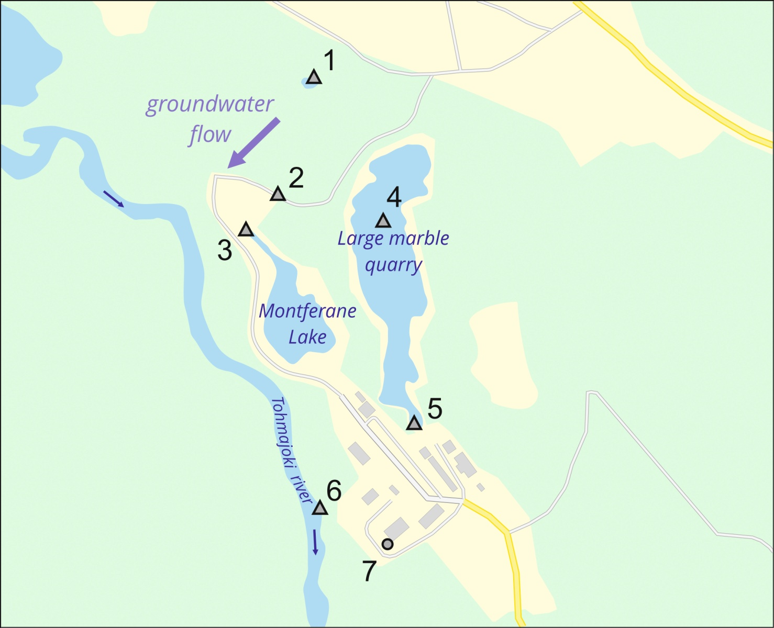
Sampling sites
1 | Cave
2 | Tunnel
3 | Lake
4 | Quarry
5 | Quarry
6 | River
7 | Well

Slide 7
Tohmajarvi River belongs to Lake Ladoga basin .
The source of the river is in Finland (Lake Tohmajärvi).

Slide 8
Sampling and Analysis of Water
Water from wells, reservoirs, and rivers were sampled
Immediately after sampling were measured electrical conductivity, pH , Eh.
Waters have been analyzed for major ions, inorganic species and trace metals, dissolved gases at the hydrochemical laboratory of the Northern Water Problems Institute of the Karelian Research Centre (Petrozavodsk) according to [Analytical, kinetic and calculation methods in hydrochemical practice / Ed. P.A. Lozovik, N.A. Efremenko. - St. Petersburg: Nestor-Istoriya, 2017 .- 272 p. (In Russia)]

Slide 9
Spatial variation in pH and EC for sample dates

Slide 10
Groundwater unloading in quarries loses dissolved gases and some elements under oxygen conditions. Water becomes more alkaline, somewhat diluted by the atmospheric precipitation, but the chemical type does not change. Due to the weak development of biota in open reservoirs, nitrates, as the final product of the transformation of nitrogen compounds arriving with a surface influx, can accumulate in water.
 | Water type eqv% | CO₂ mg/L | N-NO₃ mgN/L | N-NH₄⁺ mgN/L | Fe mg/L | Mn mg/L
Groundwater ( water well) |  | 15 | <0,1 | 0,02 | 0,56 | 0,95
Quarry, Tunnel, Cave, Lake |  | 0-10 | 0,2-1,7 | 0,02-0,57 | 0,01-0,14 | <0,01

Slide 11
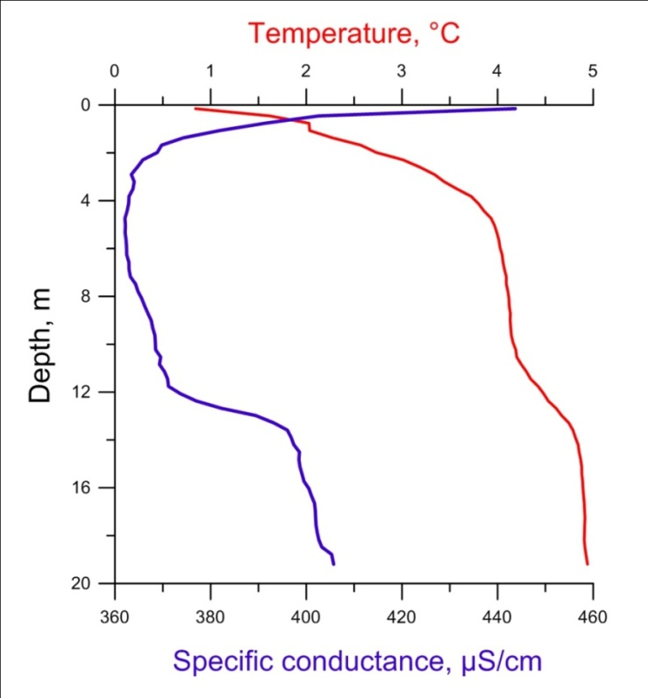
In March 2019, the CastAway-CTD measured the depth of the Large quarry, temperature and electrical conductivity in the water layer.
The mine network provides a unique opportunity to study the hydrodynamic and geochemistry of groundwater and their interaction with surface waters.
The study was supported by BSUIN project of the Interreg Baltic Sea Program

Slide 12
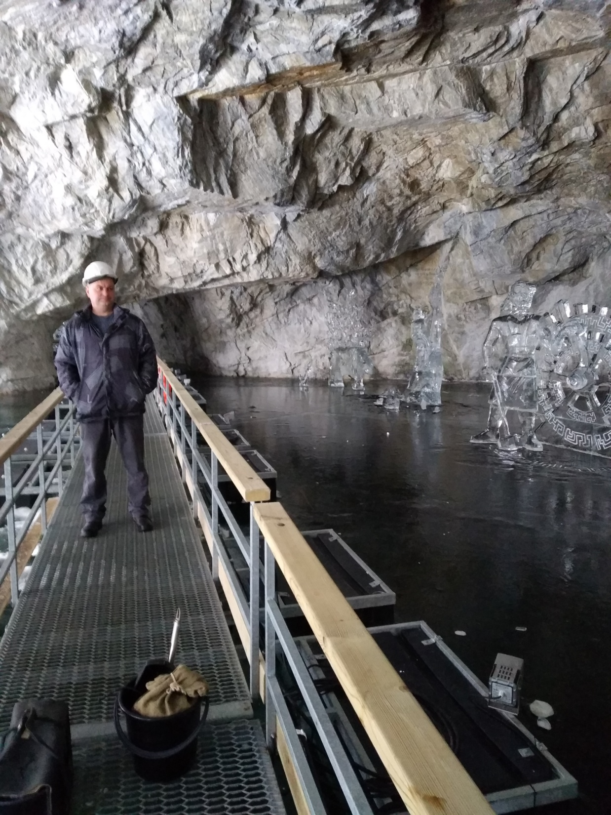
Thank you for your attention

