Slide 1
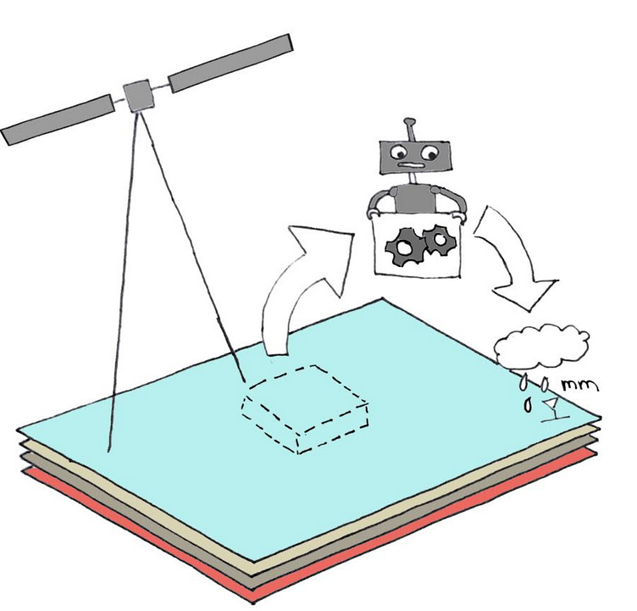




RainRunner - Machine Learning and Earth observation for reliable rainfall information in West Africa
Mónica Estébanez Camarena – TU Delft m.estebanezcamarena@tudelft.nl
Background: the Schools and Satellites (SaS) project
West Africa’s economy is mainly sustained on agriculture and over 70% of crops are rain-fed. Economic growth and food security in this region is therefore highly dependent on the knowledge of rainfall patterns. However, a sparse rain gauge distribution and data transmission challenges derive in a lack of reliable rainfall information.
The RainRunner rainfall retrieval algorithm, developed within the Schools and Satellites (SaS) project, aims to overcome the lack of ground data and good rainfall satellite products through Earth Observation and advanced Machine Learning (ML). An expanded ground rainfall observation network based on low-cost technologies and Citizen Science complements existing station data to form the training and validation dataset.
RainRunner rainfall retrieval algorithm
Input satellite data
The SaS concept
Extended ground rainfall observation network
Training and validation dataset
This is an interactive presentation, please view it in presentation mode. Clickable elements are highlighted when under the mouse and are accompanied by icons.

Slide 2










Back to main menu
The RainRunner algorithm is being developed in the frame of the Schools and Satellites (SaS) project, funded by the European Space Agency as one of the winners of the first edition of CSEOL (Citizen Science and Earth Observation Lab) (https://cseol.eu/). SaS is a cooperation between TU Delft, PULSAQUA, TAHMO Ghana, Smartphones4Water and the Ghana Meteorological Agency.
SaS combines Citizen Science, Earth observation and Machine Learning to create a reliable satellite rainfall product for West Africa. Satellite data will be fed into a Convolutional Neural Network (CNN) to estimate precipitation. To train and validate the CNN, different sources of ground rainfall information will be used, namely, rainfall data from TAHMO Ghana and the Ghana Meteorological Agency stations, Citizen Science-based rainfall data collected by Ghanaian schoolchildren and low-cost rainfall sensors – disdrometers.
The goal of SaS is to overcome the lack of ground data and good rainfall satellite products. The SaS rainfall product will guide agricultural extension agents support crop insurance, enable farmers to make informed decisions to optimise their production and contribute to climate education in schools through TAHMO. Ultimately, SaS aims to contribute towards food security.

Slide 3
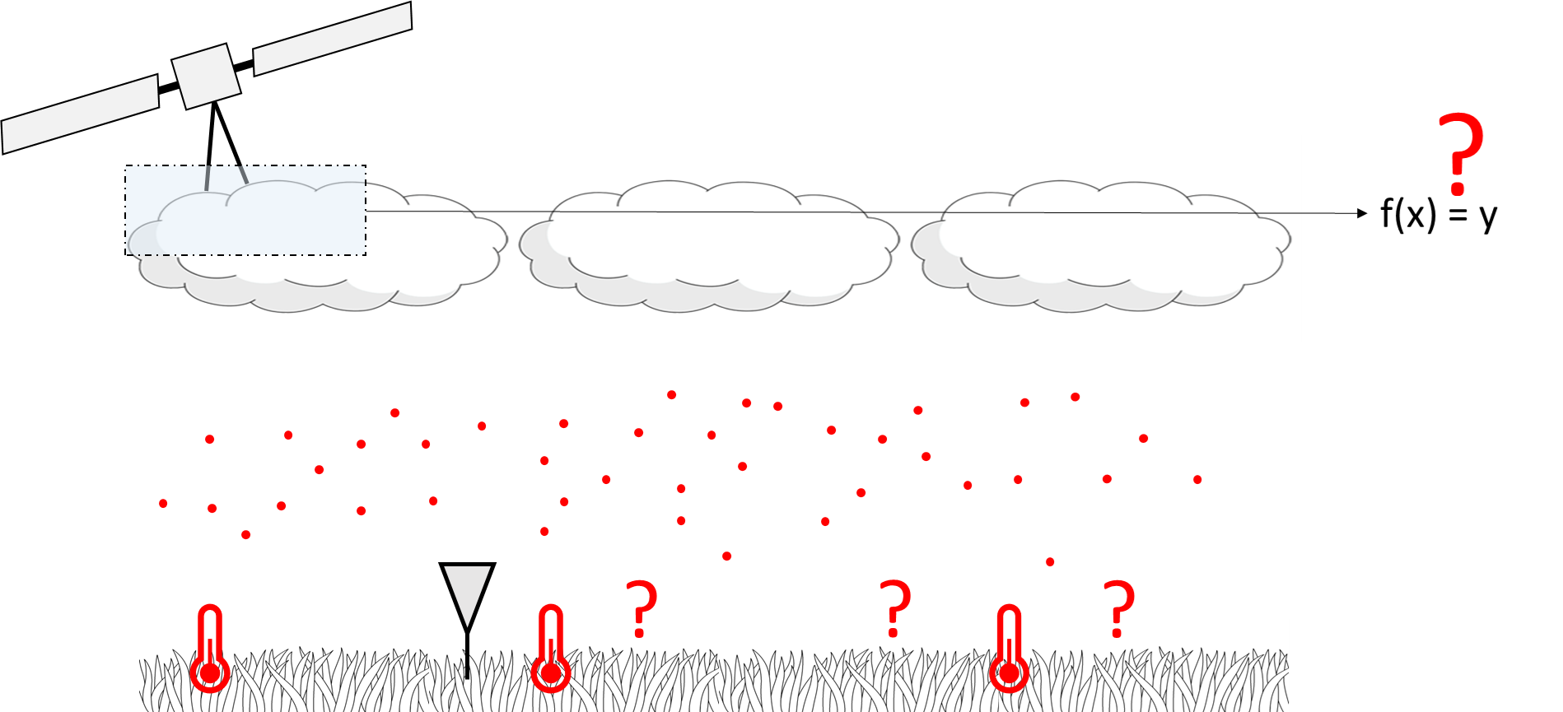


Back to main menu
The SaS concept
Satellite rainfall products currently used by the Ghana Meteorological Agency are TAMSAT and CHIRPS. Both products merge Meteosat IR data with gauge rainfall measurements and have a daily temporal and a 0.05° (CHIRPS) and 0.0375° (TAMSAT) spatial resolution.
Comparison with gauge data acquired by GMet show a very poor correlation in our study area in Northern Ghana, in the order of 30%.
Literature suggest that the reason for the poor performance of rainfall satellite products in West Africa are highly different local conditions underneath the clouds as compared to other regions, as shown in the figure.
Aerosols
Humidity
Higher concentration of aerosols in the atmosphere, coming from the Sahara desert and biomass burning in central Africa.
A higher density of aerosols constitute more cloud nuclei, that derive in smaller droplets and a less efficient rainfall process.
A drier atmosphere leads to higher clouds and therefore more evaporation before rainfall reaches the ground.
Land
surface temperature
Ground Truth Data
Higher land surface temperature will produce more evaporation before rainfall reaches the ground, affect the land-atmosphere interactions and cloud formation processes.
A sparse rain gauge distribution limits algorithm calibration.

Slide 4
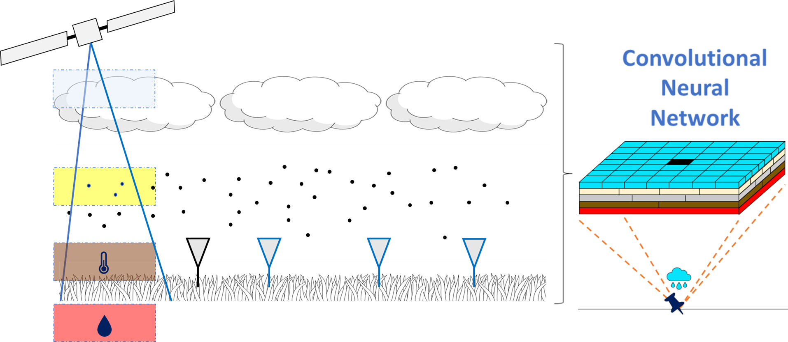


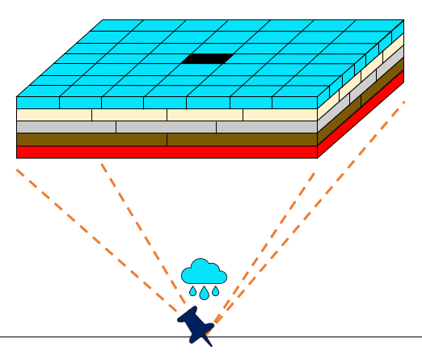





Back to main menu
The SaS concept – Input data overview
The rainfall retrieval algorithm will use a multi-satellite and multi-sensor approach, using information about clouds, aerosols in the atmosphere, land surface temperature and soil moisture derived from the European Space Agency’s Sentinel satellites and from Meteosat. A digital elevation model will also be incorporated to account for the effect of topography in the rainfall process. Lastly, Sentinel 2 multispectral data acquired by its MSI instrument will be added as an additional source of information.
MSG – SEVIRI
Clouds
Convolutional Neural Networks
S5P – TROPOMI
Aerosols
S3 – SLSTR
Land surface temperature
S1 – GRD
Soil moisture related
Overview of satellite products and their characteristics
DEM
S2 – MSI
Additional multispectral information

Slide 5
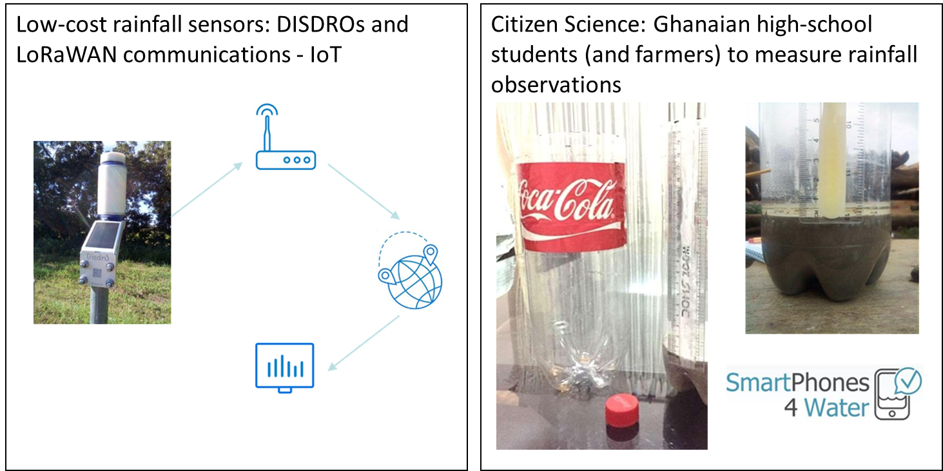
Back to main menu
Extended ground rainfall observation network
Low-cost technology and Citizen Science for denser ground observations
SaS aims at increasing the density of ground rainfall measurements in order to have more extensive data to train and validate the RainRunner algorithm.
This is done in two ways:
DISDRO sensors: Low-cost automatic acoustic rainfall sensors that transmit the collected data through LoRaWAN communications to a gateway and afterwards to the web via internet, so they can be accessed by users.
Citizen Science: Using the methodology developed by SmartPhones4Water, mainly Ghanaian high-schools students and also some farmers are measuring daily precipitation. All they need is a plastic bottle, a ruler, cement and a smartphone. For high-school involvement, this experiment is embedded in an educational module about the water cycle and climate change offered by SaS.

Slide 6
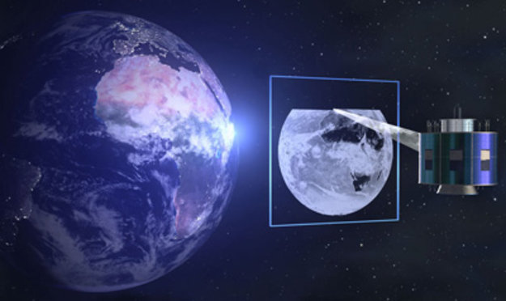
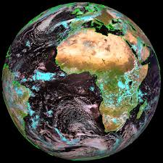
Back to main menu
RainRunner: Input data
Cloud amount and cloud top temperature
Back to input data overview
Meteosat - Spinning Enhanced Visible and Infrared Imager (SEVIRI):
Cloud Analysis Product (L2)

Slide 7
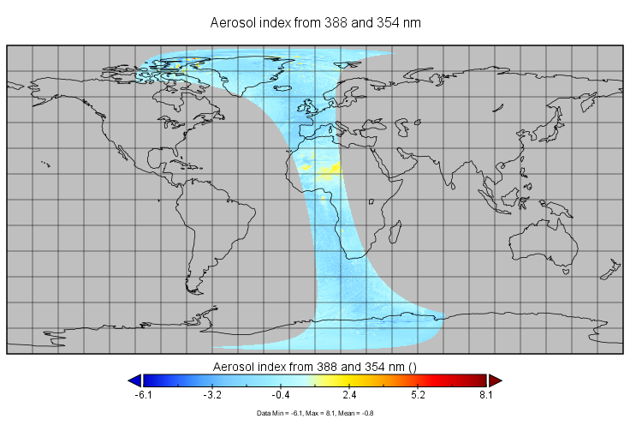
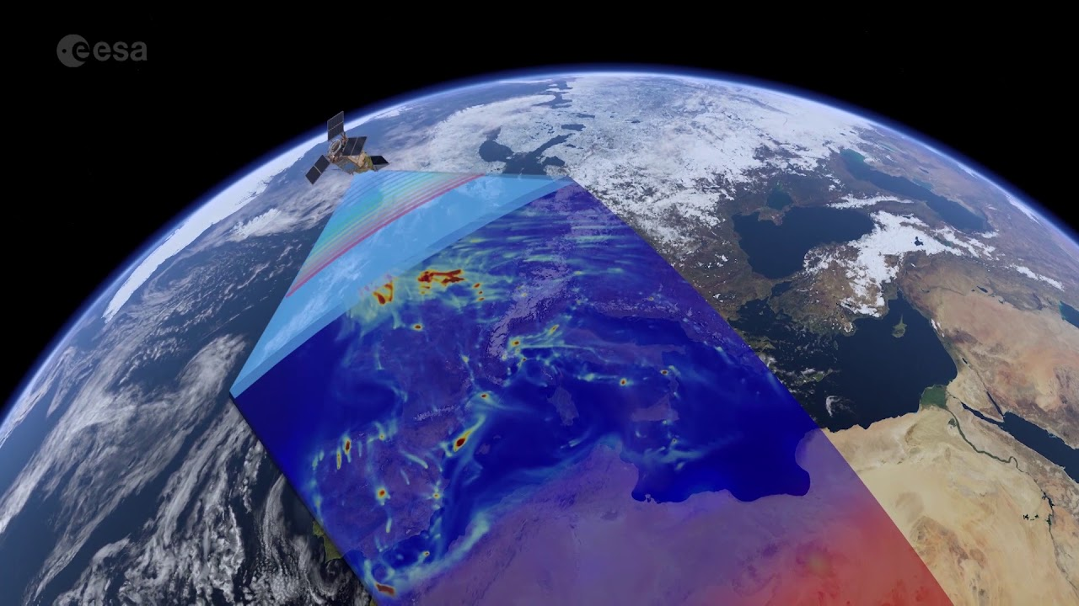
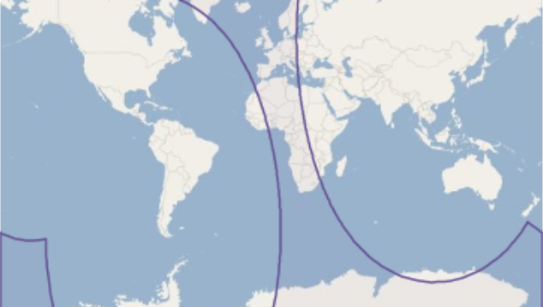

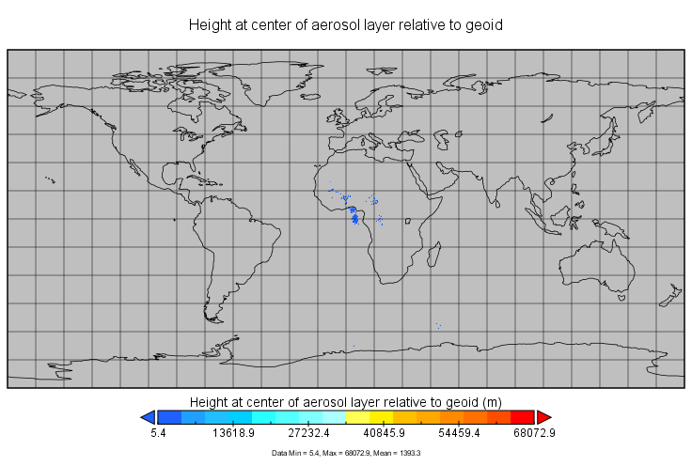
Back to main menu
RainRunner: Input data
Aerosols
Back to input data overview
Sentinel 5P – TROPOspheric Monitoring Instrument (TROPOMI):
  Aerosol Index product (L2)
  Aerosol Layer Height product(L2)

Slide 8
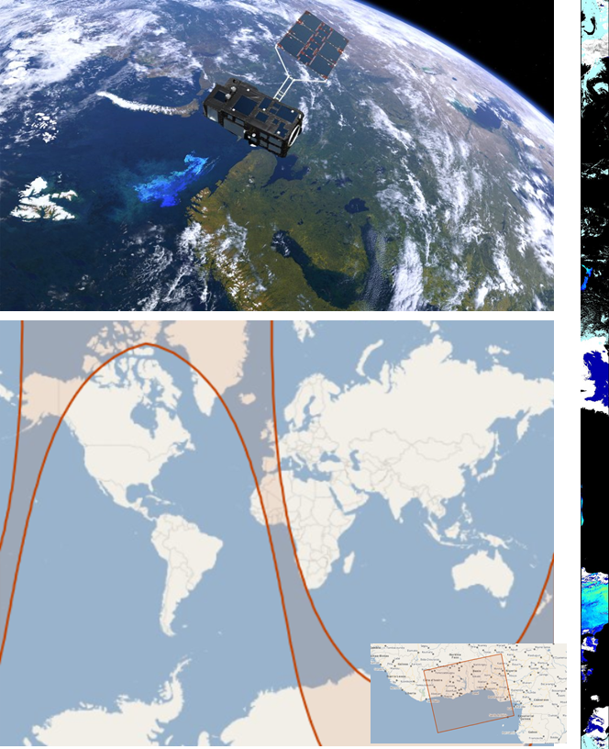
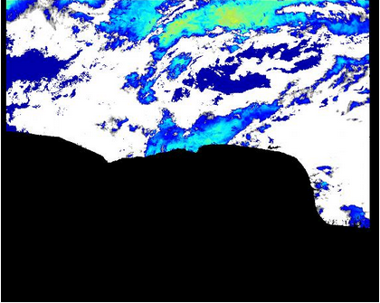
Back to main menu
RainRunner: Input data
Land surface temperature
Back to input data overview
Sentinel 3 – Sea and Land Surface Temperature Radiometer (SLTR):
Land Surface Temperature product (L2)

Slide 9
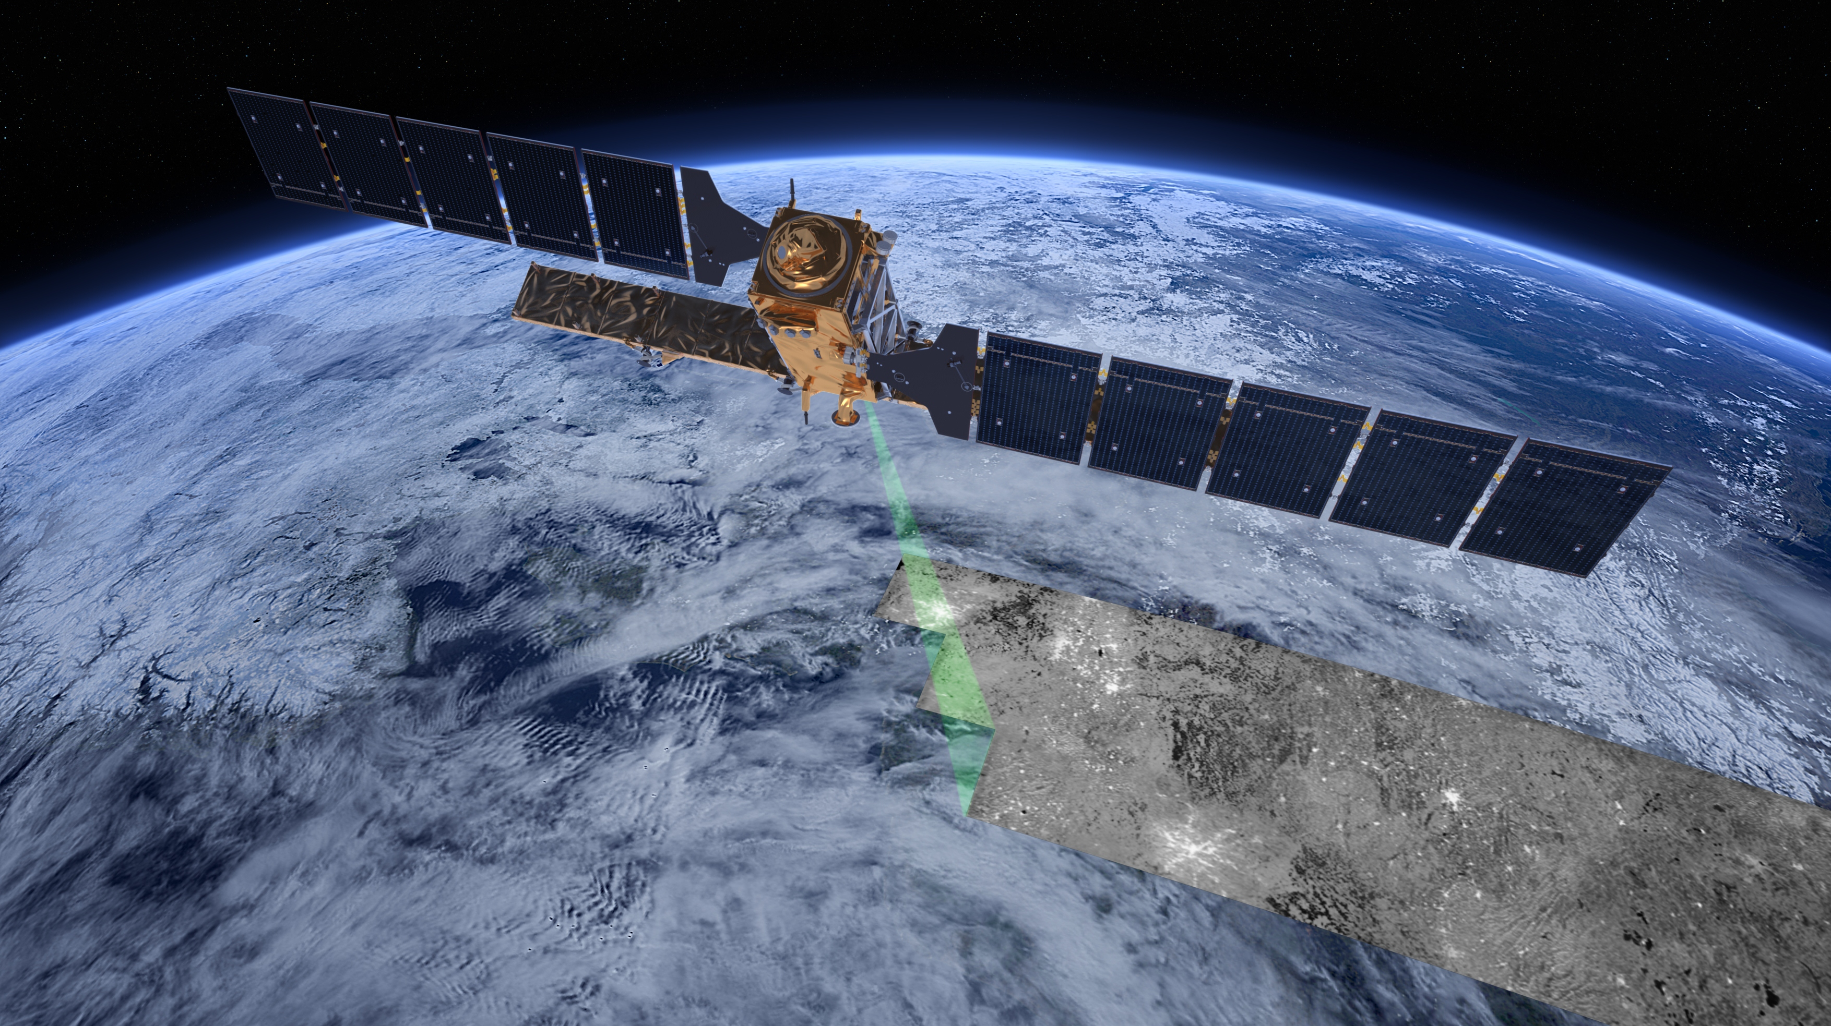
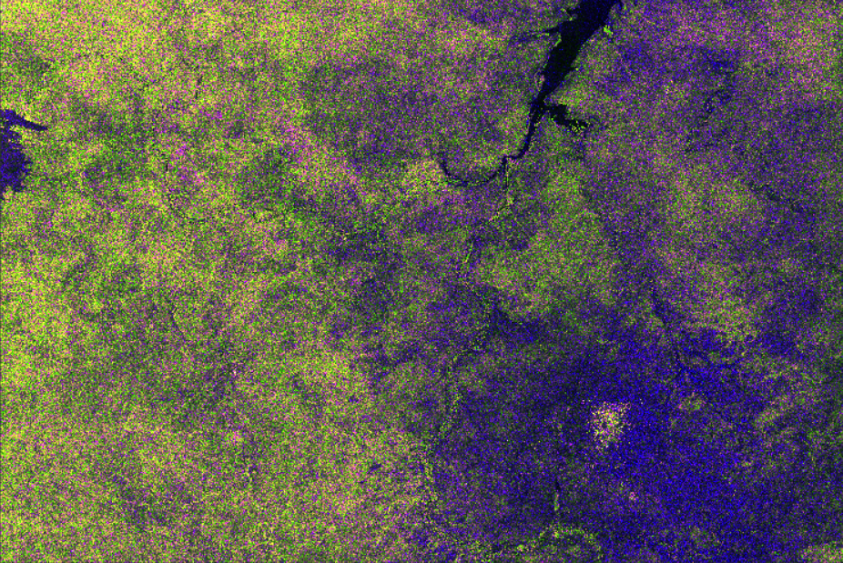
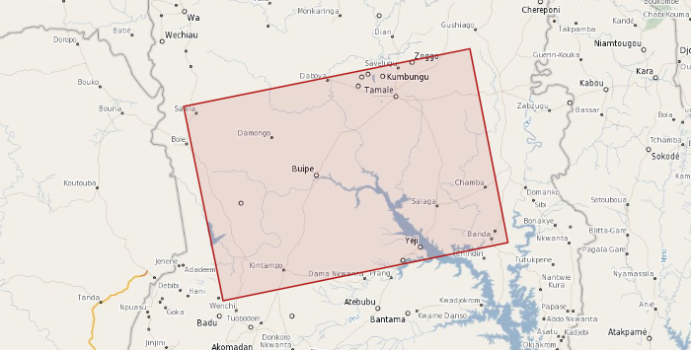
Back to main menu
RainRunner: Input data
Soil moisture (related)
Back to input data overview
Sentinel 1 – C-band radar:
Ground Range Detected (GRD) product (L1)

Slide 10
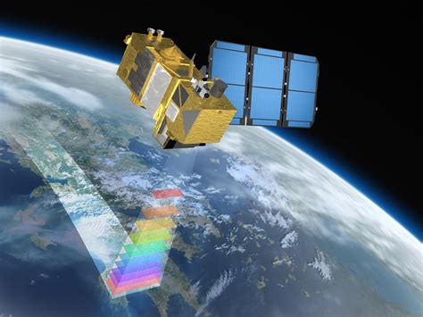
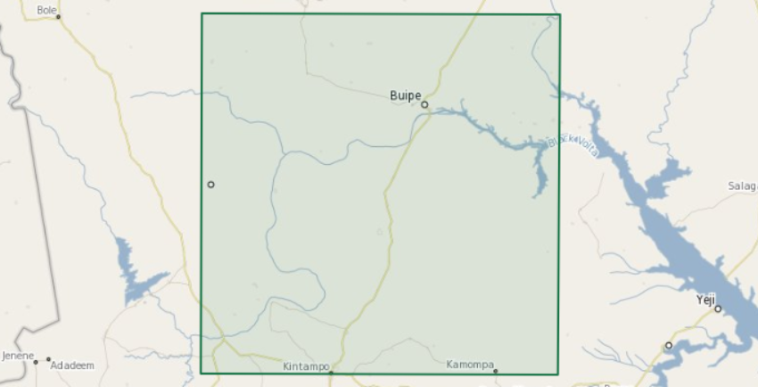
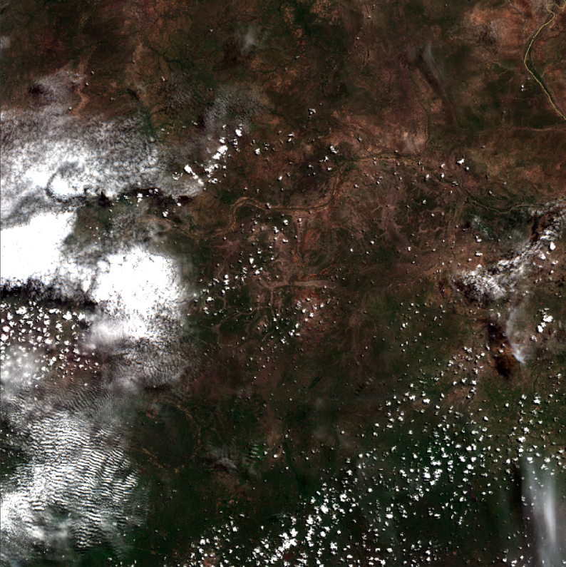
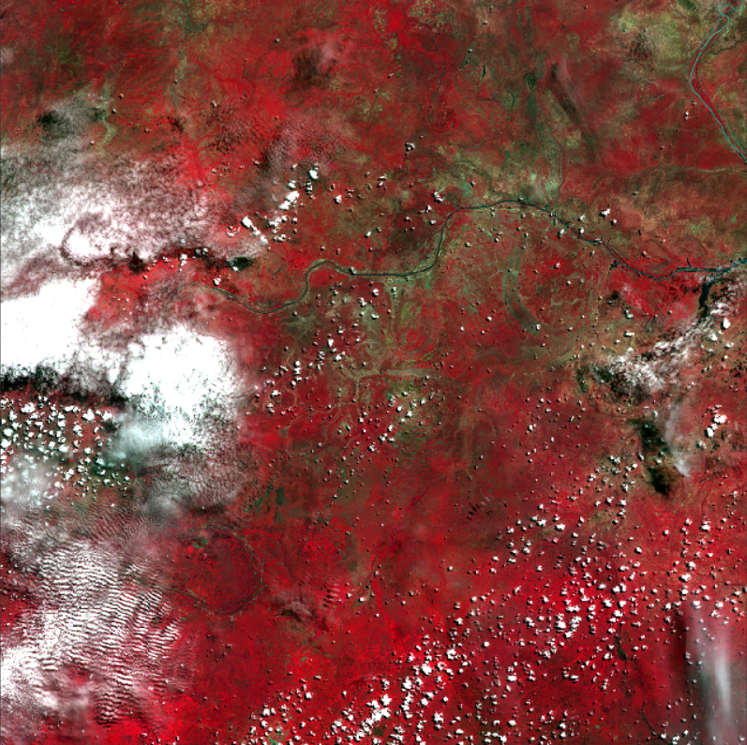
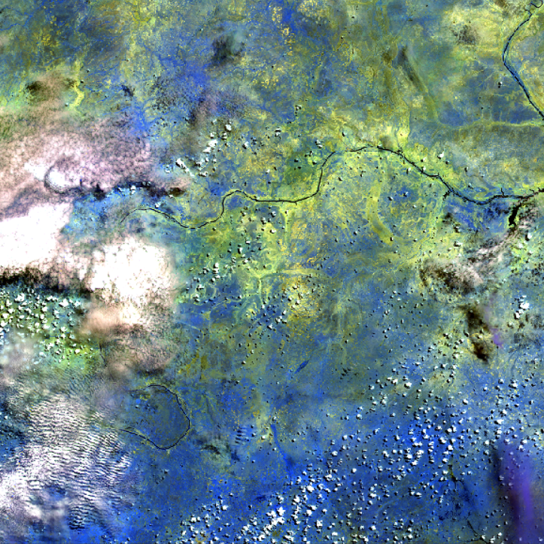
Back to main menu
RainRunner: Input data
Additional multispectral information
Back to input data overview
Sentinel 2 – Multispectral Instrument (MSI):
MSI product (L1), imagery in 13 bands in the VIS, NIR and SWIR regions
Natural colors
False colors IR
Atmospheric penetration

Slide 11
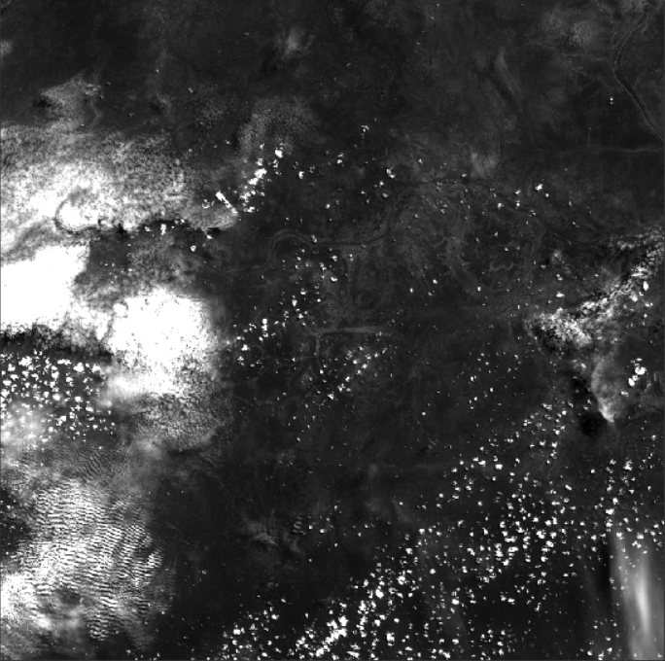
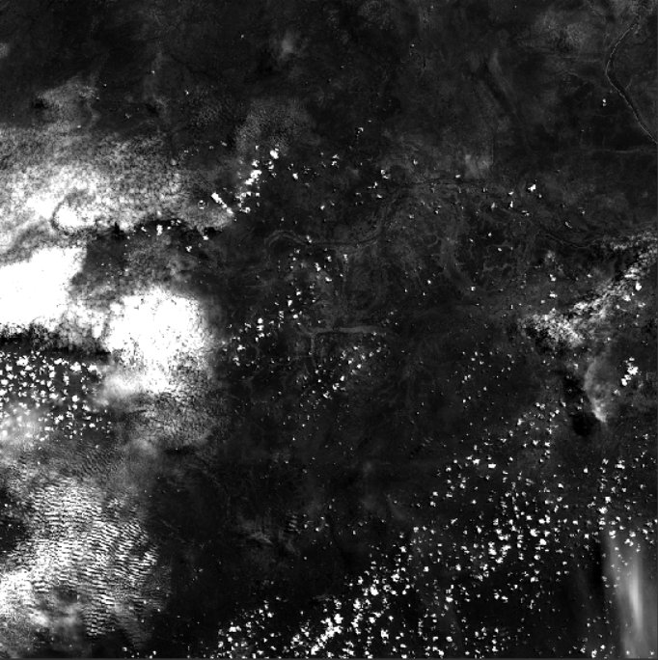
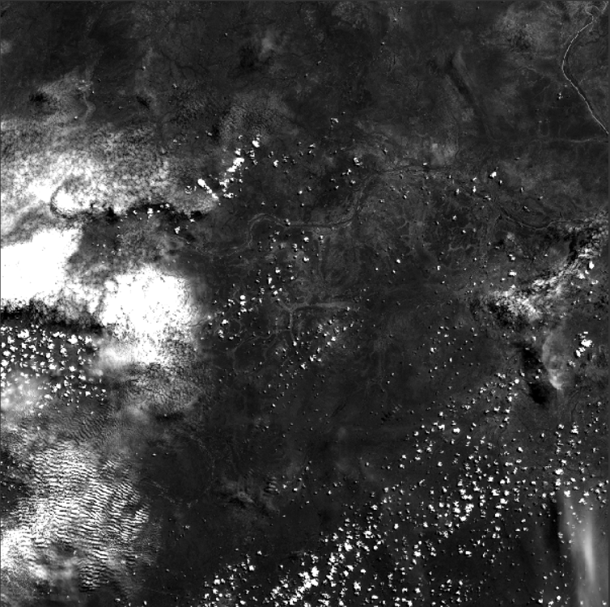
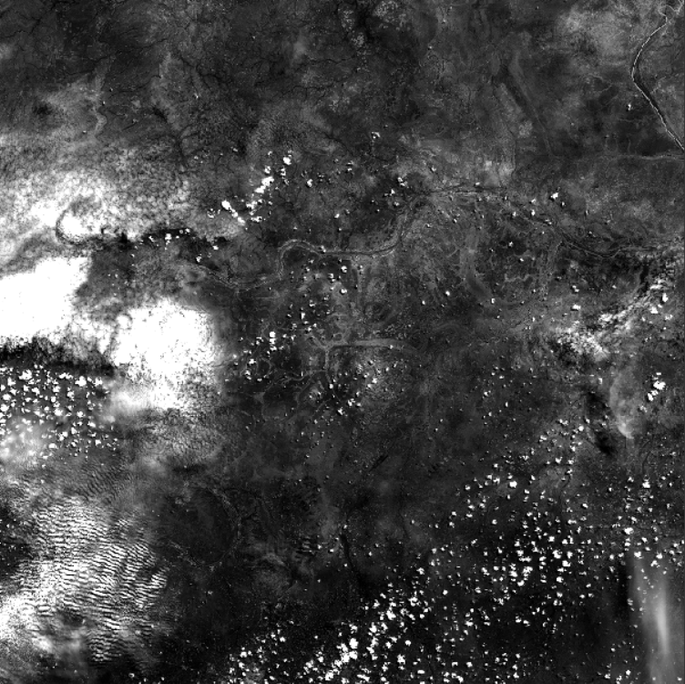
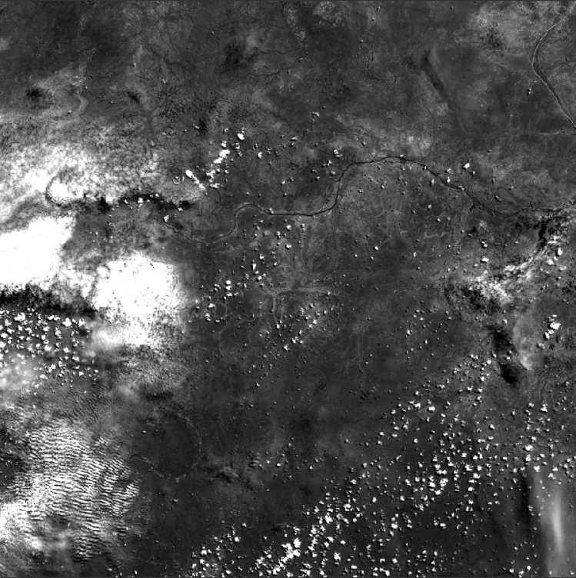
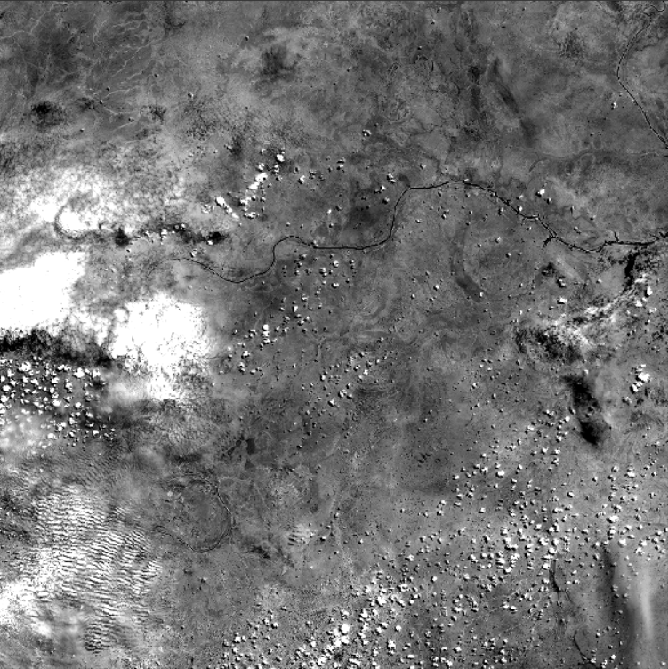
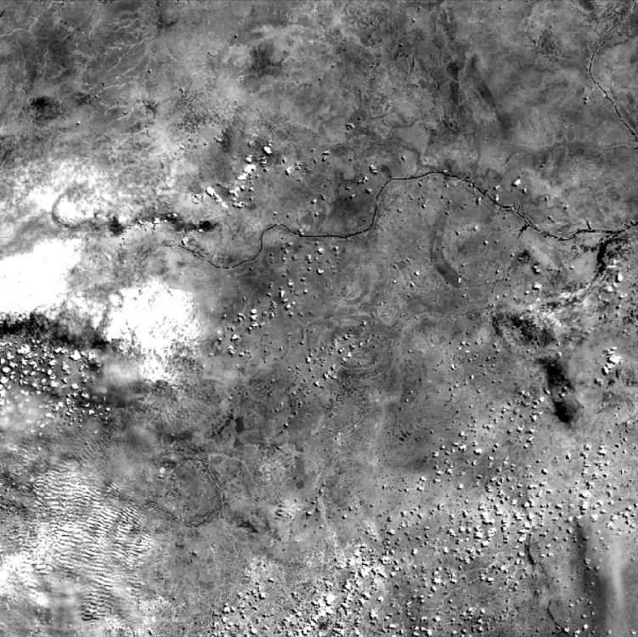
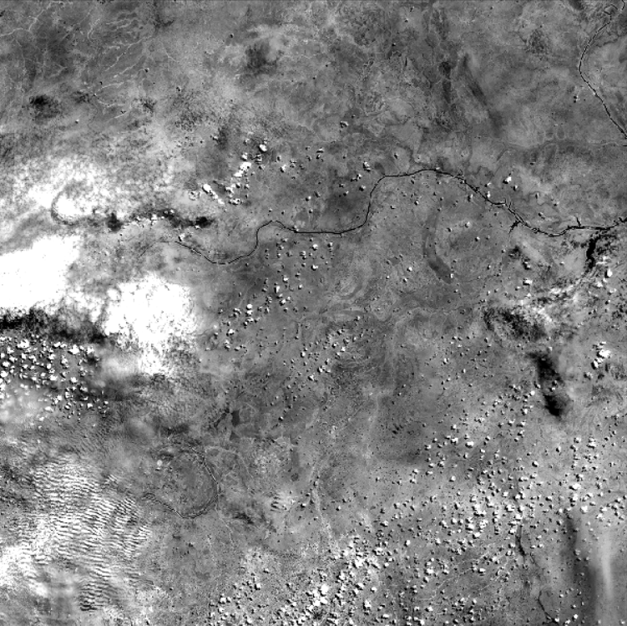
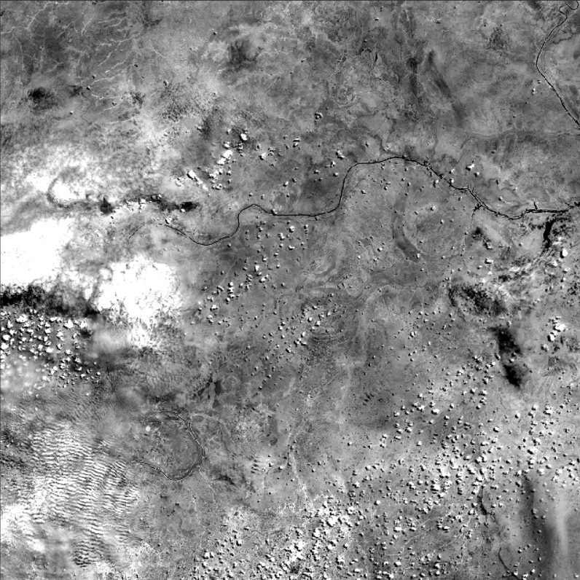
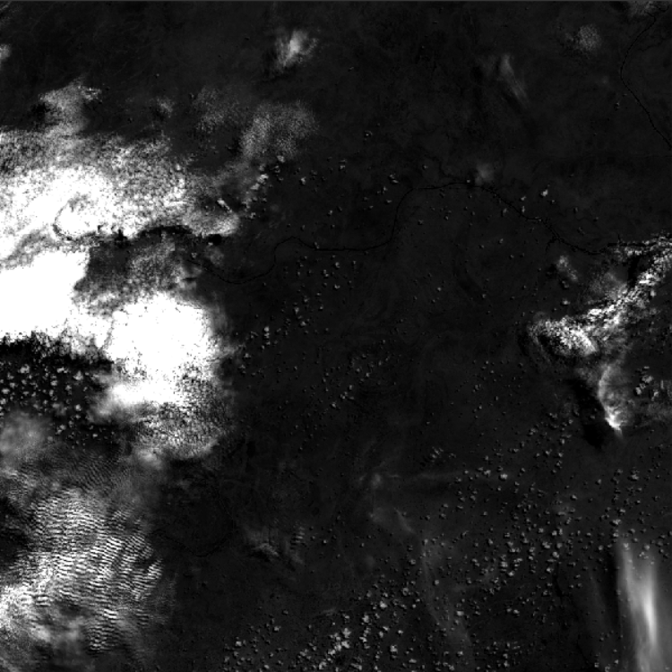
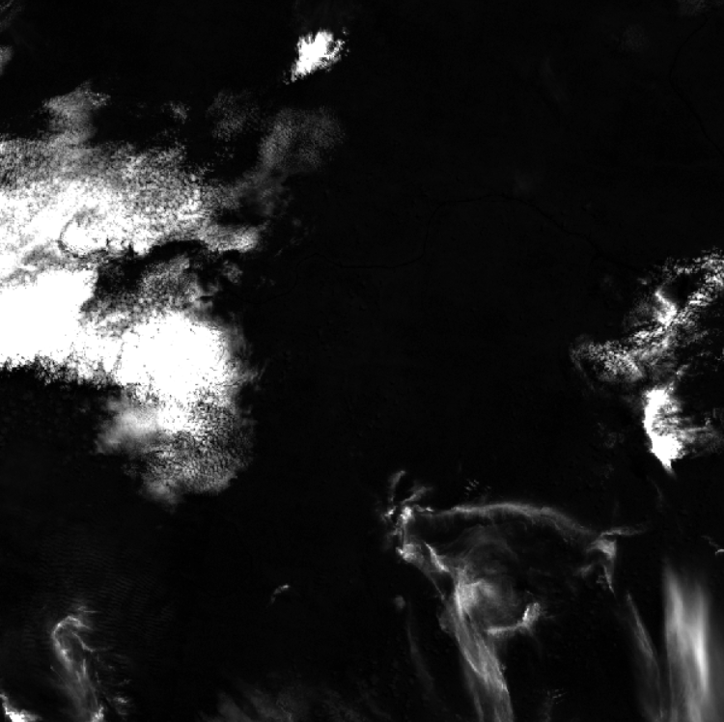
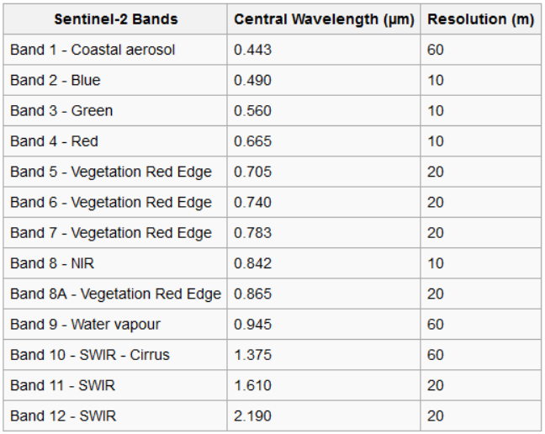
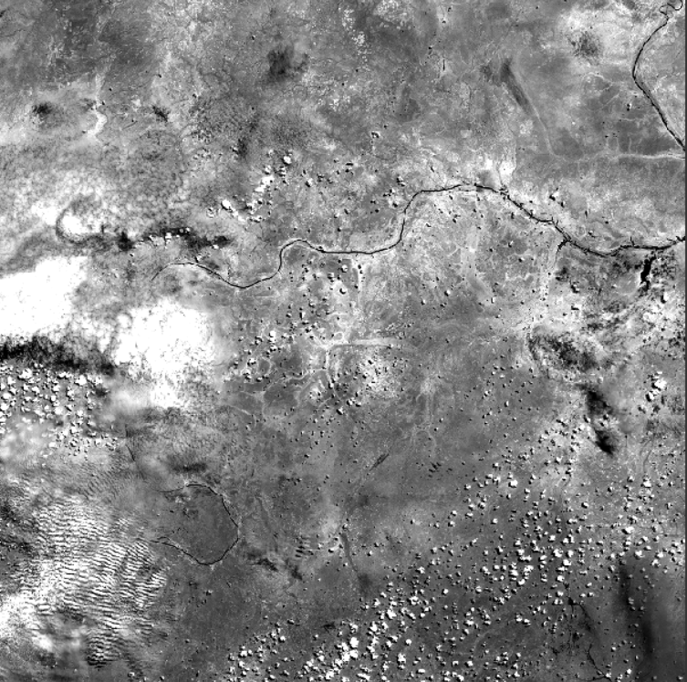
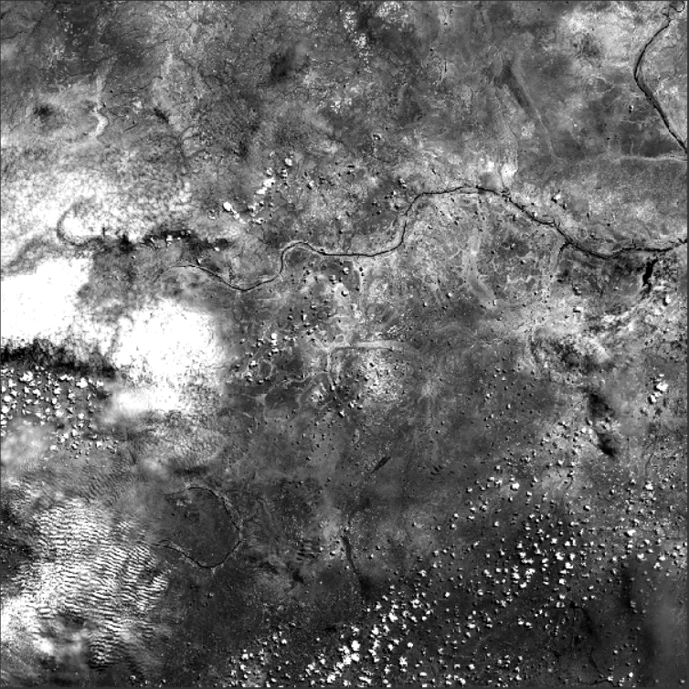
Back to main menu
Bands of Sentinel 2 MSI instrument
Back to input data overview
B1 – 443 nm
B2 – 490 nm
B3 – 560 nm
B4 – 665 nm
B5 – 705 nm
B6 – 740 nm
B7 – 783 nm
B8 – 842 nm
B8A – 865 nm
B9 – 945 nm
B10 – 1735 nm
B11 – 1610 nm
B12 – 2190 nm

Slide 12
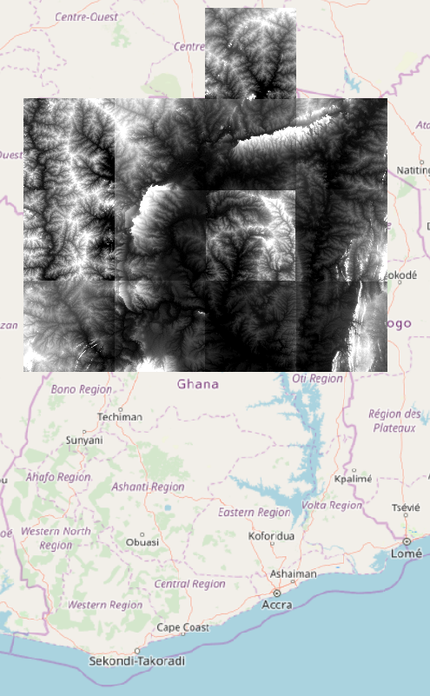
Back to main menu
RainRunner: Input data
Digital Elevation Model
Back to input data overview
NASA’s Shuttle Radar Topography Mission (SRTM): SRTM 1 arc sec DEM product

Slide 13
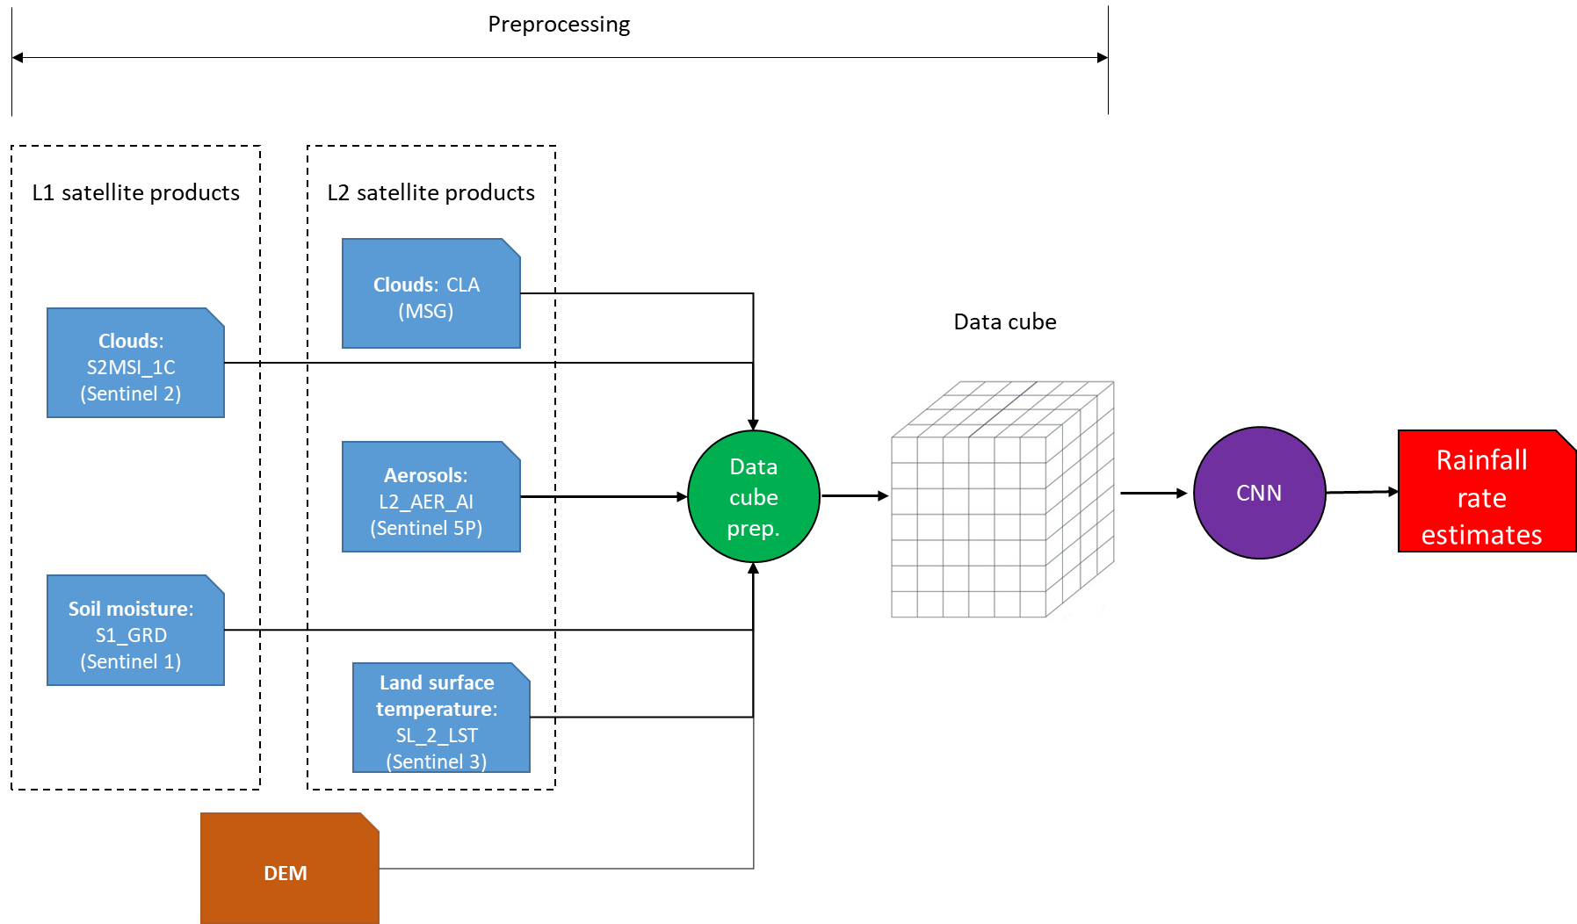
Back to main menu
RainRunner: Algorithm architecture

Slide 14


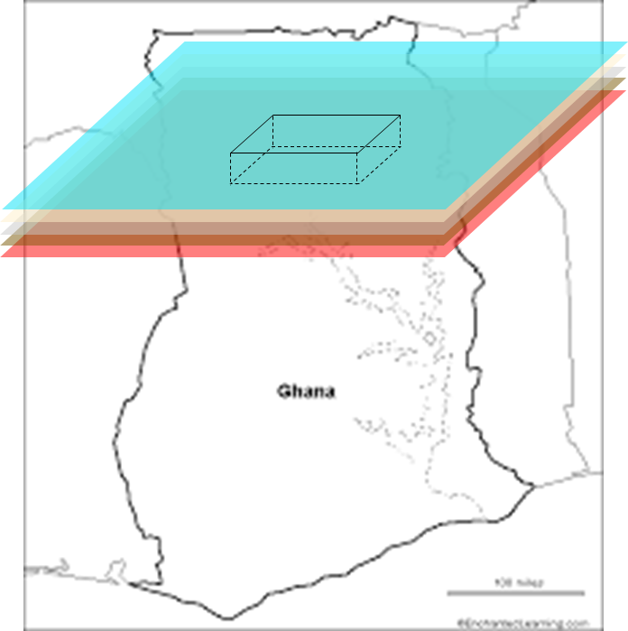
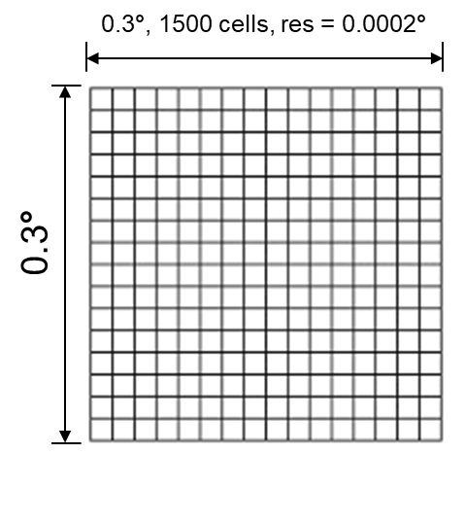
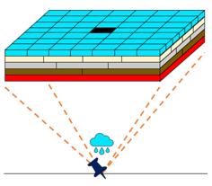
Back to main menu
Object | Product (Level) | Instrument (satellite / constellation) | Temporal resolution | Spatial resolution | Product format
Cloud amount and cloud top temperature | Cloud Analysis - MSG - 0 degree (CLA) (L2) | Seviri (MSG) | Hourly | 16 x 16 pixels (each image corresponds to one quarter of the Earth) | BUFR
Aerosol index | L2_AER_AI (L2) | Tropomi (Sentinel 5P) | Daily and occasionally more than one observation a day | 7 km x 3.5 km | NetCDF
Aerosol layer height | L2_AER_LH (L2) | Tropomi (Sentinel 5P) | Daily and occasionally more than one observation a day | 7 km x 3.5 km | NetCDF
Soil moisture | S1_GRD (L1) | C-SAR (Sentinel 1) | 6 days | HR: 10 m x 10 m MR: 40 m x 40 m | Sentinel-SAFE
Land surface temperature | SL_2_LST (L2) | SLSTR (Sentinel 3) | Daily and often more than one observation a day | 1 km x 1 km | NetCDF
Additional multispectral information | S2MSI_1C (L1) | MSI (Sentinel 2) | 5 days | L1C products are available in 10 m, 20 m and 40 m GSD, depending on the native resolution of the spectral bands. | Sentinel-SAFE
DEM | SRTM 1 arc sec DEM | Shuttle Radar Topography Mission (SRTM) | - | 1 arc sec (approx. 0.0003 deg, 30 m) | TIFF
RainRunner: Creation of a data cube for Northern Ghana
The different products will be input to the CNN in the form of a data cube. For this, first all the product will be ingested in a data cube over the North of Ghana and for the years 2018-2020, that will be open source and possibly incorporated into the already existing African Digital Earth (www.digitalearthafrica.org).
From this bigger data cube, smaller 0.3° x 0.3° data cubes centered on each ground rainfall measurement and with a 0.0002° resolution, covering a time span in the order of 6 days leading to the rainfall measurement will be extracted. In the next phase these smaller data cubes will be input to the CNN.
Satellite products
Different spatial resolutions and coverages
Different data formats (BUFR, NetCDF, Sentinel-SAFE, TIFF)
0.3° x 0.3°; 0.0002° x 0.0002°
Same data format: NetCDF

Slide 15
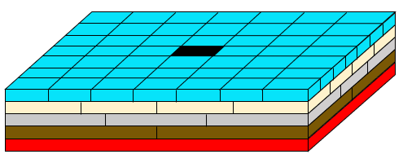

Back to main menu
RainRunner: Rainfall estimation
The RainRunner rainfall retrieval algorithm will estimate daily precipitation for the central cell of each data cube in two stages: Binary rain/no rain classification followed by rainfall amount estimation, in the case of a positive first classification.
No rain
CNN1
CNN2
Rain
Rainfall amount
Would regression or classification (e.g. 12 rainfall intensity classes) be more appropriate for rainfall amount estimation, considering the limited available rainfall data?
Think along

Slide 16
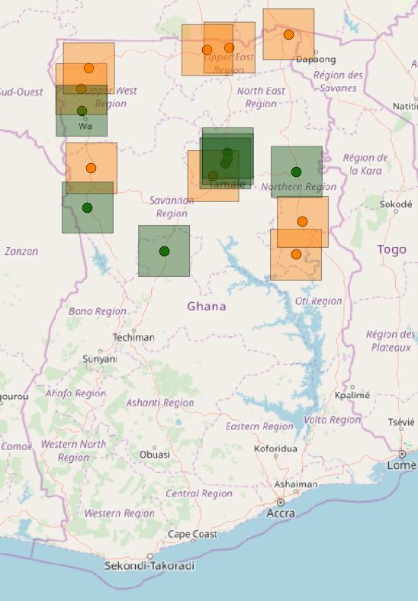
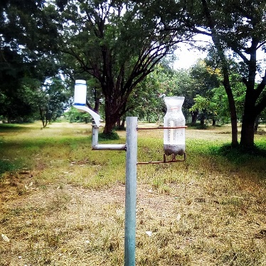
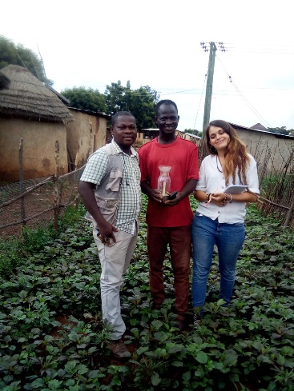
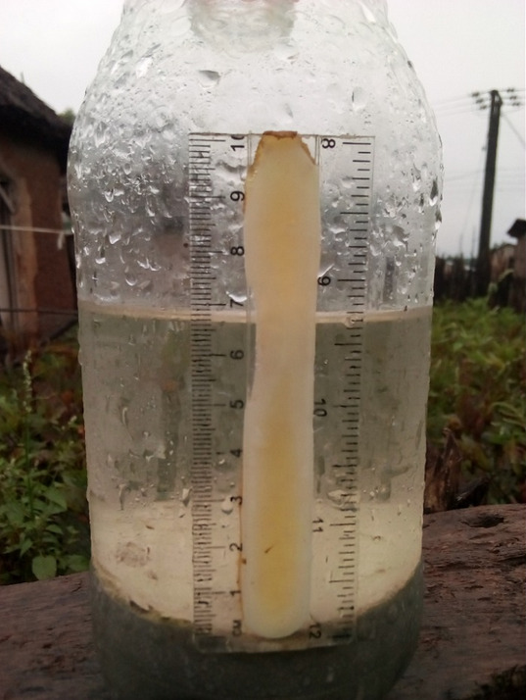
Back to main menu
RainRunner: Training and validation dataset
Proof-of-concept algorithm:
Target data: 2018 & 2019 rainfall data from TAHMO and Ghana Meteorological Agency (GMet) stations (left)
Extended algorithm:
+ DISDRO and Citizen Science data from 2020 rainy season (bottom)
TAHMO stations
GMet stations
Installation of a DISDRO sensor and a CS gauge
One of the first farmer citizen scientists that joined SaS in August 2019, and an example of one of the measurement pictures sent in October 2019.

Slide 17
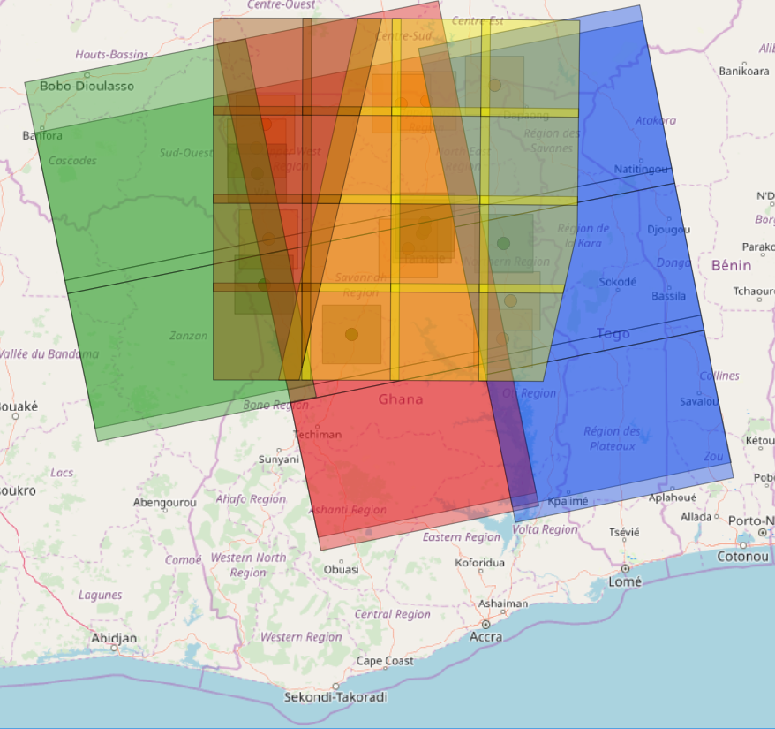
Back to main menu
RainRunner: Training and validation dataset
Input data: Satellite data 2018 & 2019
An example of Sentinel 1 (green, red and blue) and Sentinel 2 (brown and yellow) product footprints over our study area.

