Slide 1
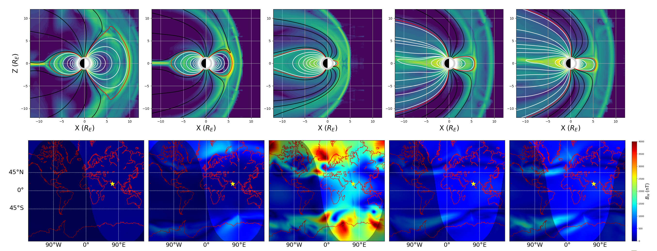
Recreating Carrington Event B_{H} Measurements using the Space Weather Modeling Framework
Seán P. Blake^{1,2}, Antti Pulkkinen¹, Pete Schuck¹, Alex Glocer¹, Denny Oliveira¹, Dan Welling³
1 - NASA Goddard Space Flight Center, MD, USA
2- Catholic University of America, DC, USA
3 – The University of Texas at Arlington, Texas, USA

Slide 2
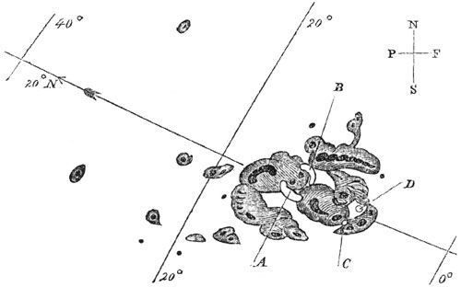
1/11
2-3 September 1859 Carrington Event
The Carrington Event is possibly (probably) the largest geomagnetic storm on record
Estimated minimum Dst between -650 and -1150 nT
Saw extremely low-latitude aurora (at least 29° MLAT)
Magnetometers worldwide went off-scale.
Would likely cause widespread technological effects today
Kew Magnetogram going off-scale (Cliver & Dietrich, 2013)
Carrington's sketch of sunspot group,
September 1, 1859

Slide 3
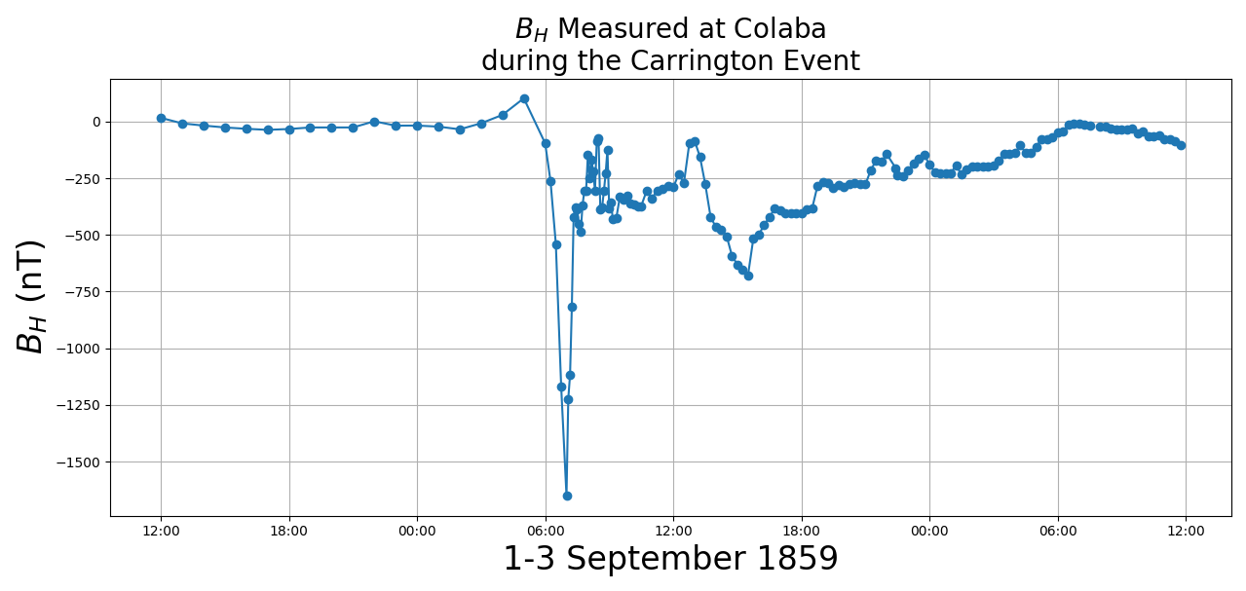
2/11
B_{H} at Colaba, India
The Colaba B_{H} measurements are exceptional for a few reasons:
Low-latitude
High cadence
Remains in scale
B_{H} drops around 1750 nT in two hours, then mostly recovers in an hour
It is unclear what causes this sharp dip and recovery.
Different studies suggest magnetospheric, ionospheric, magnetospheric + ionospheric or field-aligned currents as likely culprits…

Slide 4
2/11
B_{H} at Colaba, India
The Colaba B_{H} measurements are exceptional for a few reasons:
Low-latitude
High cadence
Remains in scale
B_{H} drops around 1750 nT in two hours, then mostly recovers in an hour
It is unclear what causes this sharp dip and recovery.
Different studies suggest magnetospheric, ionospheric, magnetospheric + ionospheric or field-aligned currents as likely culprits…
Objective: Can we simulate a scenario which will recreate this low-latitude B_{H}?

Slide 5
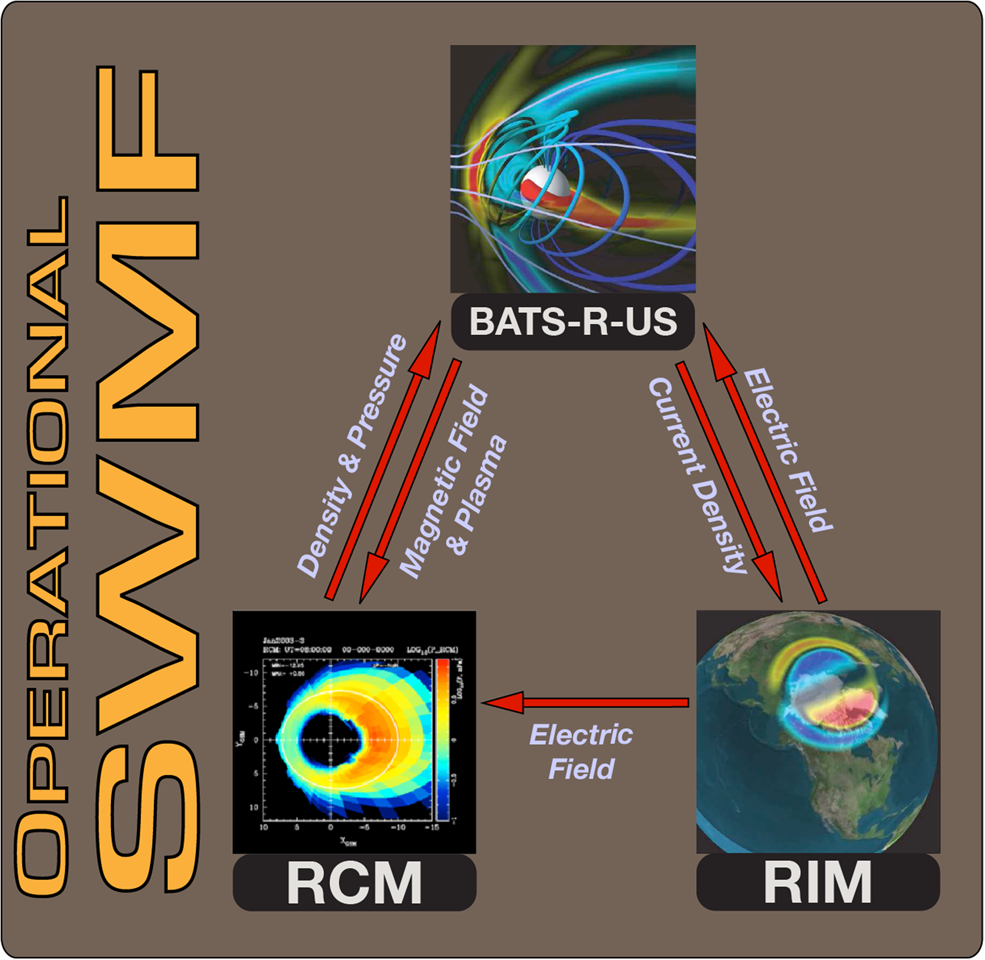
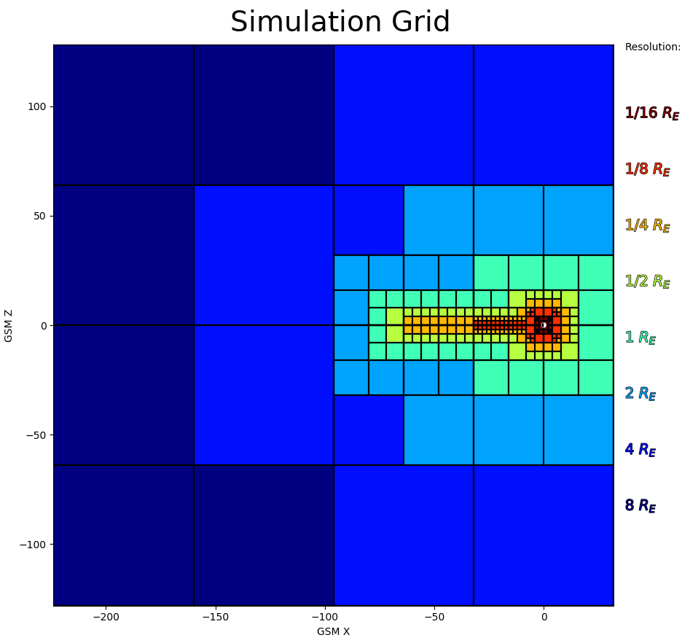
Space Weather Modeling Framework (SWMF)
3/11
The SWMF is a framework for combining MHD and kinetic models
Can be used to simulate from the solar corona, down to the Earth’s surface magnetic field
Uses solar wind conditions as inputs
SWMF Modules Used
(Haiducek et al., 2017)

Slide 6
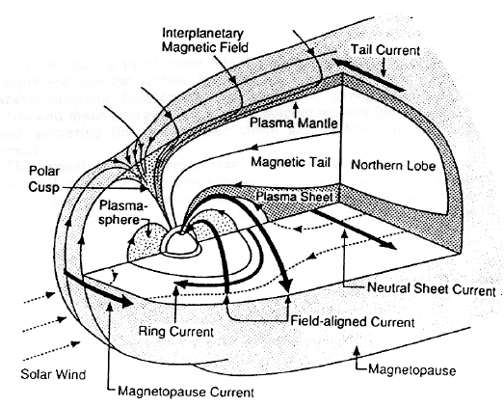
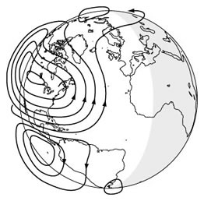
Space Weather Modeling Framework (SWMF)
4/11
Magnetosphere
Ionosphere
Surface magnetic field values are calculated from each of the domains in the simulation
Solar
Russell and Luhmann, 1997
www.USGS.gov
Magnetic field from a line current:

Slide 7
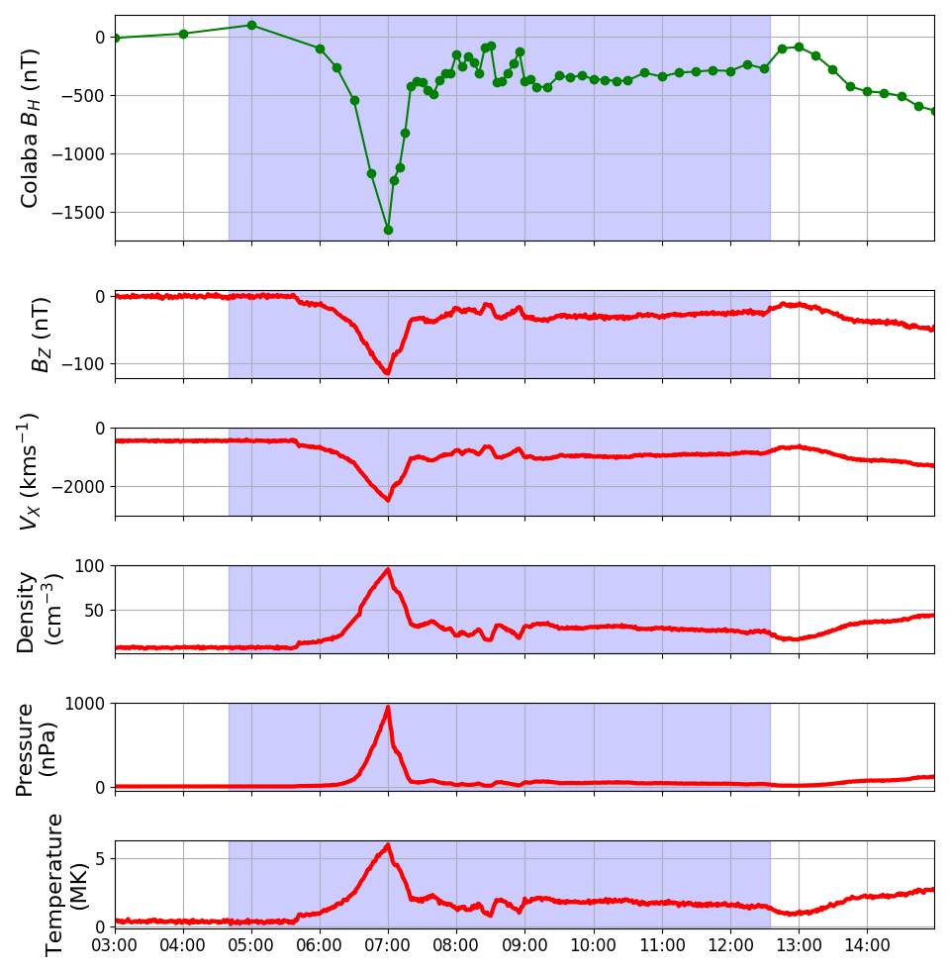
Our Carrington Solar Wind Inputs
5/11
General idea for the solar wind drivers:
Create extremely impulsive solar wind conditions to greatly compress magnetopause
Use extreme but not unrealistic solar wind values
We used the Colaba B_{H} timeseries as the shape of the driving solar wind, and scaled solar wind conditions:
V_{x} = -2,500 kms⁻¹
B_{z} = -118 nT
N = 100 ccm⁻³
These values are large but not unprecedented for historical solar wind conditions*
*except B_{Z} which was empirically calculated from V_{x}

Slide 8
Simulated Results
6/11
Magnetopause is forced to around 2.7 R_{E}
Maximum 𝚫B_{H} of 6,000 nT is seen at high latitudes
Dayside B_{X} from magnetosphere dramatically decreases as magnetopause is pushed earthward
Minimum Dst = -775 nT

Slide 9
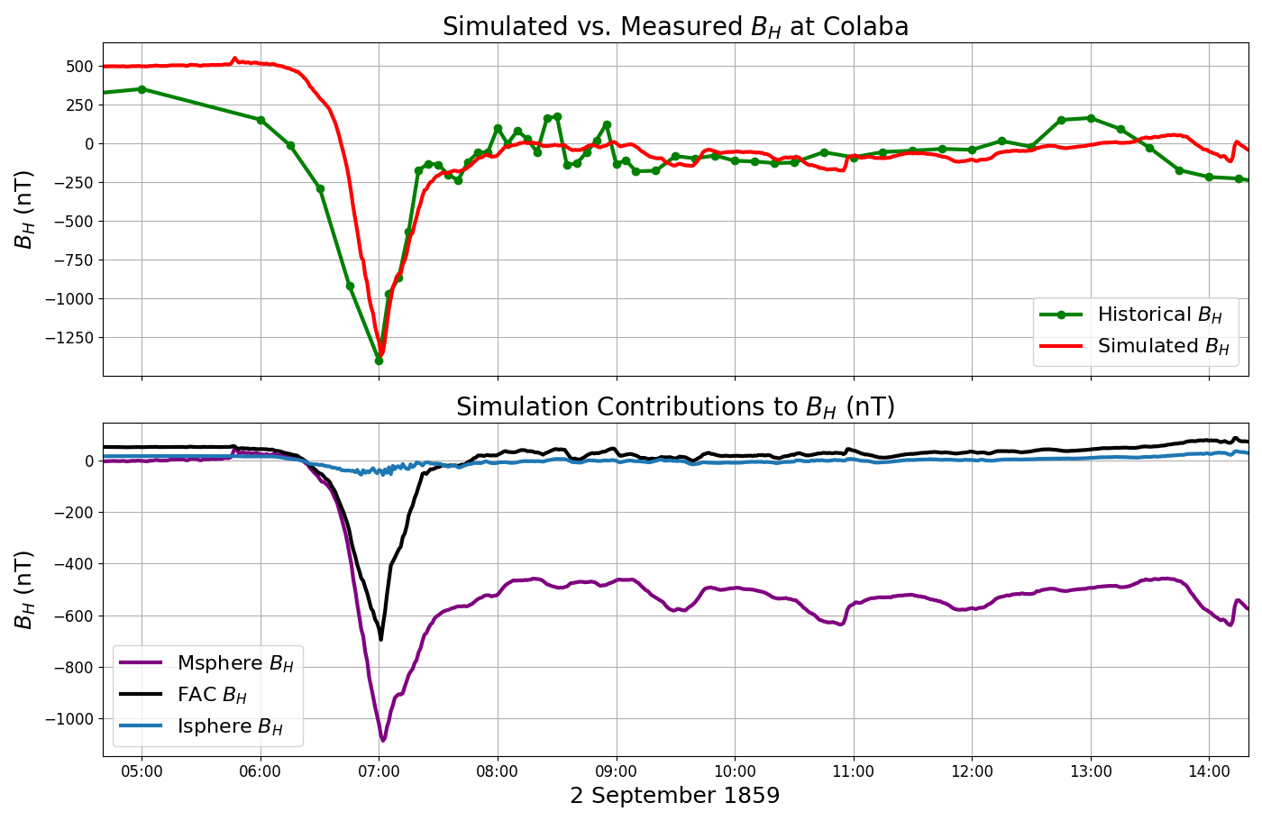
Simulated B_{H} at Colaba
7/11
From all the current systems in the simulation, we can calculate B_{H} at Colaba, and compare to the historical timeseries
The simulated Colaba B_{H} exhibits the quick decline and recovery
The breakdown of the B_{H} showsthat the magnetosphere is the primary contributor to the Colaba signal, then FACs, with the ionosphere contributing the least

Slide 10
Simulated B_{H} at Colaba
8/11
R_{E}
Here are 2D slices of the current density in the magnetosphere:
This large magnetic contribution at low-latitudes is due to compressed plasma at the off-noon dayside.
These two lobes counteract the magnetic contribution from the magnetopause, and lead to a very negative surface B_{X} at low-latitude noon

Slide 11
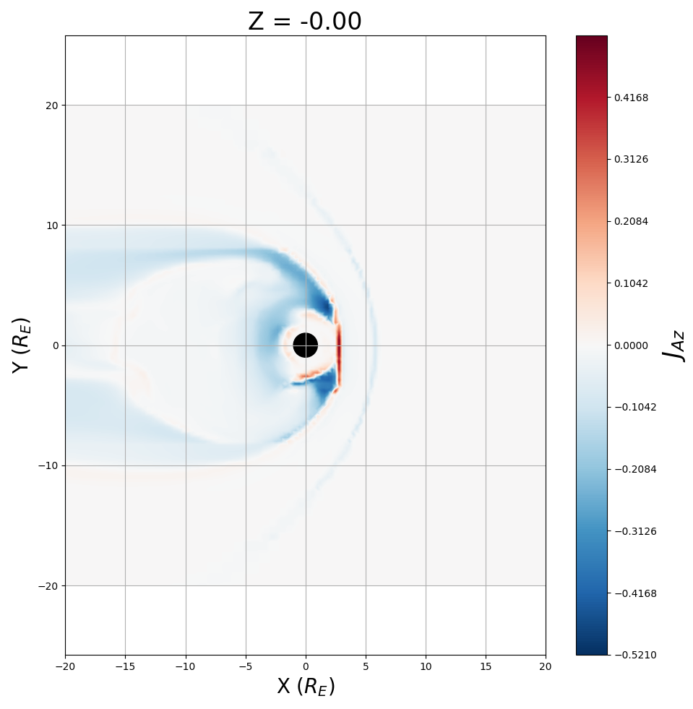
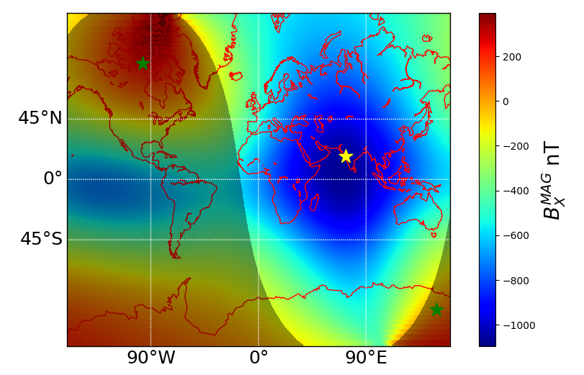
Simulated B_{H} at Colaba
8/11
R_{E}
R_{E}
Here are 2D slices of the current density in the magnetosphere:
This large magnetic contribution at low-latitudes is due to compressed plasma at the off-noon dayside.
These two lobes counteract the magnetic contribution from the magnetopause, and lead to a very negative surface B_{X} at low-latitude noon

Slide 12
Dst of Event
9/11
Dst is calculated from 4 low-latitude observatories equally spaced longitudinally.
For our particular event, the low-latitude area of one side of the Earth sees a massive change in 𝚫B_{H.}
Calculating Dst is therefore hugely dependent on the location of the measuring sites.
The minimum Dst can therefore range from -347 nT to -973 nT depending on what time of day the CME impacts
Extreme-event statistics usually rely on Dst for estimating frequency of huge events. Impulsive storm events (such as our simulation) could be underestimated in this case.

Slide 13
Conclusion
10/11
We can recreate the intense dip and rapid recovery in B_{H} at low-latitudes during for Carrington event using the Space Weather Modelling Framework.
The solar wind conditions needed are extreme, but not incredible.
Currents in the magnetosphere are the main contributors to the dip and recovery of B_{H} at the dayside
Due to the nature of the event, Dst may not be suitable to classify its intensity

Slide 14
Future Work
11/11
While we could recreate the B_{H} measured at Colaba, other fragmentary B_{H} measurements were not reproduced very well elsewhere
The solar wind conditions that were used do not represent a typical (i.e., realistic!) CME structure – future simulations will apply CME-like structures to solar wind inputs

