Slide 1
Benthic investigations at the Arctic long-term deep-sea observatory HAUSGARTEN
Hasemann, C.; Schewe, I.; Soltwedel, T.
Notes:
Some results from the first 15 years of the benhtic time-series work at the deep-sea long-term observatory HAUSGARTEN in the Arctic Ocean

Slide 2
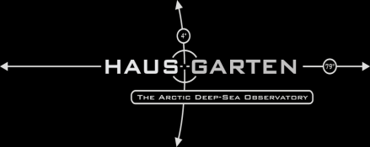
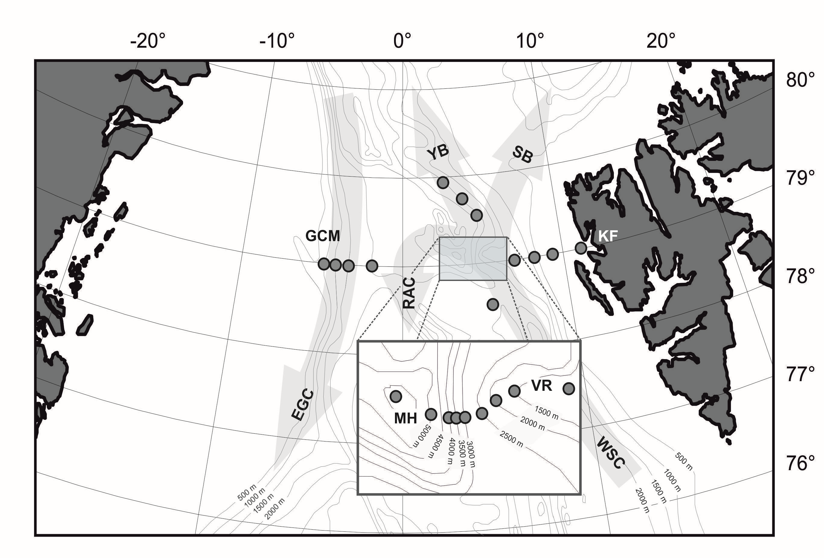
Site description…
since 1999
21 stations
bathymetric transect
(1000 - 5500 m)
latitudinal transect
(2500 m)
repeated sampling
continuous measurements
KF: Kongsfjorden; VR: Vestnesa Ridge; MH: Molloy Hole; GCM: Greenland Continental Margin; WSC: West Spitsbergen Current; EGC: Eastern Greenland Current; RAC: Return Atlantic Current; YB: Yermak Branch, and SB: Svalbard Branch of the WSC.(Soltwedel et al. 2016)
visual observations
experimental work
Notes:
The Fram Strait, located between Svalbard and Greenland, is the only deep connection between the Central Arctic Ocean and the Nordic Seas. It is a gateway to the Arctic with warm Atlantic water inflow and polar water outflow.
Cold polar waters exit the Arctic Ocean with the EGC and and sea-ice is transported out of the Arctic. Warmer and nutrient rich Atlantic water masses are transported into the central Arctic Ocean with the WSC.
In this transition zone at 79°N, 4°E the deep-sea observatory LTER HAUSGARTEN was established in 1999 by the Alfred-Wegener-Institute
HAUSGARTEN consits of 21 stations along a depth gradient between 1000-5500 m water depth and along a latitudinal transect at 2500 m water depth
Repeated sampling and the deployment of moorings and different long-term lander systems for continuous measurements take place to analyse variations of biological, geochemical and sedimentological parameters
Frequent visual observations with towed photo/video systems allow the assessment of largescale distribution patterns of larger epibenthic organisms.
we also established several long- and short-term experiments to study causes and effects of gradients on biodiversity of the small-sediment inhabiting biota
Fram Strait is located between Svalbard and Greenland and is in an area marked by exchange of Atlantic and Arctic water masses. As the only deep-water connection between the Arctic Ocean and the world ocean, Fram Strait is an important site for the exchange of mass, heat, and salt. The warm West Spitsbergen Current (WSC) carries warm Atlantic waters north into the Arctic Ocean the EGC transports Arctic Ocean water masses, and >90% of the ice exported from the Arctic Ocean. The EGC is an important link between the Arctic Ocean and the North Atlantic Ocean.

Slide 3
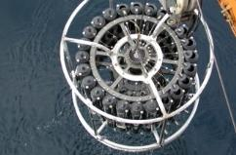
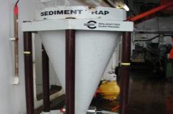
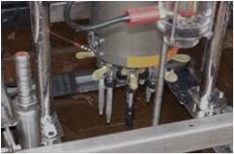
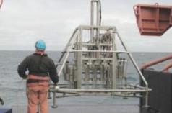
Core measurements…
Pelagic Zone
temperature, currents ¹(speed, direction), oxygen concentrations,
particle flux rates, phyto-/zooplankton ², (sediment traps)
Sediment-Water-Interface
currents and oxygen concentrations, carbon remineralisation
(oxygen microelectrodes, sediment community oxygen consumption)
Sediments
granulometry, porosity, organic matter input (phytodetrital pigments),
organic carbon content,
biomarker ³(marine, terrigenous), biomass parameter (proteins, lipids)
Benthos
bacteria, meiofauna ⁴, macrofauna ⁵, mega/epifauna, demersal fish
(microbial activity, densities, biomass, distribution, biodiversity)
in cooperation with:
¹ AWI - Climate Sciences – Observational Oceanography
² AWI - Biosciences - Polar Biological Oceanography (PEBCAO)
³ AWI - Geosciences - Marine Geology and Paleontology
⁴ University Gent, Institute for Oceanology / Polish Academy of Sciences
⁵ Institute for Oceanology / Polish Academy of Sciences, Shirshov Institute, Russian Academy of Sciences
Notes:
Sampling sites are revisited yearly in the summer month during expeditions with the German Research icebreaker Polarstern and we sample the water column from the surface down to the deep-seafloor.
Water column studies comprise the assessment of physico-chemical parameters as well as flux measurements of particulate organic matter, and we sample the plankton community.
At the sediment-water interface, we measure changes of the current regime and oxygen concentrations, and suspended matter including organic material, that is transported along or accumulated at the sediment surface.
We sample the sediments for granulometry and porosity, and organic matter input as phytodetrial pigments and organic carbon content as well as for biomarker and biomass parameters.
And we sample the benthic organisms from bacteria to epibenthic larger organisms and demersal fish to analyse activity, density, biomass, distribution patterns and diversity.

Slide 4
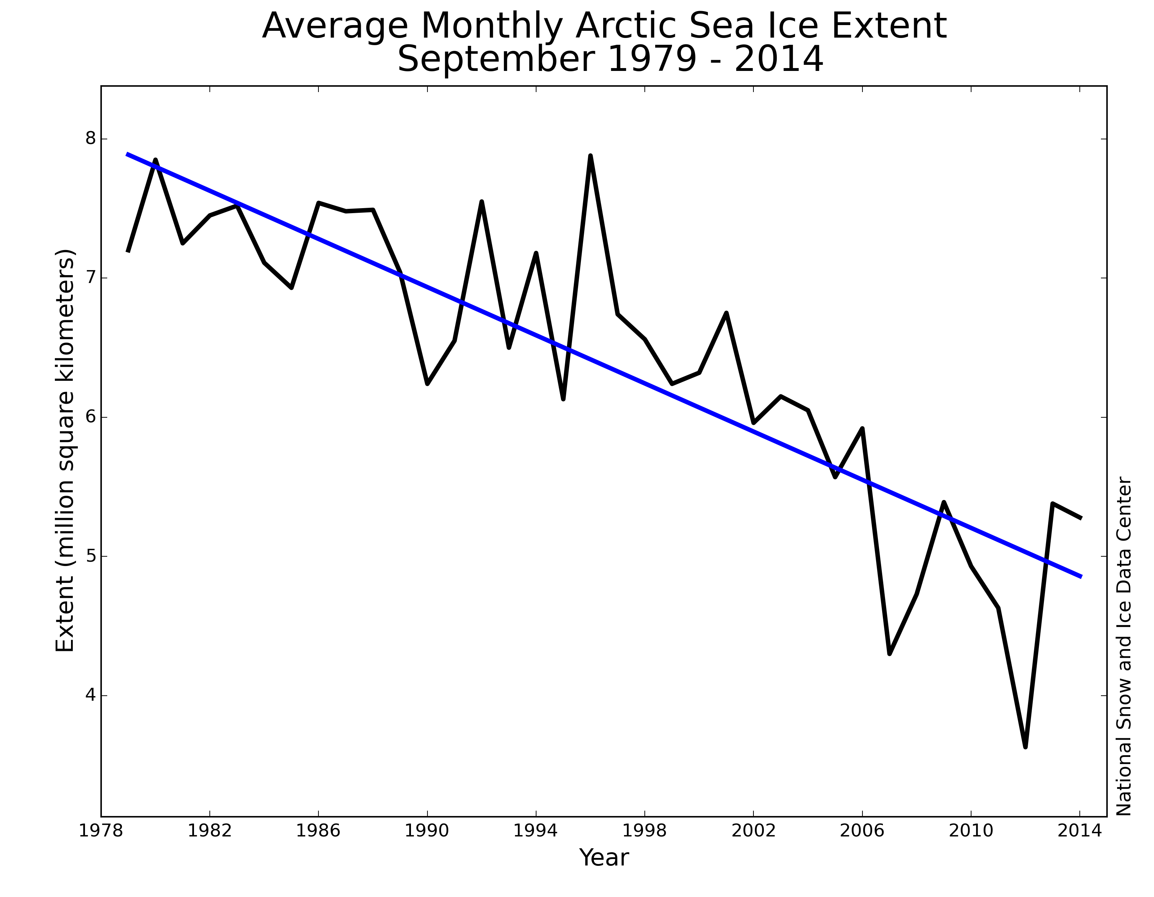
continuous sea ice decline…
Notes:
Data from the National Snow and Ice Center for the Summer Sea Ice extent in the central Arctic from 1979-2014
Arctic sea ice during the 2007 and 2012 melt season have reached lowest extent, in 2012 Artic sea ice extent is about half the size of the average extent from 1979 to 2010.
The general sea ice decline in the central Arctic causes also considerable changes in the Fram Strait --- less in a general decline but in higher variability of sea ice coverage
So, we observed strong variations in physical & biological parameters during the first 15 years of investigation at HAUSGARTEN.

Slide 5
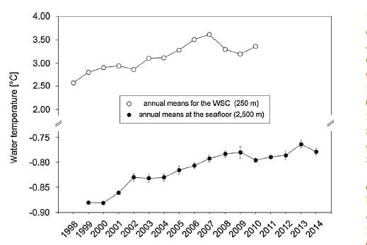
oceanographic time-series…
Increase in water temperature in the eastern Fram Strait between 1998 and 2014
annual means in the WSC at 250 m (data from Beszczynska-Möller et al. 2012, top) and
at 2500 m water depth at the central HAUSGARTEN site off Svalbard (Gloveret al. 2010 and Soltwedel et al. 2016, bottom)
Notes:
Results of the time series work between 1999-2010 from the moored instruments in Fram Strait indicate an increase of the water temperature at 250 m water depth in the West Spitsbergen Current (WSC) until 2007 and a decrease since then until 2010
Between 2005 – 2007 the Atlantic water masses, warmer than usual, reached the Fram Strait, resulting in warmer surface waters in the HAUSGARTEN area
This increase in surface water temperature until 2007 and subsequently decrease was also observed at the deep-seafloor, with a time lag of about one year, temperatures increased until the time period between 2008 and 2009 and decreased in 2010/2011, since then temperatures at the deep-seafloor starting to increase again
These changes in water temperature may impact primary production and organic matter export to the deep-seafloor.
We observed changes in some parameters investigated at HAUSGARTEN observatory following the sea ice minimum extent and the increase in water temperatures in 2007

Slide 6
benthic time-series…
Temporal variations in biogenic sediment compounds at the Central HAUSGARTEN (2500 m)
Phospholipid concentrations
Sediment-bound chloroplastic pigments indicating food availability
from phytodetritus sedimentation
between 2000 and 2014
(Soltwedel et al. 2016, unpubl. data)
Notes:
Chloroplastic pigment concentrations in the sediments at the central HAUSGARTEN station at 2500 m water depth between 2000-2014
Chloroplastic pigments in the sediment, indicating food input to the sea floor from phytodetritus sedimentation , show much higher values in the years 2007–2014 than in the years 2000–2006. The data suggest higher food input to the seafloor following the year 2007.

Slide 7
benthic time-series…
Temporal variations in biogenic sediment compounds at the Central HAUSGARTEN (2500 m)
(Soltwedel, unpubl. data)
Proteins
indicating biomass of small organisms and detrital matter
between 2000 and 2014
Notes:
Protein content of the sediments, indicating benthic biomass, shows a steady increase from 2000 to 2014,
with generally lower values in the time period from 2000 -2007 compared to the years following 2007, (with highest values in 2011)

Slide 8
benthic time-series…
Temporal variations in biogenic sediment compounds at the Central HAUSGARTEN (2500 m)
(Soltwedel, unpubl. data)
Potential bacterial exo-enzymatic activity
indicating decomposition of organic matter
between 2000 and 2014
Notes:
Potential bacterial exo-enzymatic activities between 2000 and 2014.
Values for bacterial activity within the time period 2000-2007 are generally on a higher level compared to the years following 2007
During starvation periods bacteria actively release exoenzymes to improve the uptake capacity of cells at low substrate concentrations
Compared to the time period 2000-2007, lower exoenzymatic activity, in the years following 2007 may be an indication that the bacteria are exposed to a larger quantity of energy-yielding substrate.

Slide 9
benthic time-series…
Variability in meiobenthos at the Central HAUSGARTEN (2500 m)
(Hoste et al. 2007, Grzelak 2015)
Meiofauna
total meiofauna abundance
between 2000 and 2014
Notes:
Meiofauna densities at 2500 m water depth between 2000 and 2014 divided into nematode densities (left y-axis) and densities of all other (rare) meiofauna taxa (right y-axis)
Apart from 2000 with exceptionally low values, nematode densities decrease from 2001 to 2004 and increase again in the following years, with highest values in 2007, decrease again until 2010 and start to increase in the following years with highest values in 2013, but never again reached values as high as in 2007
In contrast to nematode densities, densities of the remaining rare meiofauna taxa decreased in the years after 2007 continuously until 2014, and showed in the time period before 2007 in most years an opposite trend to the nematode densities
This interannual variation in nematode densities, the most abundant metazoan taxon at HAUSGARTEN seems to reflect the differences in food availability of the sediments, at least abundances in 2007 seems to show a change related to the elevated supply of organic matter to the seafloor, which also can be seen in densities of the remaining rare meiofauna taxa

Slide 10
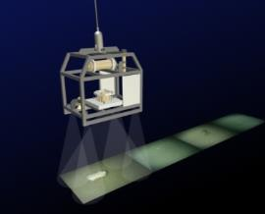
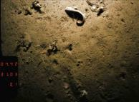
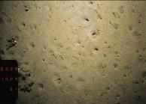
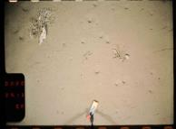
benthic time-series…
Variability in the mega/epibenthos at the Central HAUSGARTEN (2500 m)
© N. Lochthofen
(Bergmann et al. 2011, Soltwedel et al. 2016)
Notes:
We record large scale distribution patterns of megafaunal organinsms by a towed camera system called OFOS (Ocean Floor Observation System)
Since 2002 we conduct repeated photographic surveys at different HG stations
This plot shows densities analysed from photographic transects in 2002 , 2004, 2007 and 2011 at 2500 m water depth
The change in organic matter availability was also reflected in interannual variations in megafaunal densities in the HAUSGARTEN area
Overall megafaunal densities decreased from 2002 to 2007 and increased between 2007 and 2012, although we do not know what happened in 2005/06 and from 2008-1010
Suspension-feeder densities also declined, predator/scavenger and deposit-feeder densities decreased to such a degree that suspension feeders made up >90% of the megafauna in 2007.
Decreasing megafauna densities in the years leading up to 2007 might reflect the decrease in food input to the seafloor in this time period
In the years 2007–2011, elevated levels of phytodetrital input were recorded, This elevated food input may help to explain the increase in total megafaunal density between 2007 and 2011
So the megafauna seems to respond to the changes in food supply, but in contrast to the meiofauna with a time lag of about one year

Slide 11
to conclude…
investigations at HAUSGARTEN provide insights into processes and dynamics within an Arctic deep-sea ecosystem and represent a baseline for further investigations of ongoing changes in the Fram Strait
long-term investigations are crucial to understand and predict ecosystem variation on different time scales
a better understanding of natural systems will allow for improved future predictions under different climate scenarios
it remains unclear if the ecosystem changes can be attributed to climate change or if they reflect natural variations

