Slide 1
SO₂ emissions from 28th August 2019 Stromboli Paroxysm observed by TropOMI
Mike Burton, Catherine Hayer and
Giuseppe La Spina
University of Manchester, UK
Thanks to EUROVOLC project

Slide 2
TropOMI: A new powerful tool for volcano monitoring
Launched in October 2017 on Sentinel 5P
Operational since August 2018. Data are free.
Daily global coverage, minimum pixel size 3.5 km x 7 km

Slide 3
Challenge: How to convert a single plume image to an SO₂ flux and plume height time series
Need age, height and mass of SO₂ in each pixel
We use back trajectory modelling to determine age, height and mass
Back trajectories use modelled wind fields to determine where the gas in the pixel came from
Naturally occurring wind shear allows us to determine at which height the gas must have been erupted to travel between the volcano and the pixel
With this trajectory we also measure when the gas was emitted
We can also correct SO₂ mass for the measured height
Produces time series of SO₂ flux and plume height
Plume height is dependent on mass eruption rate, so erupted mass can also be quantified
With gas mass and erupted mass we can see if there is an excess of gas powering the eruption, as we know the concentration of SO₂ dissolved in Stromboli’s magma

Slide 4
We use a 3 dimensional wind field to model where the gas in the pixel came. This track is called a back trajectory. We run multiple back trajectories with different heights from the location of each pixel.
10 km
8 km
Starting height of back trajectory
6 km
4 km
2 km

Slide 5
Natural wind shear in the atmosphere means that different heights of back trajectory go in different directions. The back trajectory which goes back to the volcano is the right height.
2 km pixel height
4 km pixel height
Volcanic source of the plume
6 km pixel height
8 km pixel height
TropOMI pixel
3.5 km x 7 km
10 km pixel height

Slide 6
Back-trajectory modelling uses wind shear to constrain the height of the gas plume in the pixel
2 km pixel height
Distance of closest approach 10 km
4 km pixel height
6 km pixel height
8 km pixel height
TropOMI pixel
3.5 km x 7 km
10 km pixel height

Slide 7
The curve of minimum distance vs pixel height allows us to constrain the height
Distance of closest approach to volcano
40 km
30 km
20 km
10 km
0 km
2 km
4 km
6 km
8 km
Height of back-trajectory starting at pixel

Slide 8
The curve of minimum distance vs pixel height also reveals the height error
Distance of closest approach to volcano
40 km
30 km
20 km
3 km
5 km
10 km
Pixel width
0 km
2 km
4 km
6 km
8 km
Height of back-trajectory starting at pixel

Slide 9
TropOMI sensitivity to identical masses of SO₂ is dependent on the plume height, but TropOMI does not measure the plume height, so a major source of uncertainty in mass of SO₂
Strong SO₂ absorption line
20 km
Medium SO₂ absorption line
Plume
Height
10 km
Weak SO₂ absorption line
0 km
The same mass of SO₂ located at different heights will produce a different absorption strength as measured by the TropOMI spectrometer, and a different SO₂ amount, can be a factor of ten between 1 and 10 km

Slide 10
Knowing the plume height from trajectory modelling we can get the right mass
20 km
Plume
Height
10 km
4 km, 20 DU
0 km
The same mass of SO₂ located at different heights will produce a different absorption strength as measured by the TropOMI spectrometer and a different SO₂ amount, can be a factor of ten between 1 and 10 km

Slide 11
28 August 2019 TropOMI image, collected 11:30 UTC, 73 minutes after 10:17 UTC eruption

Slide 12
Back-trajectories from each plume pixel, selected for closest approach

Slide 13
Distance of closest approach

Slide 14
Calculated height of each pixel

Slide 15
Age of each pixel - eruption at 10:17 lasting ∼9 minutes

Slide 16
SO2 VCD with correct heights for each pixel
Corrected image
Original image assuming 1 km
Same SO2 scale

Slide 17
SO₂ flux time series
Estimated total SO2 mass erupted: 360 tonnes

Slide 18
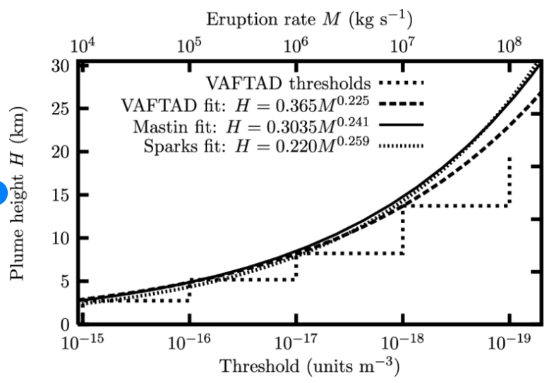
Estimated total mass erupted based on plume height and eruption duration
Height of the main eruption plume 4.3 km asl, 3.4 km above vent
Mastin et al. 2009
H=0.3035M^{0.241}
H is plume height (km)
M is mass eruption rate (kg/s)
For 3.4 km MER is 22000 kg/s
Assuming 9 minutes eruption duration = 12,000 tonnes erupted material
Assume vesicularity of 0.50 and density 1250 kg/m3 we have 10,000 m3 erupted.

Slide 19
SO₂ plume height time series
Suggestion of some elevated gas flux in hour prior to paroxysm, but mixed in with umbrella cloud effects

