Slide 1
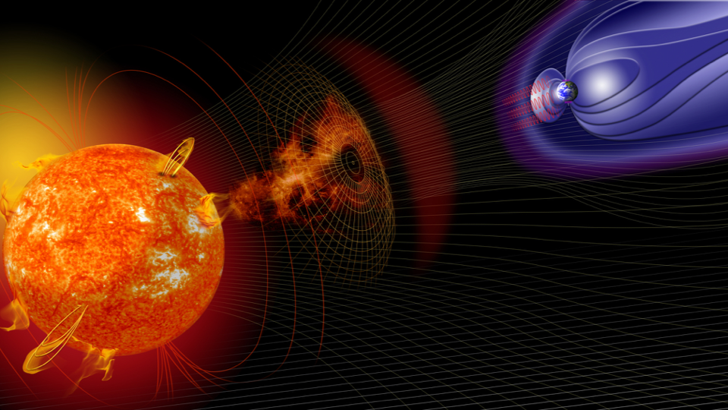
EGU2020-22144
The SWx TREC Integrative Space Weather Data Portal and Model/Algorithm Testbed Environment
An Emerging Community Resource for Integrative Space Weather Data Access and Model/Algorithm R2O Promotion
https://www.colorado.edu/spaceweather/
Chris Pankratz LASP Data Systems Manager SWx TREC, Applications Lead Laboratory for Atmospheric and Space Physics (LASP) University of Colorado Boulder, Colorado, USA Chris.pankratz@lasp.Colorado.edu +1-303-492-0696
Thomas Berger, Thomas Baltzer, Greg Lucas, James Craft, Thomas Berger, Daniel N. Baker, Allison Jaynes, Scot Elkington, Jennifer Knuth
Notes:
Let me begin by telling you about my organization
We are a research institute of the University of Colorado in Boulder, Colorado, USA
We specialize in space-based research and occupy three buildings on the CU campus, two of which are depicted in this photograph
The Laboratory for Atmospheric and Space Physics (LASP) is a research institute at the University of Colorado in Boulder, Colorado
LASP began in 1948, a decade before NASA
LASP has an extensive history of making cutting-edge space-based measurements and conducting groundbreaking research in numerous areas, including solar-terrestrial interactions, space physics, planetary, atmospheric, and climate sciences.
LASP combines all aspects of space exploration through expertise in science, engineering, mission operations, and scientific data management and analysis, fully encompassing the entire space research lifecycle.
LASP also works to educate and train the next generation of space scientists, engineers and mission operators. Integral involvement
LASP has led the Science Operations Centers (SOCs) on several major missions, including MMS and MAVEN, comprising cutting edge mission and instrument operations, as well as end-to-end data management and dissemination solutions.

Slide 2
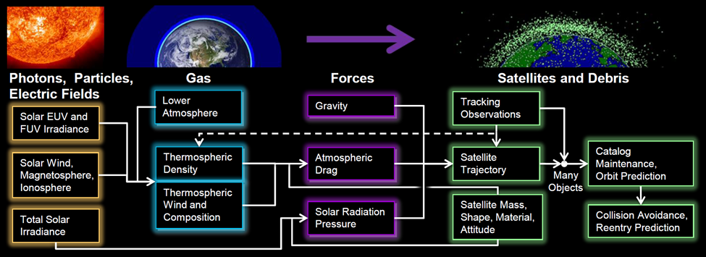
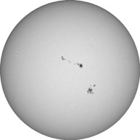
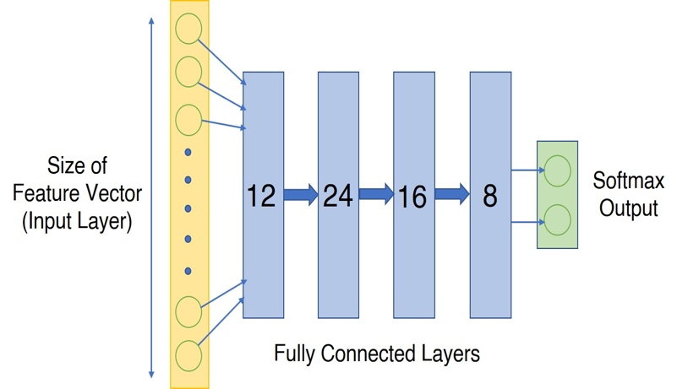
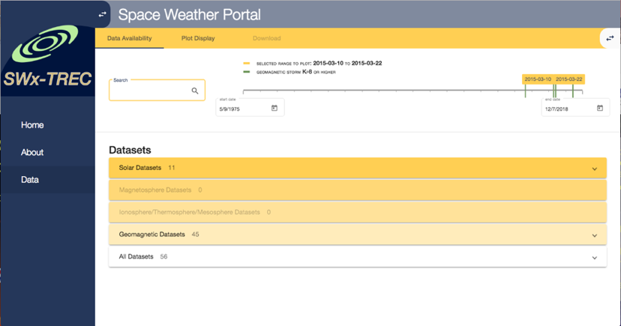
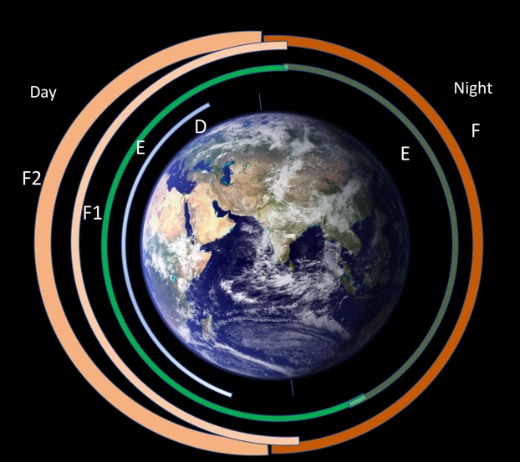
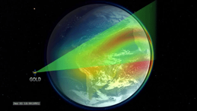
SWx TREC: Space Weather Technology, Research & Education Center an academic center for R2O-O2R
Research
Applications
Education
Space Weather Graduate Certificate
Whole-Atmosphere Satellite Drag Model
Hybrid Research-Operations
Observing Platforms
Space Weather O2R / R2O
Data Portal & Testbed
Boulder Space Weather Summer School participation
Deep Learning Laboratory
NASA Mission Data R2O:
GOLD
IMAP
GONG Calibration
(NASA O2R
w/NSO)
Professional Development
*Missions, Applications, and Data Technology
Notes:
SWx TREC is a collaborative academic center devoted to addressing three aspects of the space weather domain
• Research
• Education
• Applications

Slide 3
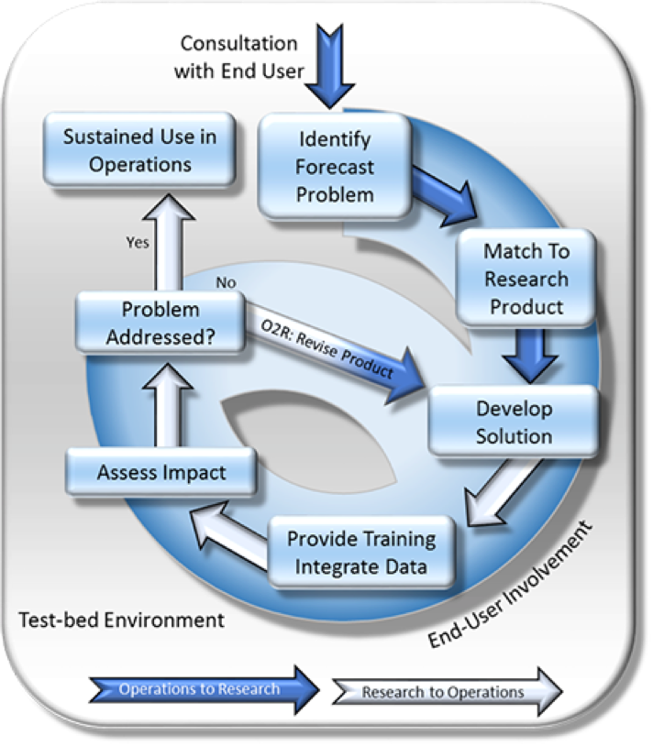
Motivation for SWx TREC: Space Weather Forecasting is ~50 years behind Terrestrial Weather Forecasting
The Problem
Lack of Observations
Need for improved “Full System” Coupled Models
Need stronger Research-to-Operations (R2O) link
Models are designed for research
Data visualization tools are not forecast products
Long delays in getting research mission data and models to Forecast Offices
Need stronger Operations-to-Research (O2R) feedback
Limited community access to operational models
Difficulty accessing disparate data products
End Users (e.g. forecasters and their customers) not always consulted in R&D strategy
Terrestrial Weather R2O-O2R System
Jedlovec et al., 2013
Notes:
To motivate the need…
To create a much stronger connection between research and operations. matching forecast problems to data and research capabilities, testing solutions in a quasi-operational environment, and then transitioning proven solutions into the forecaster’s decision support system.
Aiding researchers in more easily accessing and utilizing space weather data, models, and visualizations

Slide 4
The SWx TREC Solution
Multi-disciplinary research, technology innovation, and education
Enable collaboration among federal agencies, academia, and commercial sector
Address evolving forecasting, mitigation, and response requirements
New models, tools, visualization, missions, and data to advance understanding and prediction of SWx phenomena
A Data Portal to lower barriers to broad data access
A Testbed environment to
Lower barriers to working with operational and research models
Shorten the R2O promotion lifecycle

Slide 5
The space weather ecosystem
Space Weather R2O-O2R Feedback
Research to Operations (R2O)
Targeted Model Development & Assessment
Research Models & Observations
Applied Science
Centers of Excellence
Operational Models & Observations
Scientific Understanding
Operational Forecasting
Targeted Instrument
Development
Operations to Research (O2R)
Pieces are often widely distributed. There’s a need for centers of critical mass…
Notes:
SWx TREC is an academic center of excellence
Based at the University of Colorado in Boulder, Colorado, USA
Our approach bridges and serves all aspects of the space weather ecosystem and lifecycle

Slide 6
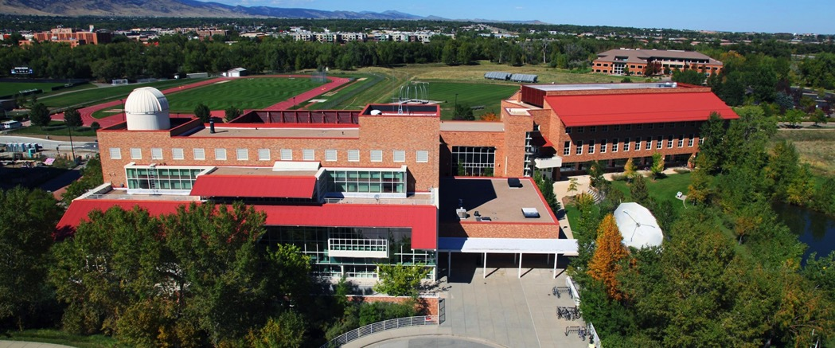
SWx TREC Facilities
Located on the campus of the University of Colorado, Boulder, USA
3000 sq. ft. in new Aerospace Engineering building
Offices and open collaboration space
Space Weather Testbed forecasting area
LASP Space Sciences building
LASP Space Technology building
Computing
NVIDIA Titan V GPU workstations
Extensive use of Cloud technology, e.g. Amazon Web Services
Notes:
we have envisioned a prototype space weather forecasting center of the future

Slide 7
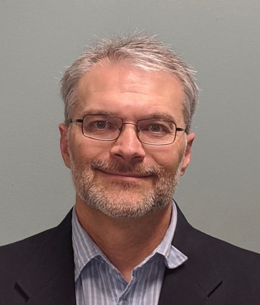
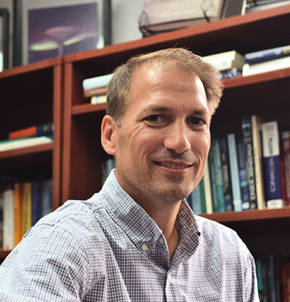
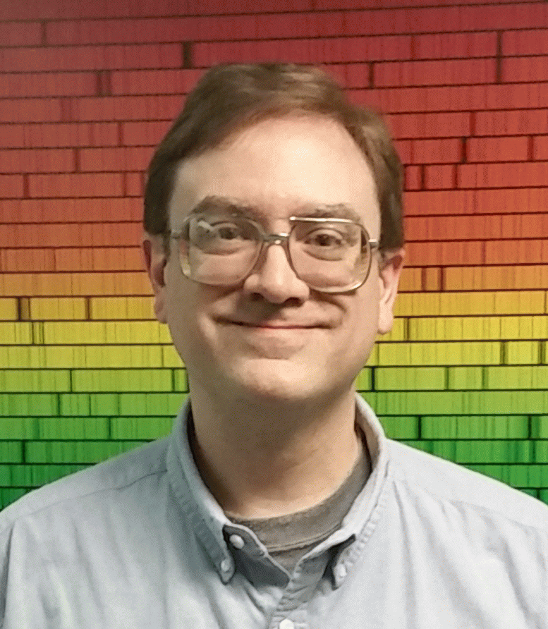
SWx TREC Organization Chart & Affiliates
College of Engineering
Keith Molenaar, Acting Dean
Office of the Chancellor
Emily Cobabe-Ammann
LASP
Dan Baker, Director
Office of the Director
Tom Berger, Executive Director
Julia Putt, Financial Program Manager
CIRES
Waleed Abdalati, Director
Research
Jeff Thayer, Lead*
Eric Sutton, ITM science
Jade Morton, GNSS science Delores Knipp, ITM science
Bob Marshall, Satellite drag
Tim Fuller-Rowell, CIRES & NOAA
Applications
Chris Pankratz, Lead
Tom Baltzer, Portal
Jim Craft, Testbed
Jenny Knuth, Portal
Greg Lucas, Testbed
Education
Delores Knipp
Steve Cranmer
*Also TREC Faculty Director

Slide 8
Focus on Space Weather Applications
Applications
Objectives
Promote, enable, and advance new models, tools, missions, data, and visualizations
Streamline O2R and R2O transitions
Key Development Areas
Next-generation SWx Data Portal
Provide a variety of disparate SWx Data to the community
Easier-to-use and more centralized fashion
Open SWx Testbed Environment
Enable development, testing, maintaining, and upgrading operational models, algorithms, visualizations, and data streams
Cooperative model, data and visualization advancement / transition (e.g. Enlil, GOLD)
Hybrid Research-Operations
Observing Platforms
Space Weather O2R / R2O
Data Portal & Testbed
NASA Mission Data R2O:
GOLD
IMAP
*Missions, Applications, and Data Technology
Notes:
The focus for this presentation is the Applications are of SWx TREC.

Slide 9
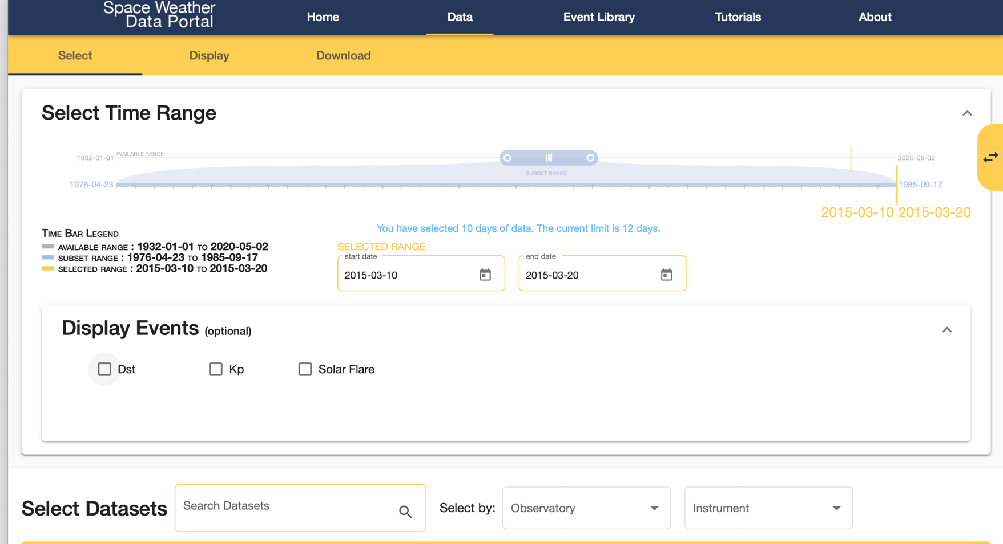
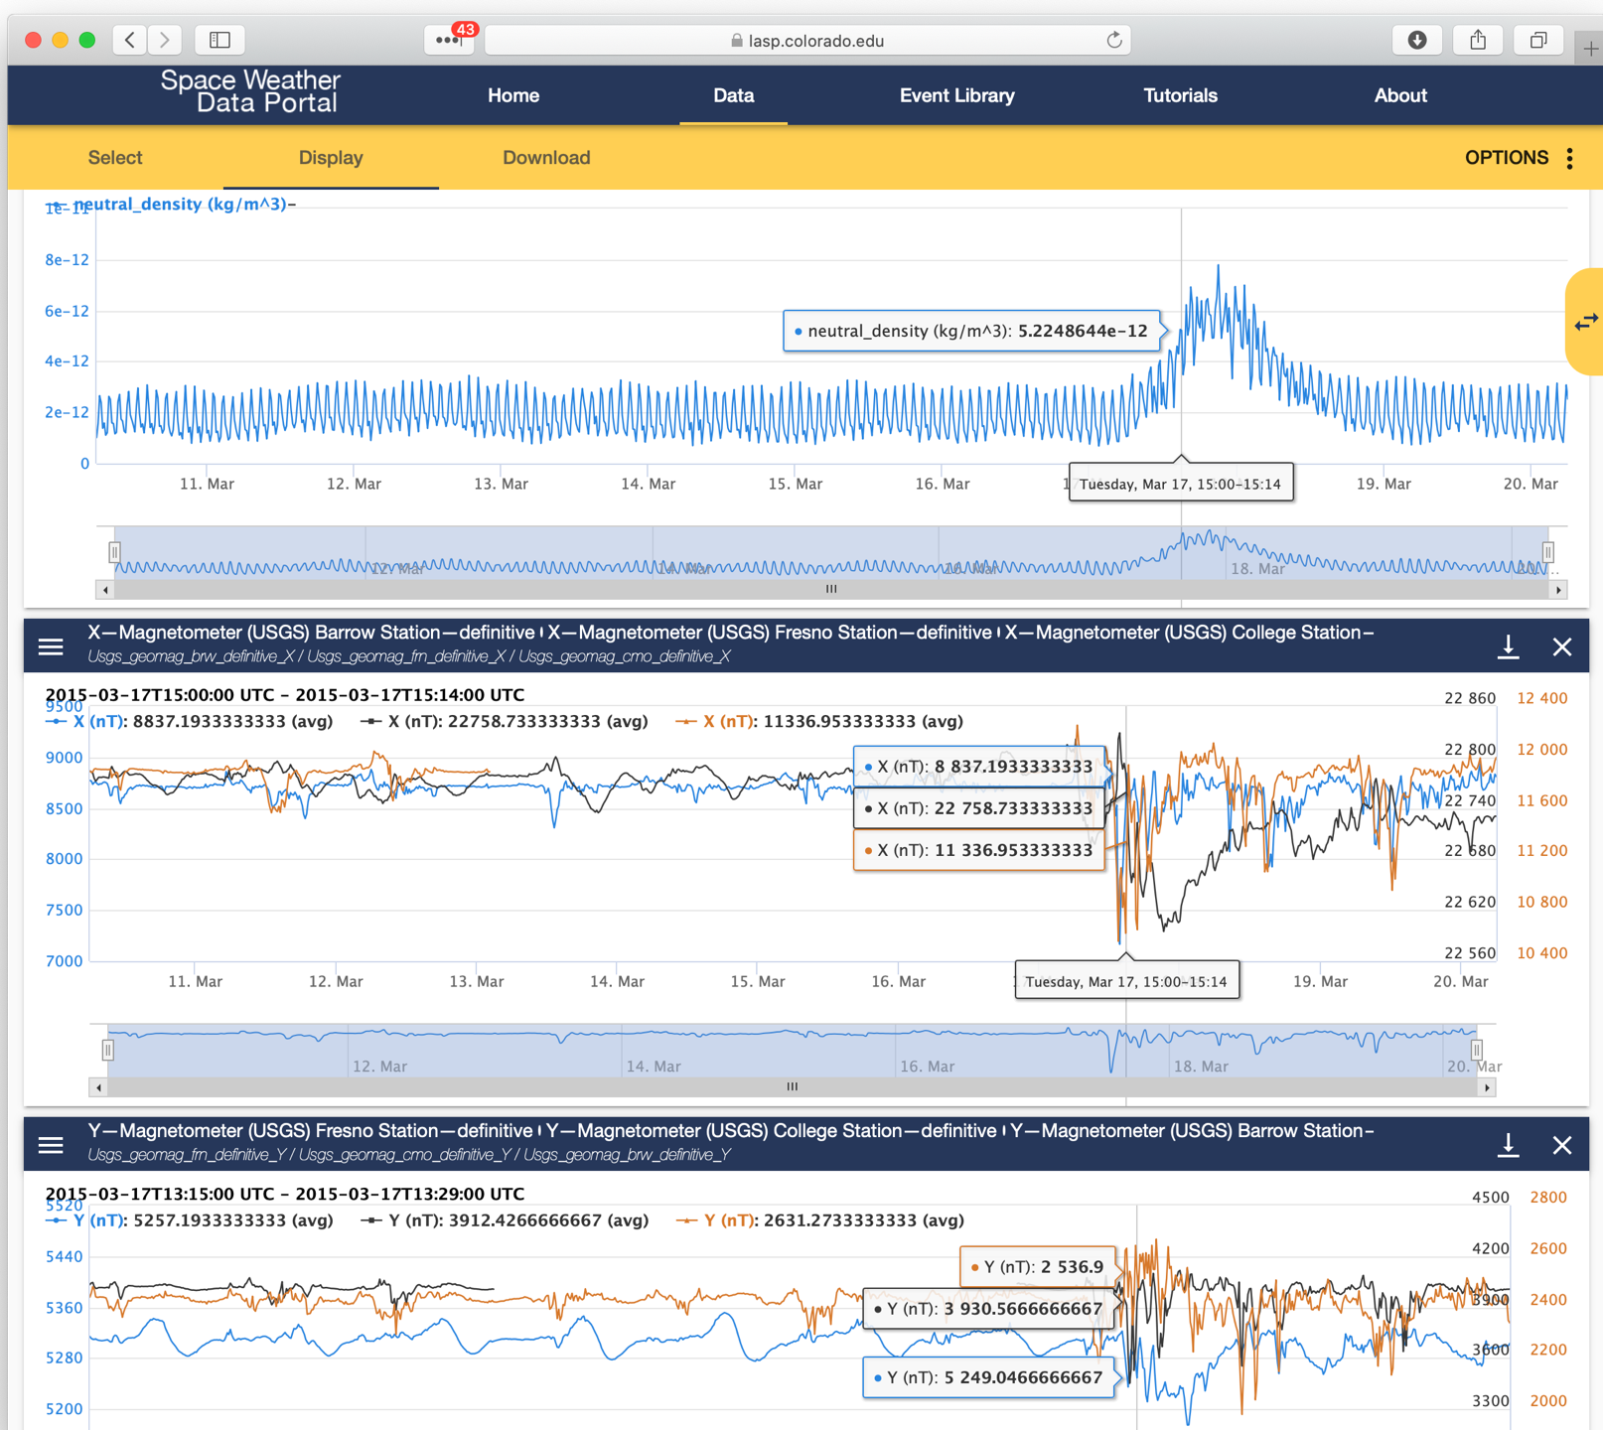
Space Weather Data Portal Enabling access to disparate datasets for SWx research
The Problem
Researchers now access data from multiple sites in multiple formats with varying availability
Extensive time is spent just acquiring data and getting it into a usable form
Inconvenient access to both Operational and Research data sets
The SWx TREC Solution
A centralized portal to SWx products
A “FAIR” data portal (Findable, Accessible, Interoperable, Reusable data)
Interactive data discovery
Interactive & customizable plots and ”dashboards”
User-selectable formats
Persistence / Citations
Session / Dashboard Recall
API-based access supporting RESTful, scriptable data access
See Poster EGU2020-22188 (this session) for more details
http://lasp.colorado.edu/space-weather-portal
Notes:
Tailored to needs of Modeling, Research, and Operations communities

Slide 10
Space Weather Testbed Environment Enabling Research to Operations Code Adoption with the Cloud
R&D
Gov’t
Academia
Industry
The Problem
Need to accelerate R2O, providing a bridge to the operational SWx environment
Need to incubate and promote new model codes, data, tools, and information
The SWx TREC Solution
Open computing environment to host 3rd party model, product, analysis, viz, or other codebases
Hosted computing testbed for model development and testing
Full lifecycle code management, deployment, and testing environment.
Full ownership and control by researchers
Versatile computing resources
Tools, libraries, and environments tailored to specific models
Initial deployment: WAM-IPE, TIEGCM, SWMF, USGS E-fields models
Research Models &
Applications
SWx Forecasting Center
(e.g NOAA/SWPC)
Models, Algorithms, Visualizations
SWx-TREC Testbed
Open Operational Algorithm Dev & Test Environment
R2O Model Evaluation Center (e.g. NASA/CCMC)
Operationally
Validated Models & Applications
Validated & Verified
Research Models
SWx-TREC
Data Portal
External O2R
Researchers
O2R Feedback
Notes:
I will be placing the most emphasis in this presentation on our Testbed Environment, which can be central to streamlining many aspects of space weather forecasting and research
Chief in this need is enabling more rapid advancement and promotion of models

Slide 11
SWx TREC Testbed Environment Data, Models, and Visualizations
Forecast Center of the Future
We invite code/tools from the community and host on your behalf
Researchers
Access Data from Portal
Modify and Run Code
Create New Visualizations
Forecasters
Access Data from Portal
Request Model Runs
Interact with Visualizations
Now
Operational
Identity and Access Management
Space Weather Data Portal
Code Repositories
Auto-scaling
Compute Resources
Cloud Data Storage
Private
Public
WAM-IPE
TIEGCM
HPC 1
HPC 2
HPC n
SWMF
…
Notes:
We have built Space Weather Testbed Environment in the Cloud to host data, models, and visualizations.
The Testbed provides identity and access management to the resources to make sure that IP stays within each modeler/group using the Testbed.
Within the Testbed we have code repositories to maintain version control of any updates and changes to the codes once they enter the Testbed.
By leveraging the Cloud, we can choose which operating system and build environment the code is installed into, providing flexibility and ease of use for researchers who may not know how to install their software on multiple architectures.
Once the code is installed, we can request a run on any number of compute resources we’d like, just like a normal supercomputer, but without the delay of waiting in a long queue.
Finally, the data produced in the Testbed is stored in the Cloud and can be accessed anywhere, providing an easy mechanism to share results and update the community on progress.
We are currently building an in-person interface to this Testbed environment that we are calling the Forecast Center of the Future.
A user or forecaster will be able to sit down at a workstation and request model runs and interact with the model output directly via a Portal into the Cloud.

Slide 12
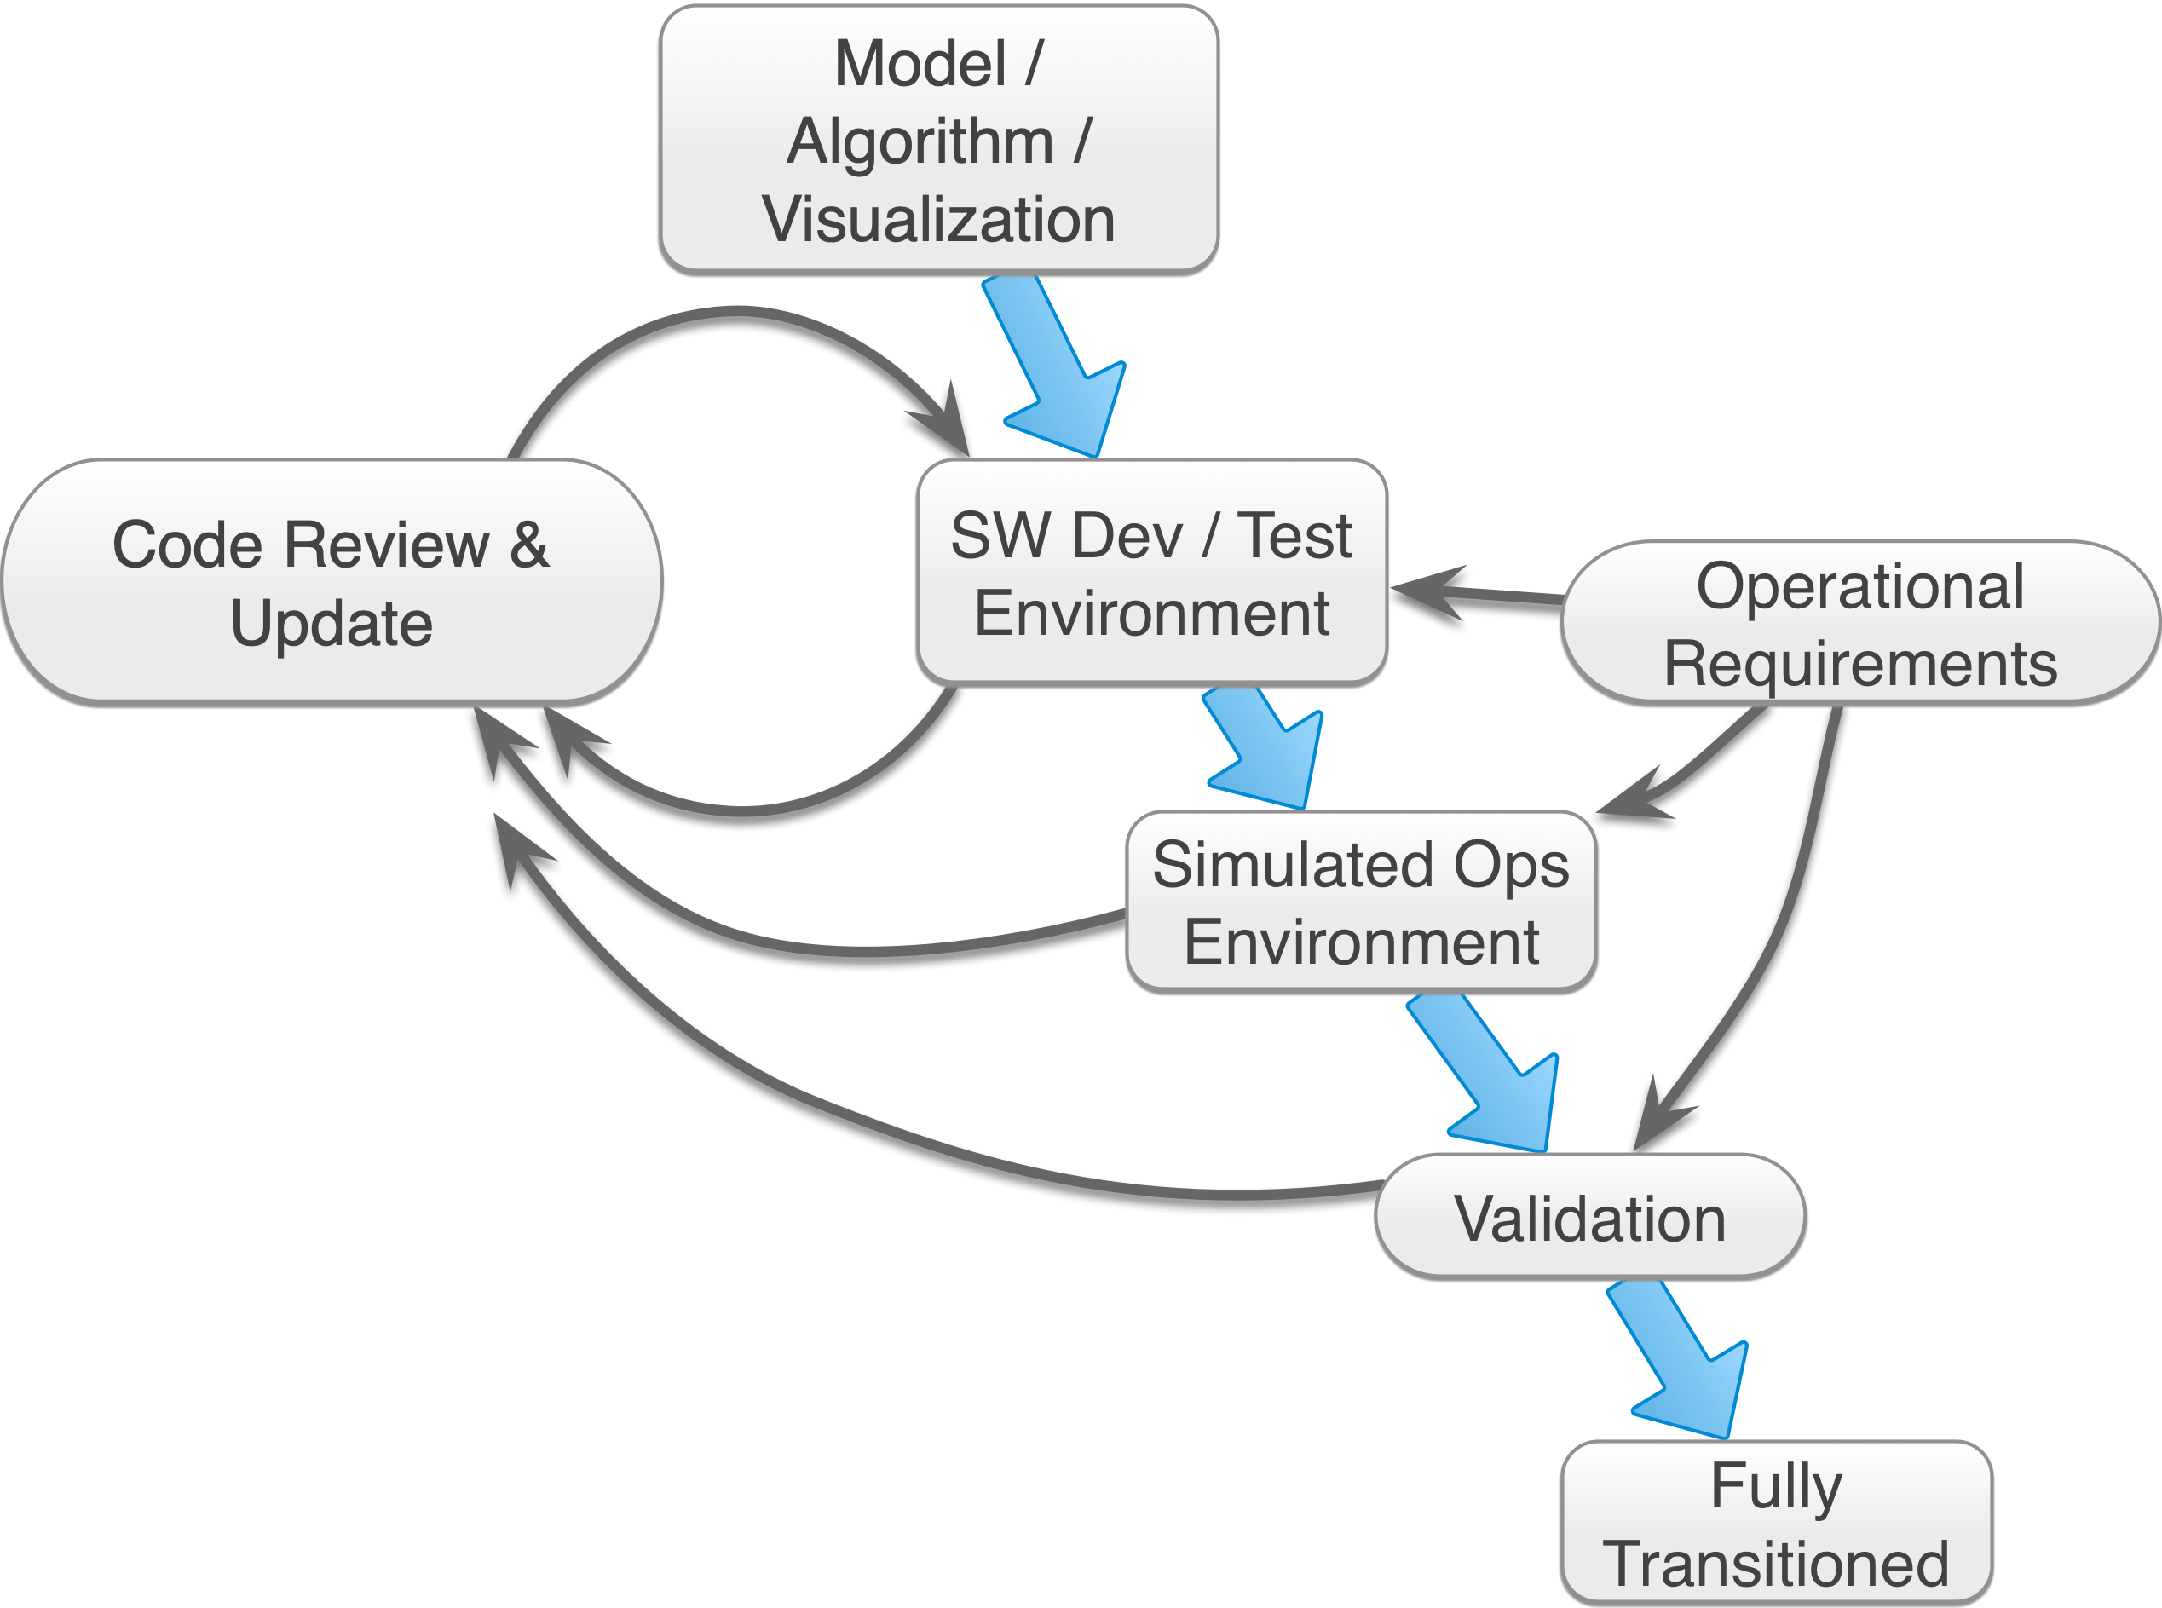
Space Weather Testbed Environment Enabling code testing and transition
We can support modelers in advancing towards operational transition
A hosted, accessible computing environment for model & algorithm testing & transition
Versatile computing resources
Variable compute capacity
Local or Cloud
Supports formal code management, deployment, and testing
Tailorable tools, libraries, and environments
Tailored, ad-hoc model runs
Expertise to assist with code
Stability, performance, or other enhancements
General code maintenance and management
Notes:
There is often a large hurdle to get research grade code into operations that isn’t due to the quality of the model output, but simply because the model’s code is not robust enough to be run on-demand, deal with missing data, or can’t be compiled onto other machines.
By hosting the Testbed in the Cloud we will alleviate many of these pain points of moving over to an operational environment by allowing researchers a way to simulate their own operational environment.
We can choose what types and size of compute resources, including architectures for users to be able to test on multiple machines and scale up as they need.
Our team has many expert software engineers that are able to assist with building and maintaining code in remote environments to lower this barrier to entry into the operational world.

Slide 13
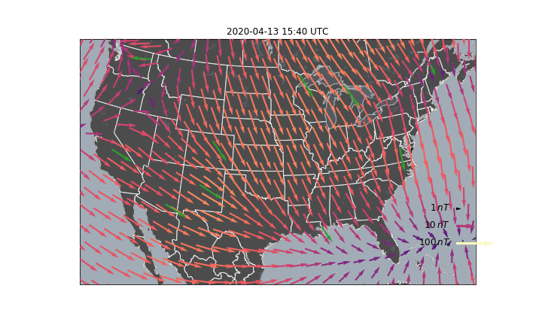
SWx TREC Testbed Environment Progress
Automated data visualizations in the Cloud – two examples
Open source solar wind visualization package runs daily https://github.com/SWxTREC/enlilviz
Vector magnetic field interpolations available on the Data Portal https://lasp.colorado.edu/space-weather-portal
Notes:
One area of specialization within the Testbed is our ability to work with model output and create new visualizations.
New visualization routines can be created and put in front of forecasters side-by-side with the current model output to demonstrate differences and get feedback about what a forecaster would like to see.
On the left we have created a new solar wind visualization tool in Python using output of Enlil. We are currently running it in a daily operational mode, with additional runs on demand when desired. This work is related to an in-progress collaboration between SWx TREC and the Enlil developer.
On the right, we are showing a new prototype magnetic field map that forecasters would be able to have in the forecasting office alongside the current time-series plots they are used to. Showing a much richer set of spatial information.

Slide 14
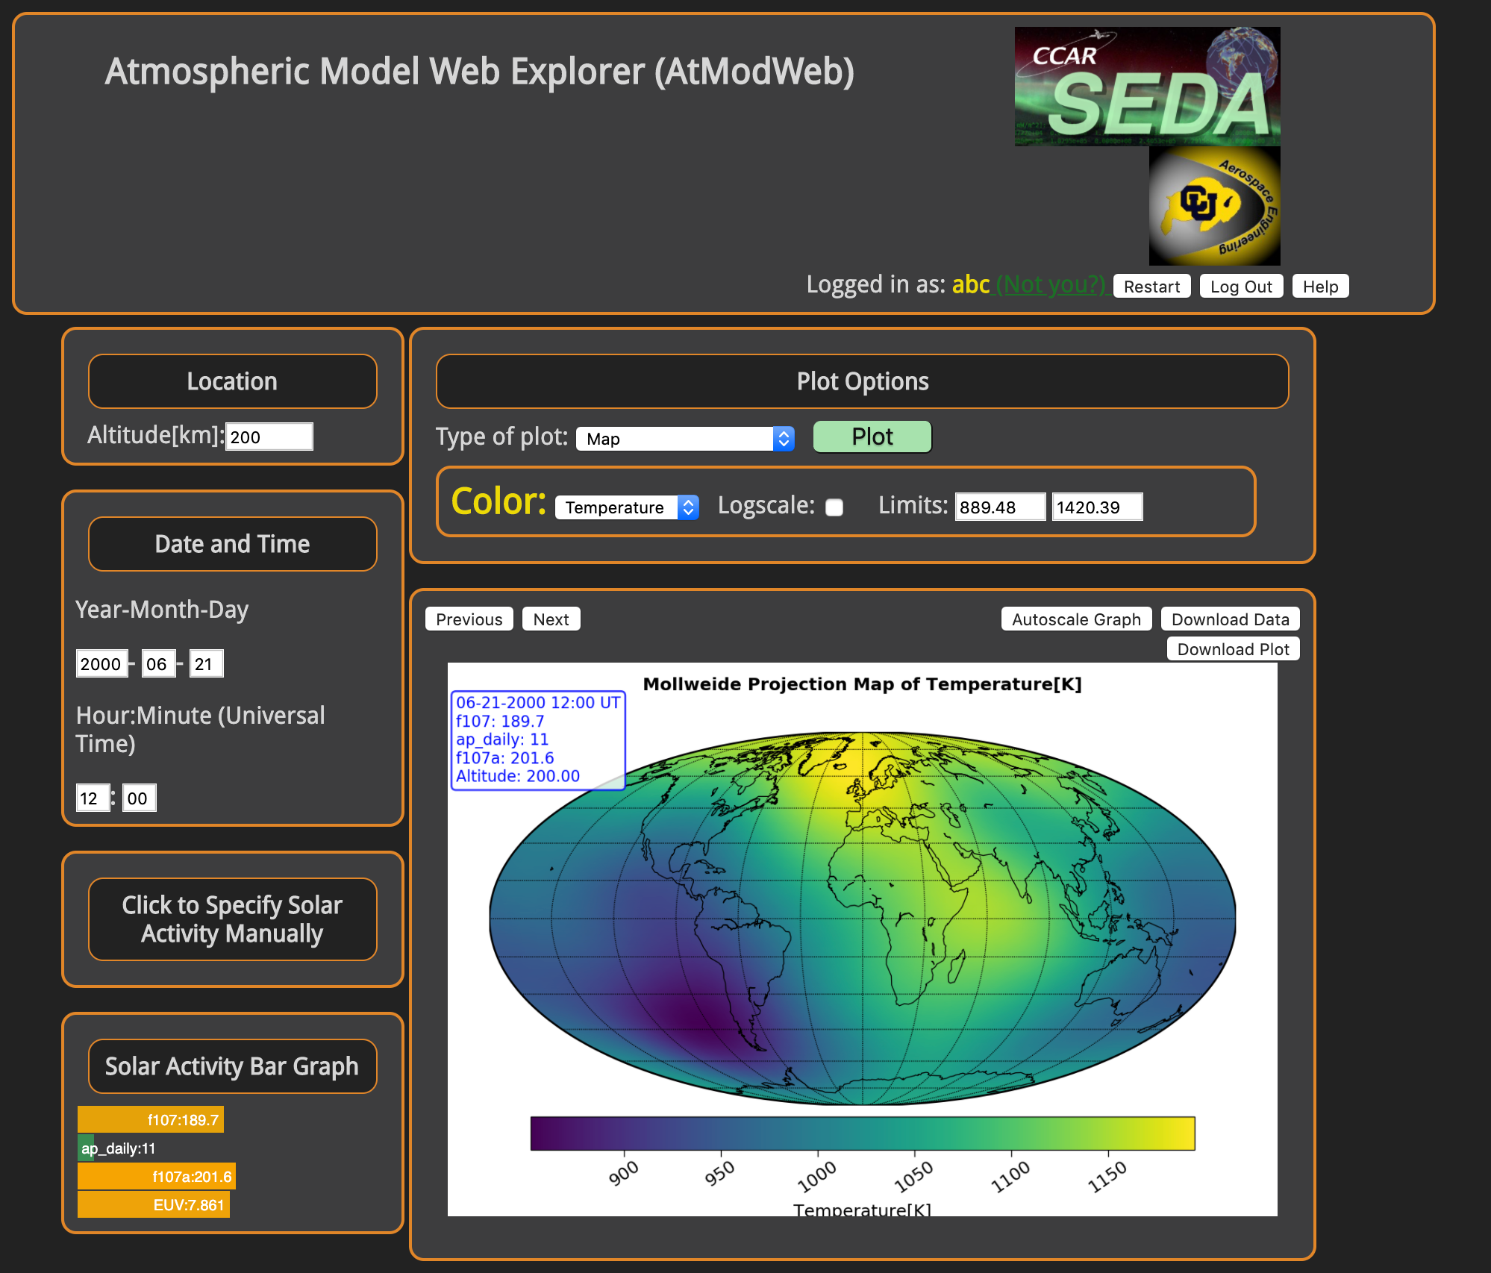
SWx TREC Testbed Environment Progress
Satellite drag calculator https://swxtrec.github.io/vector
Developing and hosting interactive educational tools for the classroom and community
Notes:
In addition to visualizations being produced in the Cloud, we are standing up research codes that can be interacted with in real time.
On the left is a satellite drag calculator that is available on a public website. Users can select a pre-defined satellite geometry, or upload their own and select the angle of attack and atmospheric environment the satellite will be flying through to determine the drag and force coefficients on their satellite.
This satellite drag tool enables access to research grade calculations computed in the Cloud through a simple interactive interface.
On the right we have another public interface to explore upper atmospheric model parameters. This is another interface to research codes being run within the Cloud environment with a public facing webpage for the users to interact with.
This model is currently being used in classroom and educational settings to demonstrate how space weather impacts the upper atmospheric environment to aspiring space weather researchers and forecasters.

Slide 15
SWx TREC Testbed – Future Direction
Incorporate additional models, applications, visualizations
Web-based interface to readily enable scenario-based model runs
Developmental space weather forecast testbed
E.g. what the “forecast center of the future” could look like
Develop tools to investigate the space weather domain from a systems science approach
We plan to expand the number of real-time data products we process and produce for operational space weather
We plan to promote our prototype NASA GOLD low-latency data (including O/N2 ratio) to NOAA SWPC
Notes:
Ability to select a model and time-period or scenario to run through an easy-to-use interface.
Build a hyperwall for users to interact with multiple models and visualizations at once.
Develop tools to take a systems analysis approach to the space weather system. This will include developing tools to see how one model in the chain influences and drives another model.
We will develop a unified public interface to the models we currently have running in the Testbed and easier access for researchers to submit a model run request.
We are currently in charge of producing NASA GOLD low-latency data for NOAA SWPC. We plan to continue this data processing pipeline and add to our portfolio of products served to the community.

Slide 16
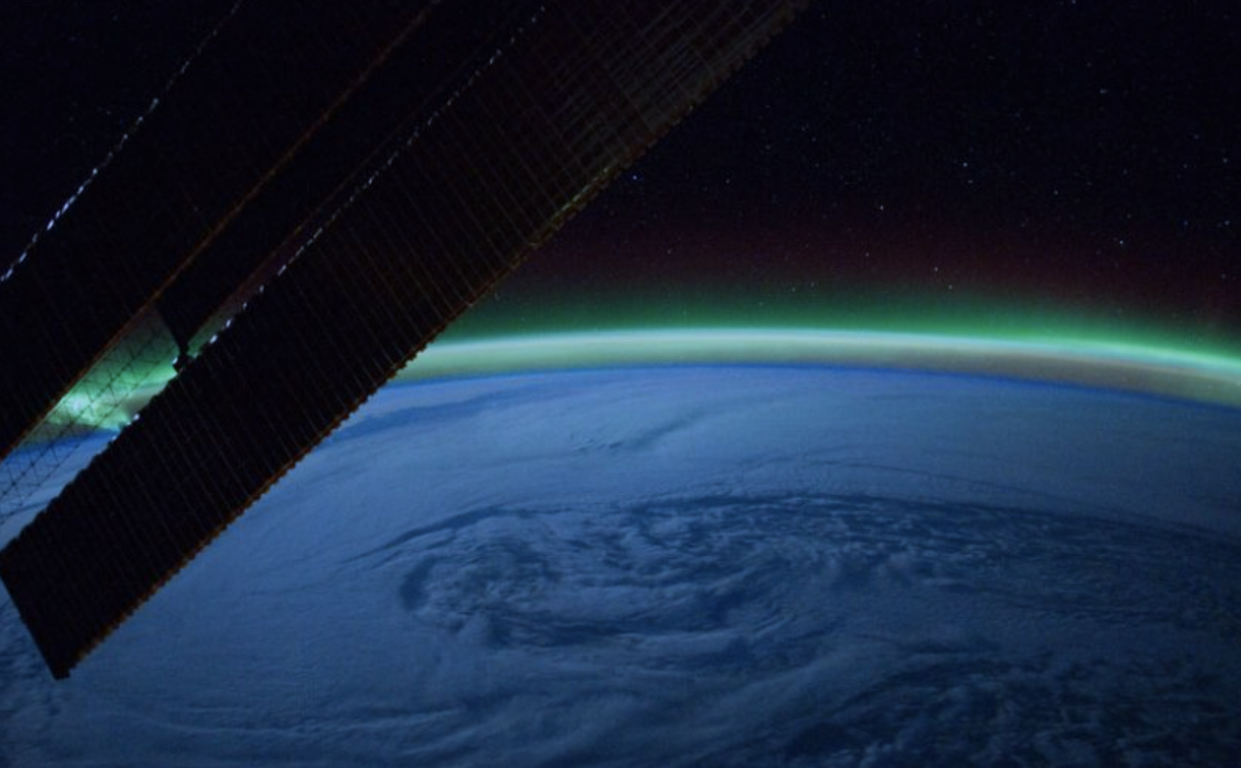
THANK YOU!
SWx TREC: Space Weather Technology, Research & Education Center
https://www.colorado.edu/spaceweather/
Chris Pankratz SWx TREC / University of Colorado Boulder, Colorado, USA
Chris.Pankratz@lasp.Colorado.edu
+1-303-492-0696

