Slide 1
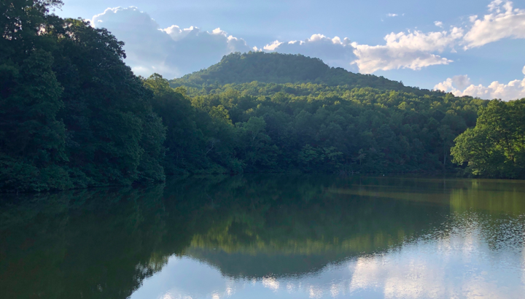
Dynamic carbon-oxygen interactions over minute to annual time scales in an experimentally-oxygenated reservoir
Cayelan C. Carey, Abigail S. Lewis, Alexandria G. Hounshell, Dexter W. Howard, Ryan P. McClure, Nicholas W. Hammond, Mary E. Lofton, Paul C. Hanson, John C. Little, Madeline E. Schreiber, and François Birgand
Underlined authors will be available to chat during the session

Slide 2
Background
Reservoirs are hotspots for carbon processing, burying more organic carbon than ocean sediments each year
Global change in climate and land use could alter the future role of reservoirs in the global carbon cycle
Specifically, oxygen dynamics are changing in lakes and reservoirs around the world. This has the potential to affect carbon processing, as oxygen regulates whether organic carbon inputs will be buried, respired as carbon dioxide, or respired as methane
To date, the effect of oxygen on carbon processing has been primarily measured in small-scale incubations or through observational studies, giving little predictive power on a whole-ecosystem scale

Slide 3
How do changes in oxygen over time scales ranging from weeks to months alter freshwater carbon processing, burial, and greenhouse gas dynamics?
To answer this overarching question, our multi-institutional team of ecologists, geologists, hydrologists, engineers, and ecosystem modelers is conducting a wide variety of ongoing research projects.
This presentation will highlight progress in three areas:
How do variable oxygen conditions affect greenhouse gas production?
How do temperature and oxygen affect the rate of bottom-water oxygen demand?
How does oxygen affect mineral associations with organic matter?

Slide 4
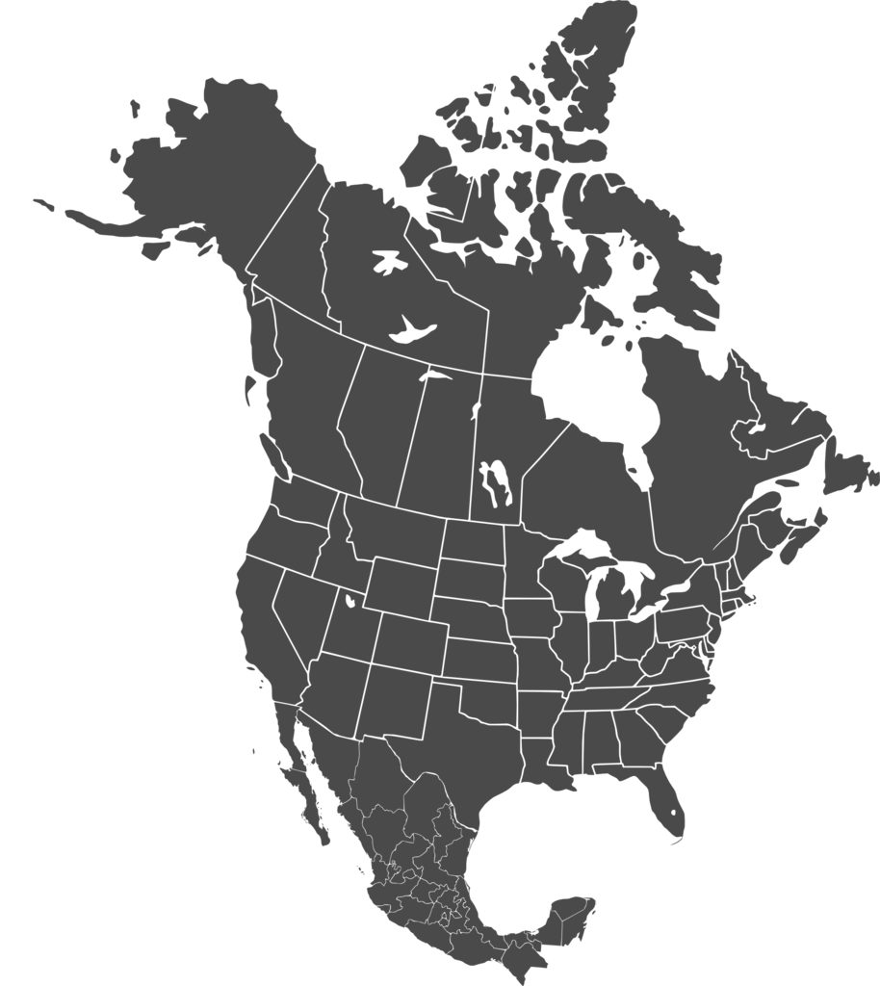
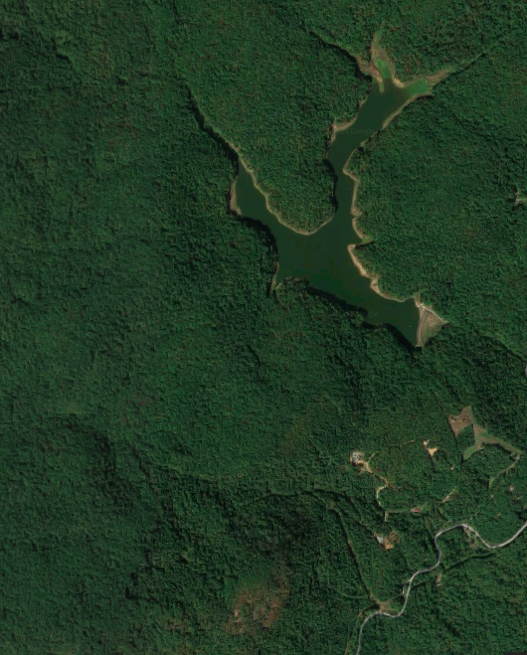
Six years of oxygenation have provided a unique opportunity to analyze the effects of oxygen on whole-ecosystem carbon processing
Falling Creek Reservoir (FCR; Virginia, USA)
Built in 1898
9.3 m max depth
Equipped with a bottom-water oxygenation system which has been operated on a variable schedule from 2013-2019
Beaverdam Reservoir (BVR)
Built in 1872
11 m max depth
Reference reservoir
Beaverdam Reservoir
Falling Creek Reservoir
1 km

Slide 5
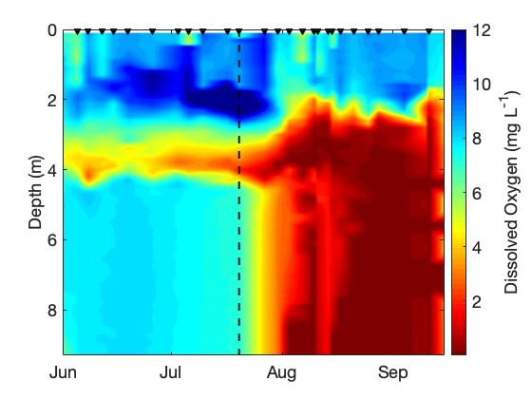
Oxygenation is effective at experimentally increasing bottom-water oxygen concentrations
Falling Creek Reservoir 2018
Oxygenation system ON
Oxygenation system OFF

Slide 6
Section 1: How do variable oxygen conditions affect greenhouse gas production?
Reservoirs play an important role in the global carbon cycle as hotspots of greenhouse gas production (GHGs as CO₂ and CH₄)
Climate change is expected to lead to more anoxic bottom waters, which are predicted to alter GHG production in lakes and reservoirs
We conducted whole-ecosystem oxygenation experiments in summer 2016, 2017, and 2018 to manipulate hypolimnetic oxygen concentrations in Falling Creek Reservoir (FCR)
Results were compared to an anoxic reservoir (BVR) to assess the impact of oxygen on GHG dynamics in freshwater reservoirs.

Slide 7
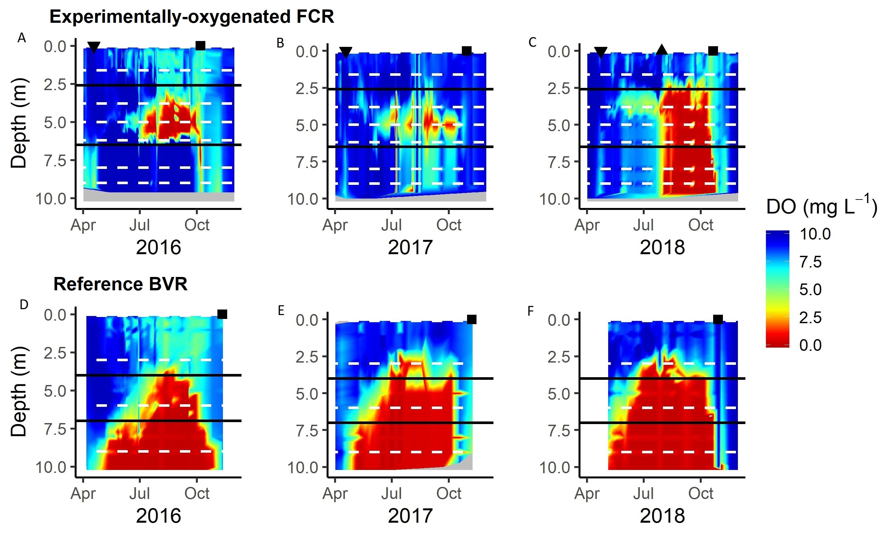
Section 1: How do variable oxygen conditions affect greenhouse gas production?
Experimentally-oxygenated FCR in 2016, 2017, and 2018 as compared to the reference reservoir (BVR).
Black triangles indicate when the oxygenation system was turned on and turned off
Black squares indicate date of fall turnover
In revision, Hounshell et al. L&O-L

Slide 8
Section 1: How do variable oxygen conditions affect greenhouse gas production?
Higher hypolimnetic CH₄ concentrations in anoxic vs. oxic hypolimnia, but similar CO₂ concentrations
May lead to greater hypolimnetic global warming potential from lakes and reservoirs under future conditions
In revision, Hounshell et al. L&O-L

Slide 9
Section 2: How do temperature and oxygen affect the rate of bottom-water oxygen demand?
Oxygen demand encompasses organic carbon mineralization as well as oxidation of reduced inorganic substances
In this study, we created a process-based model of oxygen demand based upon temperature and oxygen concentrations, then tested the importance of each factor by comparing the full model to temperature-only and oxygen-only models
We assessed the predictive power of each model by converting it into a hindcast (a forecast using historical data) and assessing hindcast performance

Slide 10
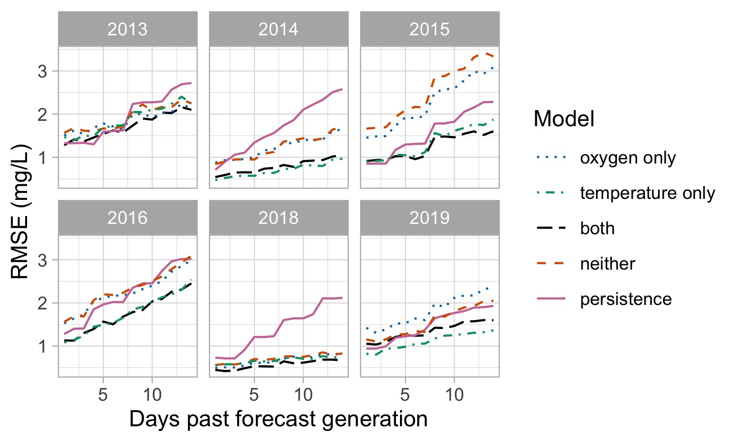
Section 2: How do temperature and oxygen affect the rate of bottom-water oxygen demand?
Root mean squared error (RMSE) assesses forecast performance. RMSE was lowest (best) for the temperature-only model and the model with all predictors across all years.
In general, these simple models have high predictive capabilities (within 2.5 mg/L after 14 days)
The temperature-only model and full model offered substantial improvements over the null model of persistence from the last observation.

Slide 11
Section 2: How do temperature and oxygen affect the rate of bottom-water oxygen demand?
Based upon these results, oxygen demand appears to be closely linked to bottom-water temperature
Counter to previous research, this study found that variable oxygen concentrations have no noticeable effect on the rate of bottom-water oxygen demand

Slide 12
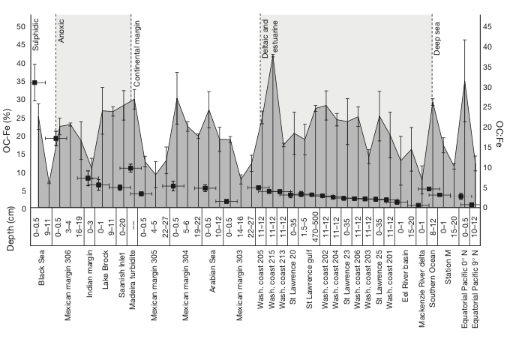
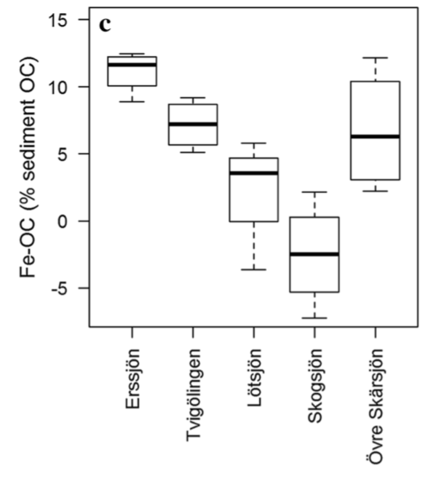
Section 3: How does oxygen affect mineral associations with organic matter?
Iron (Fe) plays a critical role in marine OC burial
The importance of iron-bound organic carbon (Fe-OC) in freshwater systems is unclear, but could serve as an important (yet currently-unquantified) sink of OC
Anoxic conditions may cause release of dissolved organic carbon from Fe complexes in sediments
µ = 23%
(Freshwater: Peter and Sobek, 2018)
(Primarily marine: Lalonde et al. 2012)

Slide 13
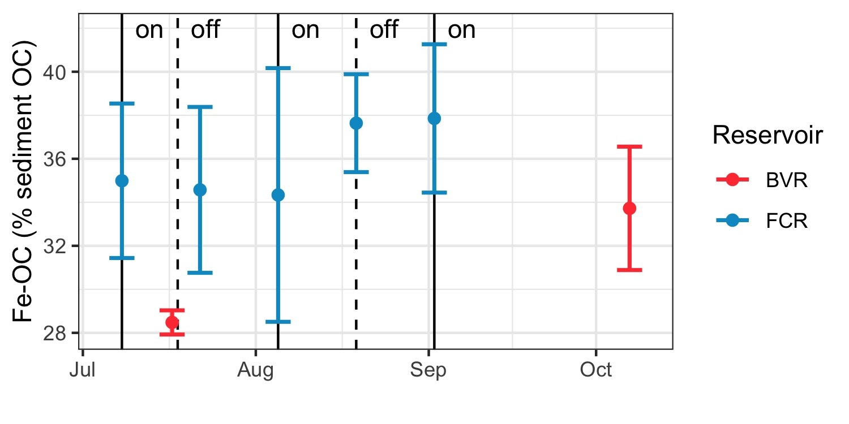
Section 3: Mineral associations with organic matter
Fe-OC levels were higher in the experimentally-oxygenated reservoir, but did not vary with short-term (2 week) oxygenation
Fe-OC levels in both reservoirs are much higher than those observed in freshwater lakes, and on the higher end of values reported for marine systems
Overall, these results indicate Fe-OC plays an important role for carbon sequestration in some freshwater ecosystems and its sensitivity to oxygen can vary with timescale.
n = 4

Slide 14
Whole-ecosystem oxygenation experiments provide insight to changing C dynamics
Land use and climate change are increasing the variability of oxygen conditions in lakes and reservoirs, substantially altering carbon processing
Our study reveals that decreasing bottom-water oxygen concentrations will likely result in greater CH₄ production, little to no effect on bottom-water oxygen demand, and lower Fe-OC complexing rates on a whole-ecosystem scale
Next steps in our work include using ecosystem modeling to study the long-term effects of variable oxygen on C processing and greenhouse gas emissions
For more information, contact: aslewis@vt.edu; Cayelan@vt.edu; alexgh@vt.edu

Slide 15
Acknowledgments
We thank U.S. National Science Foundation support from grants DEB-1753639 and CNS-1737424 and the Western Virginia Water Authority for their long-term support of this research and access to field sites
Many, many undergraduate research assistants supported the data collection in this project, whom we gratefully acknowledge!

