Slide 1
Barriers to Including REDD+ in Land Degradation Neutrality
Alan Grainger
School of Geography
University of Leeds

Slide 2
Menu
Forest degradation and Land Degradation Neutrality.
Three barriers to monitoring forest degradation and restoration and LDN.
Consequences of barriers and how to reduce them.

Slide 3
Forest Degradation and Land Degradation Neutrality

Slide 4
Land Degradation Neutrality Goal
The area of land degraded each year equals the area of degraded land restored each year.

Slide 5
17 Sustainable Development Goals
Social | Economic | Environmental
1: No Poverty | 8: Decent Work and Economic Growth | 6: Clean Water and Sanitation
2: Zero Hunger | 9: Industry, Innovation and Infrastructure | 7: Affordable and Clean Energy
3: Good Health and Well-being | 12: Responsible Consumption & Production | 11: Sustainable Cities and Communities
4: Quality Education |  | 13: Climate Action
5: Gender Equality |  | 14: Life Below Water
10: Reduced Inequality |  | 15: Life on Land
16: Peace and Justice Strong Institutions
17: Partnerships to achieve Goals
Target 15.3 By 2030, combat desertification, restore degraded land and soil, including land affected by desertification, drought and floods, and strive to achieve a land degradation-neutral world

Slide 6
Land Degradation
Land degradation involves degradation of soil and degradation of vegetation.
Desertification (UN Convention to Combat Desertfication).
Forest degradation (REDD+ - UN Framework Convention on Climate Change).
Biodiversity degradation (Aichi Targets – Convention on Biological Diversity).

Slide 7
Reducing Emissions from Deforestation and Degradation (REDD+) mechanism
UN Framework Convention on Climate Change.
Negotiations began in Bali in 2007 to reduce greenhouse gas emissions in developing countries, ultimately leading to Paris Agreement 2015.
Forests account for 11% of net emissions.
Reducing Emissions from Deforestation and Degradation.

Slide 8
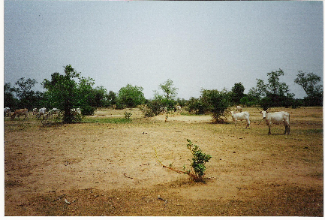
Spatial Forest Degradation
Degradation: Canopy coverage of forest reduced by cutting trees for fuelwood or browsing of trees by livestock.
In open forests in dry areas, and an underlying cause of desertification.
Restoration: by planting more trees, or farmer managed natural regeneration.

Slide 9
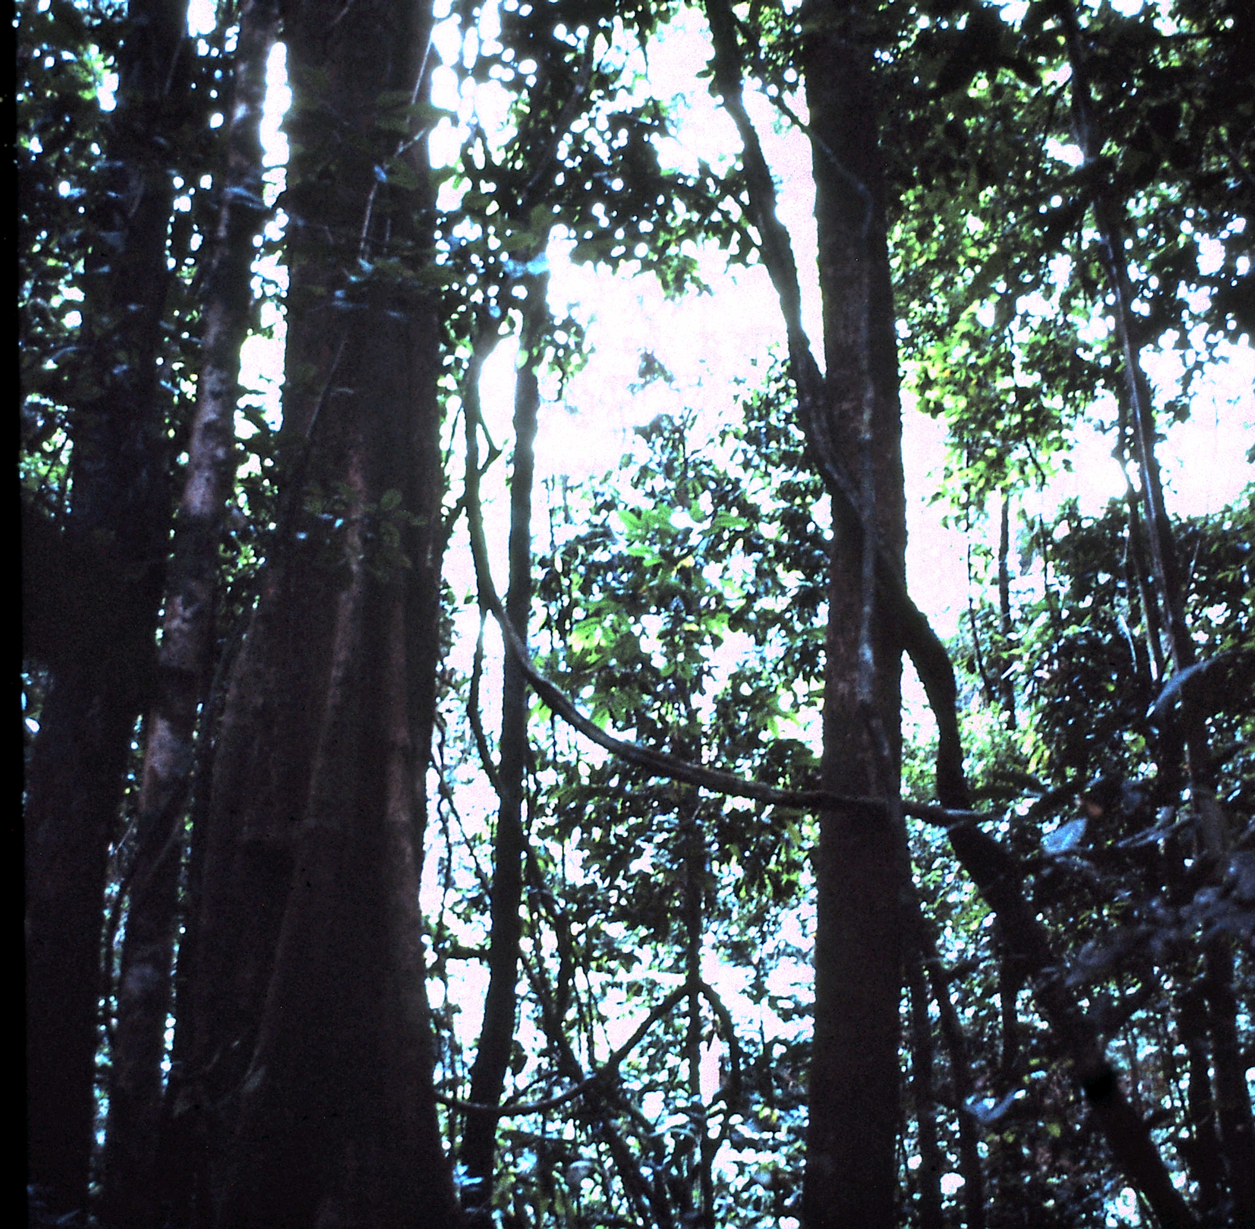
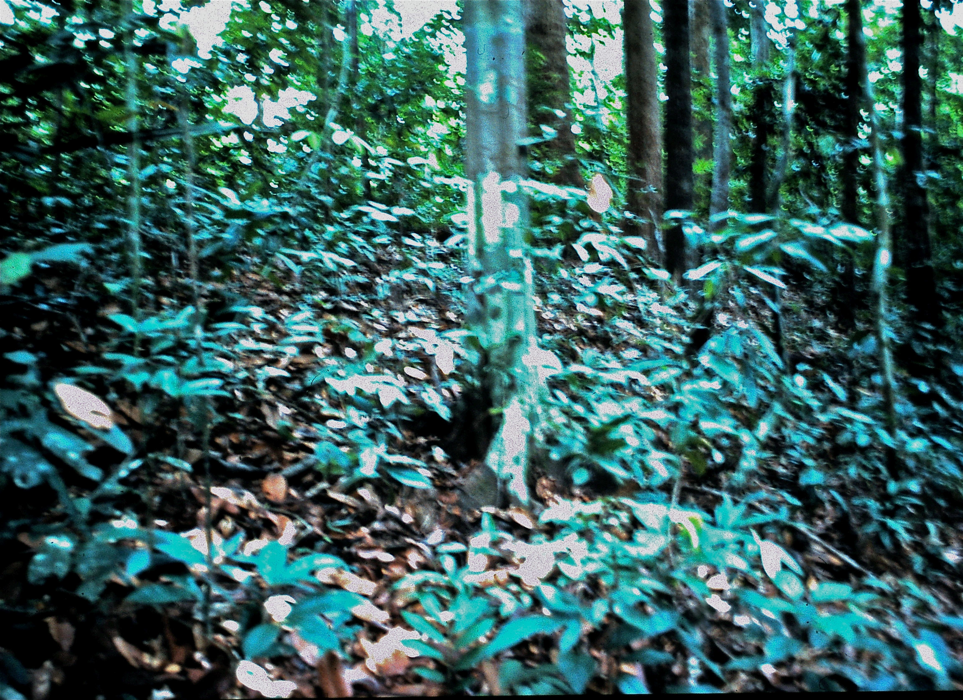
Vertical Forest Degradation
Degradation: selective removal of tall timber trees in moist forests, in “selective logging”.
Restoration: natural regeneration or artificial enrichment in commercial tree species.

Slide 10
Three Barriers to Monitoring Forest Degradation, Restoration and LDN

Slide 11
National Greenhouse Gas Inventories Reported to UNFCCC by 12 Tropical Countries
Democratic Republic of the Congo
Ghana
Nigeria
Tanzania
Cambodia
Indonesia
Laos
Malaysia
Brazil
Costa Rica
Mexico
Peru

Slide 12
Barrier 1: Definitions
The UNFCCC has not yet agreed on a definition of the term forest degradation.
The IPCC proposed a definition in 2003, but the UNFCCC has not taken action on this.
“A direct human-induced long- loss (persisting for X years or more) of at least Y% of forest carbon stocks [and forest values] since time T and not qualifying as deforestation or an elected activity under Article 3.4 of the Kyoto Protocol”.
The IPCC didn’t include a definition in its 2006 Guidelines for Reporting National Greenhouse Gas Inventories.

Slide 13
Current Reporting
“Forest remaining as forest" in the IPCC Matrix of land-use and land cover change.

Slide 14
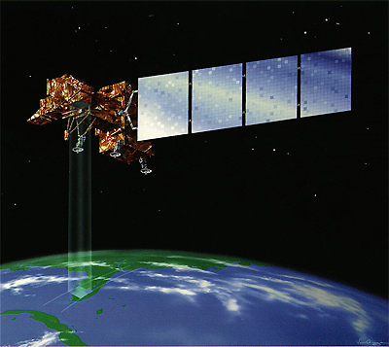
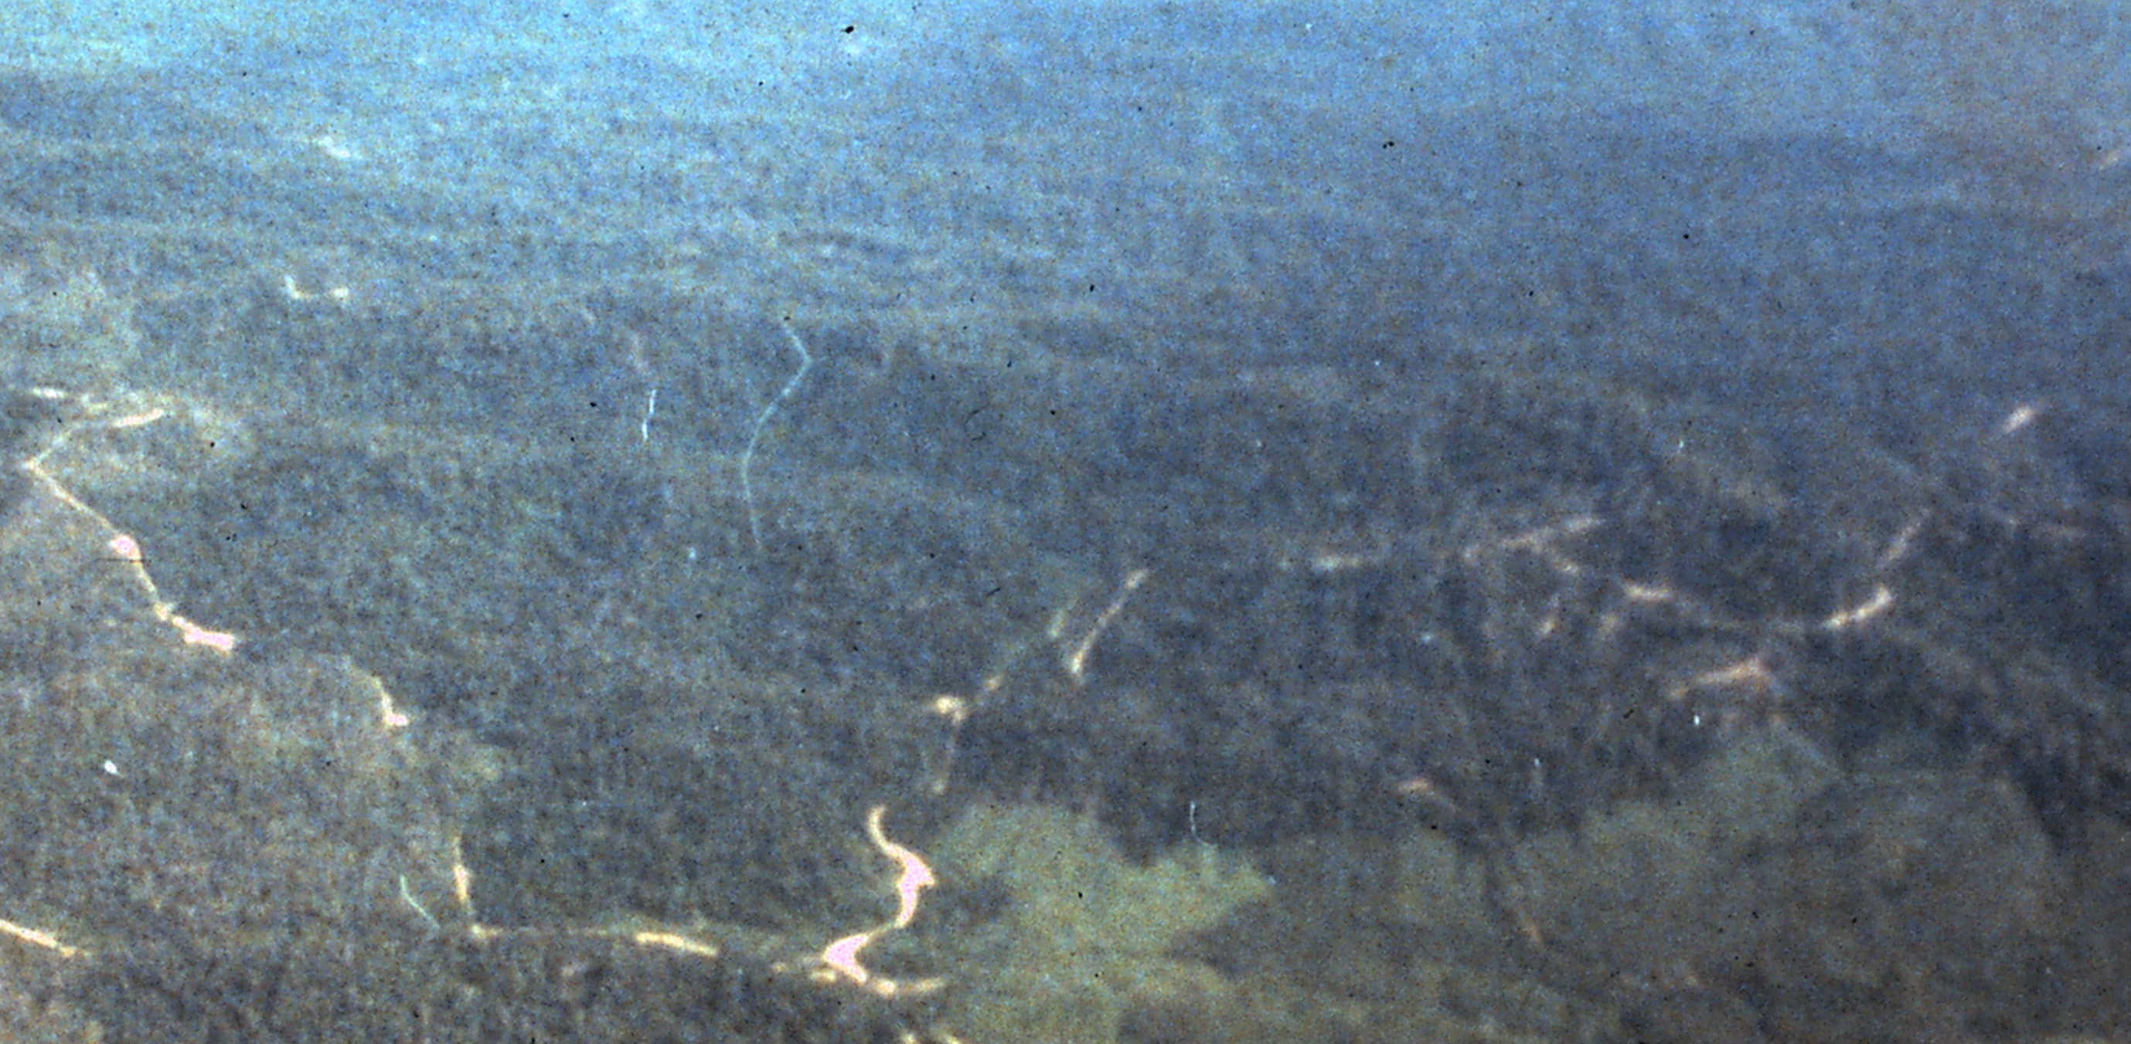
Barrier 2:Remote Sensing Limitations A
Source: NASA
No single existing Earth observation method can directly measure reduce carbon emissions from forest degradation by selective logging. Only indirect mapping using medium resolution satellite images, e.g. by spotting bare soil on skid trails and logging roads etc., is feasible.
But this can be used to estimate degraded forest areas.
National Greenhouse Gas Inventories must estimate carbon emissions from logging degradation using inaccurate national wood production statistics.

Slide 15
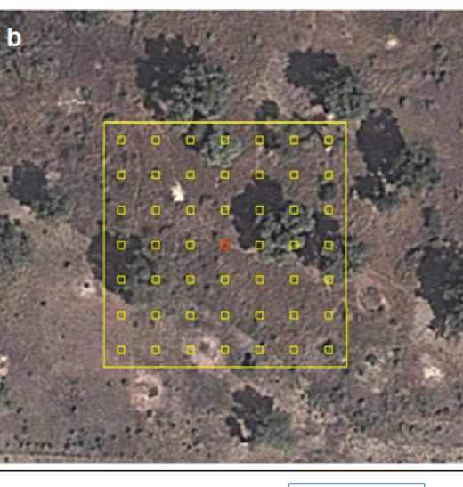
Barrier 2:Remote Sensing Limitations B
Very high (≤1 m) resolution satellite images can now be interpreted by a new method to measure tree cover in dry areas.
This method could also be used to measure spatial forest degradation in these areas.

Slide 16
Barrier 3: Monitoring Deforestation Given Priority Over Monitoring Forest Degradation in National Greenhouse Gas Inventories
 | Spatial Degradation | Logging Degradation | Forest Regrowth
Congo
Ghana | Y
Nigeria
Tanzania
Cambodia |  |  | Y
Indonesia |  |  | Y
Laos |  | Y
Malaysia |  | Y | Y
Brazil
Costa Rica
Mexico |  | Y
Peru |  | Y | Y
TOTAL | 1 | 4 | 4

Slide 17
Consequences of Barriers and How to Reduce Them

Slide 18
Consequences
 | Degradation | Regrowth
Balanced | Y | Y
Imbalanced | Y
Imbalanced |  | Y
1. Estimates of the net contribution of forests to global climate change that are inaccurate and imbalanced: degradation only or regrowth only.
2. Constrain incorporating forest degradation in LDN.

Slide 19
Reducing Barriers
UNFCCC should define the term ‘forest degradation’.
Technical advances in remote sensing are needed.
Launch REDD Readiness Phase II: forest degradation.

