Slide 2
Monitoring sediment coverage from Distributed Temperature Sensing measurements in the Port of Rotterdam, the Netherlands
Authors: Manos Pefkos, Pieter Doornenbal, Arjan Wijdeveld, Ebi Meshkati Shahmirzadi, Pauline Kruiver
EGU 2020
Wednesday, 8th May 2020
Naam

Slide 3
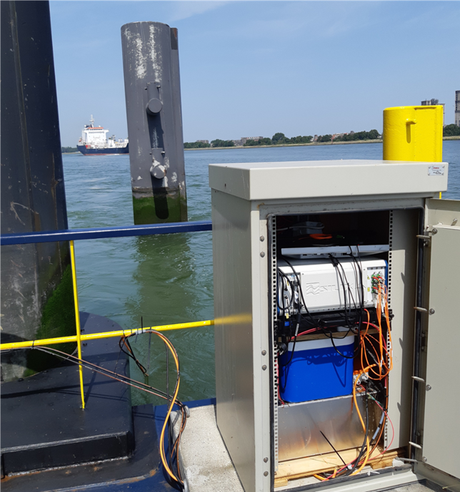
Study Aims
Detect sediment coverage on the passive cables and pole in relation to nourishments (transfer of sediment from the port to offshore locations).
Monitor the change in sediment coverage over time and identify spatial patterns in sediment deposition/erosion.
Silixa Ultima DTS installation at the Port of Rotterdam
© Authors. All rights reserved.

Slide 4
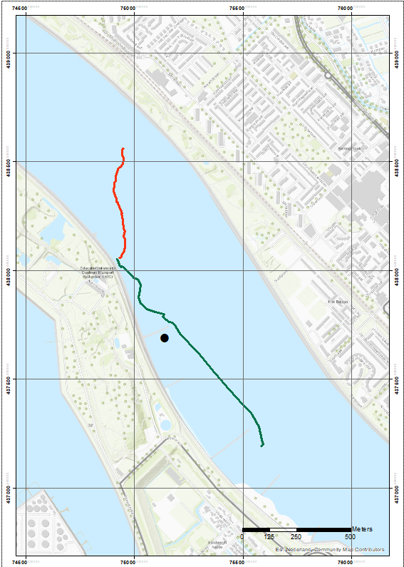
Field Setup
System:
Instrument: Silixa ULTIMA DTS.
Spatial Resolution: 0.1256 m.
Temporal Resolution (passive data):
14 minutes (between 13/5/19 - 11/7/19)
2 hours (11/7/19 – 12/09/19)
Heating Cable:
Voltage and Resistance: $230 V$and $120 \text{Ω}\text{m}$ respectively.
Passive Cable:
2 profiles of length ~1km and ~750m.
Pole:
Heating cable and passive cable both wrapped helically.
0.77m high.
Passive Cable 2
Pole Location
Passive Cable 1
Spatial configuration of pole and the two passive cables in the Port of Rotterdam.
© Authors. All rights reserved.

Slide 5
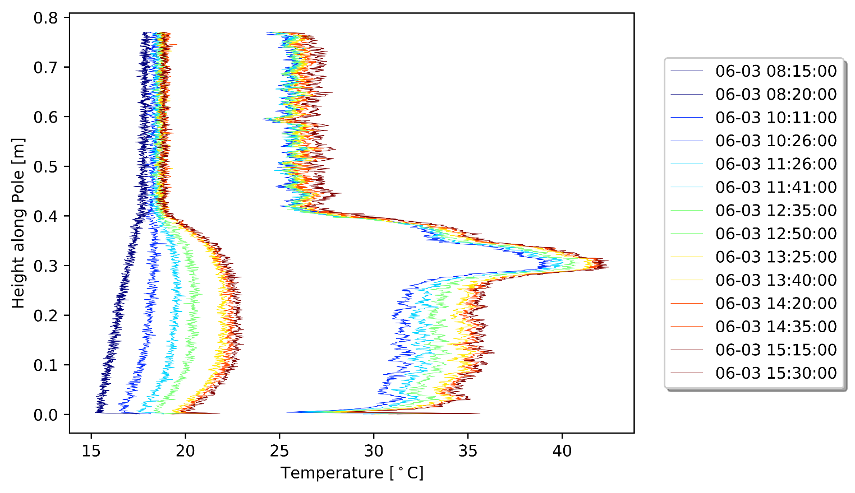
Active Heating Experiments: Results
1. Before Heat On
Temperature curves (3rd June 2019)
3. Maximum temperature just before Heat Off
interface
2. Heating phase
4. Cooling phase
The active heating experiments show that the water-sediment interface along the pole can be tracked from the difference in response to heating by the cable.
© Authors. All rights reserved.

Slide 6
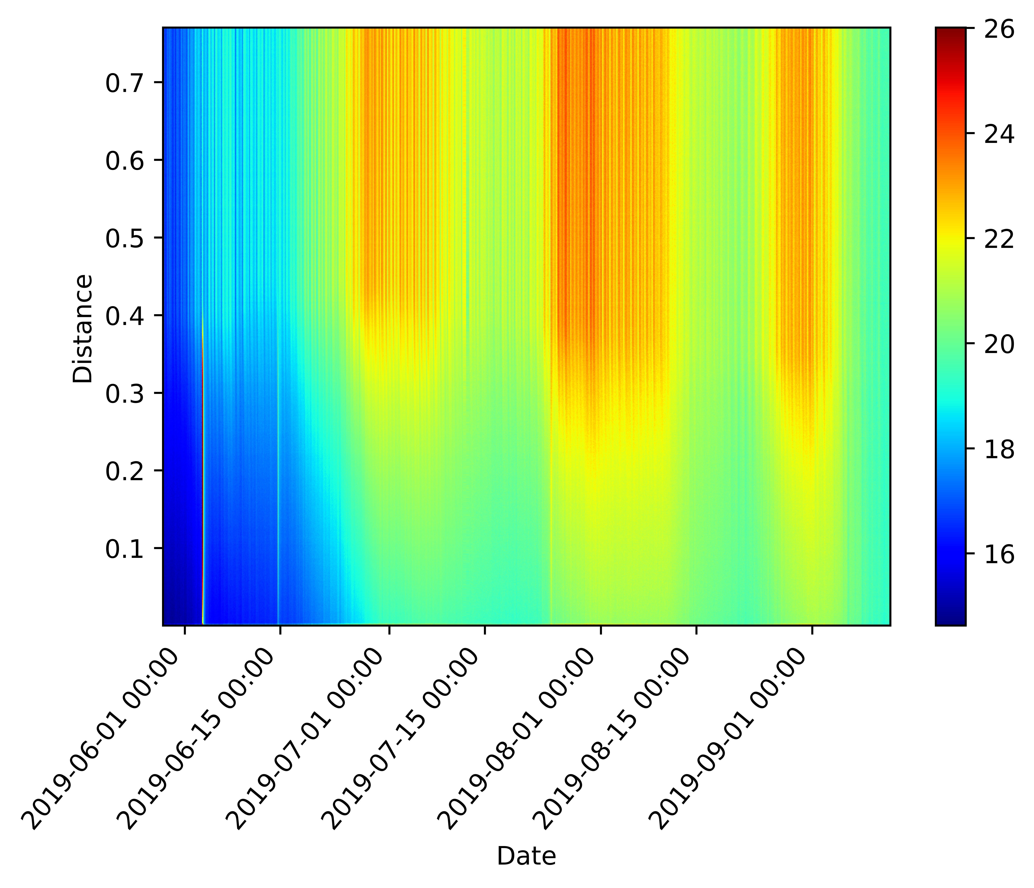
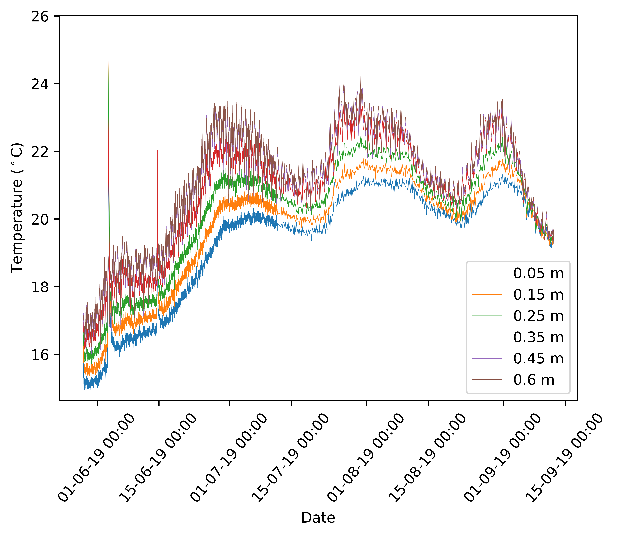
Passive Pole: Results
Raw Data from the pole’s passive measurements
Temperature signals at selected heights along the pole
Temperature [°C]
Change in sampling rate
© Authors. All rights reserved.

Slide 7
Passive Pole: Frequency Analysis
Spectrogram of signal (in water)
Fourier Amplitude Spectrum (sediment)
0.5 day period
1 day period
0.25-day
Half-day
One-day
Both water phase and sediment phase show clear peaks of 0.5 and 1 day periods.
Water phase shows additional harmonics, at higher magnitudes.
© Authors. All rights reserved.

Slide 8
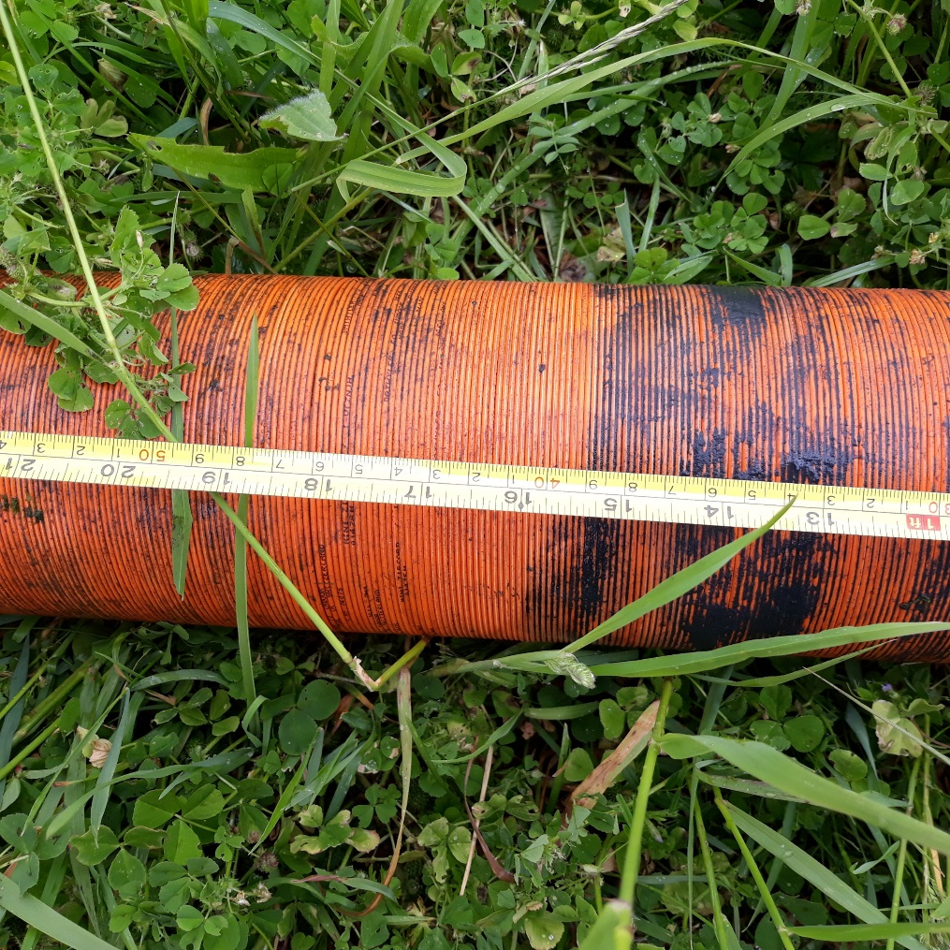
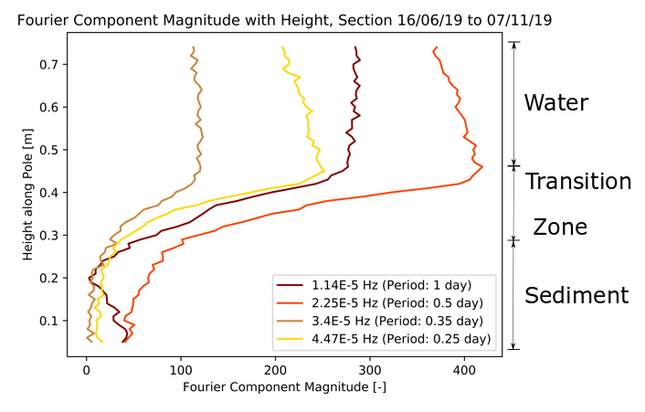
Passive Pole: Water-Sediment Interface
Fourier component magnitude for 3.5 weeks of data
Sediment – Water Interface: 39cm
Various harmonics show a consistent and clear transition zone between the water and sediment phases.
Water-Sediment interface height on the pole was 0.39cm after it was removed.
© Authors. All rights reserved.

Slide 9
Passive bottom cable: Results
Raw data plot from passive cable 1.
Sediment coverage on passive cable 1 over time. Blue = water, brown = sediment
The data was split up into segments of 10m width and 5 days duration.
After performing a frequency analysis, reading the values of the FAS magnitude at half-day cycle frequencies and following the same approach, these segments were classified as either sand or sediment.
© Authors. All rights reserved.

Slide 10
Conclusions
DTS measurements allowed the detection and monitoring of sediment coverage, both on the vertical pole and on the horizontal bottom cables.
Signals from the water phase seem to have higher Fourier magnitudes at frequencies corresponding to half-day period events. This characteristic was used to classify signals as coming from water or sediment.
For the passive pole data, the interface between water and sediment seems to correlate well with the location where the derivative of the Fourier magnitude at half-day cycles with height is zero (see abstract).
On horizontal bottom Cable 1, certain areas seem to be constantly submerged in water or constantly covered by sediment, however zones of dynamic interaction between deposition/erosion are also visible.
Better criteria need to be deduced for classifying phases on the passive cable, and the results must be compared to real-world observations of sediment coverage.
The effect of breaking down the DTS data into time-distance segments must be further investigated in order to determine the optimal resolution that allows determination of sediment coverage.
© Authors. All rights reserved.

Slide 11
Contact
www.deltares.nl
Manos.Pefkos@deltares.nl
linkedin.com/company/deltares
Questions?
facebook.com/deltaresNL
linkedin.com/company/deltares
@deltares
@deltaresNL

