Slide 1
An experimental study of sorption properties of natural zeolite-containing rocks and their ability for purification of aquatic solutions contaminated with Ni and Zn
V.I. Vernadsky institute of Geochemistry and Analytical chemistry, Russian Academy of Sciences (GEOKHI RAS), Geochemical Dept
Moscow, Russia
Liudmila Кolmykova*, Valentina Nikashina and Elena Korobova
*(kmila9999@gmail.com)

Slide 2
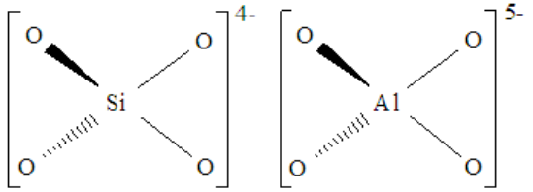
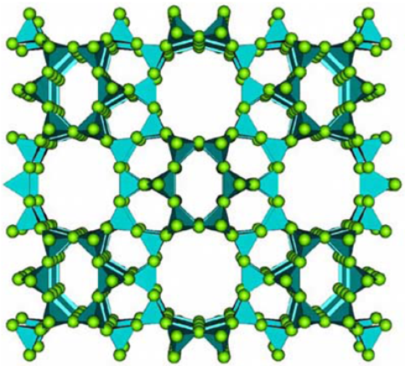
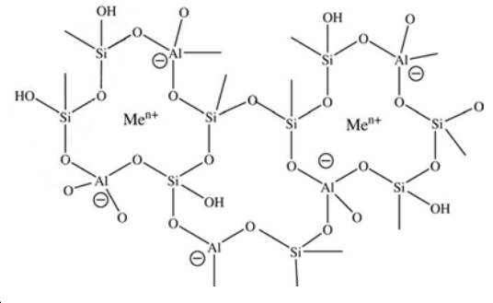
Natural zeolites. Structure. Properties and application
Zeolites are aluminosilicate minerals, the structure of which consists of a tetrahedral arrangement of silicon cations (Si4+) and aluminium cations (Al3+) that are surrounded by four oxygen anions (O2-). Each oxygen ion within the Si-O and Al-O bonds connects two cations and is shared between two tetrahedrons (as shown in figure 1.1), thus yielding a macromolecular three-dimensional framework of SiO2 and AlO2 tetrahedral building blocks (Fig.1-2). Cavities (“defects”) which are typical for natural zeolites cause imbalance of charges inside their structure which allows mono- or di-valent ions such as sodium, potassium, magnesium, calcium, and barium enter the mineral (Fig.3).
As a result the general chemical formula: [(Li, Na, K)_{a}(Mg, Ca, Sr, Ba)_{d}(Al_{(a+2d})Si_{n-(a+2d)}O_{2n}]·mH₂O [Coombs et al., 1997].
Highly selective adsorption and cation exchange properties
Fig.2. Tetrahedral arrangement of the SiO4 and AlO4 molecules forming unit blocks of a zeolite [Moshoeshoe et al., 2017]
-Water and Soil Purification from heavy metal, radionuclides, organic pollutants,
-Medicinal Uses of Zeolites,
-Catalysis etc.
Fig.1. A chemical model of a complex zeolite structure [Ratner and Ratner, 2003]
Fig.3. A two-dimensional representation of the framework structure of zeolites [Granda, 2006]

Slide 3
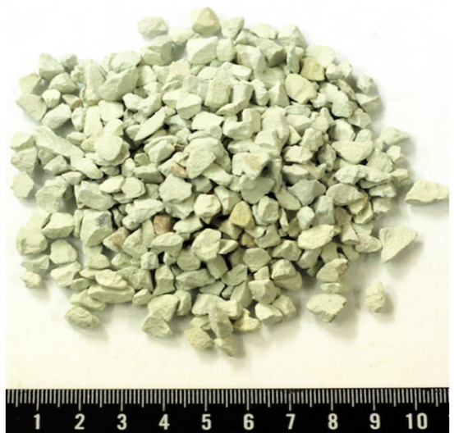
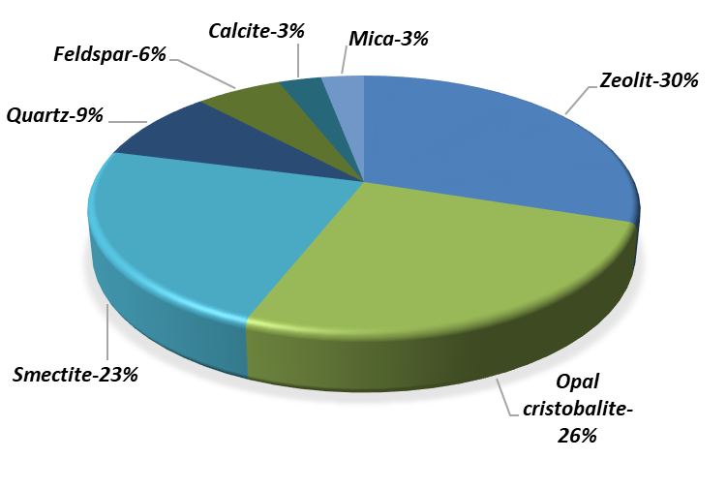
Zeolite-containing tripolite (ZCT) of the Khotynetsky deposit
(Russia, Oryol region)
ZCT chemical composition (%)*:
SiO2-68.18
Al2O3-8.31
CaO-3.51
Fe2O3-3.26
K2O-1.76
TiO2-0.5
P2O5-0.38
Na2O-0.17
Sr-0.07
MnO-0.01
Rb-0.008
Zn-0.006
Ni-0.003
Cu-0.001
Phase composition
Fig.4. Natural ZCT from the Khotynetsky deposit
Fig.5. The ratio of the various mineral phases of the test ZCT
The purpose of research was to study of ion exchange and adsorption properties of natural zeolite-containing tripolite from the Khotynetsky deposit as a possible geochemical barrier for teсhnogenic Ni²⁺ and Zn²⁺ contaminating soils and ground waters.
*X-ray fluorescence analysis
Loss on ignition -12.64%

Slide 4
Experiment 1. Total cation exchange capacity of the ZCT
Before the experiment the test material was prepared: sieving (hole size 1 and 0.25 mm), washing off dust with distilled water, drying for 2 hours at a temperature of 100 degrees. The content of the elements was determined using of X-ray fluorescence method.
The determination of the total cation exchange capacity of the ZCT was carried out by NH4+.
Table 1. ZCT exchange capacity
Cations | Ca²⁺ | K⁺ | Mg²⁺ | Sr²⁺
Total amount of exchangeable cations in ZCT (mg/g) | 20.2 | 2.57 | 1.08 | 0.47
Сation exchange capacity (meq/g) (displacement by NH4 ions) | 1.01 | 0.07 | 0.09 | 0.01
According to the results of comparing the chemical composition of the natural and ammonium forms of TSST, mainly calcium, potassium and magnesium ions and a certain amount of strontium are involved in the substitution for ammonium ion.

Slide 5
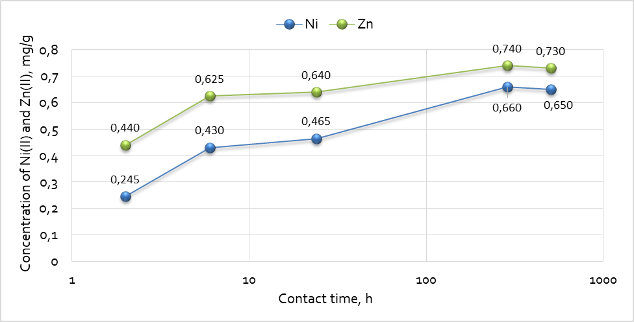
Experiment 2. Sorption kinetics
Sorption equilibrium
.
The model saline solution was represented by a solution of calcium choride simulating the composition of natural river water (0.003 n) and filtration water from solid domestic waste landfill (0.06 n).
The kinetic characteristics were determined in batch experiments using the method of "limited volume". V/m= 500. Contact time: from 2h to 21 days. The model solutions contained 2 mg/l of Ni²⁺ and Zn^{2.}
Fig.6. Sorption of Ni²⁺ and Zn²⁺ by ZCT of the Khotynetskoye deposit in a solution of 0.003n CaCl2 depending on the contact time

Slide 6
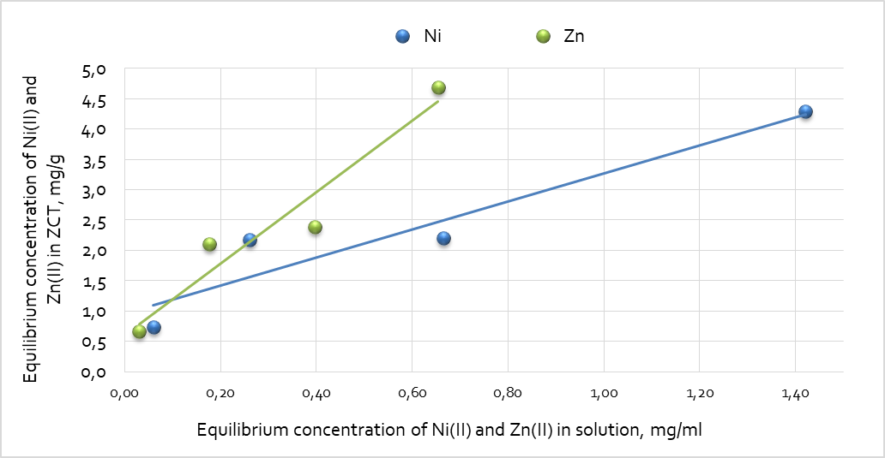
Experiment 3. Sorption isotherm
The prepared model solutions contained 2, 5, 7 and 10 mg/l of Ni²⁺ and Zn²⁺. V/m=500. Contact time =21 days.
The amount of Ni²⁺ and Zn²⁺in solutions was determined by the ICP-AES.
Fig.7. Sorption isotherms of Ni²⁺ and Zn²⁺ onto the ZCT of the Khotynetsky deposit from a solution of 0.003N CaCl2 (contact time 21 days)

Slide 7
Main results
The most mobile ion in ZCT are Ca and Mg. The total cation exchange capacity of the ZCT for displaced cations is 1.18 meq/g.
Sorption equilibrium in the system ZCT- model solution (0,003n CaCl2) is reached in the intervals from 200 to 500 hours (20 days). Equilibration time was determined also in solution of higher salinity (0.06n).
In spite of some scatter of points, the sorption of Ni⁺² and Zn²⁺ by natural ZCT may be approximated with a linear isotherm, at that Zn²⁺ is sorbed much better than Ni⁺².
The average values of distribution coefficients (Kd) in 0.003n CaCl2 solution equaled for Ni⁺² to 2.7*10³ [ml/g], and for Zn²⁺ to 6.7*10³ [ml/g]. 20-fold increase in the mineralization of the model solution leads to a decrease in the sorption of Ni by about 20 times, and Zn by almost 30 times.
Natural tripolite of the Khotinetsky deposit may well be used as a natural geochemical barrier for extraction of technogenic Ni⁺² and Zn²⁺ from soils and natural waters draining landfills and contaminated by these ions.

Slide 8
Acknowledgements
The authors thank T.G. Kuzmina (GEOKHI) and I.N. Gromyak (GEOKHI) for carrying out analytical measurements
(X-ray fluorescence analysis; ICP-AES).
Thank you for your attention!

