Slide 1




Climate change and landslides: introducing a thermo-hydro-mechanical approach
GIANVITO SCARINGI
gianvito.scaringi@natur.cuni.cz
sadly not in Vienna, 4-8 May 2020
© Author. All rights reserved
The Faculty of Science, Albertov Campus, Prague, Czech Republic

Slide 2

Funding
2
This work is funded by the Grant Agency of the Czech Republic
Grant No. GJ20-28853Y (2020-2022)
Project title:
Effects of thermo-hydro-mechanical coupling
on slope deformation in expansive clays:
advanced experiments and hypoplastic modelling

Slide 3

Notes
3
I am not going to show you any results here, as the project has just kicked off.
I am going to explain the rationale behind the project proposal.
I am really looking forward to discussing the project with you, its potential and limitations, and find common grounds for collaboration.

Slide 4
Motivation (ab ovo)
4
Scientific evidence for warming of the
climate system is unequivocal.
- Intergovernmental Panel on Climate Change

Slide 5
General evidence
5
The evidence for rapid (and accelerating) climate change is compelling
It is already evident in:
global surface temperature rise (+0.9 °C since the late 19th century, mostly in the past 35 years)
warming oceans (+0.2 °C since 1969)
ocean acidification (+30% since the beginning of the industrial era, due to CO₂ emissions)
shrinking ice sheets (Greenland: -286 Gt/year 1993-2016; Antarctica -127 Gt/year 1993-2016, now 3x faster than 10 years ago)
declining Arctic Sea Ice (-30% to -50% area in summer compared to 1979)
glacial retreat (almost everywhere around the world, including in the Alps, Himalayas, Andes, Rockies, Alaska and Africa)
decreased snow cover (the amount of spring snow cover in the Northern Hemisphere has decreased over the past five decades and the snow is melting earlier)
sea level rise (+20 cm the 20th century; the rate has doubled in the last two decades and is accelerating every year)
extreme weather events (e.g. in the US: more record high – less record low temperature events, more record intense rainfall events)
- climate.nasa.gov

Slide 6
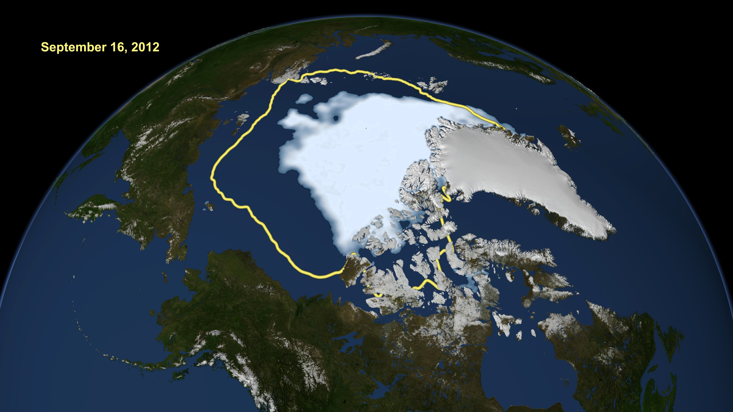
Ice cap melting
6
30-year average
2012 extension
- nasa.gov

Slide 7
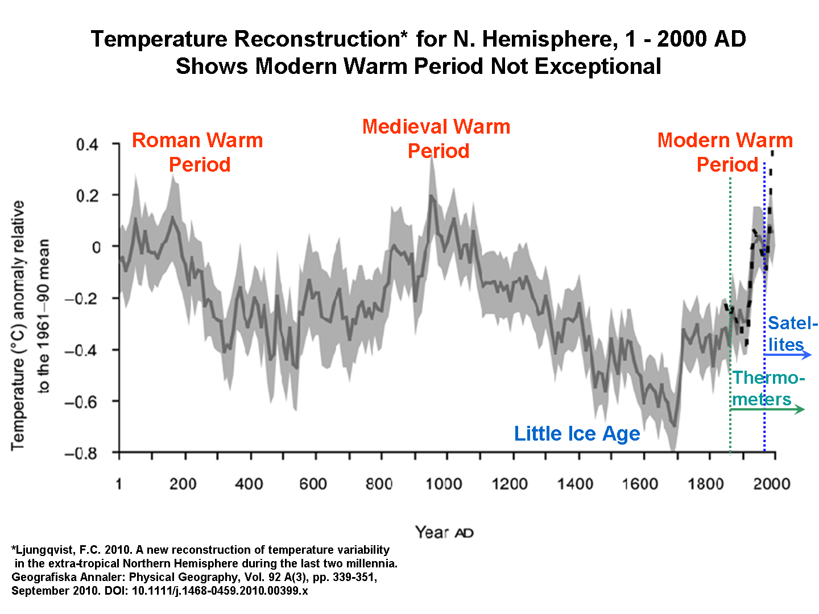
Trends of temperature
7
data manipulation trick!

Slide 8
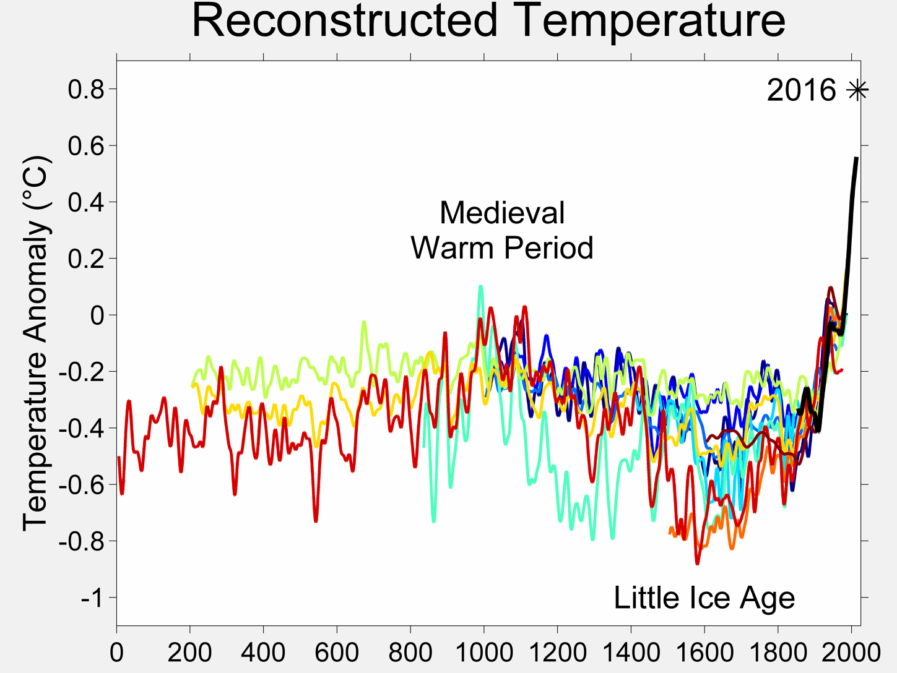
Trends of temperature (updated)
8

Slide 9
The ongoing climate change is anthropogenic
9
Human influence on the climate system is clear,
and recent anthropogenic emissions of greenhouse gases
are the highest in history.
Recent climate changes have had widespread impacts
on human and natural systems.
- Intergovernmental Panel on Climate Change

Slide 10
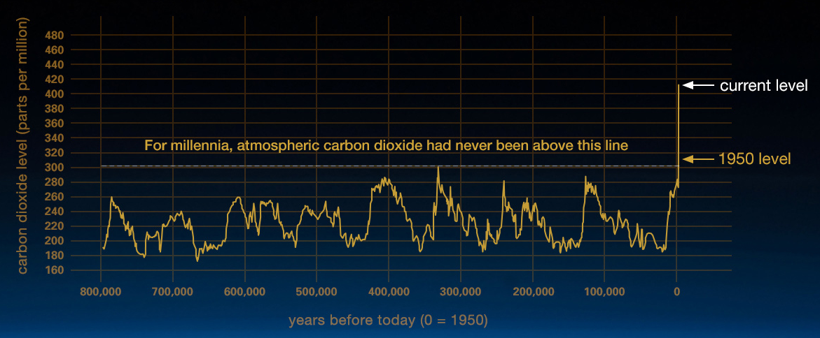
Carbon dioxide in the atmosphere
10
- climate.nasa.gov

Slide 11
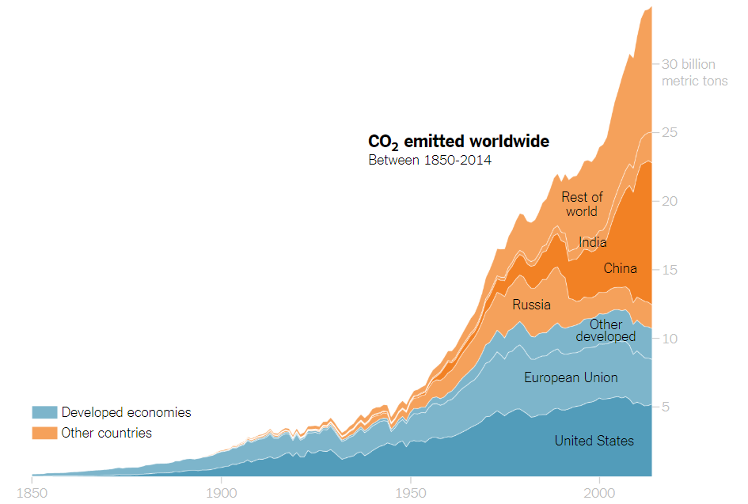
The emitters
11
- Nature, 2019

Slide 12
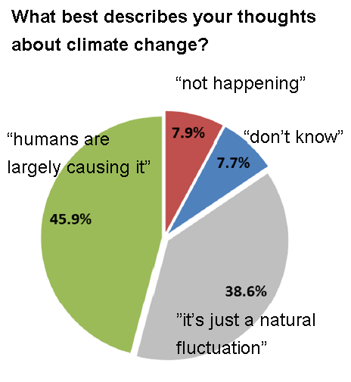

(un)believers
12
(Australian adults, 2015)

Slide 13
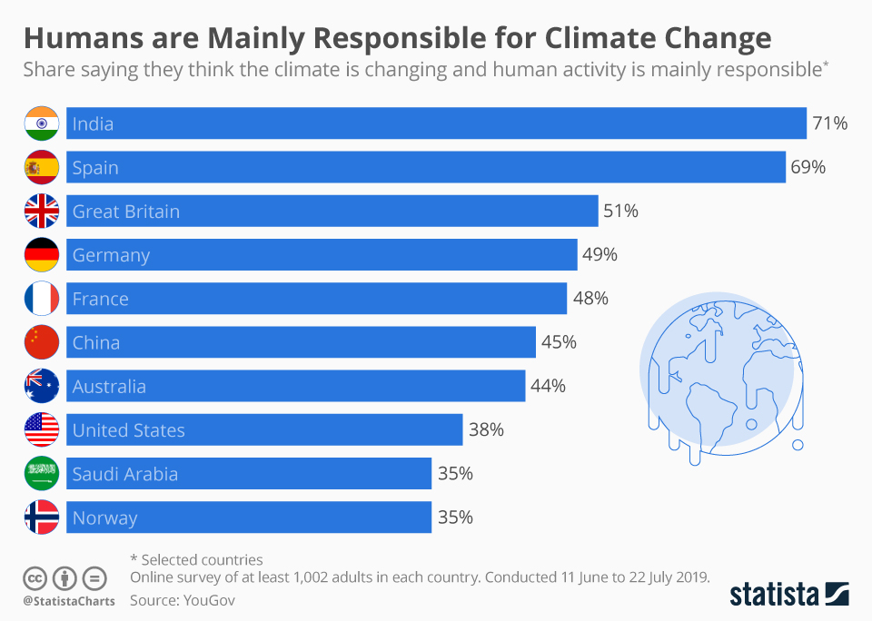
(un)believers
13

Slide 14
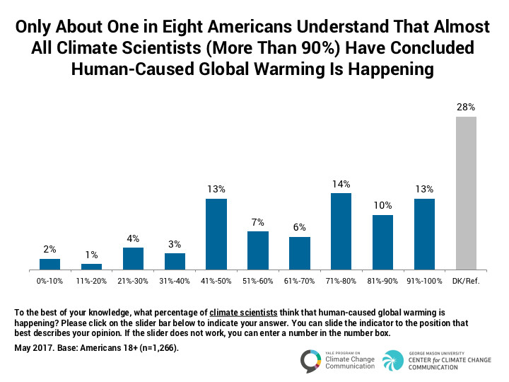
(un)believers
14

Slide 15
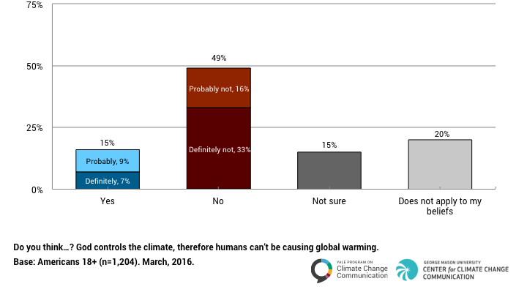
(un)believable!
15
15% of Americans think God controls the climate, therefore people can’t be causing global warming

Slide 16
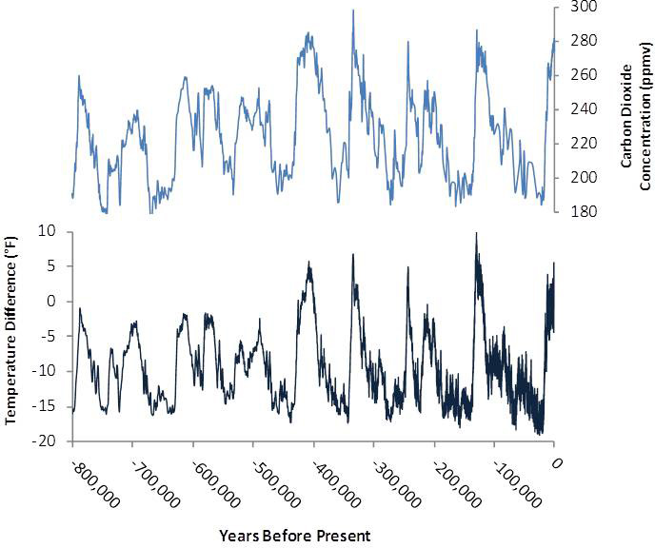
The ongoing climate change is anthropogenic
16
correlation does not imply causation, but...
Antarctic temperature
- US EPA

Slide 17
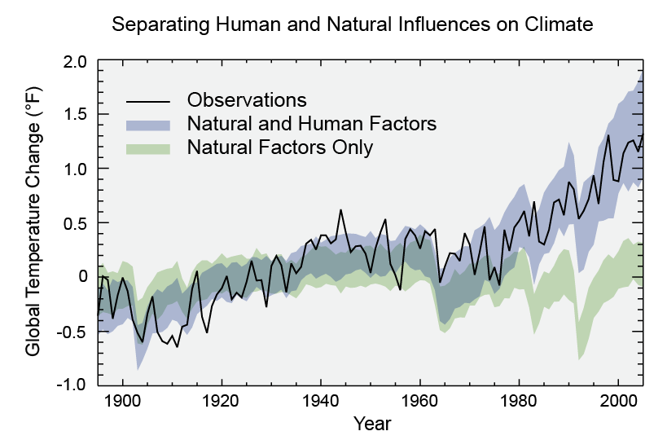
The ongoing climate change is anthropogenic. Yes, it is.
17
...this should convince you
- US EPA

Slide 18
Climate change is a threat
18
Continued emission of greenhouse gases
will cause further warming and long-lasting changes
in all components of the climate system,
increasing the likelihood of severe, pervasive
and irreversible impacts for people and ecosystems.
- Intergovernmental Panel on Climate Change

Slide 19
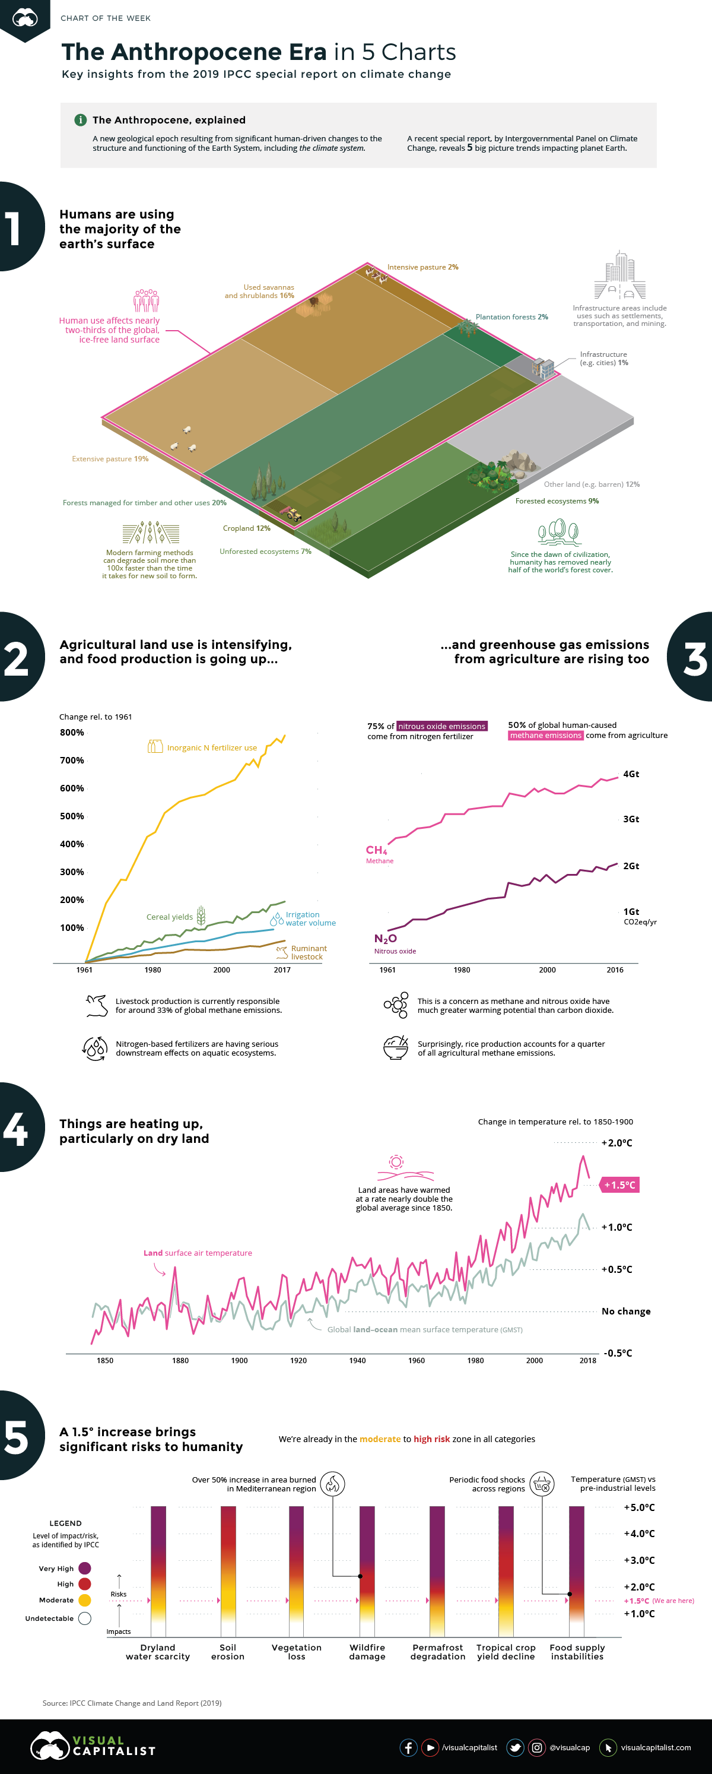
We use most of the land...
19
- N. Routley, The Anthropocene, explained

Slide 20
...and global warming particularly affects the land
20
- N. Routley, The Anthropocene, explained

Slide 21
More heatwaves, more droughts
21
Heatwaves are projected to increase in frequency, intensity and duration in most parts of the world
and drought frequency and intensity is projected to increase
in some regions that are already drought prone.
- Intergovernmental Panel on Climate Change

Slide 22
Significant risk. Today. Already.
22
- N. Routley, The Anthropocene, explained

Slide 23
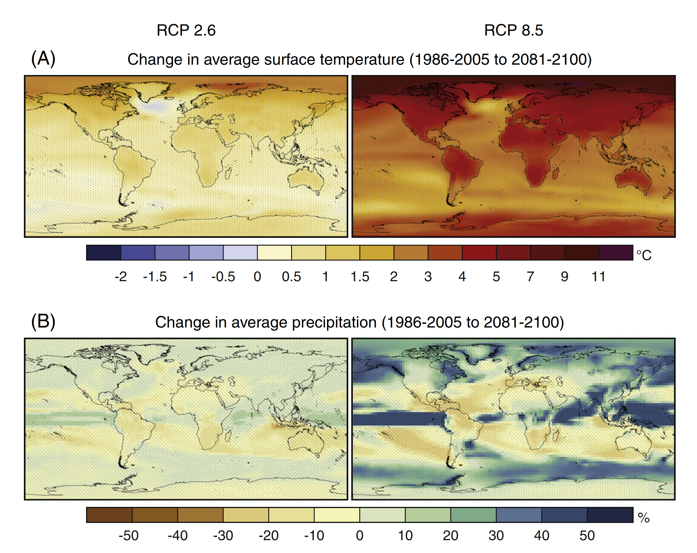
Higher temperature, new precipitation patterns.
23
some regions are hit more than others
Gariano & Guzzetti (2016),
mod. from IPCC (2014)

Slide 24
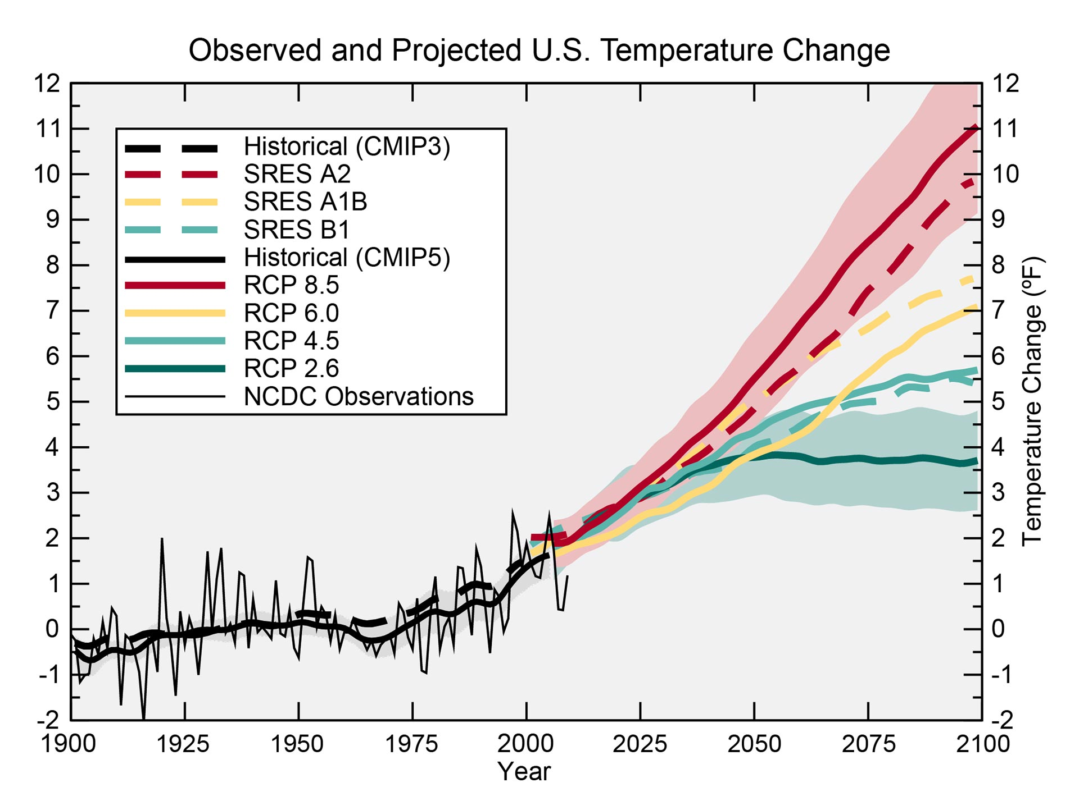
Some places will be hit badly.
24
Look at the US:
up to +12°C in the worst-case scenario!
US National Climate Assessment 2014

Slide 25
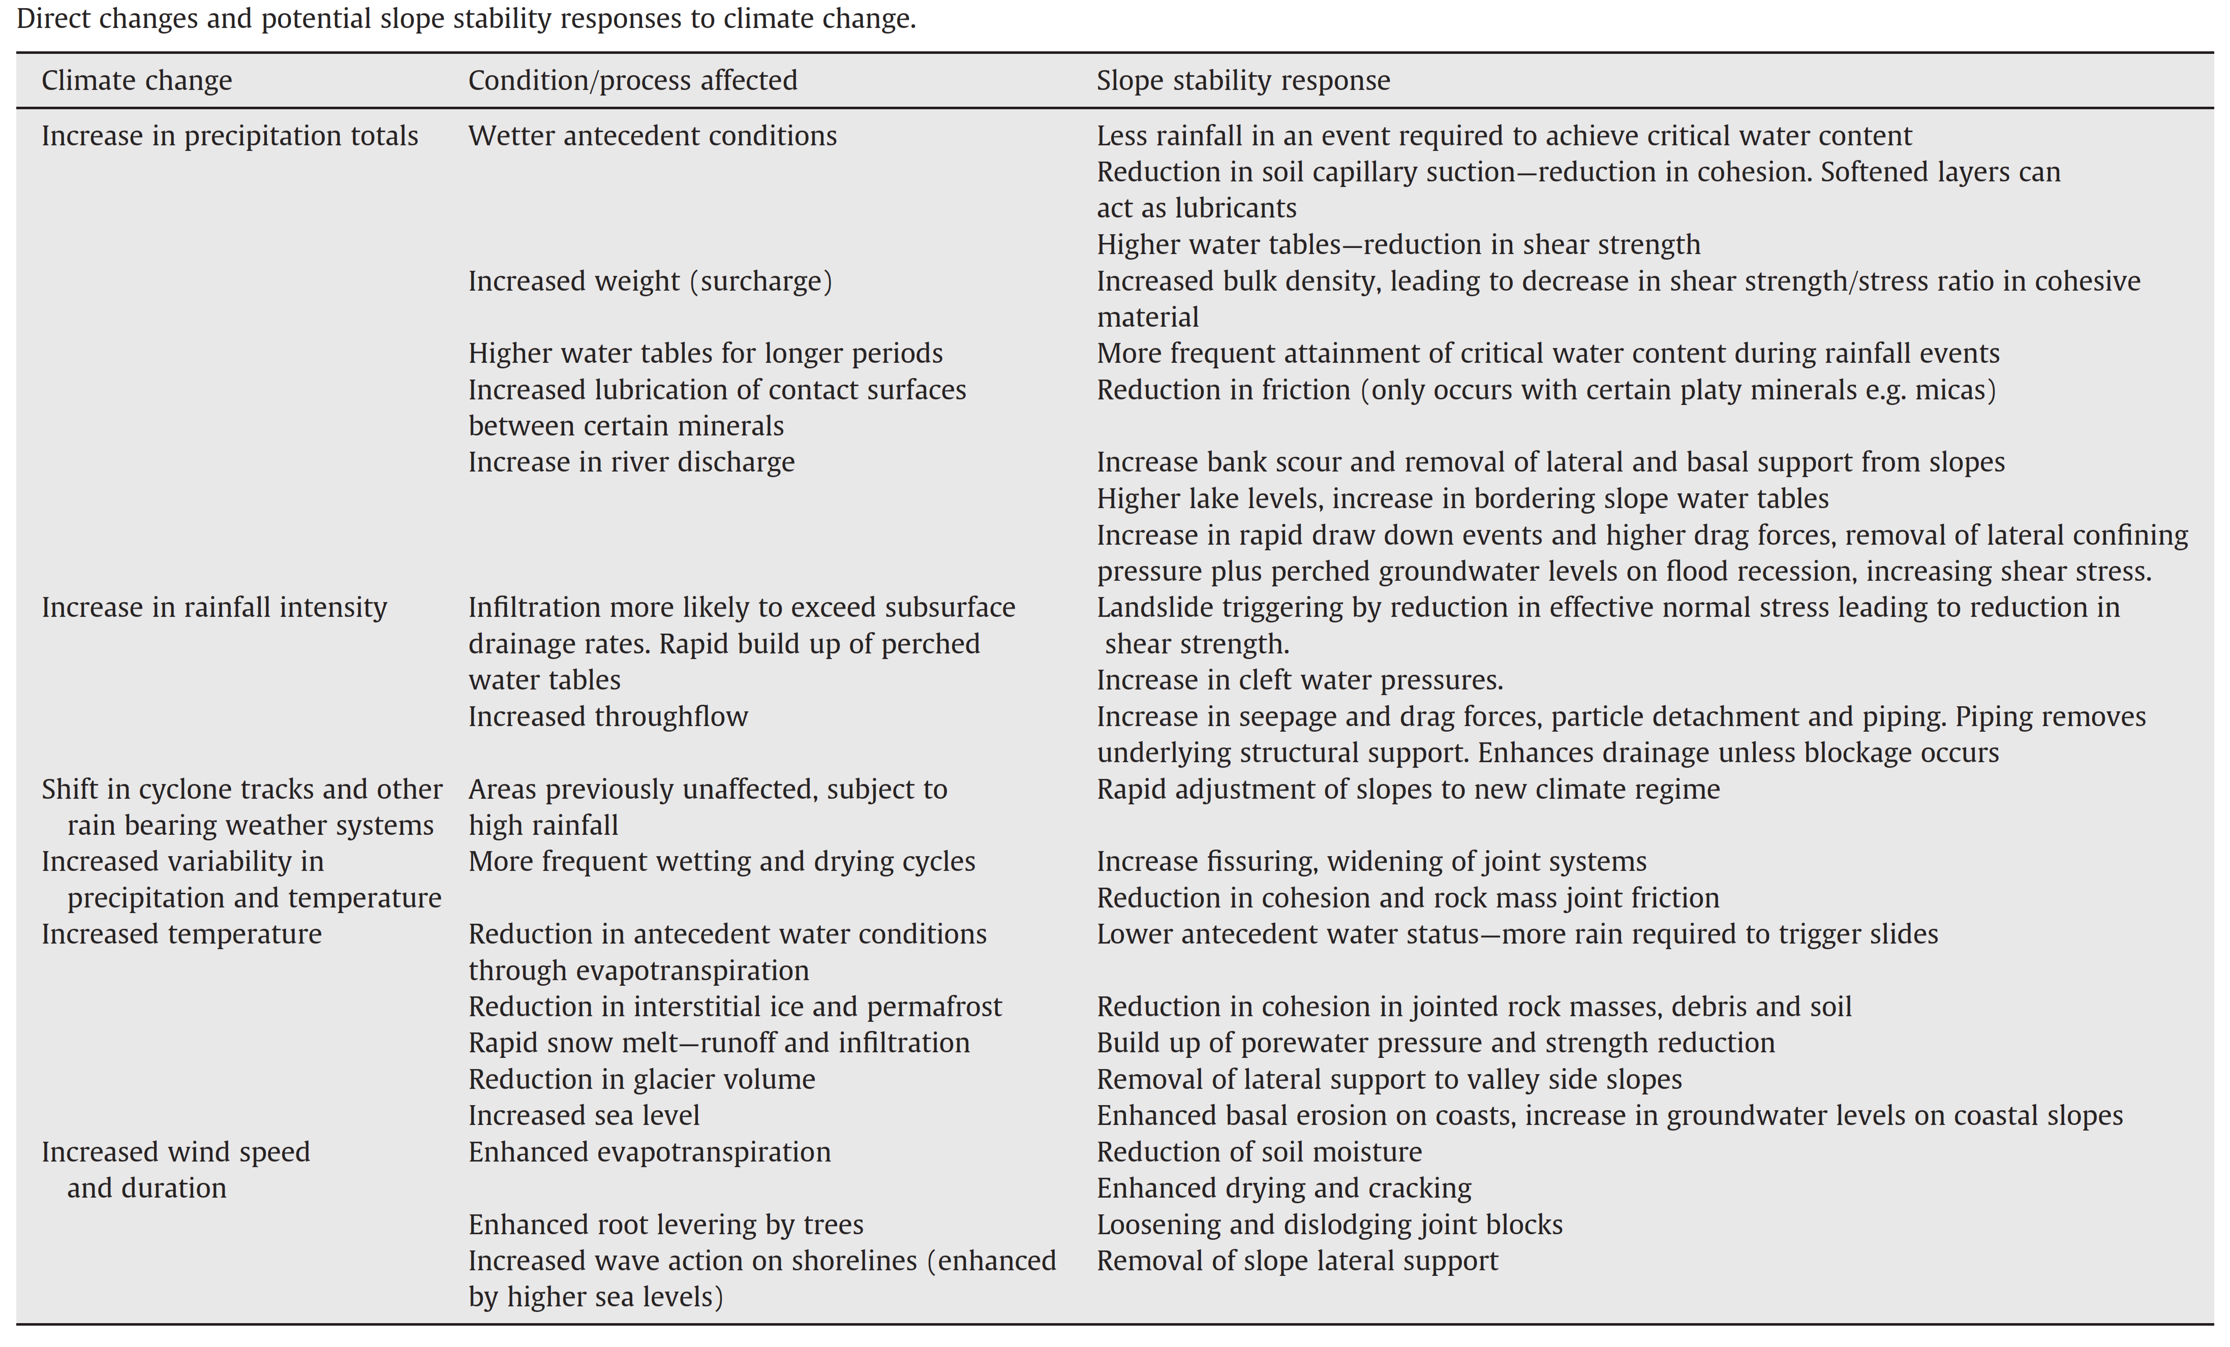
How will climate change affect landslide patterns?
25
not only through changes in precipitation!
the effect of the increased temperature is considered here, but is incomplete
Crozier
(2010)

Slide 26
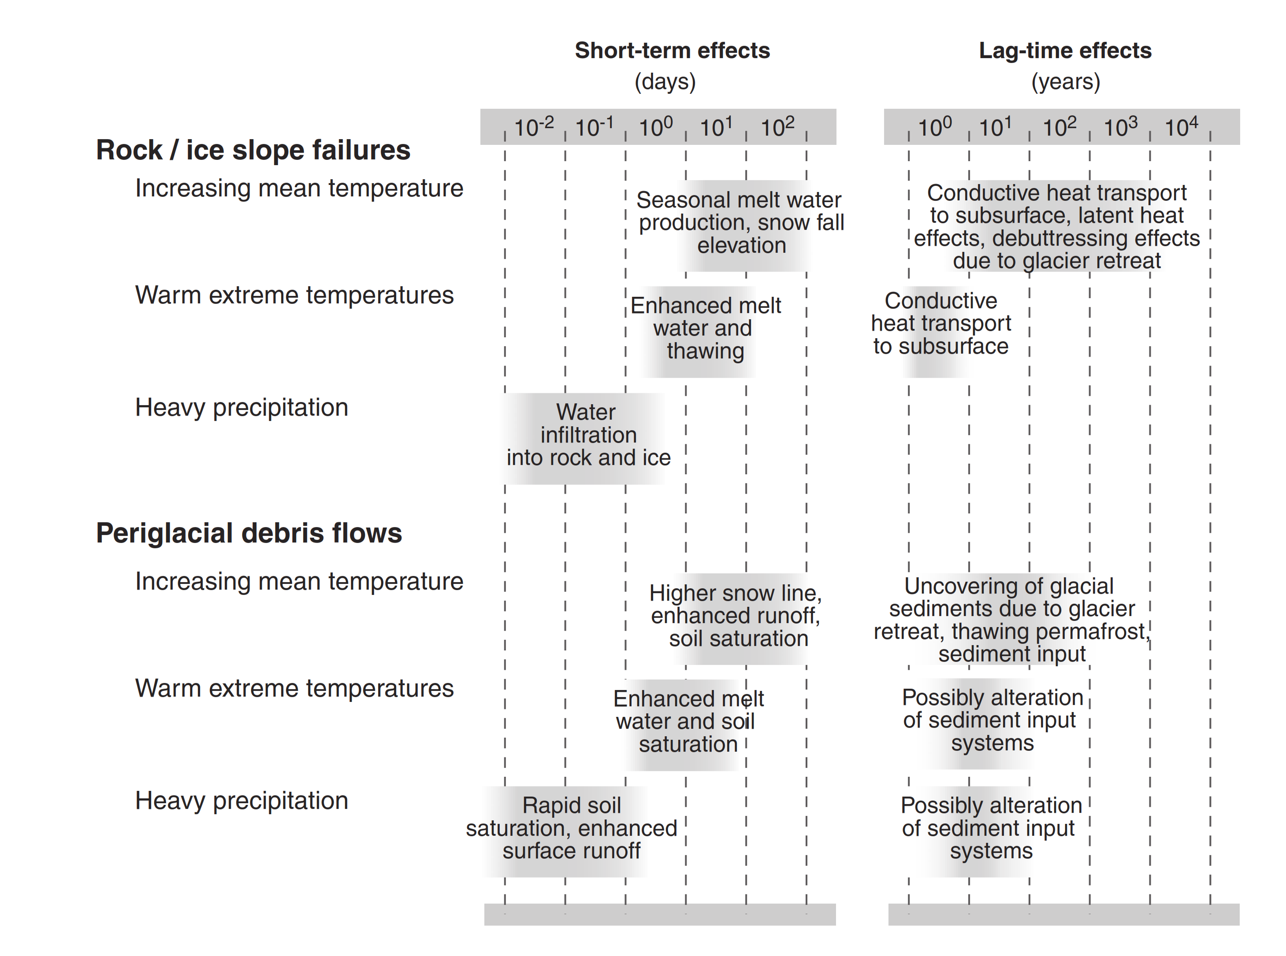
Temperature affects many processes, not only hydrological ones
26
(also soil)
important, we’ll see why
Huggel et al. (2012)

Slide 27
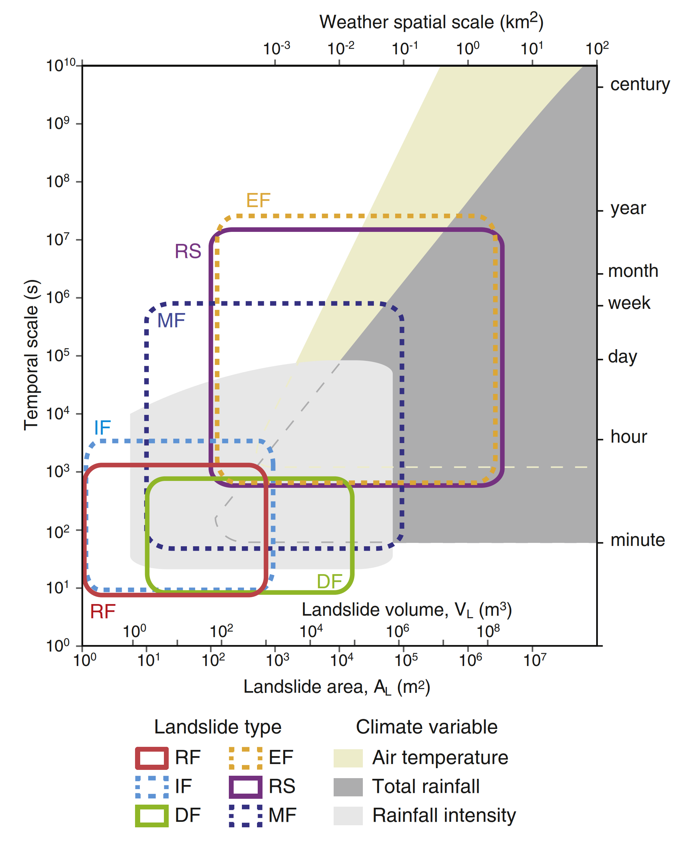
Air temperature and landslides
27
effect of air temperature
from very local to regional weather
from hours to centuries
from shallow to deep landslides
(mudflows, rockslides, earthflows)
Gariano & Guzzetti (2016), open access
https://doi.org/10.1016/j.earscirev.2016.08.011

Slide 28
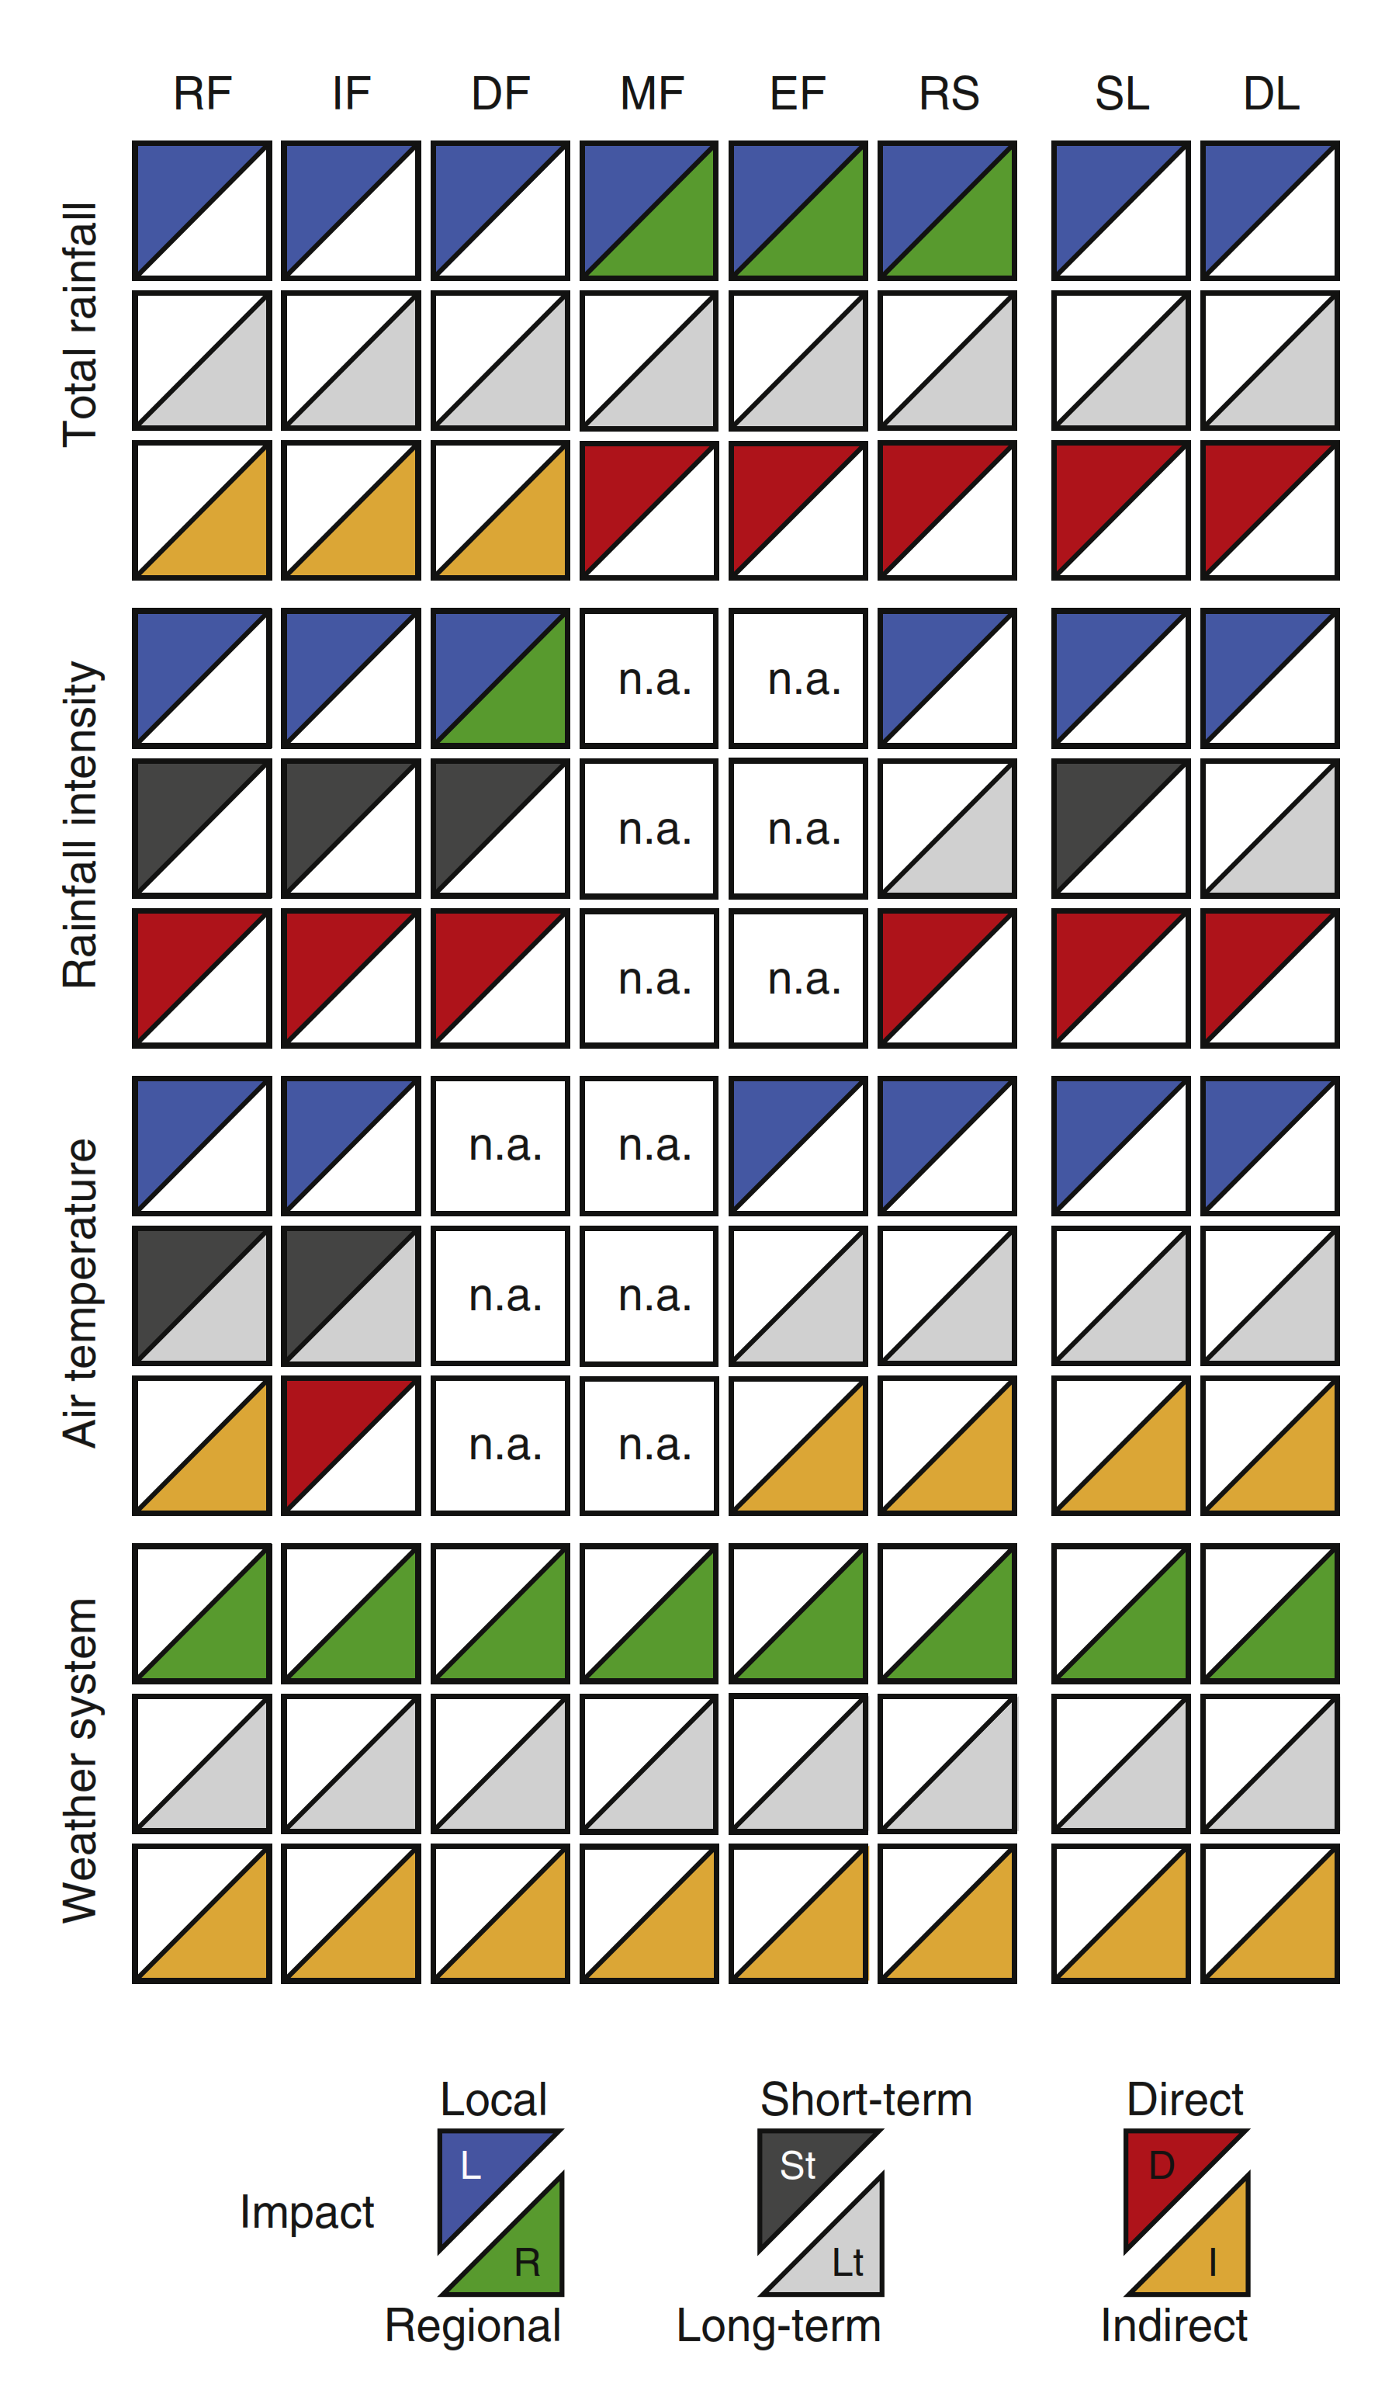
An indirect effect? Not only.
28
effect of air temperature
local
long-term
indirect
but there is more...
Gariano & Guzzetti (2016), open access
https://doi.org/10.1016/j.earscirev.2016.08.011

Slide 29
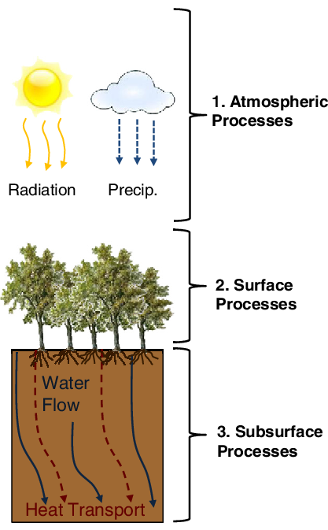
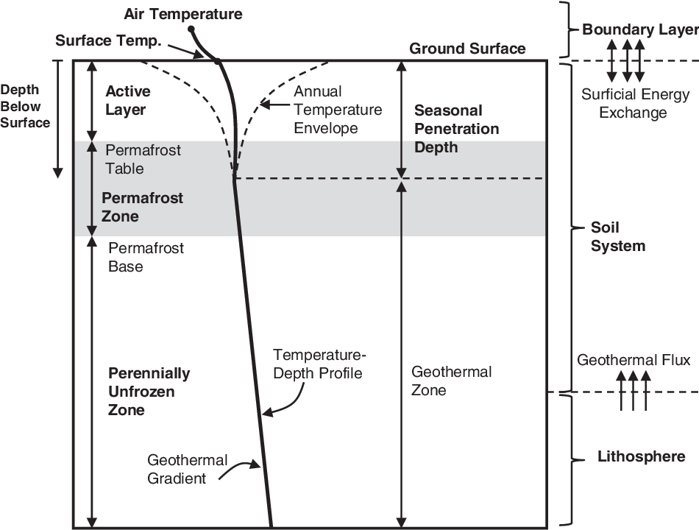
So, heat transport, first of all. Long-term trends go deep!
29
Conductive heat transport to the subsurface
Kurylyk et al. (2014)

Slide 30
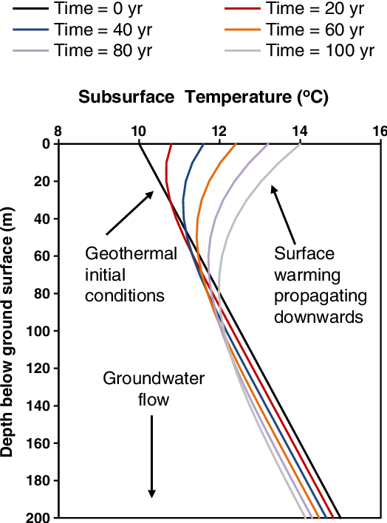
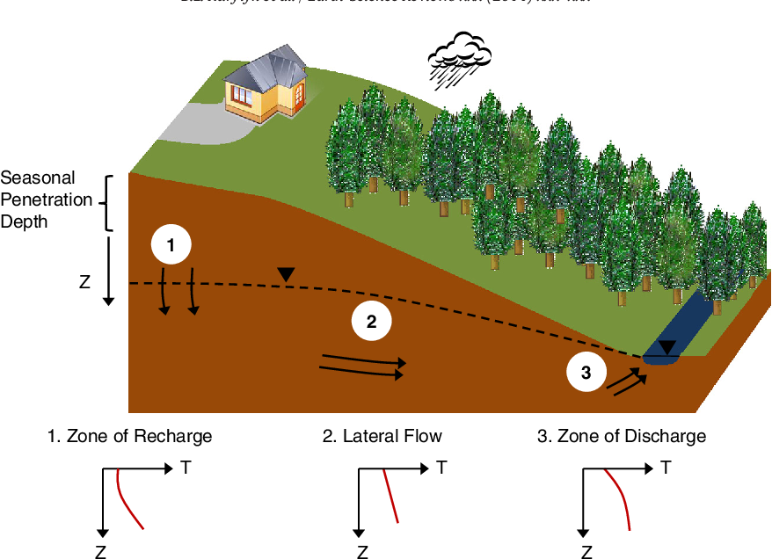
Within decades, deep slip surfaces will feel climate change!
30
Kurylyk et al. (2014)

Slide 31
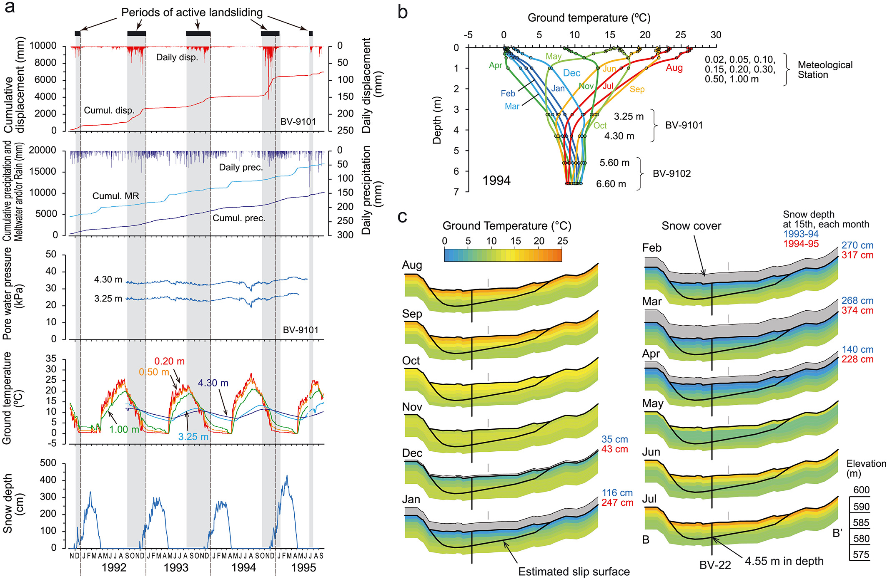
Ok, so what? Well, temperature can control the soil strength!
31
A landslide in clay soil reactivated by low temperatures, Shibasaki et al. (2016)

Slide 32
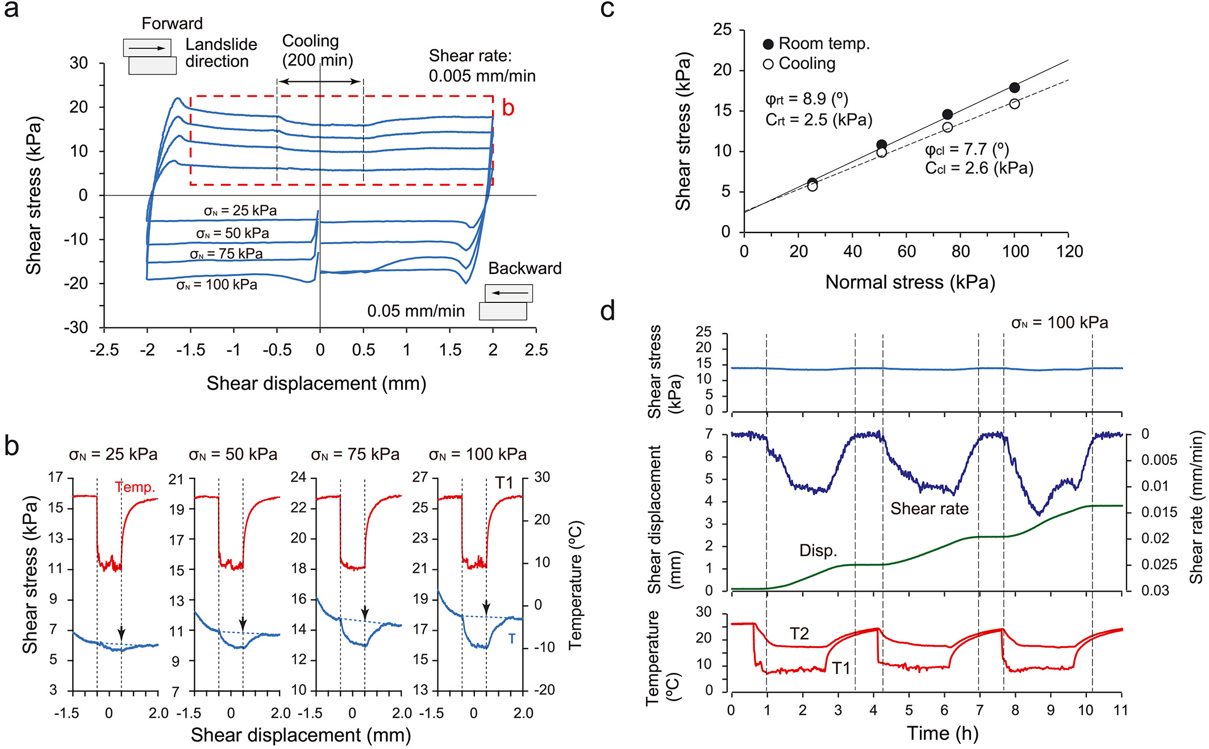
Ok, so what? Well, temperature can control the soil strength!
32
Here we see a direct effect of temperature (not through hydrology/hydraulics, as there is no pore pressure excess here: this is a slow drained direct shear test in saturated active clay; there is no rainfall either)
Variations of ~10 °C caused significant changes in residual shear strength (~15%).
This can imply variations of factor of safety, changes in landslide activity, acceleration/ deceleration.
A landslide in clay soil reactivated by low temperatures, Shibasaki et al. (2016)

Slide 33
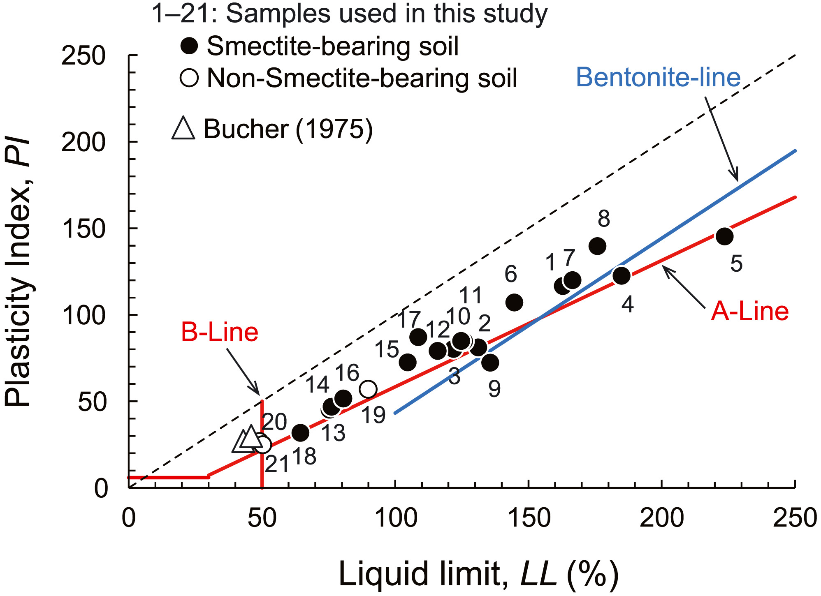
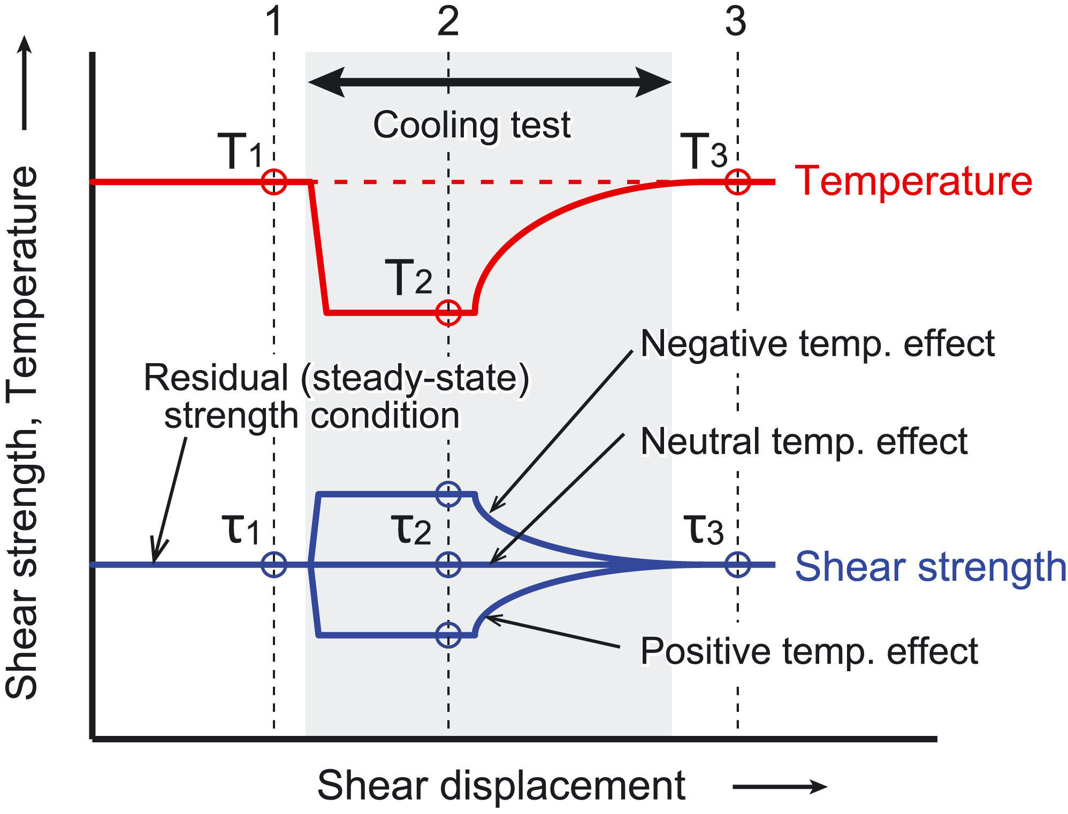
Temperature can control the soil strength
33
Experiments show that the strength of some soils increases with temperature, while it decreases for some other soils.
Effect of temperature on the residual shear strength of clay soils, Shibasaki et al. (2017)

Slide 34
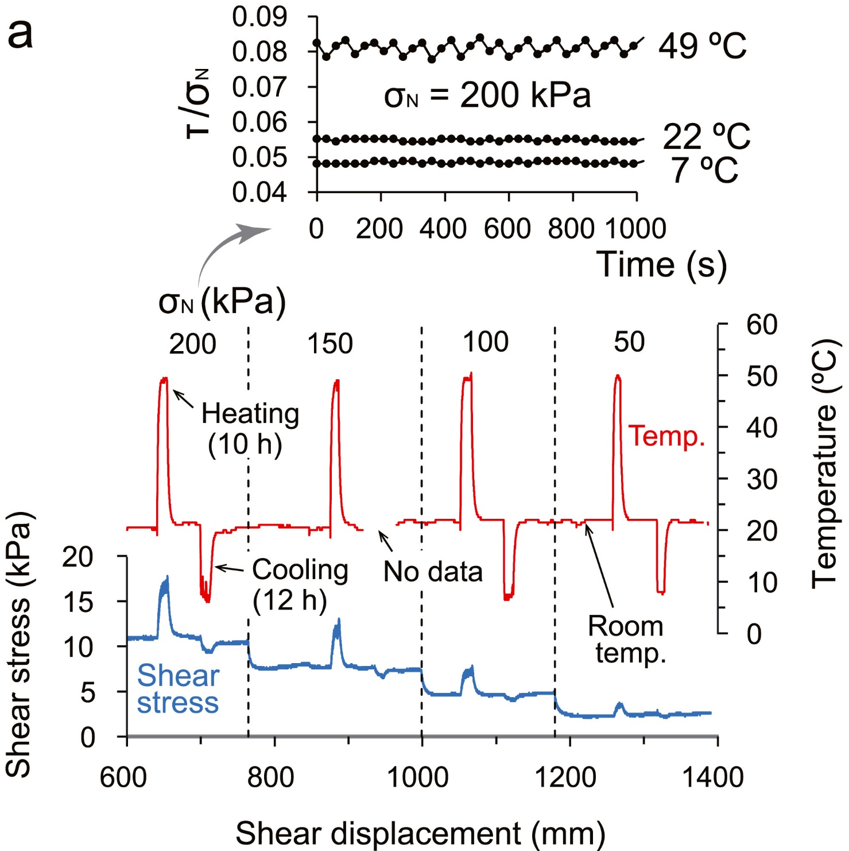
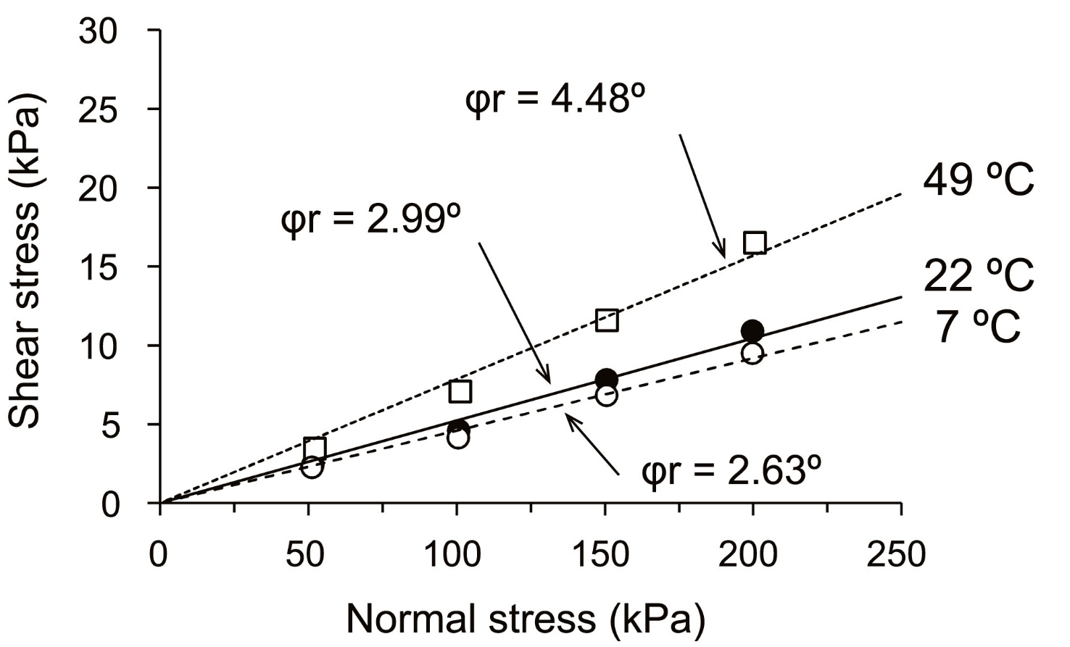
Some like it hot
34
Bentonite, for example: its residual shear strength increases quite a lot with increasing temperature
Effect of temperature on the residual shear strength of clay soils, Shibasaki et al. (2017)

Slide 35
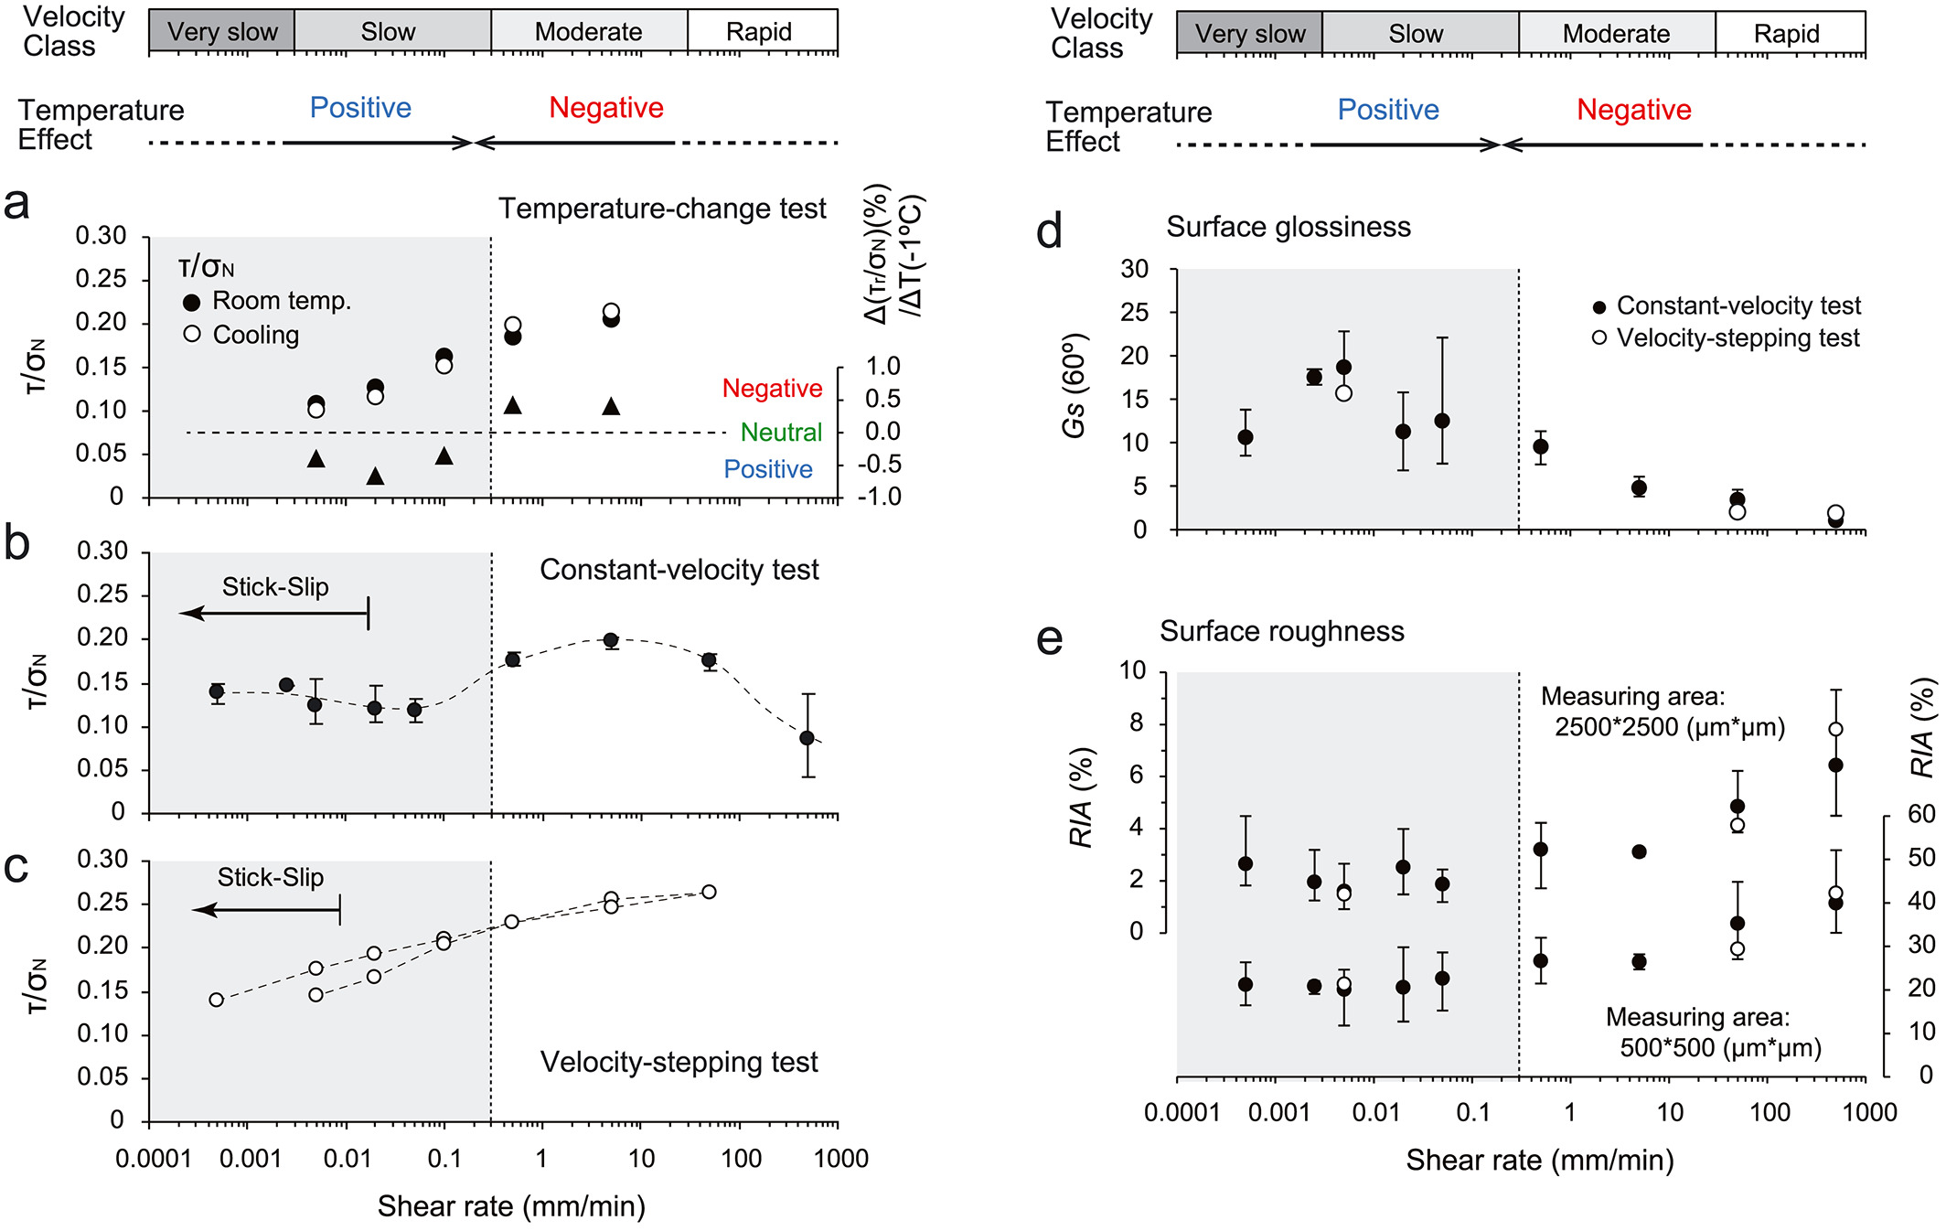
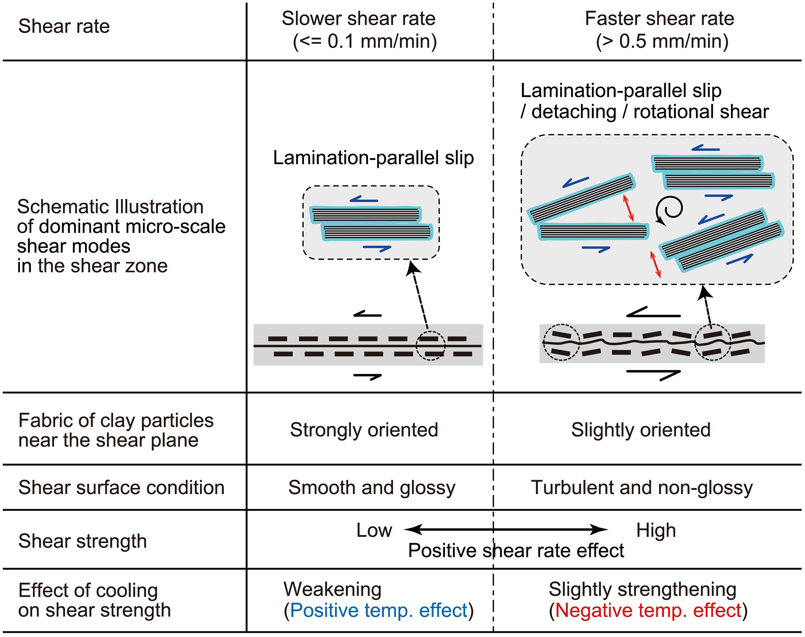
A possible mechanism of temperature-residual strength dependence
35
...and of shear rate-residual strength dependence as well
Effect of temperature on the residual shear strength of clay soils, Shibasaki et al. (2017)

Slide 36
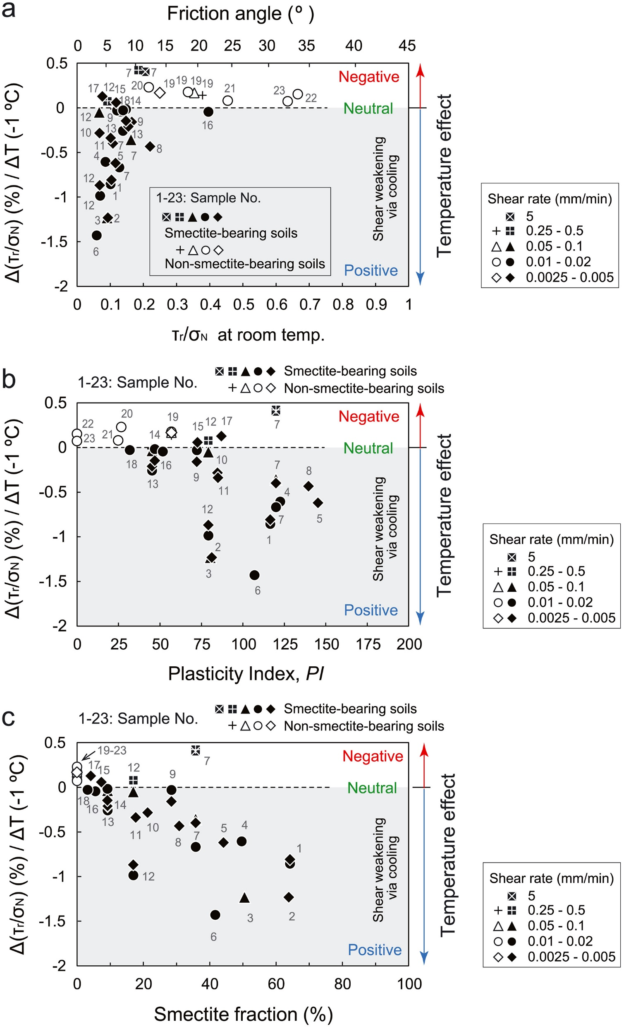
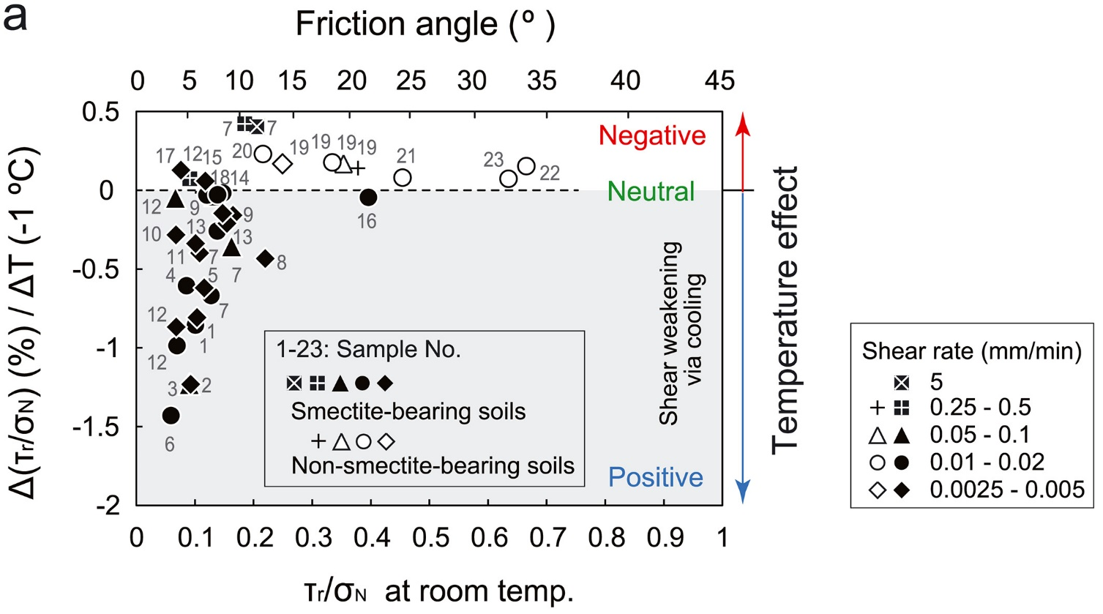

A possible mechanism of temperature-residual strength dependence
36
Effect of temperature on the residual shear strength
of clay soils, Shibasaki et al. (2017)

Slide 37
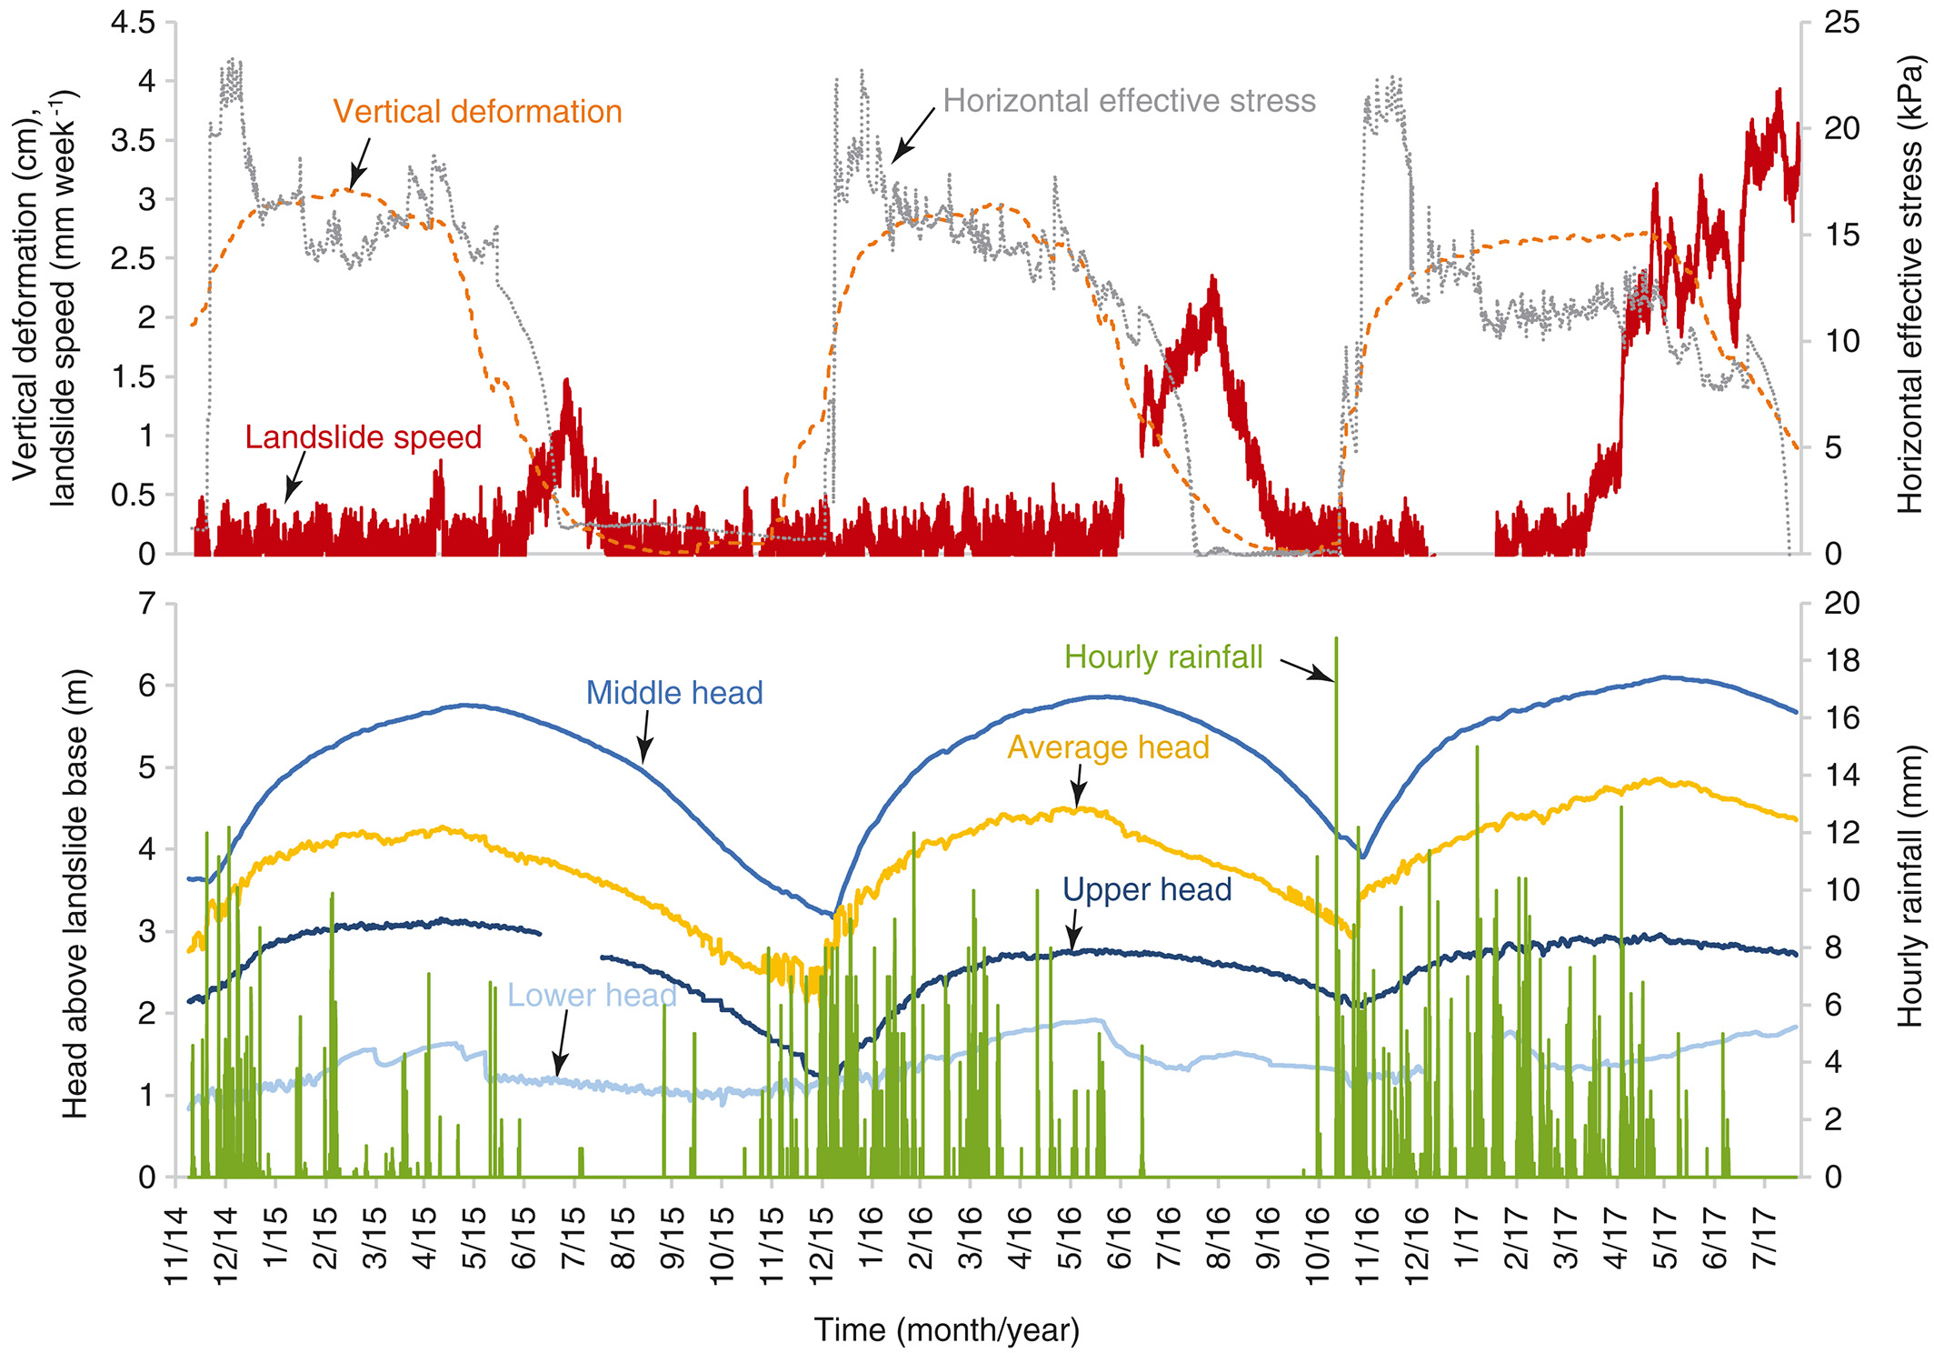
More: swelling and swelling pressures can control landslides
37
In this case study, the authors observe that only by accounting for the pressure exerted by the landslide body on the lateral boundary they can correctly reproduce the landslide activity in response to changes in pore water pressures.
This pressure is generated through a swelling / swelling pressure mechanism.
Although the authors do not discuss the effect of temperature in this case (and probably it is negligible here), it is known that swelling behaviour & swelling pressure generation (actually, the entire hydro-mechanical response of an active clay) are strongly influenced by temperature.
A landslide in clay soil controlled by lateral soil swelling / swelling pressure, Schulz et al. (2018)

Slide 38
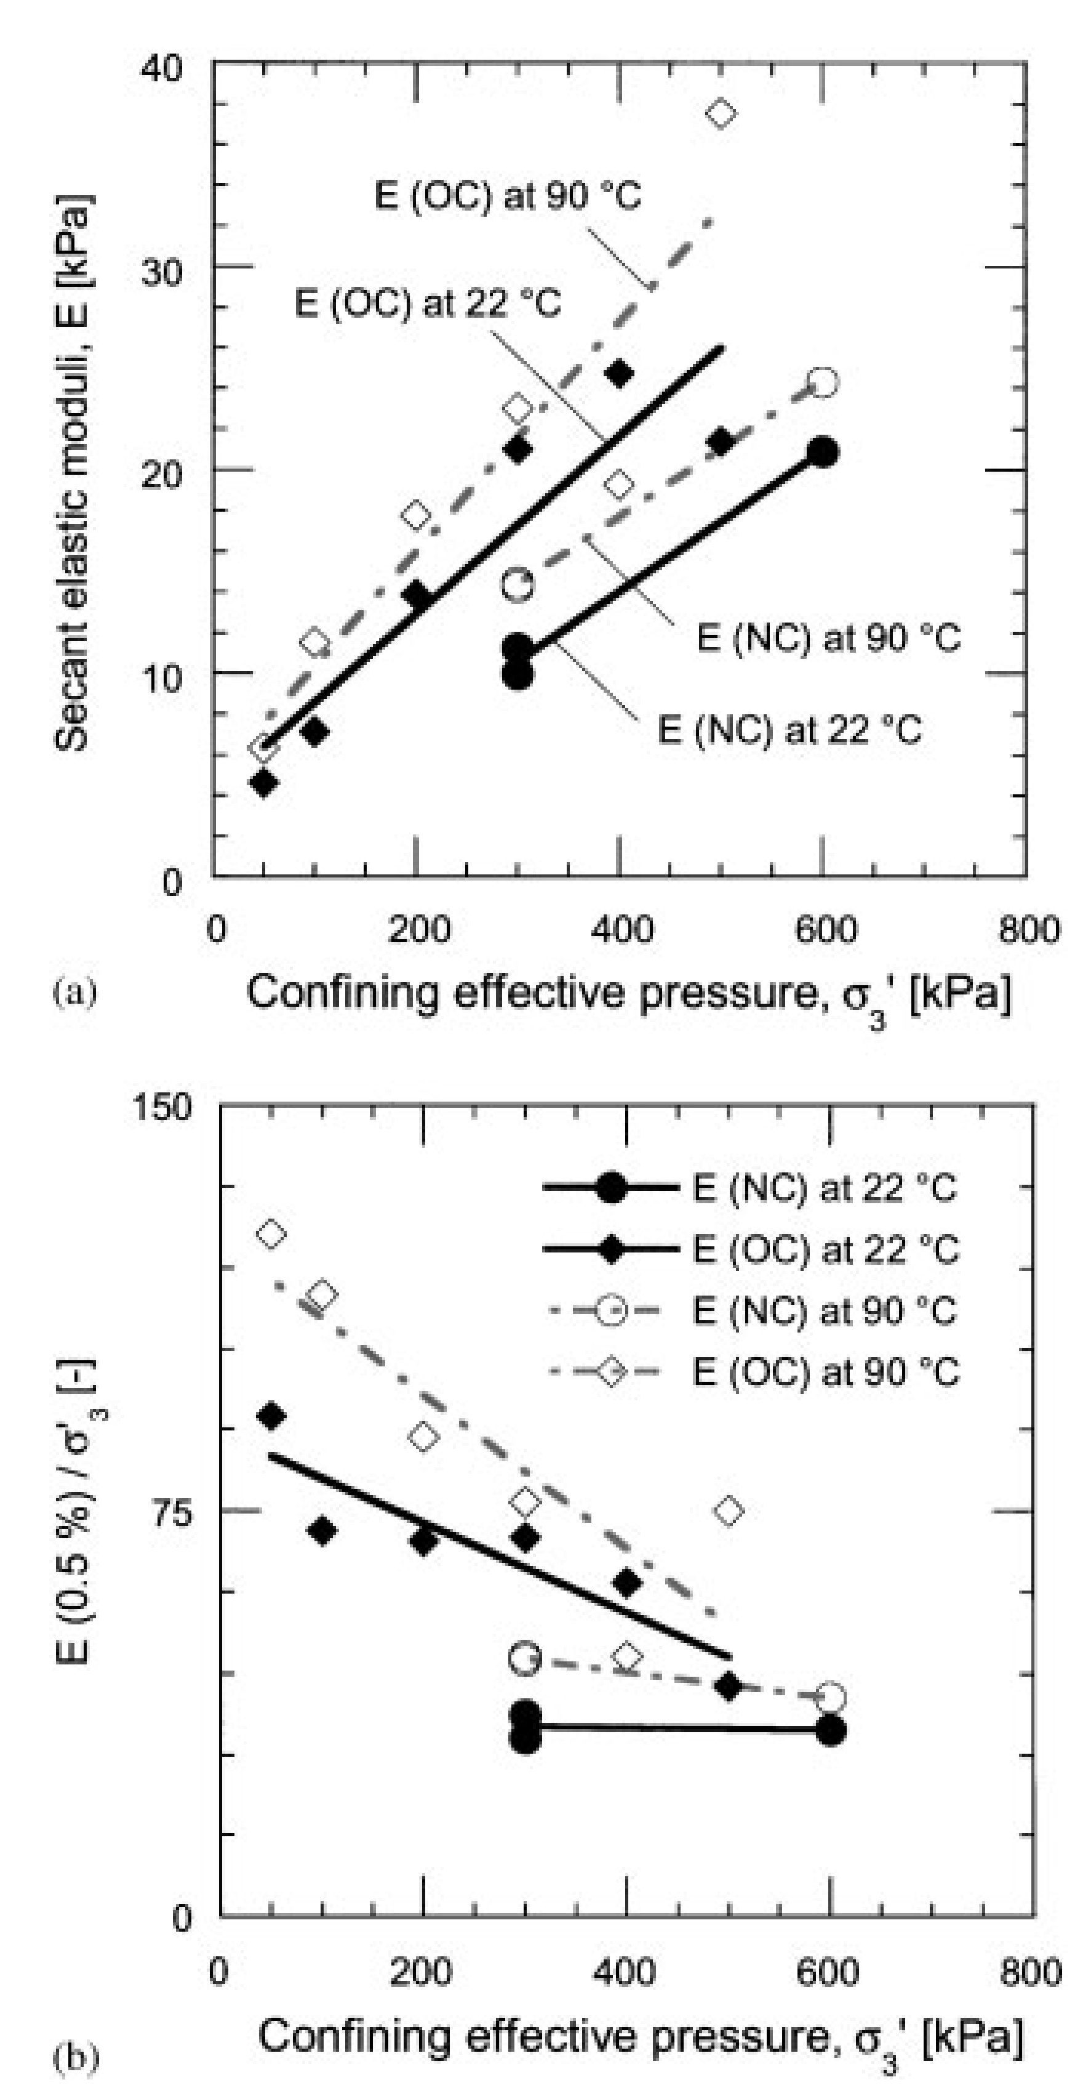
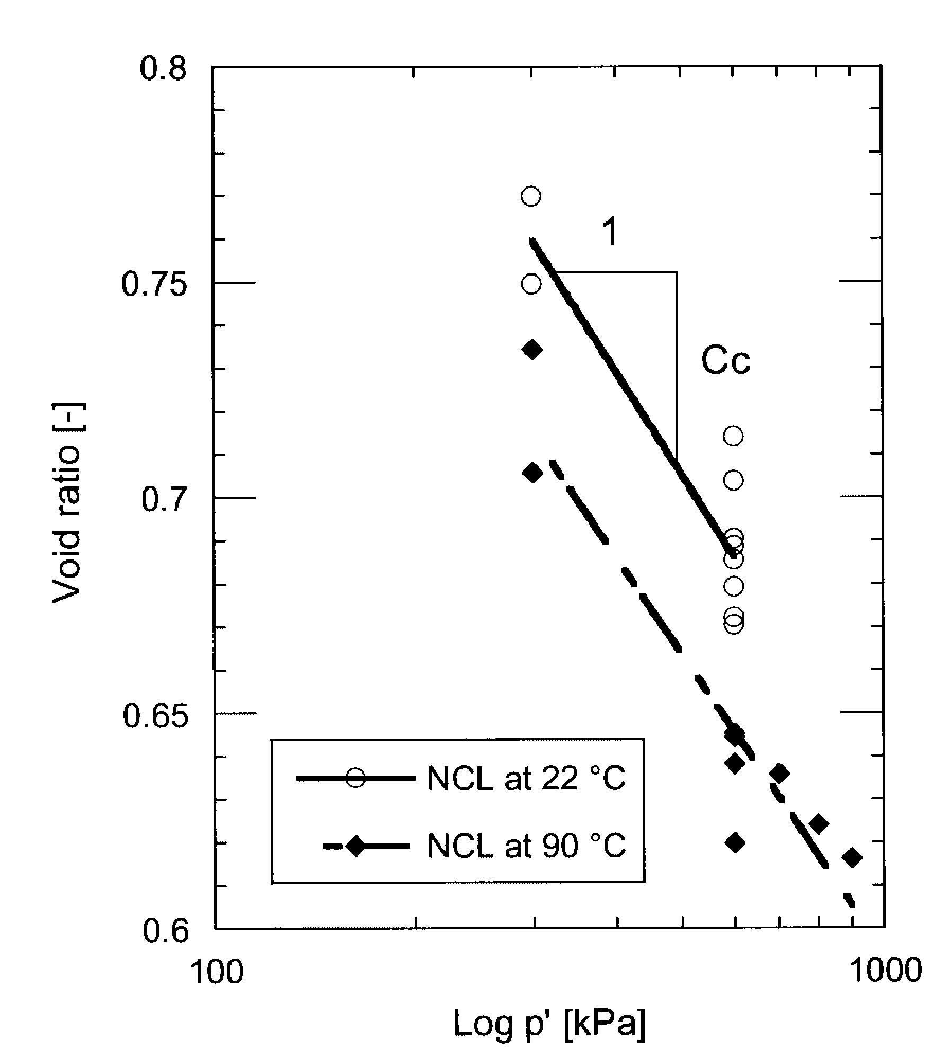
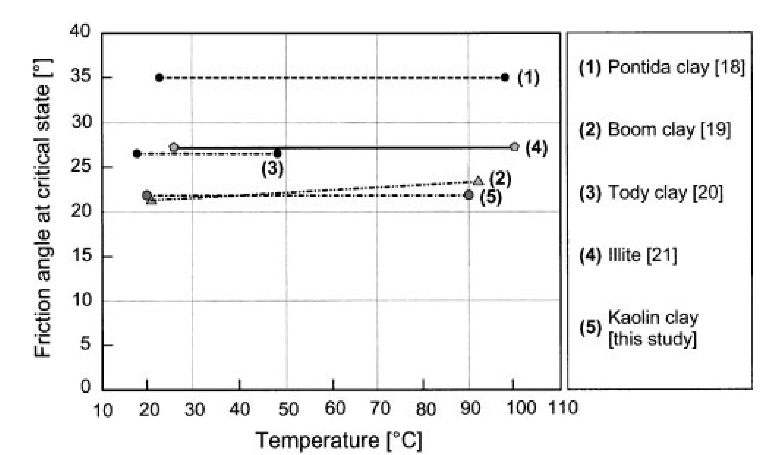
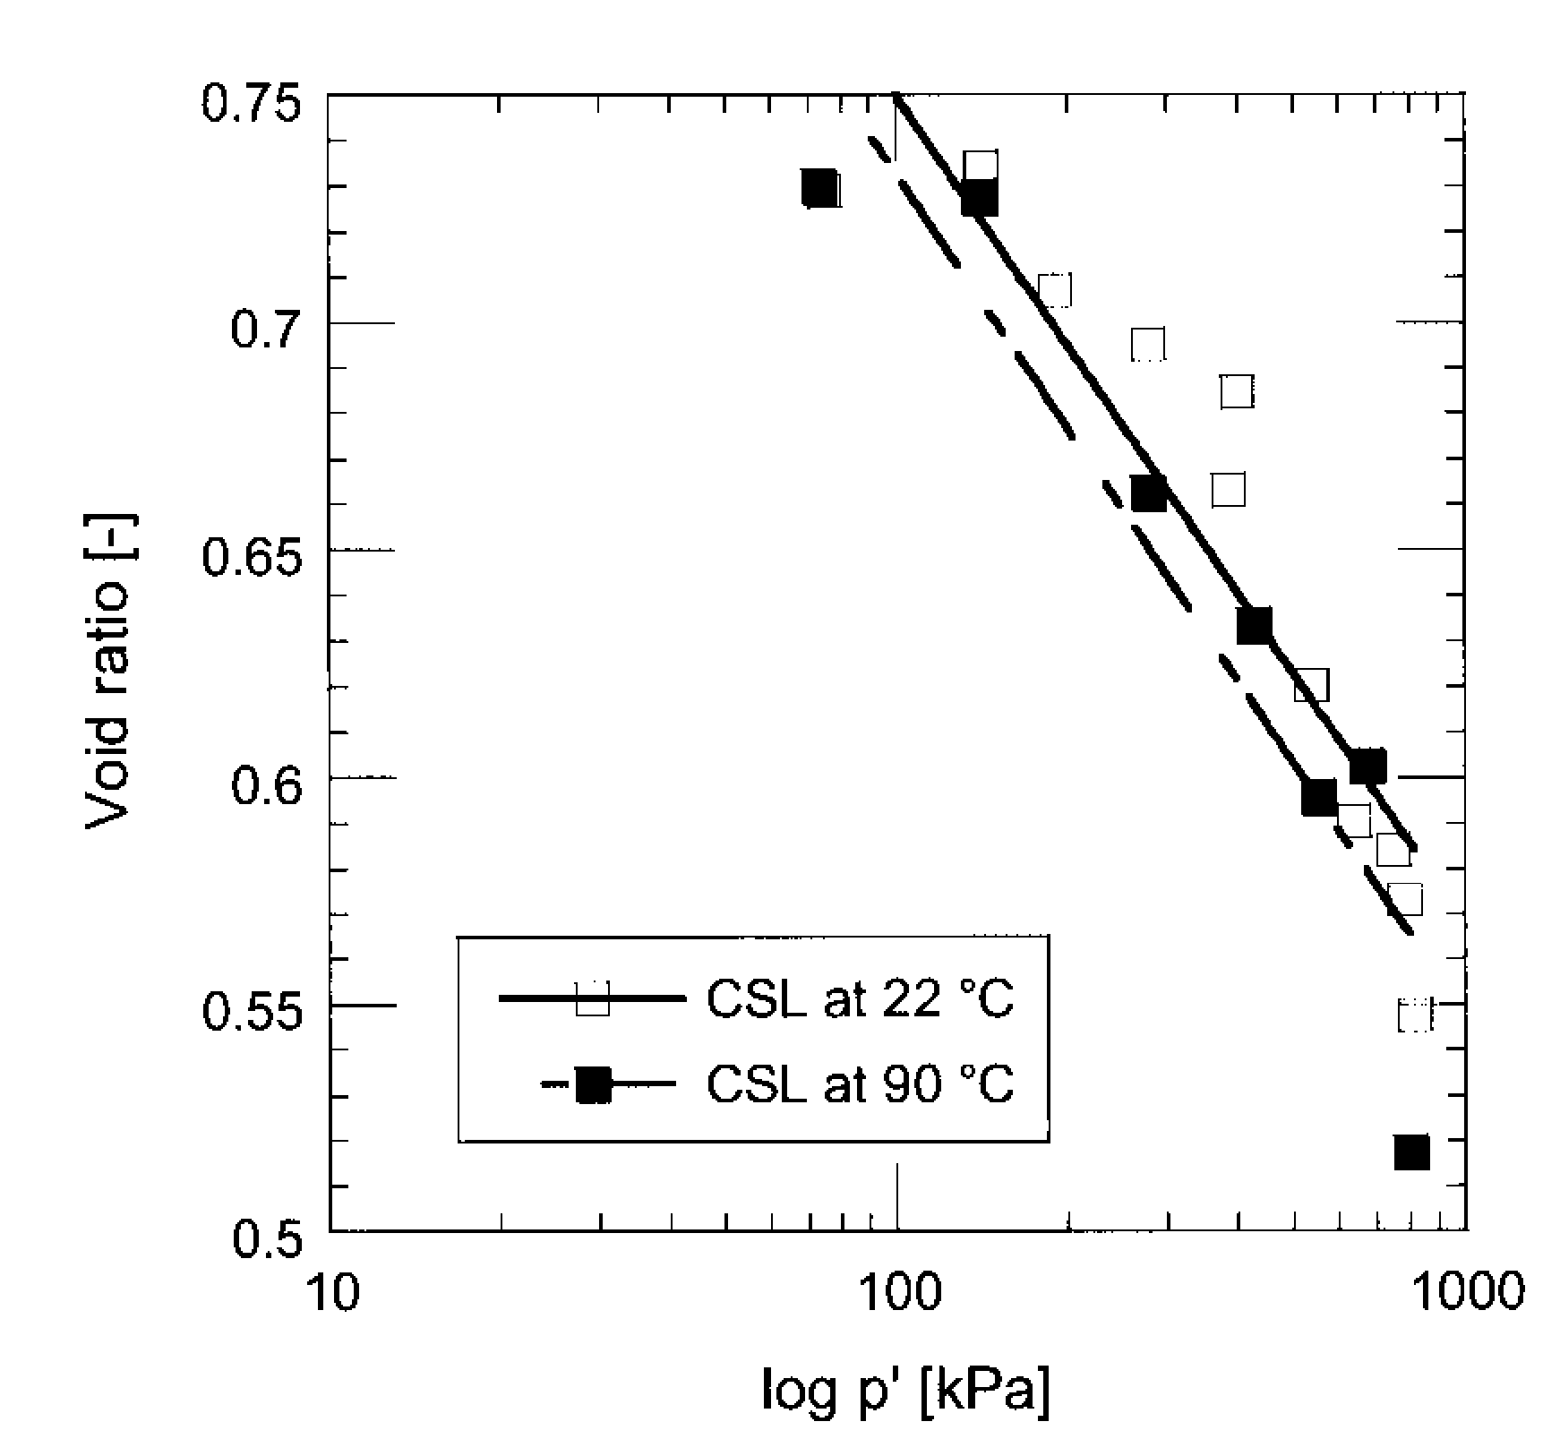
A lot of literature on temperature effects in clay soils
38
In these tests on kaolin clay, a large increase of temperature does not affect the critical state friction angle, but decrease the void ratio and increase the soil stiffness
Triaxial tests on saturated kaolin, Cekerevac & Laloui (2003)

Slide 39
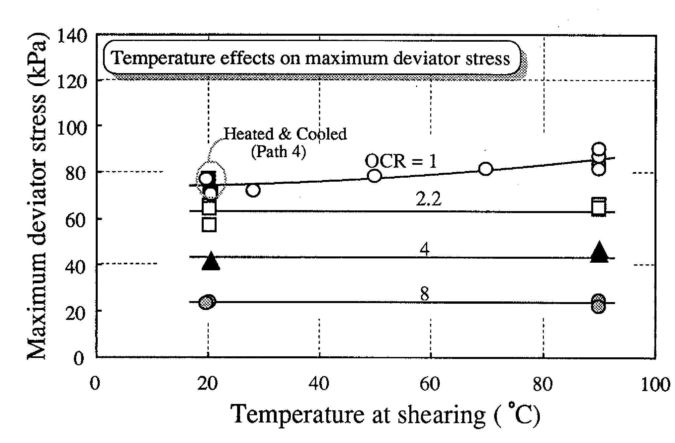
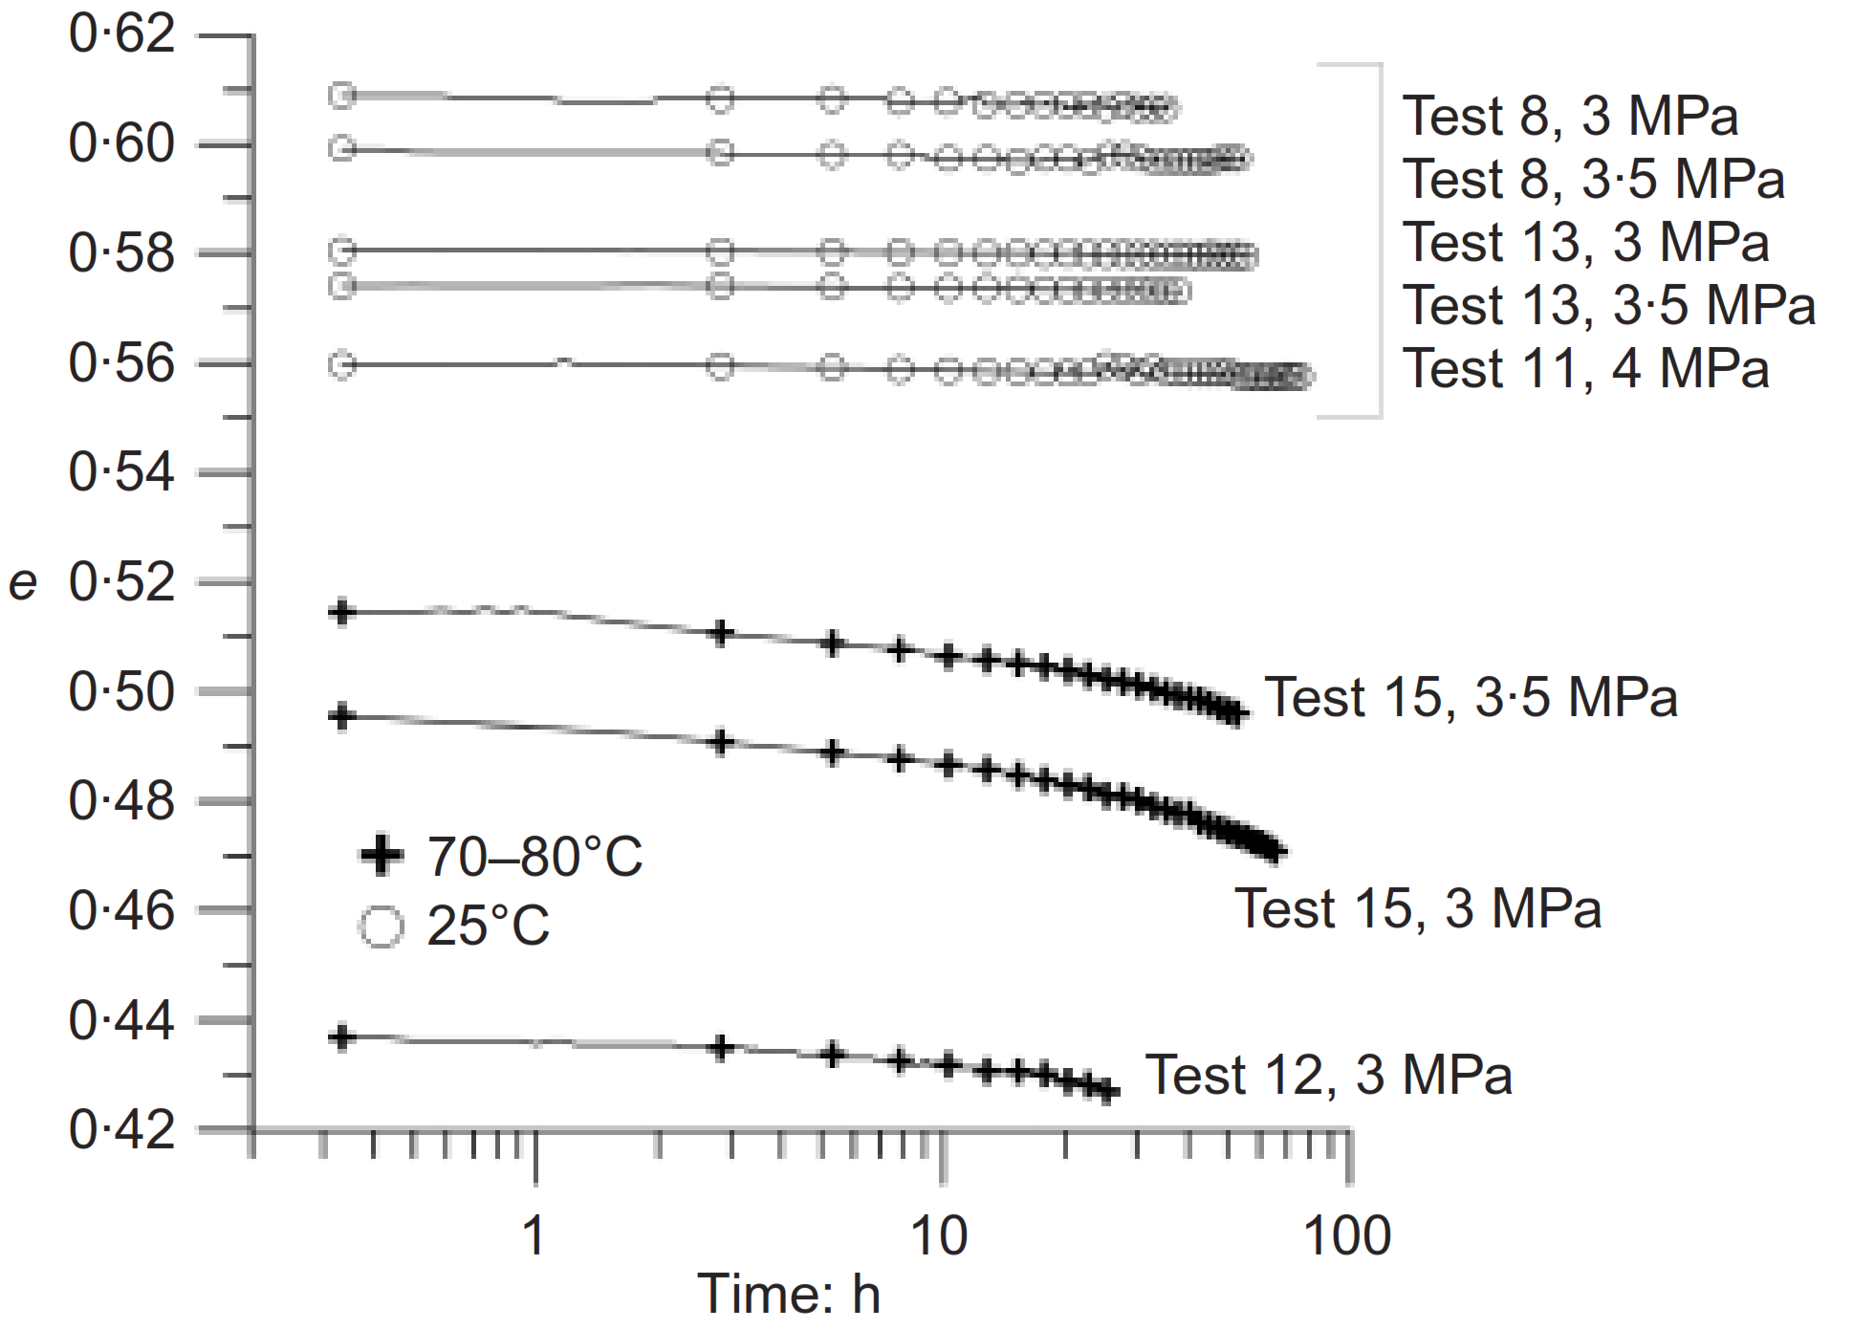
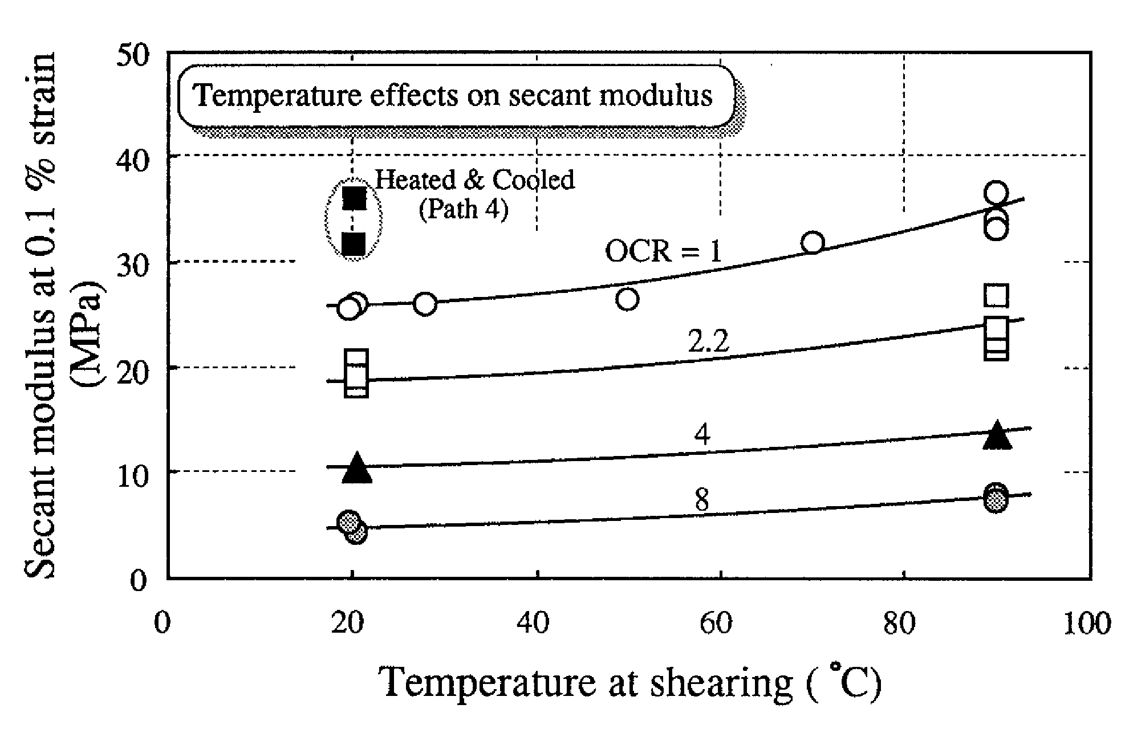
A lot of literature on temperature effects in clay soils
39
Again we see an increase of stiffness in kaolin clay, and a decrease in void ratio in Boom clay. We also see an increase in secondary compression (volumetric creep) with temperature
Triaxial tests on kaolin clay, Kuntiwattanakul et al. (1995)
Compression tests on Boom clay, Cui et al. (2009)

Slide 40
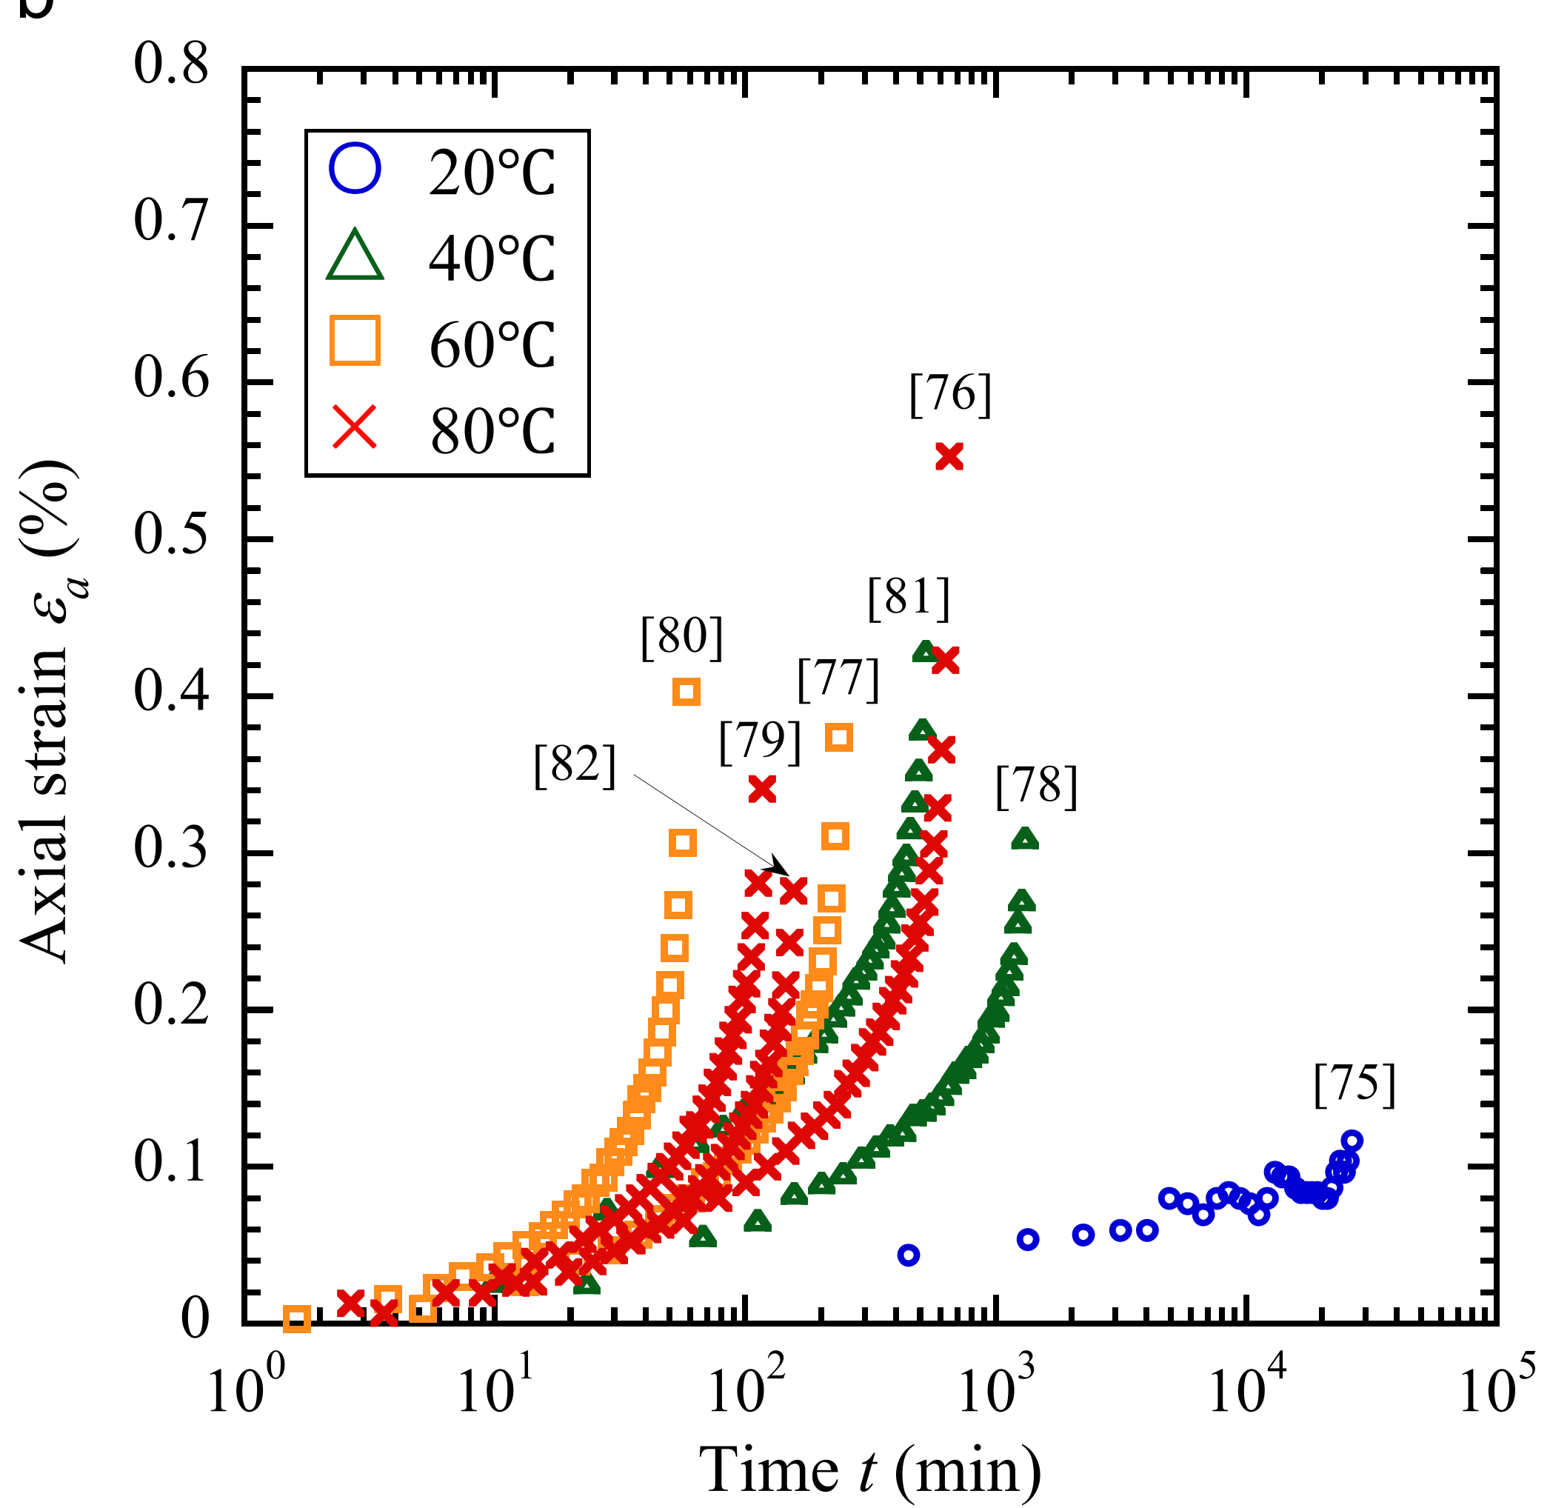
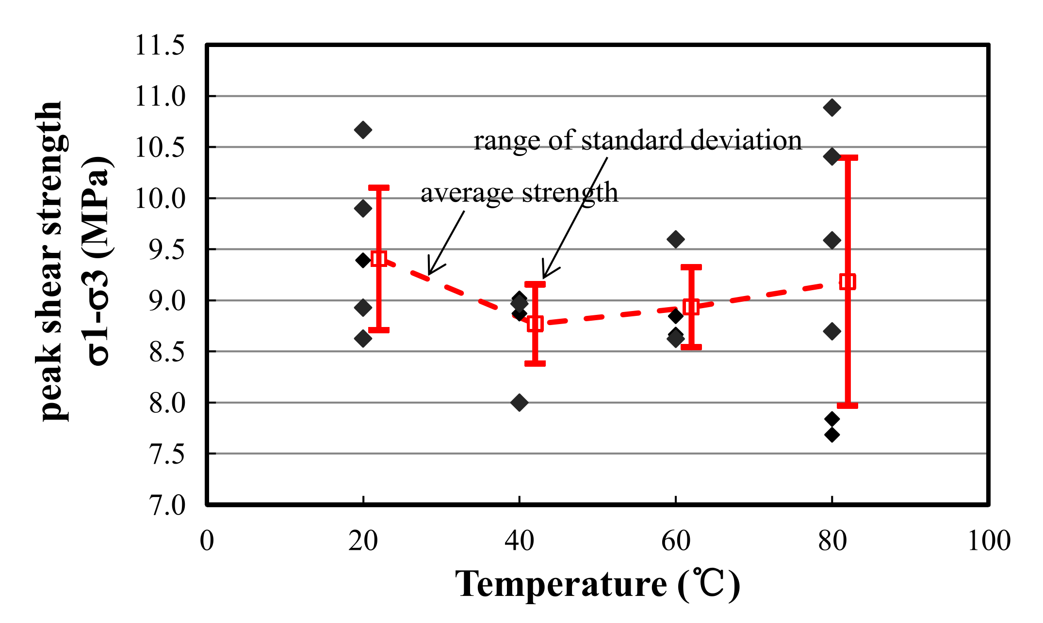
Soft rocks behave like soils
40
Higher temperature was not related to changes in peak shear strength in this case study. However, higher deviatoric creep rates were observed, with tertiary creep and faster failure at elevated temperature
Experiments on a soft rock, Ye et al. (2015)

Slide 41
Results are sometimes inconsistent: more research needed!
41
Here, higher temperature
means lower shearing resistance
Again, higher deviatoric creep rates
Mitchell (1993), Kuhn and Mitchell (1993)

Slide 42
Statistical mechanics may help
42
Rewritten Coulomb strength
Mitchell (1993)
Kuhn and Mitchell (1993)
Steady-state creep
Concept of T-dependent activation energy and bond number (Andersland & Douglas, 1970)
Even though it was developed for granular materials, the rate process theory can explain some temperature-dependent behaviours.
However, the complexity of clay soils calls for deeper investigation into the effects of temperature at the micro-scale (through physico-chemical processes of particle interaction)

Slide 43
Back to conceptualisation: a multiscale approach
43
Climate change, thermo-hydro-mechanical behaviour of soils,
and landsides: a conceptual sketch of interaction at local scale.

Slide 44
The roadmap for the next 3-5 years
44
Main goal
Demonstrate the applicability of an advanced model to slope stability analyses under non-isothermal conditions
Objective 2
Objective 3
Investigate a real case study with complex boundary conditions to demonstrate practical applicability
Objective 4
Propose an upscaling to improve regional landslide risk assessments, and submit it for funding
Objective 1
Evaluate the direct effect of thermal forcing on slope stability under climate change scenarios
Develop and run a virtual experiment to quantify the effect of various climate patterns on slope stability
We are here
we have a good thermo-hydro mechanical model which we already apply to a variety of problems
we will perform experiments to improve the thermal coupling description (esp. of residual strength)
we will construct a slope stability model to demonstrate the applicability of the framework

Slide 45




More about the model
45
It is being developed under two EURATOM projects in which we want to understand the behaviour of bentonite clay under elevated temperature, in conditions that may occur in bentonite buffers surrounding nuclear waste in deep geological repositories.
We are talking about the temperature range 10 – 90 °C with possible extension up to 150 °C. However, only thin layers of bentonite in contact with the waste canister reach the top of the range: the temperature gradient is normally strong, and most of the bentonite remains at < 50 °C during the operational life of the facility.
The range 10 – 50 °C is very commonly experienced by natural soils, especially in shallow soil covers.
The model development is carried out in cooperation with the Czech Technical University and the National Agency for Nuclear Waste Disposal of the Czech Republic.

Slide 46
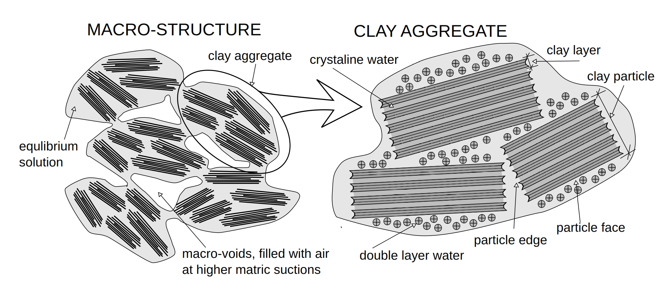
More about the model
46
Our research in Prague focuses on developing constitutive models for geomaterials
and the related numerical implementations
In particular, we model bentonite buffers for nuclear waste repositories using the
theory of hypoplasticity and a double-structure approach.
Mašín (2017)

Slide 47
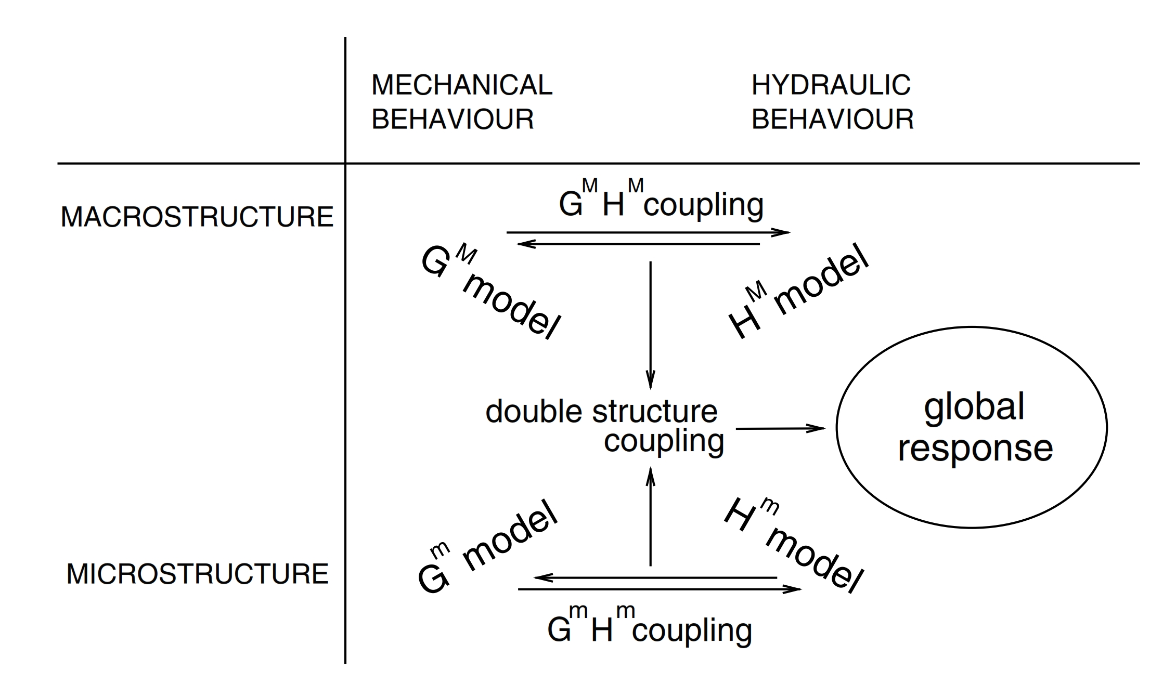
More about the model
47
In our approach we have:
two mechanical models for macro-structure and micro-structure defined in terms of effective stresses
two water retention models defined in terms of degrees of saturation
hydro-mechanical coupling at both structural levels
thermo-hydro and thermo-mechanical couplings (featuring, e.g., temperature-dependent NCL and WRC).
T
T
T
T
Mašín (2017)

Slide 48
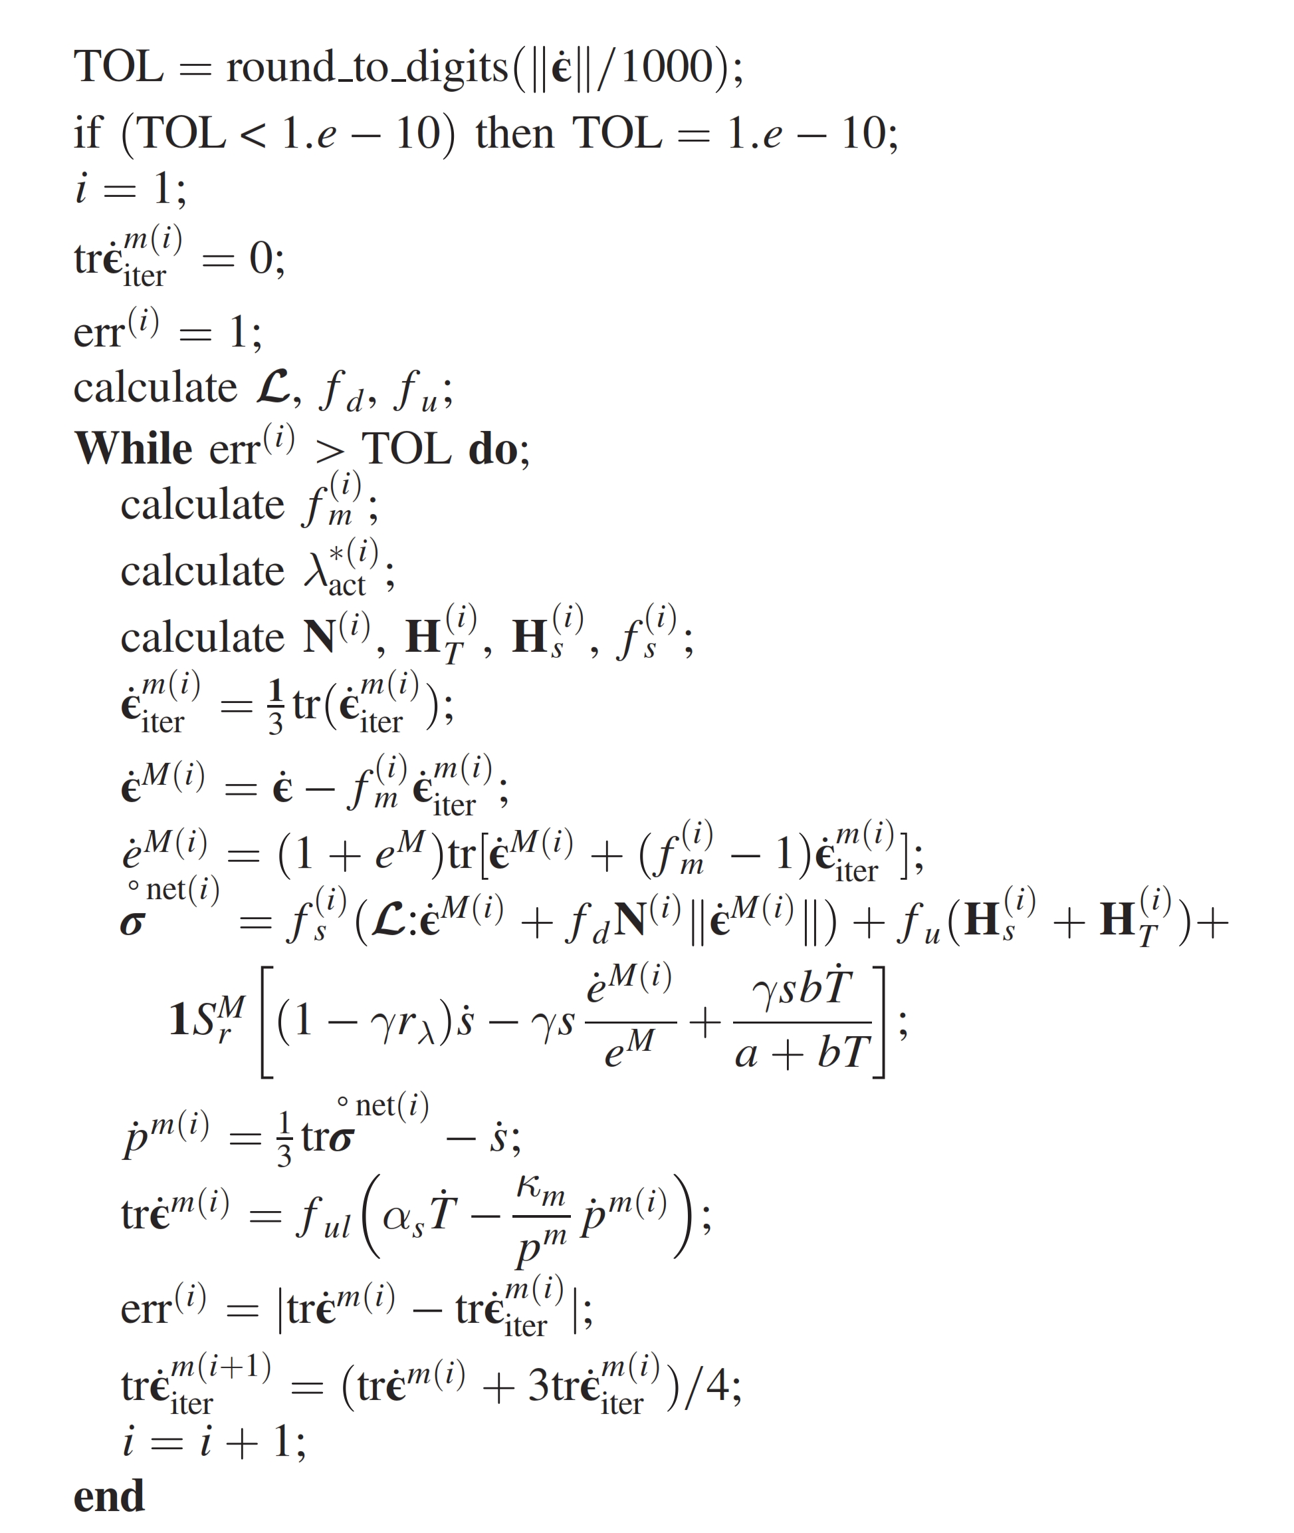
More about the model
48
The model formulation is implemented in an
in-house general-purpose THM single-element code
The implementation works as a standalone application (TRIAX)
It is used for calibration of parameters
and element-test simulations.
Mašín (2017)

Slide 49
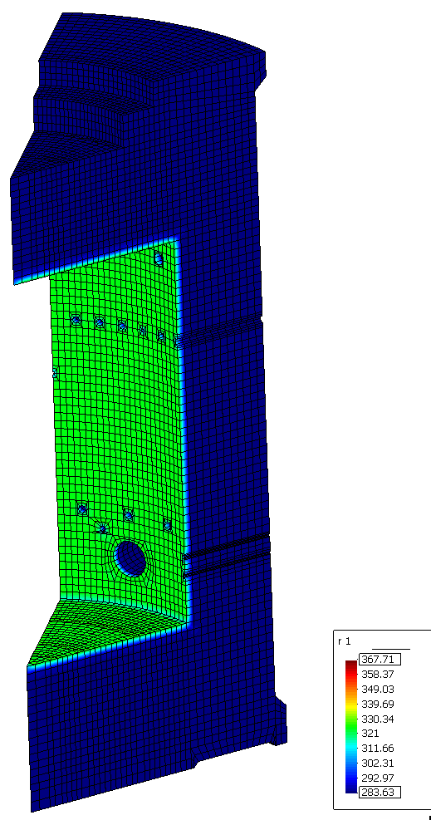
More about the model
49
The single-element implementation is plugged into a finite-element (FEM) package
We work with SIFEL, an in-house
multi-purpose tool developed by CTU
The code is used for simulations of tests with
complex geometry, stress-history, etc.
(including lab-scale as well as field-scale experiments).
Kruis et al. (2012)

Slide 50
More about the model
50
Current tasks within ongoing projects
Improving the implementation of the hypoplastic model in the FEM package SIFEL focusing on numerical techniques to solve coupled THM processes, either by a fully coupled or a staggered approach
Simulating small-scale experiments (e.g., constant volume permeability tests), as well as mid-scale experiments (e.g., idealised bentonite barrier sections) in round robins and blind benchmarks.
Current challenges
Some issues with numerical stability or slow convergence in near-saturation or large deformations
Some underestimation of volumetric response in non-isotropic conditions (because of a simplified model for the microstructure which needs improvement)
Prediction of the water retention behaviour: good accuracy, but not great (need to improve the shape of the hysteretic water retention loop)
Limitations in predicting triple-structure materials (e.g., pellet aggregates, in principle also scaly clays)

Slide 51
Climate change and landslides: introducing a thermo-hydro-mechanical approach
GIANVITO SCARINGI
gianvito.scaringi@natur.cuni.cz
sadly not in Vienna, 4-8 May 2020
© Author. All rights reserved
The Faculty of Science, Albertov Campus, Prague, Czech Republic

