Slide 1
Magnetic Gradient May Play As a Driver of Solar Eruptions
Baolin Tan^{(1,2)}
Key Laboratory of Solar Activity, National Astronomical Observatories of Chinese Academy of Sciences, Beijing 100101, China. bltan@nao.cas.cn
School of Astronomy and Space Science, University of Chinese Academy of Sciences

Slide 2
1. When does the magnetic reconnection begin during the flare process?
Supposing that a solar flare started from magnetic reconnection, then we meet the questions:
When does the reconnection start?
Does it start in phase A or phase B?
If it occurred in phase A, why the temperature just increase slowly?
If it occurred in phase B, then why the temperature increases before reconection?
What heat the source region during phase A?
What is the physical connection between the heating process and magnetic reconnection?
phase B
start
phase A
The evolutionary profile of a typical solar flare

Slide 3
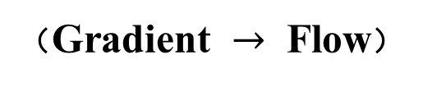
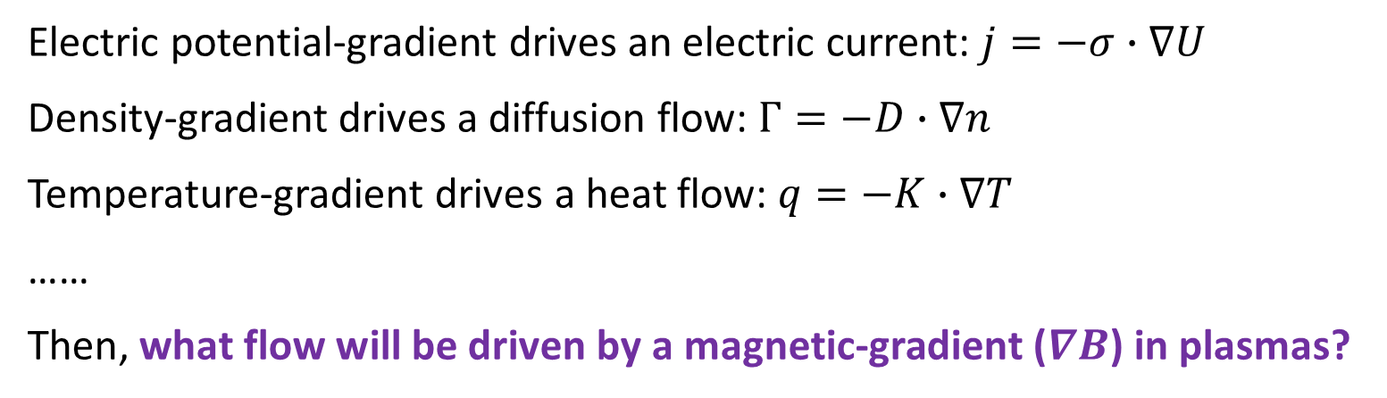
As we know, if there is a gradient, it must drive a flow inevitably
（Gradient $→$ Flow）
Electric potential-gradient drives an electric current: $j=−σ∙∇U$
Density-gradient drives a diffusion flow: $Γ=−D∙∇n$
Temperature-gradient drives a heat flow: $q=−K∙∇T$
……
Then, what flow will be driven by a magnetic-gradient ($∇B$) in plasmas?

Slide 4
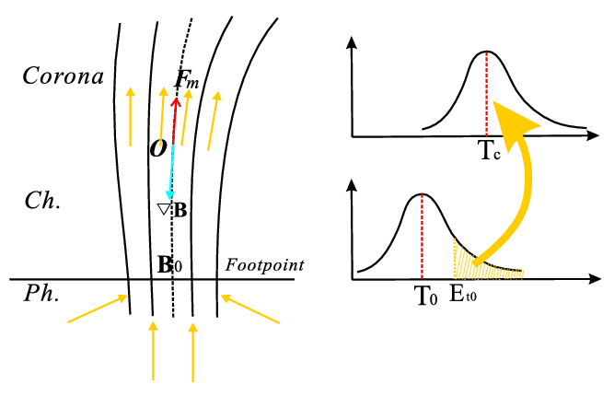
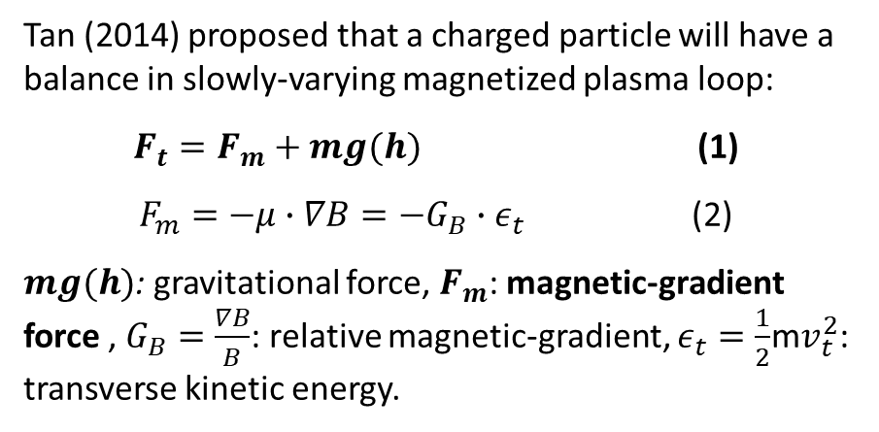

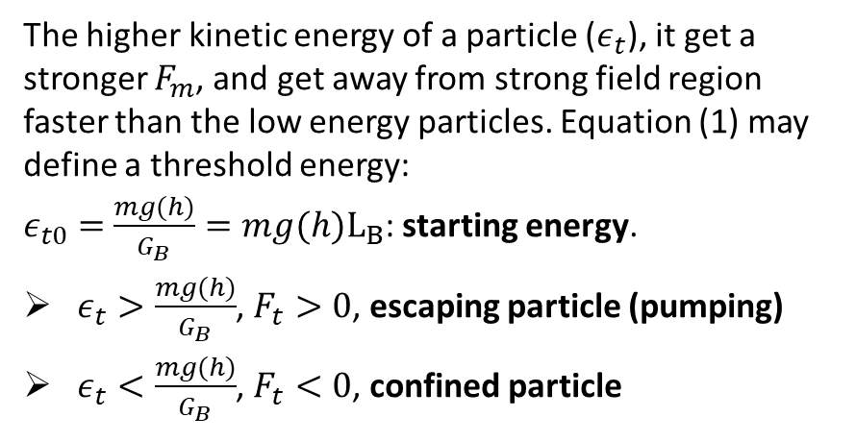
2. Magnetic-gradient pumping (MGP) mechanism
Tan (2014) proposed that a charged particle will have a balance in slowly-varying magnetized plasma loop:
$F_{t}=F_{m}+mg(h)$ (1)
$F_{m}=−μ∙∇B=−G_{B}∙ε_{t}$ (2)
$mg(h)$: gravitational force, $F_{m}$: magnetic-gradient force , $G_{B}=\frac{∇B}{B}$: relative magnetic-gradient, $ε_{t}=\frac{1}{2}$m$v_{t}^{2}$: transverse kinetic energy.
The higher kinetic energy of a particle ($ε_{t}$), it get a stronger $F_{m}$, and get away from strong field region faster than the low energy particles. Equation (1) may define a threshold energy:
$ε_{t0}=$ $\frac{mg(h)}{G_{B}}=mg(h)L_{B}$: starting energy.
$ε_{t}>\frac{mg(h)}{G_{B}}$, $F_{t}>0$, escaping particle (pumping)
$ε_{t}<\frac{mg(h)}{G_{B}}$, $F_{t}<0$, confined particle
(Tan, ApJ, 2014)
$∇B$ → energetic charged particle flow
Remind: The gravitational force is a key factor for MGP mechanism, which is ignored by Shibasakis (2001), Hollweg (2006), etc., therefore they had not come to a conclusion of corona heating.

Slide 5
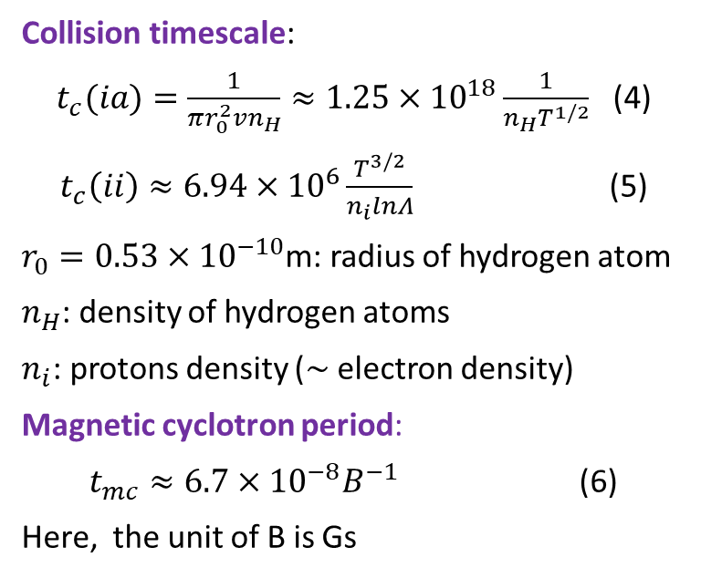
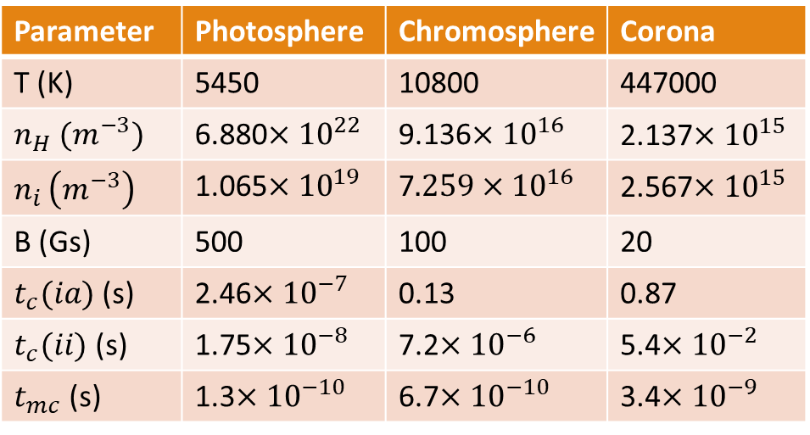
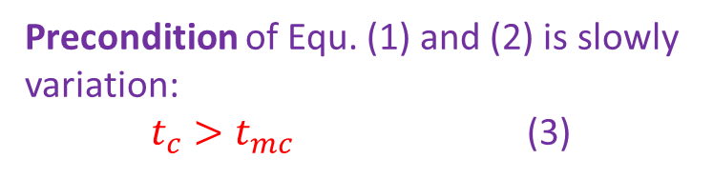
Is MGP valid especially in the partial ionized photospheric and chromospheric plasmas?
Precondition of Equ. (1) and (2) is slowly variation:
$t_{c}>t_{mc}$ (3)
Parameter | Photosphere | Chromosphere | Corona
T (K) | 5450 | 10800 | 447000
$n_{H} (m^{−3})$ | 6.880$×{10}^{22}$ | 9.136$×{10}^{16}$ | 2.137$×{10}^{15}$
$n_{i }\left(m^{−3}\right)$ | 1.065$×{10}^{19}$ | 7$.259×{10}^{16}$ | 2.567$×{10}^{15}$
B (Gs) | 500 | 100 | 20
$t_{c}(ia)$ (s) | 2.46$×{10}^{−7}$ | 0.13 | 0.87
$t_{c}(ii)$ (s) | 1.75$×{10}^{−8}$ | 7.2$×{10}^{−6}$ | 5.4$×{10}^{−2}$
$t_{mc}$ (s) | 1.3$×{10}^{−10}$ | 6.7$×{10}^{−10}$ | 3.4$×{10}^{−9}$
Collision timescale:
$t_{c}(ia)=\frac{1}{πr_{0}^{2}vn_{H}}≈1.25×{10}^{18}\frac{1}{n_{H}T^{1/2}}$ (4)
$t_{c}\left(ii\right)≈6.94×{10}^{6}\frac{T^{3/2}}{n_{i}lnΛ}$ (5)
$r_{0}=0.53×{10}^{−10}$m: radius of hydrogen atom
$n_{H}$: density of hydrogen atoms
$n_{i}$: protons density ($\sim$ electron density)
Magnetic cyclotron period:
$t_{mc}≈6.7×{10}^{−8}B^{−1}$ (6)
Here, the unit of B is Gs
In photosphere, a proton can gyrate at least 100 times before it collides with other ions, and gyrate more than 1000 time before it collides with other atoms.
MGP mechanism is valid even in the photosphere, chromosphere as well as in the corona!

Slide 6
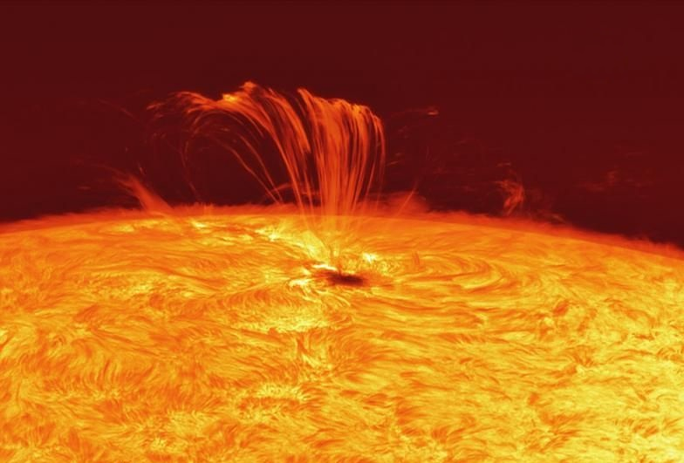
Energetic particles flow
The magnetic-gradient force can pump the energetic particles from the solar underlying atmosphere and transport them in the corona.
Magnetic-gradient pumping

Slide 7
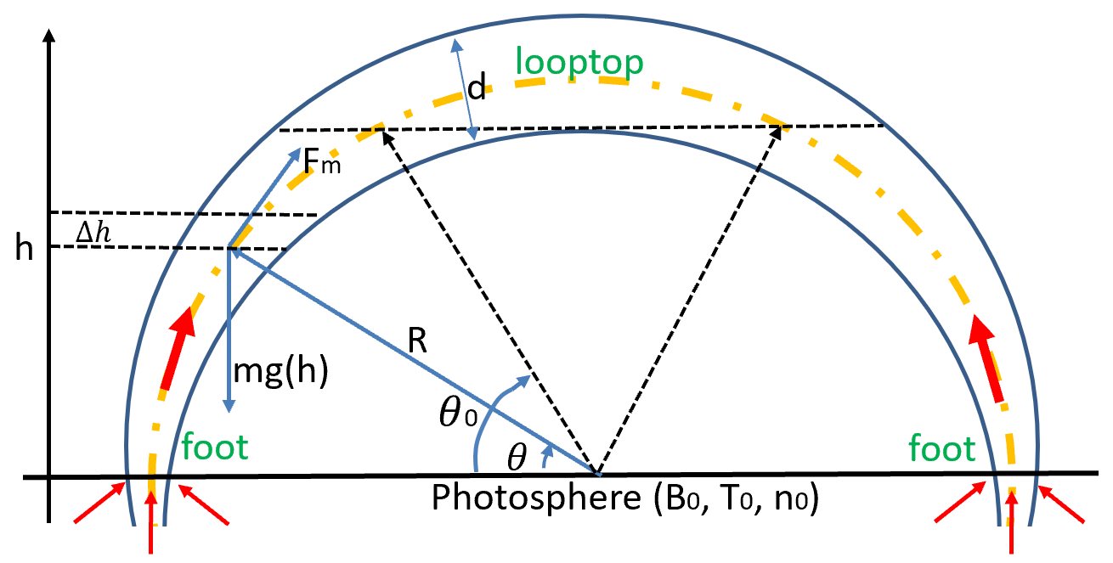
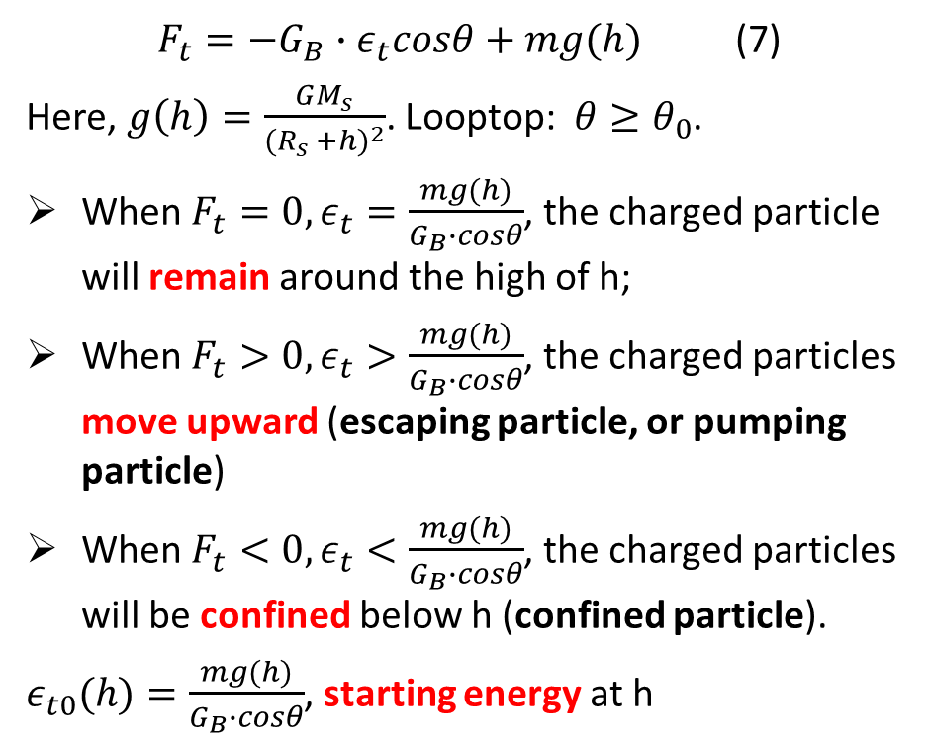

3. Magnetic-gradient drives the solar eruptions
In a closed solar plasma loop, Equation (1) will be in the following form
$F_{t}=−G_{B}∙ε_{t}cosθ+mg(h)$ (7)
Here, $g\left(h\right)=\frac{GM_{s}}{{(R_{s} +h)}^{2}}$. Looptop: $θ≥θ_{0}$.
When $F_{t}=0, ε_{t}=\frac{mg(h)}{G_{B}∙cosθ}$, the charged particle will remain around the high of h;
When $F_{t}>0, ε_{t}>\frac{mg(h)}{G_{B}∙cosθ}$, the charged particles move upward (escaping particle, or pumping particle)
When $F_{t}<0, ε_{t}<\frac{mg(h)}{G_{B}∙cosθ}$, the charged particles will be confined below h (confined particle).
$ε_{t0}(h)=\frac{mg(h)}{G_{B}∙cosθ}$, starting energy at h
$G_{B}$ is a key factor !

Slide 8
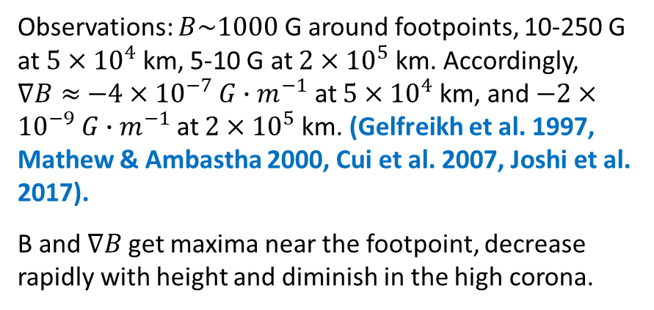
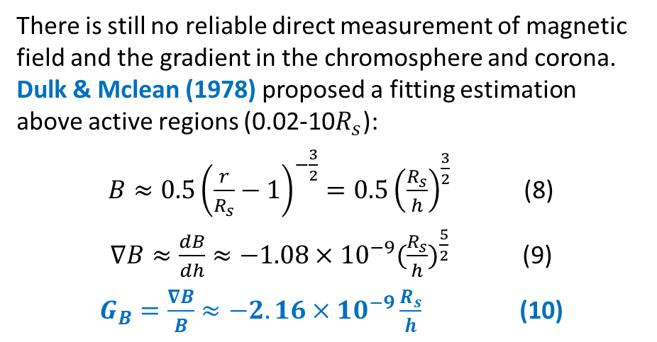
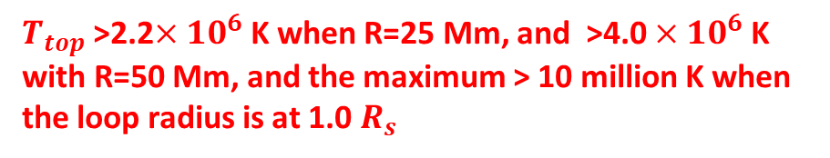
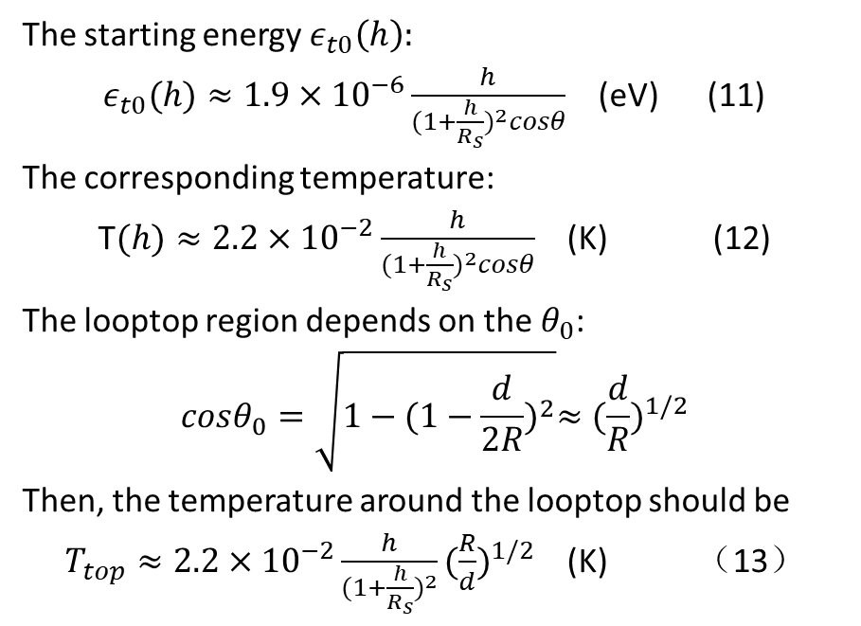
Magnetic-gradient in solar atmosphere
The starting energy $ε_{t0}\left(h\right):$
$ε_{t0}(h)≈1.9×{10}^{−6}\frac{h}{{(1+\frac{h}{R_{s}})}^{2}cosθ}$ (eV) (11)
The corresponding temperature:
T$(h)≈2.2×{10}^{−2}\frac{h}{{(1+\frac{h}{R_{s}})}^{2}cosθ}$ (K) (12)
The looptop region depends on the $θ_{0}$:
$$cosθ_{0}=\sqrt{1−{(1−\frac{d}{2R})}^{2}}≈{(\frac{d}{R})}^{1/2}$$
Then, the temperature around the looptop should be
$T_{top}≈2.2×{10}^{−2}\frac{h}{{(1+\frac{h}{R_{s}})}^{2}}{(\frac{R}{d})}^{1/2}$ (K) （13）
There is still no reliable direct measurement of magnetic field and the gradient in the chromosphere and corona. Dulk & Mclean (1978) proposed a fitting estimation above active regions (0.02-10$R_{s}$):
$B≈0.5{\left(\frac{r}{R_{s}}−1\right)}^{−\frac{3}{2}}=0.5{\left(\frac{R_{s}}{h}\right)}^{\frac{3}{2}}$ (8)
$∇B≈\frac{dB}{dh}≈−1.08×{10}^{−9}{(\frac{R_{s}}{h})}^{\frac{5}{2}}$ (9)
$G_{B}=\frac{∇B}{B}≈−2.16×{10}^{−9}\frac{R_{s}}{h}$ (10)
Observations: $B\sim 1000$ G around footpoints, 10-250 G at $5×{10}^{4}$ km, 5-10 G at $2×{10}^{5}$ km. Accordingly, $∇B≈$ $−4×{10}^{−7}$ ${G∙m}^{−1}$ at $5×{10}^{4}$km, and $−2×{10}^{−9}$ ${G∙m}^{−1}$at $2×{10}^{5}$ km. (Gelfreikh et al. 1997, Mathew & Ambastha 2000, Cui et al. 2007, Joshi et al. 2017).
B and $∇B$get maxima near the footpoint, decrease rapidly with height and diminish in the high corona.
Generally, R/d≈20 (Bray et al. 1991)
$T_{top}$ >2.2$×{10}^{6}$ K when R=25 Mm, and >4.0 $×{10}^{6}$K with R=50 Mm, and the maximum > 10 million K when the loop radius is at 1.0 $R_{s}$

Slide 9
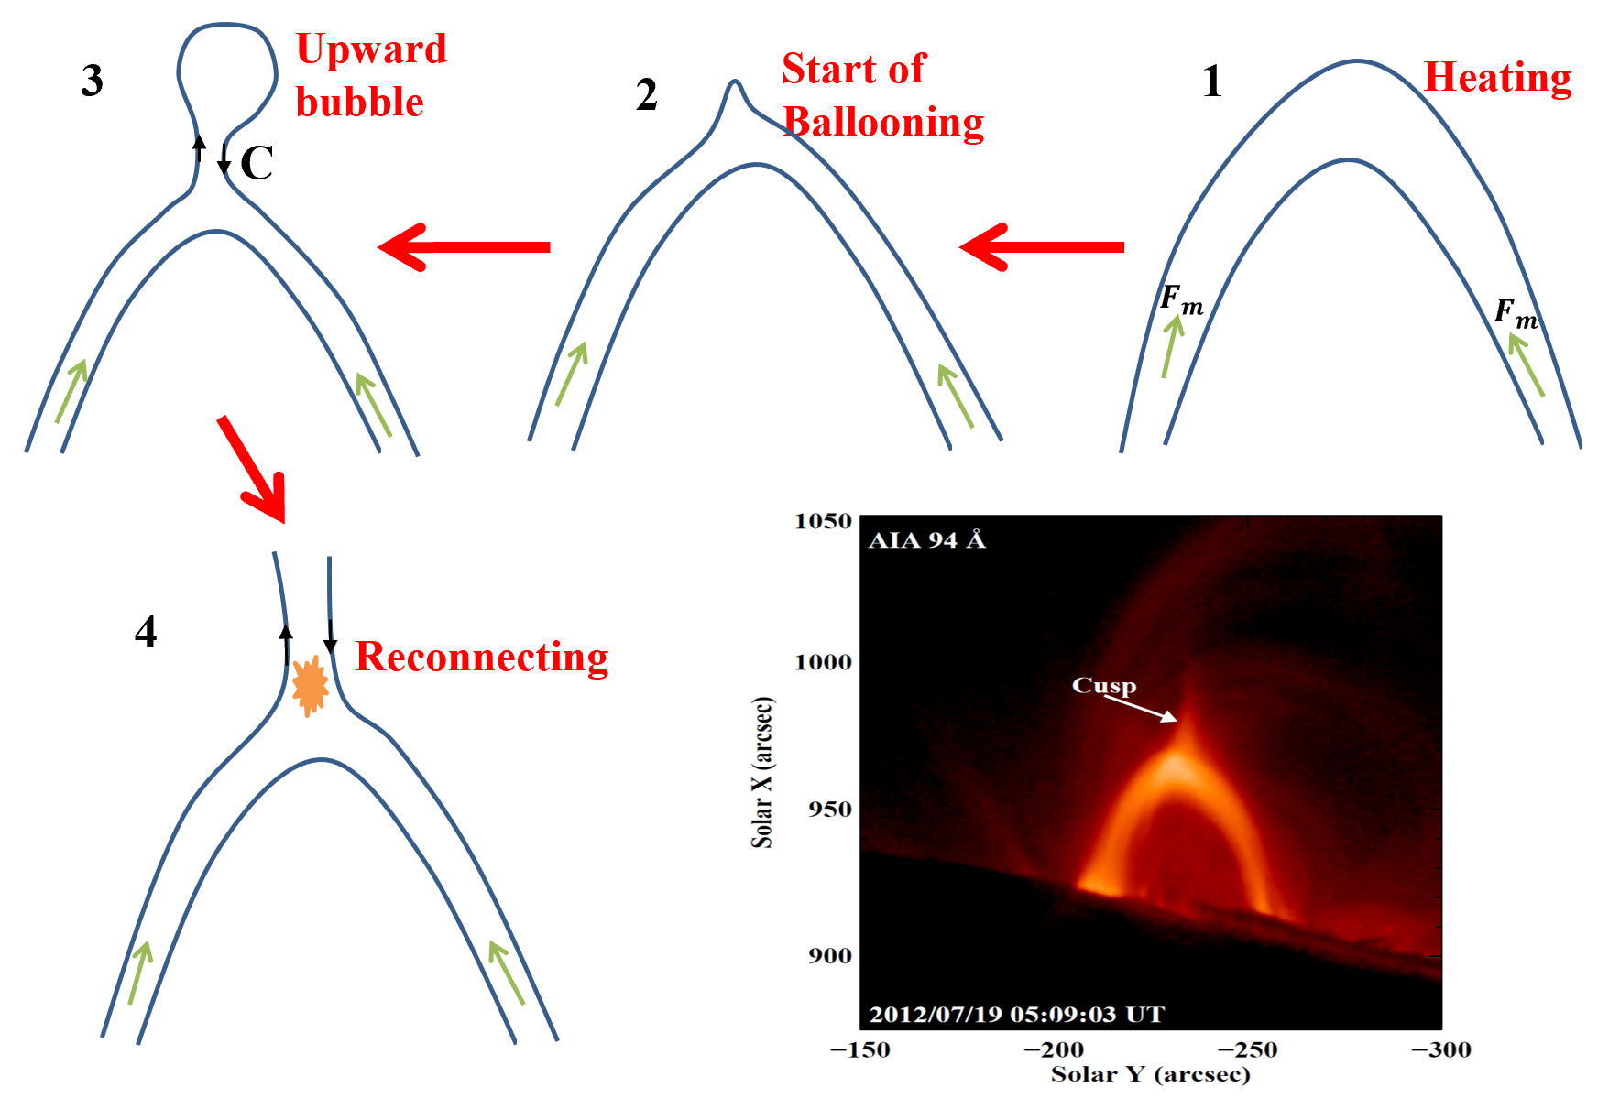
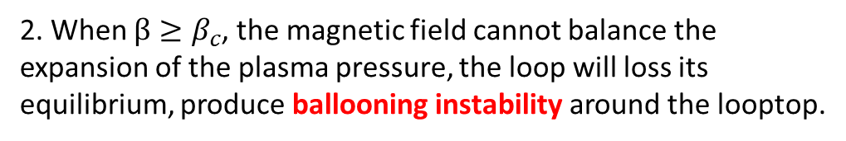
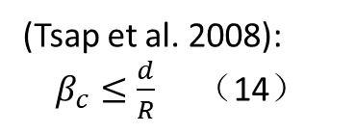
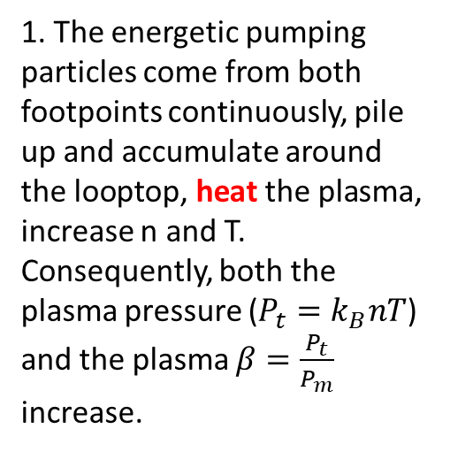
2. When $β≥β_{c}$, the magnetic field cannot balance the expansion of the plasma pressure, the loop will loss its equilibrium, produce ballooning instability around the looptop.
(Tsap et al. 2008):
$β_{c}≤\frac{d}{R}$ （14）
3. Produce upward bubble and anti-parallel magnetic field below it, generate electric current sheet.
1. The energetic pumping particles come from both footpoints continuously, pile up and accumulate around the looptop, heat the plasma, increase n and T. Consequently, both the plasma pressure ($P_{t}=k_{B}nT$) and the plasma $β=\frac{P_{t}}{P_{m}}$ increase.
4. Magnetic reconnection, and form cusp-configuration, and eruption.
A typical cusp-configuration in preflare phase
MGP is a continuous process, which may drive the onset of solar eruptions.

Slide 10
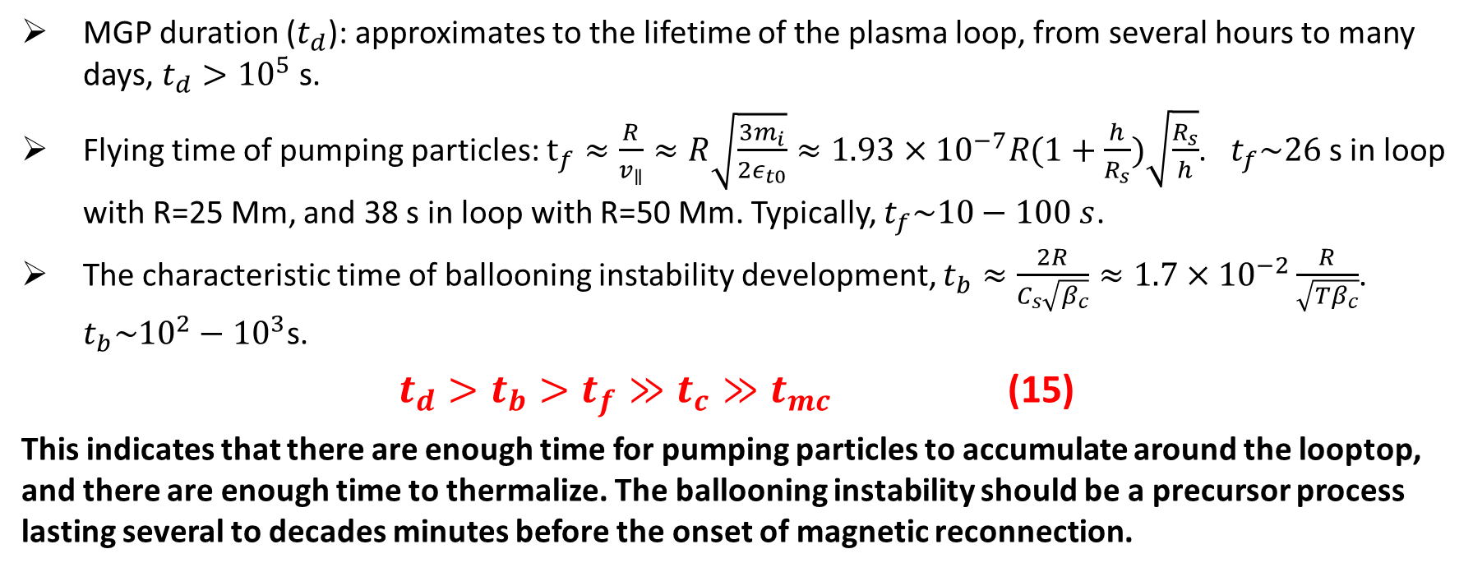
Comparisons of timescales
MGP duration ($t_{d}$): approximates to the lifetime of the plasma loop, from several hours to many days, $t_{d}>{10}^{5}$ s.
Flying time of pumping particles: $t_{f}≈\frac{R}{v_{∥}}≈R\sqrt{\frac{3m_{i}}{2ε_{t0}}}≈1.93×{10}^{−7}R(1+\frac{h}{R_{s}})\sqrt{\frac{R_{s}}{h}}$. $t_{f}\sim 26$ s in loop with R=25 Mm, and 38 s in loop with R=50 Mm. Typically, $t_{f}\sim 10−100 s$.
The characteristic time of ballooning instability development, $t_{b}≈\frac{2R}{C_{s}\sqrt{β_{c}}}≈1.7×{10}^{−2}\frac{R}{\sqrt{Tβ_{c}}}$. $t_{b}\sim {10}^{2}−{10}^{3}$s.
$t_{d}>t_{b}>t_{f}≫t_{c}≫t_{mc}$ (15)
This indicates that there are enough time for pumping particles to accumulate around the looptop, and there are enough time to thermalize. The ballooning instability should be a precursor process lasting several to decades minutes before the onset of magnetic reconnection.

Slide 11
The role of MGP in solar flares
Reconnection
Temperature (MK)
Ballooning instability
MGP Heating

Slide 12
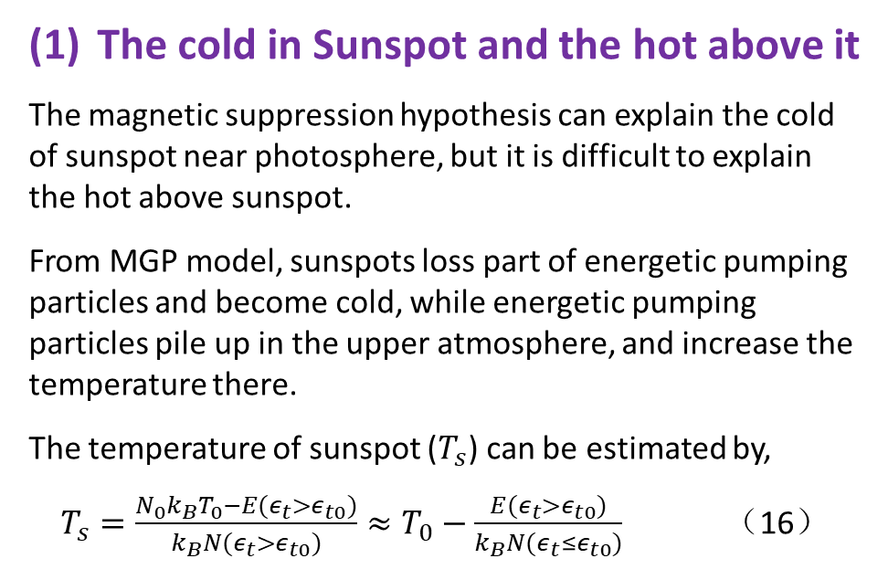

4. Other applications of MGP mechanism
The cold in Sunspot and the hot above it
The magnetic suppression hypothesis can explain the cold of sunspot near photosphere, but it is difficult to explain the hot above sunspot.
From MGP model, sunspots loss part of energetic pumping particles and become cold, while energetic pumping particles pile up in the upper atmosphere, and increase the temperature there.
The temperature of sunspot ($T_{s}$) can be estimated by,
$T_{s}=\frac{N_{0}k_{B}T_{0}−E(ε_{t}>ε_{t0})}{k_{B}N(ε_{t}>ε_{t0})}≈T_{0}−\frac{E(ε_{t}>ε_{t0})}{k_{B}N(ε_{t}≤ε_{t0})}$ （16）
4615K
$$L_{B}\sim 900 km$$
5650K

Slide 13
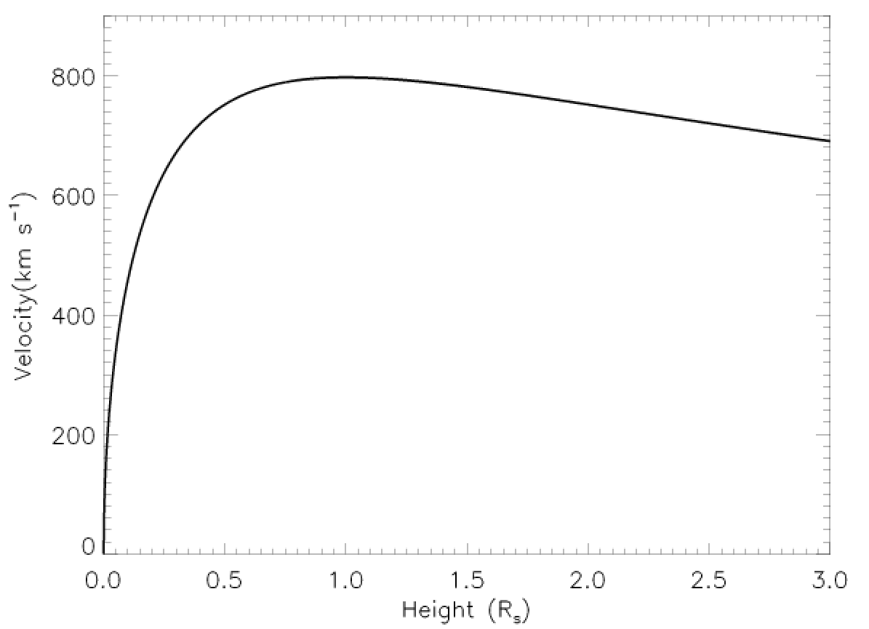
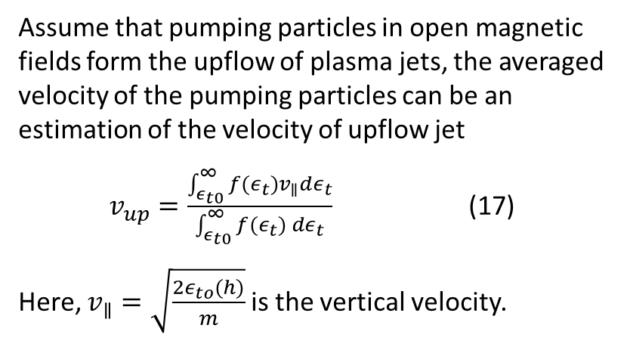
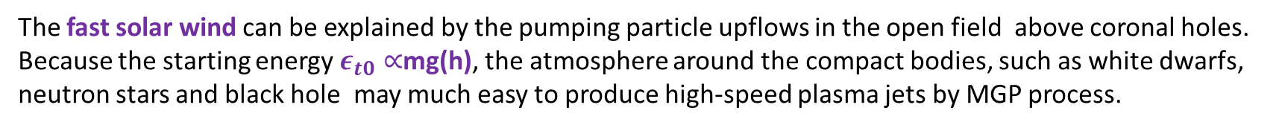
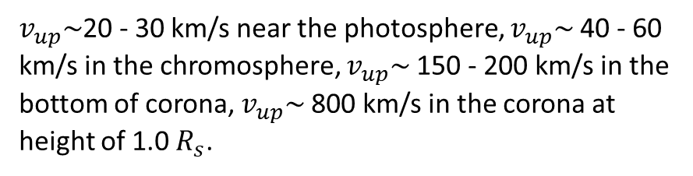
(2) Formation of solar plasma jets
Assume that pumping particles in open magnetic fields form the upflow of plasma jets, the averaged velocity of the pumping particles can be an estimation of the velocity of upflow jet
$v_{up}=\frac{\int_{ε_{t0}}^{∞}{f(ε_{t})v_{∥}dε_{t}}}{\int_{ε_{t0}}^{∞}{f(ε_{t}) dε_{t}}}$ (17)
Here, $v_{∥}=\sqrt{\frac{2ε_{to}(h)}{m}}$ is the vertical velocity.
800 km/s
$v_{up}\sim$20 - 30 km/s near the photosphere, $v_{up}\sim$40 - 60 km/s in the chromosphere, $v_{up}\sim$150 - 200 km/s in the bottom of corona, $v_{up}\sim$800 km/s in the corona at height of 1.0 $R_{s}$.
The fast solar wind can be explained by the pumping particle upflows in the open field above coronal holes.
Because the starting energy $ε_{t0}∝$mg(h), the atmosphere around the compact bodies, such as white dwarfs, neutron stars and black hole may much easy to produce high-speed plasma jets by MGP process.

Slide 14

(3) MGP: one of the possible coronal heating mechanism
$$∇B$$
Wave model
(Davila, 1987, ApJ, De Pontieu et al. 2007, Sci., etc.)
Reconnection model
(Parker, ApJ, 1987, 1995, etc.)
MGP model
(Tan, 2014, ApJ)
MGP model indicates that the upward hot flow occurring in solar magnetic flux tubes might play a key role for coronal heating and the evolution of solar active regions.

Slide 15
5. Summary
MGP mechanism is valid in the solar photosphere, chromosphere as well as in the corona.
Magnetic gradient may provide a possible triggering mechanism for solar eruptions.
MGP mechanism may explain the formation of the cold sunspots and the hot above them, solar plasma jets, fast solar wind, and coronal heating.
(Tan et al., RAA, 2020, in press)

Slide 16
Thank you for your attentions!

