Slide 1
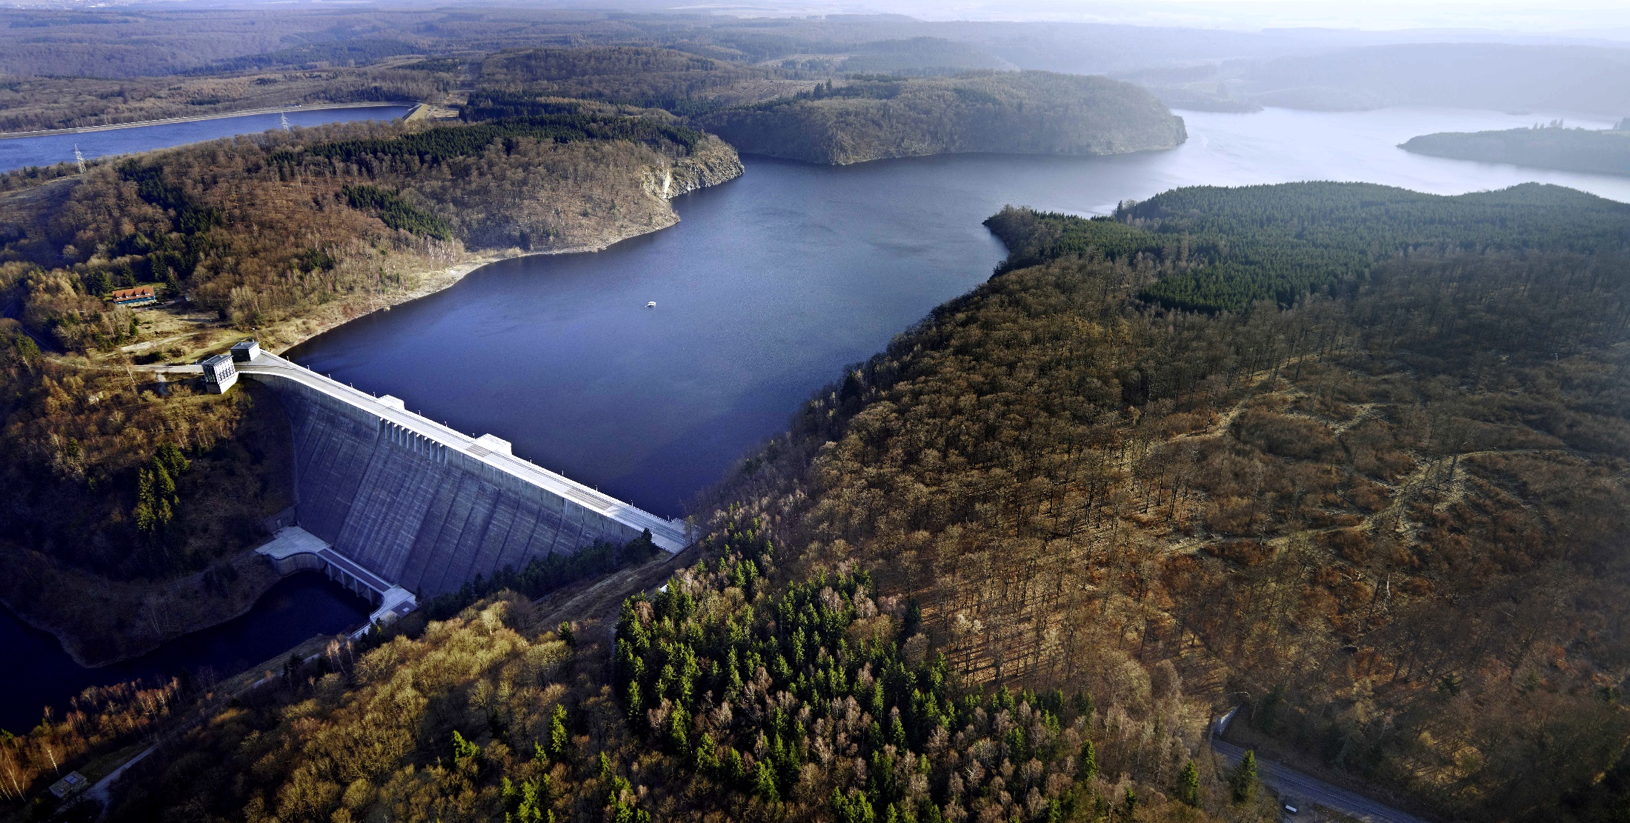
Effect of climate warming on the mixed layer depth in lakes
This presentation contains audio.
Click on the speaker symbol in the top left corner of each slide to listen.
Photo: UFZ
EGU General Assembly 2020: Lakes and Inland Seas in a Changing Environment
Tom Shatwell, Georgiy Kirillin

Slide 2
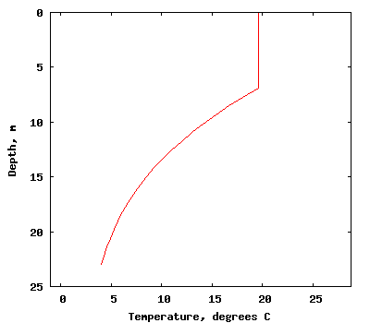
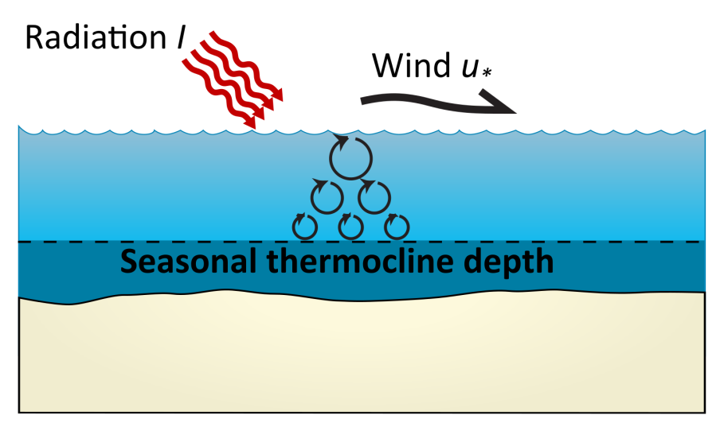
Introduction
h_{mix}
Mixed layer depth
Depends on: Solar radiation, wind, transparency, morphometry

Slide 3
Why do we care about mixed layer depth?
Assess homogeneity of water column for remote sensing
It directly influences primary production
I₀
I
$$I_{z}=I_{0}e^{−γz}$$
I: radiation
Z: depth
H_{mix}: mixed layer
γ: extinction
z
$$I_{mean}=\frac{I_{0}}{γh_{mix}}\left(1−e^{−γh_{mix}}\right)$$

Slide 4
Introduction
Question:
How will h_{mix} and I_{mean} change under climate warming?
Approach:
1-D ensemble modelling with hydrodynamic model FLake (part of ISIMIP)

Slide 5
ISIMIP local lakes
62 lakes:
Median (range)
Area (km²): 6.9 (0.005 – 2488)
Zmean (m): 12.2 (1.5 – 339)
Latitutde (°): 46 (-39 – 69)
Extinction (m⁻¹): 0.48 (0.04 – 3.7)

Slide 6
FLake simulations
Forcing data: ensemble of 3 scenarios and 4 GCMs:
Run
Scenario
Model
IPSL-CM5A-LR
HadGEM2-ES
MIROC5
GFDL-ESM2M
EWEMBI
RCP26
RCP60
RCP85
Historical
Climate projections
Validation
~ 1300 simulations, ~ 300,000 lake-years
RCP: representative concentration pathway (W m⁻²)

Slide 7
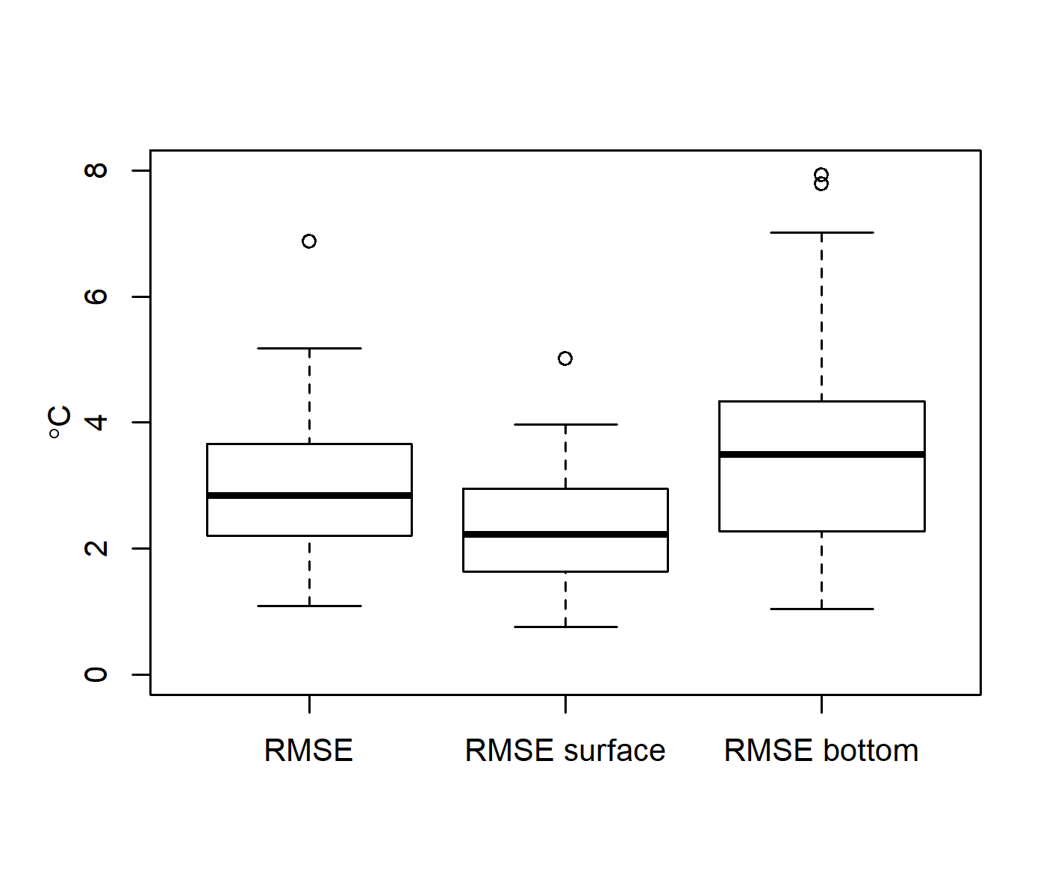
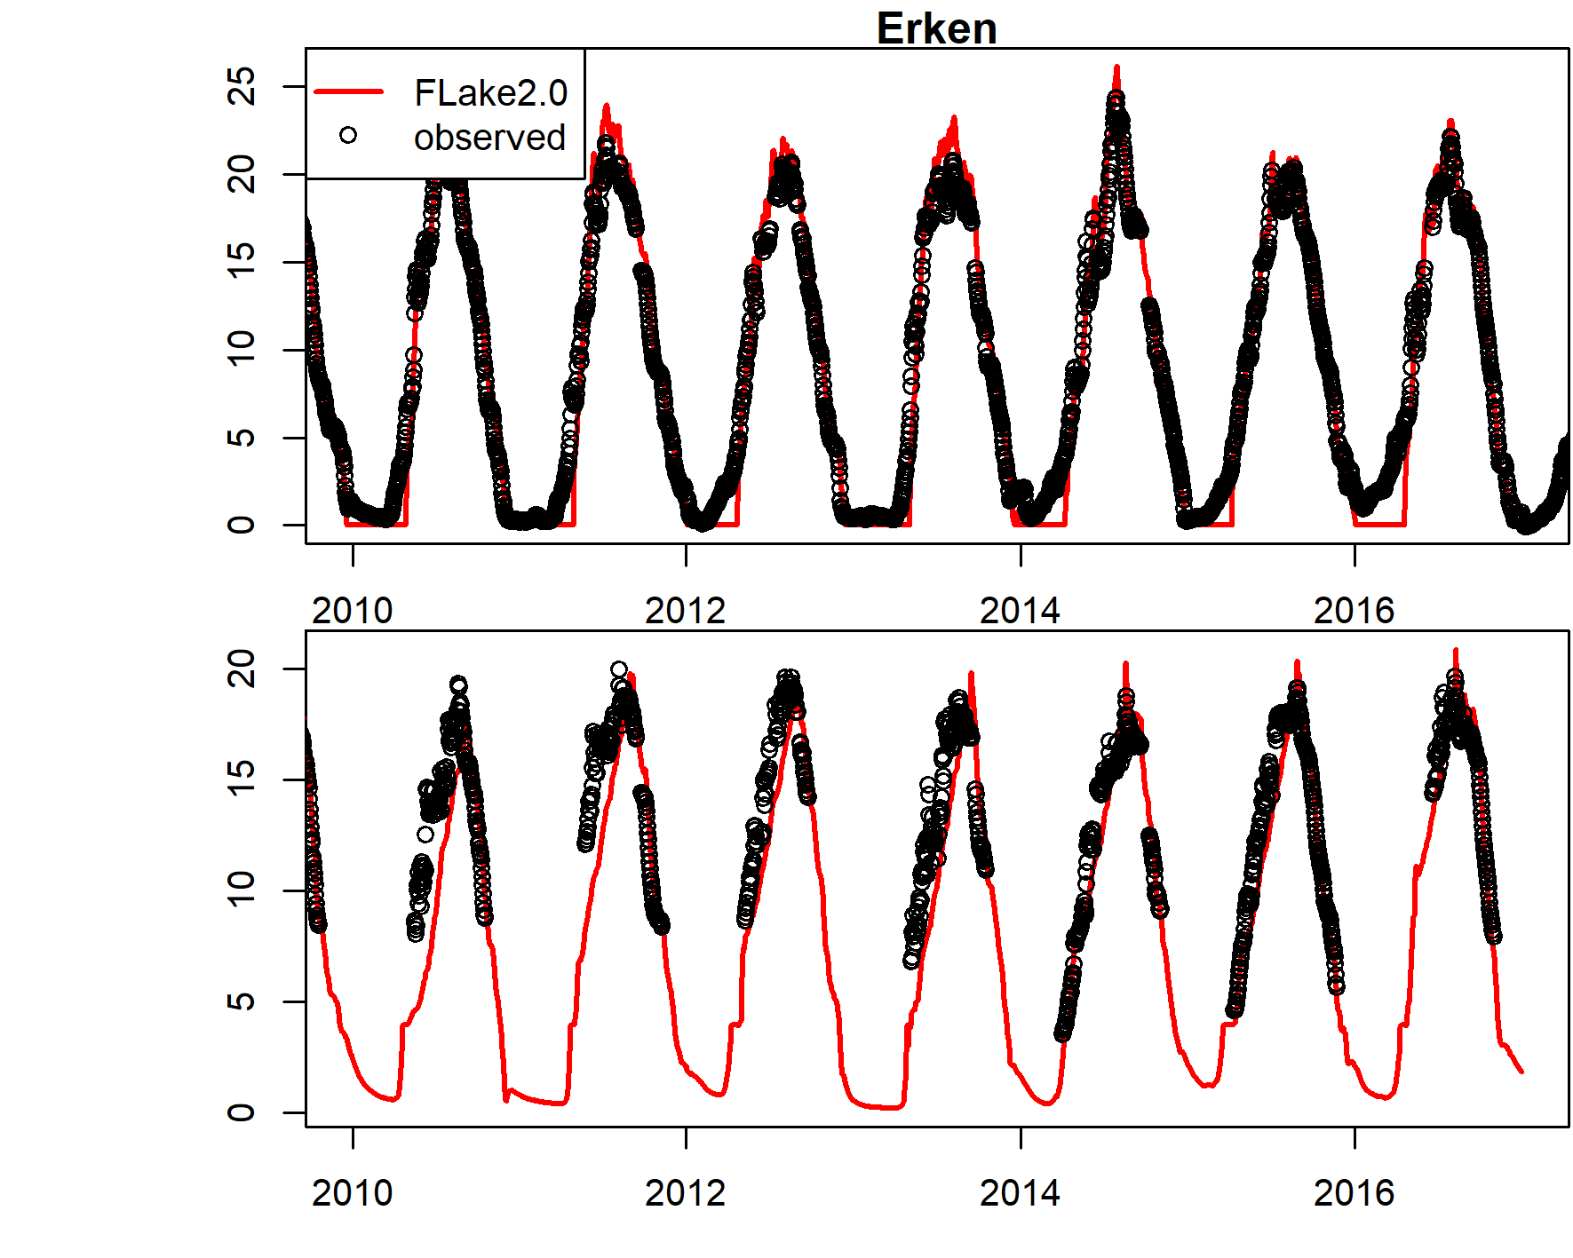
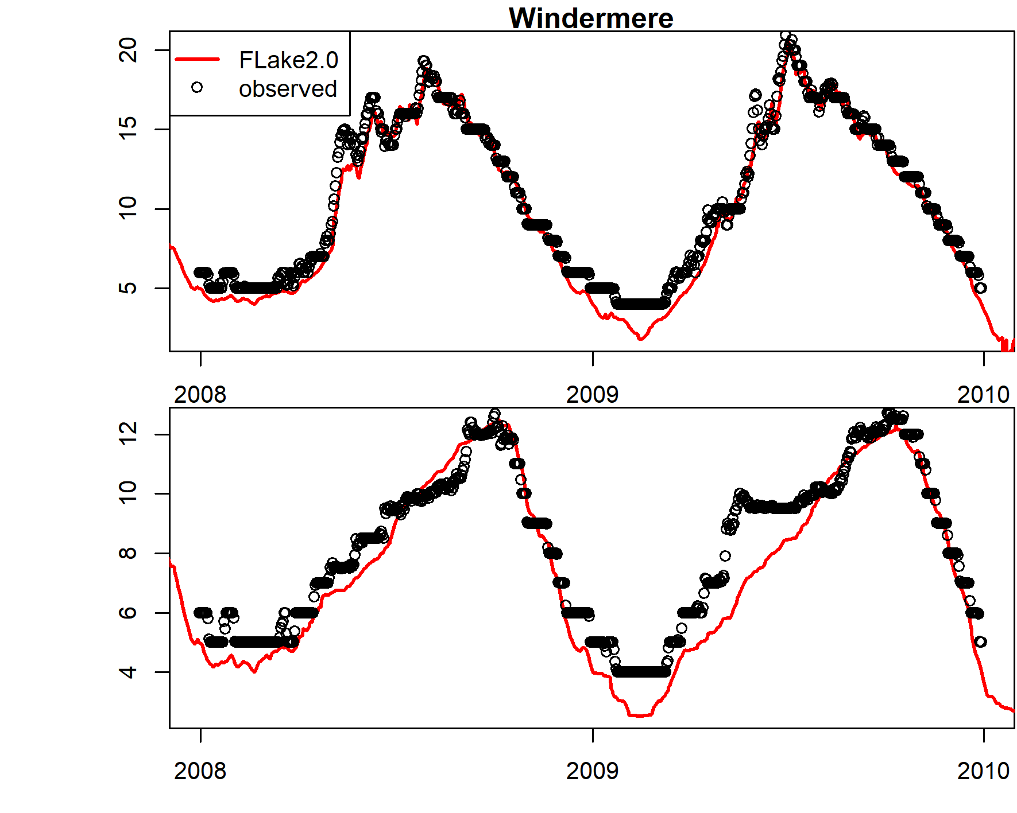
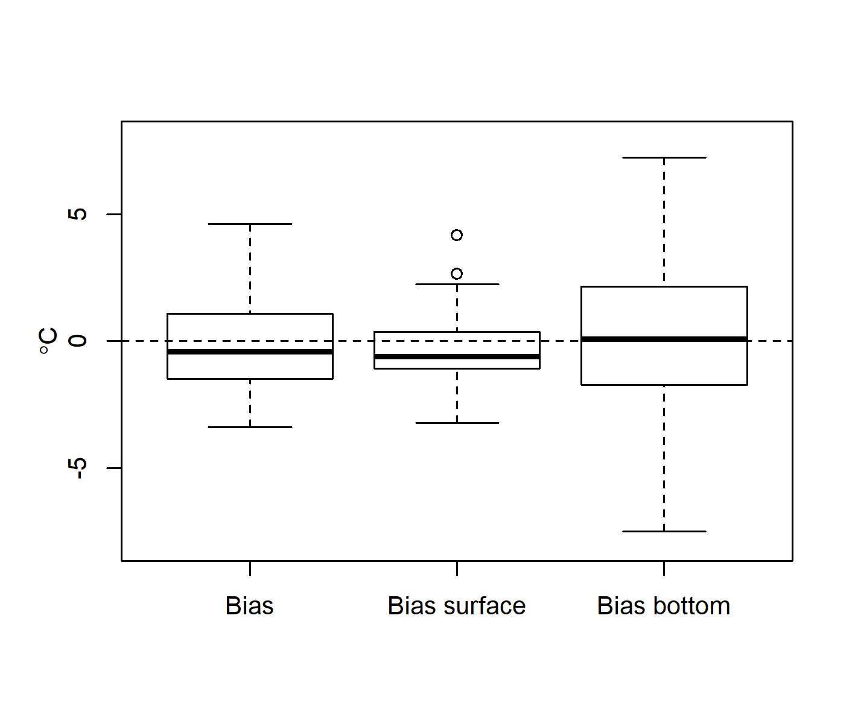
Model validation
FLake was not calibrated, but extensively validated
Parameterization: extinction, mean depth, fetch
Surface temp (°C)
Surface temp (°C)
Bottom temp (°C)
Bottom temp (°C)

Slide 8
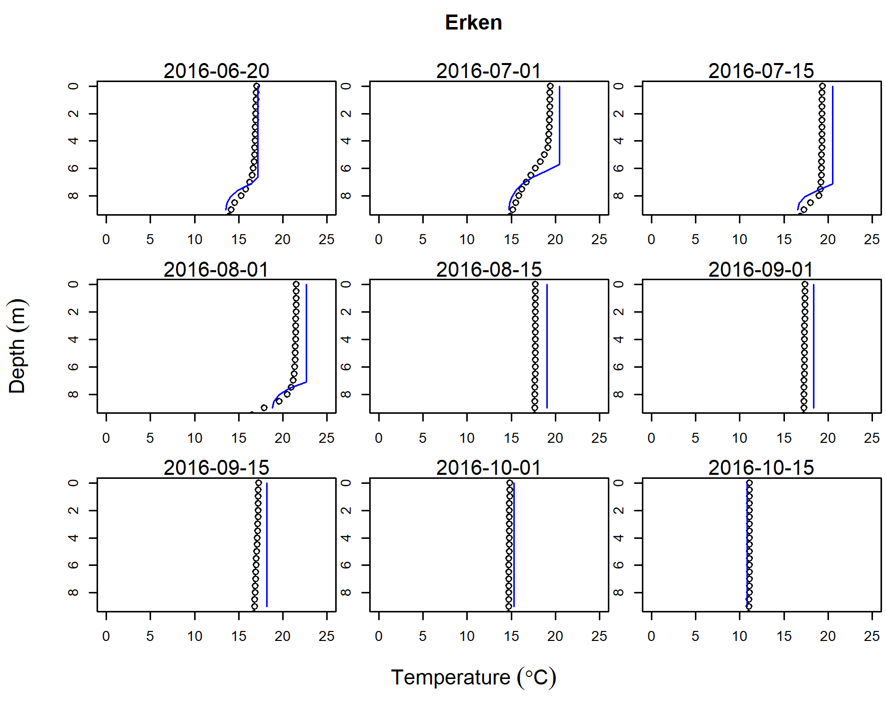
Simulated mixed layer depth

Slide 9
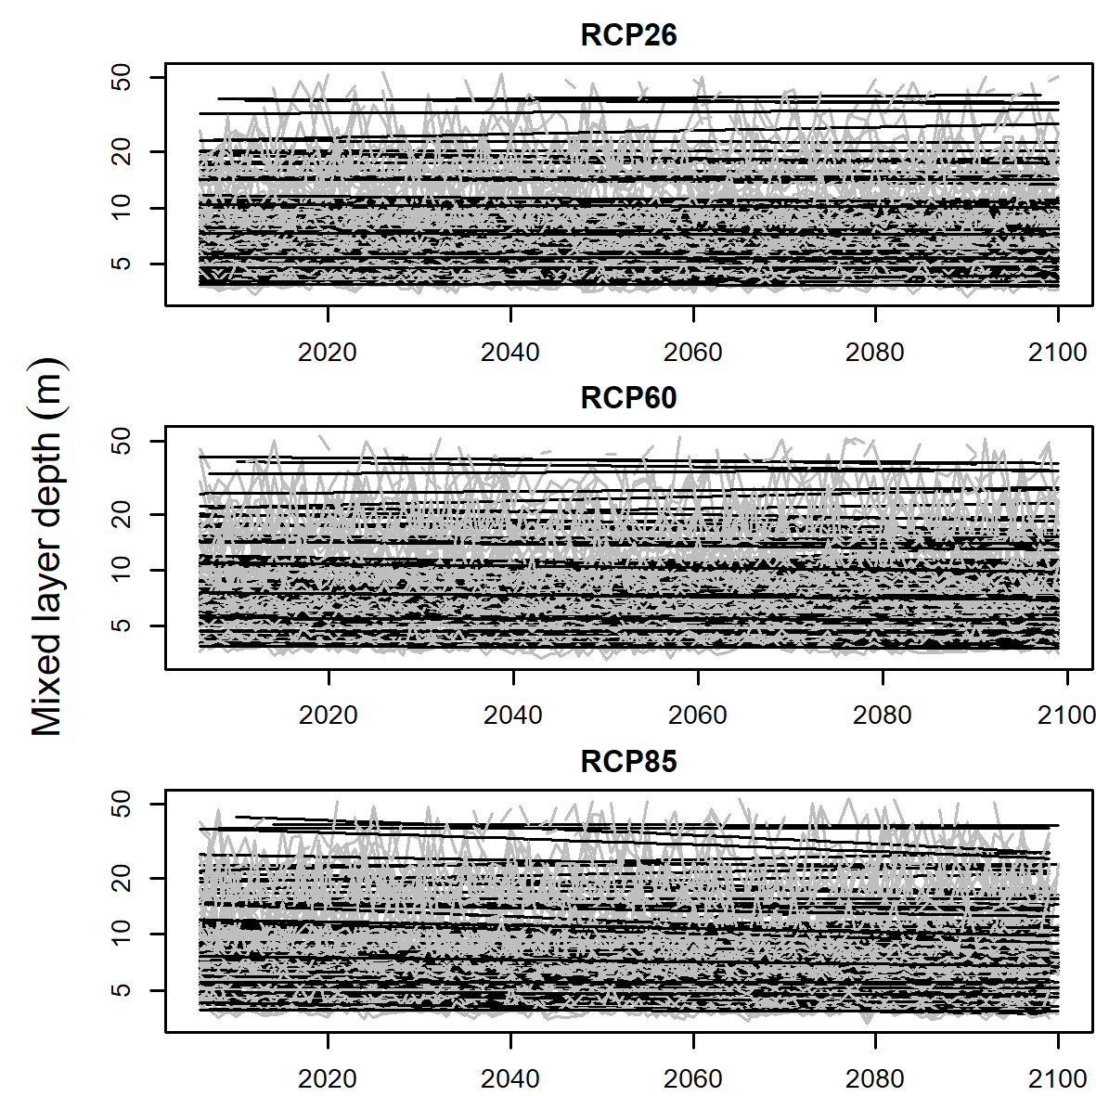
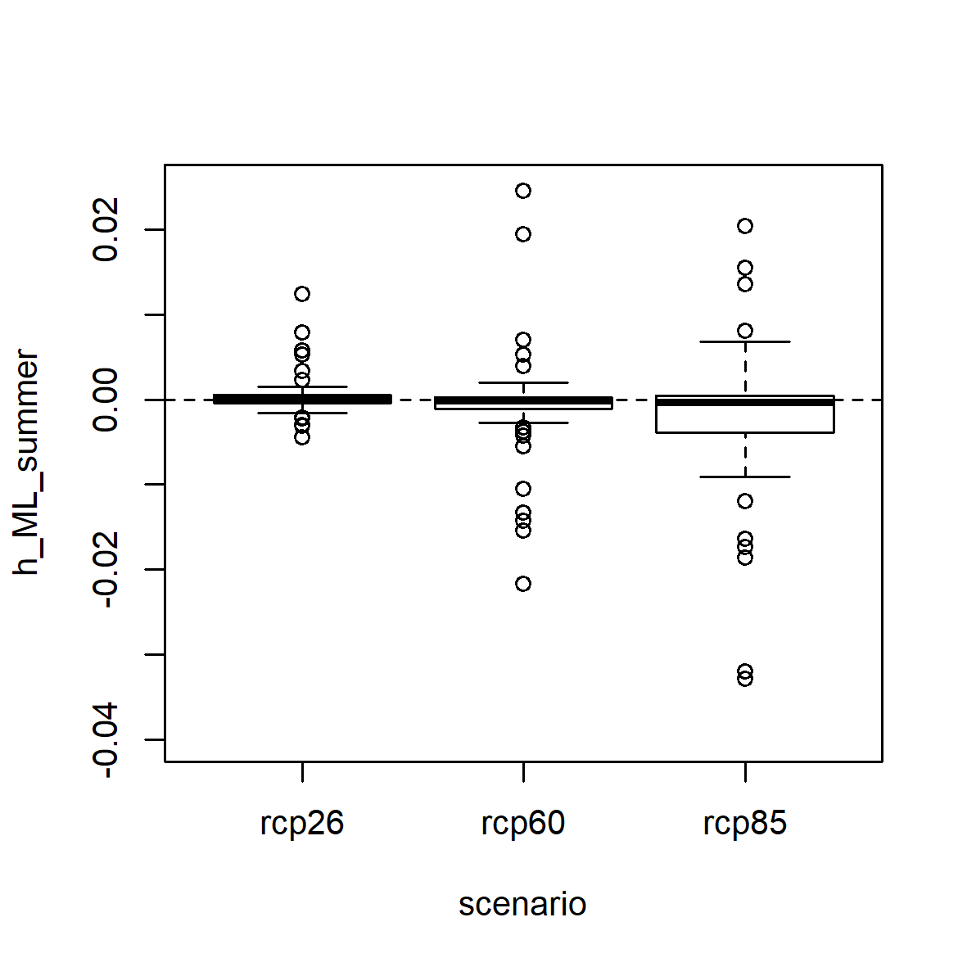
Climate warming trends
Mixed layer depth
(ns)
(ns)
(*)
(-3 mm decade⁻¹)
Mean mixed layer depth in summer
(=Jul - Sep in the north; Jan - Mar in the south)

Slide 10
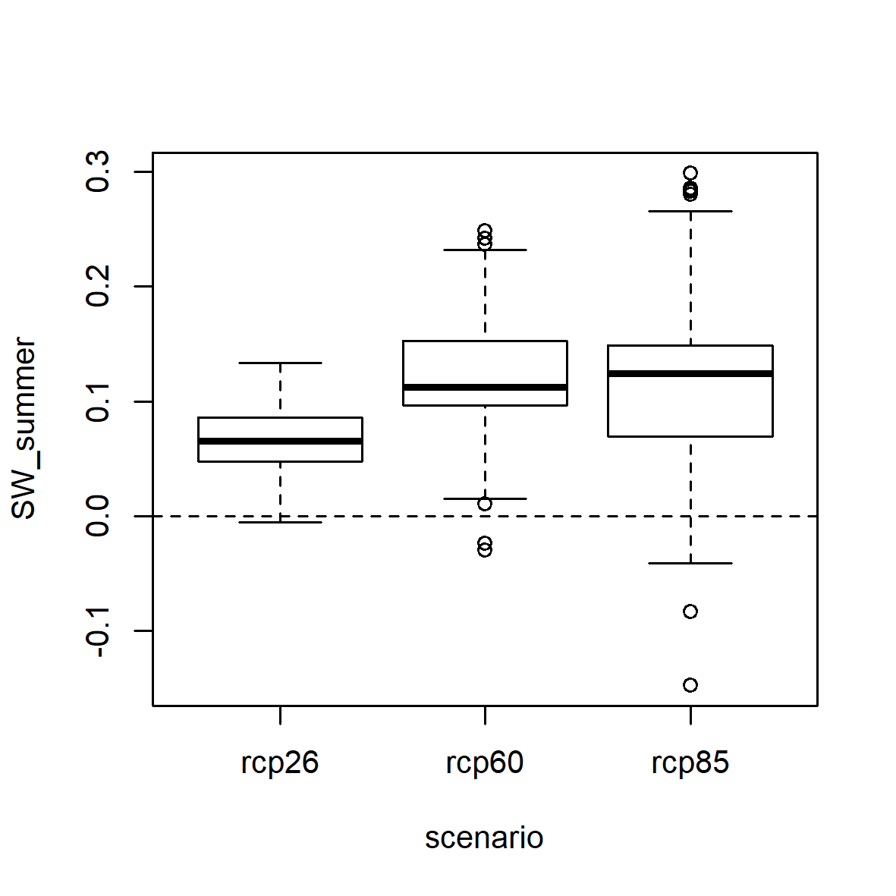
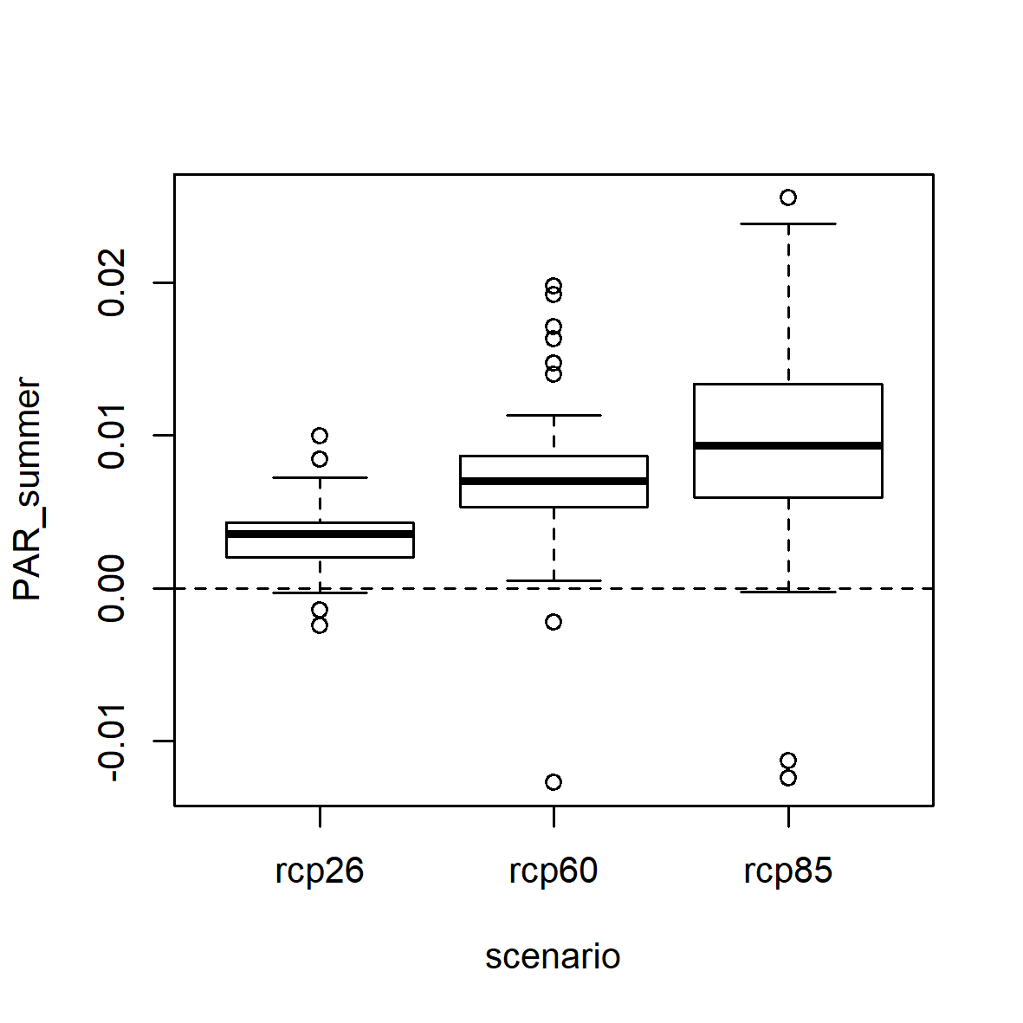
Climate warming trends
Underwater light is predicted to increase as a direct effect of climate change
Indirect effects (change in transparency) probably stronger
Solar radiation
Underwater light (PAR)
(*)
(***)
(***)
(0.09 mol m⁻² day⁻¹ decade⁻¹)
~10% over 100 years
(1.2 W m⁻² decade⁻¹)
~6% over 100 years

Slide 11
Summary and conclusions
h_{mix} in summer appears to be unaffected directly by warming
The mean light in the productive zone in summer is expected to increase, but this is due to an increase in solar radiation rather than decrease in h_{mix}.
Underwater light and thus primary production may increase under warming, depending also on other indirect effects, especially water transparency.

Slide 12
Thanks for listening
Funding: UFZ, DFG
Thanks to the ISIMIP community

