Slide 1
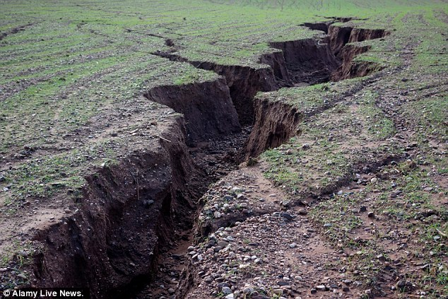
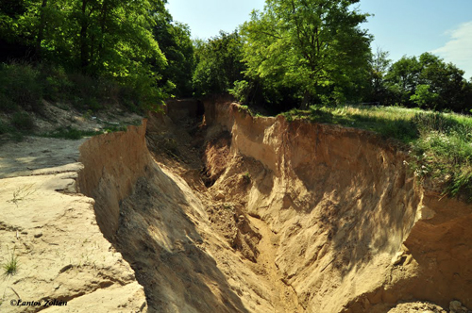
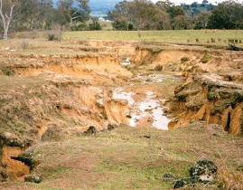
Gully Erosion · Soil and Water Conservation
Quantitative assessment of gully erosion dynamics using a GIS implementation of Sidorchuk’s DYNGUL model in Southern KwaZulu-Natal, South Africa.
By
Dr. Adel Omran
Prof. Dr. Ing. Dietrich Schröder
Prof. Dr. Volker Hochschild
Christian Sommer
Prof. Dr. Aleksey Sidorchuk
Prof. Dr. Michael Märker

Slide 2
Key messages
We implemented a state-of-the-art Gully Erosion Model in a GIS environment
This allows to perform computing-intensive sensitivity analyses for calibration and validation runs of the model…
… which helps to reconstruct and predict land degradation in South Africa

Slide 3
The Model

Slide 4
Gullies develop in two stages
The quick initial stage lasts only 5% of a gully‘s lifetime, but is responsible for 90% of its final length and 80% of its final depth.
In the later stage, the gully grows more gradually in terms of area and volume. (Kosov et al. 1978)
Sidorchuck, 1999

Slide 5
DYNGUL simulates several gully processes
Surface runoff incises a rectangular channel in the topsoil substrate or the gully bottom, if a certain erosion threshold is exceeded
This can destabilize sidewalls, so that slope failure creates trapezoidal channel cross sections
Lateral erosion and slow mass movements transform gully side walls till stable conditions are reached.
(CC-BY Omran)
transport equation
with
q=Q/W
where
$K_{e}$ Erosion coefficient
q Specific discharge
W Flow width
Q Water discharge

Slide 6
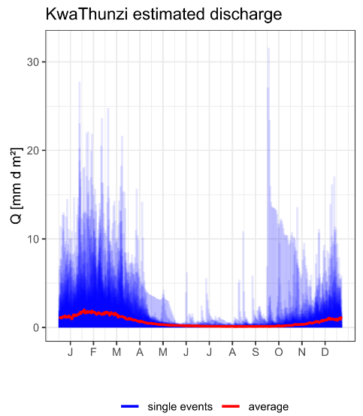
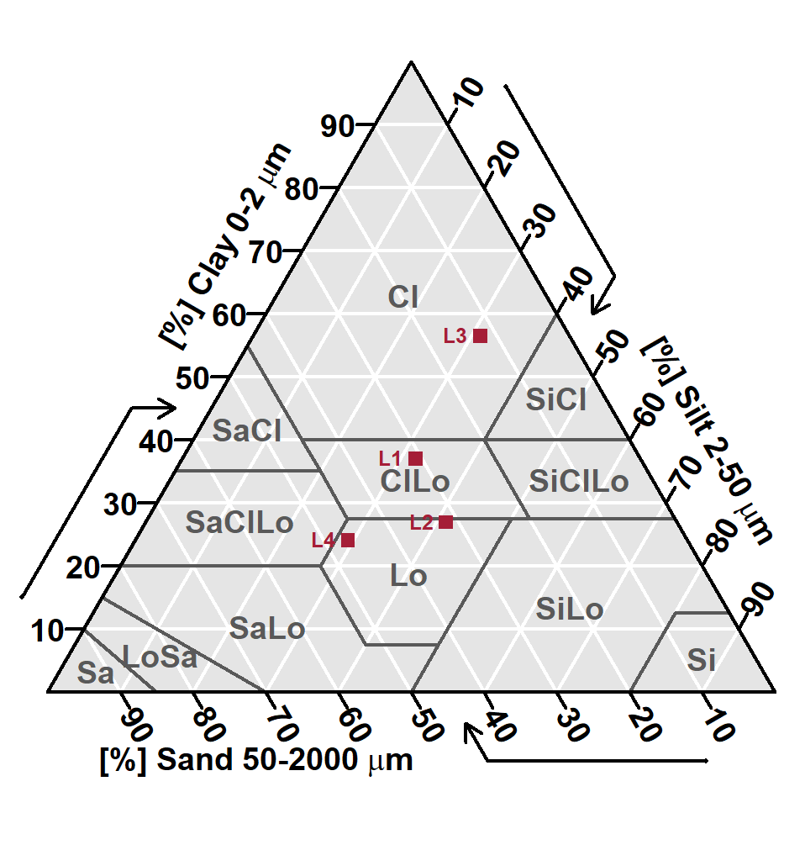
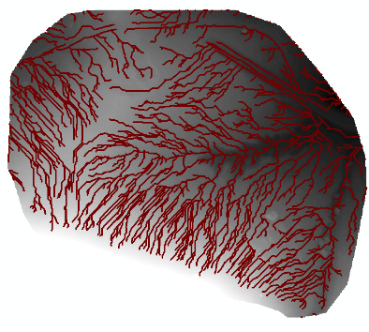
Basic model input data
Initial topography and stream networks
Runoff data
Soil erodibility
Automated stream network extraction using the GIS model (Omran et al., 2012)
67 Years of daily discharge of gully KwaThunzi aggregated by day-of-year (CC-BY Sommer)
Soil texture triangle of gully KwaThunzi (CC-BY Sommer)

Slide 7
Model input
Hydrological timeseries with runoff height (mm) or discharge (m³s⁻¹)
Channel network derived from DEM (Omran et al., 2012)
Parameters describing the hydraulic properties of the soil layers, i.e.
The soil erodibility coefficient K_{e} after Sidorchuk (1999) and Alberts (1995)
Critical velocity V_{crit} after Mirtskhulava (1988)
Slope stability from field observations or DEM analysis

Slide 8
DYNGUL is a spatially explicit physical model
The model incorporates conceptional sediment stores along the main stream line and selected side streams
Each store holds information on position, sediment budget and soil layer erodibility
The eq. of mass conservation and the eq. of deformation are solved for each store and each iterative step of the runoff timeseries
The drainage network of gully KwaThunzi and a detailed view of the conceptional sediment stores on the main channel (CC-BY Sommer)

Slide 9
GIS Implementation

Slide 10
DYNGUL was implemented in a GIS environment
Sidorchuk (1999) developed the method in FORTRAN and applied the model in studies around the world: Yamal (RUS), South Africa, New South Wales (AUS), etc.
We developed a Python implementation, which allows to prepare, process and visualize the model embedded in a GIS software.
Screenshot of the ArcGIS tool & Python implementation
CC-BY Schröder, Omran

Slide 11
Automated implementation of gully model
The workﬂows can be developed using model builders available in GIS and saved in the form of scripts that support fully automated simulations. Complex physically-based models usually require partial differential equation solvers and can be fully integrated with GIS using their libraries for managing the geospatial data. More often, such models are only loosely linked to GIS.
Model input data paramters derivation
Gully model code
(Data calculation and visualization)
Model validation
(Senstivity analysis for evaluation of the model results)
Model output data results
(Volume, length, area, depth)

Slide 12
The code calculates gully geometrical parameters (first module)
The aim of this module is to calculate the main geometrical parameters of the gully along the selected flow line:
Elevation before erosion (m)
Elevation after erosion (m)
Top width (m)
Bottom width (m)
Volume of gully erosion (m³)
Area of the gully (m²)
Length of the gully (m)
CC-BY Schröder, Omran

Slide 13
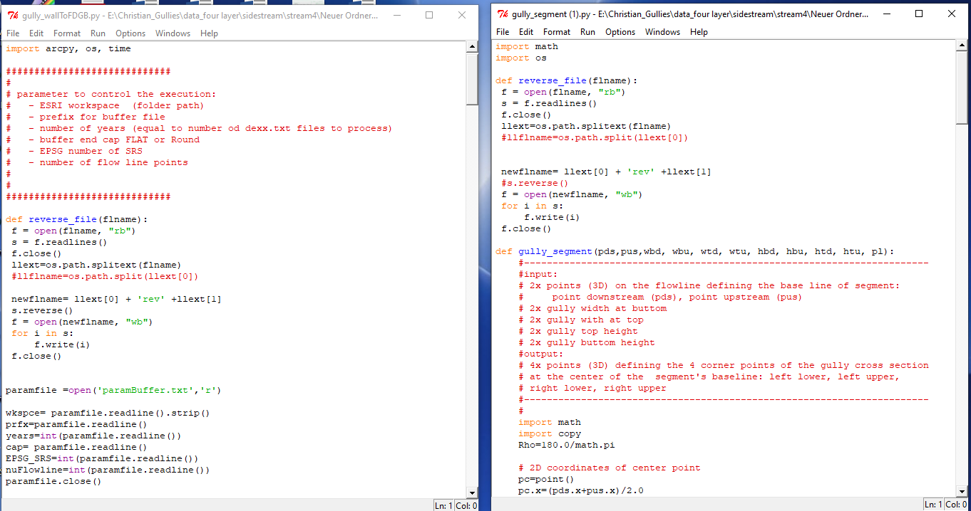
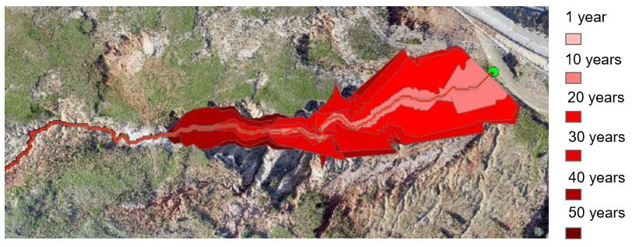
The visualization is included in the second module
The aim of this module is to create a sequence of 2D as well as 3D polygons for each time step representing the respective topographic situation describing the erosion dynamics. These polygons represent the extent of gully erosion for each time step (e.g. year).
CC-BY Schröder, Omran

Slide 14
Sensitivity Analyses

Slide 15
Estimates of channel width and depth vary strongly and should be calibrated
We compared 4 methods to derive channel width and depth from runoff data with our field observations, in order to find the best estimate
It is recommended to fit your own function in case of sufficent in situ observations.
(CC-BY Sommer)
$$W=3.0∗Q^{0.4}$$ | Sidorchuk 1999
$$W=3.17∗Q^{0.368}$$ | Sidorchuk revised
$$W=2.51∗Q^{0.412}$$ | Nachtergaele 2002
$$W=2.66∗Q^{0.396}∗n^{0.387}∗S^{−0.16}∗{​t}_{​cr}^{−0.024}$$ | Woodward 1999
W flow width S slope n Manning’s roughness coefficient
Q water discharge t_{cr} shear stress of critical flow

Slide 16
We tested 216 iterative combinations of soil erodibility coefficient (K_{e}), Slope stability and Critical velocity
Layer specific field & lab data (e.g. texture, SOC, etc.)
K_{e}-Factor
Soil parameters
6x
Slope stability
4x
216x
Critical velocity
9x
PARAM.txt
for each layer
Gully model
Layer thickness
fixed
Hydro data (e.g. gauging station)
Hydrological parameters
fixed
Literature or width/depth measurements
S150.txt
Channel parameters
fixed

Slide 17
Critical velocity is the most sensitive input parameter
Sensitivity analysis using 216 combinations of critical velocity, slope stability and erodibility coefficient evaluating the predicted eroded area and volume shows:
Gully area and volume are sensitive to critical flow velocity. Effects in the range between loam and sandy loam are non-linear. This was confirmed by Sidorchuk (1998).
The effect of the erodibility coefficient K_{e} and slope stability are less intense and gradual.
Access interactive version at https://plot.ly/~sommergeo/9/#/ and https://plot.ly/~sommergeo/11/#/
(Please press to open the link)

Slide 18
Results from the KwaThunzi Gully case study, KwaZulu-Natal, South Africa

Slide 19
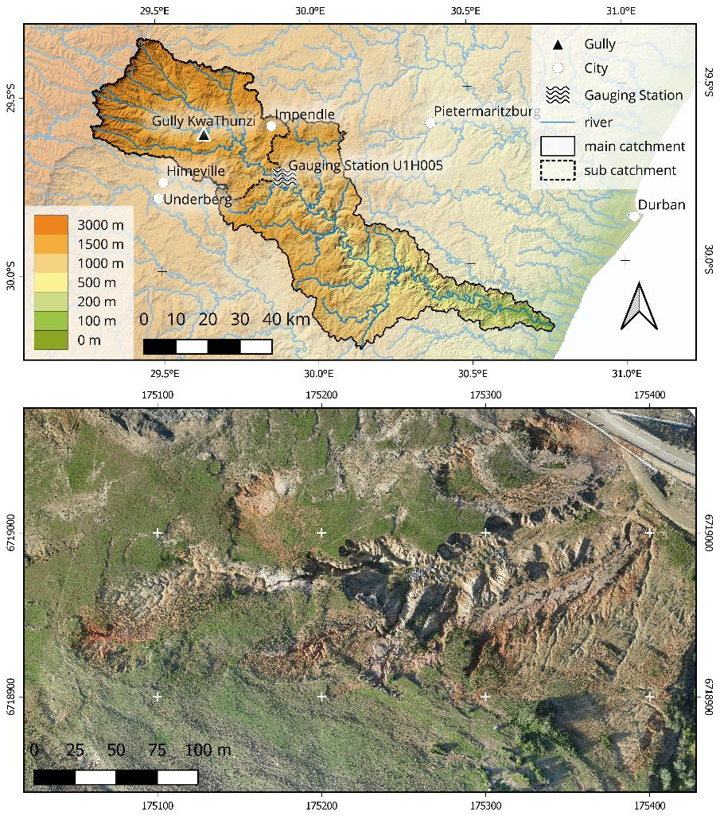
KwaThunzi - a long story of scientific research
Gully KwaThunzi is an example of the widespread gully erosion in the Masotcheni Formation in the Drakensberg Mountains. In the Upper Umkomazi Basin, erosion is driven by seasonal summer precipitation.
This is a threat for arable land, but it also exposes Middle Stone Age lithic artefacts.
Earlier studies by, Märker et al., 2001, 2003 etc. produced a valuable scientific record.
Study area and detailed view if the gully (CC-BY Sommer)

Slide 20
DYNGUL can handle substrate variance
The gully is developed in the Masotcheni Formation, which consists of stratified colluvial layers. Due to past cycles of climate and landscape stability, these vary strongly from loose soil.
DYNGUL is able to include this variance in the computations in terms of the erodibility parameters.
Runoff width and depth of KwaThunzi is close to Sidorchuk‘s revised function. Although it was originally produced from permafrost observations, it is adaptable to semiarid crusted Masotcheni soils.
Stratified colluvial deposits of Gully KwaThunzi. Mapped by Bosino.

Slide 21
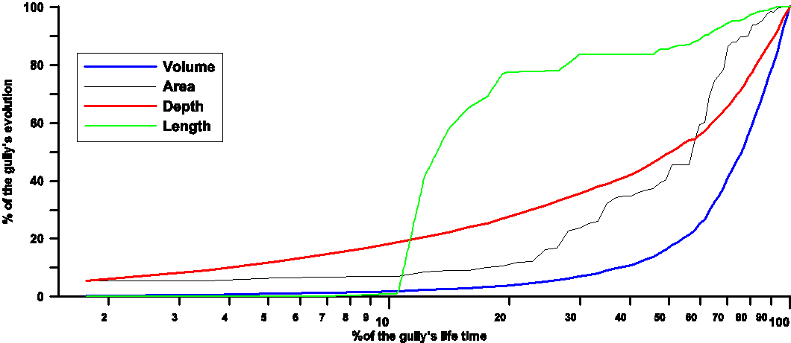
Incision is delayed at KwaThunzi
The gully model describes the final morphology of the gully. The shape of its longitudinal profile becomes independent from the shape of the initial slope and gully evolution is only controlled by discharge (critical velocity) and soil texture.
The figure shows that the length of the gully and the area are quite stable after 60% of the gully’s lifetime.
Incision is less intense than in Kosov’s observations, what is presumably related to the crusted sediments of KwaThunzi
The development of Gully in volume, length, depth and area through time (CC-BY Omran)

Slide 22
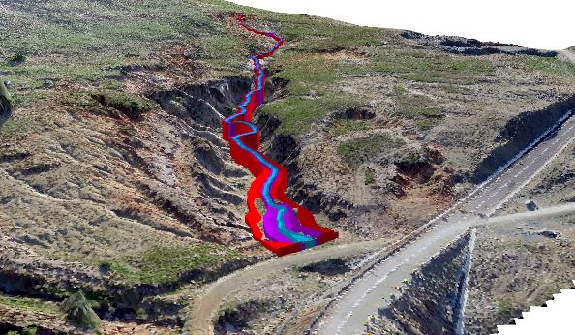
Timeseries visualizations allow to keep track of the gully evolution stages
3D
2D
(CC-BY Schröder, Omran)
(CC-BY Schröder, Omran)
Please press to play Video
Please press to play Video

Slide 23
Conclusion & Outlook

Slide 24
Conclusion
We calculated and visualized the gully 2D and 3D morphometry
The GIS-code implementation reproduces successfully the results of the Sidorchuk model.
Gully side walls can be extracted for visualization purposes
Parameter sensitivity analysis is implemented in the model
Multi-layer soil/substrate runs are feasible

Slide 25
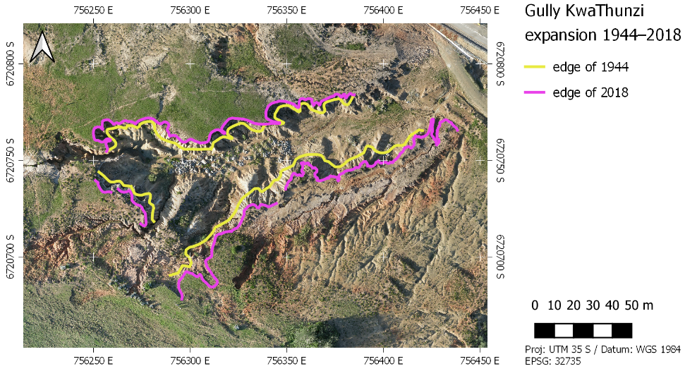
Outlook
Transfer data preparation to open source GIS (QGIS)
Calibration of model parameter
Improved 3D visualization
Improved timeline visualization
Transfer to other study areas with good data and good validation information
The code can be used for the managment system to solve problems related to gully erosion
Related to the study area:
Age of the gully?
Prediction of future erosion?
Multitemporal analysis of gully extents helps to estimate erosion rates (CC-BY Sommer)

Slide 26
References
Alberts E. E., Nearing M. A., Weltz M. A., Risse L. M., Pierson F. B., Zhang X. C., . . . Simanton J. R. (1995): Soil component. In USDA Water Erosion Prediction Project: Hillslope Profile and Watershed Model Documentation (pp. 7.1–7.45). West Lafayette, IN: National Soil Erosion Research Laboratory.
Hochschild, V., Märker M., Rodolfi G., Staudenrausch H. (2003): Delineation of erosion classes in semi-arid southern African grasslands using vegetation indices from optical remote sensing data. Hydrol. Process. 17, 917–928.
Kosov B., Nikol’skaya I., & Zorina Y. F. (1978): Eksperimental’nyye issledovaniya ovragoobrazovaniya. Eksperimental’naya geomorfologiya, 3, 113-140.
Märker, M., Moretti, S. & G. Rodolfi (2001): Assessment of water erosion processes and dynamics in semiarid regions of southern Africa (KwaZulu/Natal RSA; Swaziland) using the Erosion Response Units concept (ERU). Geogr. Fis. Dinam. Quat., 24. 71-83.
Märker, M., Sidorchuk, A (2003): Assessment of gully erosion process dynamics for water resources management in a semiarid catchment of Swaziland (Southern Africa). Erosion Prediction in Ungauged Basins: Integrating Methods and Techniques (Proceedings of symposium HS01 held during IUGG2003 at Sapporo.
Mirtskhulava, T. Y. (1988): Osnovy fiziki i mekhaniki erozii rusel. Leningrad: Gidrometeoizdat.
Nachtergaele, J., Poesen, J., Sidorchuk A., Torri, D. (2002): Prediction of concentrated ﬂow width in ephemeral gully channels. Hydrol. Process. 16, 1935–1953
Omran, A., Schröder, D., El- Rayes, A. and Geriesh, M. (2012): Flood Hazard Assessment in Wadi Dahab, Egypt Based on Basin Morphometry using GIS Techniques. AGIT, Salzburg, Austria.
Schröder, D., Omran, A. (2013): Terrain analysis for flash flood risk mapping. In: Proceeding of Applied Geoinformatics for Society and Environment (AGSE), HFT-Stuttgart, Germany. p. p.1–8. ISBN978-3-940670-42-2.
Sidorchuk, A. (1996): Gully erosion and thermo-erosion on the Yamal Peninsula. In: Geomorphic Hazards (ed. by O. Slaymaker), 153-168. John Wiley, New York.
Sidorchuk A. (1999): Dynamic and static models of gully erosion. Catena. Vol. 37, no. 3-4. P. 401–414
Sidorchuk A. (2006): Stages in gully evolution and self-organized criticality. Earth Surface Processes and Landforms. Vol. 31, no. 11. P. 1329–1344.
Sidorchuk A., Märker M., Moretti S., Rodolfi G. (2001): Soil erosion modelling in the mbuluzi river catchment (swaziland, south africa). part i: Modelling the dynamic evolution of gullies. Geografia Fisica e Dinamicca Quaternaria. Vol. 24, no. 2. — P. 177–187
Woodward D. E. (1999): Method to predict cropland ephemeral gully erosion. CATENA, 37(3), 393-399. doi: https://doi.org/10.1016/S0341-8162(99)00028-4

Slide 27
Thank you for your attention
Contact
Dr. Adel Omran
adel.omran.geo@gmail.com
Funding

