Slide 1
EGU 7.5.2020 Case Pyhäsalmi underground mine
Rauno Heikkilä, University of Oulu, structures and Construction Technology

Slide 2
MEASUREMENT EQUIPMENT USED
GeoSLAM Horizon
Leica Pegasus Backpack
Z+F Imager 5016

Slide 3
MEASUREMENT METHODS AND DEVICES
Geoslam Horizon
hanheld laser scanners (mobile)
SLAM positioning
reference points, georeferencing method
Leica Pegasus Backpack
backbag scanner (mobile)
positioning GNSS, inertia ja SLAM-tekniikka
georeferencing GNSS or using reference points
Z+F Imager 5006
terrestrial scanner (static surveying)
positioning GNSS, inertia, adjustment of point clouds, total station
georeferencing GNSS or using reference points

Slide 4
MEASUREMENT OBJECT
Tunnel site, lenght 200 m
Tunnel profile width 5-9.4 m

Slide 5
Measurement time and accuracy of positioning
Geoslam Horizon 25 min 5-50 cm/5-10 cm
Leica Pegasus Backpag 25 min 5-10 cm / 2-5 cm
Z+F Imager 5006 with total station 120 min 1 cm / < 1 cm
Z+F Imager 5006 with point cloud registration 120 min 1 cm / < 1 cm

Slide 6
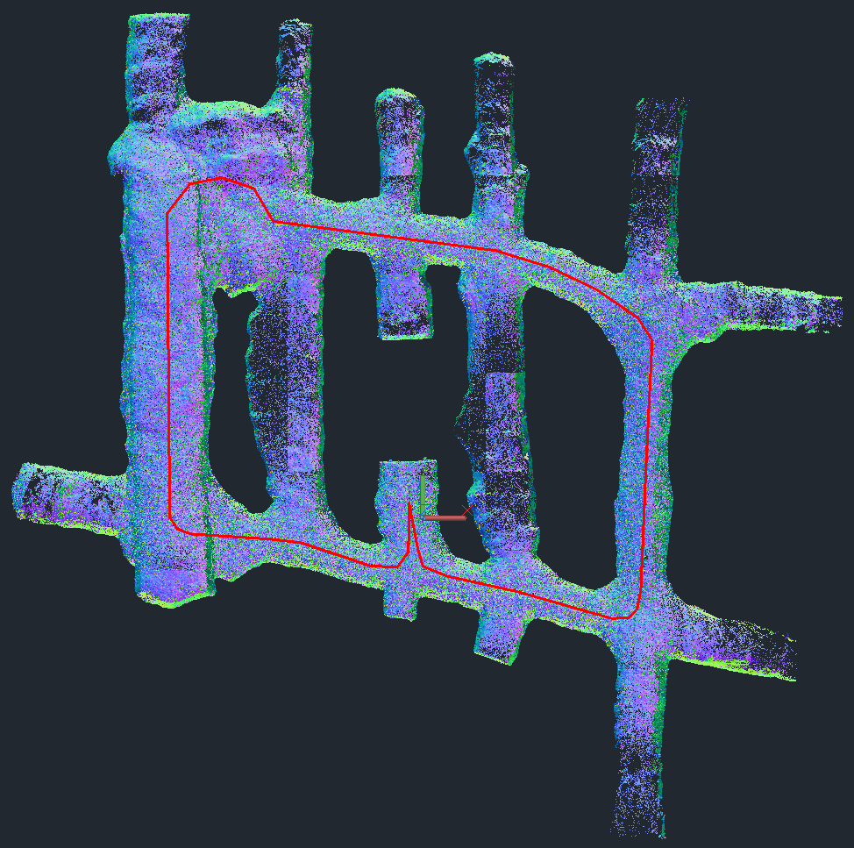

Slide 7
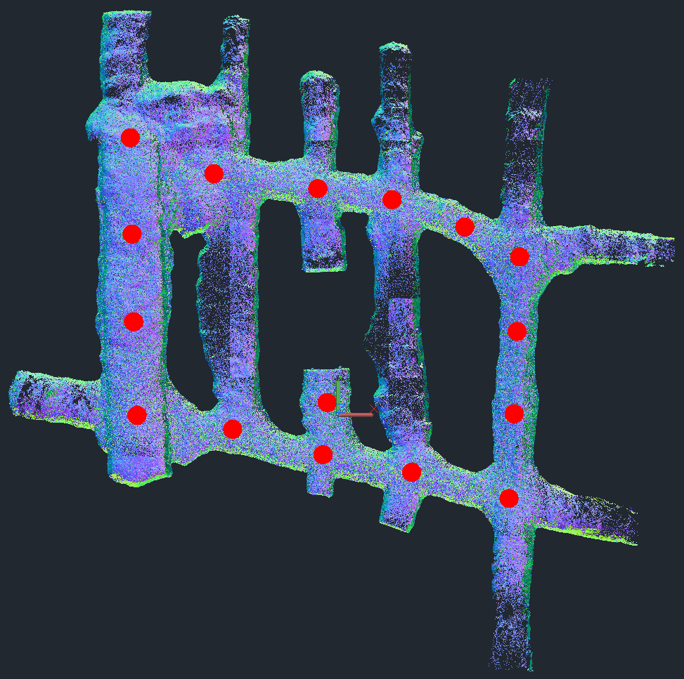

Slide 8
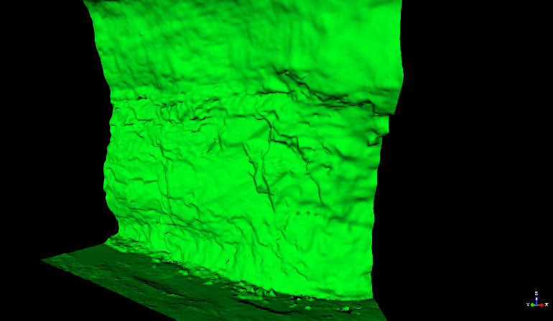
Triangulated surface

Slide 9
