Slide 1


The importance of an accurate estimation of the radiation balance and interception loss for the evaluation of evapotranspiration
Jitka Kofroňová, Václav Šípek, Miroslav Tesař
EGU, 2020
kofronova@ih.cas.cz

Slide 2
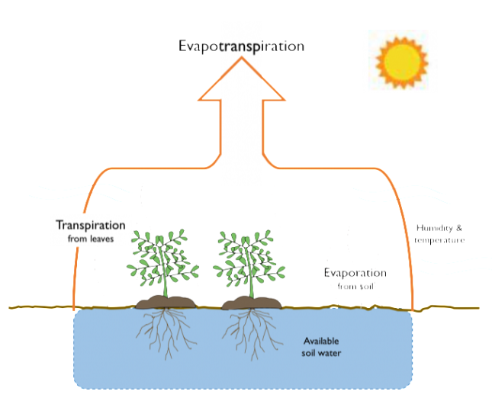
Introduction
EVAPOTRANSPIRATION
= evaporation + transpiration
component of water balance
> 60% of precipitation is evaporated
potential (PET) X actual (AET)
it´s difficult to estimate PET + the accuracy is often questioned
many influencing factors: solar radiation, air temperature, wind speed, air humidity, vegetation, …
INTERCEPTION = capturing water on vegetation
  I = precipitation measured on the open area minus precipitation measured in the forest
currently: rarely measured or measured data rarely used
RESEARCH GAP
Hydrological modeling – both processes often included as simplified component
→ such as coefficients, percent, equation, etc. (e.g. model SWAT – interception of the Norway spruce constantly 2,5 mm)
→ influences the prediction of rate of other water balance components

Slide 3



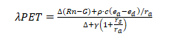
METHODOLOGY: Radiation + PET
Raditation
FAO56 (Allen et al., 1998)
FAO24 (Doorenbos and Pruitt, 1977)
a1= 0,34 b1= 1,35 a2= -0,14 b2= 0,35
a1= 0,34 b1= 0,1
a2= -0,044 b2= 0,9
coefficients based on specific conditions → should be calibrated according
to local conditions
PET
Penman-Monteith (1965)
+ tested other methods
sensitivity analysis; statistics: RMSE, BIAS

Slide 4
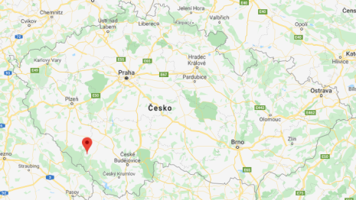
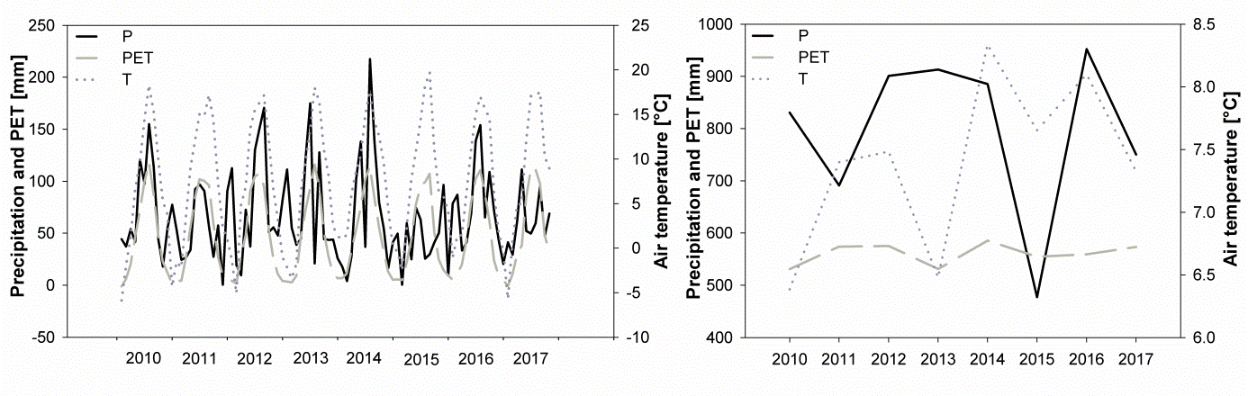
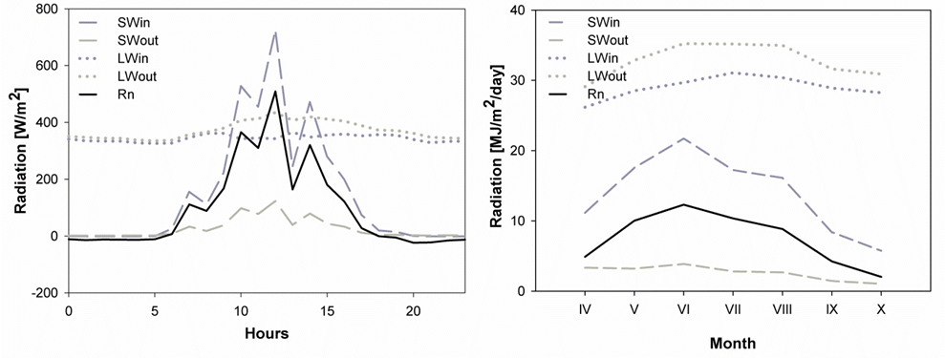
STUDY SITE
Experimentální povodí Liz (49°04´N, 13°41´E)
  monitoring since 1975
  longterm averages: 6,66°C, 851 mm
  radiation measured since 2009
  examined period: 2010-17
Monthly and annual trends in air temperature, precipitation and PET
Daily and mean seasonal trend of radiation balance and its components – shortwave (SW) and longwave (LW radiation

Slide 5
RESULTS: Radiation
FAO56
RMSE: >1,4 MJ.m⁻².day⁻¹
→ 0,8-1 MJ.m⁻².day⁻¹
BIAS: 1-1,5 MJ.m⁻².day⁻¹
→ +/-0,5 MJ.m⁻².day⁻¹
Average daily deviation of modeled Rnl values against measured values (before and after calibration)
FAO24
RMSE: 1-1,5 MJ.m⁻².day⁻¹
→ minimal changes
BIAS: +/-0,5 MJ.m⁻².day⁻¹
→ both decrease and increase

Slide 6
RESULTS: PET
Without calibration: 40-80 mm difference in PET caused by FAO56 X only ~20 mm difference caused by FAO24
After calibration: FAO56 significantly improved in almost all examined years; FAO24 more accurate without calibration
Different results shown also other methods for estimation of PET (PT - Pristley and Taylor, 1972, KP - Kimberley-Penman, 1982; TO - Thom and Oliver, 1977)

Slide 7
INTERCEPTION (I) - Methodology
  measurements: 1 raingauge in the open area, 5 raingauges randomly distributed in the forest
  5 commonly used approaches to evaluate I while using hydrological models: recalculation (model A)
    coefficient 2,2 mm (B)
    percent: I = 25% (C)
    percent: I = 35% (D)
    „linear reservoir“ with volume of 2,2 mm (E)
    „linear reservoir“ with volume of 3,3 mm (F)
  following simulations→ model HBV (Bergström, 1976)
  → How will the different amount of interception affect other component of water balance, especially surface runoff (Q), soil moisture content (SMC) and groundwater height (GWHT)?

Slide 8
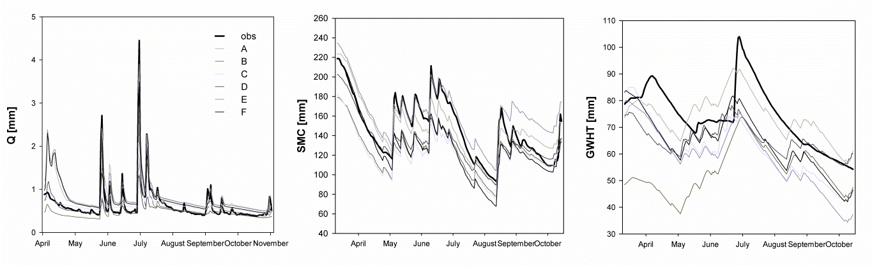
INTERCEPTION (I)
RESULTS
  all models underestimated the rate of interception except model A
  different interception sigificantly affected groundwater height (GWHT)
Runoff (Q), soil moisture content (SMC) and groundwater height (GWHT) trends under
different interception amounts during growing season of 2018

Slide 9
DISCUSSION
GENERALLY:
  the problem of accuracy: the more input parameters (calculated, not measured) the greater probability of inducing a systematic error in estimation
    radiation one of the most important factors (the main source of the energy) →its component – longwave radiation – is rarely measured → Does it lead to systematic error in calculating of PET?
  hydrological models – commonly used with simplified input parameters
In this study:
  overestimation of the FAO56 method in our conditions, resulting in overestimation of PET
    the need of coefficient calibration → FAO56 significantly improved
  in general, FAO24 barely used
  the rate of different interception amounts influences the components of hydrological balance

Slide 10
Summary and conclusions
evapotranspiration one of the most important components of water cycle: difficult to measure → modeled → many approaches originated
longwave radiation rarely measured → also modeled
  2 main approaches: FAO56 & FAO24
  include several coefficients derived on specific conditions → the necessity of coefficient calibration for local conditions
errors in resulting PET decreased to max 20 mm/season after calibration
FAO56
– widely used
– the need of calibration
– after calibration: better corresponding with
measured values
FAO24
– rarely used
→ missing data of daylight hours
– more accurate
before calibration
interception – often neglected but included as parameter in hydrological models
  it has significant influence on other components of water balance
  the best result was achieved by taking off of interception capacity

Slide 11
Thanks for reading!

