Slide 1
Two heads are better than one: A climate services that Integrate Indigenous and Scientific Forecast in Ghana
@ EGU2020: Sharing Geoscience Online
Emmanuel Nyadzi
Saskia E. Werners, Robbert Biesbroek, Fulco Ludwig
08/5/2019

Slide 2
Presentation outline
Introduction
Objective
Study area
Evaluating the techniques and skills for indigenous forecasting
Integrating indigenous and scientific forecast
Major insightS
Conclusion

Slide 3
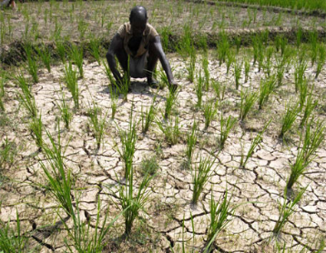
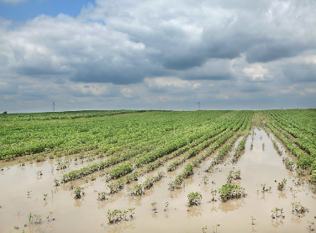
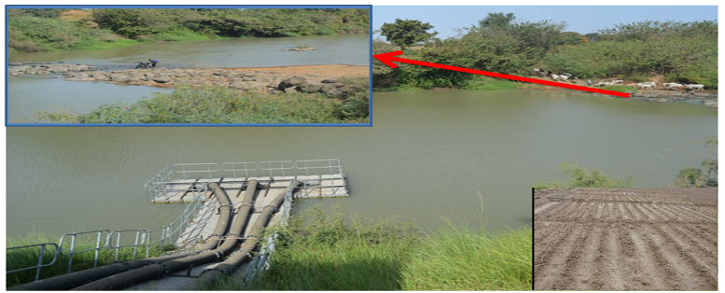
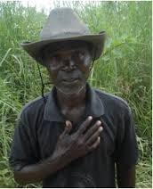
Introduction
Ghana’s agricultural sector depends heavily on (erratic) rainfall making it vulnerable to climate variability and change.
The farmers’ saga: How much rain will there be this year? Will there be another dry spell shortly after the first rain, which could destroy the seedlings? Would it be better to wait and start seeding later?
Farmers use both scientific forecast (SF) from and indigenous forecast (IF) to adjust their farm activities against weather and climate variability and change.
However both IF and SF have distinct weakness which poses challenges for their use. Therefore, increasing number of studies have suggested the integration of both IF and SF.
However, the question that remains is how IF and SF can be integrated whilst respecting the different norms and values?
Farmers troubled with dry spells and flood
Irrigation water managers in limbo
Farmer unable to use existing forecast for their decision making

Slide 4
Objectives
To determine the technique and skills in indigenous weather and seasonal climate forecast
To develop and test a method that objectively integrate Scientific forecast (SF) and Indigenous forecast (IF) into a single improved forecast information.

Slide 5
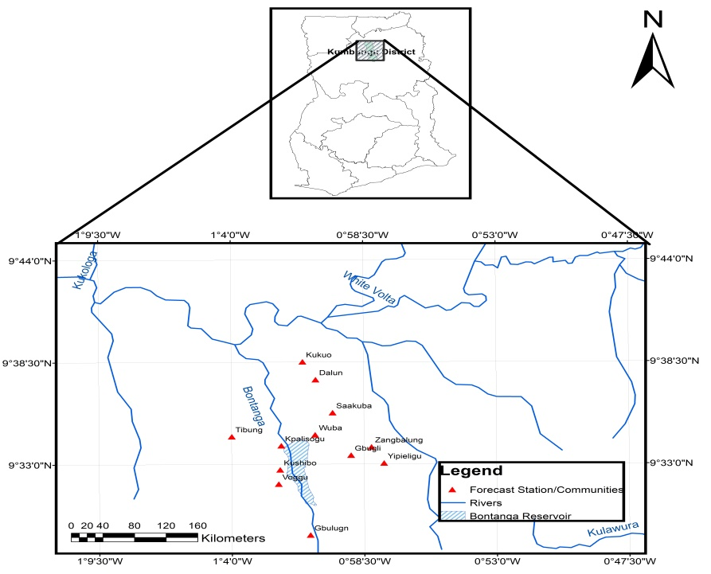
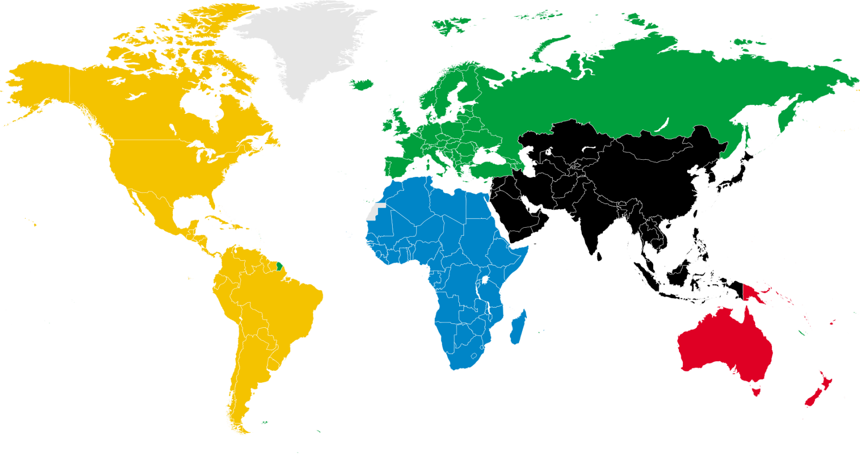
The Study Area
Location
Northern Ghana (Bontanga)
Climate
Tropical Savanna, Temperature :30-40°C
Season: Dry: Nov- April, Rainy: May–Oct
Av. annual Rainfall: 750 mm and 1050 mm
Irrigation
Largest public irrigation schemes in Northern region
570ha irrigable area / 525 farmers / 0.6 ha per farmer

Slide 6
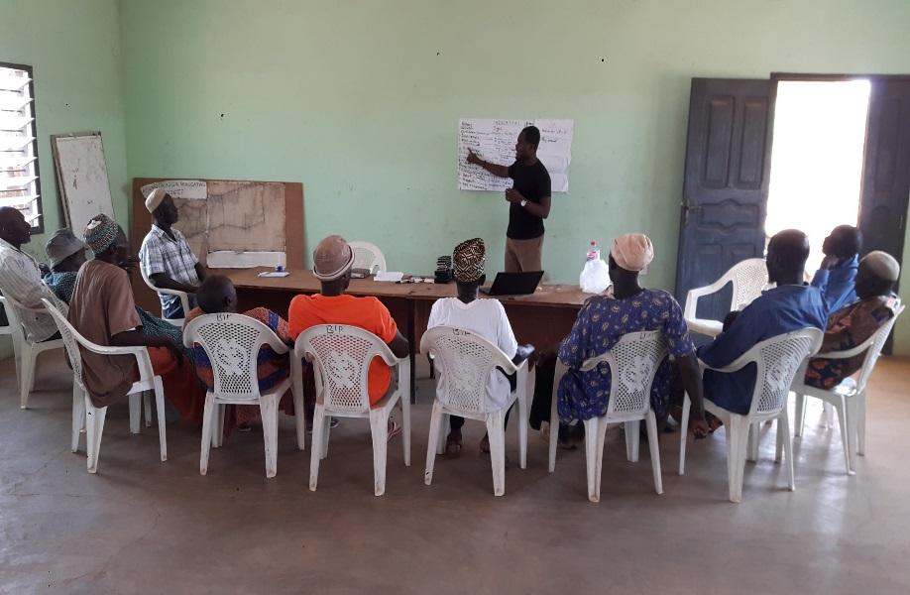
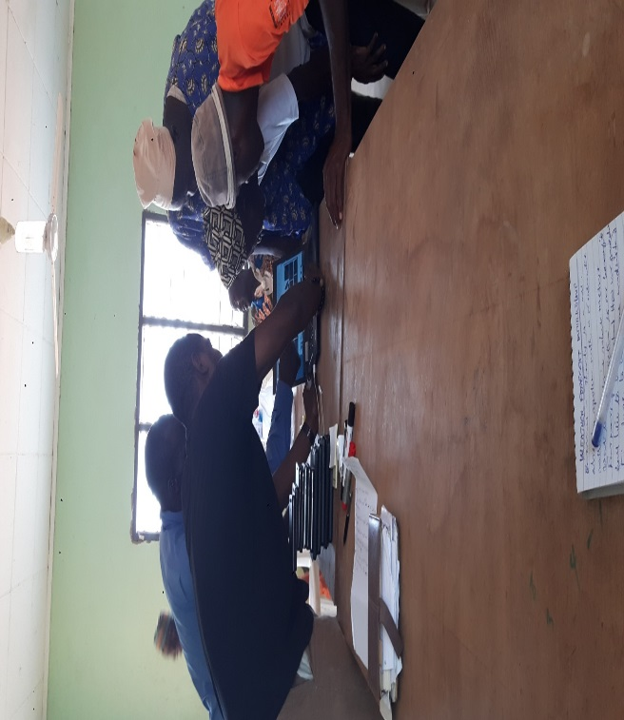
Understanding techniques for Indigenous forecasting

Slide 7
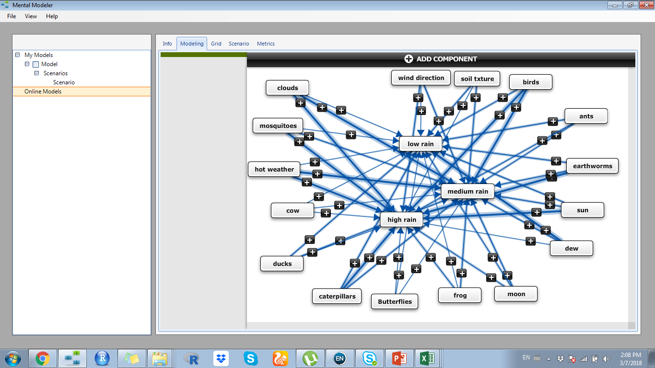
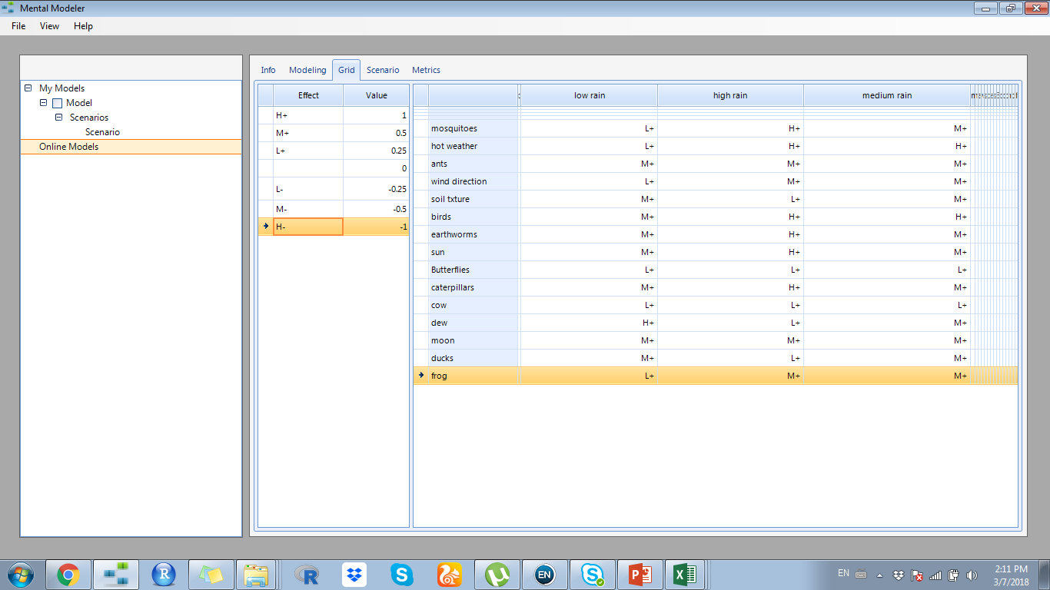
Community mental model for daily weather forecast

Slide 8
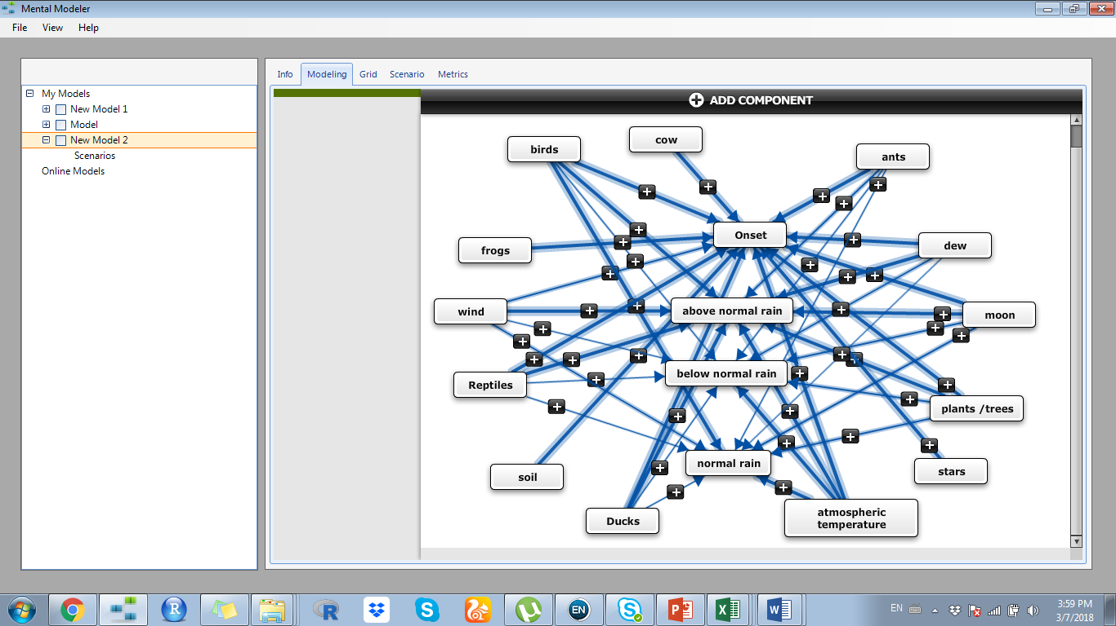
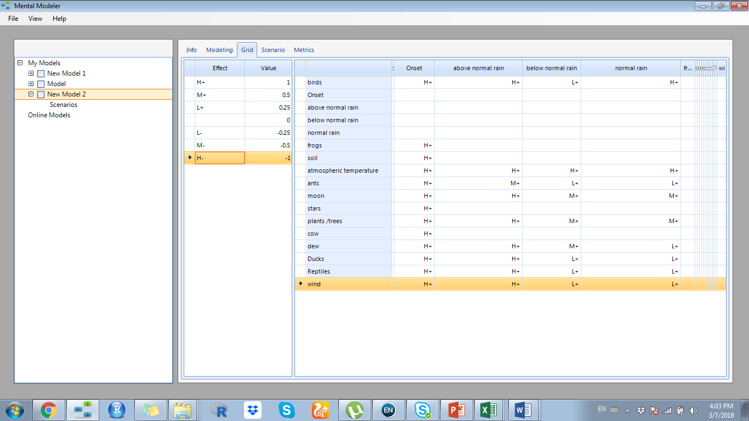
Community mental model for Seasonal Climate forecast

Slide 9
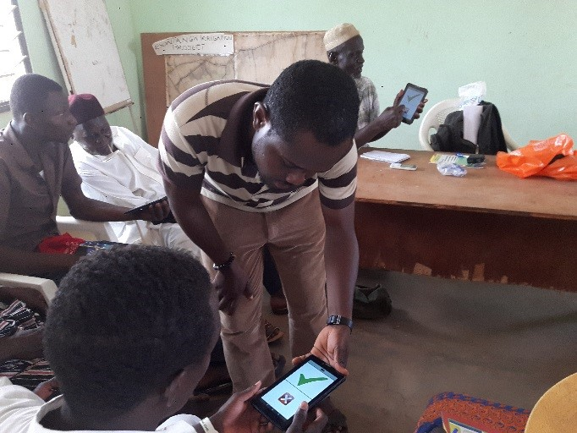
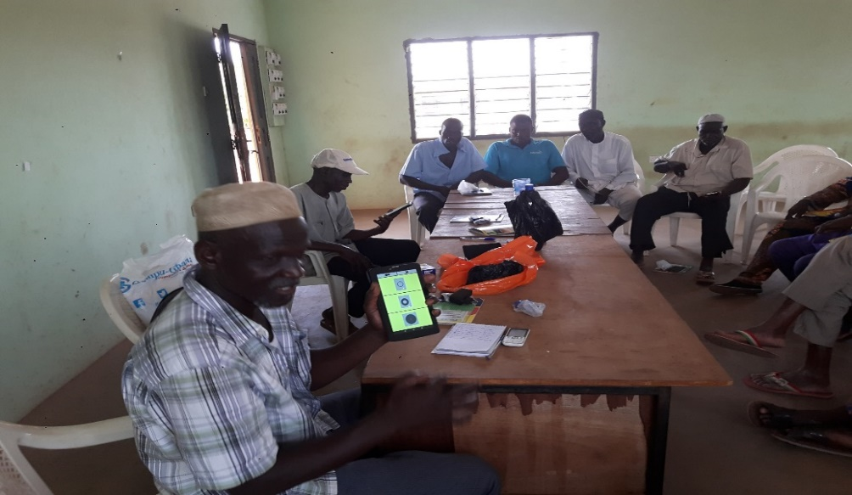
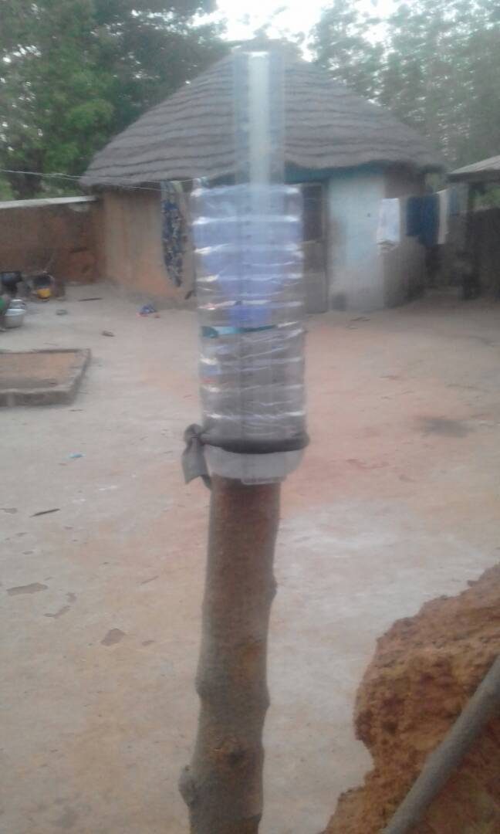
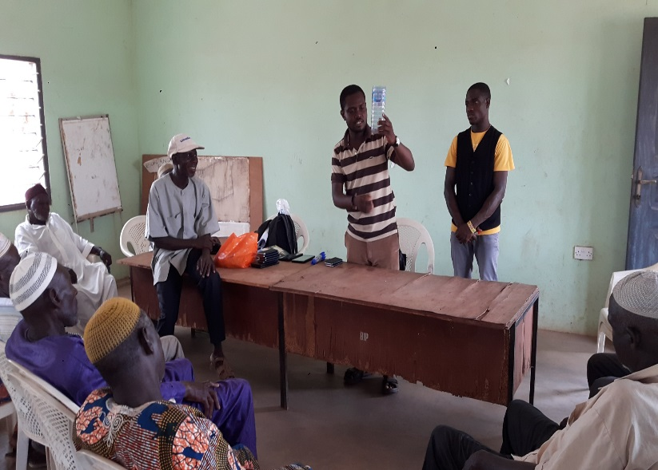
Training; using mobile app and rain gauges

Slide 10
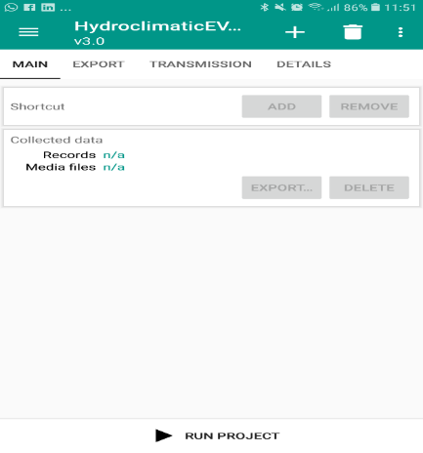
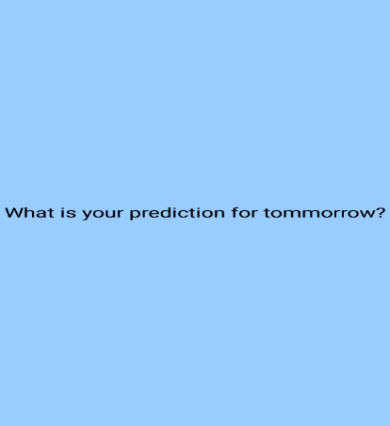
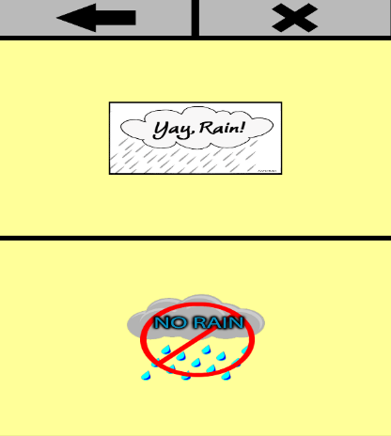
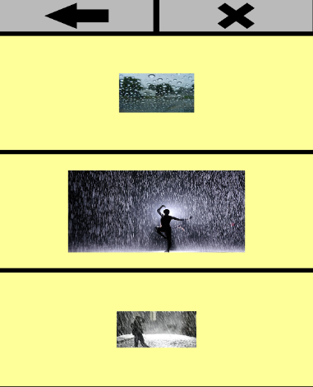
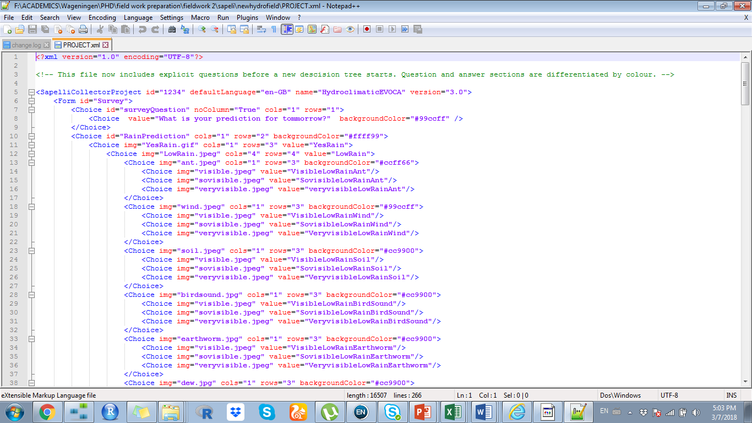
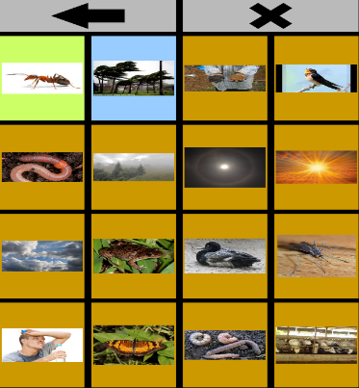
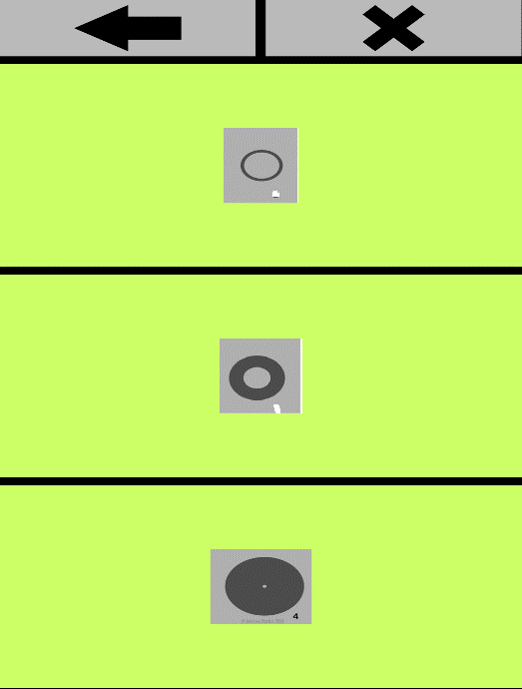
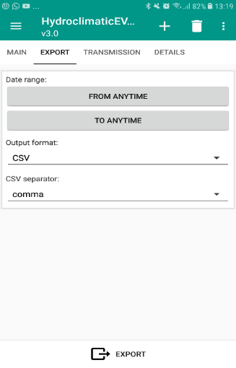
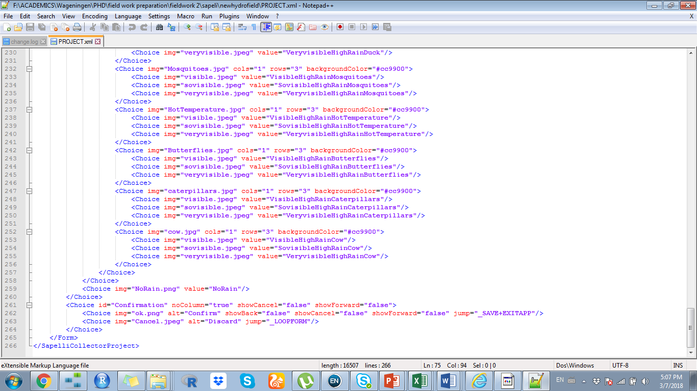
Interface and stages of using the Sapelli app
Type of rianfall
IEIs
Certainty

Slide 11
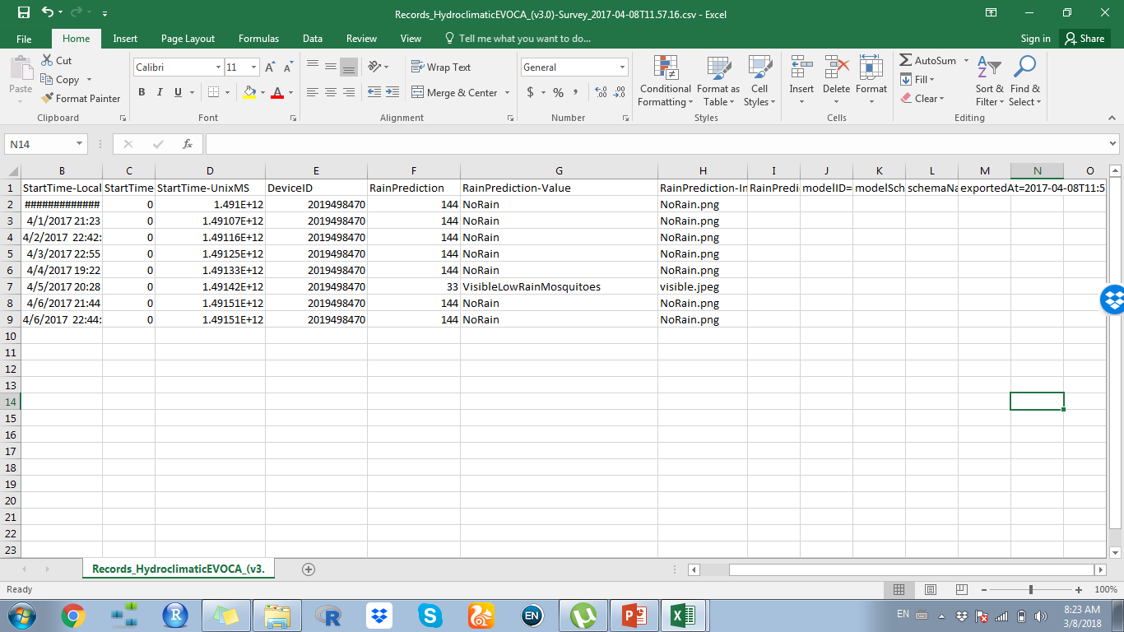
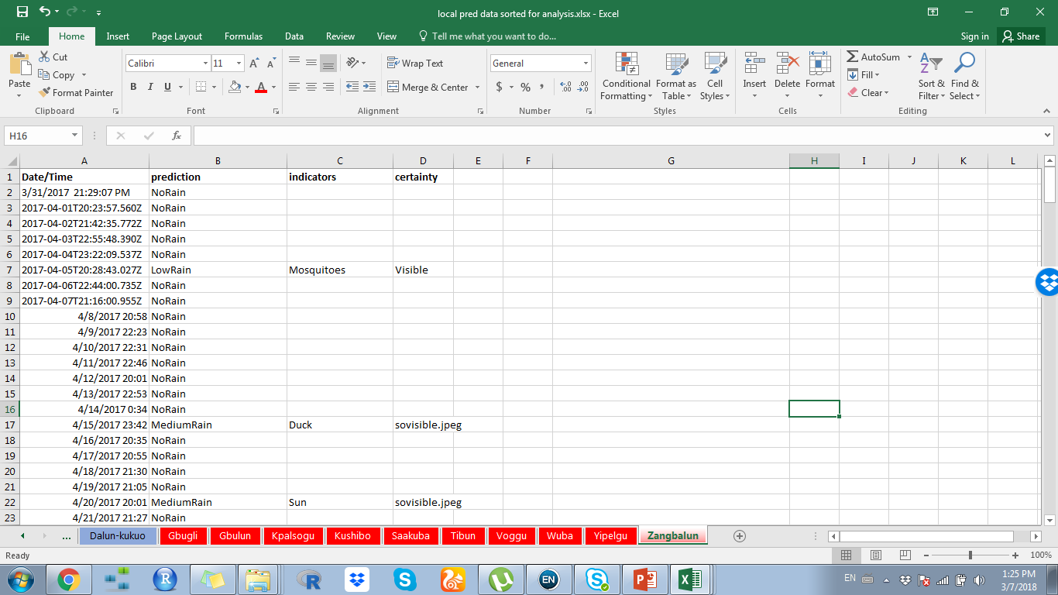
Data Handling
Exported raw rainfall Forecast data from sapelli
Sorted data for analysis

Slide 12
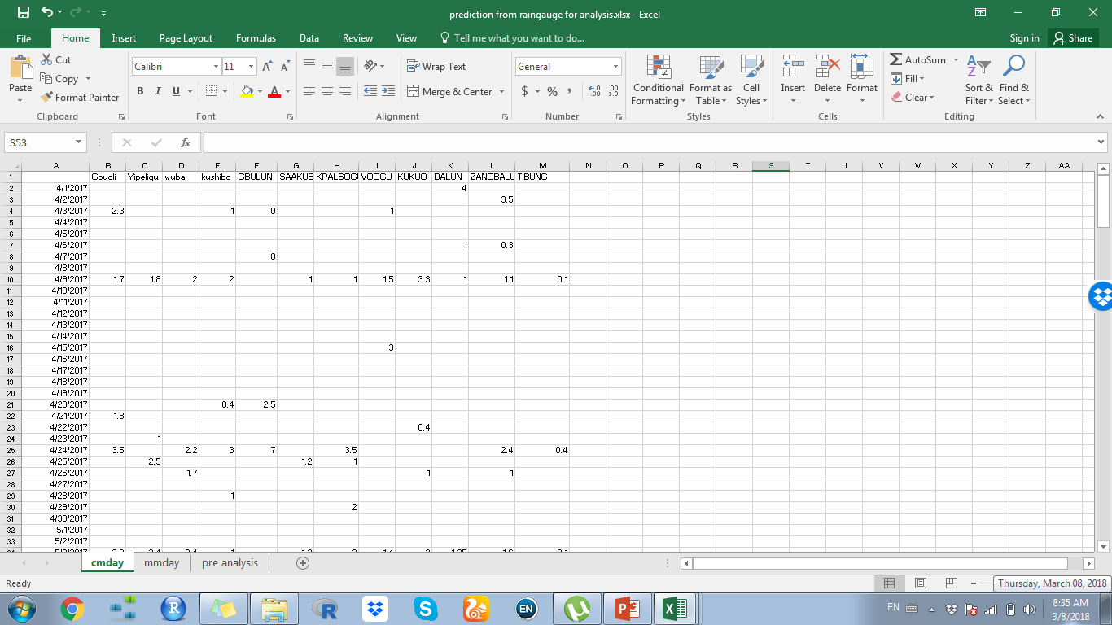
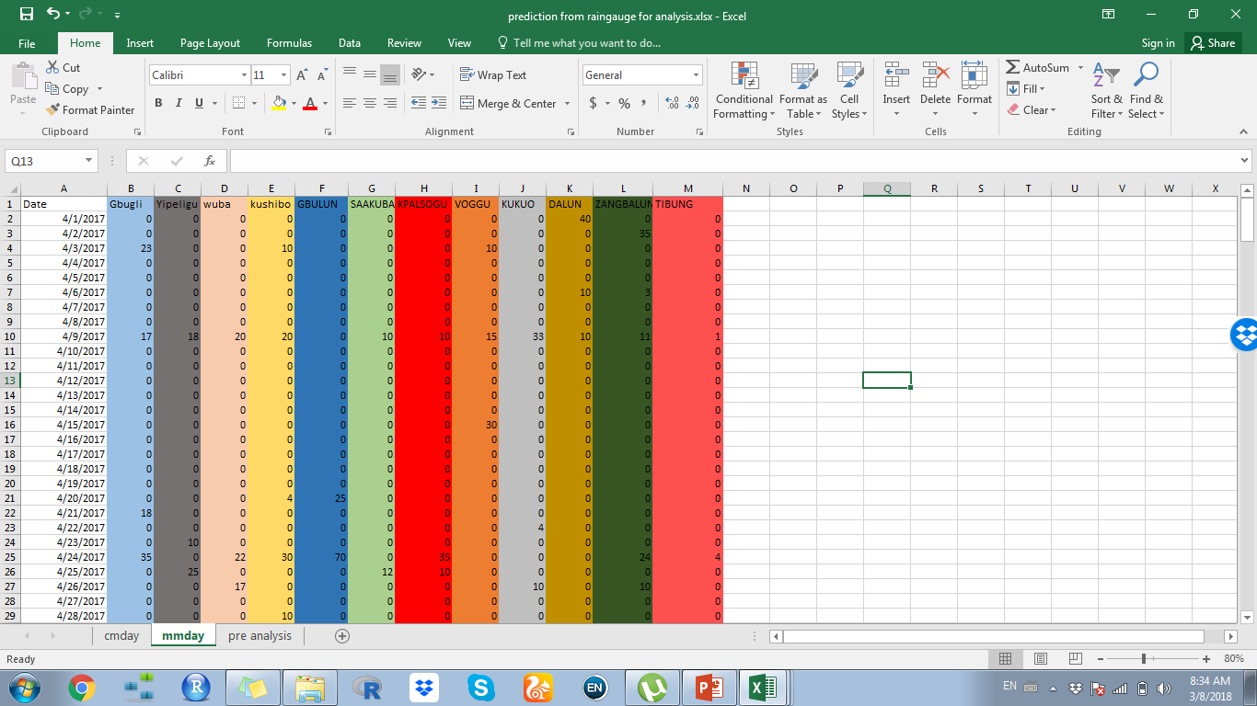
Farmers’ observed rainfall data using Rain Gauge

Slide 13
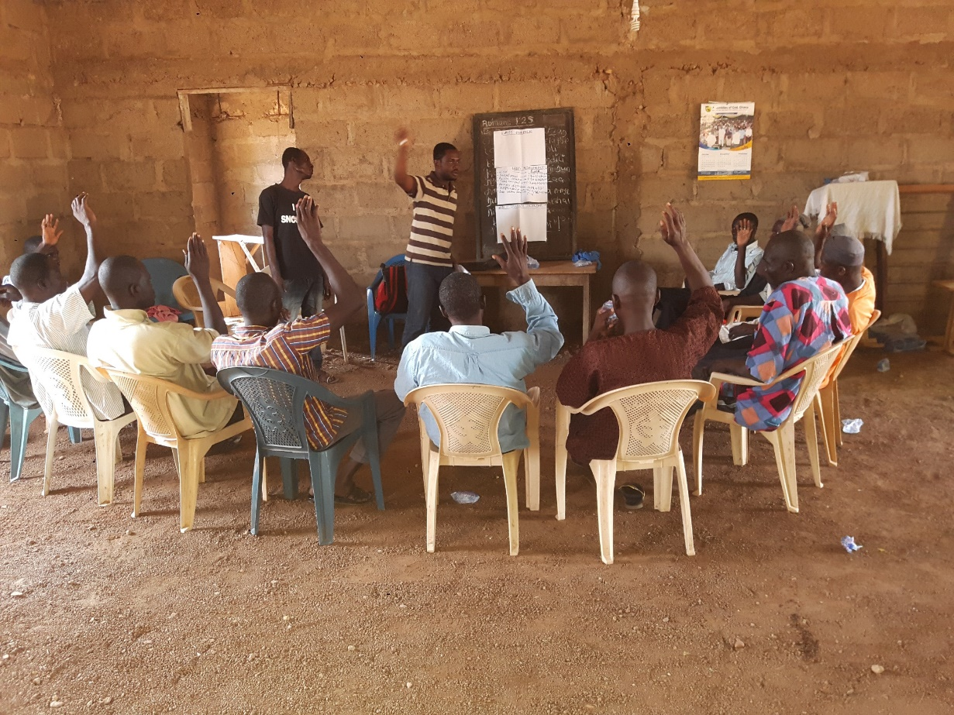
Feedback and Validation

Slide 14
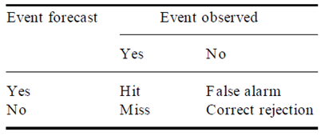
Skills Analysis
Comparison of forecast among farmers and between farmers and Gmet (forecast against observations)
Four possible outcomes for categorical forecast or binary events

Slide 15
Performance evaluation
Daily timescale: On average, both farmers and GMet correctly predict 1/3 daily rainfall events.
Seasonal timescale: Farmers: 33% accurately predict onset. 42% accurately predict rainfall amount and cessation. Gmet: GMet accurately predicted rainfall amount, onset and cessation for 42% and 25% and 0% of the communities respectively.
Reliability and Usability of indigenous Ecological indicators for predicting Yes/No Rain
Least Used
Most Used
Most reliable
Least reliable

Slide 16
Reliability and Usability of indicators for low, medium and high Rain forecast
Low Rainfall Forecast
Most Reliable: Ant
Medium Rainfall forecast
Most Reliable: Cow ,duck, fog
High Rainfall forecast
Most Reliable: Earthworm and Wind

Slide 17
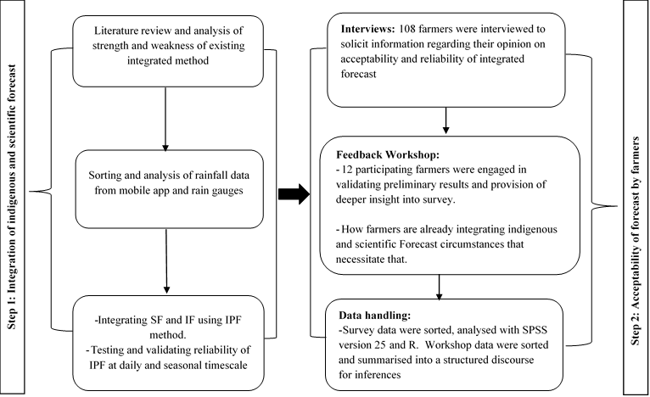
Integrating indigenous and scientific forecast

Slide 18
Formulae for integrating IF and SF; the example of seasonal climate forecast
$CF=\frac{{αX}_{1}+ βX_{2}}{α+β}$ …………………………………………….. Eqn. 1
Where X₁ is the probability of indigenous forecast (IF) and X₂ is the probability of scientific forecast (SF). α is the weighted value for IF and β is the weighted value of SF
Type of forecast | Above normal | Below normal | Near-normal
Indigenous Forecast (IF) | A_{i =} An/T (%) | B_{i=} B_{n} /T (%) | N_{i =} N_{n} /T (%)
Scientific Forecast (SF) | A_{s=} An/T (%) | = B_{s=} B_{n} /T (%) | N_{s=} N_{n} /T (%)
Integrated Probability Forecast (IPF) | $A_{C}(\%)=$ $\frac{{αA}_{i}(\%)+βA_{s}(\%)}{α+β}$ | $$B_{C}\left(\%\right)= \frac{αB_{i}(\%)+βB_{s}(\%)}{α+β}$$ | $$N_{c}(\%)=\frac{{αN}_{i}(\%)+{βN}_{s}(\%)}{α+β}$$
Where A, B and N denotes above-normal, below-normal and near-normal rainfall respectively. T denotes the total number of people who forecast A_{n}, B_{n} and N_{n} denote the number of people who forecast category A, B and N respectively. A_{i} (%), B_{i} (%) and N_{i} (%) denote the probability of occurrence of the indigenous forecast for category A, B and N respectively. A_{s} (%), B_{s} (%) and N_{s} (%) denotes the probability of occurrence of the scientific forecast for category A, B and N respectively A_{c} (%), B_{c} (%) and N_{c} (%) denote the probability of occurrence of combine forecast for category A, B and N respectively. These are the mean of each category for the indigenous and scientific forecast. α is the weighted value for IF and β is the weighted value of SF
Near normal range of 740-1230 mm (GMet, 2017).

Slide 19
Performance of Weather Forecast
Daily Performance of Indigenous(IF), Scientific(SF) and Integrated Probability(IPF) at a resultant probability of >0.5 aggregated on monthly timescale

Slide 20
Performance of seasonal climate forecast
2017 |  |  |  |  | 2018
 | A | N | B | Observed | A | N | B | Observed
Indigenous Forecast(IF) | 33 | 58 | 9 | Near-Normal (741.8 mm) | 50 | 33 | 17 | Above Normal (1316.3)
Scientific Forecast(SF) | 40 | 35 | 25 |  | 35 | 35 | 30
 |  |  |  |  | 43 | 34 | 24
Integrated Probability Forecast (IPF) | 37 | 47 | 17
Performance of IF, SF and IPF and observation for the 2017 and 2018 seasons. A: above-normal; N: near-normal; B: below-normal. Near normal range of 740-1230 mm (GMet, 2017). values in red show the highest probability and direction of the forecast by each forecast system

Slide 21
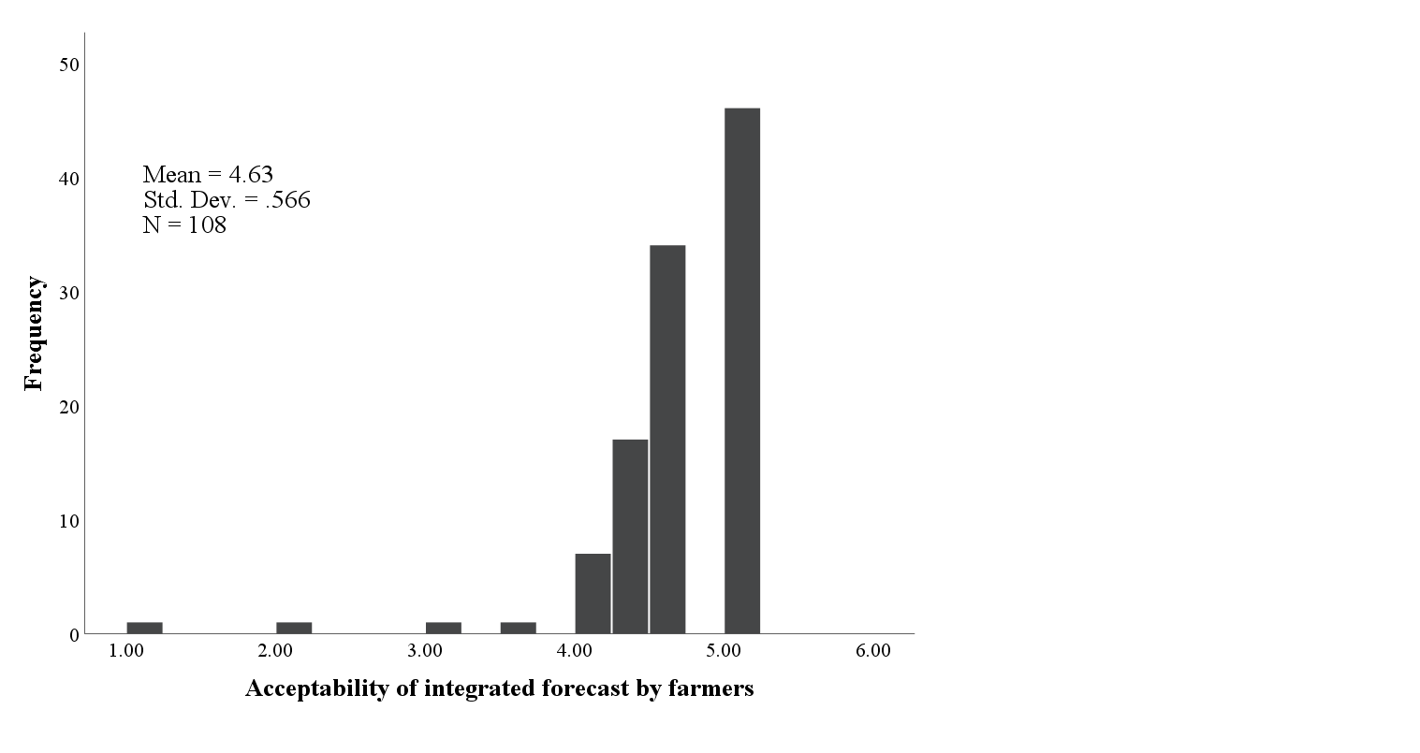
Acceptability of integrated forecast
Figure 4. Measure of acceptability of integrated forecast (Strongly disagree: 1-1.9, Disagree: 2-2.9, Neutral: 3-3.9, Agree: 4-4.9, strongly agree: 5-5.9, I don't know: >6-6.9)

Slide 22
Major Insights
Origin: IF are not intuitive but a skill which is rationally developed and improves with age and experience.
Techniques for IF: observational changes in IEIs such as sound, phenology, shape and movements in the behaviour of animals, plants, insects and heavenly bodies (sun and moon); these have generally held interpretations depending on which event is to be forecast and for short or longer time scale.
Confidence in data quality: Farmers’ observational data show rainfall patterns that are similar to those measured by GMet and shown in Manzanas et al., (2014) and Lacombe et al., (2012).
Limitations: The period of data collection and number of farmers per community does not allow inter-annual variability and variability within community respectively.
The value of integration: It eliminate contradicting forecasts information from different sources; It allow the production of forecast at a finer resolution and location specific; Improve the reputation of IF among policymakers and scientists and SF among farmers due; Improve accuracy of forecast information

Slide 23
CONCLUSION
Local people can contribute to climate science by offering observations and interpretation at a much finer spatial scale with considerable temporal depth, and by highlighting aspects that may not be considered by climate scientists.
A simple combination of SF and IF produces an objective forecast that is generally reliable. In addition, farmers prefer integrated forecast information above indigenous or scientific forecast only.
Thank you for your attention
Contact:
Emmanuel Nyadzi
Wageningen University
(emmanuel.nyadzi@wur.nl / enyadzi@yahoo.com)

