Slide 1
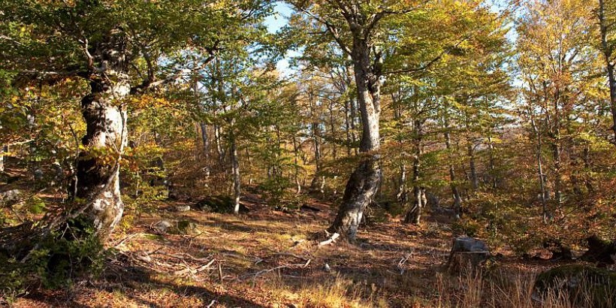
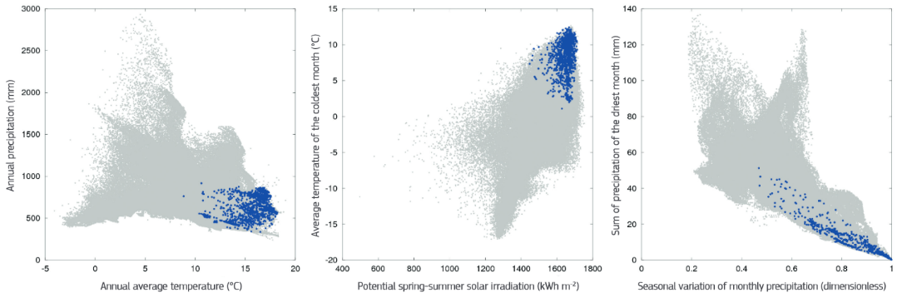






Classification of ligneous vegetation into Plant Functional Types for a dynamic reconstitution of Neolithic vegetation cover in Occitania Mediterranean seashores
Mehdi SAQALLI Marianne CAHIERRE Odile PEYRON
Julien AZUARA Nathalie COMBOURIEU-NEBOUT Marie Alexandrine SICRE
Laurent LESPEZ

Slide 2
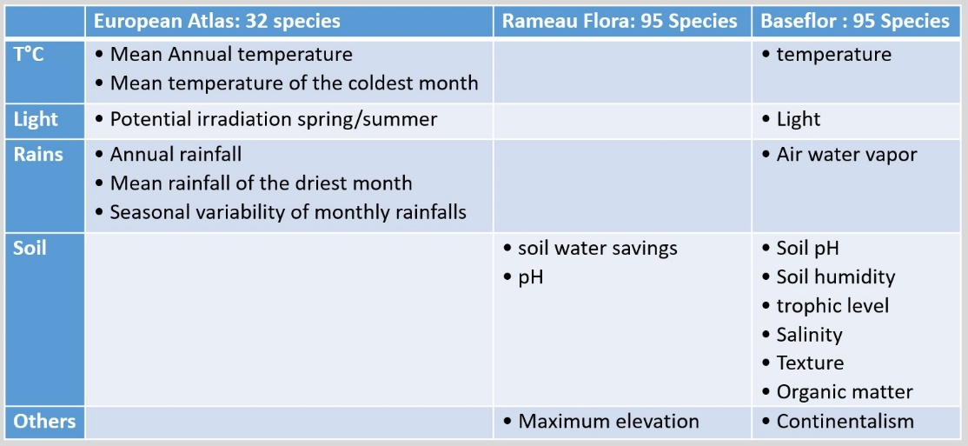
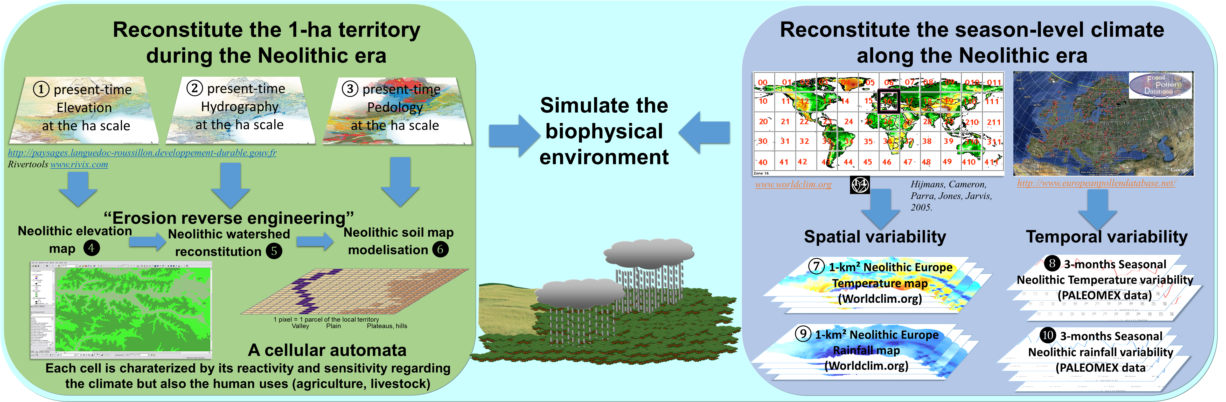

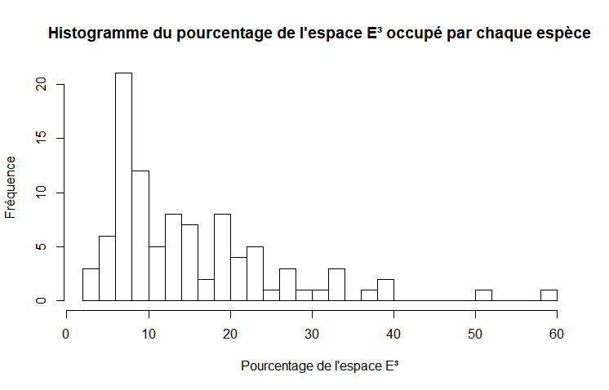
❶ Define all the lineous plants in Languedoc-Roussillon during Neolithic era
❷ Determine their conditions of growth and prosperity from different flora
Neolithics:
WHAT WAS THE VEGETATION COVER?
Paleo : Build a database of species
Botanics: Detemine which variables are crucial
Ecology : Position trees & shrubs within these variables
❸ Define the tree distribution for the 3 crucial factors
Percentage of the E³ space occupied by each species
E³ space:
Mean annual temperature, Soil water balance,
Soil pH
Frequency
% E³

Slide 3
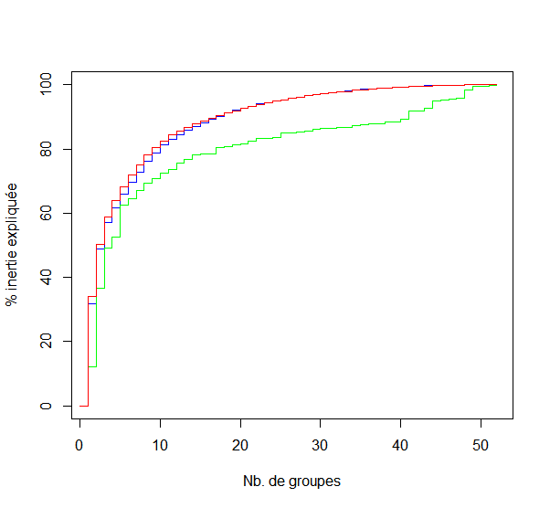
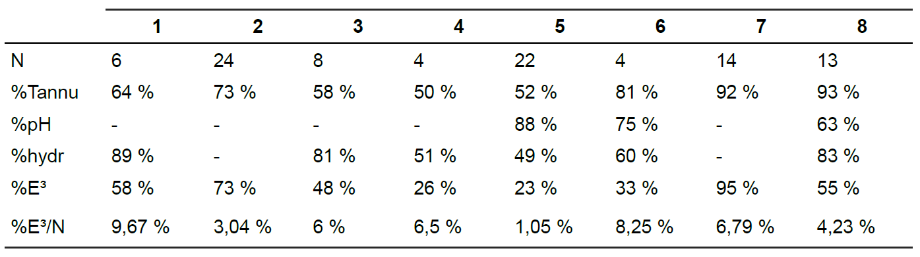
❹ group shrubs & trees in PFTs:
HAC (Ward)
Repeated Kmean
HAC max deviation
For the 43 trees
For the 53 shrubs
PFT: Plant Functional Types
Botanics: based on their ecological response to climate and soils and not taphonomy
8 lineous groups => 80% of uncertainty
  1: cold, mountain (fir, birch, yew, beech, beech tree, linden tree)
  2: broad spectrum: temperate forest and pioneer trees
  3: restricted, warm: Mediterranean trees (pines, pistachios, etc.).
  4: restricted: hygrophilous trees (oak, alder, burdock, willow).
  5: restricted, warm: thermophilic bushes
  6: Acidic, hot, humid (heather...)
  7: pioneer bushes (willows, junipers)
  8: humid, very restricted on the temperature side (muddy, buckthorn...)
❺ 8 PFTs

