Slide 1
Talking WITH not AT
J. Thielen-del Pozo, A. Eeckels, P. Hearn, A.-M. Jensen-Foreman, and J. Glovicko
EGU, Session US4, Online, 4-8 May 2020
Notes:
Some of my background

Slide 2
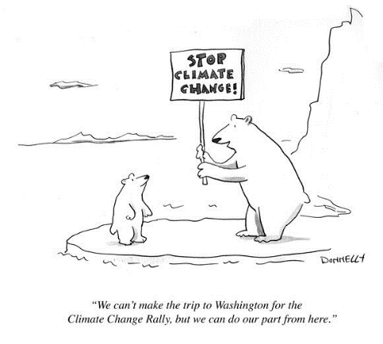
Science communication and climate change

Slide 3
The outline of this talk
At the end of this talk we will have made two points:
Scientists have a responsibility in providing support to policy makers and society in shaping our future.
Scientists must continue to do excellent research as well as communicating with policy makers and society.
We will also show some examples of how the JRC is addressing this.

Slide 4
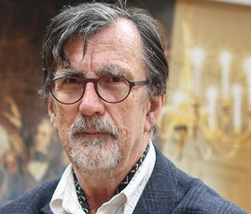
Science-policy-society interface is crucial
(B. Latour)
Bruno Latour:
"To have common facts, you need a common reality - Large groups of people are living in a different world with different realities [where the climate is not changing.]
Science and technology cannot be separated from politics! (The same applies to science and climate change/ activism)
Now, scientists have to win back respect. But the solution is the same: You need to present science as science in action. I agree that’s risky, because we make the uncertainties and controversies explicit."
Bruno Latour
(1947- )
https://www.sciencemag.org/news/2017/10/bruno-latour-veteran-science-wars-has-new-mission
Notes:
Crisis of representation implies understanding difference between matters of fact versus matters of concern: Scientists should explicitly state their interests and values

Slide 5
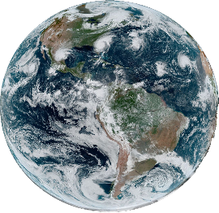
Science-Policy-Society – an algorithm?
Science
Theories
Data
Modelling
Evidences
Uncertainties
Recommendations
Policy
Set Agenda
Formulate Policy
Cost-benefit analysis
Implement
Monitor
Evaluate
Society
Huge reservoir of tacit and formal knowledge,
Big data, driver by voicing concerns
Notes:
Society:
A huge reservoir of both tacit and formal knowledge
directly linked to all sectors, whether economy, enviroment, health, …
Adapting to pressures and drivers or reacting with a certain resilience
Not passive but active shaping its environments and living conditions
Policy:
Policy makers analyse societal issues, pressures but also get input from scientists, lobbyist, stakeholders
Role of policy is to shape the future of our societies, give boundaries
Science
provides both foresight and solutions, thus shapes policy at its beginning, during implementation and in the evaluation.
Science plays a pivotal role for our society
Scin

Slide 6
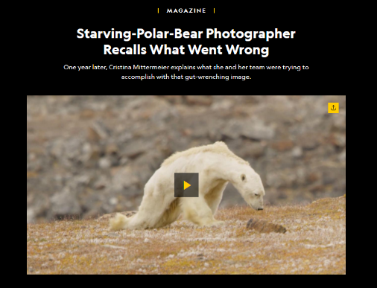
Communication is key
https://www.nationalgeographic.com/magazine/2018/08/explore-through-the-lens-starving-polar-bear-photo/

Slide 7
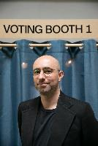
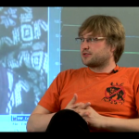
Paradigm shift in communication
(Jan.glovicko@ec.europa.eu)
Big Data/AI
society as data provider
multidirectional data and information sharing
allows citizen empowerment
allows construction of common knowledge base
From face-to-face to smartphone to smartphone
Image from: Smartappspro.com
Neuroscience:
Bio-tech solutions to non-verbal communication is not SciFi anymore (A. Valjamae’s neurocinema
Notes:
Applications such as Google maps or smartphones and other smart-wearable-devices provide individuals with added-value data, saving them time in traffic or helping them monitor their health status. Nowadays, if you fall asleep in the morning, your smartphone will calculate your fastest route to work, locate for you the closest electric bike or scooter, recommend for you a coffee place with the shortest customer queue and ultimately ensure your arrival to the office on time.

Slide 8
Communicating clearly – not infantilising
(Jan.glovicko@ec.europa.eu)
JRC Clear Writers' Network
Scientific developments can go to waste if policymakers do not understand them, and we risk alienating citizens.
Tailored training & step-by-step tools
better quality documents, e.g. executive summaries
Positive feedback back and improved visibility
Lesson learned:
clarity but no dumbing down;
Quick take up
Notes:
Under WHY: also refer to UvdL communication priorities
Tailored training, e.g.
Journalistic skills to write about science
How to write an executive summary
Translating science for policymakers
step-by-step tools, e.g.
Outline differences between abstracts, introductions, prefaces, executive summaries etc.
editing, and
dialogue via meetings and an interactive ‘one-stop-shop’ on our intranet
complementarity with Commission clear writing initiatives
WHO: Network of scientists from all JRC Directorates
[insert image of 'rings-in-the-water' which appears upon animation after the last word (Directorates)

Slide 9
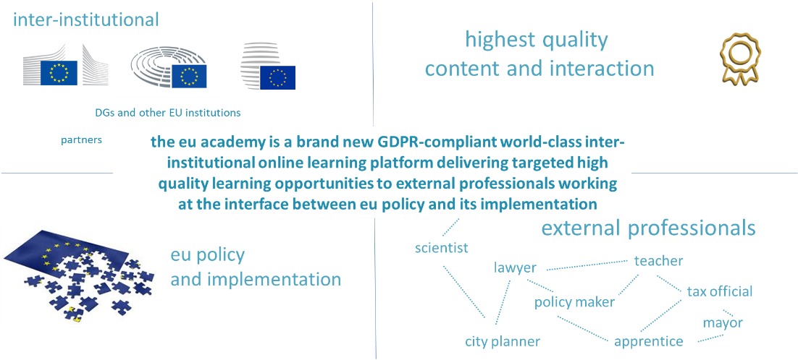
Putting people into focus – Interactive learning
(paul.hearn@ec.europa.eu)
e(u) academy: Visit us from July at academy.europa.eu!

Slide 10
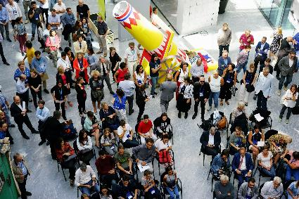
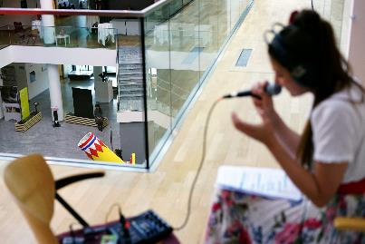
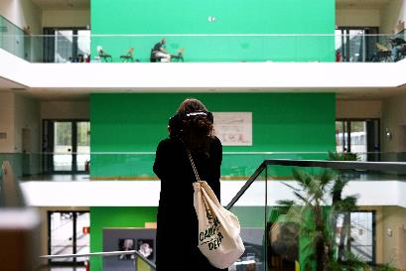
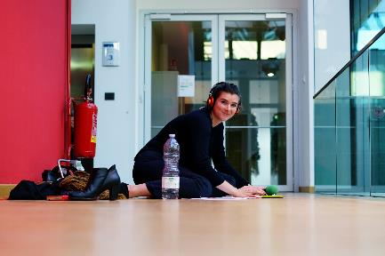
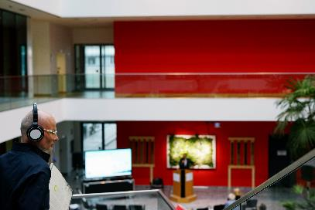
Engaging with the public – Science and Art
(adriaan.eeckels@ec.europa.eu)

Slide 11
Dialogue between artists and scientists
Power of scientific concept and artistic beauty of visualisation
A. Peterhaensel : Resonances in VR - Interactive Big Data sculpture dealing with human-induced climate change (Resonances III datami 2019/2020)

Slide 12
Accept the power of diversity
Let the arts do the talking! Scientific curiosity follows
Create safe spaces for scientists and artists to think free
R. Quehenberger : Gaia 5.0 A Holographic Image – Ambience (Resonances III datami 2019/2020)
Notes:
Power to keep silent

Slide 13
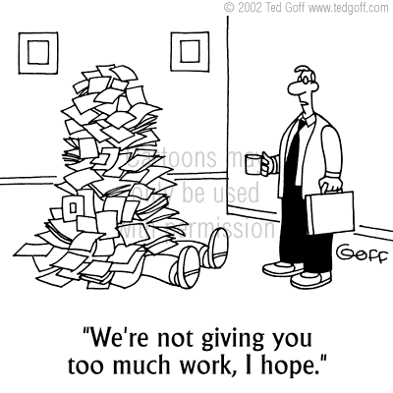
Concluding, it means that scientists must …
keep doing excellent science with vigorous peer review by the scientific community,
deliver top notch science to policy makers when needed and in a clear and easy to understand format
as well as engaging with society, understanding concerns and psychology behind issues, explaining uncertainties, (re)gaining credibility
https://www.tedgoff.com/catalog/browseall/1991.html

