Slide 1



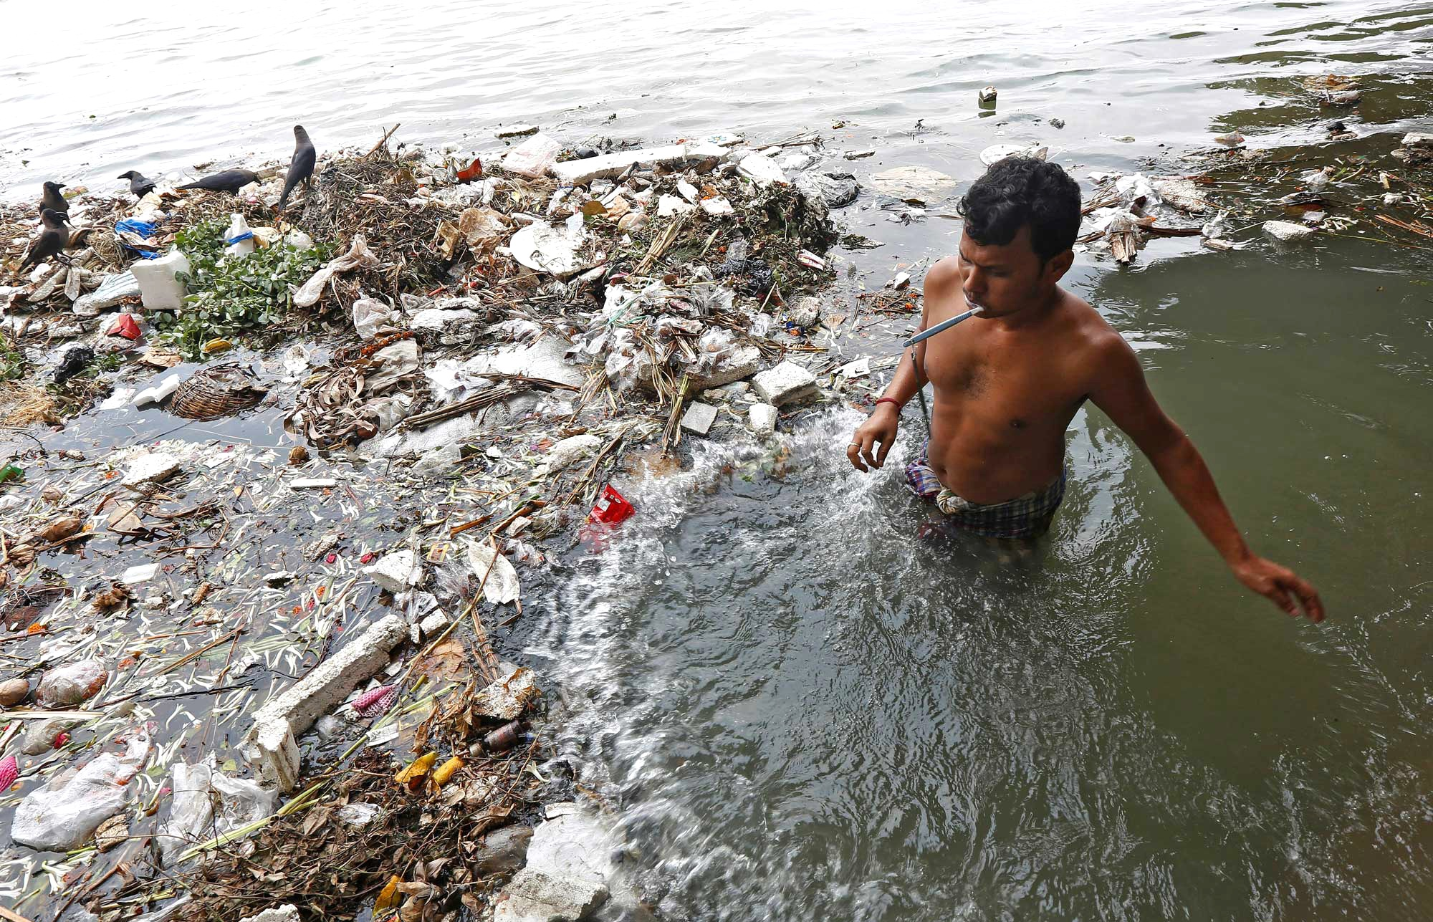
Sociohydrology can help address the Global Water Crisis
and meet the Sustainable Development Goals
Giuliano Di Baldassarre*, Murugesu Sivapalan, Maria Rusca, Christophe Cudennec, Margaret Garcia
Heidi Kreibich, Megan Konar, Elena Mondino, Johanna Mård, Saket Pande, Matthew R. Sanderson, Fuqiang Tian Alberto Viglione, Jing Wei, Yongping Wei, David J. Yu, Veena Srinivasan & Guenter Bloeschl
*Uppsala University, Department of Earth Sciences, Centre of Natural Hazards & Disaster Science, CNDS, Sweden

Slide 2
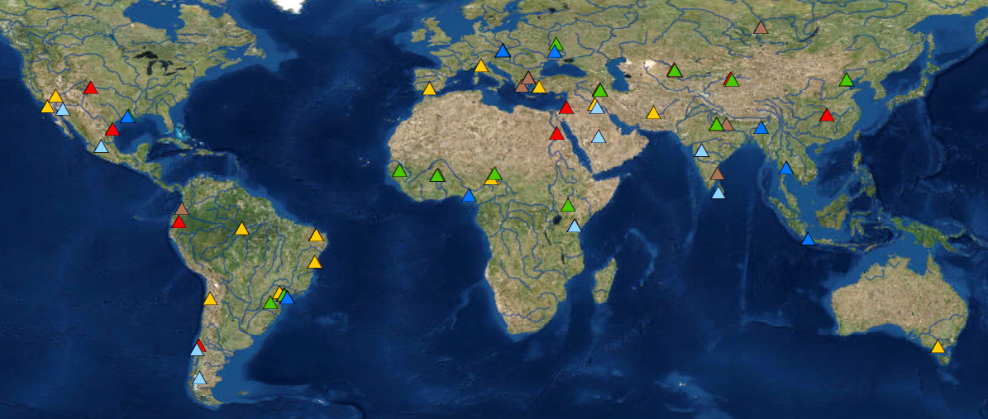
Global water crisis
Complex web of interactions between social, technical and hydrological factors
Survey of water scientists/experts (AGU & IAHS)
types
factors
Ecological degradation
Growing
population
Increasing
flood risk
Increasing
water demand
Water
conflict
Broadening groundwater access
Water
pollution
Weakening water governance
Groundwater depletion
Building
large dams
Increasing drought risk
Changing
climate
(Srinivasan et al., Water Resources Research, 2012; Di Baldassarre et al., Water Resources Research, 2019)

Slide 3
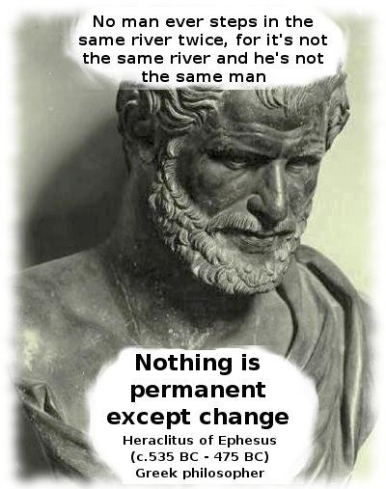
Panta Rhei –Everything Flows
IAHS research decade (2013-2022)
Change in hydrology and society
Over 300 water scientists
(Montanari et al., 2013; McMillan at al., 2016; Di Baldassarre et al., 2019)

Slide 4
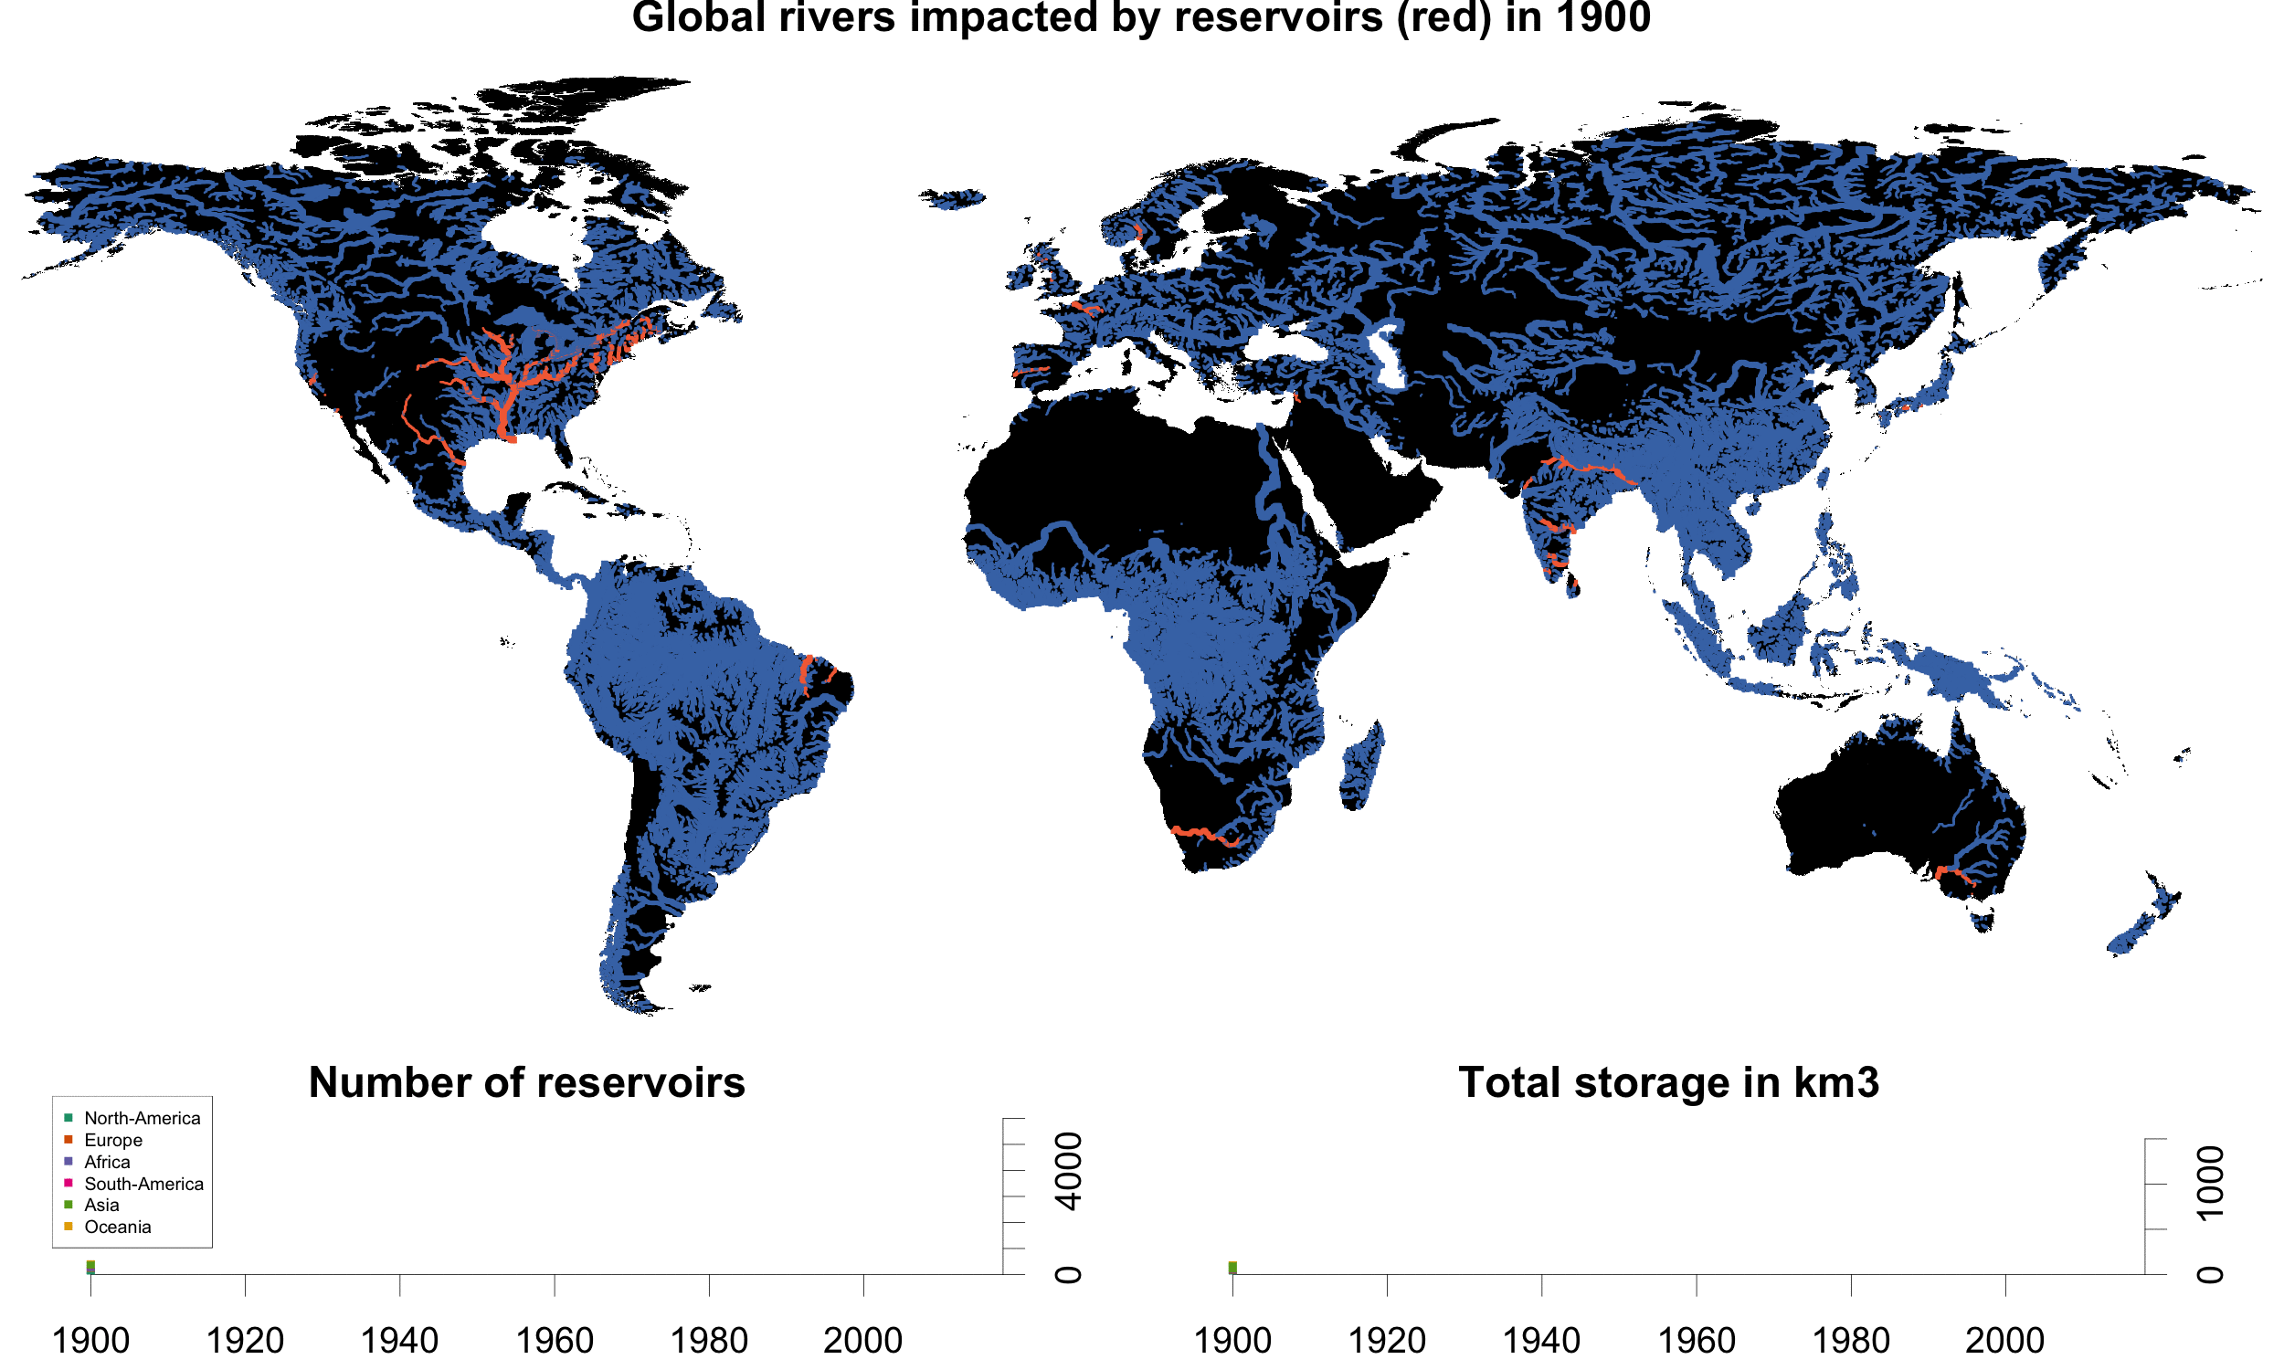
Society shapes hydrology
    Humans alter the hydrological regime
    Deliberately
      Water infrastructure
      Risk reduction measures
    Accidentally
      Land-use change
      Unintended effects
(Di Baldassarre et al., Nature Sustainability, 2018)

Slide 5
Hydrology shapes society
    Humans respond to hydrological change
    Formally
      Conservation measures
      Water infrastructure
    Informally
      Migration
      Conflict and cooperation
Water consumptions in Cape Town, South Africa
drought
onset
start of
restrictions
end of
restrictions
(Savelli et al., under review)
Notes:
We lack fundamental understanding because current apporaches focus on one-way relationships…

Slide 6
Sociohydrology
Understanding (and modelling) phenomena generated by this mutual shaping
Long history
Water resources systems (Harvard water program)
Integrated water resources management (IWRM)
Social-ecological systems (SES) and coupled human-nature systems (CHNS)
(Sivapalan et al., 2012; Srinivasan et al., 2012; Di Baldassarre et al., 2013; Gober and Wheater, 2015; Troy at al., 2015; Sivapalan and Blöschl, 2015; Pande and Savenije, 2016)

Slide 7
Mutual shaping: Phenomena
supply-demand cycle
rebound effect
reservoirs → worsen shortage
efficient irrigation → more use
safe-development paradox
(mal)adaptation effect
higher levees → increasing damage
response to drought → worsen floods
Notes:
Why can… eventually/often lead to ... ?

Slide 8
Sociohydrological modelling
System dynamic models to explain past changes and explore future trade-offs
Human-flood interactions (example)
Flood memory as a primary mechanism
Explain phenomena
  Adaptation
  Levee effect (safe-development paradox)
(Di Baldassarre et al., HESS, 2013)

Slide 9
Green system
Technical system
memory
memory
Trade-off?
damage
damage

Slide 10

Addressing the SDGs
System dynamic models can help unravel trade-offs to meet water-related SDG targets
(United Nations, 2015)

Slide 11
Phenomena
vs.
SDG targets
(water related)

Slide 12
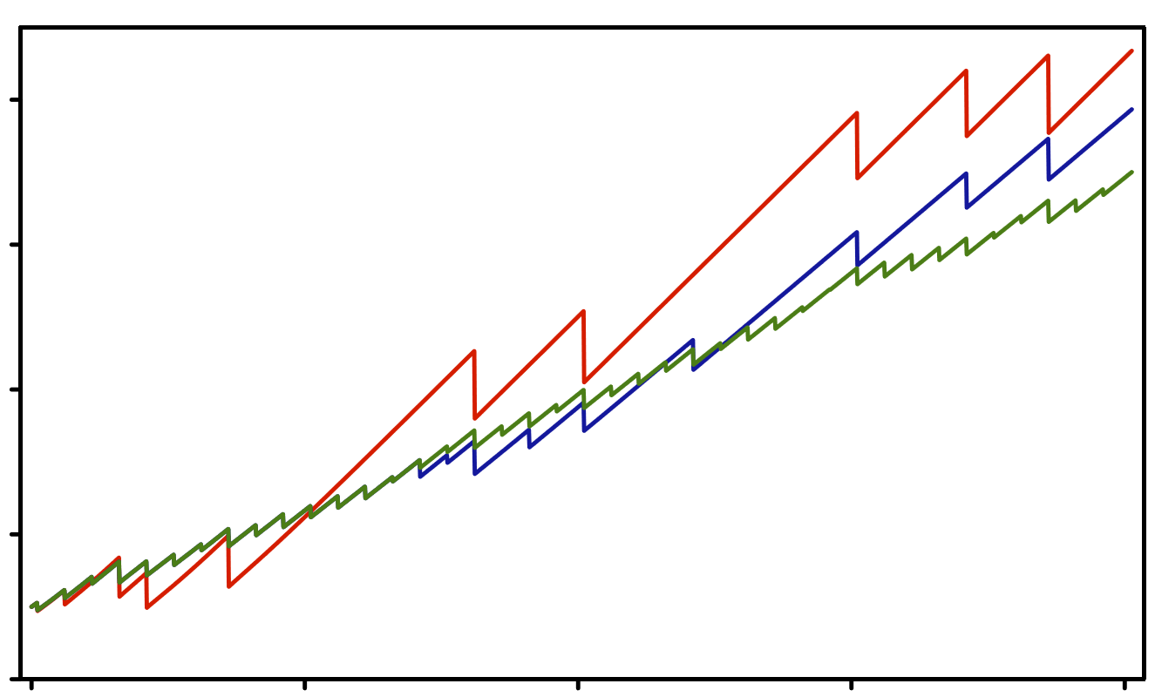
Modelling human-flood interactions
Green system
Technical system
Trade-off?
wealth
1900
1950
2000
2050
2100
(Di Baldassarre et al., HESS, 2013)

Slide 13
Addressing the SDGs (2030)
Phenomena (e.g. supply-demand cycle) as legacy
“As the past was a legacy to the present, the present is a legacy for the future”
Long-term policy
Short-term policy
(Di Baldassarre et al., Water Resources Research, 2019)

Slide 14
Addressing the SDGs (2030)
Phenomena (e.g. supply-demand cycle) as legacy
“As the past was a legacy to the present, the present is a legacy for the future”
Models can help reduce legacy risks
Avoid fixes that backfire in the long run
Short-term policy
Long-term policy
(Di Baldassarre et al., Water Resources Research, 2019)

Slide 15
How sociohydrology can help address
the global water crisis
Understanding and modelling trade-offs
  Short and long term effects (path dependency)
  Economic, social and environmental (intended and unintended) consequences
  Uneven distribution of costs and benefits across social groups (water justice)

Slide 16
