Slide 1
Hyperspectral A-band retrievals of cloud droplet number concentration from OCO-2
Mark Richardson^{1,2}, Matthew D. Lebsock¹, Graeme L. Stephens^{1,3,4}
¹Jet Propulsion Laboratory, California Institute of Technology
²UCLA JIFRESSE
³CIRA, Colorado State University
⁴⁼Department of Meteorology, University of Reading
©2020. California Institute of Technology. Government sponsorship acknowledged.

Slide 2
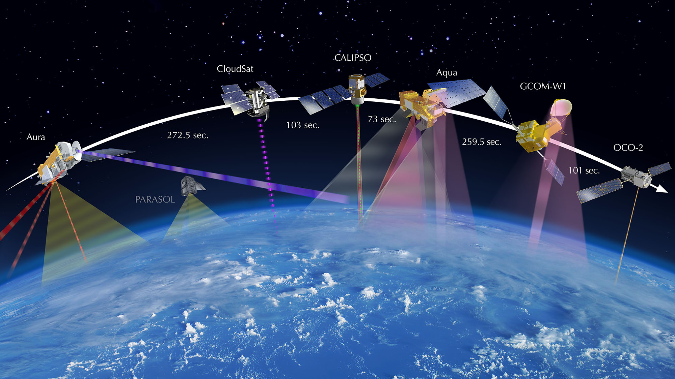
OCO-2 leads the A-Train.
It measures reflected sunlight: swath of 8 footprints, ~1.4 km x 2.2 km at nadir
Hyperspectral O2 A-band (~.78 um), plus weak and strong CO2 bands

Slide 3
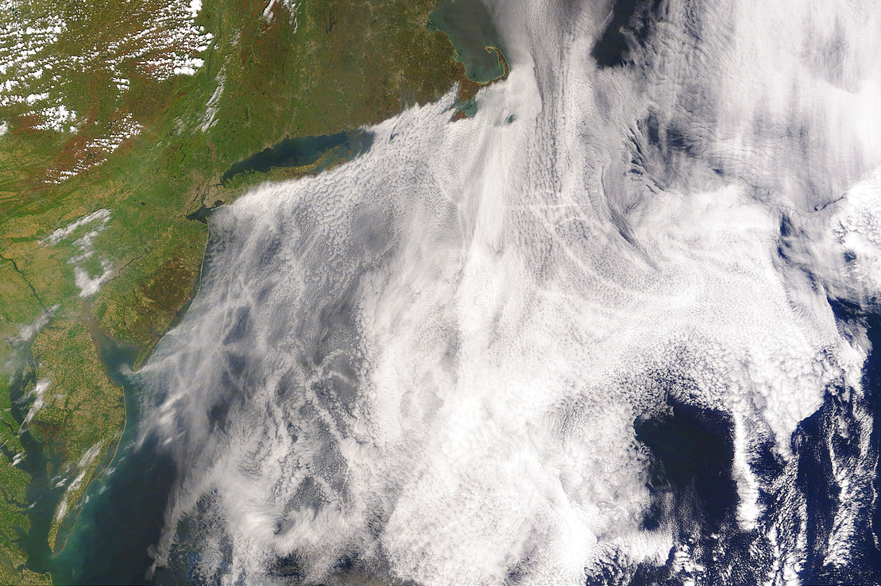
We only target liquid marine clouds, high droplet number concentration (N_{d}) and lower effective radius (r_{e}) strips here are more reflective strong, they affect radiation balance. A common cause is ship track pollution acting as condensation nuclei.
Source: NASA http://earthobservatory.nasa.gov/IOTD/view.php?id=5488

Slide 4
This is an OCO-2 A-band spectrum showing its incredible spectral resolution.
Absorption band depths are from molecular absorption strength (which we know pretty well) and the distance travelled by the photons.
Longer distance above cloud = lower cloud top = deeper bands.
Longer distance inside cloud = droplets further apart (low N_{d}) = deeper bands.
Theoretically we can retrieve P_{top} + N_{d}:
Richardson & Stephens (2018, doi: 10.5194/amt-11-1515-2018)
Richardson et al. (2019, doi: 10.5194/amt-12-1717-2019)

Slide 5
Next three slides repeat point with pictures.

Slide 6
Light travels to cloud, bounces around inside, and escapes
Extinction

Slide 7
If the cloud is lower, light travels further → more absorption by atmospheric O₂
Extinction
Extinction

Slide 8
If the cloud is stretched so droplets are further apart (lower N_{d}, higher H) → more absorption by atmospheric O₂
Extinction
Extinction

Slide 9
Our retrieval
Our retrieval is Bayesian: it needs prior cloud state estimate then does an (expensive!) iterative optimal estimation (Rogers, 2000).
We published combined CALIPSO-OCO-2 retrieval OCO2CLD-LIDAR-AUX at: http://www.cloudsat.cira.colostate.edu/data-products/level-aux/oco2cld-lidar-aux
This got 𝝉, P_{top} and geometric thickness
Now CALIPSO is falling out of the A-Train so we need to replace its contribution of (i) identifying the right clouds (liquid, single layer) and (ii) getting cloud prior properties.
We also want to get r_{e} so we can retrieve N_{d}

Slide 10
Step 1: find retrievable cloudy footprints
Look for single layer liquid clouds of 𝝉 > 1
Use collocated CALIPSO phase/layering and MODIS 𝝉 as “truth”
Train neural using different band radiances and includes A-band ratios:
AGREEMENT: ~90 %,
FALSE POSITIVES: ~7 %,
FALSE NEGATIVES: ~3 %

Slide 11
Step 2: Get cloud prior (which is also our first guess)
Nakajima-King using A-band and 2.1 micron CO2 band (2 dimensions that mostly tell you about 𝝉-r_{e})
Add a third dimension using a single A-band ratio, mostly tells you about P_{top}.
This is only our first guess: expect improvements from optimal estimation that also fits N_{d}.

Slide 12
(Left) example of the O2 and strong CO2 bands at different 𝝉 & r_{e}, (right) typical range of A-band ratios with changing P_{top}.

Slide 13
(a) OCO-2 vs MODIS 𝝉 (b) OCO-2 vs MODIS r_{e} Discrepancies are well within MODIS-reported uncertainties. Conclusion: 𝝉 & r_{e} prior estimates are fine.
MODIS 𝝉
MODIS r_{e}
OCO-2 𝝉
OCO-2 r_{e}

Slide 14
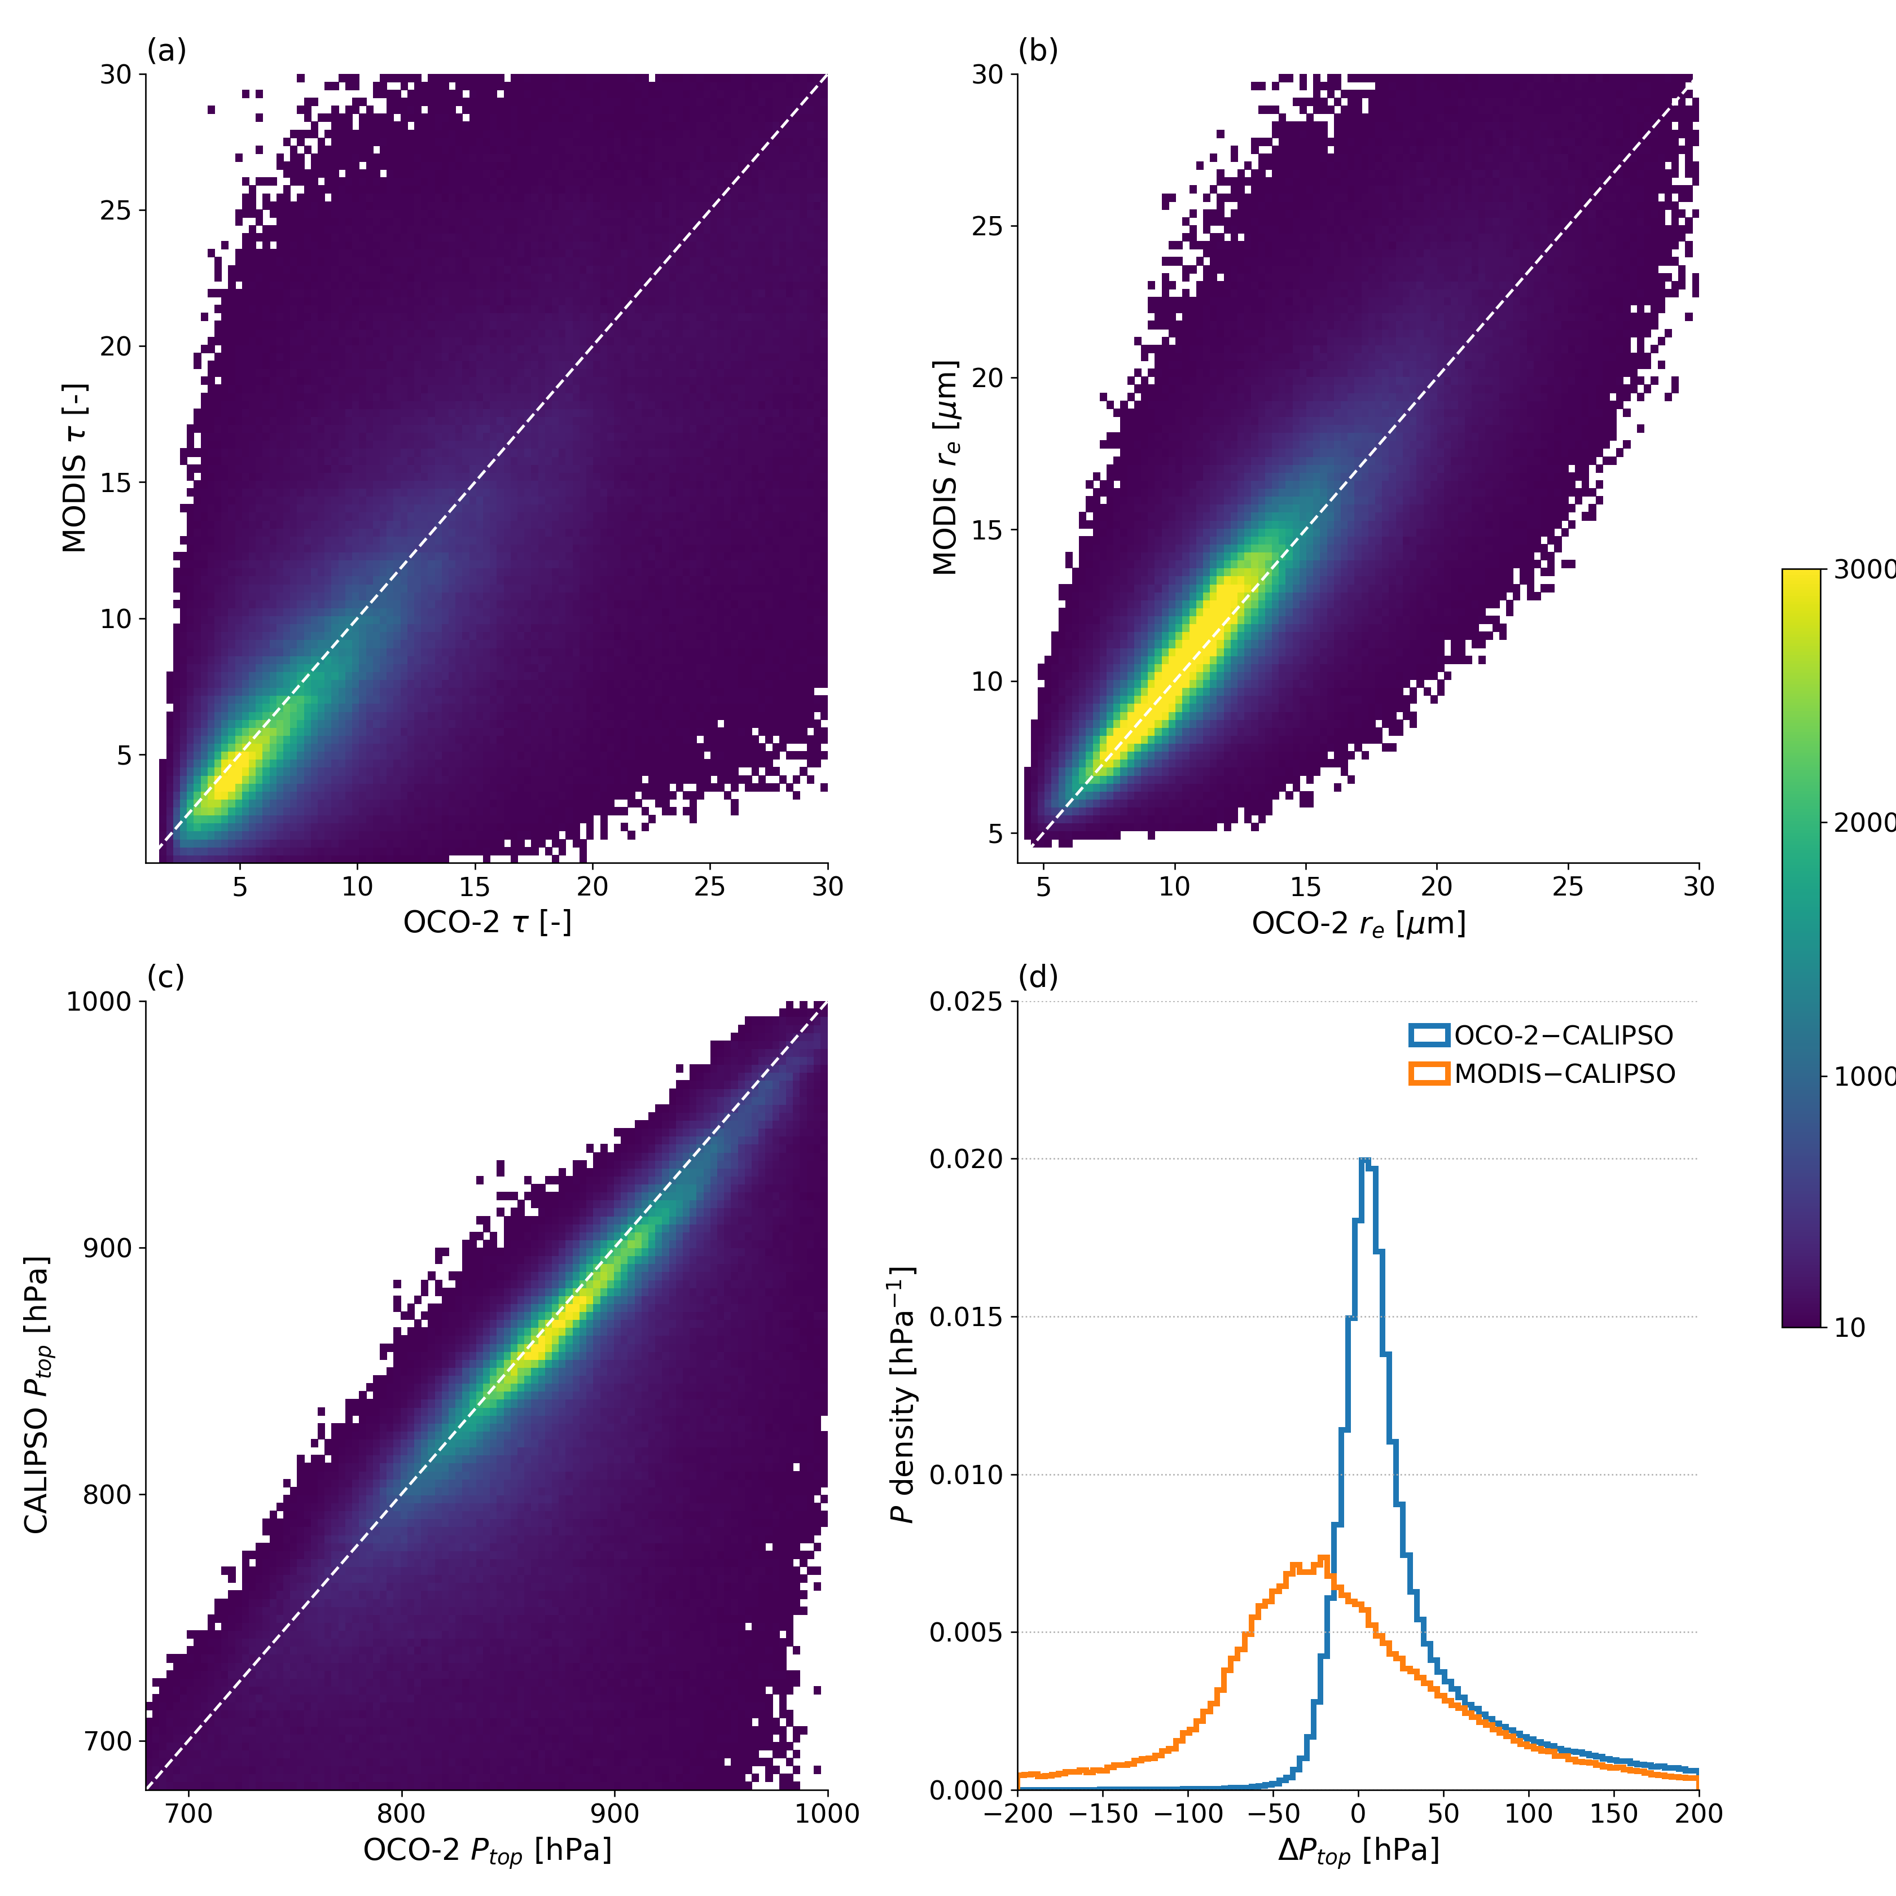
(c) OCO-2 vs CALIPSO P_{top} (d) OCO-2 or MODIS minus CALIPSO P_{top} CALIPSO P_{top} is generally most precise & accurate. These clouds are tricky for MODIS, they’re often under a temperature inversion. We approximately ~halve the discrepancy vs CALIPSO. Conclusion: Our first guess beats MODIS P_{top} for these clouds.
CALIPSO P_{top} [hPa]
OCO-2 P_{top} [hPa]
OCO-2 or MODIS minus CALIPSO P_{top} [hPa]

Slide 15
What’s next?
Our next version will attempt an OCO-2 only retrieval that gives 𝜏, P_{top}, r_{e} and N_{d}. It uses photon path lengths so is independent of MODIS N_{d} estimates.
But we have identified a potential issue: cloud vertical structure affects retrievals

Slide 16
OCO2CLD-LIDAR-AUX: P_{top} biased a bit low
Median P_{top} bias: 4.5 hPa

Slide 17
Hypothesis: vertical extinction structure of cloud matters. (explored in Rozanov & Kokhanovsky 2004, but only for very thick clouds)
Closer to “real world” cloud structure
Old retrieval assumption
Extinction
Extinction

Slide 18
Real clouds have shorter within-cloud path. Retrieval biases both P_{top} and thickness to compensate.
Extinction
Extinction

Slide 19
This is simulated radiance change if:
(blue) we push the cloud down in the atmosphere by 10 hPa
(orange) we keep it at the same height, but extinction structure changes from vertically uniform to top-weighted, as in prior slide.
Vertical extinction structure counteracts an 8—10 hPa P_{top} increase in this case.

Slide 20
Tests show that vertical structure biases our results
Imagine we look at scenes with “realistic” clouds in them, but we try our normal retrieval with its assumed vertically uniform cloud.
See if the retrieval is biased

Slide 21
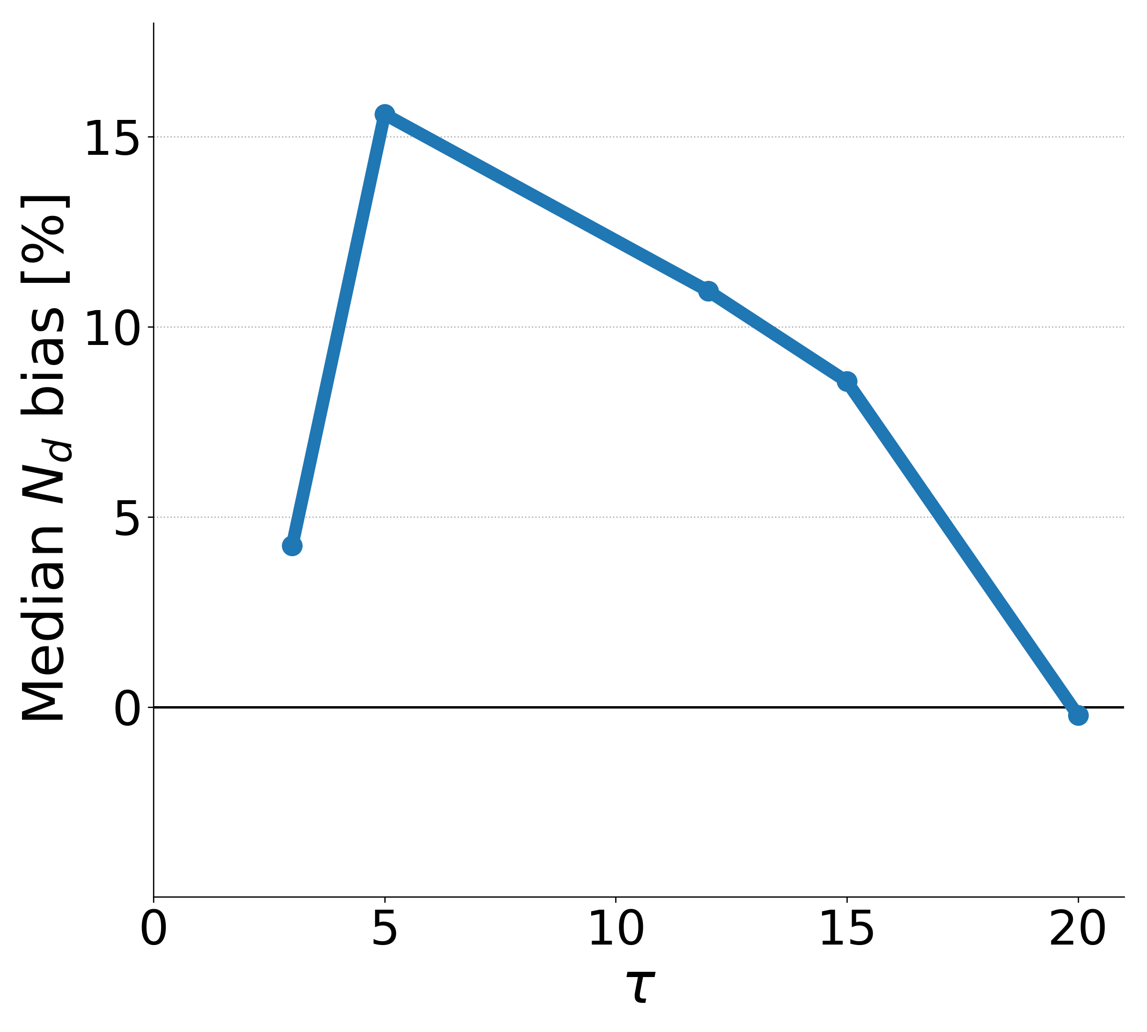
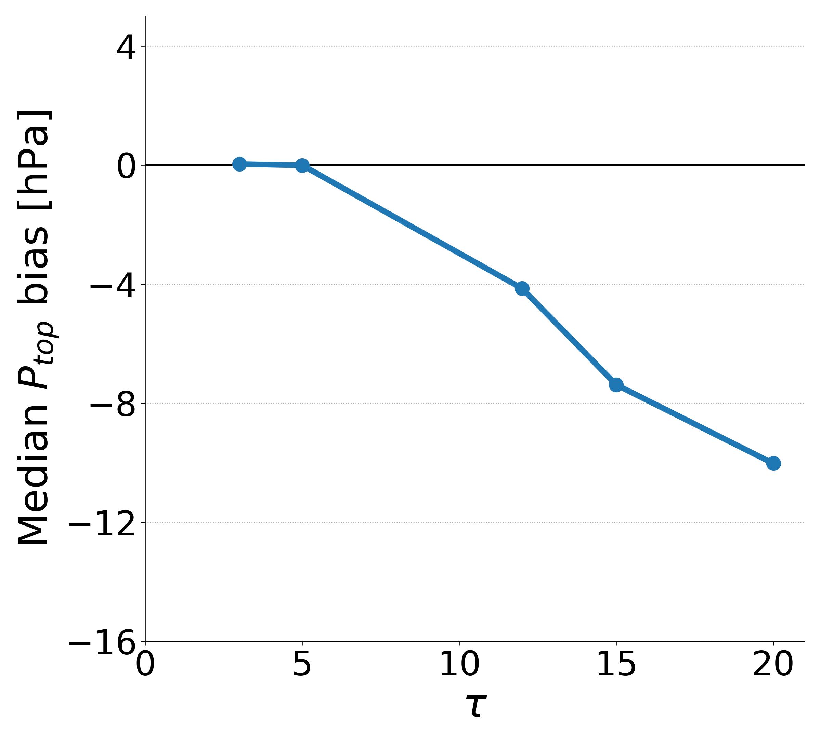
N_{d} % bias and P_{top} hPa bias for some example cloud optical depths
We always get too-high N_{d} too-low P_{top}, or both

Slide 22
Conclusions & next steps
We’re developing an OCO-2 retrieval that would include unique, independent N_{d} estimates
We can identify useful cloudy scenes with 90% accuracy and our first guess & prior P_{top} outperforms MODIS
I believe that there is a bias introduced into A-band path length-based retrievals that is caused by the vertical structure of these marine boundary layer clouds. Its covariation with other cloud properties it could undermine any attempted scientific analysis.
We are testing methods to remove this bias from our retrieval.

