Slide 1

Six Underground Laboratories (ULs) Participating in the Baltic Sea Underground Innovation Network
M Ohlsson ¹, J Joutsenvaara ², M Laaksoharju ^{1,} and E-R Niinikoski ²
1. Swedish Nuclear Fuel and Waste Management Co. Solna, Sweden
2. University of Oulu, Kerttu Saalasti Institute, Oulu, Finland
EGU 2020

Slide 2
Objectives
Baltic Sea Underground Innovation Network, BSUIN, consist of six participating Underground Laboratories (ULs) located in countries surrounding the Baltic Sea [http://bsuin.eu]. The BSUIN is a three-year project funded by the EU Interreg Baltic Sea Region Programme.
PARTNER ORGANIZATIONS

Slide 3
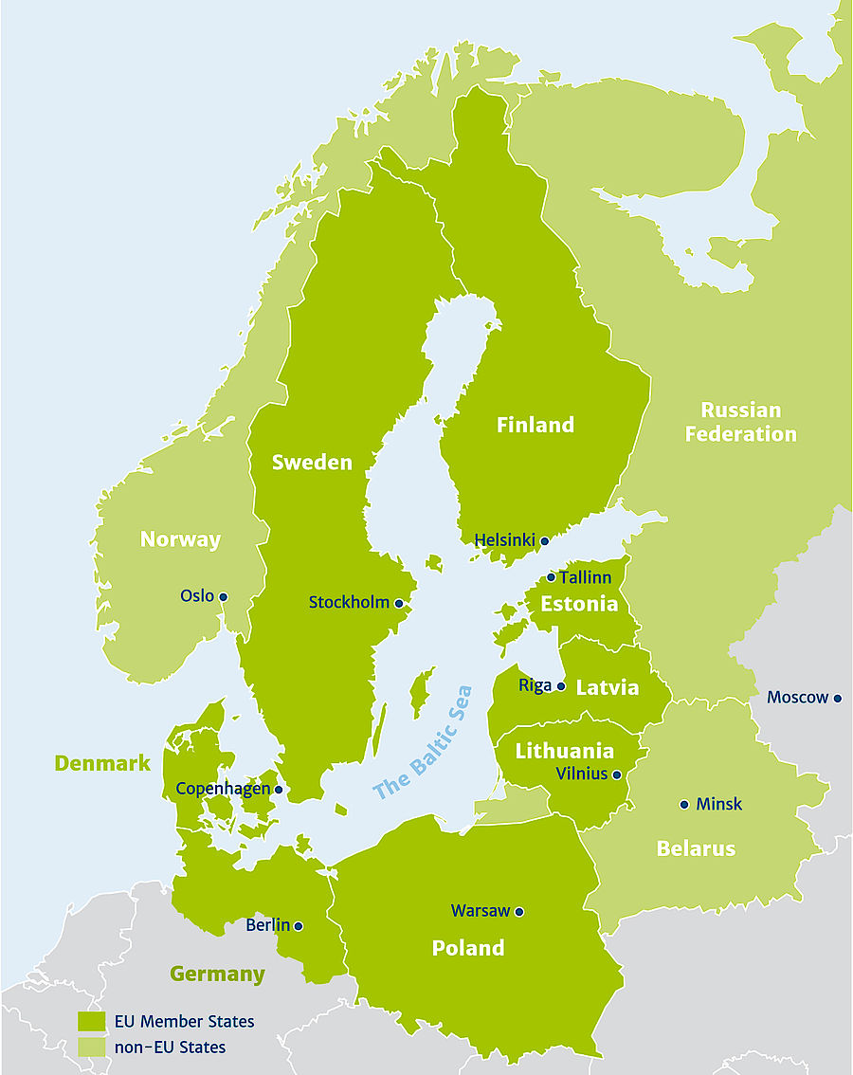
Underground Laboratories in
Baltic Sea Region
Callio Lab, Pyhäsalmi mine, Finland
Äspö Hard Rock Laboratory, Oskarshamn, Sweden
TU-Freiberg’s Research and Education mine “Reiche Zeche”, Germany
Conceptual Lab development co-ordinated by KGHM Cuprum R&D centre, Poland
Ruskeala Mining Park, Russia
Underground Laboratory of Khlopin Radium Institute, Russia
Callio Lab
Ruskeala
Khlopin
Äspö Hard Rock Lab
The BSUIN ULs consist of old mines or purpose built underground facilities. The ULs are used for research concerning e.g. environmental, geoenergy, geotechnology, physics, material science and natural sciences. Education, events, tourism and farming is also activities hosted by ULs.
Lab development
by KGHM Cuprum
Reiche Zeche

Slide 4
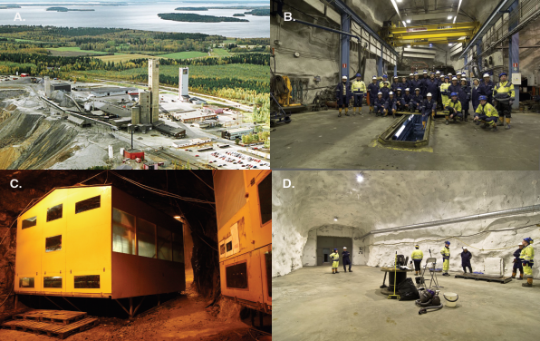
Callio Lab, Finland
Callio Lab is a new environment for underground research and other activities. The laboratory is located in the Pyhäsalmi Mine, the oldest operating mine in Finland and the deepest active hard rock mine in Europe, going as deep as 1 444 metres.

Slide 5
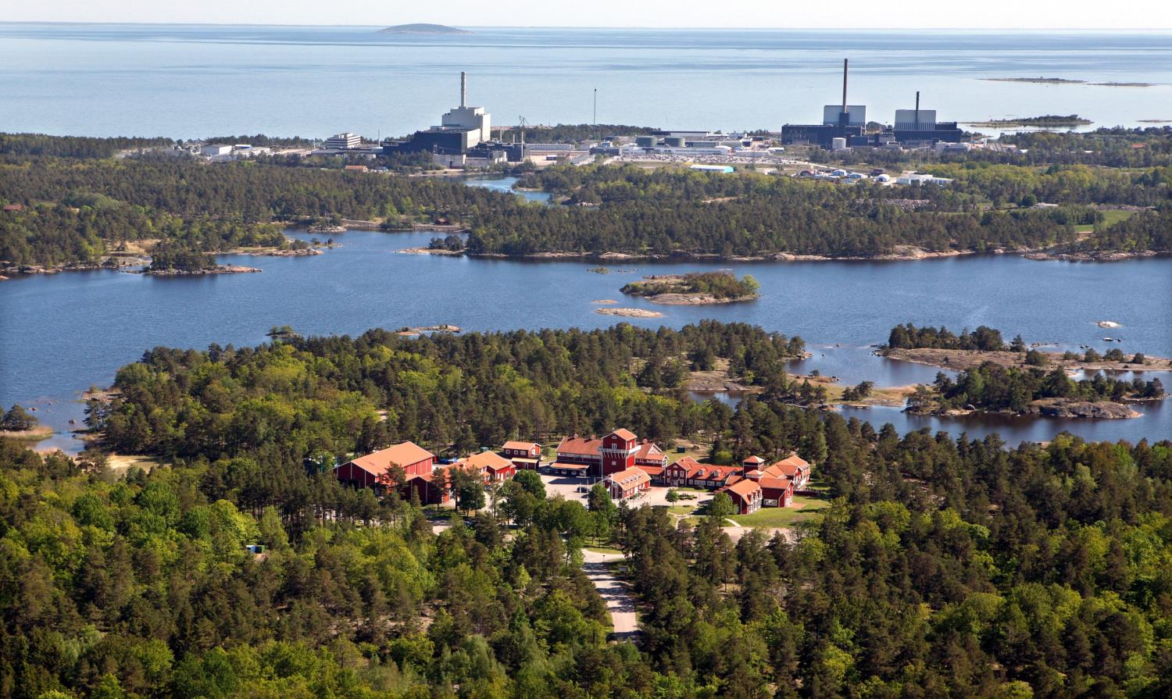
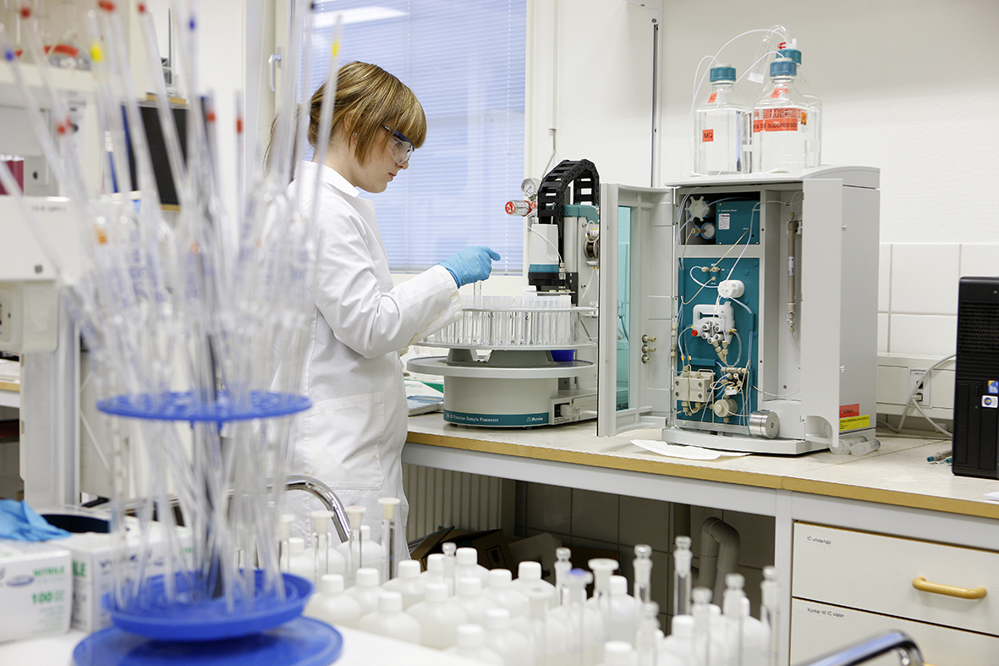
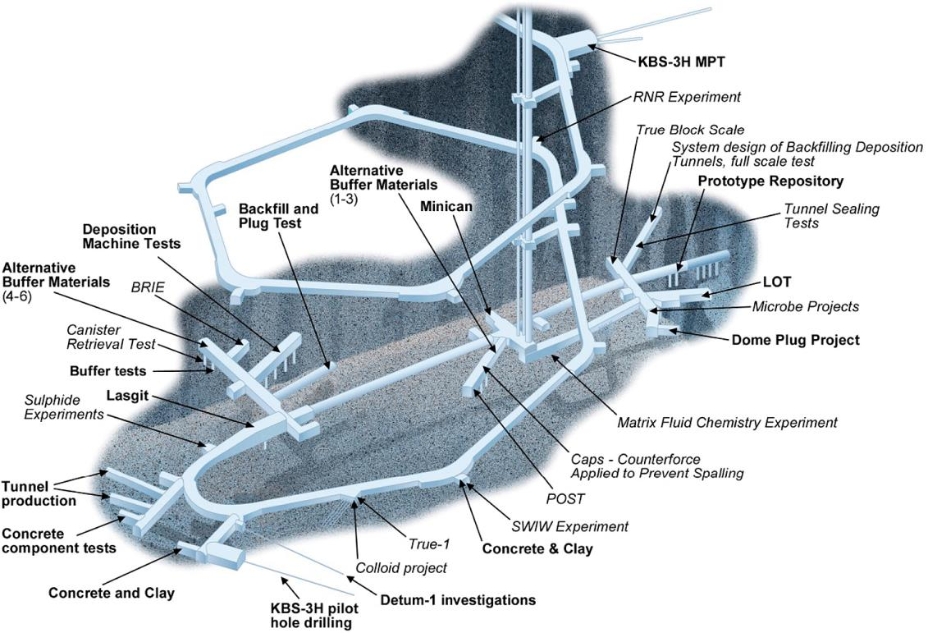
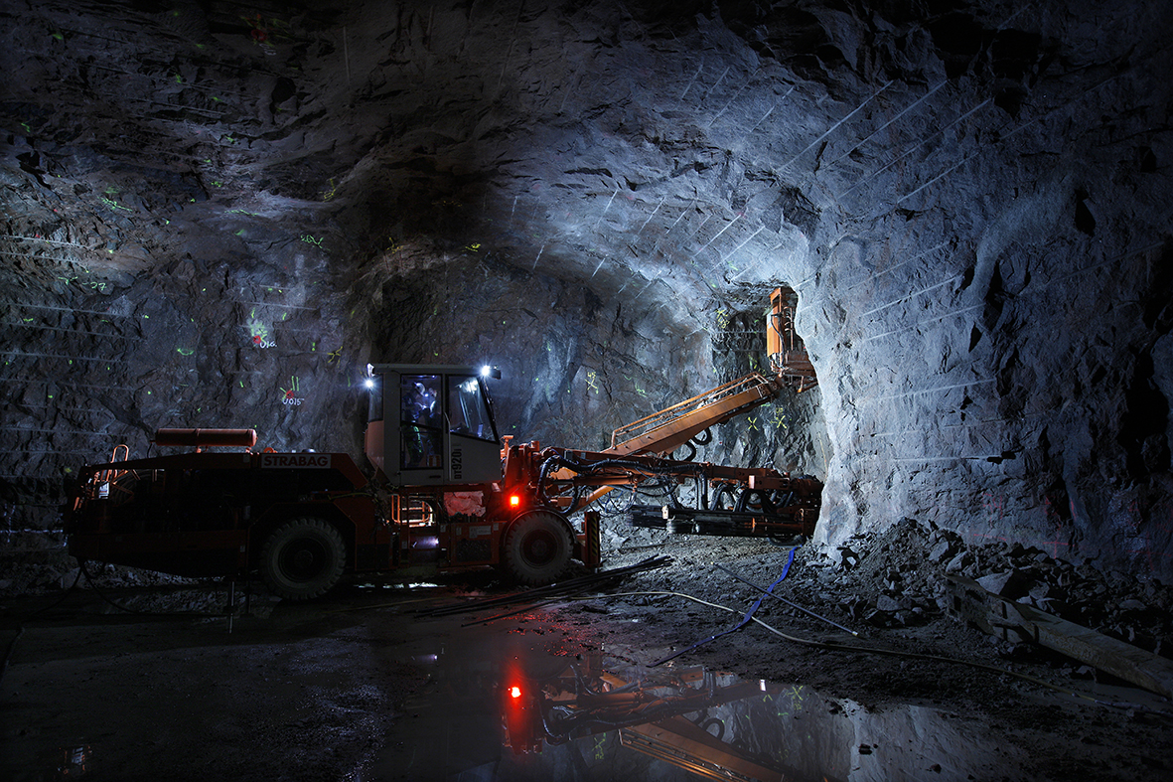
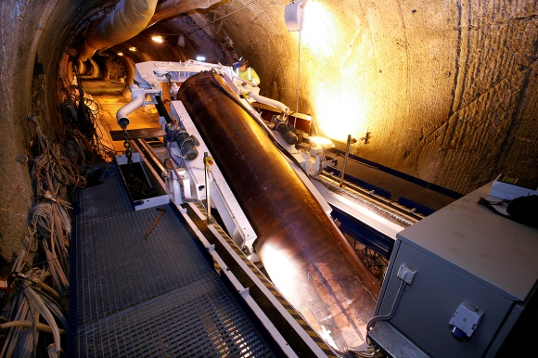
Äspö Hard Rock Laboratory, Sweden
Äspö Hard Rock Laboratory is a centre for research on Sweden’s final repository for spent nuclear fuel. It is also an open research facility that welcomes a wide range of projects.

Slide 6
Research and Education Mine
“Reiche Zeche”, Germany
Since the 1800s, silver production and mining education have benefitted from one another in Reiche Zeche. Today multiple research institutions and industry partners use the mine for developing new technology, production methods and materials.

Slide 7
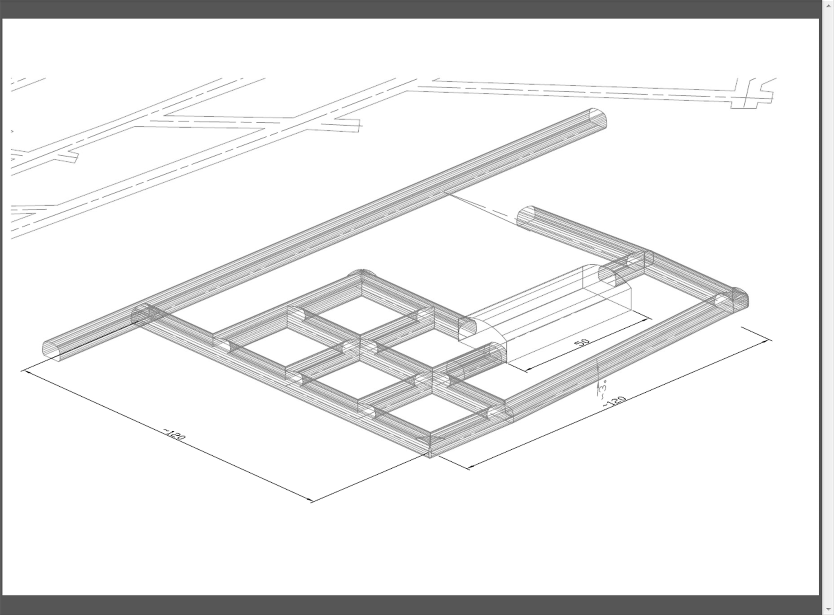
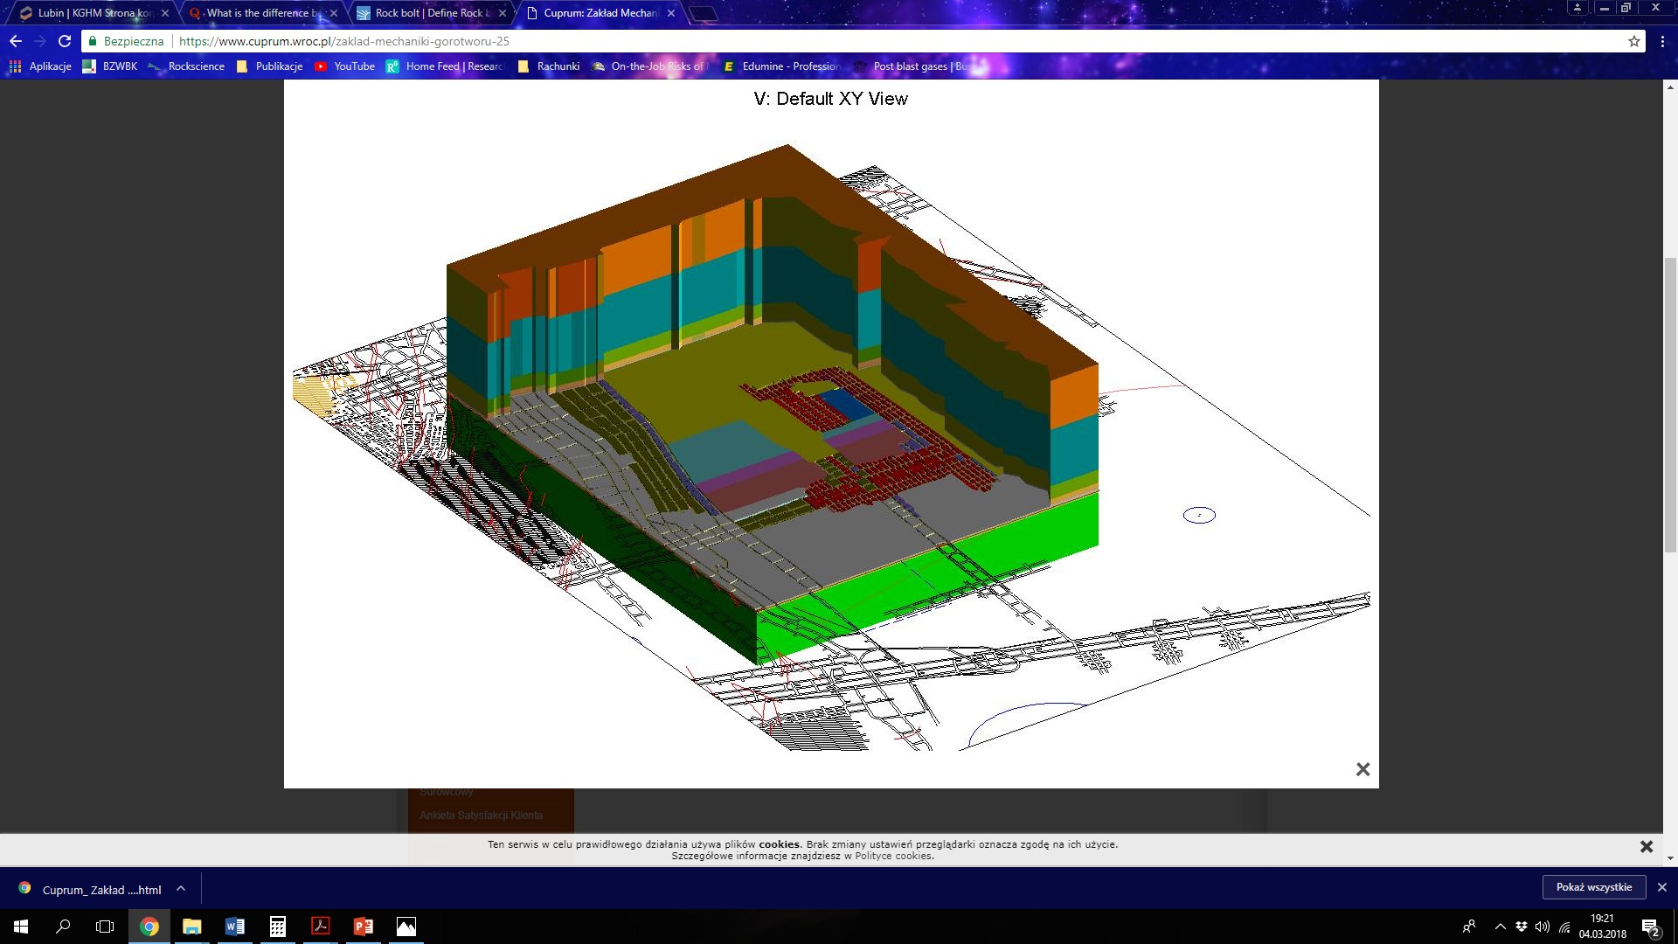
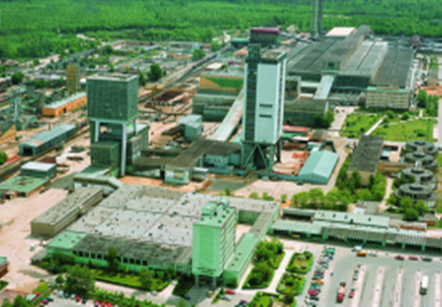
Conceptual Lab development, KGHM Cuprum Research and Development Centre, Poland
The KGHM Cuprum Research and Development Centre has a long tradition of research and design services for the copper mining industry in Poland. There are plans to set up new underground laboratories for research, technical development, tourism and education in selected areas of the existing KGHM mines.

Slide 8
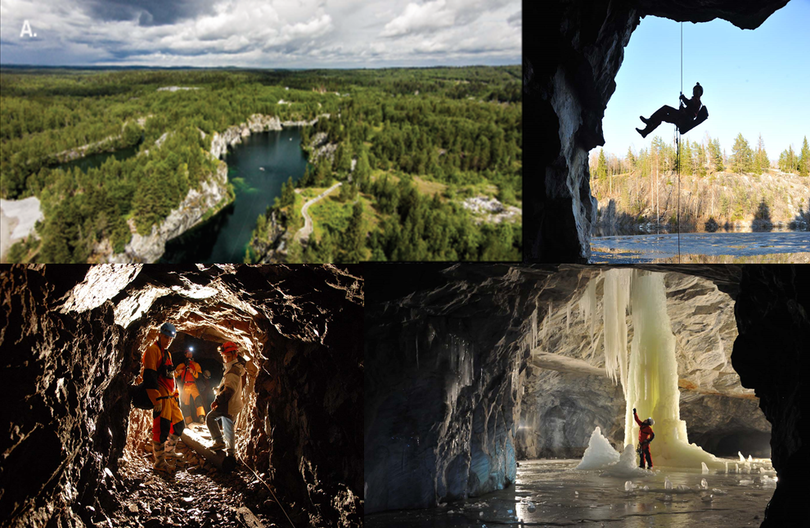
Ruskeala Mining Park, Russia
Ruskeala Underground Laboratory is the place where mining industrial heritage meets science and innovation. It is located in an old abandoned marble quarry in the Ruskeala Mining Park. Methodological and technical development is conducted for testing, designing and construction of safe tourist destinations.

Slide 9
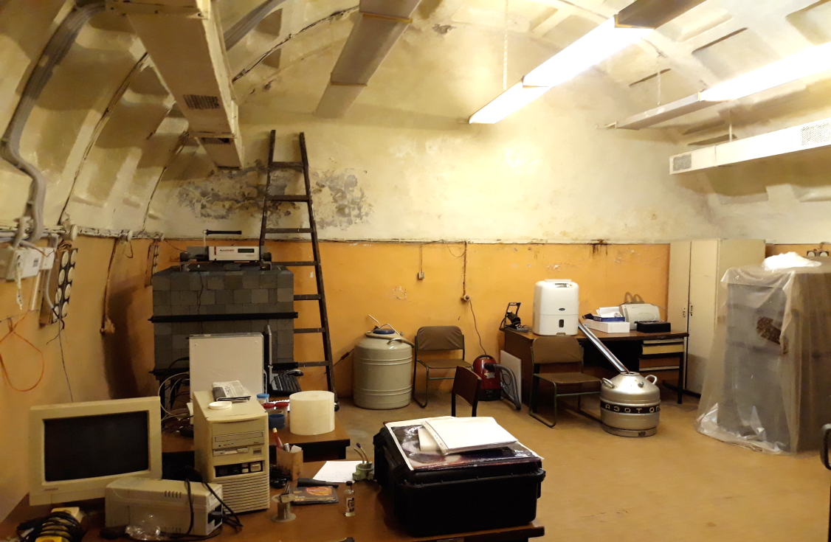
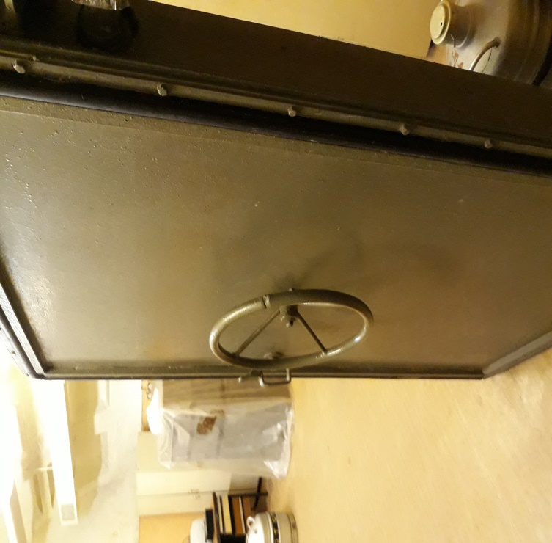
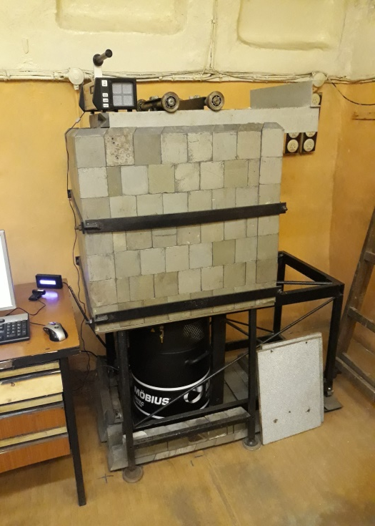
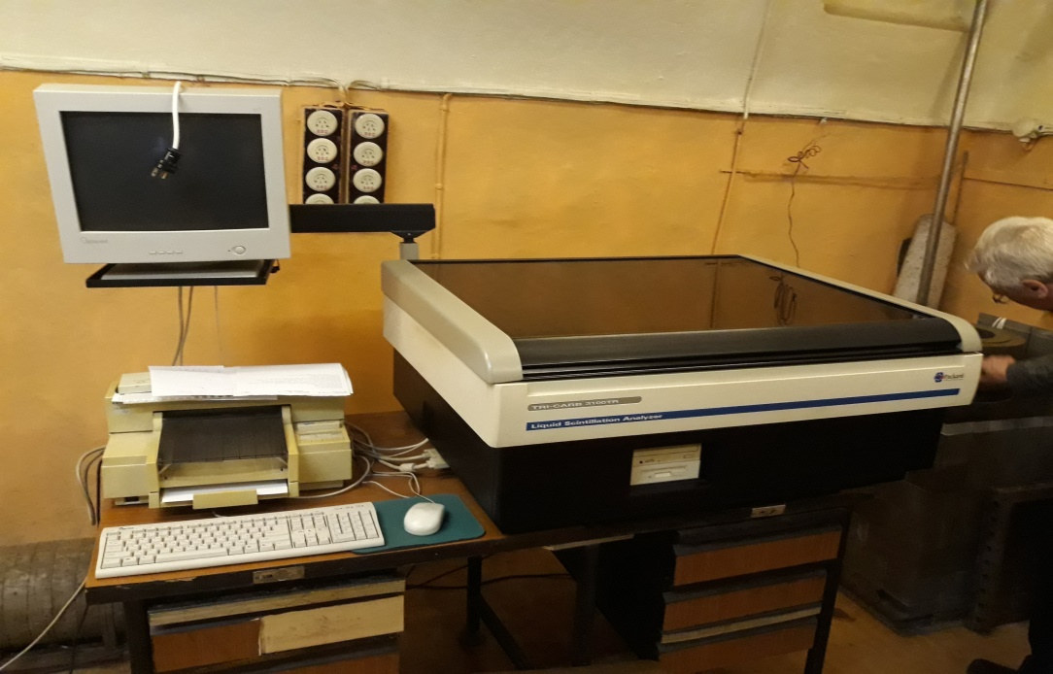
The Underground LBR of the Khlopin Radium Institute, St. Petersburg, Russia
The Underground LBR of Khlopin Radium Institute is located inside the St. Petersburg subway, at the crossing between Nevsky Prospekt and Gostiny Dvor stations. The laboratory is about 65 metres deep, equivalent to about 120 metres of water shield. The rooms were built in1965–1967 specifically as a laboratory. The Radium Institute initiated the construction.

Slide 10
The infrastructures and services provided by underground laboratories
infrastructure for research and underground activities
knowledge about each facility and the characteristics of each site
expertise in conducting underground projects
underground logistics
coordination of research projects
industry-specific machinery and equipment
support for R&D projects (e.g. funding and innovation)
international cooperation
extensive networks
references to successful projects
demonstrations
underground and industrial tours
meeting rooms and workrooms

Slide 11
Possible research and innovation in the BSUIN underground laboratories
Geosciences education and technology
Tunnel Construction and Mining Technology
Geothermal Energy Technology
Material Technology
Physics research and instrument technologies
Research of underground
work
Hotel and conferencing services
Geopark,
tourism
Underground
food
production

Slide 12
Contact
Jari Joutsenvaara
Project leader
KSI, University of Oulu
Jari.Joutsenvaara@oulu.fi
Eija-Riitta Niinikoski
Project manager
KSI, University of Oulu
eija-riitta.niinikoski@oulu.fi
BSUIN
More information
http://bsuin.eu

