Slide 1
ΕΜΤ Laboratory, Xanthi, Greece
Laboratory for Atmospheric & Space Physics CU, Boulder, Colorado
Observations and simulations of electron flux oscillations in response to broadband ULF waves
Sarris, Theodoros [1]; Li, Xinlin [2]; Temerin, Michael [3]; Zhao, Hong [2], Khoo, Leng Ying [2]; Turner, Drew L. [4], Liu, Wenlong [5], Claudepierre, Seth G. [4]
[1] {Dept. of Electrical Engineering, Democritus University of Thrace, Xanthi, Greece}
[2] {Laboratory for Atmospheric & Space Physics, University of Colorado, Boulder, CO, USA}
[3] {Retired from Space Sciences Lab, Univ. of California Berkeley, Berkeley, CA, USA}
[4] {Space Sciences Department, The Aerospace Corporation, El Segundo, CA, USA}
[5] {Beihang University, Beijing, China}
EGU 2020, Sharing Geoscience Online ST2.7, 22404, Wed., 06 May 2020, 14:00-15:45

Slide 2
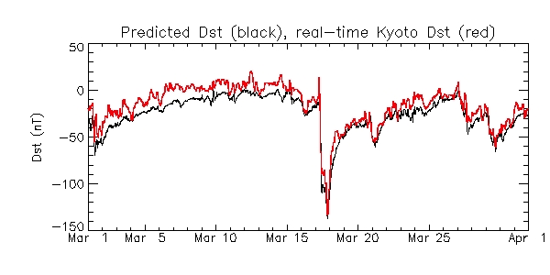
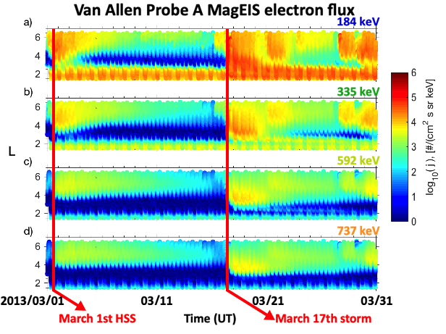
Introduction: Example of Quiet-time, prolonged radial diffusion
Quiet time diffusion between High Speed Stream on March 1st and storm of March 17, 2013
Dst index
Electron fluxes at
various energy channels

Slide 3
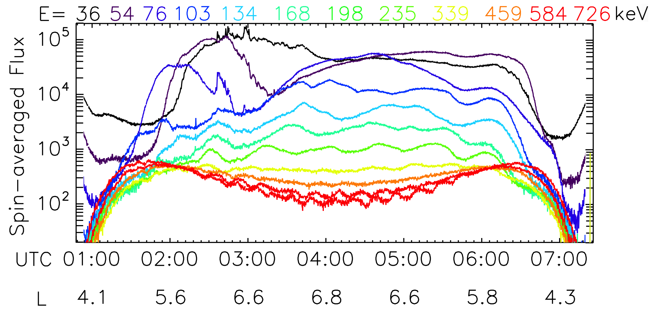
Introduction: Example of Quiet-time, prolonged radial diffusion
Quiet time diffusion between High Speed Stream on March 1st and storm of March 17, 2013
Dst index
Electron fluxes at
various energy channels
2013/03/01 03/11 03/21 03/31
Flux oscillations are observed at the electron drift frequency, at most energy channels
MagEIS electron fluxes
along one orbit,
on March 11

Slide 4
Introduction: Example of Quiet-time, prolonged radial diffusion
Quiet time diffusion between High Speed Stream on March 1st and storm of March 17, 2013
Dst index
Electron fluxes at
various energy channels
2013/03/01 03/11 03/21 03/31
Flux oscillations are observed over consecutive orbits, over multiple days
MagEIS electron fluxes
along consecutive
orbits

Slide 5
Introduction: Example of Quiet-time, prolonged radial diffusion
Motivation:
Flux oscillations are often observed by the Van Allen Probes
→ They are mostly observed at lower energy channels
→ They are also observed during quiet times
→ They are most probably not associated with storm or substorm drift echoes
Electron fluxes at
various energy channels
2013/03/01 03/11 03/21 03/31
MagEIS electron fluxes
along consecutive
orbits

Slide 6
Hypothesis: are Electron Flux Oscillations Indicators of radial diffusion?
In the past, flux oscillations have only been associated with storms and substorms…
Here, we will show that flux oscillations are also associated
with ULF wave-driven radial diffusive processes, and that
they could be used to identify the diffusion rates
MagEIS electron fluxes
Spin-averaged flux

Slide 7
Particle Tracing Simulation
Model ULF Electric and Magnetic Fields
for a monochromatic ULF wave:
m = 1
m = 2
Resonant interaction of an electron with drift frequency ω_{d} with a ULF wave of frequency ω = ω_{d} and mode number m = 1
Resonant interaction of an electron with drift frequency ω_{d} with a ULF wave of frequency ω = 2 ω_{d} and mode number m = 2

Slide 8
Particle Tracing Simulation
Resonant interaction of a particle ring
with a monochromatic ULF wave:
m = 1
m = 2
Resonant interaction of a ring of electrons with drift frequency ω_{d} with a ULF wave of frequency ω = ω_{d} and mode number m = 1
Resonant interaction of a ring of electrons with drift frequency ω_{d} with a ULF wave of frequency ω = 2 ω_{d} and mode number m = 2

Slide 9
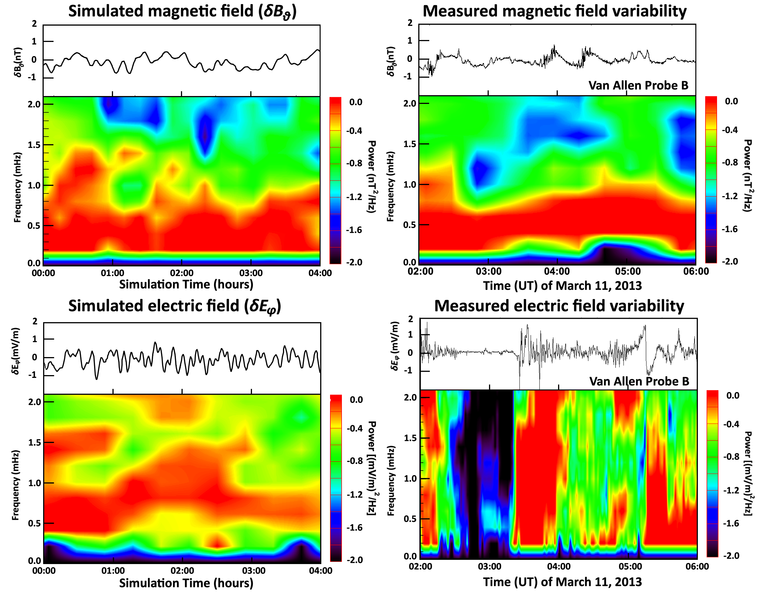
Broadband ULF waves and flux oscillations
Broadband ULF waves: sum of random amplitudes, frequencies, phases
Measured vs. Modeled Electric and Magnetic Fields:
Model field parameters are scaled to match measurements

Slide 10
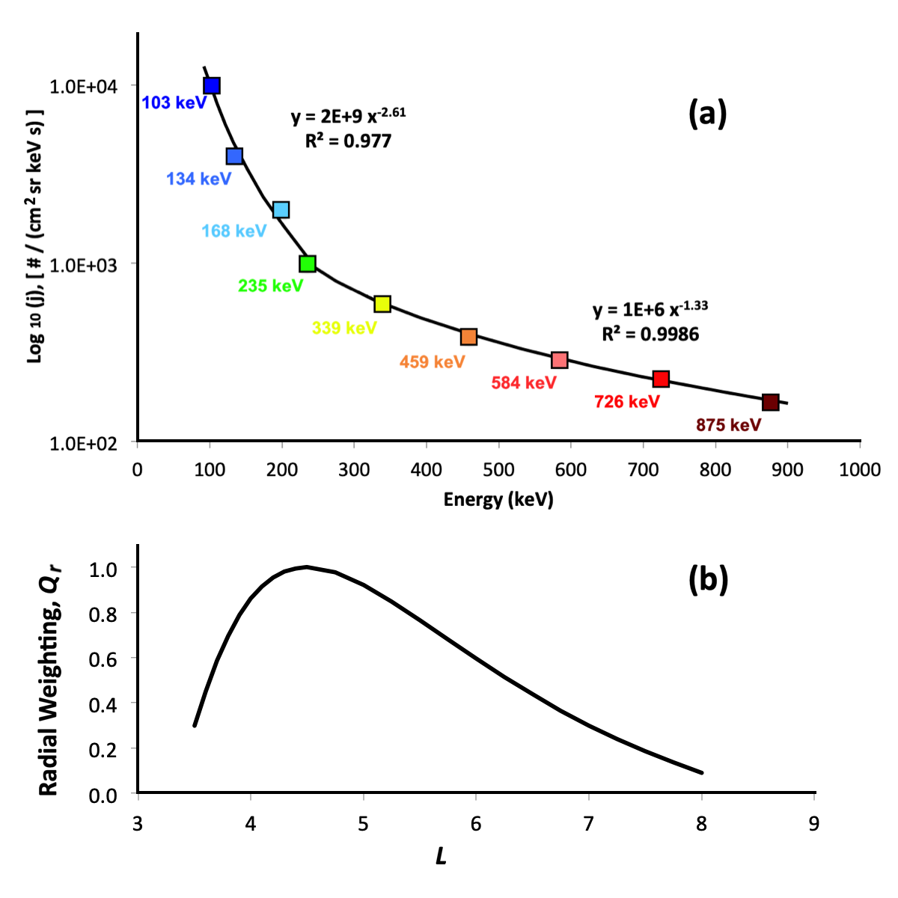
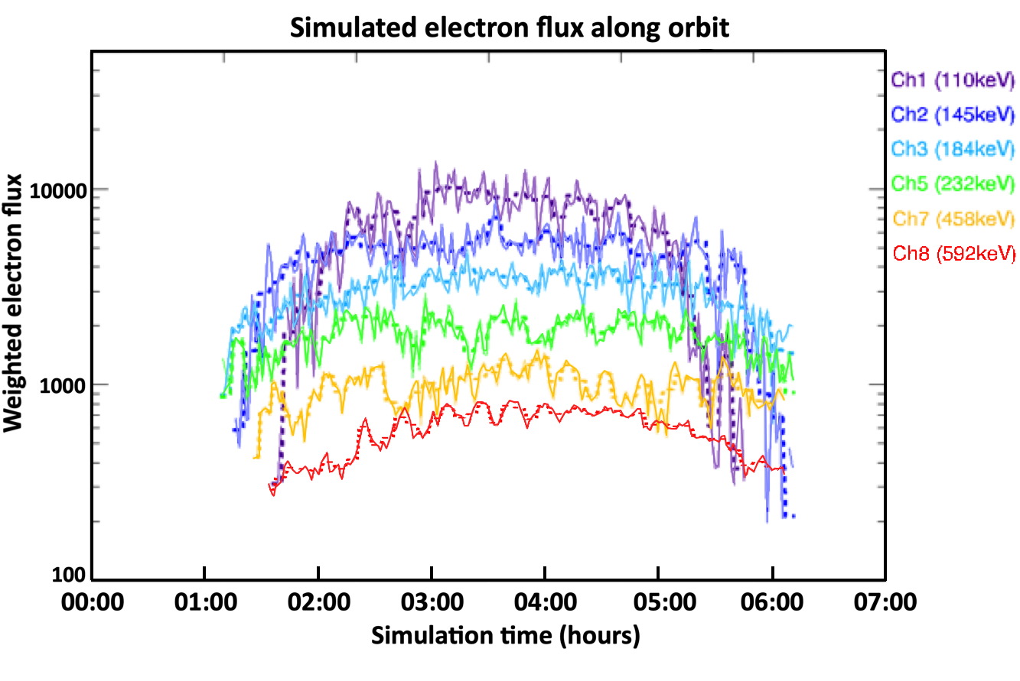
Broadband ULF waves and flux oscillations
Sampling electron fluxes along the orbit of the Van Allen Probes:
Traced electrons are weighted in
energy and radial distance…
Particle tracing simulations
reproduce resonant flux oscillations
Observation
Simulation

Slide 11
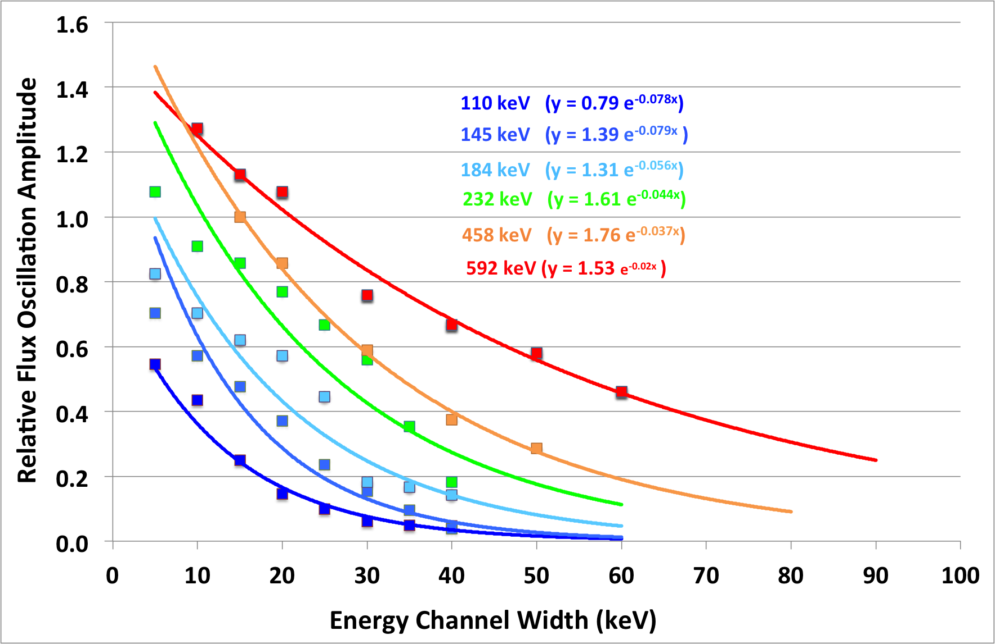
Parameters that determine flux oscillation amplitudes
A. Energy channel width
(or, why these oscillations were not observed before…)
Simulation
Observation
Wide energy channels → low observed flux oscillations
The Van Allen Probes have the highest energy resolution so far.
Perhaps still not high enough for higher energy channels?

Slide 12
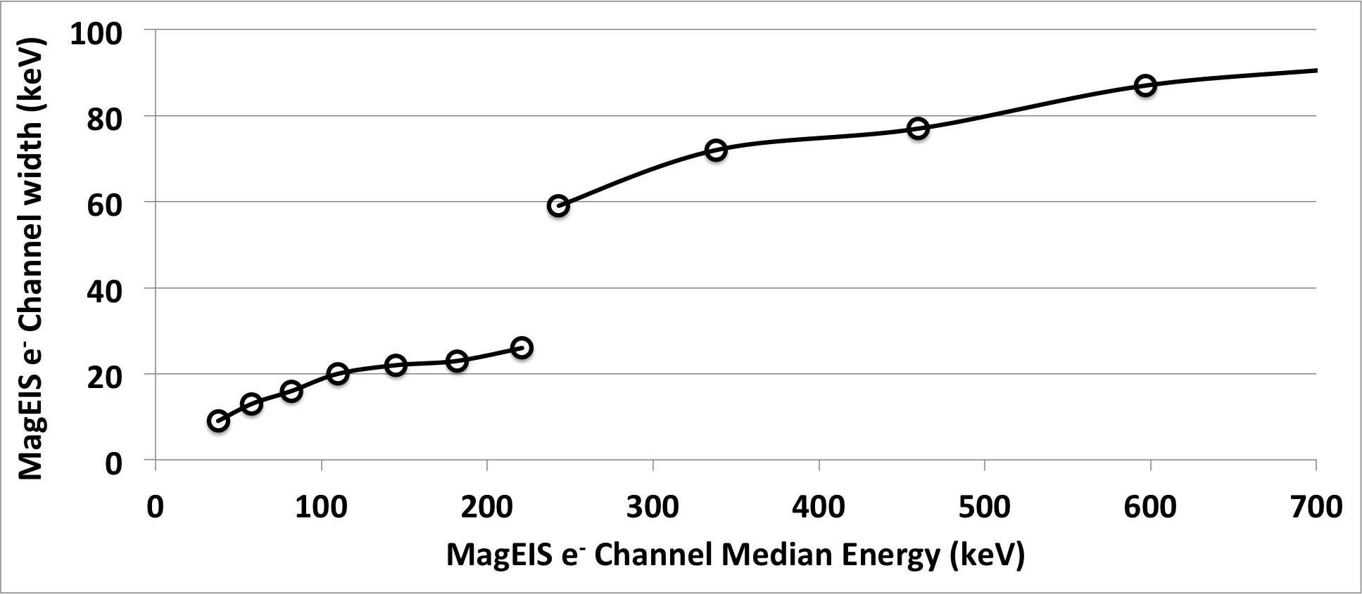
Parameters that determine flux oscillation amplitudes
A. Energy channel width
(or, why these oscillations were not observed before…)
Simulation
Observation
Medium
Low
Wide energy channels → low observed flux oscillations
The Van Allen Probes have the highest energy resolution so far.
Perhaps still not high enough for higher energy channels?

Slide 13
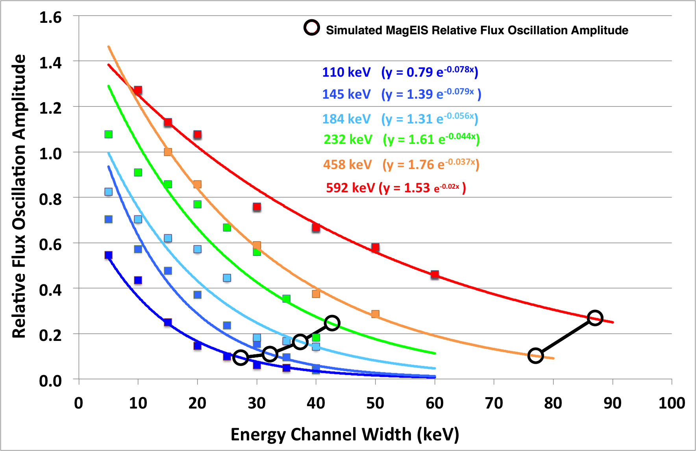
Parameters that determine flux oscillation amplitudes
A. Energy channel width
(or, why these oscillations were not observed before…)
Simulation
Observation
Medium
Low
Medium
Low
Wide energy channels → low observed flux oscillations
The Van Allen Probes have the highest energy resolution so far.
Perhaps still not high enough for higher energy channels?

Slide 14
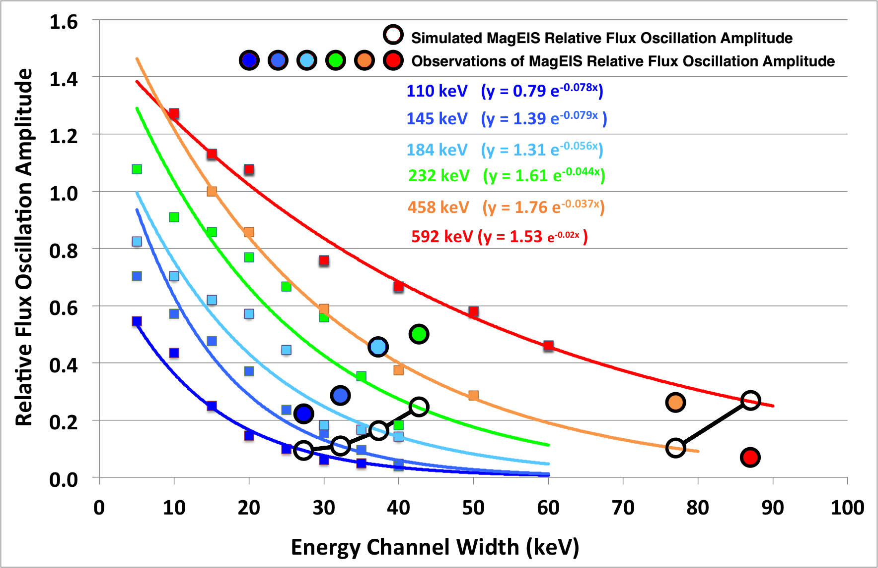
Parameters that determine flux oscillation amplitudes
A. Energy channel width
(or, why these oscillations were not observed before…)
Simulation
Observation
Medium
Low
Wide energy channels → low observed flux oscillations
The Van Allen Probes have the highest energy resolution so far.
Perhaps still not high enough for higher energy channels?

Slide 15
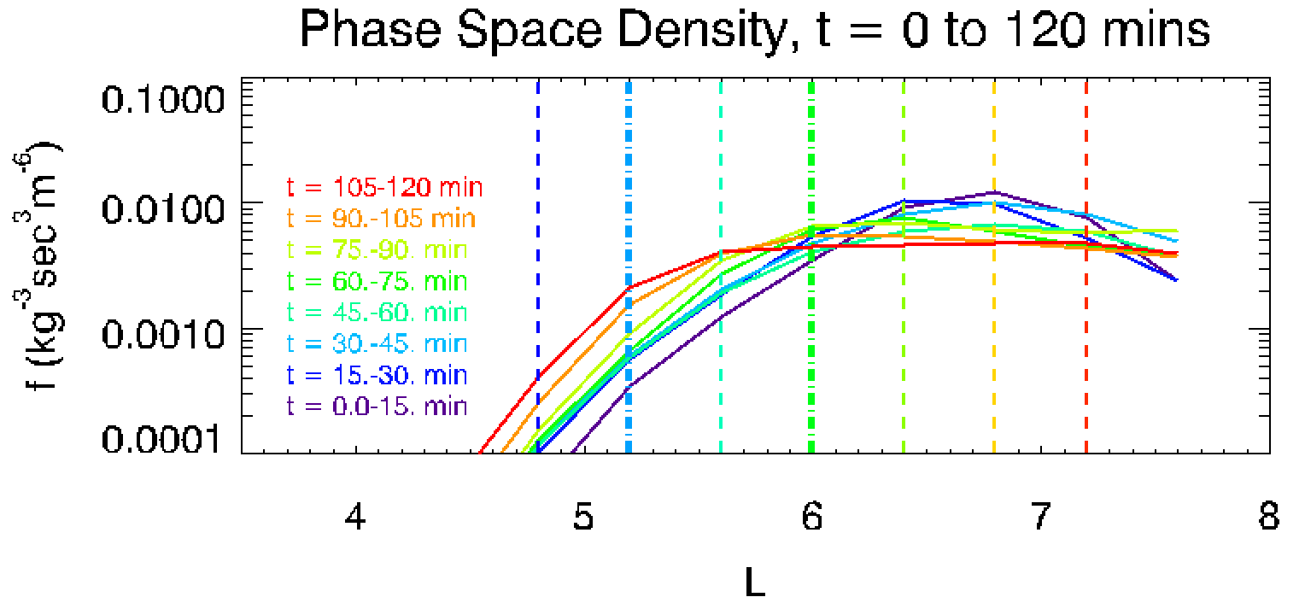
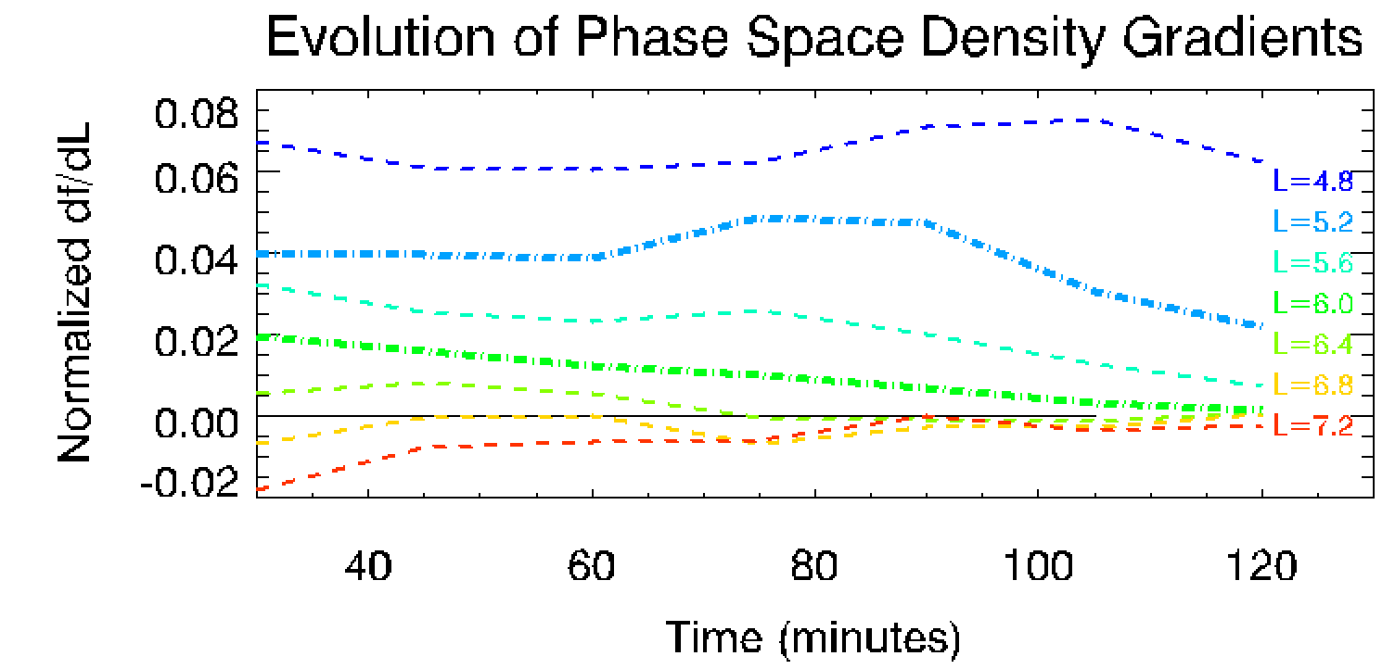
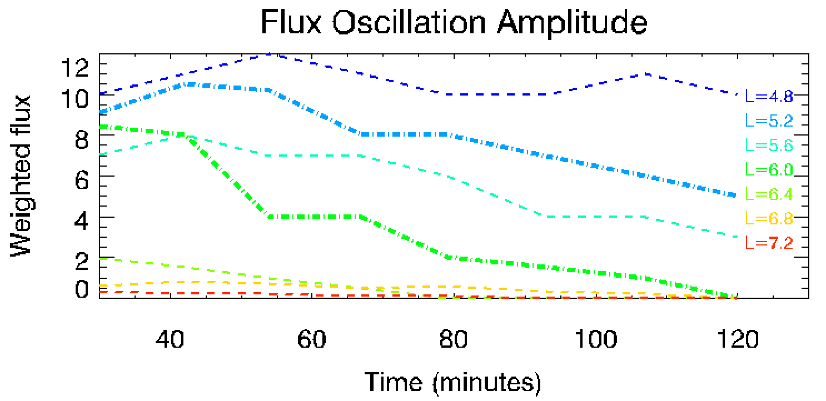
Parameters that determine flux oscillation amplitudes
B. Phase Space Density radial gradient
Larger Flux oscillation amplitudes are observed for larger local phase space density gradients
→ Simulated Phase Space Density gradients:
→ Simulated Flux Oscillation Amplitude:

Slide 16
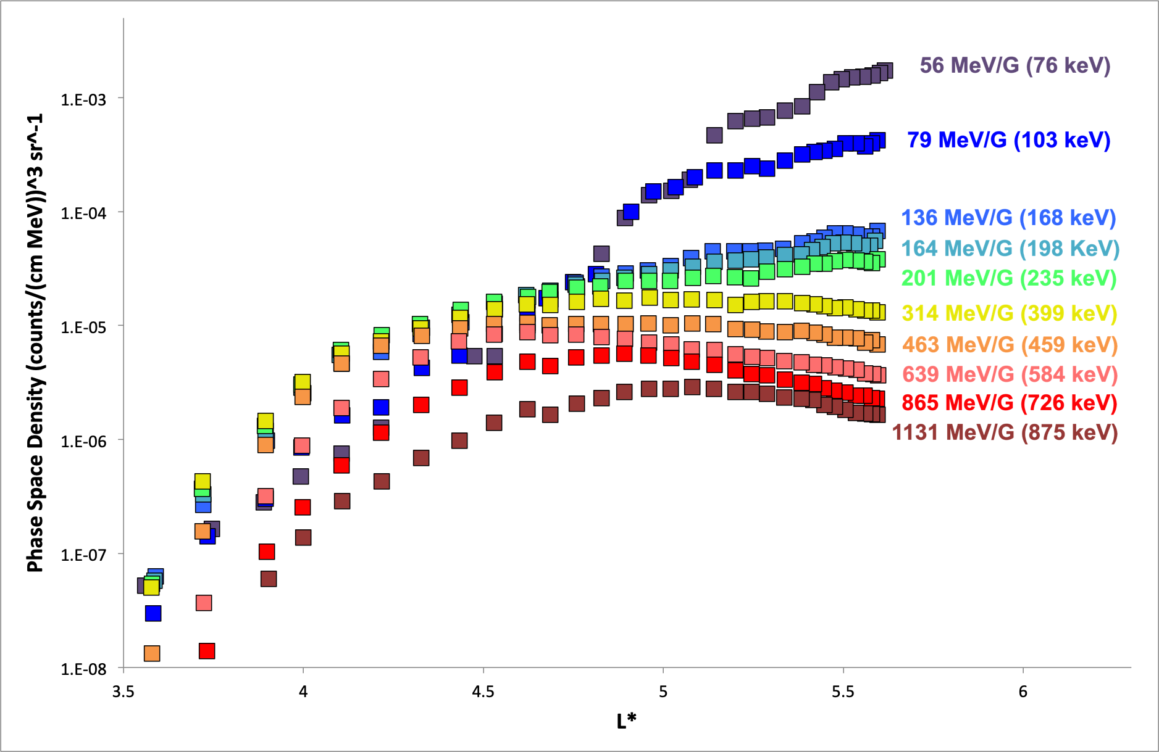
Parameters that determine flux oscillation amplitudes
B. Phase Space Density radial gradient
Larger Flux oscillation amplitudes are observed for larger local phase space density gradients
→ Observations of Phase Space Density gradients:
→ Observations of Flux Oscillations:
Observation
→ Yellow channel: zero phase space density gradient and zero flux oscillations
→ Other channels: non-zero phase space density gradient and flux oscillations

Slide 17
Conclusions - A
We have demonstrated that the amplitude of oscillations in the electron flux contains information of ongoing radial transport processes
Observations of such flux oscillation are enabled by the excellent energy resolution of the Van Allen Probes electron flux measurements.
The observed amplitude of flux oscillations depends on:
A. The width of the energy channels
B. The local gradient of Phase Space Density
C. The amplitude of the electric field oscillations (not discussed...)
Sarris et al., JGR, 2020, JGRA55716, DOI: 10.1029/2020JA027798

Slide 18
Conclusions - B
The association between flux oscillations, radial transport, the power in field fluctuations and Phase Space Density can lead to a new empirical relationship for a radial transport coefficient.
But why would we need yet another estimate of the radial transport rates?
→ The radial diffusion rates are currently calculated through electric and magnetic field measurements, which rely on having satellites with appropriate instrumentation exactly at the place and time where radial diffusion occurs.
→ Electron fluxes continue to oscillate everywhere along the electron drift paths. Thus electrons carry the oscillation information (and hence the radial diffusion information) beyond the region where field fluctuations occur.
Sarris et al., JGR, 2020, JGRA55716, DOI: 10.1029/2020JA027798

