Slide 1
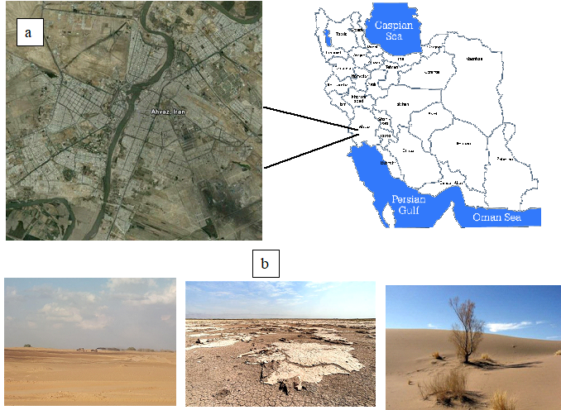
Influence of changing land use/cover and land management on wind erosion potential in southwestern Iran
Fahime Nikseresht, Rainer Schulin
Scientific Background
Department of Environmental Systems Science, ETH Zurich, Switzerland
Ph.D. in Soil Science, Shahid Chamran University of Ahvaz, Khuzestan, Iran.
Previous research: The effect of soil microorganisms on wind erosion control in Khuzestan province
Introduction
Wind erosion is one of the main factors of soil degradation and air pollution in arid and semiarid regions. In recent years, dust storms have become ever more important sources of air pollution in large areas of Iran. Dust storms previously were confined to the summer season and to western Iran. Nowadays, dust storms occur during eight months of the year and extend to the central regions and the entire south of Iran. This is causing increasing problems for the residents of the affected areas, threatening their health and impairing social, economic and agricultural activities. Ahvaz, the capital of Khuzestan Province, is the city that is most seriously affected by these problems in Iran (Fig.1).
Wind erosion is a multifaceted phenomenon influenced by a variety of factors. One of these factors that has changed considerably in recent time in Iran is land use/cover and land management.
Objectives
Investigating the impact of land use/cover changes on wind erosion
Acquiring the data necessary for calibration and validation of the IFRIR erosion model using remote sensing
Figure 1. Overview map of the study area in Ahvaz, Iran.
(a) Landsat 8 satellite image of Ahvaz in 2019.
(b) Evidence of wind erosion in the study area.
Materials and method
To investigate the impact of Land use/cover changes on wind erosion potential in southwestern Iran we applied an empirical model of the Iran Research Institute of Forest and Rangeland (IRIFR) to remote sensing data extracted from Landsat ETM+ and Landsat 8 imagery of 2010 and 2019. Relationships between changes in wind erosion and land use/cover were determined by cross-tabulation, combining the original spectral bands with synthetic bands and using Maximum Likelihood classification.
Results
The results indicate major changes in wind erosion potential over the last decade in the study area. Interestingly, while areas with a low, medium, and high sediment yield potential decreased, areas with a very high sediment yield potential have increased. Increasing soil erosion potential was primarily related to the conversion of rangeland to agricultural cropland Moreover, the results indicate an increase in desertification in the study area which is also a clear evidence of increasing in soil erosion.
Fahime Nikseresht
Ph.D in Soil Scinec,
E-mail: fahimen@ethz.ch

