Slide 1
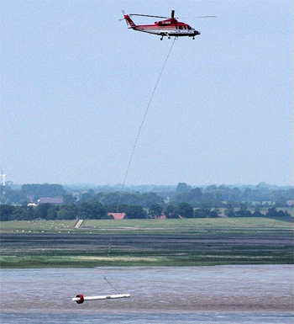
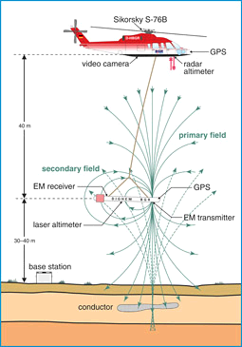
Introduction
Jude King, Utrecht University (PhD candidate)
Co-authors: Gu Oude Essink, Marc.F. P. Bierkens
Initially used for mineral exploration, airborne electromagnetics is increasingly used for groundwater. It’s rapid, economical on larger scales and non-intrusive, in contrast to conventional ground-based methods.
https://www.dutchwatersector.com
https://www.bgr.bund.de

Slide 2
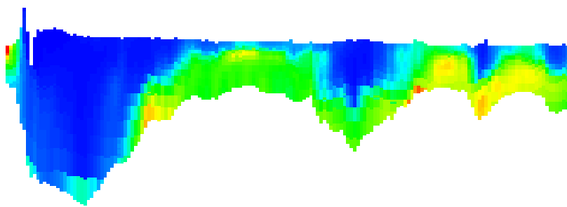
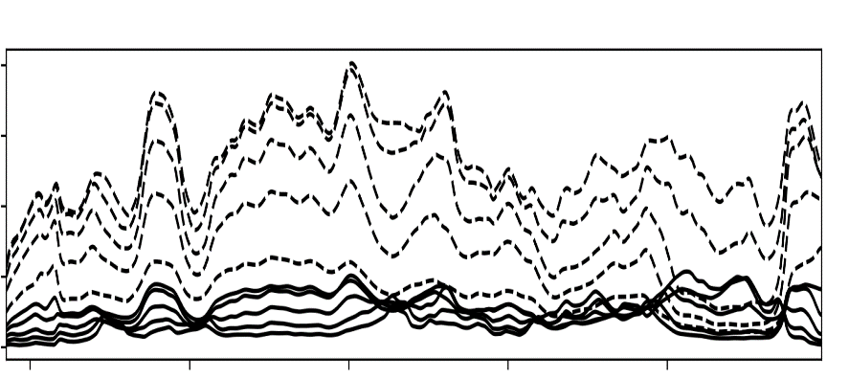
Introduction
Step 1: Collect Data
Step 2: Inversion
Conductivity (S/m)
Step 3: Transform to salinity using lithological data
Chloride g/l

Slide 3
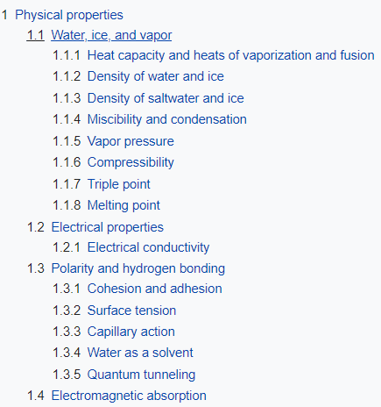
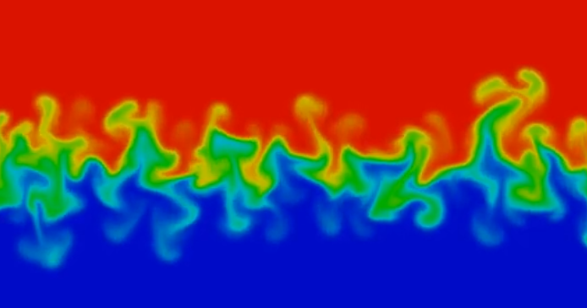
Background
Recent research has highlighted the relative sources of error for each of the three steps (see King et al., 2020). This research investigates a method to improve results.
Airborne electromagnetic surveys exploit the electrical conductivity of groundwater, can we exploit another physical property to improve results? Jointly using 2 properties should be possible.
What about density?
?
Density
https://www.youtube.com/watch?v=OMoMDsI62pY

Slide 4
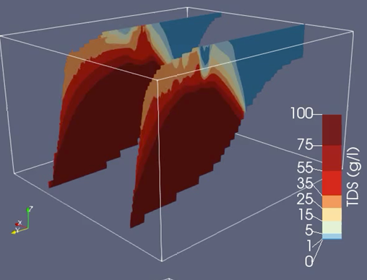
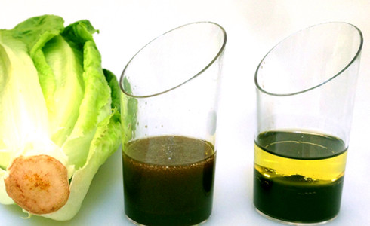
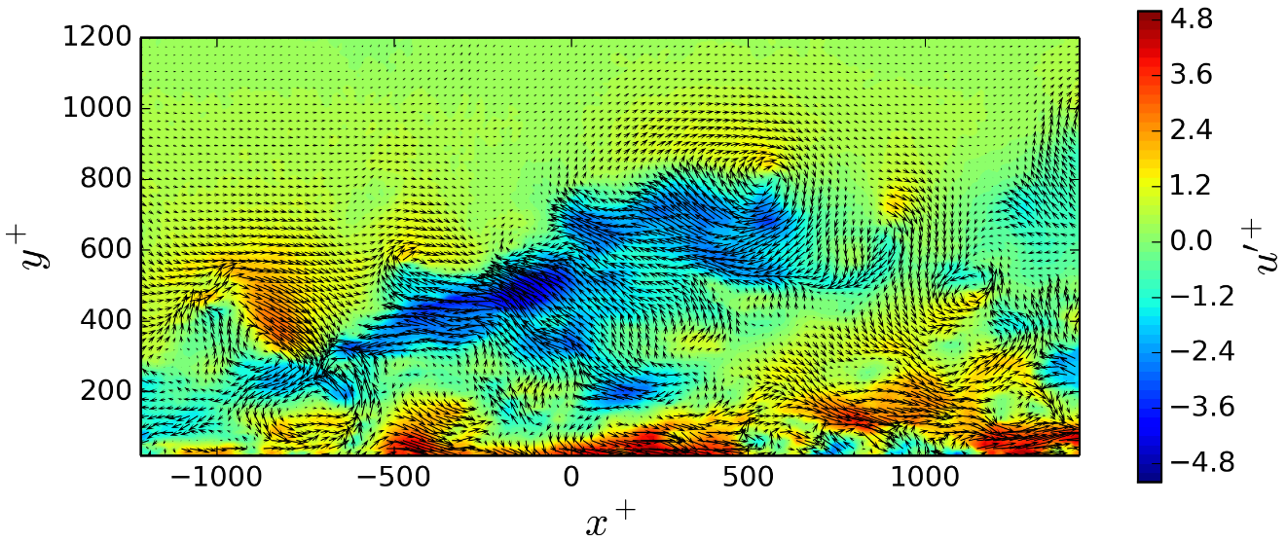
Reducing Error
Background
Variable-Density Ground-Water Flow and Transport tools can simulate movement of groundwater based on density differences (fresh/saline).
An aquifer that has not been changed for a long time should be in/close to equilibrium; only low velocity groundwater movements are expected.
Rapid changes
No/slow changes
Source: Van Engelen et al., (2018)
http://www.callumatkinsononline.com/animating-velocity-field-python-ffmpeg/

Slide 5
Background
Using the idea that no rapid changes groundwater salinity should be expected, these can be used to highlight error in the resulting fresh-saline groundwater distribution.
What causes these inaccuracies and how can this information be exploited? Is it:
Inversion procedure?
Noise from AEM acquisition?
Groundwater model parameters?
Set up synthetic model to investigate, then apply to real data. Previous article quantified relative error of inverse model/lithology.
Unexpected (inaccuracies in salinity field)
Fresh-water volume
Expected
Time (e.g. 30 years)

Slide 6
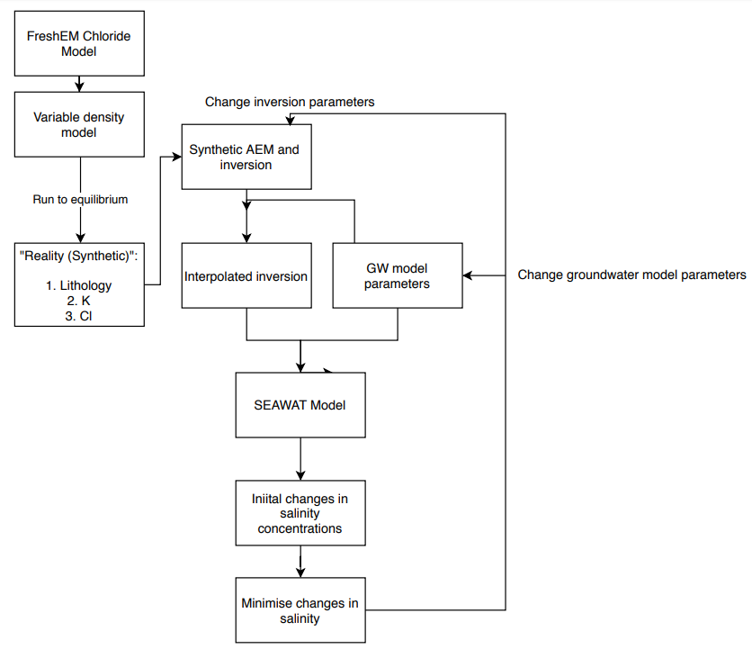
Reducing Error
Method
Summarised in 5 steps:
Run available groundwater model until a state of equilibrium is reached with the model boundaries and stress terms using SEAWAT code. This is now treated as a synthetic model;
Simulate airborne survey using standard geophysical forward modelling techniques, resulting in set of observations;
Invert geophysical observations and start with initial groundwater model parameters;
Run groundwater model in small time-steps for ~30 years;
Implement (downhill-simplex) optimization algorithm that penalizes rapid changes in salinity by iteratively changing groundwater model/inversion parameters.

Slide 7
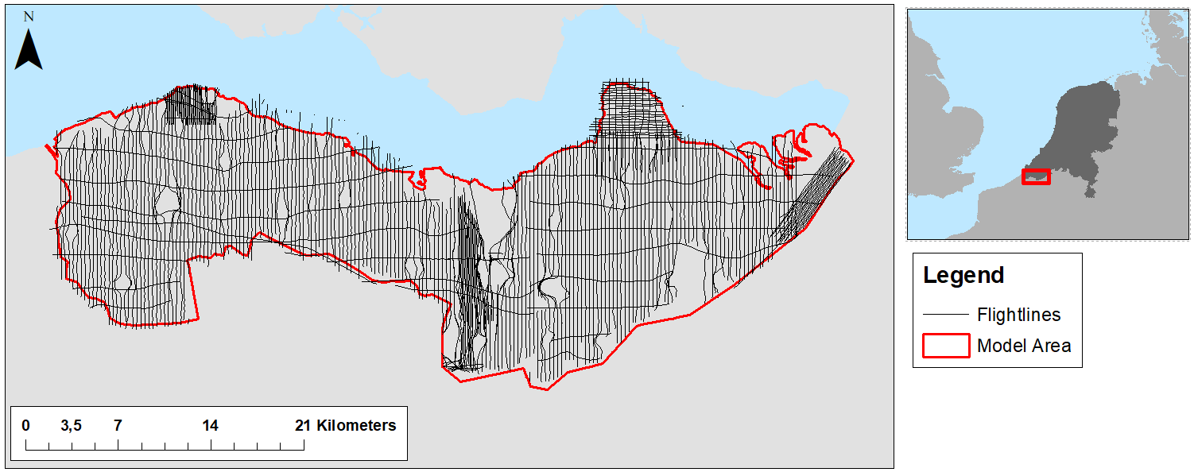
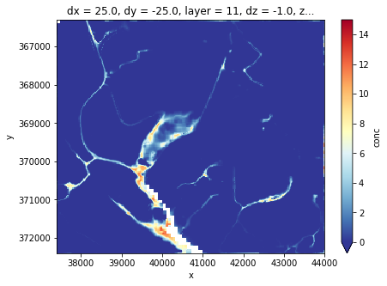
Reducing Error
Data
Model/data used to construct the synthetic model:
SEAWAT model from Zeeuws Vlaanderen (10 x 10km), 25m resolution, made using:
Lithoclasses (and K values) from available 3D lithological model. 100m resolution, 50m depth. (Stafleu et al., 2011);
Salinity data from available 3D chloride model. 50m resolution, up to ~100m depth. (Delsman et al., 2018);
Available airborne data measurement locations from previous survey (Delsman et al., 2018).
Initial results are promising and quantitative results will be available soon.

Slide 8
Thank you for looking!
Comments, questions or suggestions are welcome.
Delsman, J., Van Baaren, E. S., Siemon, B., Dabekaussen, W., Karaoulis, M. C., Pauw, P., et al. (2018). Large‐scale, probabilistic salinity mapping using airborne electromagnetics for groundwater management in Zeeland, the Netherlands. Environmental Research Letters. https://doi.org/10.1088/1748-9326/aad19e
Stafleu, J., Maljers, D., Gunnink, J. L., & Busschers, F. S. (2011). 3D modelling of the shallow subsurface of Zeeland, the Netherlands, Netherlands. Journal of Geosciences, 16(1), 5647. https://doi.org/10.5242/iamg.2011.0076
King J, Oude Essink G, Karaolis M, Siemon B, Bierkens MFP (2018) Quantifying geophysical inversion uncertainty using airborne frequency domain electromagnetic data: applied at the province of Zeeland, The Netherlands. Water Resour Res 54:8420–8441. https://doi.org/10.1029/2018WR023165
Auken, E., & Christiansen, A. V. (2004). Layered and laterally constrained 2D inversion of resistivity data. Geophysics, 69(3), 752– 761. https://doi.org/10.1190/1.1759461

