Slide 1
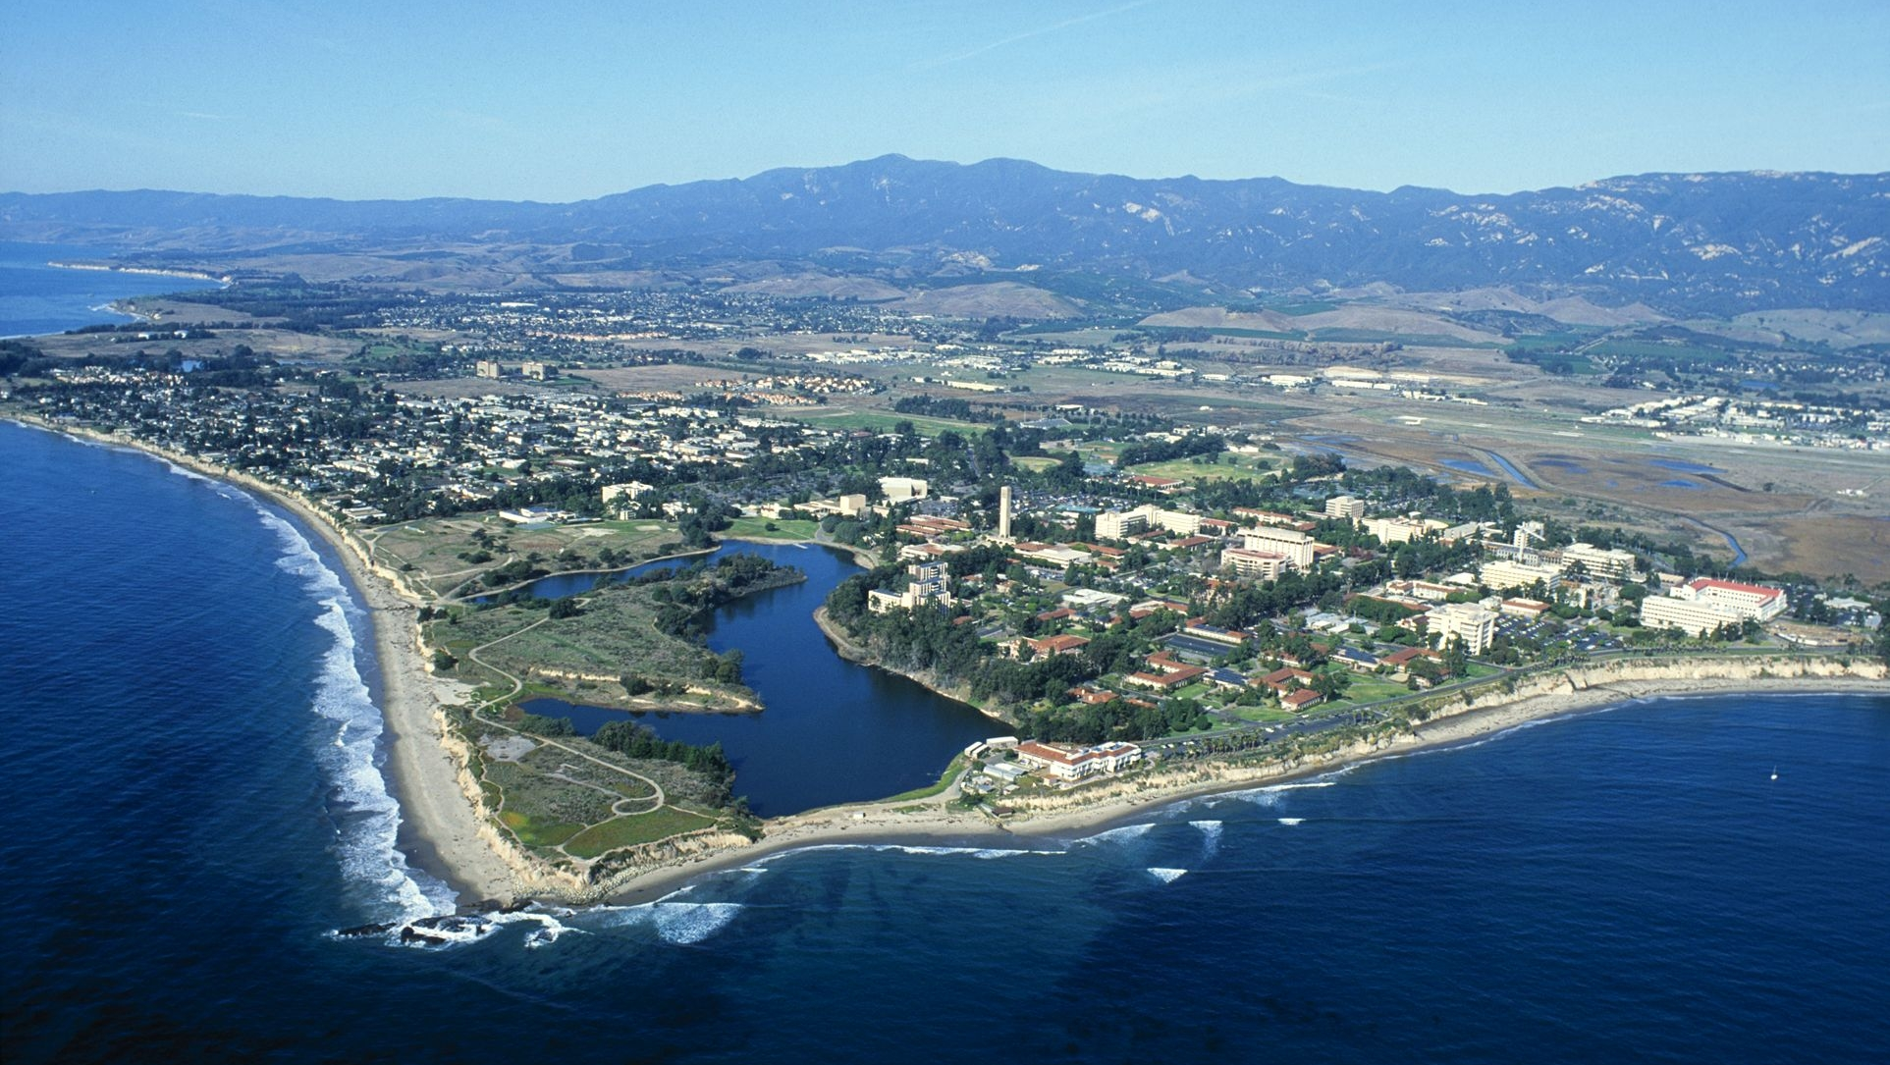



Lower Crustal Recycling: Reconciling Petrological and Numerical Constraints in the Pamir
Ryan Stoner¹
Mark Behn²
Bradley Hacker¹
UCSB¹, Boston College²
EGU 2020

Slide 2
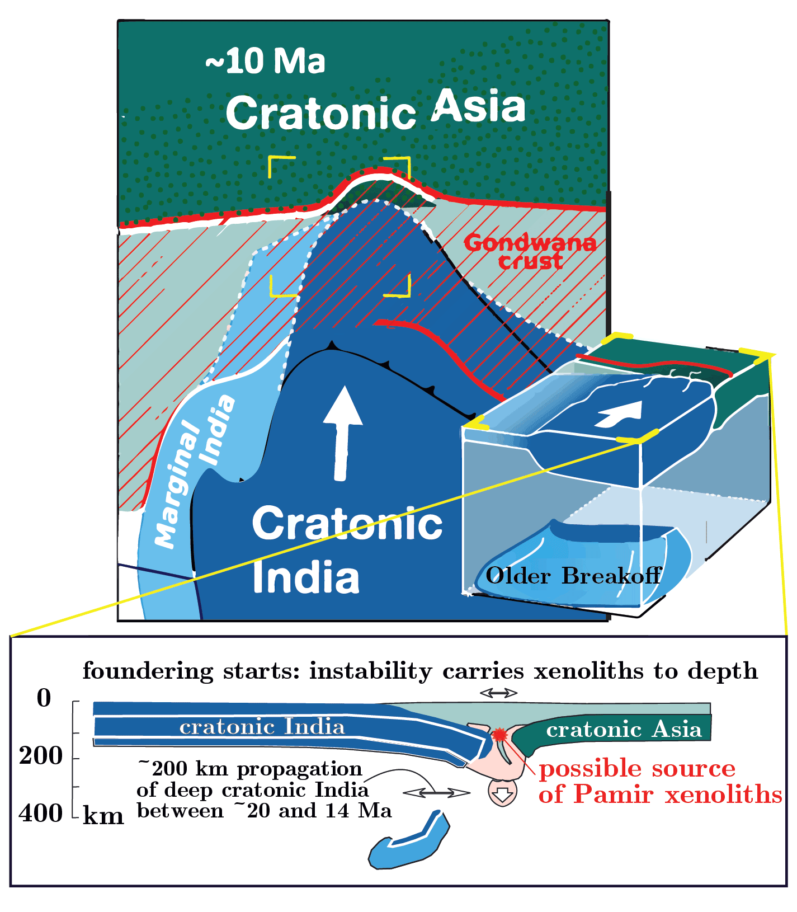
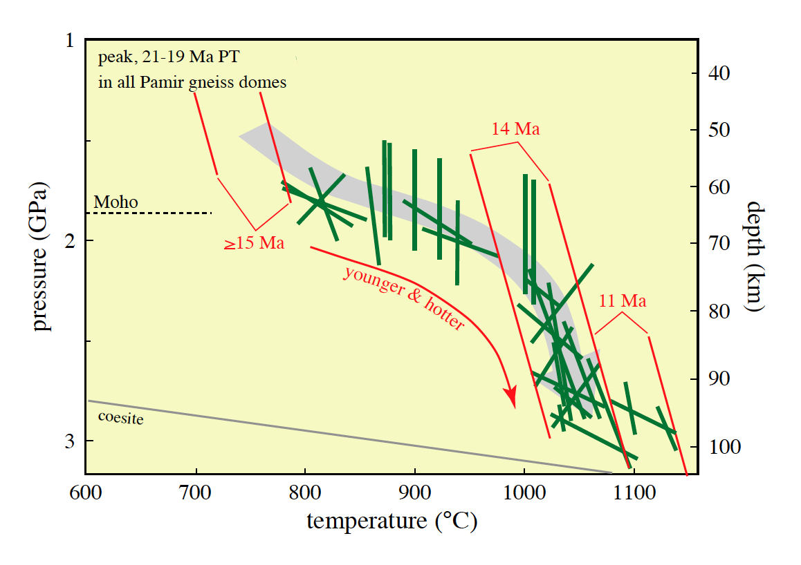
Xenoliths record foundering of lower crust in Pamir
Gordon et al., 2012; Shaffer et al., 2017
previous studies of lower crustal xenoliths from the Tashkorgan magmatic suite found evidence for heating and transport of xenoliths to sub-Moho depths after slab breakoff
constrained by thermobarometry, U-Pb zircon dates, and Ti in zircon temperatures
Shaffer et al., 2017
Kufner et al., 2016; Shaffer et al., 2017

Slide 3
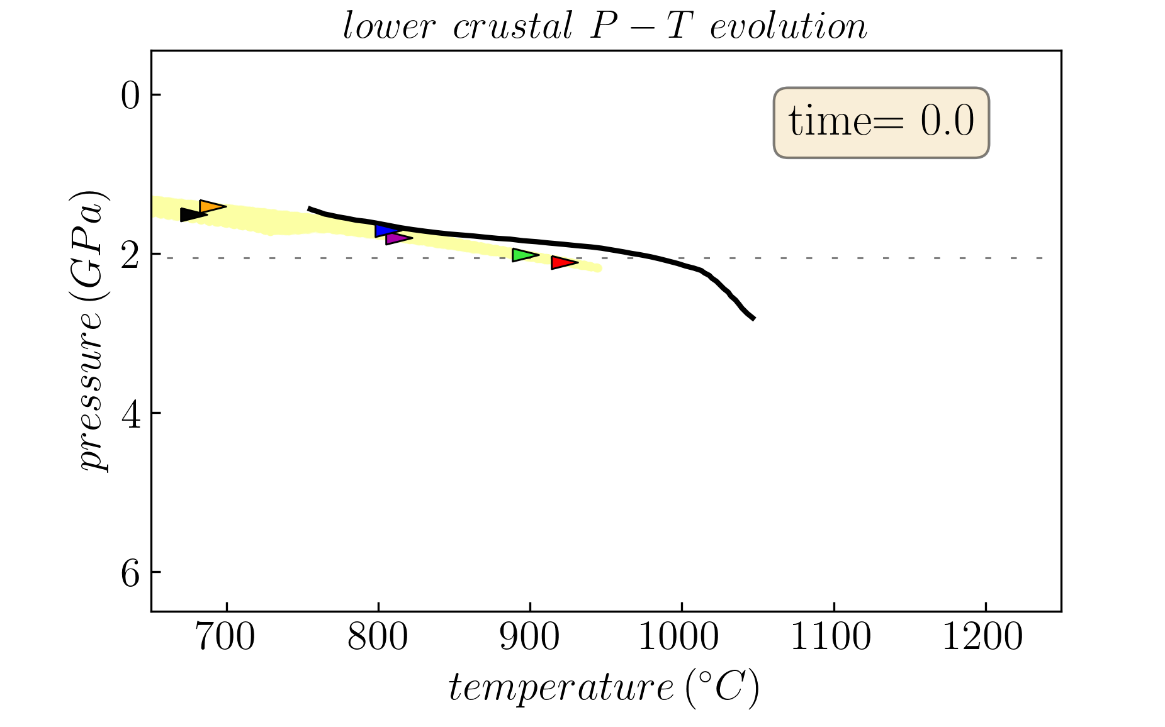
Comparing numerical and xenolith pressure-temperature (P-T) paths to constrain plausible geodynamic regimes
Gordon et al., 2012; Shaffer et al., 2017
Use Pamir as a test case for the fate of the lower crust during collisional orogeny
goal to compare numerical P-T paths (shown as arrow-shaped triangles on right) to P-T path of xenoliths (black line).
to find permissible geodynamic regimes permissible P-T paths should at minimum intersect the xenoliths’ P-T path
using the code SiStER (Olive et al., 2016)

Slide 4
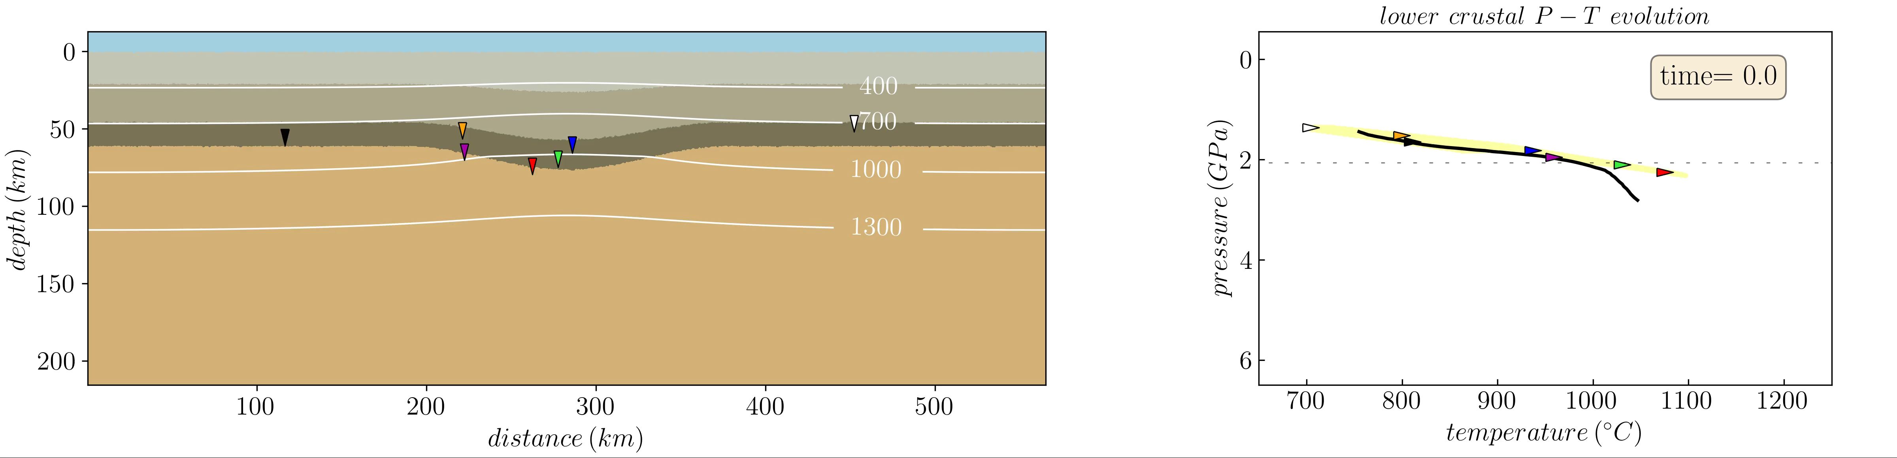
Thicker, radiogenic crust: delamination
use densities from calculated stable assemblages for upper, middle, and lower crust and associated heat production (Rudnick and Gao, 2014)
only showing the upper, near surface half of the model
cases with delamination do tend to intersect the xenolith P-T path; consistent with xenolith data
lower crust in area of thickened crust generally flows to margin of initially thickened crust and before accumulating enough material to founder

Slide 5
Thicker, radiogenic crust: delamination
use densities from calculated stable assemblages for upper, middle, and lower crust and associated heat production (Rudnick and Gao, 2014)
domain twice the size shown here in the y-direction
cases with delamination tend to intersect the xenolith P-T path
lower crust in area of thickened crust generally flows to margin of initially thickened crust before accumulating enough material to founder

Slide 6
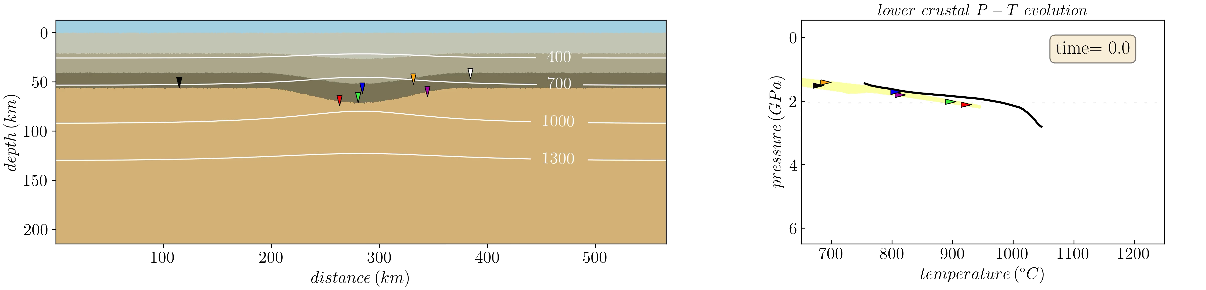
Cooler/thinner crust: mechanically-assisted dripping
thinner, less radiogenic crust, generally takes longer to founder
forms a mechanically assisted Rayleigh-Taylor-like instability (drip) driven by positive feedback between contraction and eclogitizatiion
P-T paths are generally cold; the ultra-high temperatures seen in the xenolith record are not matched at the same pressure

Slide 7
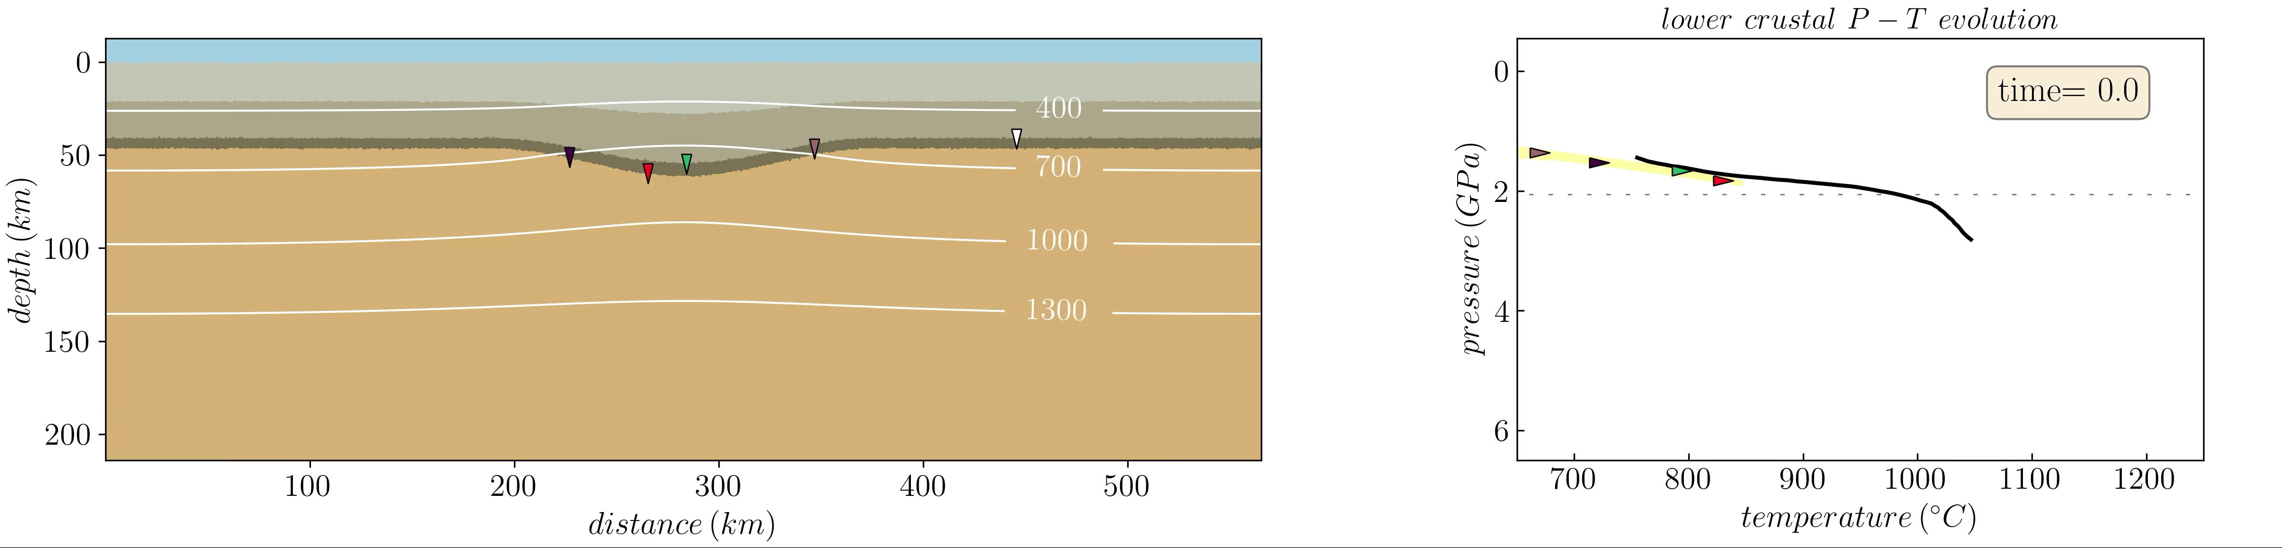
Cases with the coolest and/or thinnest crust: wholesale thickening of crust
when thin enough the crust remains coherent with minimal foundering
density contrasts between lower crust and mantle are larger than in hotter cases, but high viscosities prevent foundering
P-T paths are even colder than those for R-T instability
there is a continuum between individual geodynamic regimes though

Slide 8
Delamination favored for more radiogenic crust
thickness of buoyant upper crust dictates the geodynamic regime
feedback between contraction and eclogitization is captured
though delamination is the only mechanism we see that reproduces the P-T paths, Rayleigh-Taylor-like instabilities occasionally can nucleate delamination

Slide 9
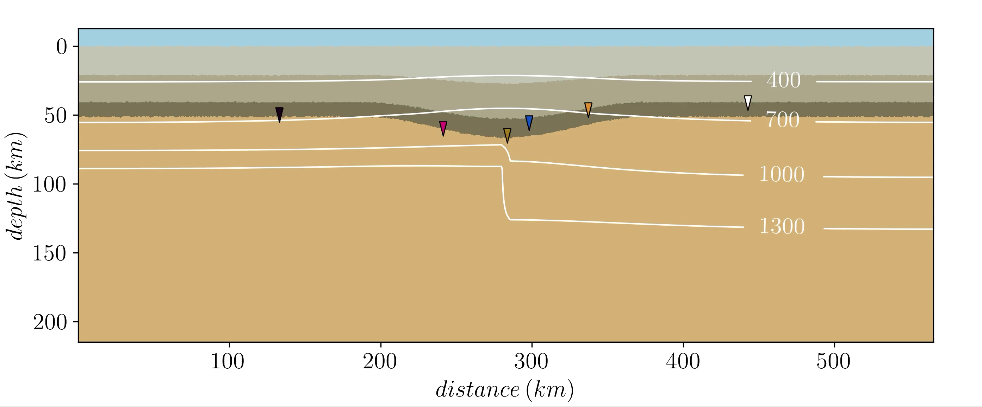
Wrapping up: parameters that don’t change the style of foundering much
wavenumber – modulates rates
contraction rate ( doubling contraction rate produces nearly identical geodynamic regime diagram as previous slide)
alternating layers of mafic and felsic material in the lower crust
locally adding a step with increased thermal gradient in the mantle lithosphere (shown on right)

Slide 10
Wrapping up: parameters that don’t change the style of foundering much
wavenumber – modulates rates
contraction rate ( doubling contraction rate produces nearly identical geodynamic regime diagram as previous slide)
alternating layers of mafic and felsic material in the lower crust
locally adding a step with increased thermal gradient in the mantle lithosphere (shown on right)

