Slide 1
Tsunami Risk Perception in Southern Italy 2020
Crescimbene Massimo
Cerase Andrea
Amato Alessandro
Cerbara Loredana
Cugliari Lorenzo
La Longa Federica

Slide 2
Why making a research on tsunami’s risk perception and understanding?
To collect data on citizens’ knowledge and characterization of tsunamis;
To assess how citizens perceive and understand tsunamis and investigate their related mental models;
To identify the most appropriate messages and channels to spread risk communication and alert messages;
To improve communication strategies and their effectiveness through different channels.
To study the differences in tsunami risk perception for coastal areas and understand how the environmental, social and psychological (and memory) context can influence it.

Slide 3
About risk perception studies
Studies of risk perception examine the opinions people express when they are asked to characterize and evaluate hazardous activities and technologies.
This research aims to aid risk analysis and societal decision making by:
improving methods for eliciting opinions about risk,
providing a basis for understanding and anticipating public responses to hazards
Improving the communication of risk information among laypeople, technical experts, and policy makers.
Paul Slovic P., Fischhoff B., Lichtenstein S. (1982), Why Study Risk Perception?. Risk Analysis, 2:83-93.
Perception is not simple knowledge of risk

Slide 4
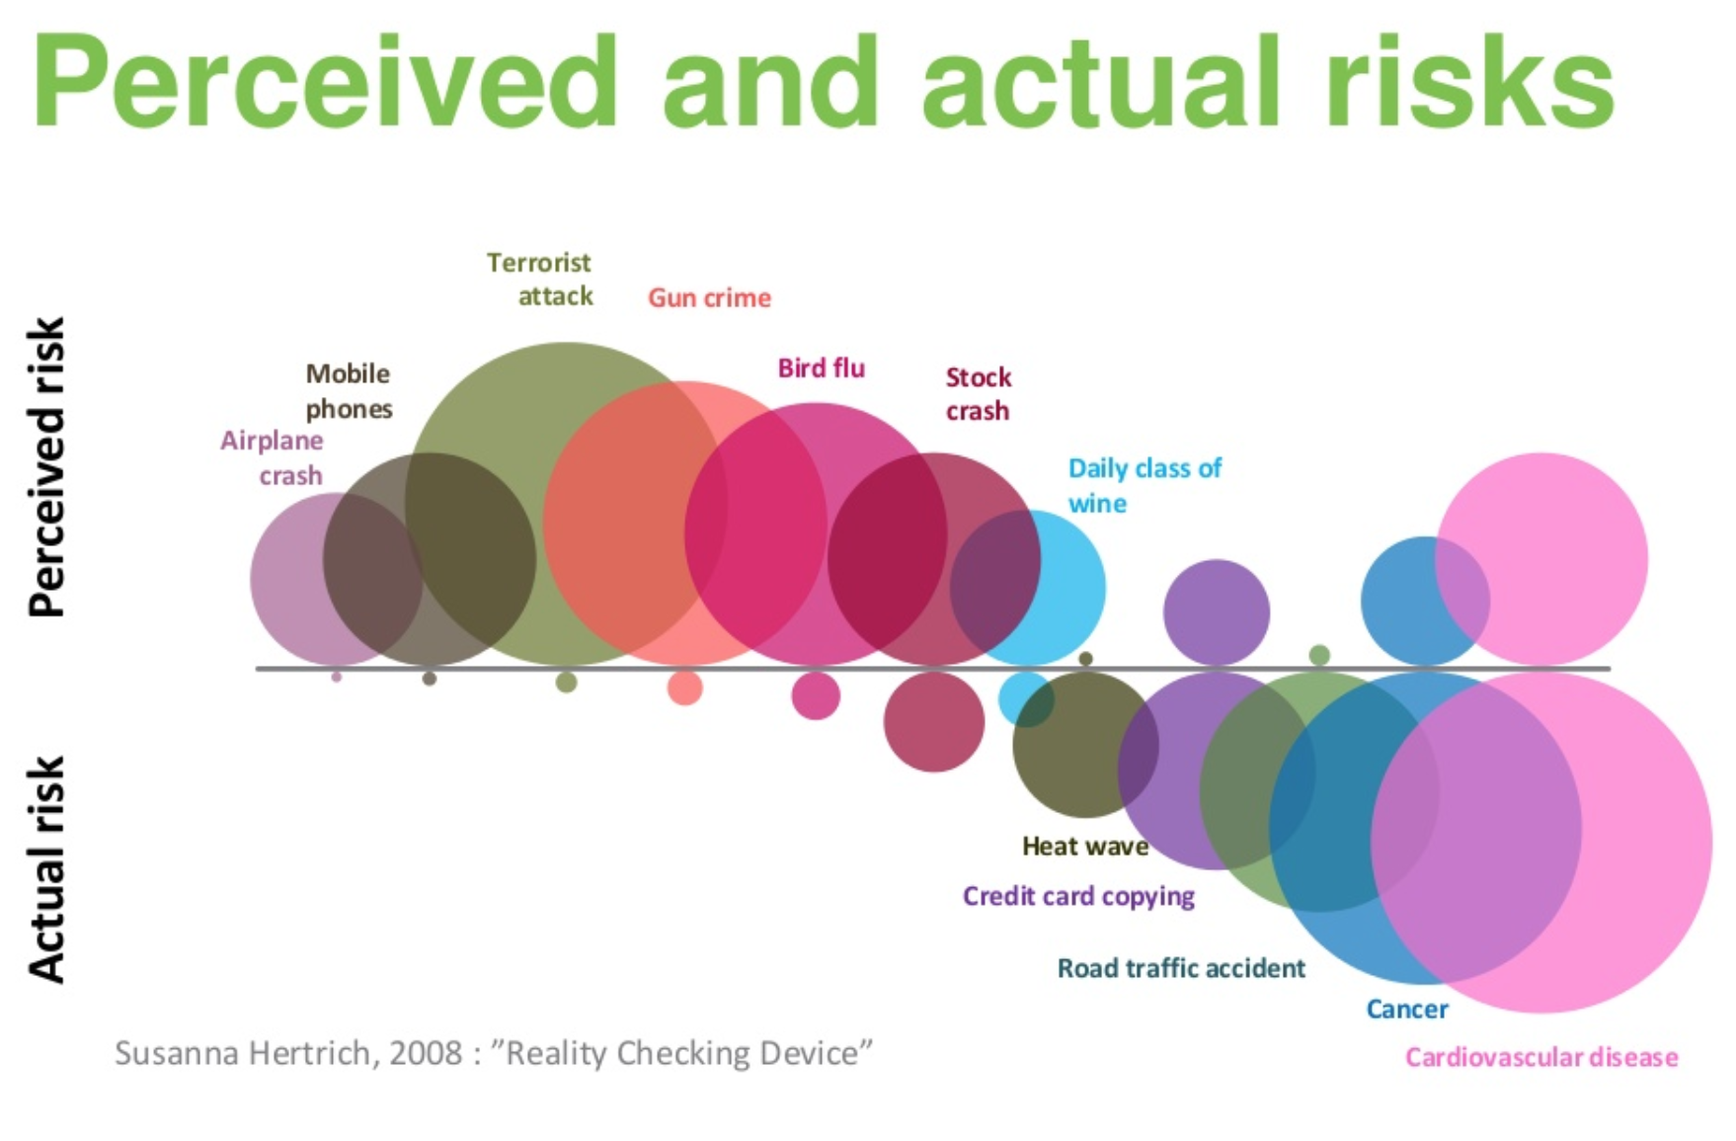
Perceived risks and real hazard
“Studies of risk perception examine the judgments people make when they are asked to characterize and evaluate hazardous activities and technologies”.
These judgments almost never depend on real risk.
However, perception is for humans the first fundamental step to know reality and to know and evaluate risk.
Perceived Risk and Actual Risk

Slide 5
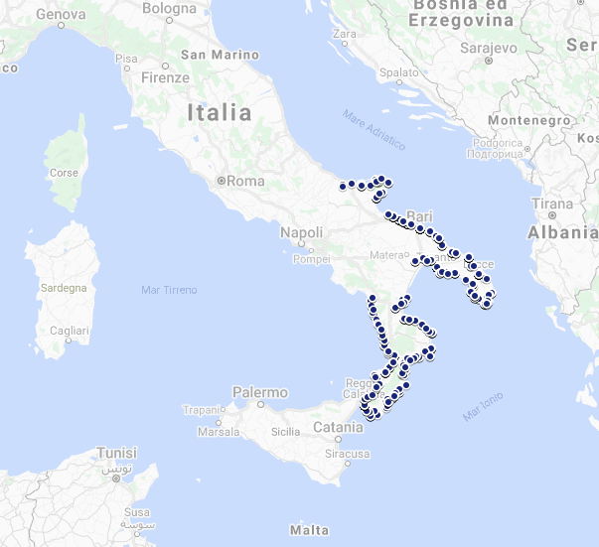
The first phase of the survey

Slide 6
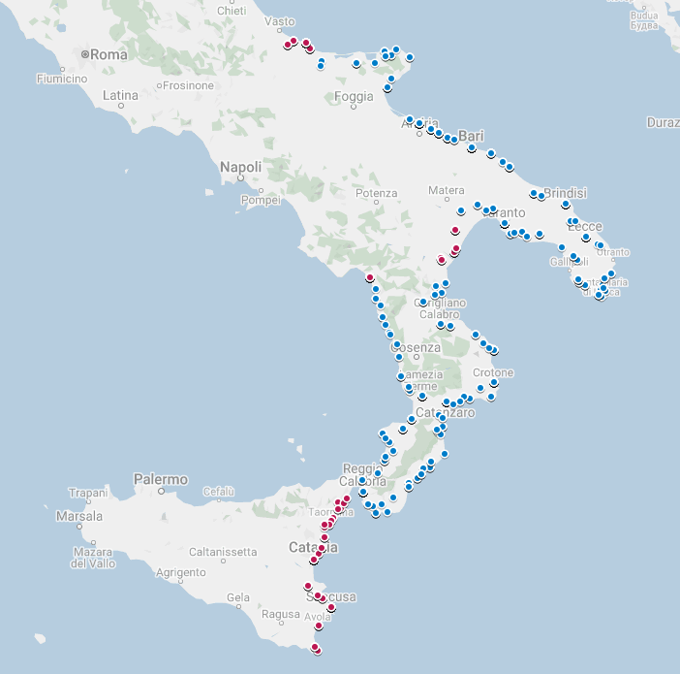
The second phase of the survey
The second phase of the survey was carried out between 27 December 2019 and 8 January 2020.
614 CATI (Computer-Assisted Telephone Interviewing) telephone interviews were completed in the regions of Adriatic Molise, Adriatic and Thyrrenian Basilicata and Eastern Sicily (Ionian).
First survey municipalities 2018 (1021 interviews in 183 coastal municipalities)
Distribuition of interviews:
Second survey municipalities 2020 (614 interviews in 37 coastal municipalities)

Slide 7
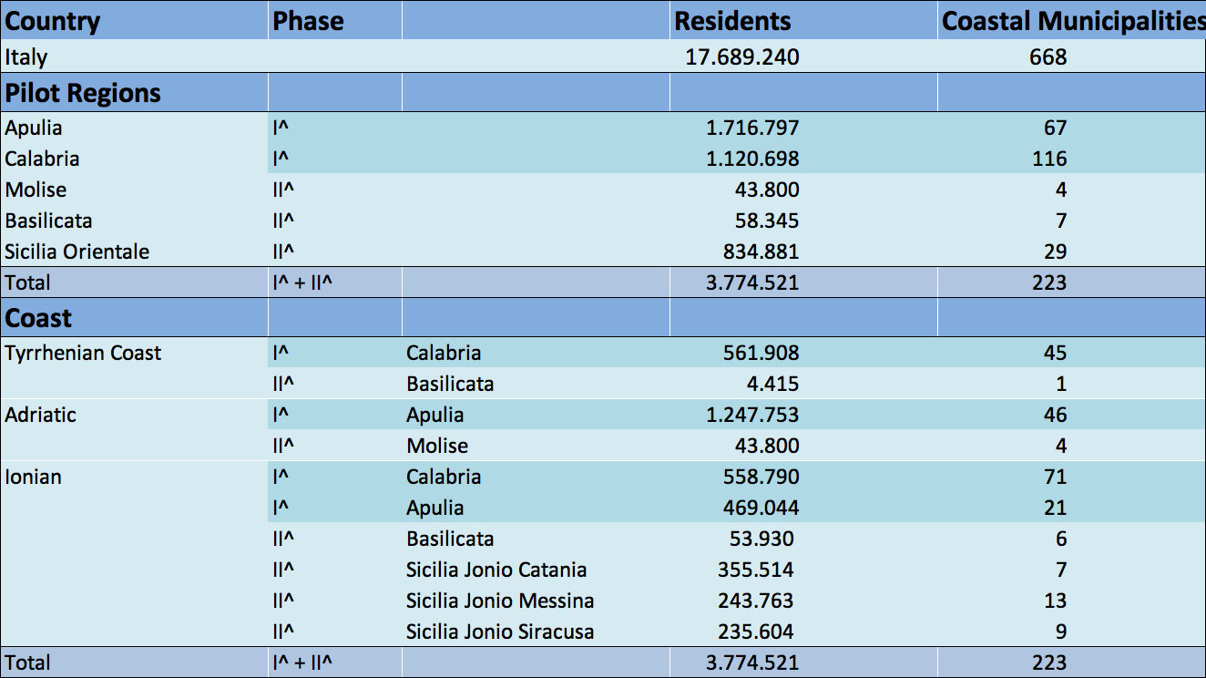
Reference Universe

Slide 8
Tsunami risk perception in southern Italy
In the Mediterranean Sea, the possibility of a tsunami is:
The graph is clear, in southern Italy the perception of tsunami risk is low. It is possible to observe two interesting information detected in the Adriatic coast, where the perception is very low due to the loss of historical memory and the events that occurred in the remote past, even if damaging. The high level of perception of tsunami risk in the Tyrrhenian coast is associated with the presence of active volcanoes in the sea (e.g. Marsili), the 2002 Stromboli tsunami and the historical memory of the 1908 tsunami (Messina and Reggio Calabria).

Slide 9
Tsunami risk perception in 1908 tsunami areas
Are the citizens living today in the coastal areas that were hit by the Tsunami generated by the earthquake in 1908, aware that they live in tsunami-prone areas?
51% of respondents living today in coastal areas affected by the 1908 tsunami are aware that they live in an area at risk. It can be seen in the graph that 53.8% of citizens living in coastal areas not affected by the tsunami are not aware of this risk.

Slide 10
Tsunami risk perception & behaviour
If you're near the coast and you feel a strong earthquake, will you run to the beach?
In the graph are represented respectively: in the "X" axis the perception of the tsunami risk in the area where you live and, in the "Y" axis, the answer to the above question. The result shows that those who have a better perception of tsunami risk also have a greater knowledge of the phenomenon. Those who have a low perception of risk, on the other hand, would not behave correctly in case of danger.

Slide 11
Source of information
Tv is the most relevant source of information on tsunamis: almost 90% of interviewes rely on Tv news.
There is a considerable gap with respect to other sources
Institutional and scientific sources are used only by few

Slide 12
Causes of Tsunamis by coastal area
Earthquakes are seen as a cause of tsunamis by over 70% of the sample, with slight differences between different coastal areas.
People living on Tyrrhenian coast are more likely to mention volcanic eruptions.
As an hypothesis, it may depends on Stromboli eruption in 2002 along with rumors on a catastrophic eruption of Mount Marsili.

Slide 13
Elicitation «tsunami» vs «maremoto»
People perceive in a different way the Japanese word “tsunami” and the word “maremoto” from spoken Italian.
These two words are associated with two different mental models, in which given features are differently recalled and combined together.
The idea of “big wave” is strongly associated with the word tsunami and, the word “earthquake” is mentioned as the main feature of maremoto

Slide 14
Conclusion
The two phases of the survey enhance the starting hypotheses:
The perception of tsunami risk in southern Italy is low and there is no knowledge of the phenomenon.
The coastal areas affected by the tsunami of 1908 (Tsunami of Messina and Reggio Calabria), preserve a bit the memory of the event.
The Tyrrhenian coastal areas reveal a greater perception of the tsunami risk induced by the fear of active submerged volcanoes, the frequent eruptions of the island of Stromboli and historical memory.
The earthquake is seen as the major cause of tsunamis followed by volcanoes (with peaks in the Tyrrhenian areas).
TV is confirmed as the major source of communication (87.9%).
The word Tsunami is associated with big waves, while the word Maremoto is more related to earthquake and in the Italian ideal, more evcative of the phenomenon.

