Slide 1
Towards best practice in managing datasets for climate monitoring
William J Wright, Australia, wjwright1385@gmail.com
Christina Lief, USA christina.lief@gmail
Ge Peng, USA, ge.peng@noaa.gov
Omar Baddour, Switzerland obaddour@wmo.int
Peter Siegmund, Netherlands peter.siegmund@knmi.nl Dominique Berod, Switzerland dberod@wmo.int
Robert Dunn, UK robert.dunn@metoffice.gov.uk Anny Cazenave, France, anny.cazenave@legos.obs-mip.fr Manola Brunet, Spain, manola.brunet@urv.cat

Slide 2
Background
Monitoring climate variability and change, modelling and predicting future climate, and setting climate-related policy, depends on reliable climate datasets covering all environmental variables
Reliable climate datasets require not just sound observational practices, but also good management (stewardship)

Slide 3
WMO and climate data standards
The World Meteorological Organisation (WMO) is the global standard-setting body for meteorological and related practices, including for climate data
At its 18th session in 2018, WMO Congress endorsed a High Quality Global Data Management Framework for Climate (HQ-GDMFC), aiming to promote good practices in the management and exchange of climate data.

Slide 4
So what challenges need to be addressed?
Lack of a regulatory framework on climate data management
Lack of knowledge among Members about how to properly manage their climate data
Credibility problems with data, exploited by «hostile stakeholders» (Climategate, etc)
Lack of visibility of key datasets to users
The HQ-GDMFC was established to address these problems. It has three components:

Slide 5
Components of the HQ-GDMFC
Manual of Best Practices and Standards
Dataset Assessment Tool (SMM-CD)*
Catalogue of Assessed Climate Data
Promoting data management standards and best practices for ensuring high-quality datasets for use in climate policy and services.
A catalogue of climate datasets available online using the WIS, providing access to data, metadata, and visualization of the data.
To measure quality of data stewardship by Data Owners.
* Stewardship Maturity Matrix for Climate Data
Discoverable, Accessible, Usable, Authoritative,
High-Quality, and Well-Managed Climate Datasets
Notes:
HOW?
A Manual of best practices and standards to improve climate data and management through WMO Technical Regulations and represents the first attempt by WMO to define a regulatory basis (as opposed to Guidelines) for the management of climate data;
A self-assessment tool that provides a scored measure of the quality of the data stewardship and governance;
A Catalogue of climate datasets maintained and made available online using the WMO Information System (WIS), where users can access the data along with metadata, information on assessment documentation, and visualize the data using an online access tool.

Slide 6
Let’s take each of these
components separately …

Slide 7
About the Manual on HQ-GDMFC
Contains definitions, recommended procedures, and regulations on climate data management
Applies to climate observations, analyses and predictions
Regulations expressed as Shall or Should
- shall means mandatory for WMO Member States
- should means recommended
Forms part of WMO Regulatory material - first time climate data management has had Regulatory status.
(The official version of the Manual: English, French, Spanish, Chinese

Slide 8
Some examples of Regulations concerning climate data management
2.1.4.1 Entities should document and retain information on data provenance, designated by the term Provenance Metadata. Such metadata should document, at a minimum, the origin and processing history (including any changes) of raw observations and derived data, such as from satellite and models, and links to the documented methodology used in creating products to ensure full traceability of the product chain.
2.1.5.2 Entities shall ensure that original and irreproducible climate records and their associated metadata are retained in perpetuity.

Slide 9
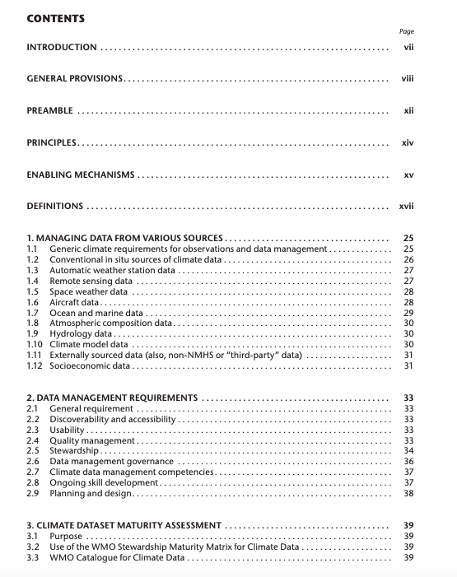
WMO No.1238: Standards and Recommended Practices Manual on High Quality Global Data Management Framework for Climate
https://library.wmo.int/doc_num.php?explnum_id=10197

Slide 10
Why do we need a dataset
Assessment tool?
Question: How do we know how
reliably a climate dataset is being
managed, and how accessible it is?
Answer: By means of a Stewardship
assessment Tool, in the same way one
might rate a Hotel on, e.g., TripAdvisor TM

Slide 11
Data stewardship assessment tool
WMO has developed a Stewardship Maturity Matrix for Climate Data (SMM-CD)
The Matrix enables scored assessment of various criteria in relation to:
- Data Access (Discoverability, Accessibility)
- Useability (Portability, Documentation, Usage/Impact)
- Quality Management (Quality Control, Quality Assessment, Integrity)
- Data Management (Preservation, Metadata, Governance)

Slide 12
SMM-CD
Degree of maturity against each of 11 attributes is assessed, on a scale of 1 to 5
Assessment is voluntary, but encouraged. Self assessment, under guidance by WMO Team members
A Guidance Booklet provides assistance with how to assess against criteria
A benefit is that dataset managers can identify, and therefore prioritise rectification of, weaknesses in Stewardship

Slide 13
Stewardship Maturity Model for Climate Data (SMM-CD)
A maturity model is a tool for monitoring and improving aspects of organizational performance (in this case in Data Stewardship) , and is often presented as a two dimensional matrix. The rows identify the various requirements and aspects for, say, data management, while the columns describe typical behaviours representing increasing capability against each aspect. Typically a maturity model uses five capability levels.
Behaviours at increasing level of maturity
Level 1 Ad Hoc Not Managed | Level 2 Minimal Managed Limited | Level 3 Intermediate Managed Defined, Partially Implemented | Level 4 Advanced Managed Well-Defined, Fully Implemented | Level 5 Optimal Level 4 + Measured , Controlled , Audit
Aspect
(Latest version: https://bit.ly/WMO-SMM-CD)

Slide 14
Diagram of SMM-CD Categories and Aspects
(The SMM-CD Guidance Booklet: https://bit.ly/SMM-CD-Manual)

Slide 15
Catalogue of assessed Datasets
SMM-CD has been peer-reviewed, road-tested, and applied to an initial 18 global datasets spanning a variety of data types.
Catalogue developed and kindly hosted by KNMI

Slide 16
Catalogue so far and next steps
Currently, the Catalogue contains 18 assessed global datasets, covering meteorological, hydrological, marine and cryospheric observations, satellite data, model data.
Most are very well known and already extensively used for climate monitoring.
Next step: Extend to national and regional data-sets

Slide 17
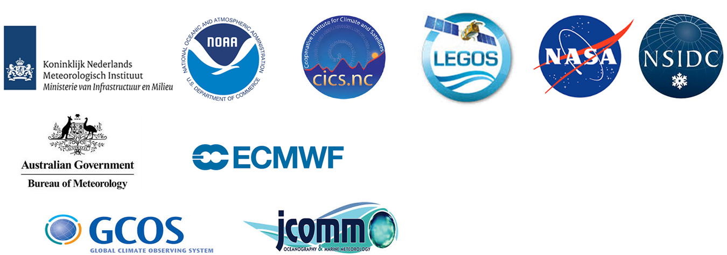
18 Assessed Global Climate Datasets
Temperature and Precipitation (ECVs) and Climate Indices | Hydrology and Marine Data | Sea Level ECVs | Sea Ice & Ice Sheets & Glacier ECVs
NOAAGlobalTemp | GRDC | GLOSS | SeaIce-Index
HadCRUT4 | ICOADS | CCI-SeaLevel | GLAS-DEM-500m
GISTEMP | WOD13 | C3S-SeaLevel | GLAS-DEM-1km
GPCC |  |  | Antarctica-GRACE
CoCoRaHS |  |  | Greenland-GRACE
HadEX2 |  |  | GLIMS

Slide 18
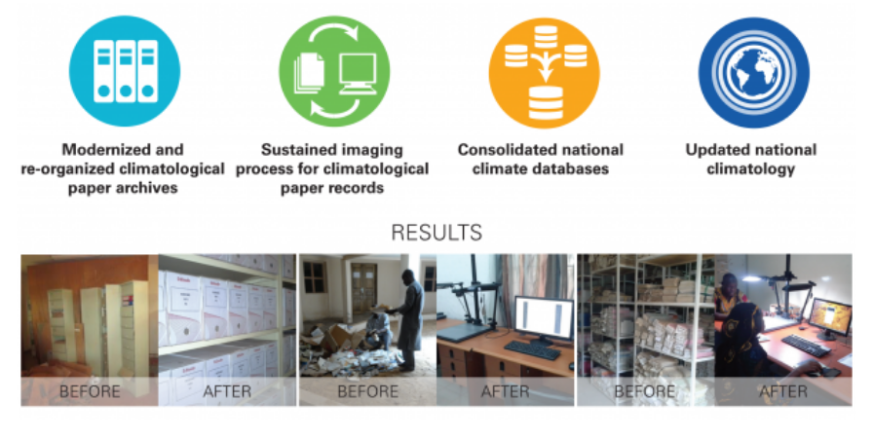
Complementary WMO climate data initiatives
The HQ-GDMFC complements, and helps enable, other WMO Climate Data Initiatives, including
- Climate Data Management Systems;
- Data Rescue;
- Climate-related messages and standard climate normals
Data Rescue

Slide 19
Some useful references
The Stewardship Maturity Matrix for Climate Data (SMM-CD)
The SMM-CD Guidance Booklet
The SMM-CD Self-Assessment Template in MS Word format
(Latest versions downloadable from Figshare)
The HQ-GDMFC Manual (versions in English, French, Spanish, Chinese)

Slide 20
Thank you
Merci

