Slide 1
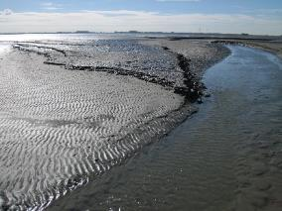
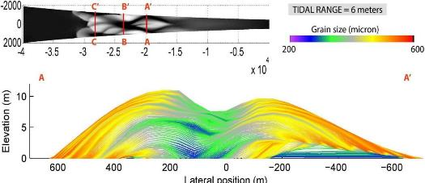



Controls on mud distribution and architecture along the fluvial-to-marine transition (EGU2020-22631)
- where is the mud? -
Wietse I. van de Lageweg^{1,2}, Lisanne Braat¹, Daniel R. Parsons³ & Maarten G. Kleinhans¹
¹Faculty of Geosciences, Utrecht University, the Netherlands
²HZ University of Applied Sciences, Delta Academy, the Netherlands
³School of Environmental Sciences, University of Hull, United Kingdom

Slide 2
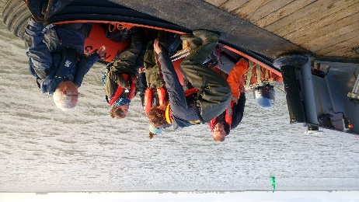
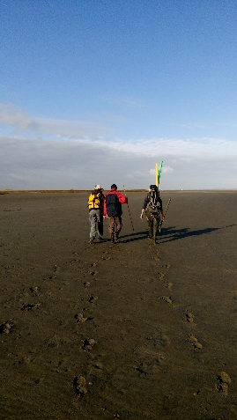
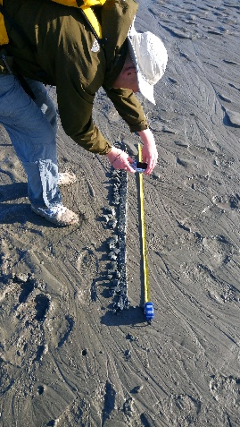
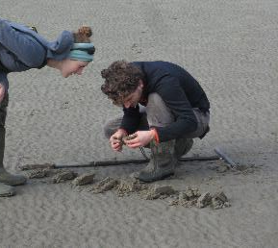
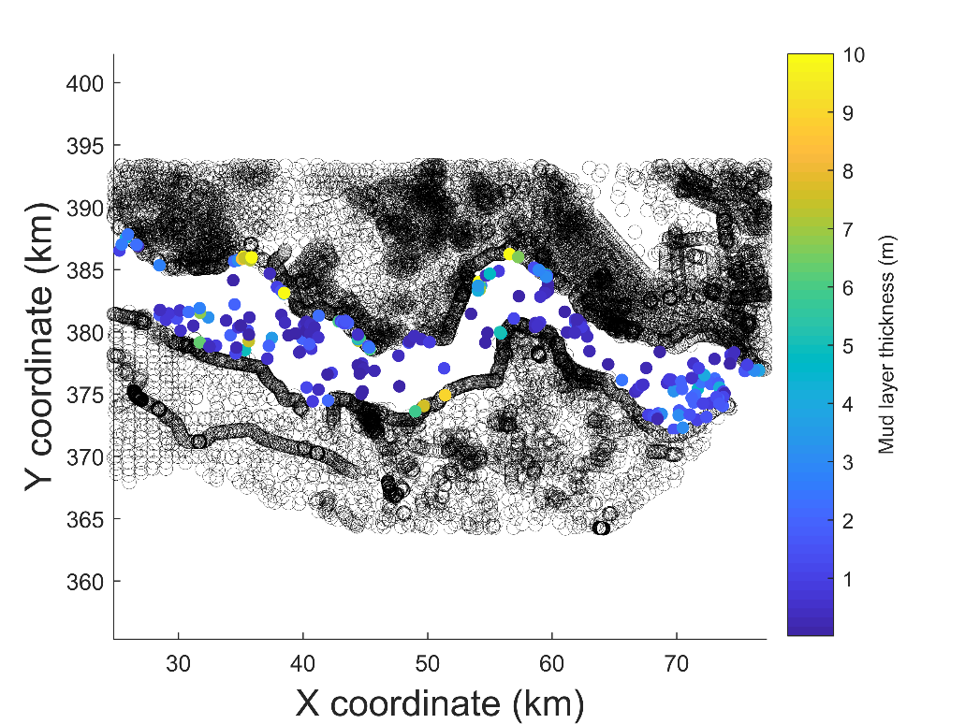
Field observations: Scheldt estuary
TNO DINO Database
In total: 14717 corings
Region of Interest: 756 corings
  Within modern Western Scheldt
Naaldwijk formation: 574 corings
  Holocene deposits
With clay: 227 corings
**Sandy system: ~5-10% mud content at surface [Van Maldegem et al. 1993]**
Lageweg et al., 2018, Geology

Slide 3
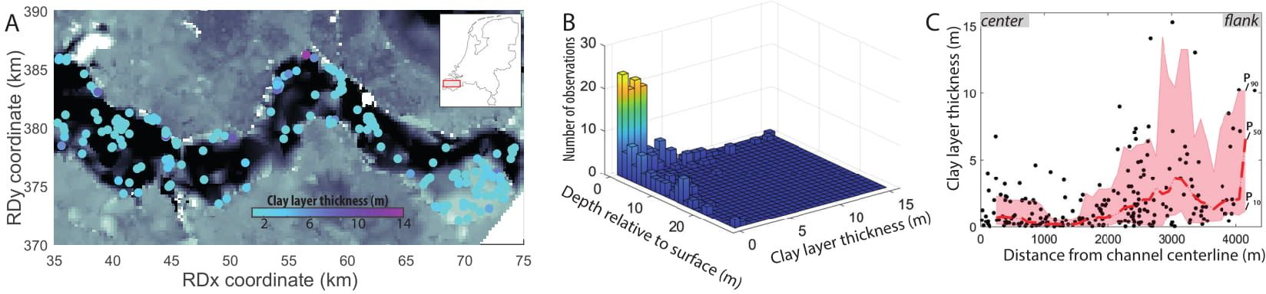
Large-scale patterns in mud deposits
Percentage mud in subsurface:
  Consistent with surface observations
Mud typically (85%) organised into a single layer
  80% of mud-layer thicknesses between 6 cm and 3.1 m
  50% of mudlayers thicker than 0.5 m
Thickening of mud deposits towards flanks
Total clay thickness
447 m
=
·100
5.1 %
=
Total core thickness
8704 m
Lageweg et al., 2018, Geology

Slide 4
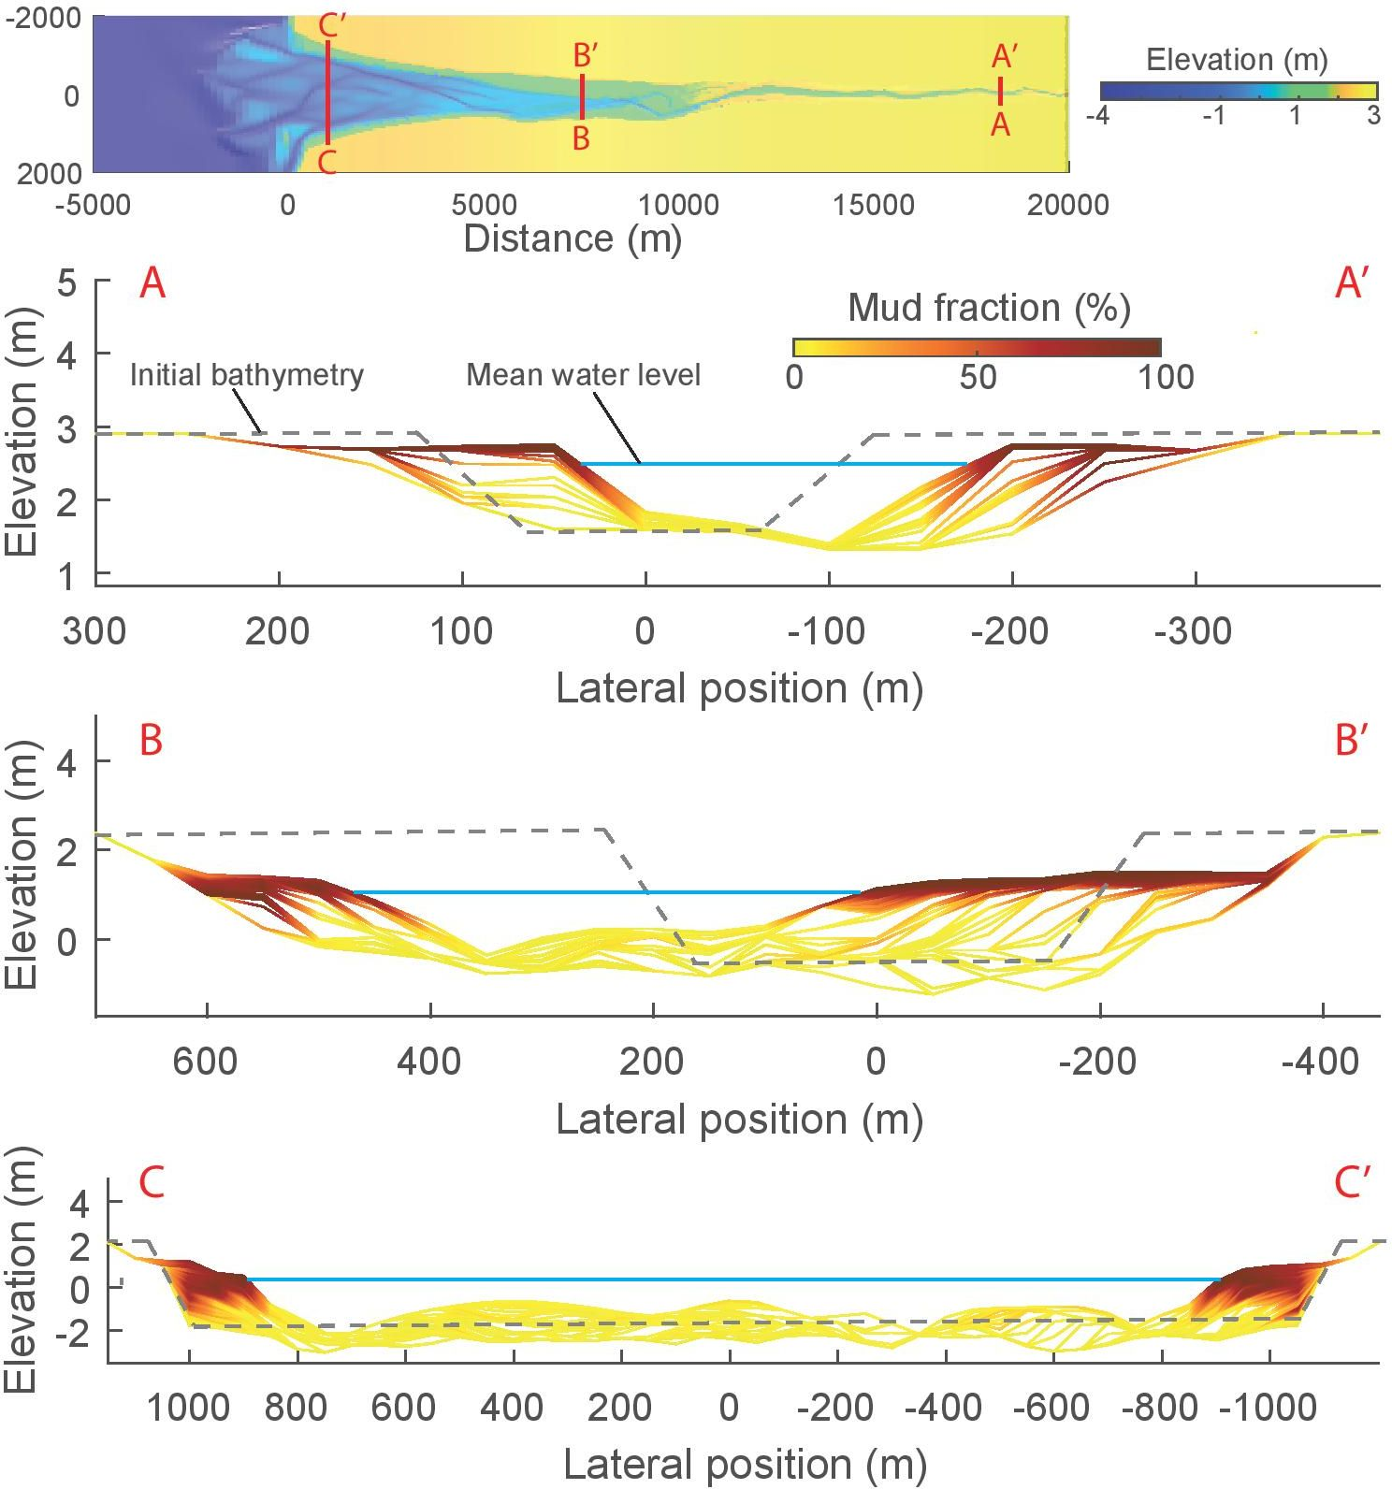
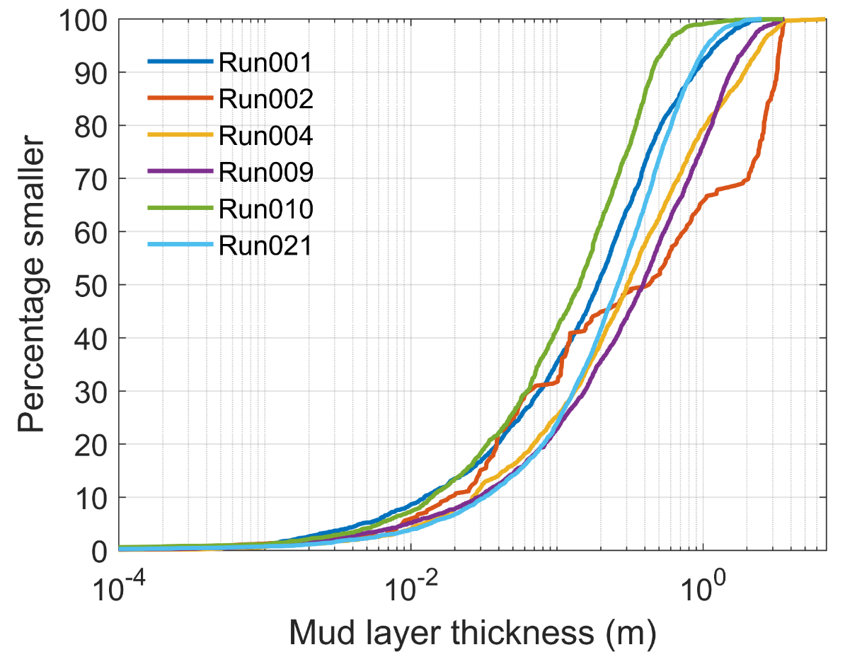
Virtual (mud) sedimentology
Default, fluvial mud
Marine mud only
Fluvial & marine mud
Larger F mud input
Smaller F mud input
No tides, fluvial mud
Thin layers
Thick layers
Lageweg et al., 2018, Geology & Braat et al., 2017, ESD

Slide 5
So, where is the mud?
Processes
  River-dominated: muddier & more heterogeneous deposits
  Tides: tend to separate sands and muds with mud deposits towards flanks
  (Low-energy) waves: prevent mud deposition in mouth area
Spatial trends (D3D & Scheldt consistent)
  Mud deposits predominantly towards flanks of system
  Typically a single (1) mud layer in core
Implications
  Mud deposits determine degree of lateral confinement (thus bar pattern)
  Heterogeneity determines scales of predictability in geological models
Lageweg et al., 2018, Geology & Braat et al., 2017, ESD

Slide 6
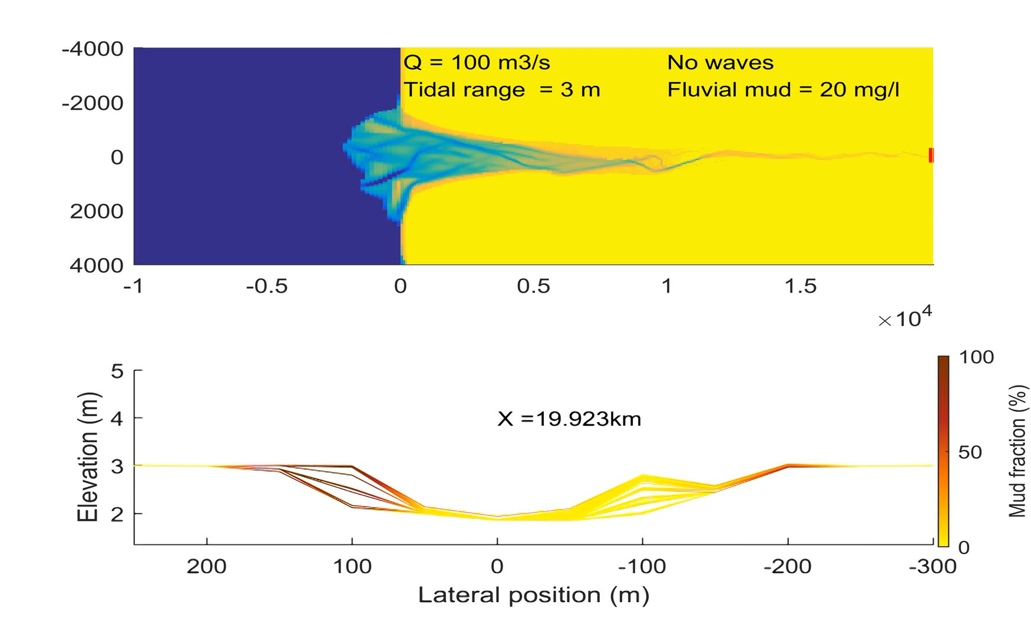
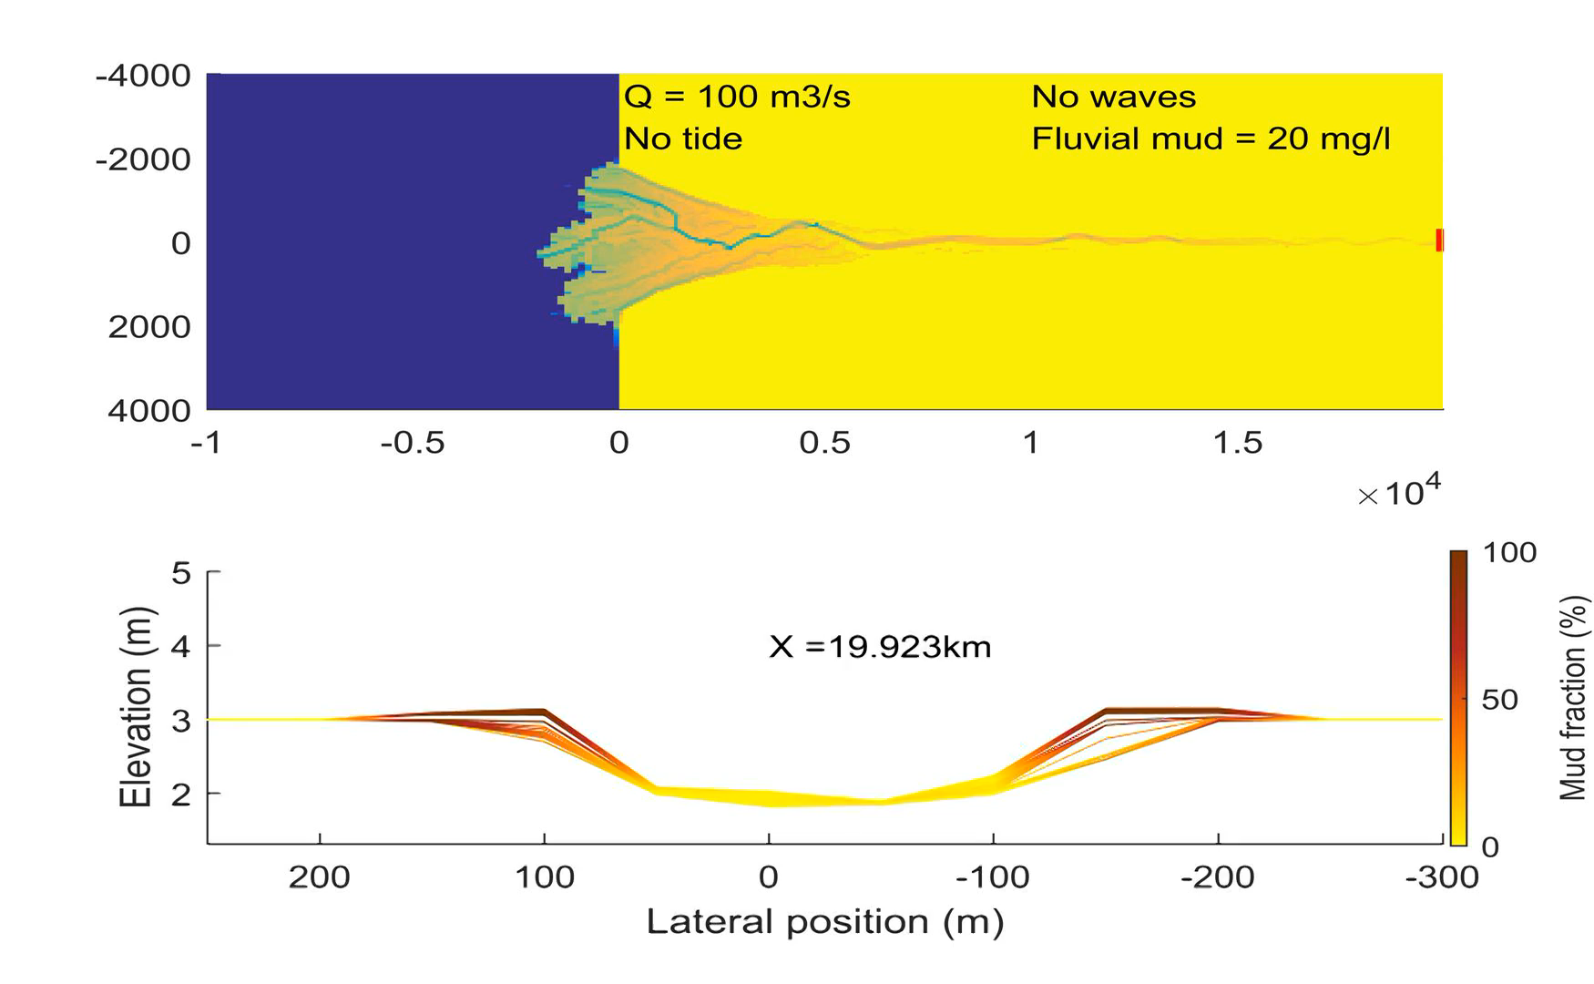
Resources & 3D virtual sedimentology
Braat et al 2017
Lageweg et al 2018
Overview of our work with movies on www.uu.nl/bruningslecture, or check out our Youtube channel https://www.youtube.com/playlist?list=PL0c2_a9_038i3yRdq11lYeU5e2799V_V-

