Slide 1






Mercury's Na Exosphere: combining ground-based and MESSENGER data
Nelly Mouawad¹, Judy Chebly¹, Francois Leblanc², Jonathan Fraine³, and Fatima Kahil⁴
¹Lebanese American University
²Sorbonne University, LATMOS
³Space Science Institute
⁴Max-Plank Institute for solar system research

Slide 2
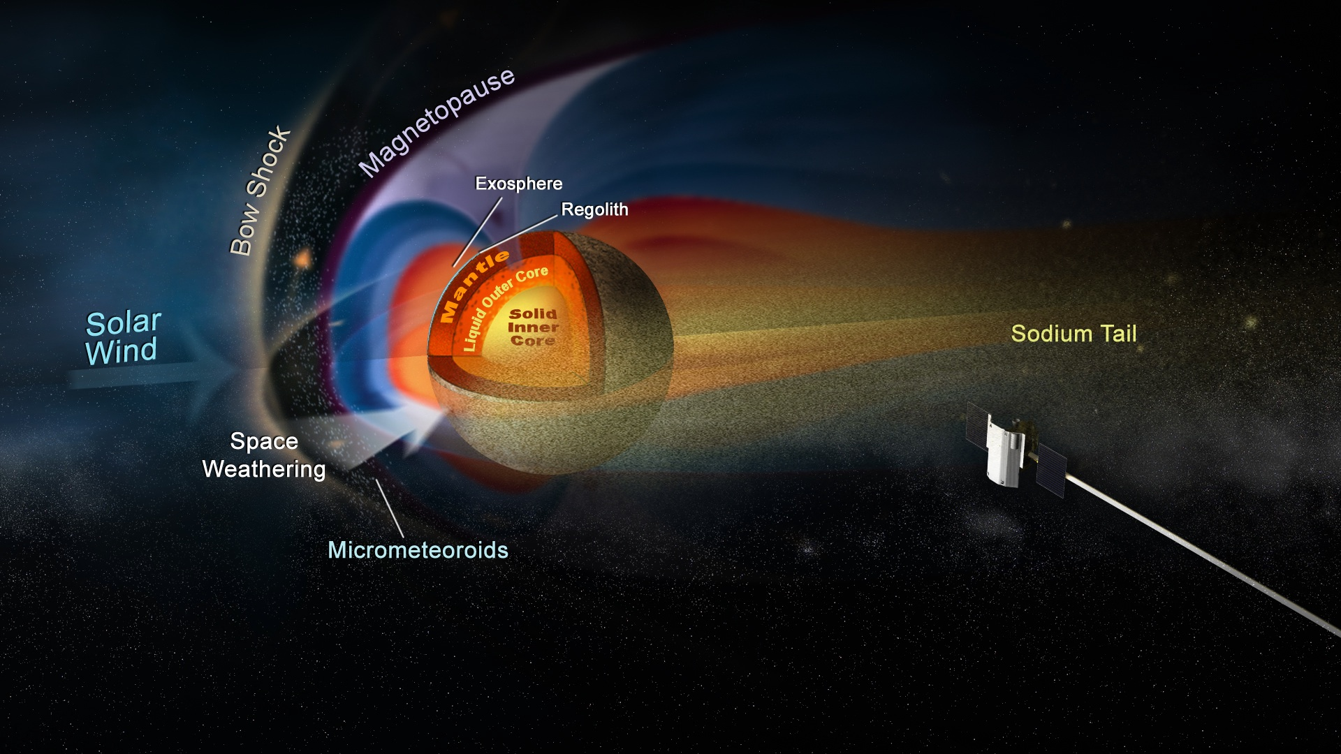
Mercury’s Exosphere
The system is coupled and dynamic - with a lot more to teach us!
MESSENGER
(2008 – 2015)
Collisionless, surface-based exosphere.
Product of interactions between the Surface,
the Solar Wind and Interplanetary Medium
Na, K, Ca, Mg & Ca+, (Al and Fe)?

Slide 3
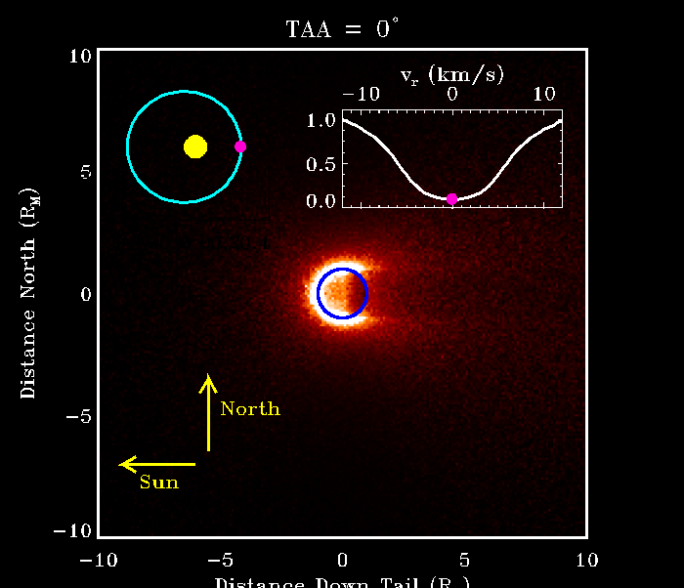
Seasonal Variations of the Na exosphere
The exosphere’s morphology, source and loss processes change along Mercury’s orbit.
Shown here the Na source due to photon-stimulated desorption.( Matt Burger )
Cassidy et al., 2015

Slide 4
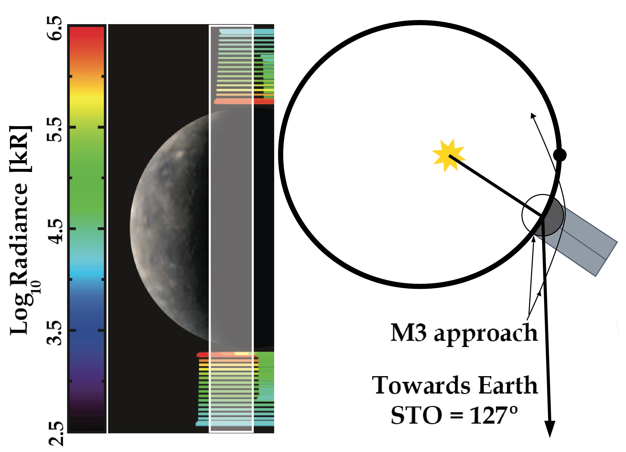
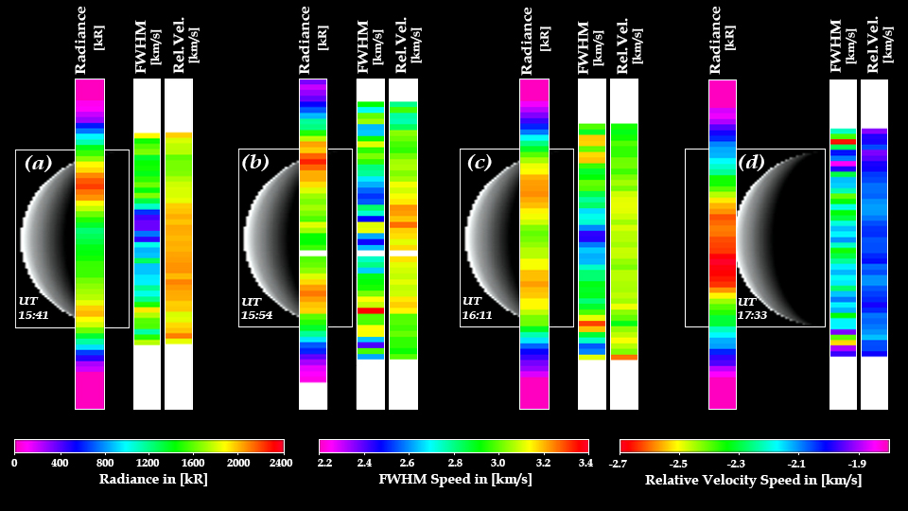
“Simultaneous” Ground-based and Space Observations during the 3rd MESSENGER flyby (M3) using the MASCS instrument
Slit position of the ground-based observations

Slide 5
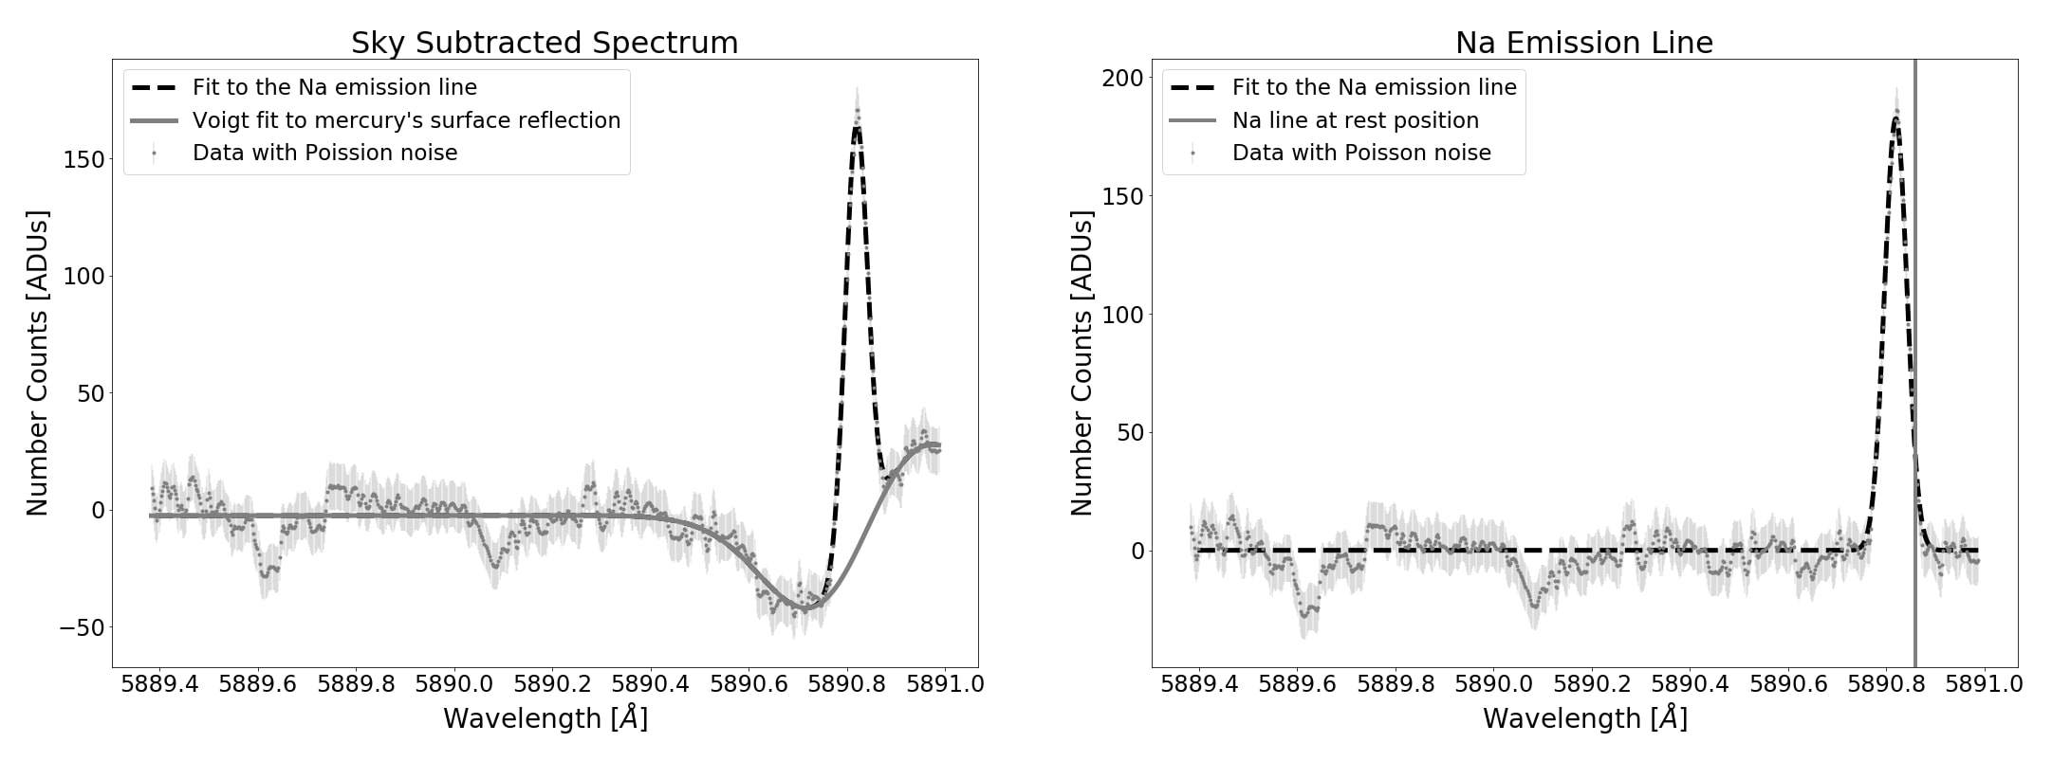
Ground-based observations
the whole range is 1.5 Å
The 2.7-m at the McDonald Observatory
Very high spectral resolution allows for radial velocities of sodium atoms.
Solar telescopes are used during the day.
Night telescopes can be used mostly at dawn or dusk, but rarely during the day.

Slide 6
Radiances, radial velocity and FWHM velocity color maps

Slide 7
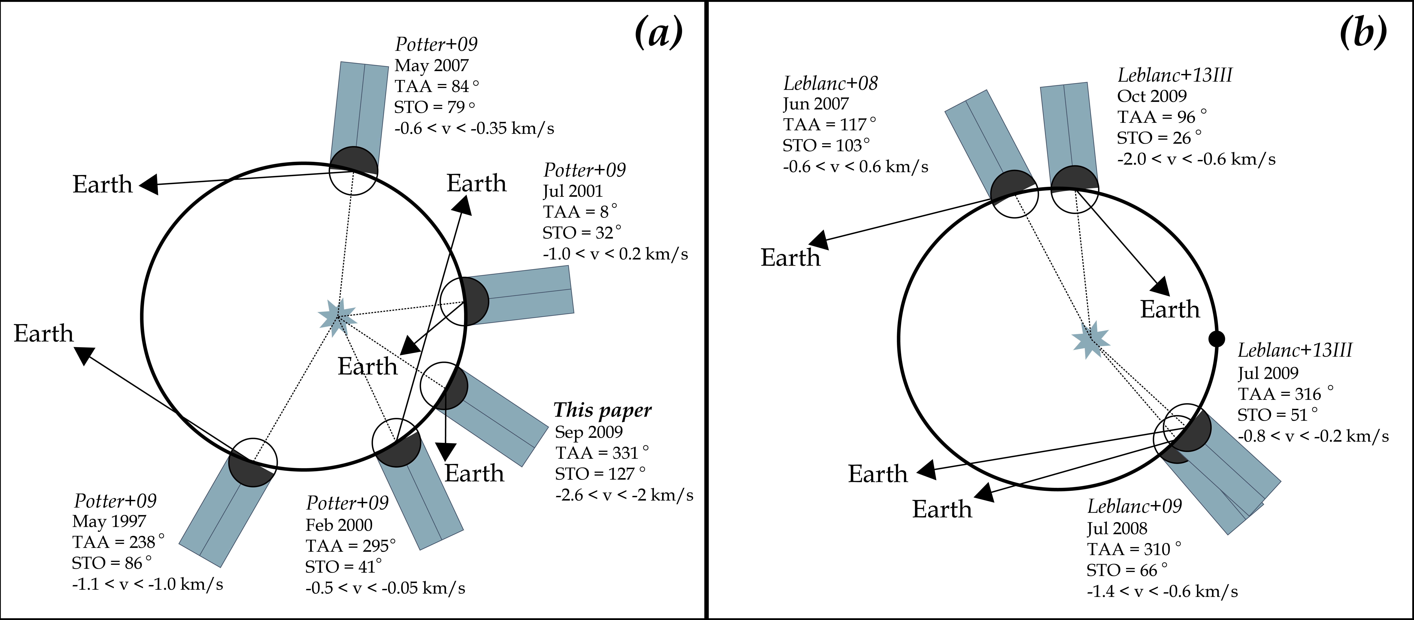
All radial velocity measurements of the Na exosphere

Slide 8
Velocity measurements help us understand the dynamics of the exosphere
The observations mentioned before help us model
the circulation of sodium atoms from, to and away from the planet.
Different processes that are at work on Mercury make it difficult to fully understand the morphology and dynamics of the exosphere.
Schmidt et al., 2013.
Notes:
A diagram showing characteristic regions of ion precipitation and sodium trajectories at Mercury. Precipitation is separated into cusp components on the day- side and “auroral” components on the nightside. Orange shows surface regions subject to ion bombardment, where fresh sodium diffuses to the surface and desorbs into the exosphere upon heating and exposure to sunlight. Trajectories for sodium vertically ejected at 1 km s1 from the cusps are shown in blue. Escape trajectories are shown for particles desorbed near dawn. Schmidt et al., 2013.

Slide 9
Combining Both Datasets

Slide 10
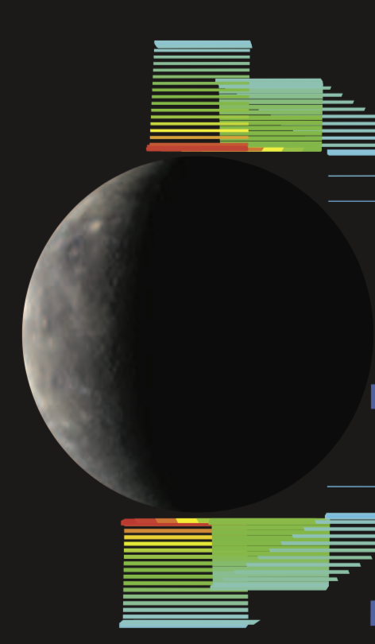
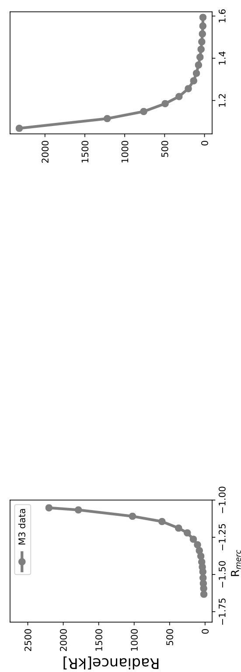
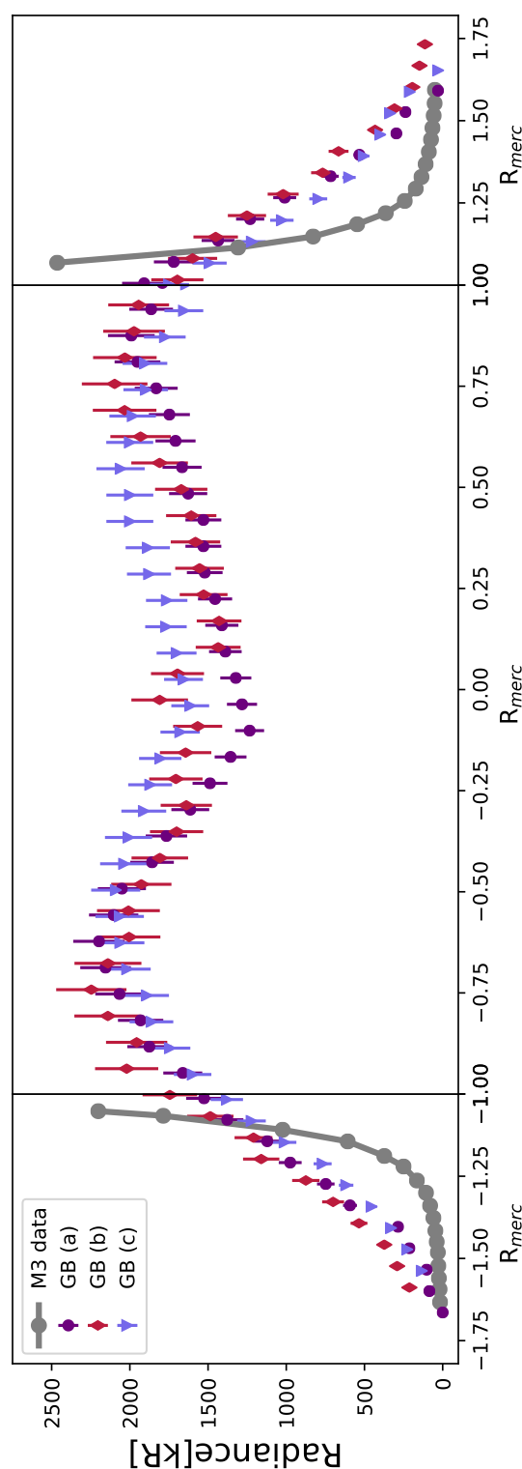
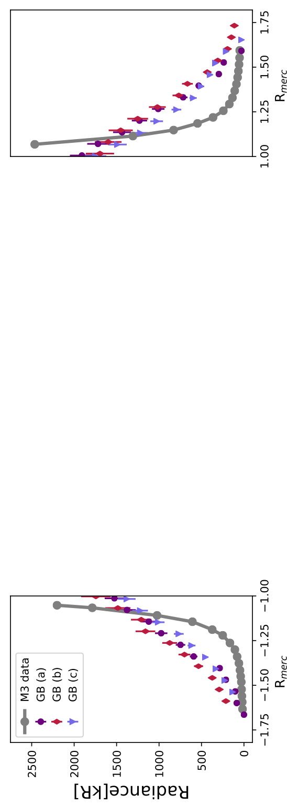
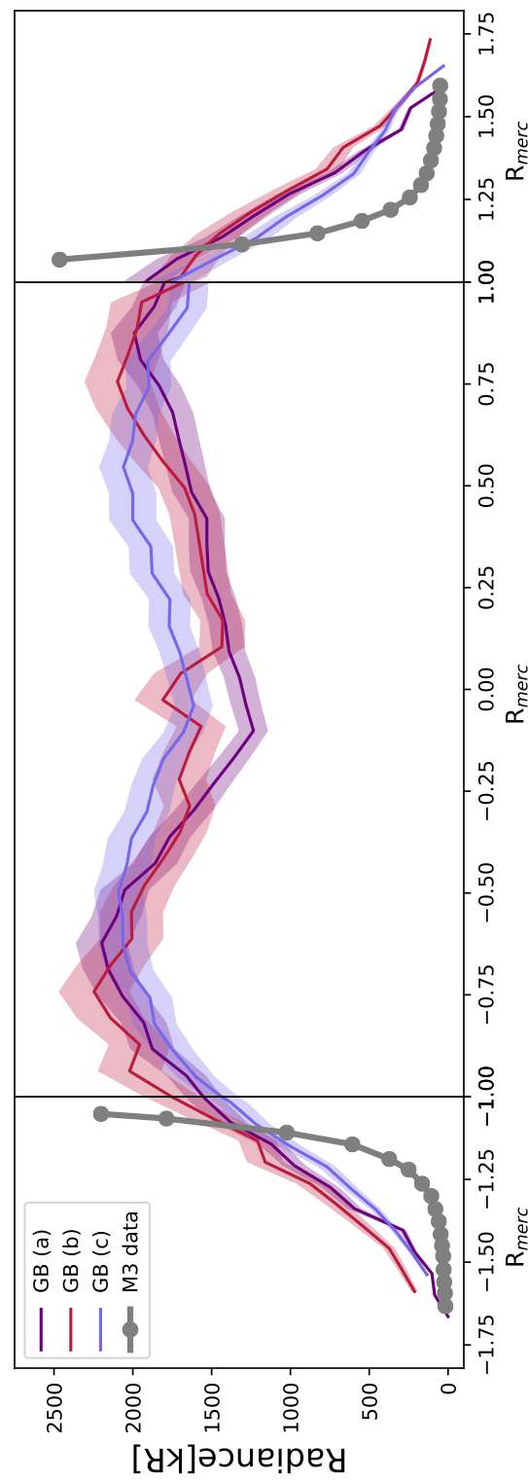
M3 data +
Ground-Based data
The Ground-Based data
complete the MESSENGER
data
Log Radiance [kR]
It is possible to reconcile both data sets if the M3 data
are extrapolated then convolved.
Convolved extrapolated
M3 data (black curve) agree
very well with the ground-
based data

Slide 11
Log Radiance [kR]
Extrapolation
to the surface
Disk obstruction
of the exosphere
results in
reduced emissions
Convolved extrapolation of M3 fits GB data very well in the polar altitude profiles and on the dayside

Slide 12
Conclusions
Combining ground-based data with space data gives us a unique look at Mercury’s Na exosphere. The key is to sample comparable spatial locations simultaneously when possible.
The comparison with the MESSENGER polar profile data acquired during M3 show that results from ground-based observations are consistent with space data, after correcting to the blurring effect of seeing.
This verifies the previous ground-based observations of Mercury's Na exosphere and reconciles the calibration mechanisms used for both.

Slide 13
Conclusions
We expect that this work to motivate future coordinated ground-based observations with the Bepi-Colombo mission, during the flyby and orbital observations starting in 2021.

