Slide 1
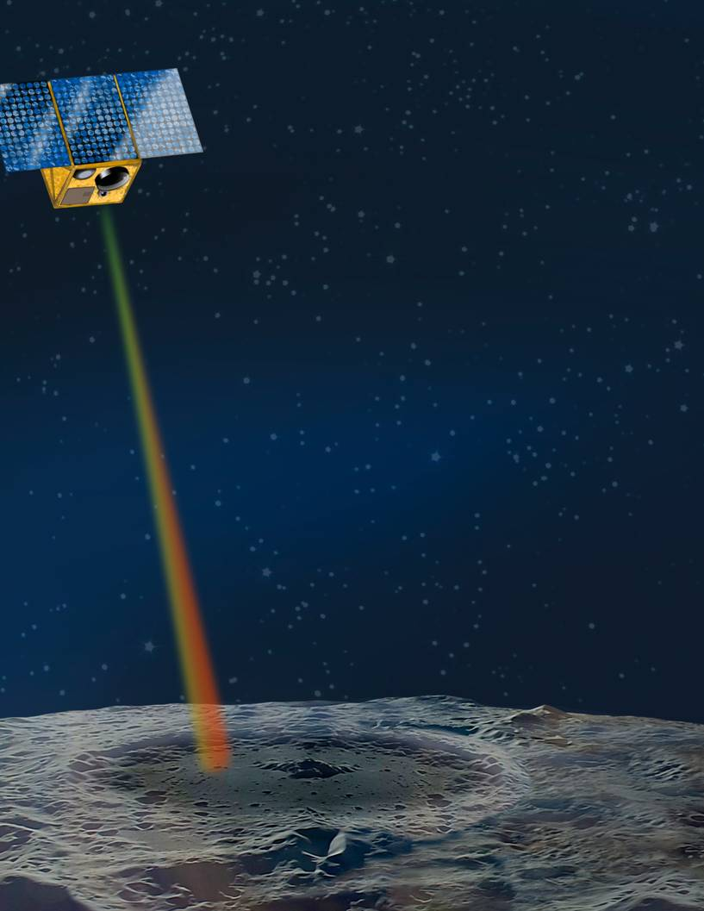
Lunar Volatile and Mineralogy Mapping Orbiter (VMMO) 12U Cubesat
EGU2020-22678
May 4, 2020

Slide 2
EGU2020-22678
May 4, 2020
Piotr Murzionak, Qi-Yang Peng, Paul Burbulea, Ian Sinclair, Gregory Schinn,
MPB Communications Inc., Pointe Claire, Quebec, Canada
Yang Gao, Chris Bridges, Roberto Armellin, Andrea Luccafabris, Nicola Baresi
Surrey Space Centre, United Kingdom
Edward Cloutis, Alexis Parkinson, Brynn Dagdick
University of Winnipeg, Manitoba, Canada
Mike Daly,
York University, Toronto, Ontario, Canada
Amélie St-Amour and Jean de Lafontaine
NGC Aerospace, Sherbrooke, Quebec, Canada

Slide 3
Outline
Introduction
Phase A VMMO Team
VMMO Science Objectives
VMMO 12U Cubesat
Lunar Volatiles and Mineralogy Mapper (LVMM) Science Payload
Preliminary Operations
Conclusions

Slide 4
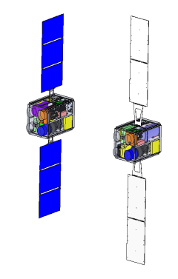
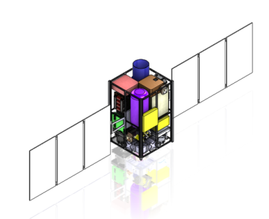
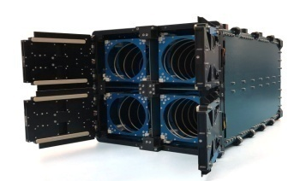
Introduction
4

Slide 5
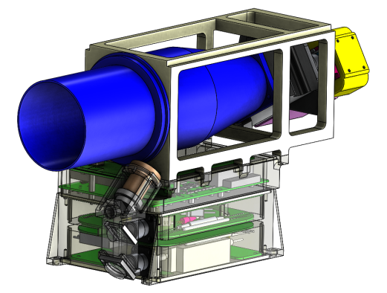

VMMO “Ice Mapper”
VMMO addresses both scientific and technical objectives for low-cost, beyond-LEO Cubesats:
1) Lunar Resource and Volatiles Prospecting
  Lunar Volatiles and Mineralogy (LVMM) multi-wavelength Chemical Lidar science payload:
    532 nm, 1064 nm and 1560 nm in Active Mode for stand-off mapping water-ice,
    300 nm, 532 nm, 1064 nm and 1560 nm in Passive Mode for stand-off mapping of in-situ resources such as ilmenite.
2) Lunar Exploration Technology
  Vision-assisted lunar Navigation
  Optical high-speed (to 100 Mbps) direct-to Earth data downlink technology demonstration at 1560 nm
  Qualification of 12U Cubesat architecture
  COTS electronics test bed
  Semi-autonomous script-based mission operations

Slide 6
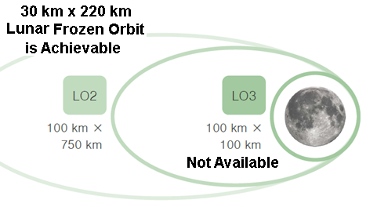
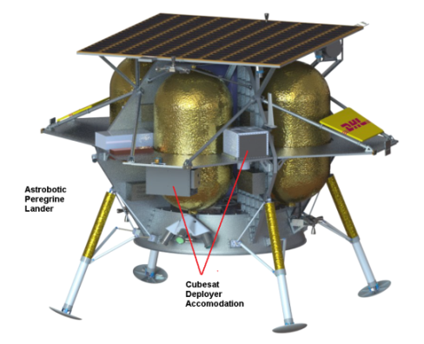
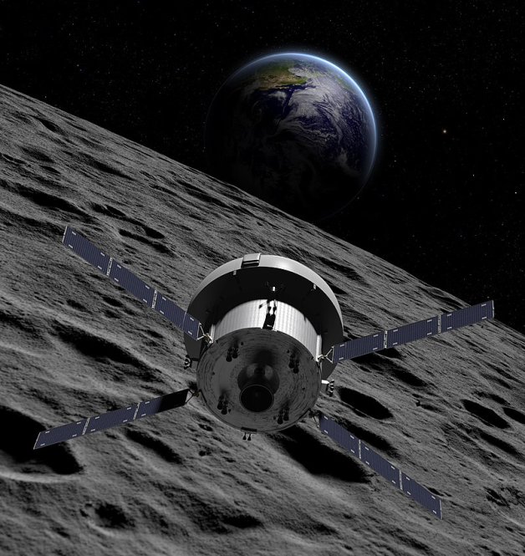
Potential VMMO Phase E in 2023
NASA CLPS Lunar Lander Lunar Transportation Option (Astrobotics Peregrine Lander, VIPER mission)
NASA Artemis 2 lunar fly-by Lunar Transportation Option

Slide 7

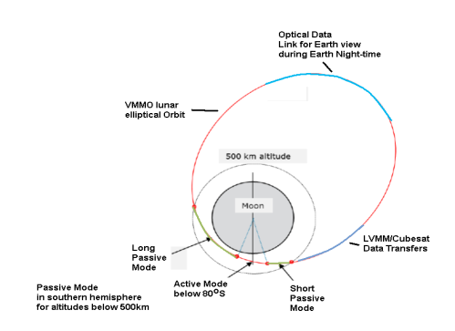
VMMO Phase A Team
7

Slide 8



VMMO Phase A Study Team
Team Member | Country | Key Personnel | Study Role
 | Canada | Dr. R.V. Kruzelecky Dr. Ian Sinclair Dr. Qi-Yang Peng Piotr Murzionak Dr. Ali Saffarpour Michel Corriveau | Study Prime LVMM Science Payload Payload Requirements and Eng. Budgets Relevant lab bread-boarding Payload TRL, Development Plan and Costing Study Deliverables
 | Canada | Prof. Edward Cloutis | LVMM Science PI Lunar mineralogy and in-situ resources VMMO Science Requirements Relevant lab predevelopment
 | United Kingdom | Prof. Yang Gao Dr. Chris Bridges Dr. Andrea Lucca Fabris Dr. Nicola Baresi | Prof. Yang Gao, science Co-I for icy regolith 12U Cubesat Platform Orbit analysis and trade-offs Propulsion subsystem trade-offs. On-Board Computer (OBC)

Slide 9



VMMO Phase A Study Team
Team Member | Country | Key Personnel | Study Role
 | Canada | Amélie St-Amour Sandro Papais Dr. Jean de Lafontaine | LVMM pointing performance assessment LVMM Data lunar geo-location Lunar South-Pole craters coverage analysis Utility of dual Star trackers for improved pointing knowledge
 | Portugal | Mauro Gameiro Paulo Fernandes Miguel Borges Joana Diz | System software requirements, architecture and specification Software AIT Plan Inputs to the VMMO Development Plan and ROM Costing
 | Portugal | Nuno Silva Paulo Rosa | VMMO lunar navigation system AOCS sensor requirements review Failure Detection, Isolation and Resolution Ground network requirements and specification. Inputs to the VMMO Development Plan and ROM Costing

Slide 10
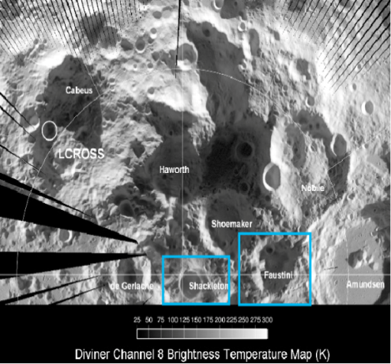
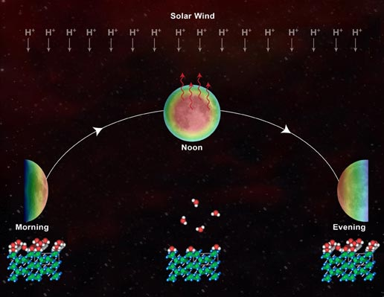
VMMO Science Objectives
10

Slide 11
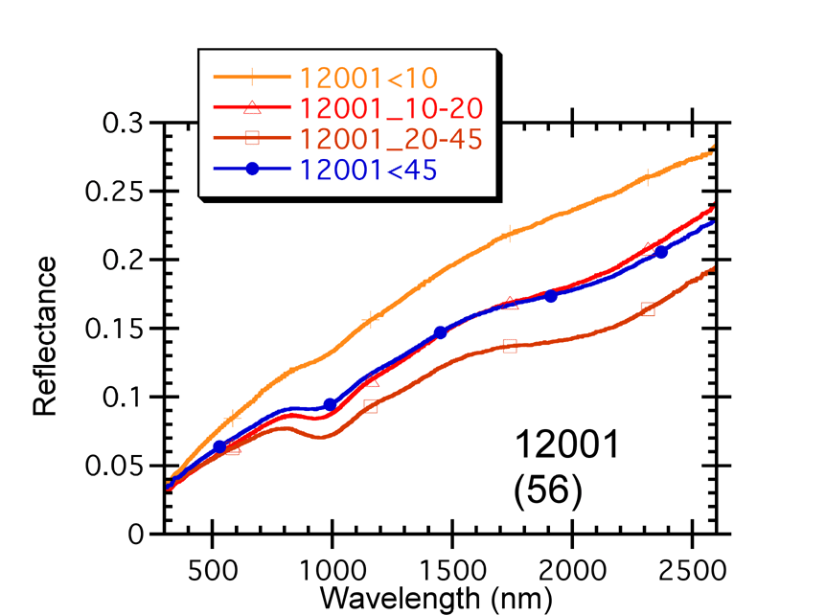
1. Water ice mapping and detection
Regolith Reflectance
Lunar regolith is red-sloped: i.e., reflectance INCREASES from 530 to 1500 nm, and is relatively DARK
Water ice is blue-sloped: i.e., reflectance DECREASES from 530 to 1500 nm, and is BRIGHT near 530 nm
532 and 1560 nm regions are very sensitive to water ice presence
With increasing ice:
  532 nm reflectance increases
  1560 nm reflectance decreases
  1560/532 nm ratio decreases
Laboratory studies have shown that water ice detection limit is better than 1% with suitable measurement SNR
Water-ice Reflectance

Slide 12

Preliminary Selected PSR Targets
Shackleton Crater (89.54º S, 0.0º E) with 21 km diameter), as considered for future manned lunar base.
60 km (N-S) x 30 km (E-W) mapping near Shackleton Crater, accumulated over several orbits.
Faustini Crater(87.2º S, 75.8º E), 39 km in diameter, as example of a younger crater with PSR. It shows enhanced Lyman-ɑ albedo indicative of excess H based on the LRO Neutron Spectrometer.
60 km (N-S) by 50 km (E-W) mapping of Faustini Crater and surroundings, accumulated over several orbits.

Slide 13
2. Nighttime Frost Deposition and the lunar water ice cycle
To better understand behaviour of volatiles (water­ice) and the lunar diurnal water ice cycle
Active and passive sensing of permanently-shadowed and polar regions
Compare overlapping daytime Passive data to the Active nighttime spectra in the lunar south polar region below 80º S
Credit: University of Maryland/McREL.

Slide 14
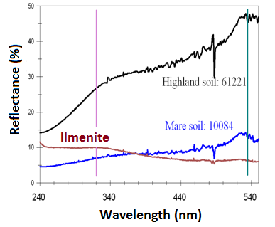
3. Ilmenite (FeTiO₃) Abundance Mapping
Ilmenite is an important in-situ resource for oxygen and solar wind-implanted hydrogen
Ilmenite differs spectrally from lunar regolith mostly in the ultraviolet
Increasing ilmenite content in regolith leads to:
  Higher ultraviolet reflectance
  Lower visible reflectance
  Higher ultraviolet/visible reflectance ratio
Requires a UV spectral channel near 300 nm
Would be unique added science as there is very little lunar UV reflectance data available – mainly some Hubble Telescope data, and M3 Moon Mineralogy Mapper on Chandrayann-1 data above 465 nm.

Slide 15
12U VMMO CubeSat
15

Slide 16
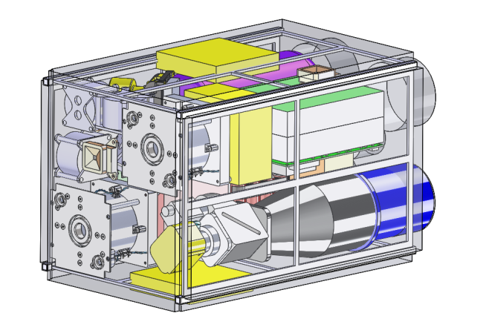
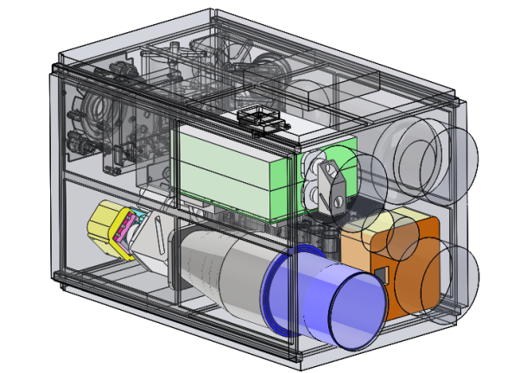
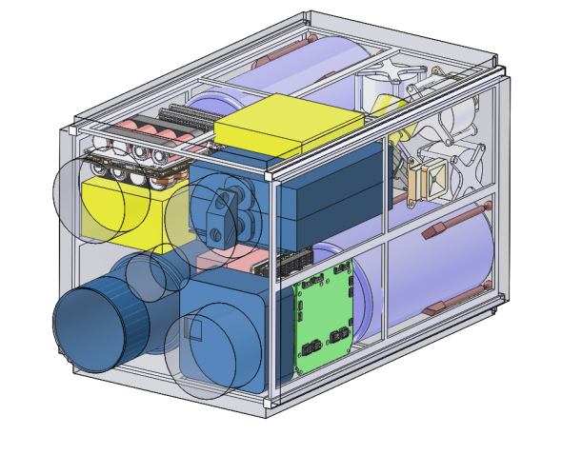
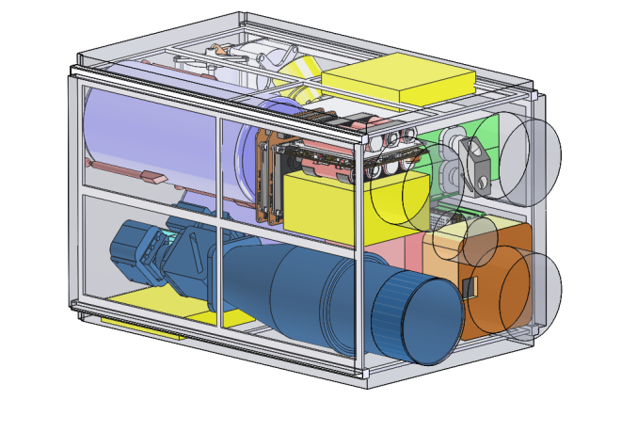
VMMO 12U Cubesat with LVMM Payload Accommodation
Ion Propulsion Option
Chemical Propulsion Option

Slide 17
Summary of the VMMO System
LVMM | Dual Band Laser Projection (532nm/1064nm, 1560 nm) to detect Water-Ice presence Active Mode Resolution: 4 m x 44 m, Passive Mode Resolution: 24 m x 24 m (x 87 cross-track pixels)
Structures | 12 U Cubesat form factor (23 x 24 x 36 cm³) < 24 kg total launch wet mass with 15% margin ISIS 12U –XL Quadpack Dispenser compatible
Propulsion | 2x IFM Nano Thrusters (0.35 mN at 35 W each, total impulse of 10,000 Ns) 0.5 kg of propellant (TBC)
C&DH | Radiation Tolerant LEON 3 system: Xilinx XCKU060, 512 kB SDRAM, 4 MB SRAM and 64 MB PROM
Power | 2x GOMSpace Solar arrays, each with 3 panels and with IMT’s drive assembly 2x GOMSpace batteries (2x2600 mA⋅h), GOMSpace P60 EPS controller
Comms | Dual S-band transceivers with omnidirectional S-band antennas
AOCS | 4x Reaction Wheels (RW0-03) Sinclair Interplanetary: Momentum 30 mNms, 8x RCS butane thrusters with 1.12 kg of propellant ST-16RT2 star tracker (5 arcsec boresight RMS) (1 or 2 TBD) Lens R&D BiSon64-B sun sensors (x3), SINPLEX MEMS IMU
Orbit | Polar30 km (perilune) x 220 km near-frozen elliptical orbit (TBC) based on Astrobotic Peregrine lunar orbit insertion

Slide 18
Baseline VMMO Engineering Budgets
Subassembly | Description | Suppliers | Mass (kg) | Volume (cm³) | Avg. Power (W)
Payload | LVMM | MPBC | 5.50 | 3856 | 25.0
Attitude Control | Reaction Wheels (x4) | Sinclair Interplanetary | 0.48 | 190 | 24.2
 | Star Tracker | Sinclair Interplanetary | 0.19 | 236 | 0.5
 | Sensors | Lens R&D, Angstrom | 0.18 | 236 | 0.5
 | Cold Gas Thruster Tank | Surrey | 0.14 | 510 | -
 | ACS Propellant | Surrey | 0.27 | - | -
 | ACS 12 Thrusters | Surrey | 0.90 | 108 | 0.5
 | AOCS Electronics | ESL | 0.06 | 133 | 1.5
Propulsion | Two Electric Propulsion Units | Enpulsion IFM Nano Thrusters | 1.74 | 1320 | 70.0
Thermal | Radiator Passive Cooling, Active Heating | Surrey | 0.20 | 119 | 10.0
Command & Data Handling | LEON 3 Board | Surrey | 0.38 | 335 | 3.5
Communications | S-band (x2) | ISIS/Surrey | 0.60 | 335 | 1.3
Power | LiFePO4 Batteries (x6) | AA Portable Power | 1.98 | 1498 | -
 | Solar Panels (6 arrays) | DHV Technology | 1.80 | 673 | -
 | NanoPower - P60 EPS | GomSpace | 0.19 | 168 | 0.5
Structure | 12U Structure | Surrey | 2.12 | - | -
(Propulsion) |  |  |  |  | 112.5
Totals |  |  | 16.7 | 9720 | 67.5
Totals with 15% margin |  |  | 19.2 | 1180 | 78

Slide 19
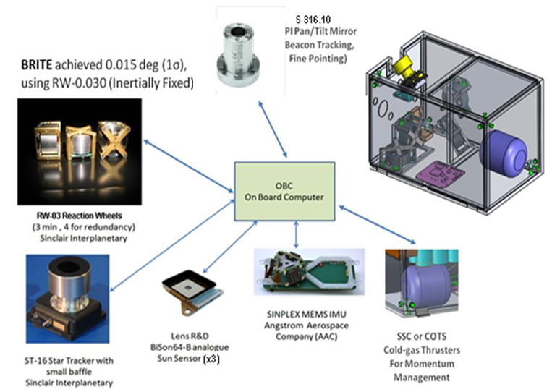
VMMO AOCS System

Slide 20
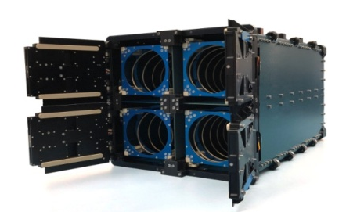
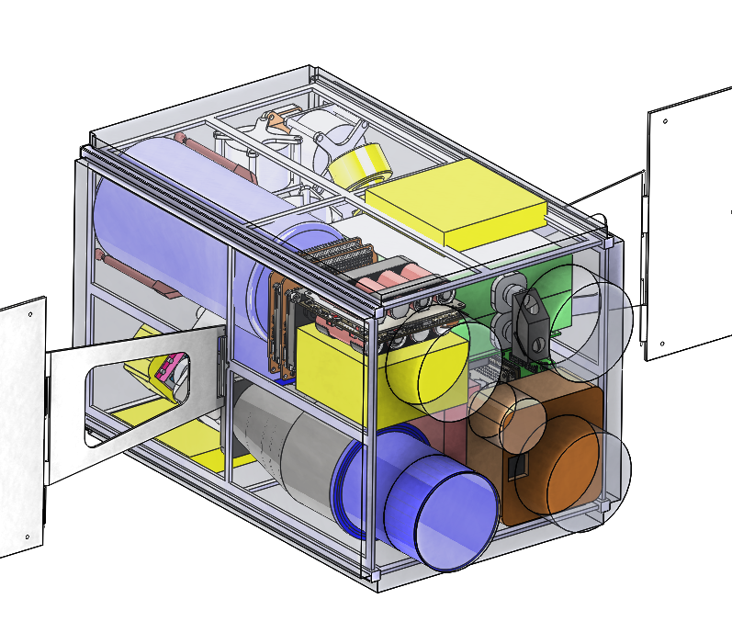

VMMO Interfaces
Accommodation within ISIS Quadpack-XL Cubesat deployer
RS422 system health monitor interface
DC power interface for VMMO battery charge-up
Chemical Propulsion
Electric Propulsion

Slide 21
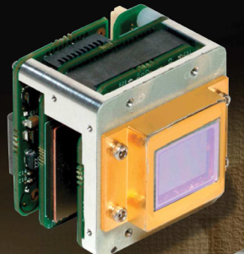

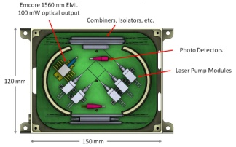
LVMM Science Payload
21

Slide 22
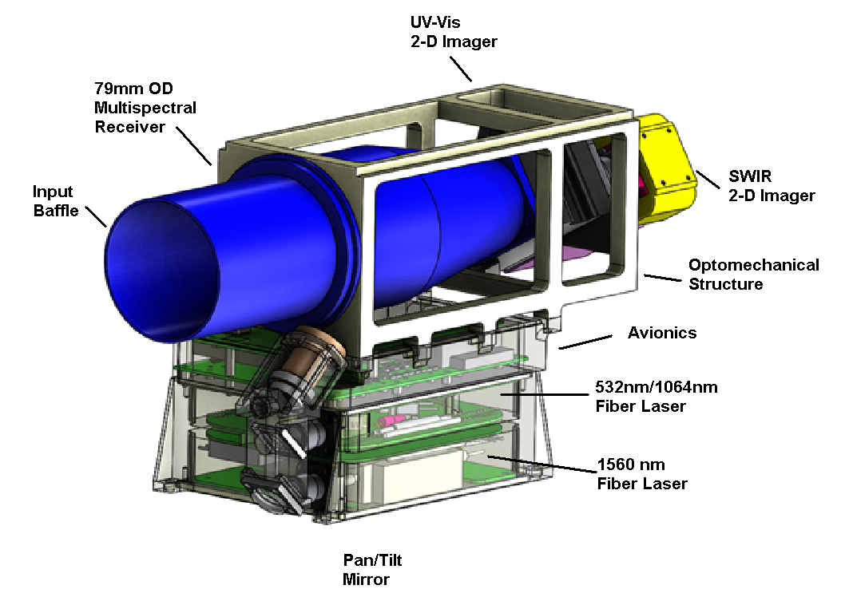
LVMM Baseline Mechanical System

Slide 23
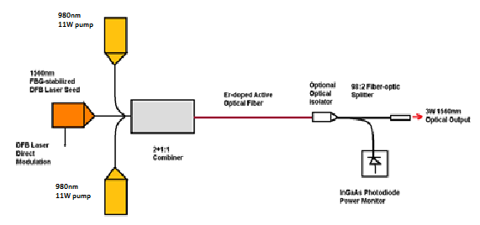

4 W, 1560 nm Fiber Laser
Over 10 years product maturity
Leverage the FSD (Proba-2) and Shefex (DLR) flight heritage
Single-mode 1560 nm output with M² < 1.1 beam quality for better beam collimation
Directly-modulated DFB laser seed
Cold-redundant uncooled 980 nm pumps
Space-qualified fusion splices
Mass < 600 grams, including the pumps and fiber-optics

Slide 24
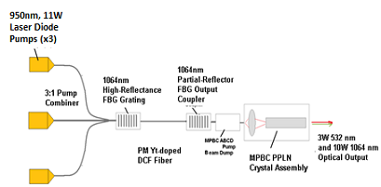
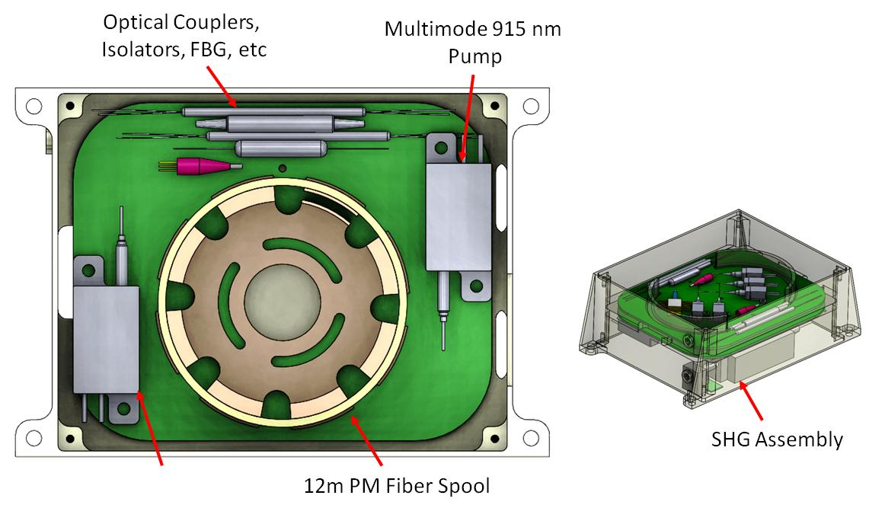
4 W, 532 nm/10 W 1064 nm Fiber Laser
Leverage MPBC commercial units
Over ten years technology maturity
1064nm critical optics integrated within the optical fiber using Fiber-Bragg gratings (FBGs) for stable optical alignment
Mass < 700 grams with fiber-optics
Fiber-optics repackaging for compact form factor based on allowable long­term bend radius (r > 35 mm)
Well-developed 532 nm second harmonic generation (SHG)
Two 25 W 915 nm pumps, one redundant
Some proton and gamma testing to 100 krad completed on key 1064 nm components
TVAC testing (-40°C to +40°C)

Slide 25
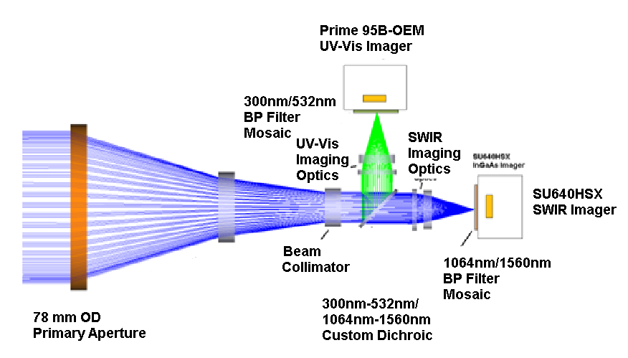
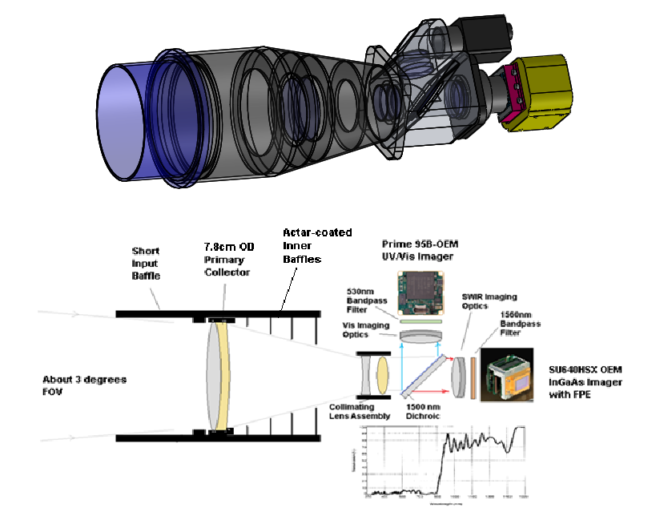
LVMM Optical Receiver Preliminary Design
Leverage the GHGsat-D optomechanical and baffle design
GHGsat/LCROSS InGaAs SU640HSX 2-D Array
Back-illuminated Prime 95B-OEM CMOS UV/Vis Imager
UV-Vis/SWIR Dichroic Optics
Selection of radiation tolerant glass materials
Broadband AR coating using ECI COTS coating technology
Zemax optical design and simulations
7.8 cm OD primary aperture

Slide 26
LVMM SNR in Active mode using 4 W fiber lasers at 532nm and 1560 nm (0.12 Albedo. lunar night)
10% optical throughput margin
80% of signal within 2 x 2 pixel
Noise sources:
  Imager read-out noise (2 e rms (Prime-95B), 35 e rms (Su640HSX)
  Optical signal shot noise, imager dark signal shot noise, digitization noise
Altitude | Measurement Mode Pointing | Integration Time | SWIR along-track GSD | SNR
km |  | s | m | 532nm | 1560 nm
26 | Nadir | 0.024 | 44 | 185 | 289
50 | Nadir | 0.024 | 46 | 96 | 138
75 | Nadir | 0.024 | 49 | 63 | 79
100 | Nadir | 0.024 | 52.5 | 47 | 52
100 | Step and Track | 0.2 | 52 | 137 | 178
150 | Step and Track | 0.2 | 78 | 91 | 99
200 | Step and Tack | 0.2 | 104 | 68 | 62

Slide 27
LVMM SNR in Passive Mode with 78 mm primary receiver aperture (0.12 Albedo, Lunar Day)
10% Optical throughput margin
Altitude | Integration Time | IGSD per SWIR Pixel | SNR
km | s | m | 290nm | 532nm | 1064 nm | 1560 nm
26 | 0.002 | 4 | 201 | 523 | 427 | 344
50 | 0.002 | 7.7 | 201 | 523 | 427 | 344
75 | 0.002 | 11.5 | 209 | 527 | 444 | 350
100 | 0.002 | 15.4 | 201 | 523 | 427 | 344
200 | 0.002 | 23 | 209 | 527 | 444 | 350

Slide 28
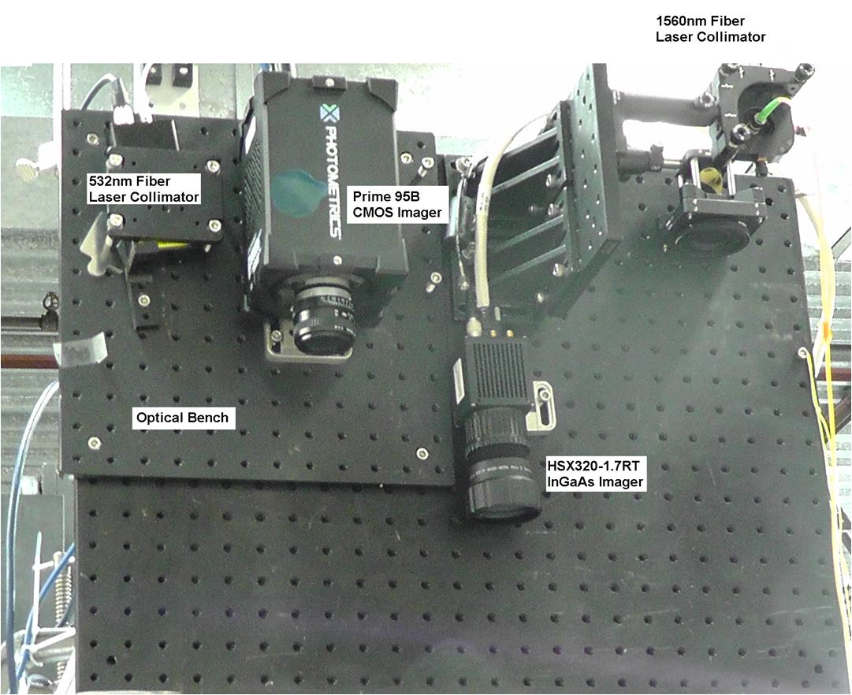
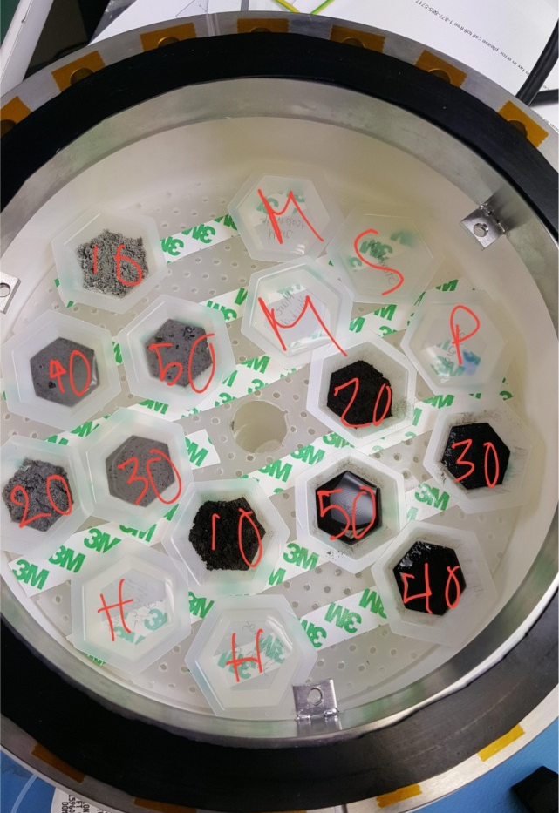
Fiber Laser/Imager Test Setup
Water-Ice Mineral Samples Test Setup

Slide 29
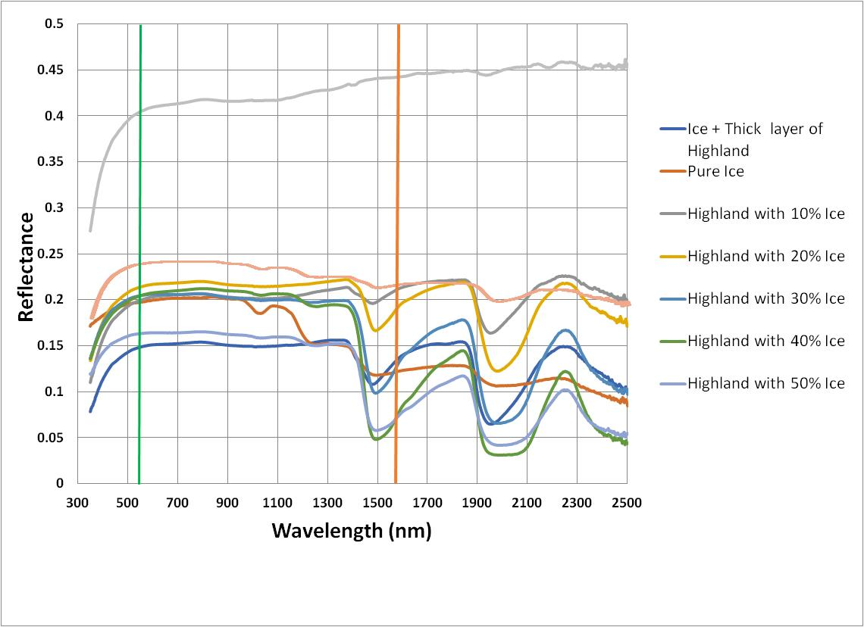
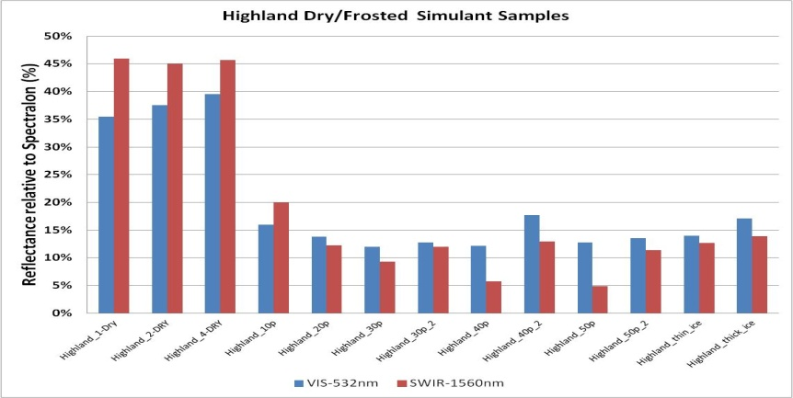
Preliminary Laboratory Calibration
The laboratory calibrations will continue and will include both reference continuum spectra and measurements using the LVMM breadboard:
  Active Mode: 532 nm, 1064 nm and 1560 nm diffuse reflectance
  Passive Mode: 300 nm, 532 nm, 1064 nm and 1560 nm diffuse reflectance
Summary of the lab samples:
  water/ice/Lunar simulant versus water/ice content by mass fraction (0.1%, 0.5%, 1%, 5%, 10%, 20%, 50%)
  ilmenite/regolith mixtures by mass fraction
  relevant lunar near-surface minerals
  relevant lunar meteorites
Continuum reference spectra
532nm/1560 nm LVMM Breadboard data

Slide 30


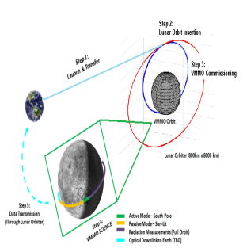
Preliminary VMMO Mission Operations
30

Slide 31
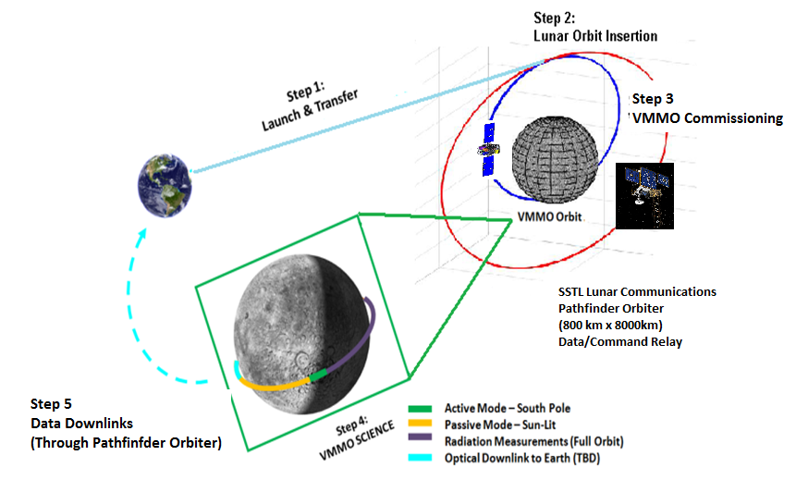
Summary of the Preliminary VMMO Mission Operations

Slide 32
LVMM Active Mode
  Active laser illumination at 532 nm, 1064 nm and 1560 nm
  Condensed volatiles: lunar South Pole (80º S to 90º S) permanently shadowed regions focusing on key craters (Shackleton, Faustini, Cabeus)
  Volatile transport: Lunar night side (80ºS to lunar South Pole)
  Nadir VMMO spacecraft pointing mode
  Pushbroom geo-colocated line scans with typical 4 m × 44 m GSD per measurement point for altitudes below 100 km or “Point and Track” measurements of targets for increased integration time to provide higher SNR at higher altitudes

Slide 33
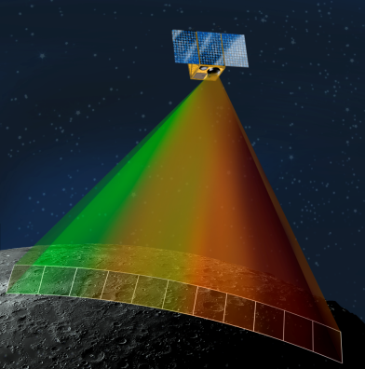
LVMM Passive Mode
  Spectral channels at 300 nm, 532 nm, 1064 nm and 1560 nm
  Lunar in-situ resources such as ilmenite (equator to South pole) during the lunar day
  Data acquisition on sunlit lunar surface at altitudes below 500 km
  Pixel binning for 87 effective cross-track pixels
  24 m x 24 m GSD/binned pixel
  Data calibration using measurements over former Apollo landing sites
  Data “on board” real time processing and lossless compression to reduce the downlink data size

Slide 34
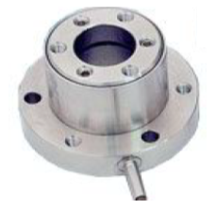
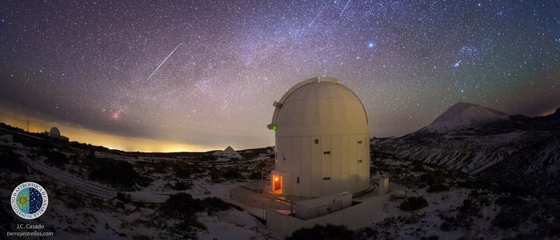
Optical Downlink Technology Demonstration
LLCD on LADEE demonstrated an optical data down link from lunar orbit to Earth at 622 Mbps
Use LVMM 1560 nm channel with direct modulation of the DFB laser diode seed.
Use the SWIR or VIS imagers for the uplink beacon tracking
Use PI miniature pan/tilt mirror for the required fine point-ahead with respect to the uplink beacon
Laser output diameter 18 mm OD
Earth downlink spot size of 52 km OD
50 Mbps at SNR >12

Slide 35

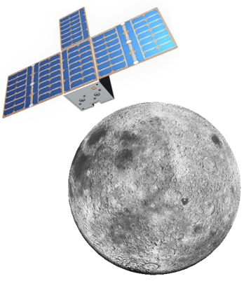
VMMO Conclusions
Page 35

Slide 36
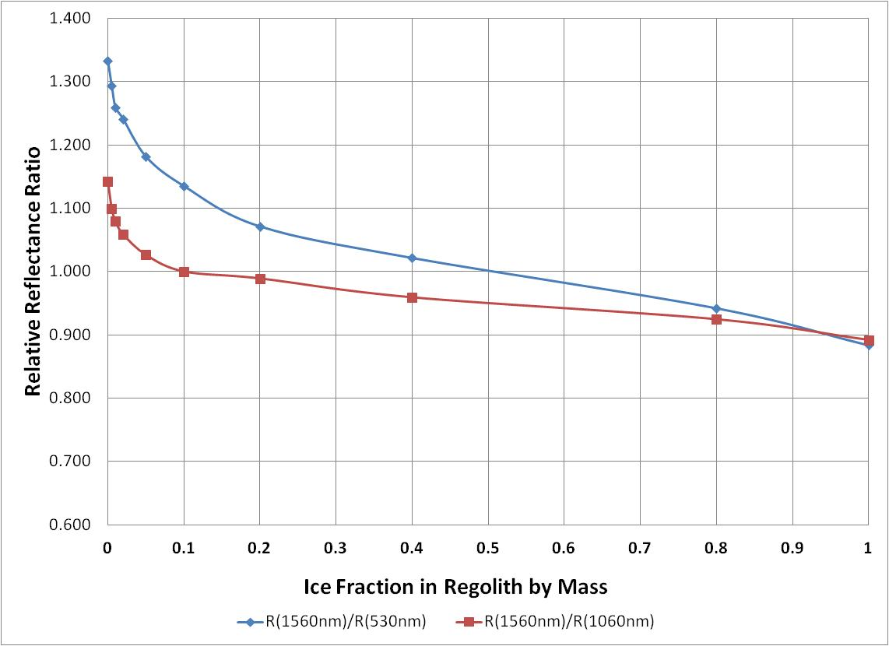
VMMO - Conclusions
VMMO currently undergoing Phase A study with ESA.
The relatively high spatial resolution (< 10m/pixel in Active Mode) offered by LVMM greatly improves the probability of finding local high concentrations of volatiles in the lunar PSR cold traps.
The relatively high R(1560nm)/R(532nm) sensitivity to the presence of lunar water ice, and associated SNR > 100 for both the 532 nm and 1560 nm spectral channels at the 30 km to 50 km perilune facilitates mapping concentrations of water/ice to under one percent mass fraction.

Slide 37
Acknowledgements
The authors would like to acknowledge the European Space Agency (ESA) for enabling the initial mission concept study through the ESA LUCE Cubesat SysNova Challenge program, the ESA CDF Study and the Canadian Space Agency (CSA) for the follow-on VMMO Augmented Mission Concept LVMM science study.
Special thanks to Dr. Roger Walker and Johan Vennekens at ESA, and James Doherty, Dr. Vicky Hipkin, Dr. Alexander Koujelev, Dr. Tim Haltigin and Christian Lange at CSA.

