Slide 1
The Lagrangian ice microphysics code LCM: Introduction, current developments and benefits
S. Unterstrasser (DLR Oberpfaffenhofen)
Contribution D3624 | EGU2020-2307
in session AS5.9

Slide 2
Introduction
In the original format, this solicited contribution should have an extended introduction to Lagrangian cloud modelling.
I decided to keep those slides with basic facts of Lagrangian cloud models.
Due to time limitations, however, I will have to go quickly over all slides.
Introduction:
Lagrangian cloud models (LCMs) are considered the future of cloud microphysical modeling, though they are computationally expensive.
Particle-based methods can be applied in 0D and 1D.
This presentation, however, focuses on LCMs coupled to a LES model and used in 2D and 3D simulations.
Most upcoming statements are relevant for LCMs irrespective of the cloud type (pure ice, warm clouds, mixed-phase).
But a few aspects in the ice microphysical model are differently treated than in all present liquid cloud LCMs.

Slide 3
Terminology
Lagrangian cloud model (LCM) = particle-based microphysics = super-droplet method.
Simulation particle (SIP) = computational droplet = super-droplet. Usually, each SIP represents a certain number of identical hydrometeors or CCNs.
Weighting factor = multiplicity
In my case of ice microphysics, LCM = Lagrangian Cirrus Model

Slide 4
Design concept
General design concepts of (current) LCMs:
Information about hydrometeors is carried in simulation particles (SIPs), not in field variables.
These SIPs carry information on: location, size, weighting factor and other attributes (e.g. ice crystal habit, aerosol properties, tags, chemical composition)
Separation of transport and microphysical processes unlike to Eulerian methods.
Transport: Solve $∂$x_{particle}/$∂$t = u_{particle}
Treatment of Microphysical Processes is intuitive as the evolution of single hydrometeors is of relevance.
All other variables like velocity, temperature, pressure, water vapour concentration are field variables of the coupled LES model.
All SIPs that lie inside a grid box volume are associated with this grid box.

Slide 5
Features of ice LCM
Described in Sölch & Kärcher, 2010 with technical improvements from Unterstrasser & Sölch, 2014
Spectrally resolved aerosol physics: non-equlibrium growth of supercooled aerosol particles (solution droplets of sulphuric acid H₂S0₄ and water H₂0 (and optionally HNO3)) + their homogeneous freezing; starts at RH_{i} around 150%
Heterogeneous ice nucleation of ice nuclei (immersion/deposition mode); Threshold RH_{i} depends on IN, but usually smaller than for homogeneous freezing.
Deposition/sublimation including ventilation, Kelvin and kinetic regime corrections and optionally radiative surface fluxes
Transport including sedimentation and the effect of subgrid scale turbulence
Aggregation with collision history
Several ice crystal habit options (plates, bullet rosettes, spheres, hexagonal columns, aggregates), but no habit prediction
Stochastic nucleation implementation
SIP Merging and Splitting

Slide 6
Benefits
Comparison between two moment bulk scheme and LCM
Tagging feature inexpensive
Numerical diffusion: interaction of contrail cirrus and natural cirrus
Trajectory analysis
Etc.
Further benefits are discussed in Grabowski et al, 2019.
The benefits discussed there are mainly complimentary to ones picked here.

Slide 7
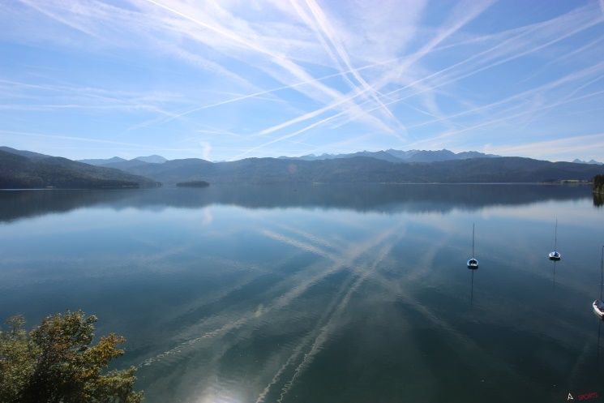
LCM vs. Eulerian bulk scheme
Simulation example: Spreading contrail in the upper troposphere
Extinction coefficient $χ$in m⁻¹
LCM
BULK; two moments
(Spichtinger & Gierens, 2009)
LCMs feature fine-scale structures/fluctuations.

Slide 8
LCM vs. Eulerian bulk scheme
Comparison of LCM (solid) and BULK (dotted): Vertical distribution
Humidity profile
Solid black: original LCM implementation;
Solid red: LCM implementation with sedimentation parametrization as in BULK
Numerical treatment of sedimentation more important than physical parametrisation of settling velocity.

Slide 9
LCM vs. Eulerian bulk scheme
Comparison of LCM (solid) and BULK (dotted): size distribution
Broadening of size distribution due to Kelvin effect (Lewellen, JAS, 2012).
In (contrail-)cirrus, “spectral ripening“ occurs in slowly ascending air and ice crystals get lost (Unterstrasser et al, 2017a).
Adopted from Fig. 9 of Unterstrasser et al, 2017a

Slide 10
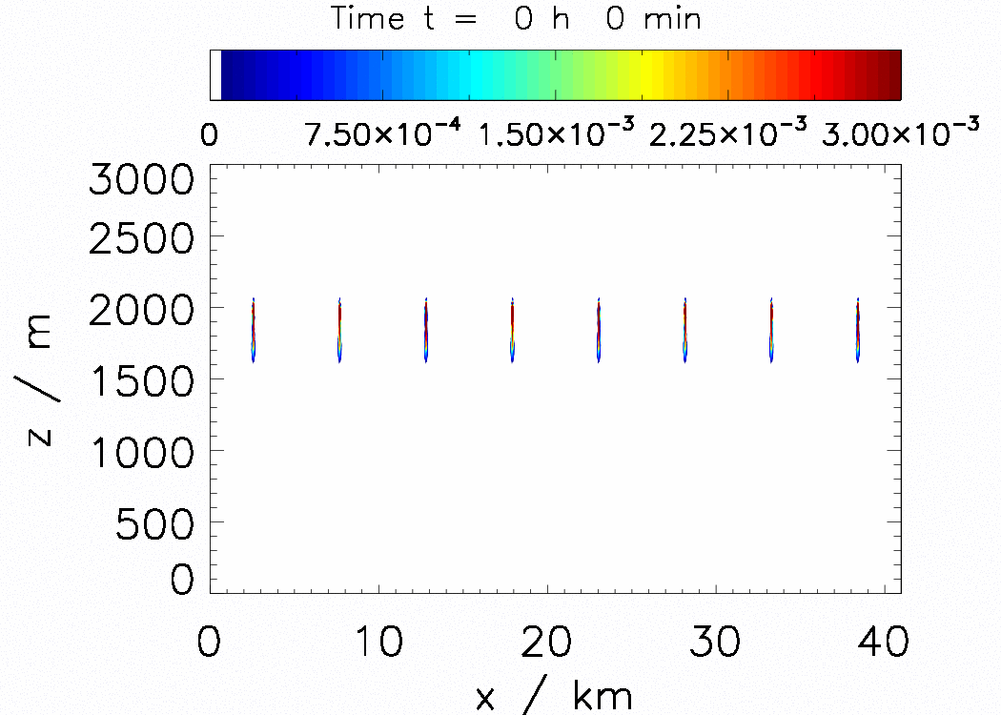
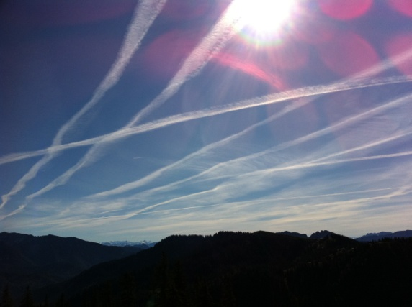
Tagging feature
Eight contrails in a supersaturated layer with background vertical wind shear over 4 hours.
Analysis important for quantities for nonlinear dependence of air traffic impact on contrail climate impact.
$χ$in m⁻¹
Unterstrasser & Sölch, 2012
Notes:
Animation ist /athome/unte_si/_data/idl_disp_ausgelagert/grafik186/animation_s25_s4_w02_KS8_long.gif
Rechtes Bild aus
/athome/unte_si/_data/idl_disp_ausgelagert/grafik169

Slide 11
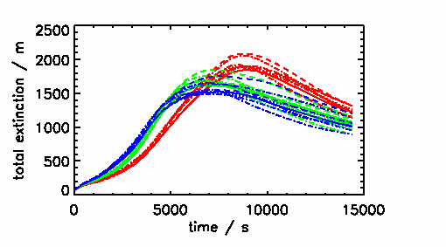
Tagging feature
Eight contrails in a supersaturated layer with background vertical wind shear over 4 hours.
Analysis important for quantities for nonlinear dependence of air traffic impact on contrail climate impact.
$χ$in m⁻¹
Analyse each contrail instance separately by introducing a memory-efficient flag variable
Unterstrasser & Sölch, 2012
For the same analysis in a Eulerian model, one had to establish eight sets of prognostic micro-physics equations. In an LCM, it comes basically for free. No additional computations are required.
Notes:
Animation ist /athome/unte_si/_data/idl_disp_ausgelagert/grafik186/animation_s25_s4_w02_KS8_long.gif
Rechtes Bild aus
/athome/unte_si/_data/idl_disp_ausgelagert/grafik169

Slide 12
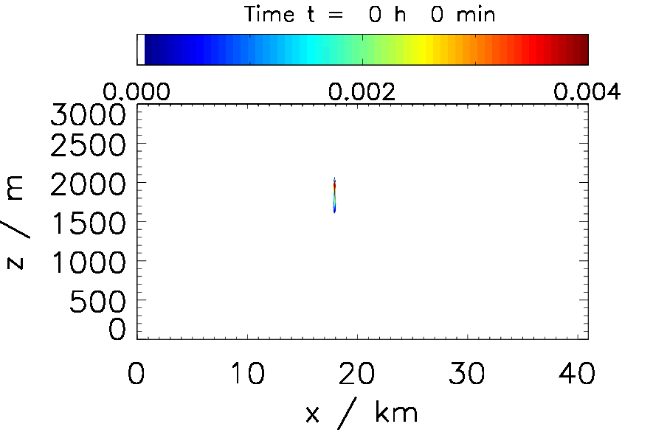
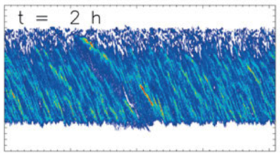
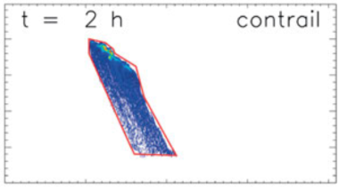
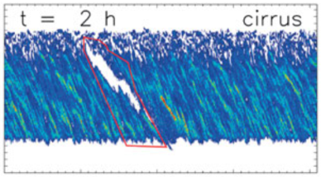
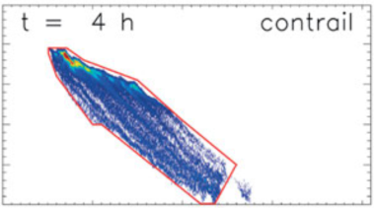
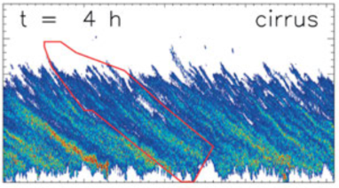
Numerical diffusion
In rising air, contrail-cirrus becomes surrounded by natural cirrus once RH_{nuc} is surpassed in the vicinity. Ice crystals of natural cirrus can only form outside of existing contrail-cirrus. Identification of anthropogenic „contamination“ in naturally formed cirrus is important for assessing climate impact of aviation.
$χ$in m⁻¹
TOTAL ice crystals
Only CONTRAIL ice crystals
Only CIRRUS ice crystals
hole
Completely mixed
After four hours, „natural“ ice crystals are present everywhere inside the contrail-cirrus below z=1500m.
In Eulerian models, this effect could be a spurious one due to numerical diffusion.
There is no numerical diffusion in LCMs and one can be sure that the local co-existence of both cloud types is due to physical reasons. In this example, it is mainly due to differential sedimentation.
Adopted from Figs. 3 & 11 of Unterstrasser et al, 2017b

Slide 13
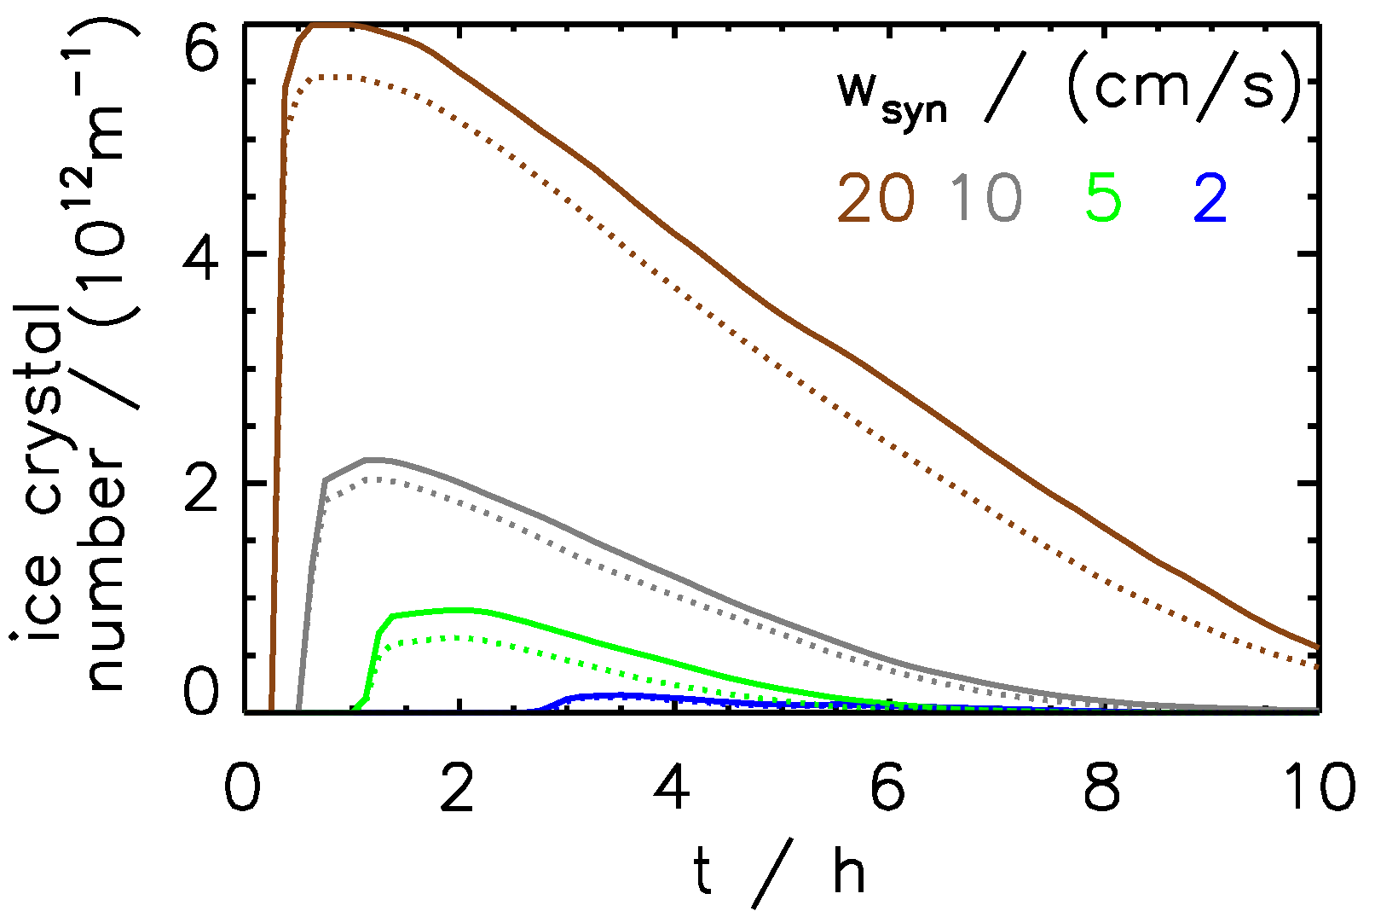
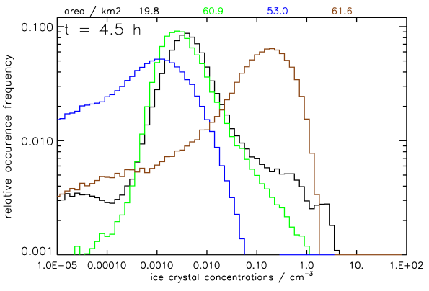
Formation of hydrometeors in LCMs
In liquid cloud LCMs: SIPs are usually initialized in the whole domain and represent CCNs. After activation, the SIP changes its status from aerosol particle to cloud droplet. No new simulation particles are generated during cloud formation.
Total ice crystal
number evolution
In ice LCM: Strong dependence of number of formed ice crystals on updraught speed w_{syn}. Use spectral bin for solution droplets and generate SIPs with variable weighting factors during ice formation.
Physics: Number of nucleated ice crystals n_{nuc} in a grid box:
n_{nuc} = J_{f}(a_{w}) * V_{a,i} * n_{a,i} * Δt_{nuc} * V_{GB}
Nucleation rate J_{f}(a_{w}): depends very sensitively on relative humidity, i.e updraught speed
V_{a,i} volume of one aerosol in bin i
n_{a,i} number concentration of aerosols in bin i
Nucleation timestep Δt_{nuc}
Grid box volume V_{GB}
Adopted from Figs. 4 & 8 of Unterstrasser et al, 2017a
PDF of ice crystal
number concentrations
Depends on
number of bins
Increase resolution
=> n_{nuc} is smaller
Numerical parameters
Implementation with strong threshold:
SIP generation condition n_{nuc} > n_{min} (avoids generation of too many SIPs).
Not necessary in Eulerian models, where n can be continuously increased.
0.01L⁻¹ ………….10cm⁻³

Slide 14
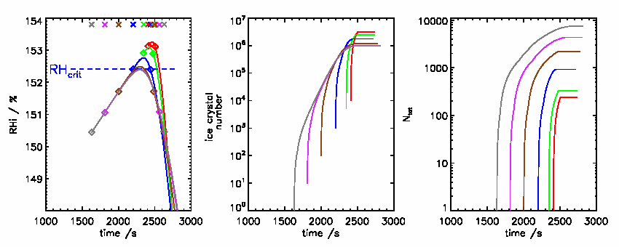
Nucleation implementation with strong threshold
Variation of strong threshold n_{min} in box model simulations
No convergence in N_{ice} with N_{SIP}
RH_{i}
N_{Ice}
N_{SIP}
Small n_{min}
Medium n_{min}
Large n_{min}
SIP generation condition n_{nuc} > n_{min} with large n_{min} retards ice crystal formation and number of formed ice crystals is eventually too high!!
Adopted from Fig. 9 of Unterstrasser & Sölch, 2014

Slide 15
Stochastic nucleation implementation
Use a weak threshold:
If n_{nuc} > n_{min}: generate SIP with n_{sim} = n_{nuc} (as before)
If n_{nuc} < n_{min}:
generate a SIP with n_{sim} = n_{min} with probability P_{SIP} = n_{nuc} / n_{min}
Add stochastic component to nucleation implementation

Slide 16
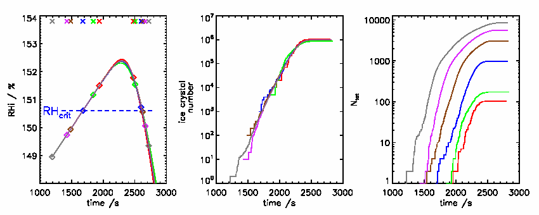
Stochastic nucleation implementation
Variation of weak threshold n_{min} in box model simulations
Convergence in N_{Ice}
RH_{i}
N_{Ice}
N_{SIP}
Small n_{min}
Medium n_{min}
Large n_{min}
Physical convergence reached with 100 SIPs, not 10000!!
Stochastic component removes sensitivity to numerical parameter n_{min} !!
Adopted from Fig. 9 of Unterstrasser & Sölch, 2014

Slide 17
Summary
General design concept introduced
A few benefits of the LCM approach
Spectral ripening due to Kelvin effect illustrated.
Numerical treatment of sedimentation more important than physical parametrisation of settling velocity.
Tagging feature illustrated.
LCMs with no numerical diffusion => better interpretable simulation results.
Stochastic nucleation implementation with a weak threshold.
=> Avoid strong thresholds in discrete LCMs (an aspect absent in continuous Eulerian approaches).

Slide 18
Figure sources
Unterstrasser, S., and I. Sölch, 2012: Numerical modeling of contrail cluster formation. Proceedings of the 3rd International Conference on Transport, Atmosphere and Climate (TAC-3) R. Sausen, S. Unterstrasser, and A. Blum, Eds.,114-119
Unterstrasser, S. , I. Sölch, 2014: Optimisation of the simulation particle number in a Lagrangian ice microphysical model, Geosci. Model Dev., 7, 695-709
Unterstrasser, S., K. Gierens, I. Sölch, M. Lainer, 2017a: Numerical simulations of homogeneously nucleated natural cirrus and contrail-cirrus. Part 1: How different are they?, Meteorol. Z., 26, 621-642
Unterstrasser, S., K. Gierens, I. Sölch, M. Wirth, 2017b: Numerical simulations of homogeneously nucleated natural cirrus and contrail-cirrus. Part 2: Interaction on local scale, Meteorol. Z., 26, 643-661

