Slide 1
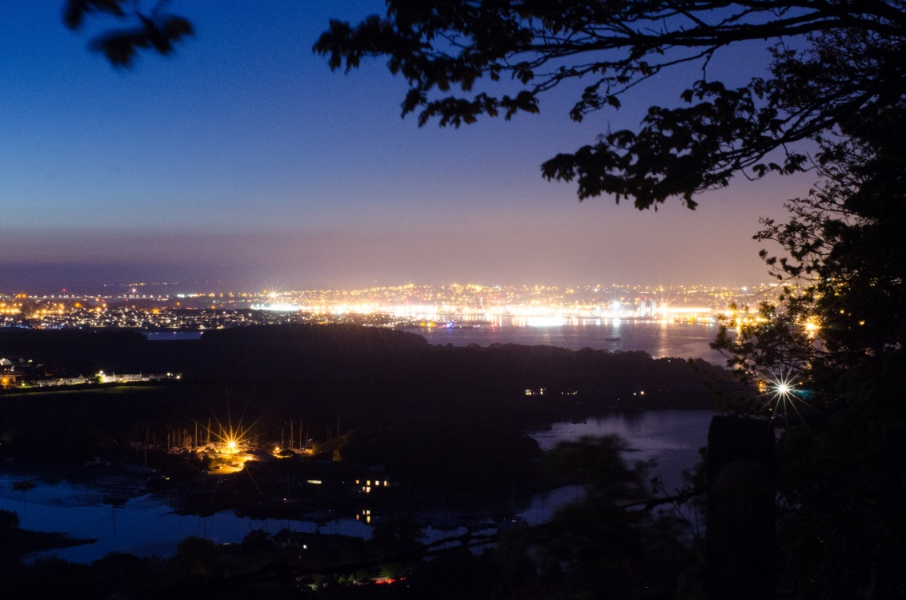
The global extent of artificial light pollution (ALAN) in the marine environment
Tim Smyth (PML), Tom Davies (UoP), David McKee (UoS)

Slide 2
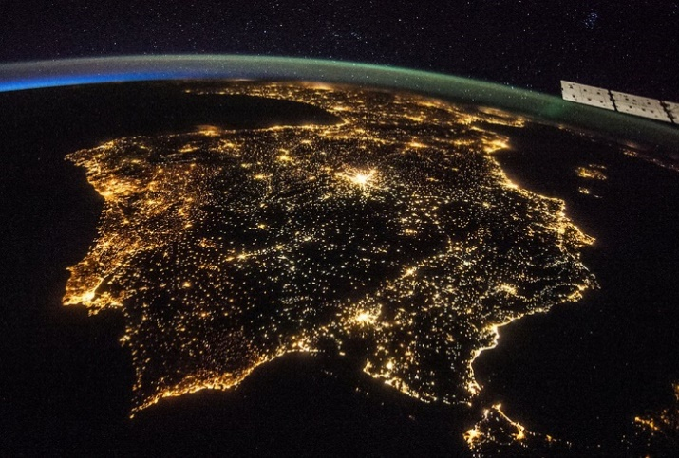
Background
Geoffery West: “… sharp transition out of the purely Anthropocene and entered another epoch … the Urbanocene” – Scale: The universal laws of life and death in organisms, cities and companies (p214)
Coastal light pollution on the Iberian Peninsula. International Space Station (NASA).

Slide 3
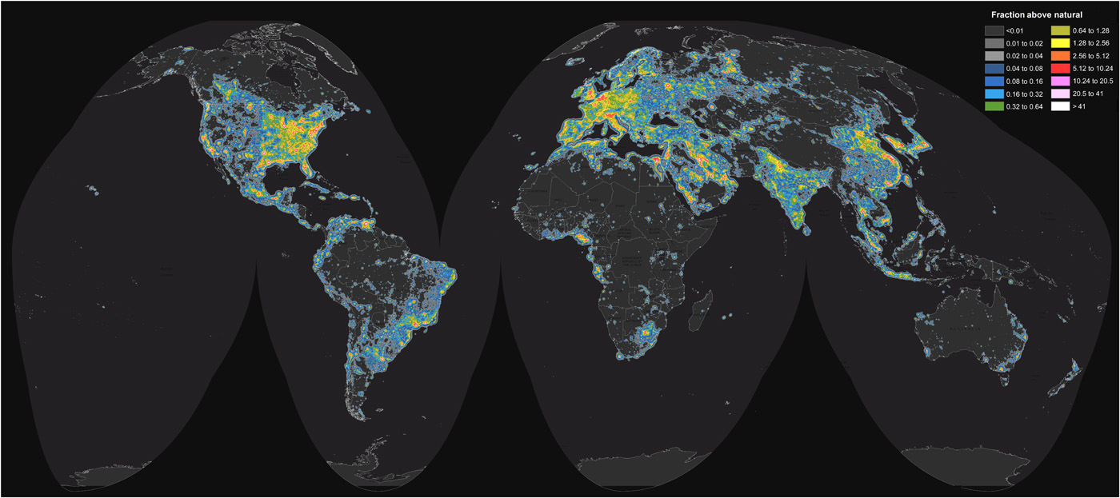
Starting point
Source: Fig 2 of Falchi et al. (2016) “The new world atlas of artificial night sky brightness” Science Advances, Vol. 2, no. 6, e1600377 DOI: 10.1126/sciadv.1600377

Slide 4
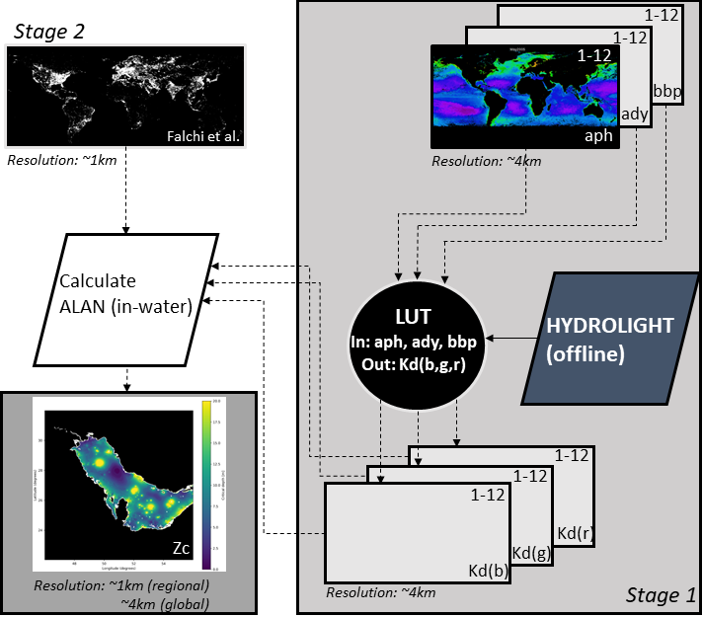

Slide 5
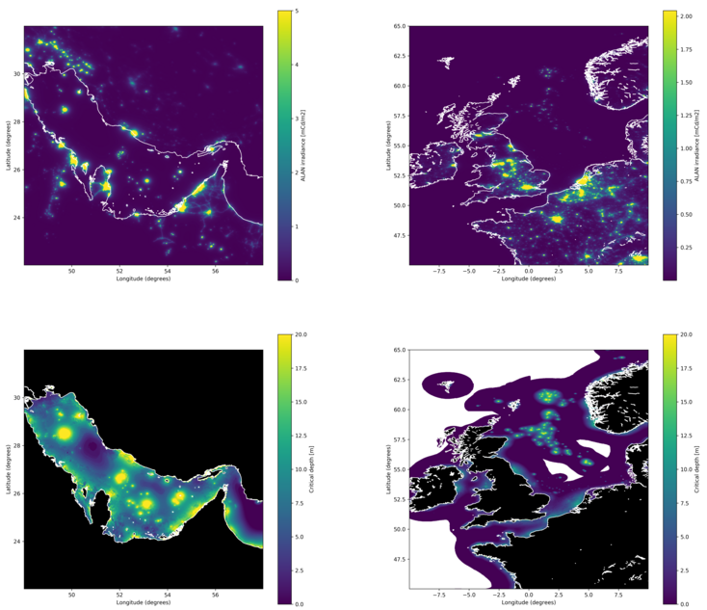

Slide 6
Impact upon Exclusive Economic Zones (EEZ)
 |  |  | Total area affected by ALAN >Zm (km²)
Rank | EEZ | km² | >1m | >10m | >20m | >30m | >40m
1 | United Kingdom part of the North Sea | 489021 | 191207 | 29830 | 2445 | 489 | 0
2 | Chinese part of the Yellow Sea | 342731 | 151144 | 4798 | 343 | 343 | 0
3 | Chinese part of the South China Sea | 518534 | 149338 | 16593 | 1037 | 519 | 0
4 | Vietnamese part of the South China Sea | 785201 | 141336 | 44756 | 3141 | 785 | 0
 |  |  | Percentage of region affected by ALAN >Zm (%)
Rank | EEZ | km² | >1m | >10m | >20m | >30m | >40m
1 | Palestinian part of the Mediterranean | 600 | 100 | 99.8 | 4.7 | 0 | 0
2 | Iraqi part of the Persian Gulf | 940 | 100 | 4.8 | 3.1 | 1.4 | 0.1
3 | Iran / UAE Persian Gulf | 5872 | 99.9 | 7.4 | 0 | 0 | 0
4 | Belgian part of the North Sea | 4245 | 99.8 | 0 | 0 | 0 | 0

Slide 7
Acknowledgements
National Geographic: grant CP-116R-17
UK Natural Environment Research Council: grant NE/S003568/1
Fabio Falchi for making the entire floating-point dataset from the 2015 World Atlas of Artificial Night Sky Brightness available to us upon request.

