Slide 1
The overlap of aftershock coda-waves and forecasting the first hour aftershocks
Eugenio Lippiello, Giuseppe Petrillo, Cataldo Godano & Lucilla de Arcangelis
University of Campania «L. Vanvitelli»
Anna Tramelli, INGV, Napoli
Eleftheria Papadimitrou & Vassilis Karakostas, Thessaloniki University
Reference manuscript, Nature Communications volume 10, Article number: 2953 (2019)
https://www.nature.com/articles/s41467-019-10763-3
Dipartimento
di
Matematica e Fisica

Slide 2
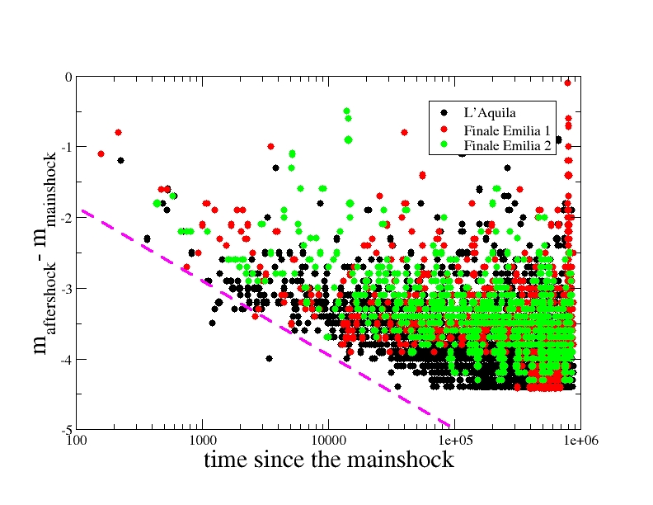
THE PROBLEM
Small aftershocks are not detected in the first part of aftershock sequences
(Kagan, BSSA 2004, Helmstetter, Kagan, Jackson, BSSA (2006))
This incompeleteness can be described as the existence of a completeness magnitude
$$m_{c}\left(t\right)=m_{MAIN}−δ\log\left(t\right)−∆$$
Events with $m<m_{c}(t)$ are not detected
Dipartimento
di
Matematica e Fisica

Slide 3
THE PROBLEM
Small aftershocks are not detected in the first part of aftershock sequences
(Kagan, BSSA 2004, Helmstetter, Kagan, Jackson, BSSA (2006))
This incompeleteness can be described as the existence of a completeness magnitude
$$m_{c}\left(t\right)=m_{MAIN}−δ\log\left(t\right)−∆$$
Events with $m<m_{c}(t)$ are not detected
Dipartimento
di
Matematica e Fisica

Slide 4
THE PROBLEM
The missing of events introduces a huge bias in the estimate of parameters K,c in the Omori law, necessary in all statistical models for short-term forecasting
n$\left(t\right)={K (t+c)}^{−p}$
Refined methods have been developed,
(Omi et al. S.Rep. 2013, JGR 2015, BSSA 2016, SRL 2018)
These methods can be efficient only having at least 30 identified events
It is necessary to wait at least some hours after the mainshock to elaborate a reliable forecasting
Dipartimento
di
Matematica e Fisica

Slide 5
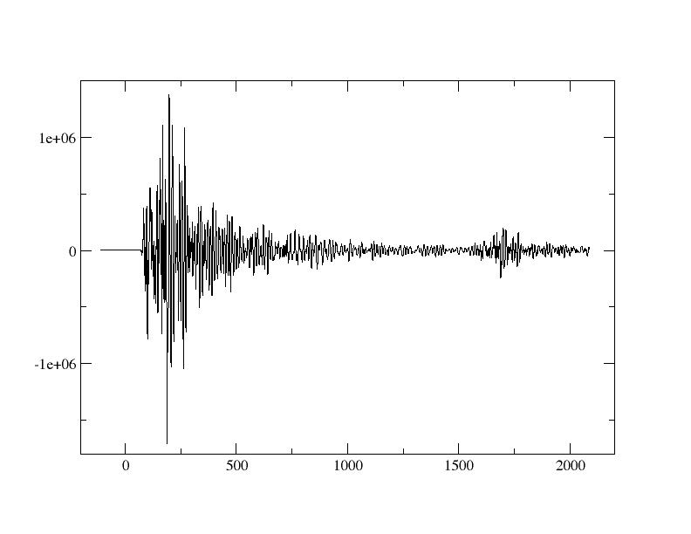
THE MECHANISM
The main mechanism responsible for missing of events is the overlap of aftershock coda-waves (Lippiello et al., GRL 2016, Hainzl. JGR. 2016, de Arcangelis, et al., JGR, 2018)
Example for a M6.6 mainshock
followed by a M=5.5 aftershock after 30 minutes
Dipartimento
di
Matematica e Fisica

Slide 6
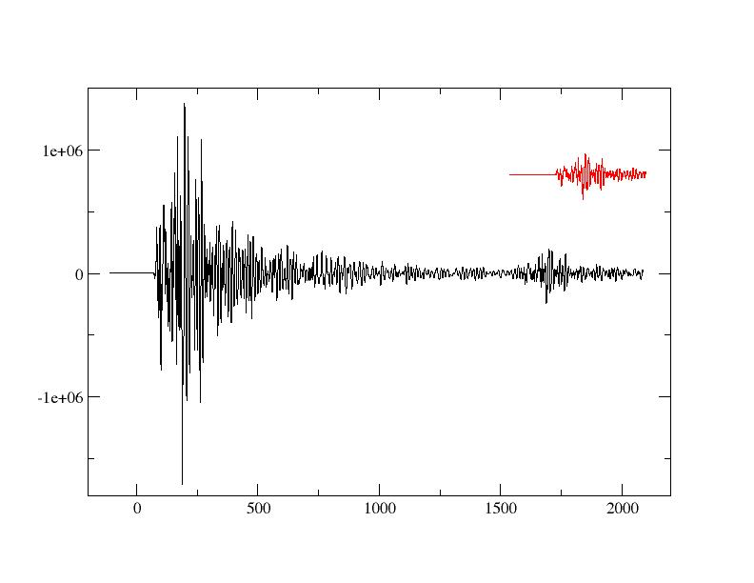
THE MECHANISM
The main mechanism responsible for missing of events is the overlap of aftershock coda-waves (Lippiello et al., GRL 2016, Hainzl. JGR. 2016, de Arcangelis, et al., JGR, 2018)
The M55 aftershock is easily identified
Example for a M6.6 mainshock
followed by a M5.5 aftershock after 30 minutes
Dipartimento
di
Matematica e Fisica

Slide 7
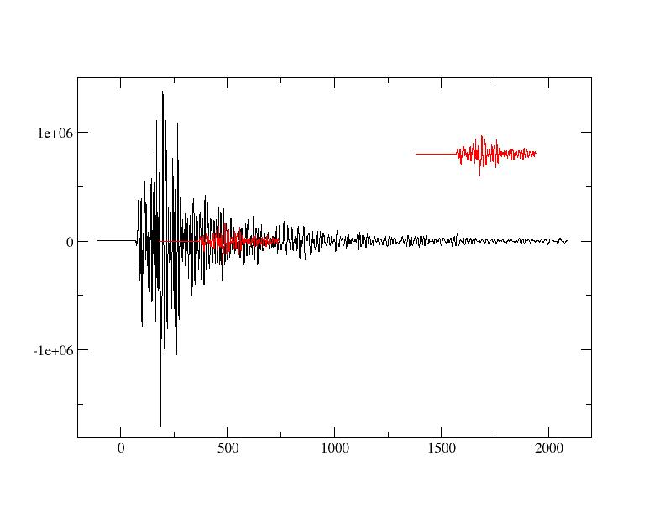
THE MECHANISM
The main mechanism responsible for missing of events is the overlap of aftershock coda-waves (Lippiello et al., GRL 2016, Hainzl. JGR. 2016, de Arcangelis, et al., JGR, 2018)
The M55 aftershock is NOT identified
Example for a M6.6 mainshock
followed by a M5.5 aftershock after only 8 minutes
Dipartimento
di
Matematica e Fisica

Slide 8
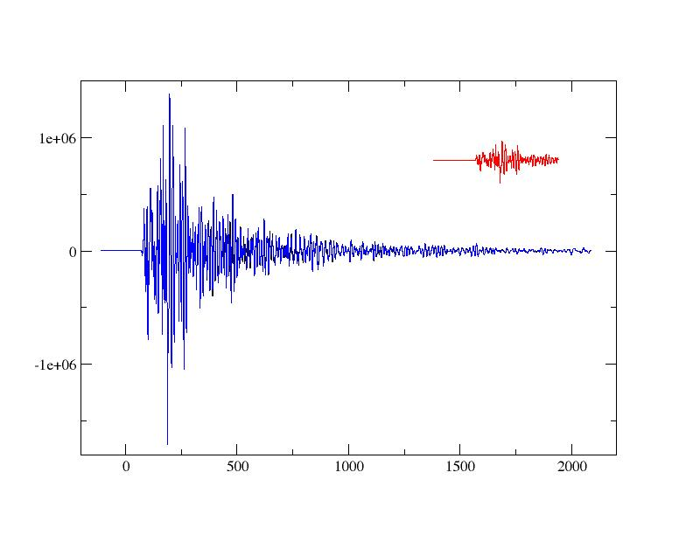
THE MECHANISM
The main mechanism responsible for missing of events is the overlap of aftershock coda-waves (Lippiello et al., GRL 2016, Hainzl. JGR. 2016, de Arcangelis, et al., JGR, 2018)
There is no hint of the M55 aftershock
Example for a M6.6 mainshock
followed by a M5.5 aftershock after only 8 minutes
Dipartimento
di
Matematica e Fisica

Slide 9
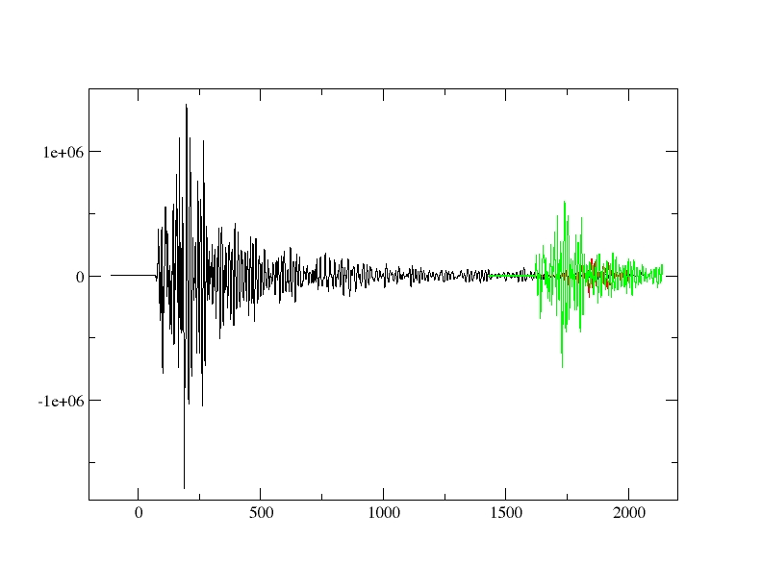
THE MECHANISM
The main mechanism responsible for missing of events is the overlap of aftershock coda-waves (Lippiello et al., GRL 2016, Hainzl. JGR. 2016, de Arcangelis, et al., JGR, 2018)
The M6 aftershock hides the
M5.5 aftershock
Example for a M6.6 mainshock
followed by a M5.5 aftershock after only 30 minutes
It is not sufficent to be far in time from the mainshock.
The M5.5 aftershock can be hidden by a M6 aftershock occurred before it
Dipartimento
di
Matematica e Fisica

Slide 10
Summary of the Preamble
Because of the very high level of sesimic rate after large mainsocks many aftershocks
are hidden by the coda-wave of a previous larger aftershock:
small aftershocks are undectable
Reliable forecasting is realiable only some hours after the mainshock
The most dangerous aftershocks usually occur the first hours after the mainshock,
when forecasting is not available
Our Approach
We will NOT try to bypass aftershock overlapping but we will use it to obtain a very
efficient forecasting, some minutes after the mainshock
Dipartimento
di
Matematica e Fisica

Slide 11
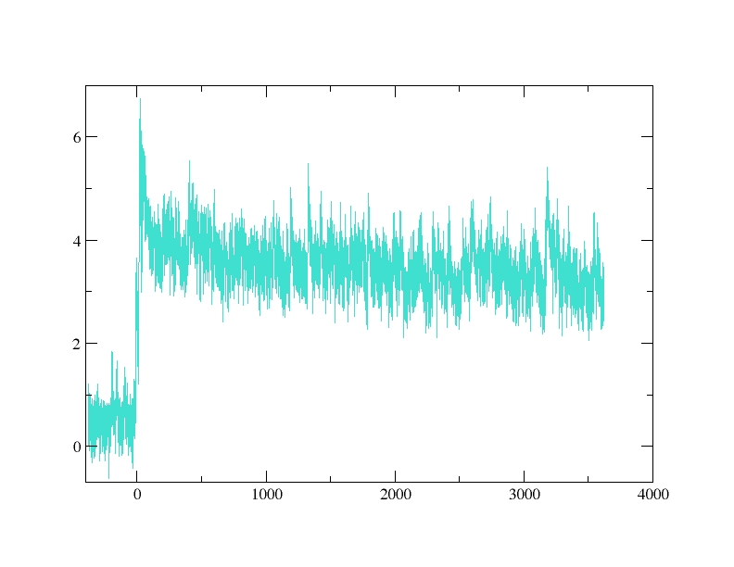
First step: The envelope function
We introduce the quantity μ(t) which is the envelope of the seismic waveform.
Being always positive is more simple to manage
Hilbert transformation
Dipartimento
di
Matematica e Fisica

Slide 12
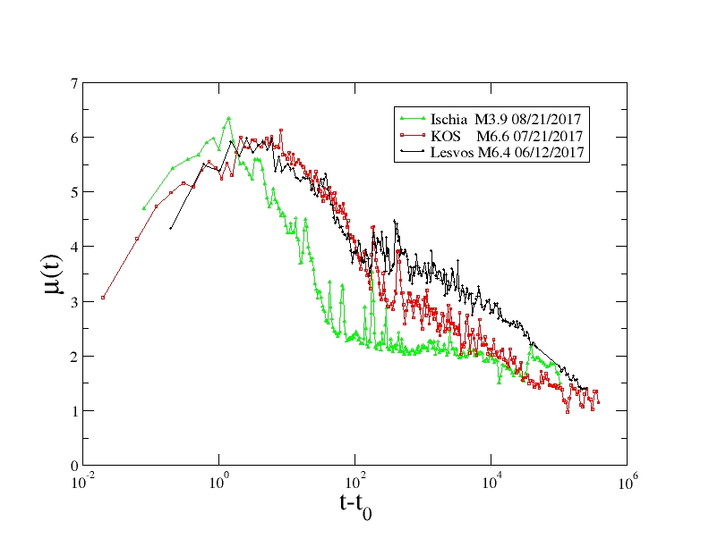
How to extract information from the envelope function
3 Different earthquakes
3 different envelopes.
WHY?
Dipartimento
di
Matematica e Fisica

Slide 13
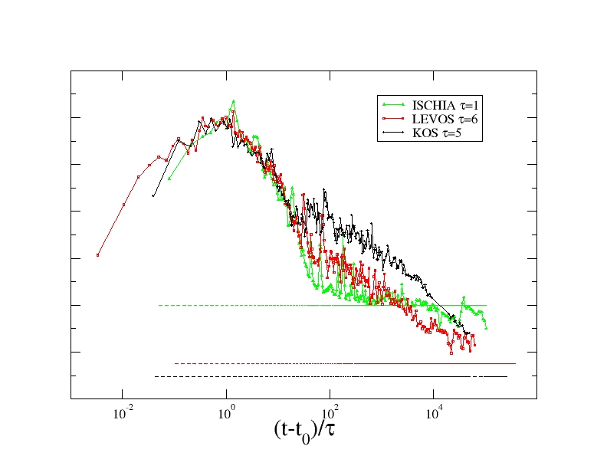
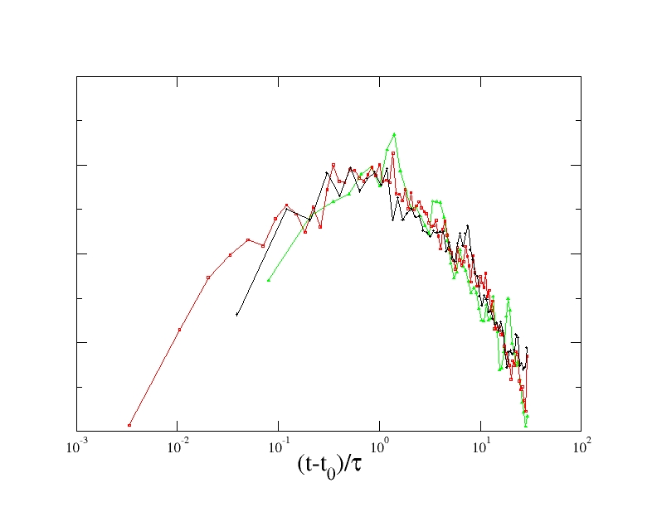
How to extract information from the envelope function
3 Different earthquakes
3 different envelopes.
Rescaling time by an earthquake dependent
characteristic time τ
The first part of μ(t) are identical
Dipartimento
di
Matematica e Fisica

Slide 14
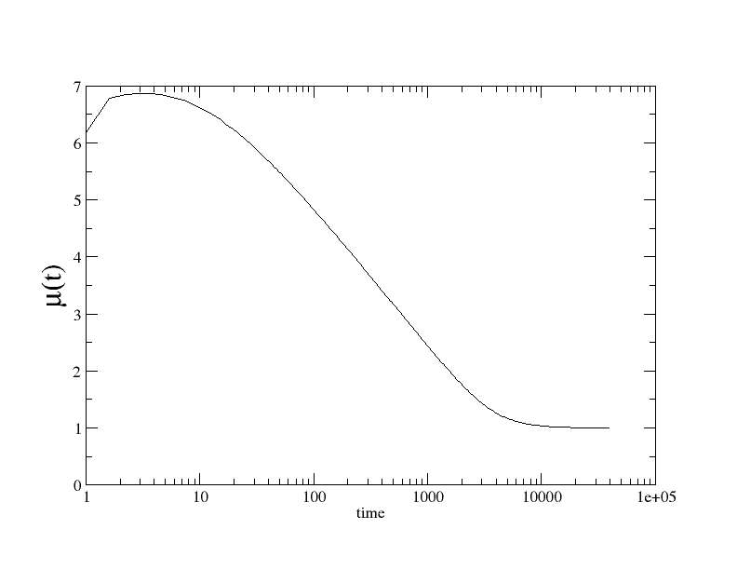
How to extract information from the envelope function
The envelope function μ(t) of an isolated event
$μ_{th}\left(t\right)=μ_{M}−3.5 \log_{10}\left(t/τ\right)$+ $μ_{B}$
$μ_{M}$ is the perceived magnitude related, i.e. the local magnitude of the eartqhuake
$μ_{B}$ is the level of background seismicity
Dipartimento
di
Matematica e Fisica

Slide 15
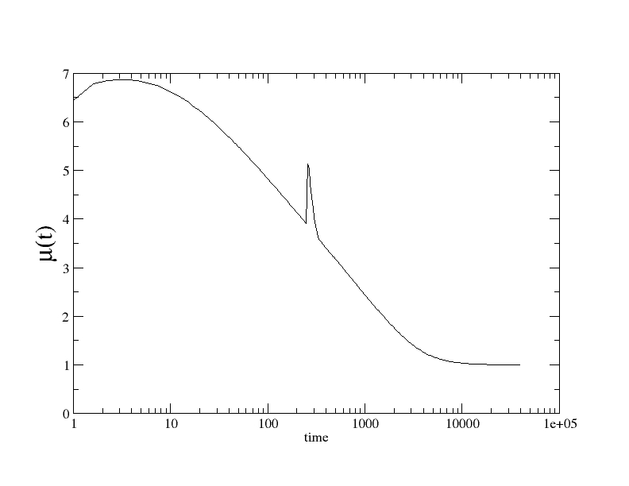
How to extract information from the envelope function
The envelope function μ(t) of two isolated events
$$μ_{th}\left(t\right)=μ_{M}−3.5 \log_{10}\left(t/τ\right)\text{+ }μ_{B}$$
$${+μ}_{1}−3.5 \log_{10}((t−t_{1})/τ)$$
$μ_{M}$ is the mainshock perceived magnitude
$μ_{1}$ is the aftershock perceived magnitude
Dipartimento
di
Matematica e Fisica

Slide 16
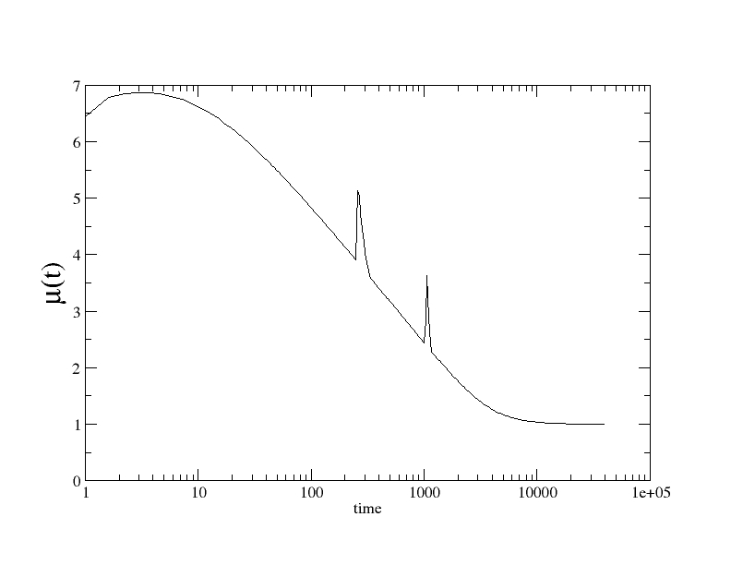
How to extract information from the envelope function
The envelope function μ(t) of two isolated events
$$μ_{th}\left(t\right)=μ_{M}−3.5 \log_{10}\left(t/τ\right)\text{+ }μ_{B}$$
$${+μ}_{1}−3.5 \log_{10}((t−t_{1})/τ)$$
$${+μ}_{2}−3.5 \log_{10}((t−t_{2})/τ)$$
$μ_{M}$ is the mainshock perceived magnitude
$μ_{1}$ is the 1° aftershock perceived magnitude
$μ_{2}$ is the 2° aftershock perceived magnitude
Dipartimento
di
Matematica e Fisica

Slide 17
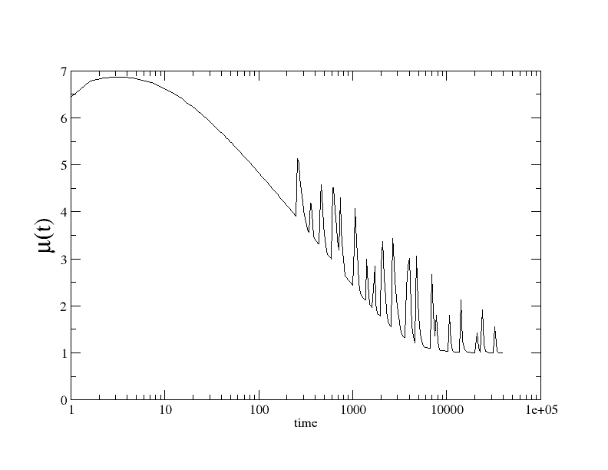
How to extract information from the envelope function
The envelope function μ(t) of n isolated events
$$μ_{th}\left(t\right)=μ_{M}−3.5 \log_{10}\left(\frac{t}{τ}\right)\text{+ }μ_{B}+$$
$\sum_{i=1}^{n}{{(μ}_{i}}−3.5\log_{10}\left((t−t_{i})/τ\right)$)
$μ_{M}$ is the mainshock perceived magnitude
$μ_{i}$ is the i-th aftershock perceived magnitude
Dipartimento
di
Matematica e Fisica

Slide 18
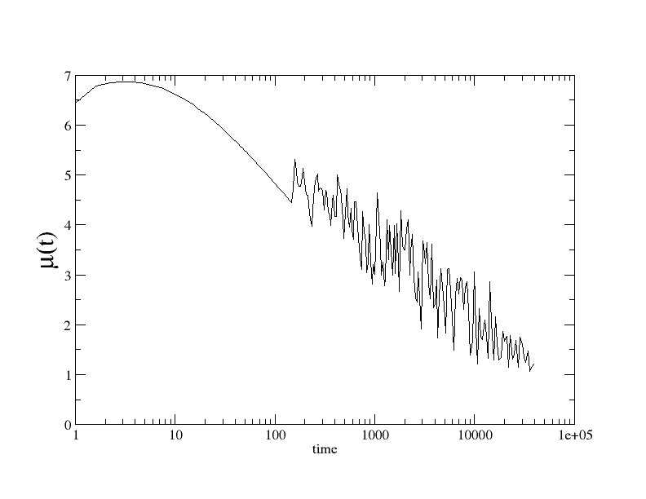
How to extract information from the envelope function
The envelope function μ(t) of n isolated events
$$μ_{th}\left(t\right)=μ_{M}−3.5 \log_{10}\left(\frac{t}{τ}\right)\text{+ }μ_{B}+$$
$\sum_{i=1}^{n}{{(μ}_{i}}−3.5\log_{10}\left((t−t_{i})/τ\right)$)
$μ_{M}$ is the mainshock perceived magnitude
$μ_{i}$ is the i-th aftershock perceived magnitude
for a larger n
Dipartimento
di
Matematica e Fisica

Slide 19
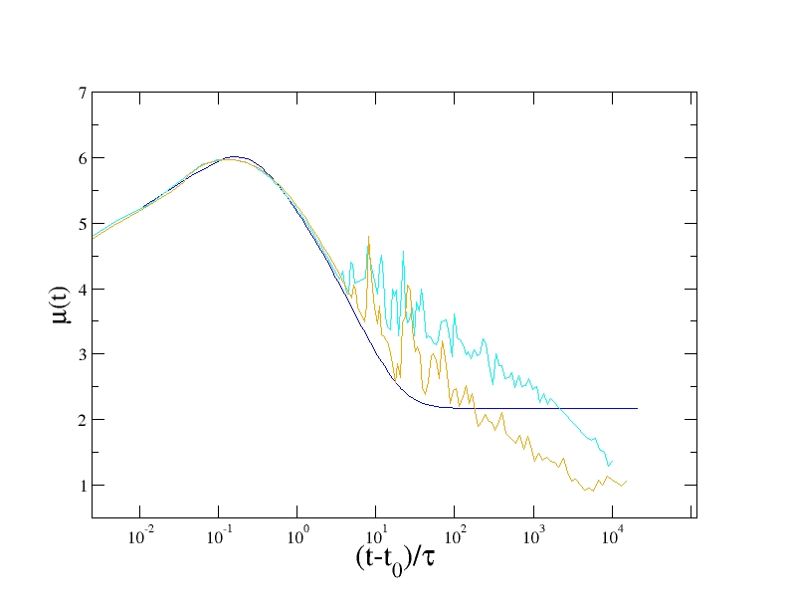
How to extract information from the envelope function
The envelope function μ(t)
$$n\left(t\right)=\frac{K}{{(t+c)}^{p}}$$
$$μ_{th}\left(t\right)=μ_{M}−3.5 \log_{10}\left(\frac{t}{τ}\right)\text{+ }μ_{B}+$$
$\sum_{i=1}^{n}{{(μ}_{i}}−3.5\log_{10}\left((t−t_{i})/τ\right)$)
$μ_{M}$ is the mainshock perceived magnitude
$μ_{i}$ is the i-th aftershock perceived magnitude
for an aftershock rate following the Omori law with different values of K & c
Dipartimento
di
Matematica e Fisica

Slide 20
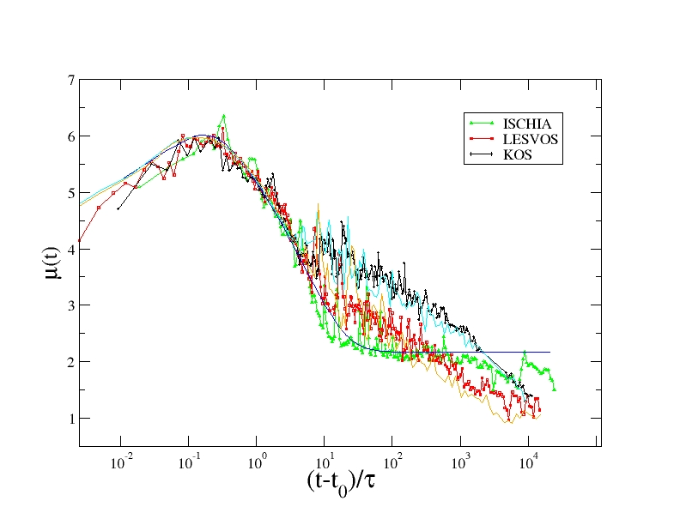
How to extract information from the envelope function
The envelope function μ(t)
$$n\left(t\right)=\frac{K}{{(t+c)}^{p}}$$
$$μ_{th}\left(t\right)=μ_{M}−3.5 \log_{10}\left(\frac{t}{τ}\right)\text{+ }μ_{B}+$$
$\sum_{i=1}^{n}{{(μ}_{i}}−3.5\log_{10}\left((t−t_{i})/τ\right)$)
$μ_{M}$ is the mainshock perceived magnitude
$μ_{i}$ is the i-th aftershock perceived magnitude
for an aftershock rate following the Omori law with different values of K & c
Dipartimento
di
Matematica e Fisica

Slide 21
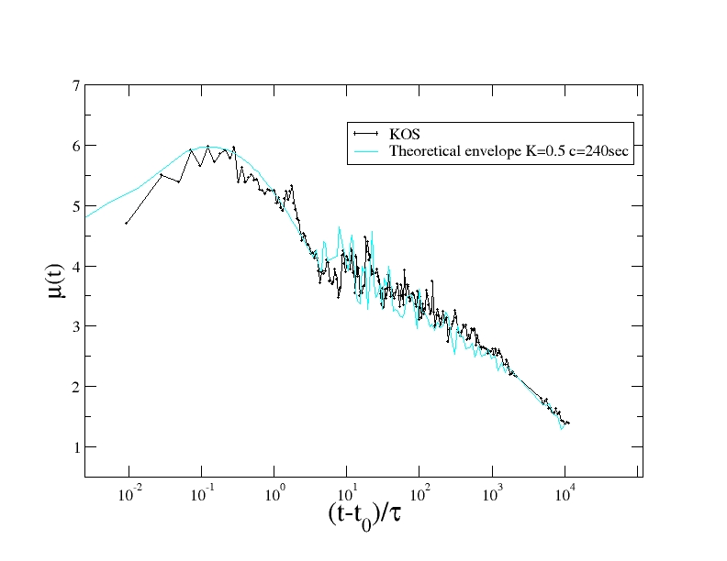
KEY RESULT
For every instrumental envelope
there exists a best choice of the
four parameters $μ_{M}, τ, K, c$
such as that the theoretical envelope
is very similar to the instrumental one
$$μ_{th}≈μ$$
$$μ_{th}\left(t\right)=μ_{M}−3.5 \log_{10}\left(t/τ\right)\text{+ }μ_{B}+$$
$\sum_{i=1}^{n}{{(μ}_{i}}−3.5\log_{10}\left((t−t_{i})/τ\right)$)
It is possible to find the best parameters K & c in the Omori law
Dipartimento
di
Matematica e Fisica

Slide 22
THE ALGORITHM
We estimate the four parameters $μ_{M}, τ, K, c$
by minimizing the quantity
$$χ\left(T\right)=\int_{0}^{T}{ⅆt^{′}}{\left(μ\left(t^{′}\right)−μ_{th}\left(t^{′}\right)\right)}^{2}$$
by means of a simulated-annealing procedure in two step procedure
Step 1) Evaluate $μ_{M}, τ$by minimzing $χ\left(T\right)$ in the interval (0,T=100sec)
Step 2) Evaluate $K, c$using $μ_{M}, τ$evaluated at step 1 and by minimzing $χ\left(T\right)$ in the inerval (T=100sec,T=30min) or larger T
Dipartimento
di
Matematica e Fisica

Slide 23
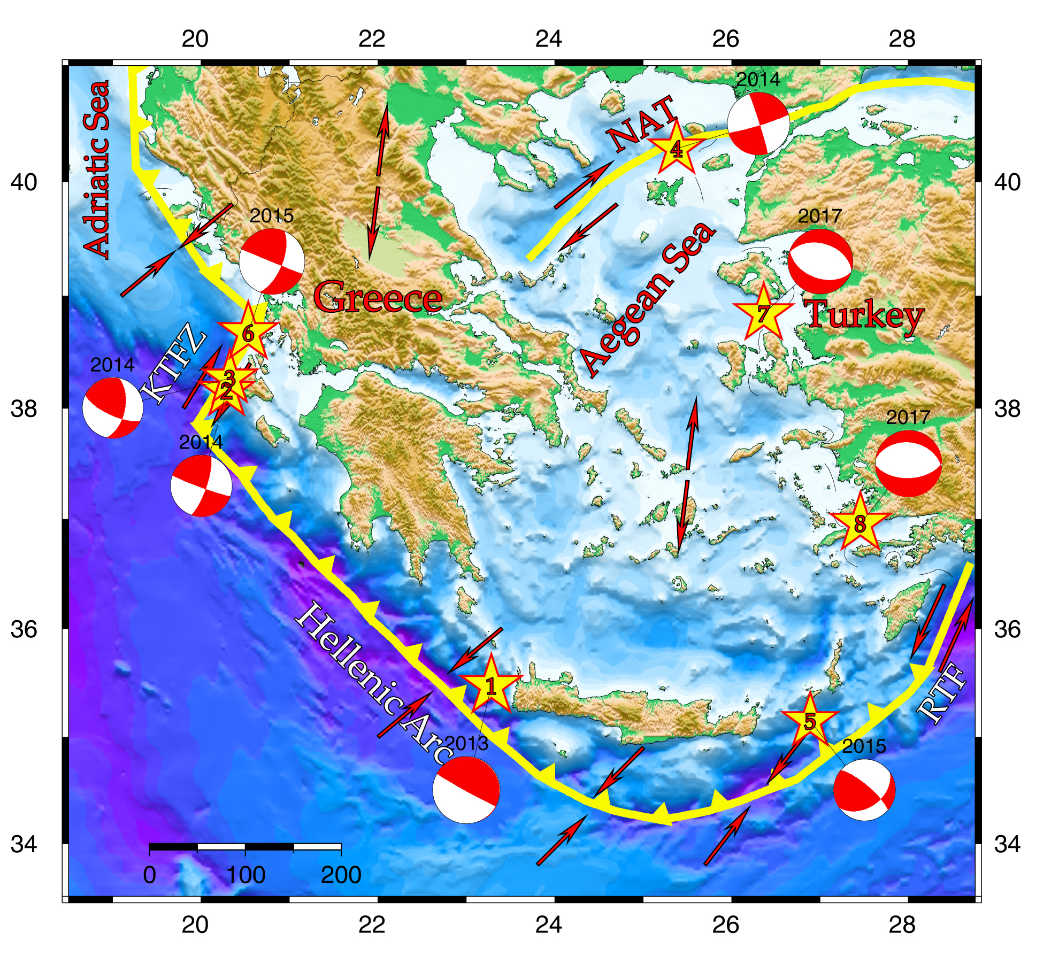
THE TESTING PROCEDURE
We test the method for all nine M6+ mainshocks occurred since 2013 in the Aegean area.
Only few aftershocks are reported in the official Greek catalog in the first hours after each mainshock.
Existing methods could be available only several hours after each mainshock
Dipartimento
di
Matematica e Fisica

Slide 24
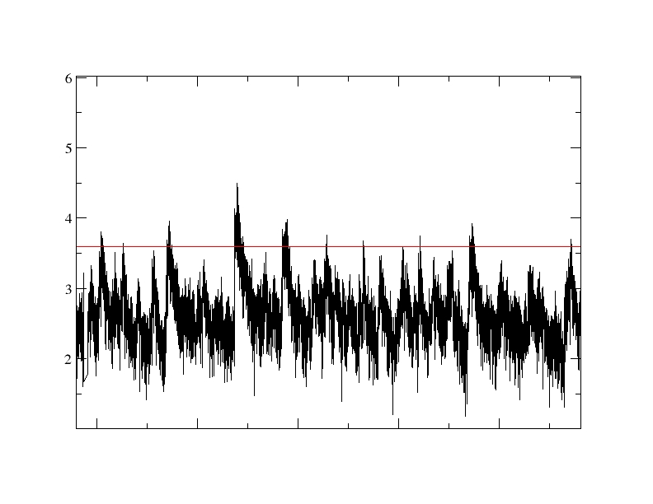
THE TESTING PROCEDURE
We use the Peng et al procedure (Peng et al. JGR 2007) to identify large aftershocks
as peaks in the envelope function with
$$μ_{i}>μ_{M}−3$$
Which is a compromise between a sufficient number of aftershocks for robust statistical
tests and considerable ground shaking induced by each aftershock.
We dentify many more aftershocks n_{obs} than those reported in the official Greek catalog in the testing period [2h,72h]
Dipartimento
di
Matematica e Fisica

Slide 25
THE TESTING PROCEDURE
We use the envelope μ(t) up to the time T (learning period (0,T),
to estimate the parameters $μ_{M}, τ, K, c$
We use these parameters in the Omori law and obtain the number of predicted events
$$n_{pred}\left(T\right)=\frac{K}{p−1}\left({\left(t_{i}+c\right)}^{1⋅p}−{\left(t_{f}+c\right)}^{1−p}\right)$$
and compare $n_{pred }VS n_{obs}$, for $t_{i}$=2h and $t_{f}=72h$
Dipartimento
di
Matematica e Fisica

Slide 26
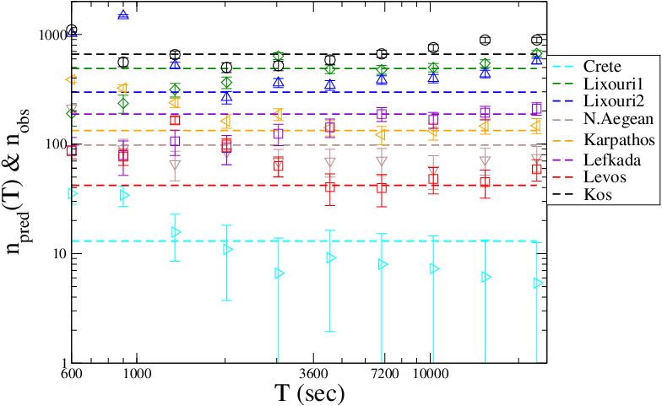
THE TESTING PROCEDURE
Dashed horizontal lines represent n n_{obs} , i.e. the number of identified aftershocks.
Symbols are the number of predicted aftershocks for different values of the learning period T, n_{pred}(T).
Different symbols and colors are used for different mainshocks (see legend).
For all mainshocks we find that our procedure
forecasts the number of observed aftershocks with
a discrepancy typically smaller than 20% even with a learning period of 30 minutes
Dipartimento
di
Matematica e Fisica

Slide 27
Final Summary
We present a novel method to forecast early aftershocks based on the behavior of seismic waveforms, the first hour after a mainshock.
ADVANTAGES WITH RESPECT T0 TRADITIONAL METHODS
It works in a temporal window when traditional methods are not efficient:
Already after about 30 minutes from the mainshock, the method forecasts the number of aftershocks in the subsequent hours or days with an accuracy smaller than 20 %.
Traditional methods reach this accuracy only some hours after the mainshock
It can work in areas with a poor seismic coverage
Traditional methods need a dense seismic network to locate small aftershocks
The seismic hazard can be elaborated in-situ
Traditional methods must elaborate the signal coming from several seismic stations
Dipartimento
di
Matematica e Fisica

