Slide 1
2019 Performance Assessment Calculations for the Recertification of the Waste Isolation Pilot Plant
Todd R. Zeitler*, James Bethune, Sarah Brunell, Dwayne Kicker, and Jennifer Long
May 4, 2020

Slide 2
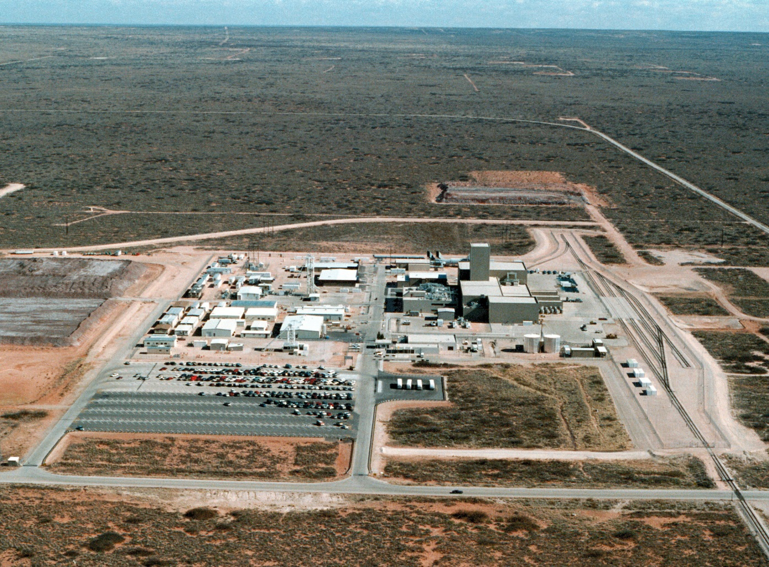
Outline
WIPP Background
WIPP Performance Assessment (PA)
  Regulatory drivers
  Assumed release mechanisms
2019 Compliance Recertification Application (CRA-2019)
  PA Calculations
  Discussion of some changes made to WIPP PA since CRA-2014
  PA Results

Slide 3
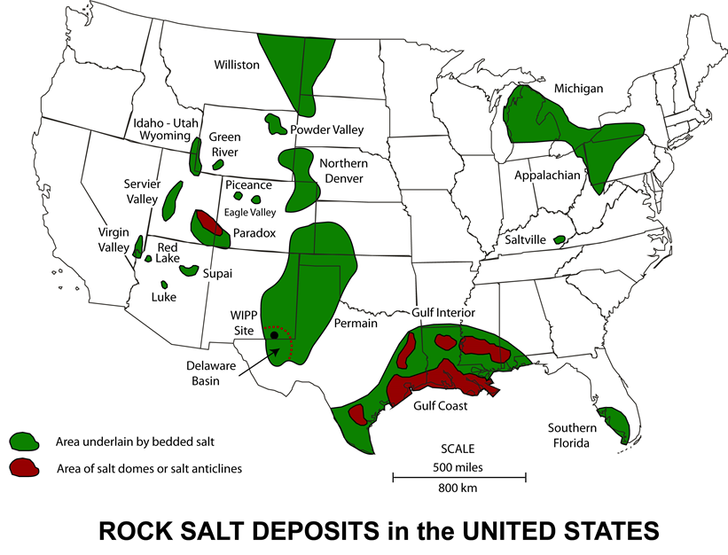
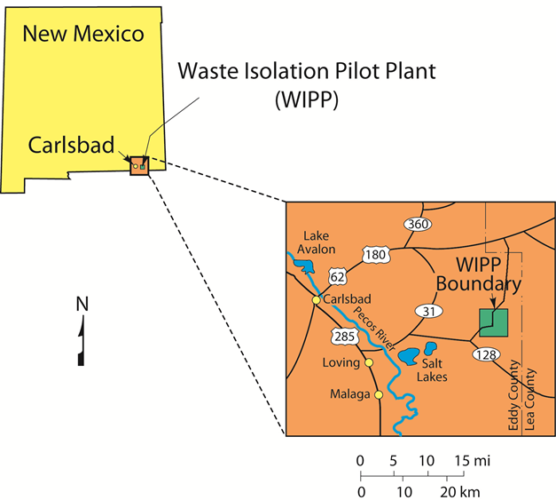
Waste Isolation Pilot Plant Location

Slide 4
About the WIPP
The WIPP is a permanent disposal facility for transuranic (TRU) waste
The only licensed deep geologic repository for nuclear waste in the U.S.
Operated by U.S. Department of Energy (DOE)
Long-term performance regulated by U.S. Environmental Protection Agency (EPA)
Waste is emplaced in a bedded salt formation deep underground
Long-term regulatory compliance is demonstrated via Performance Assessment (PA) undertaken by SNL Carlsbad
655 m deep
Waste Panels

Slide 5
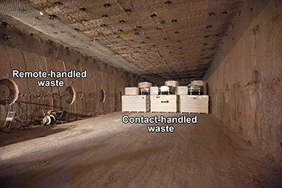
Long-Term Regulatory Requirements – WIPP PA Framework
Regulatory requirements guide the WIPP PA framework.
The WIPP must be designed to provide reasonable expectation that cumulative releases of radionuclides to the accessible environment for 10,000 years after closure from all significant processes and events shall be less than specified release limits.

Slide 6
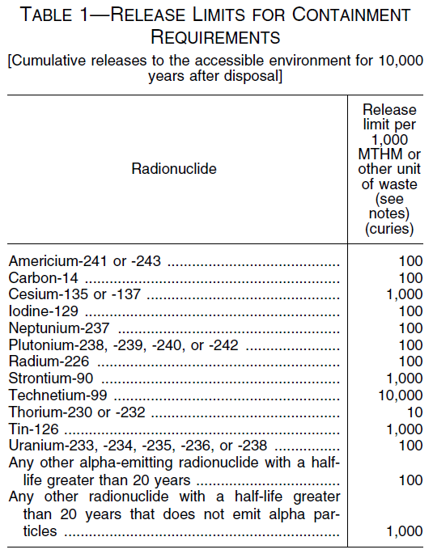
Regulatory Requirements
Reasonable expectation: regulations acknowledge substantial uncertainties
10,000 years: PA must predict behavior for entire regulatory time period
Significant processes and events: PA must include all of these, including the possibility of human intrusion
Recertification of WIPP required every five years
Latest recertification application submitted in 2019
  Included updated PA calculations (CRA-2019 PA)
From 40 CFR (Code of Federal Regulations) 191
R = Normalized release in “EPA units”
Q_{i} = 10,000-year cumulative release (in Ci) of radionuclide i
L_{i} = Release Limit for radionuclide i
C = the total transuranic inventory (in Ci of α-emitters w/halflives > 20 years)

Slide 7
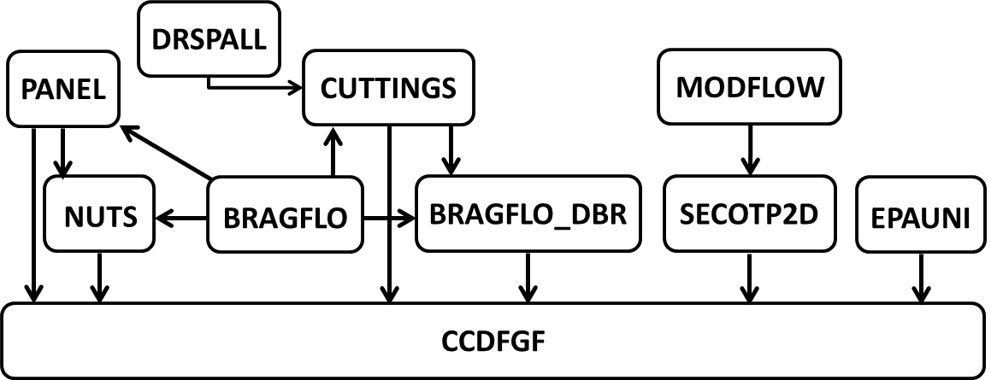
WIPP PA for Compliance Recertification
PA calculations cover 24 peer-reviewed conceptual models
PA codes include 10 principal codes and many utility codes
Codes are used to calculate estimated releases over 10,000 yrs
Compliance Metric

Slide 8

Potential Release Pathways in WIPP PA
Releases for the unintruded repository are generally negligible.
Direct Releases from Drilling Events
Ground Surface
Ground Surface
Culebra
Land Withdrawal
Boundary
Land Withdrawal
Boundary
Borehole
Shaft
Waste Area
Marker Bed

Slide 9
Changes to WIPP PA Implemented in CRA-2019 PA
Changes are implemented in recertification calculations due to: 1) the availability of new data; 2) routine updates; and 3) planned changes
The 16 changes below were implemented for CRA-2019 PA calculations
Approach to Abandonment of Panel Closures in the South and No Waste in Panel 9
Additional Shaft and Associated Drifts
Brine Radiolysis as Part of Gas Generation Process Model
Refinement to the Probability of Encountering Pressurized Brine
Refinement to the Corrosion Rates of Steel
Refinement to the Effective Shear Strength of WIPP Waste
Refinement to Colloid Enhancement Parameters
Refinement to Hydromagnesite Conversion Rate
Removal of Iron Sulfidation Reactions
Correction to Length of Northernmost Panel Closure Representation
Updates to Drilling Rate and Plugging Pattern Parameters
Updates to WIPP Waste Inventory Parameters
Updates to Radionuclide Solubilities
Update to BH_OPEN:RELP_MOD Parameter
New Materials to Define Properties in DRZ Surrounding OPS, EXP, and Panel Closure Areas
Hardware and Computational Code Updates

Slide 10
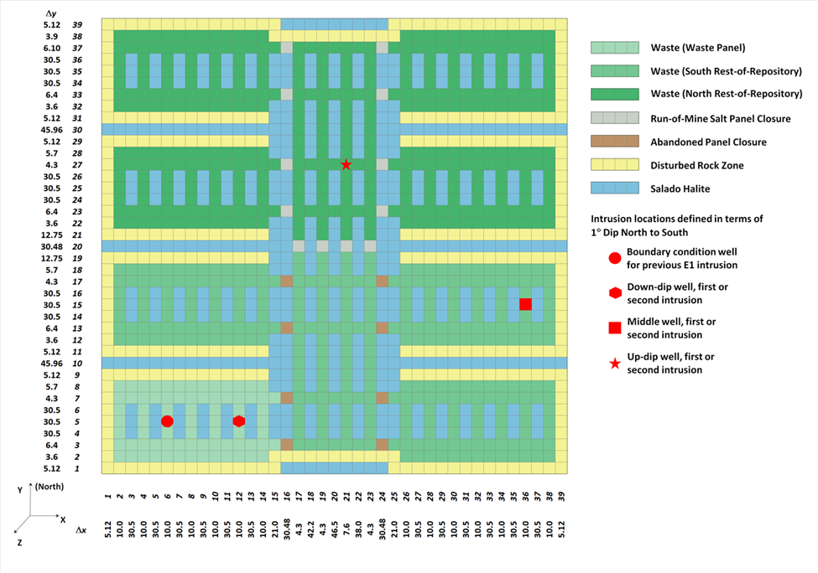
1. Approach to Abandonment of Panel Closures in the South and No Waste in Panel 9
Operational considerations
  No panel closures (PCS) in Panels 3, 4, 5, 6
  No waste in Panel 9
Repository model was modified to accommodate these operational changes
8
1
10
7
2
6
9
3
5
4

Slide 11
2. Additional Shaft and Associated Drifts
Work is underway to add an additional utility shaft to the surface.
Repository model was modified to account for additional excavated volume.
New Area for Shaft #5
North →

Slide 12
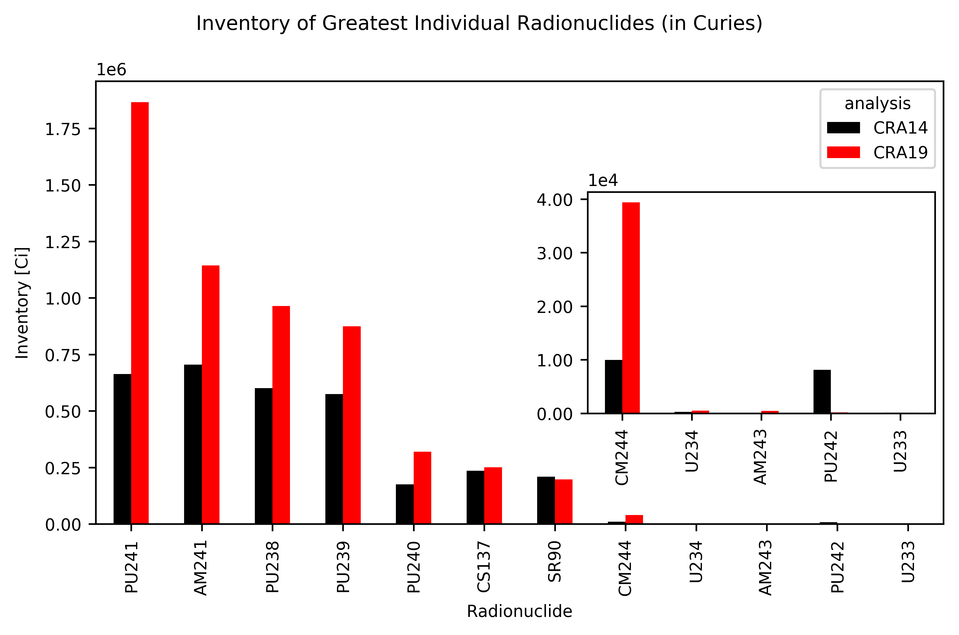
12. Updates to WIPP Waste Inventory Parameters
Assumed inventory at the time of repository closure is reevaluated with each recertification.
New data is collected from waste generator sites.
For CRA-2019, there was increased Pu and Am.

Slide 13
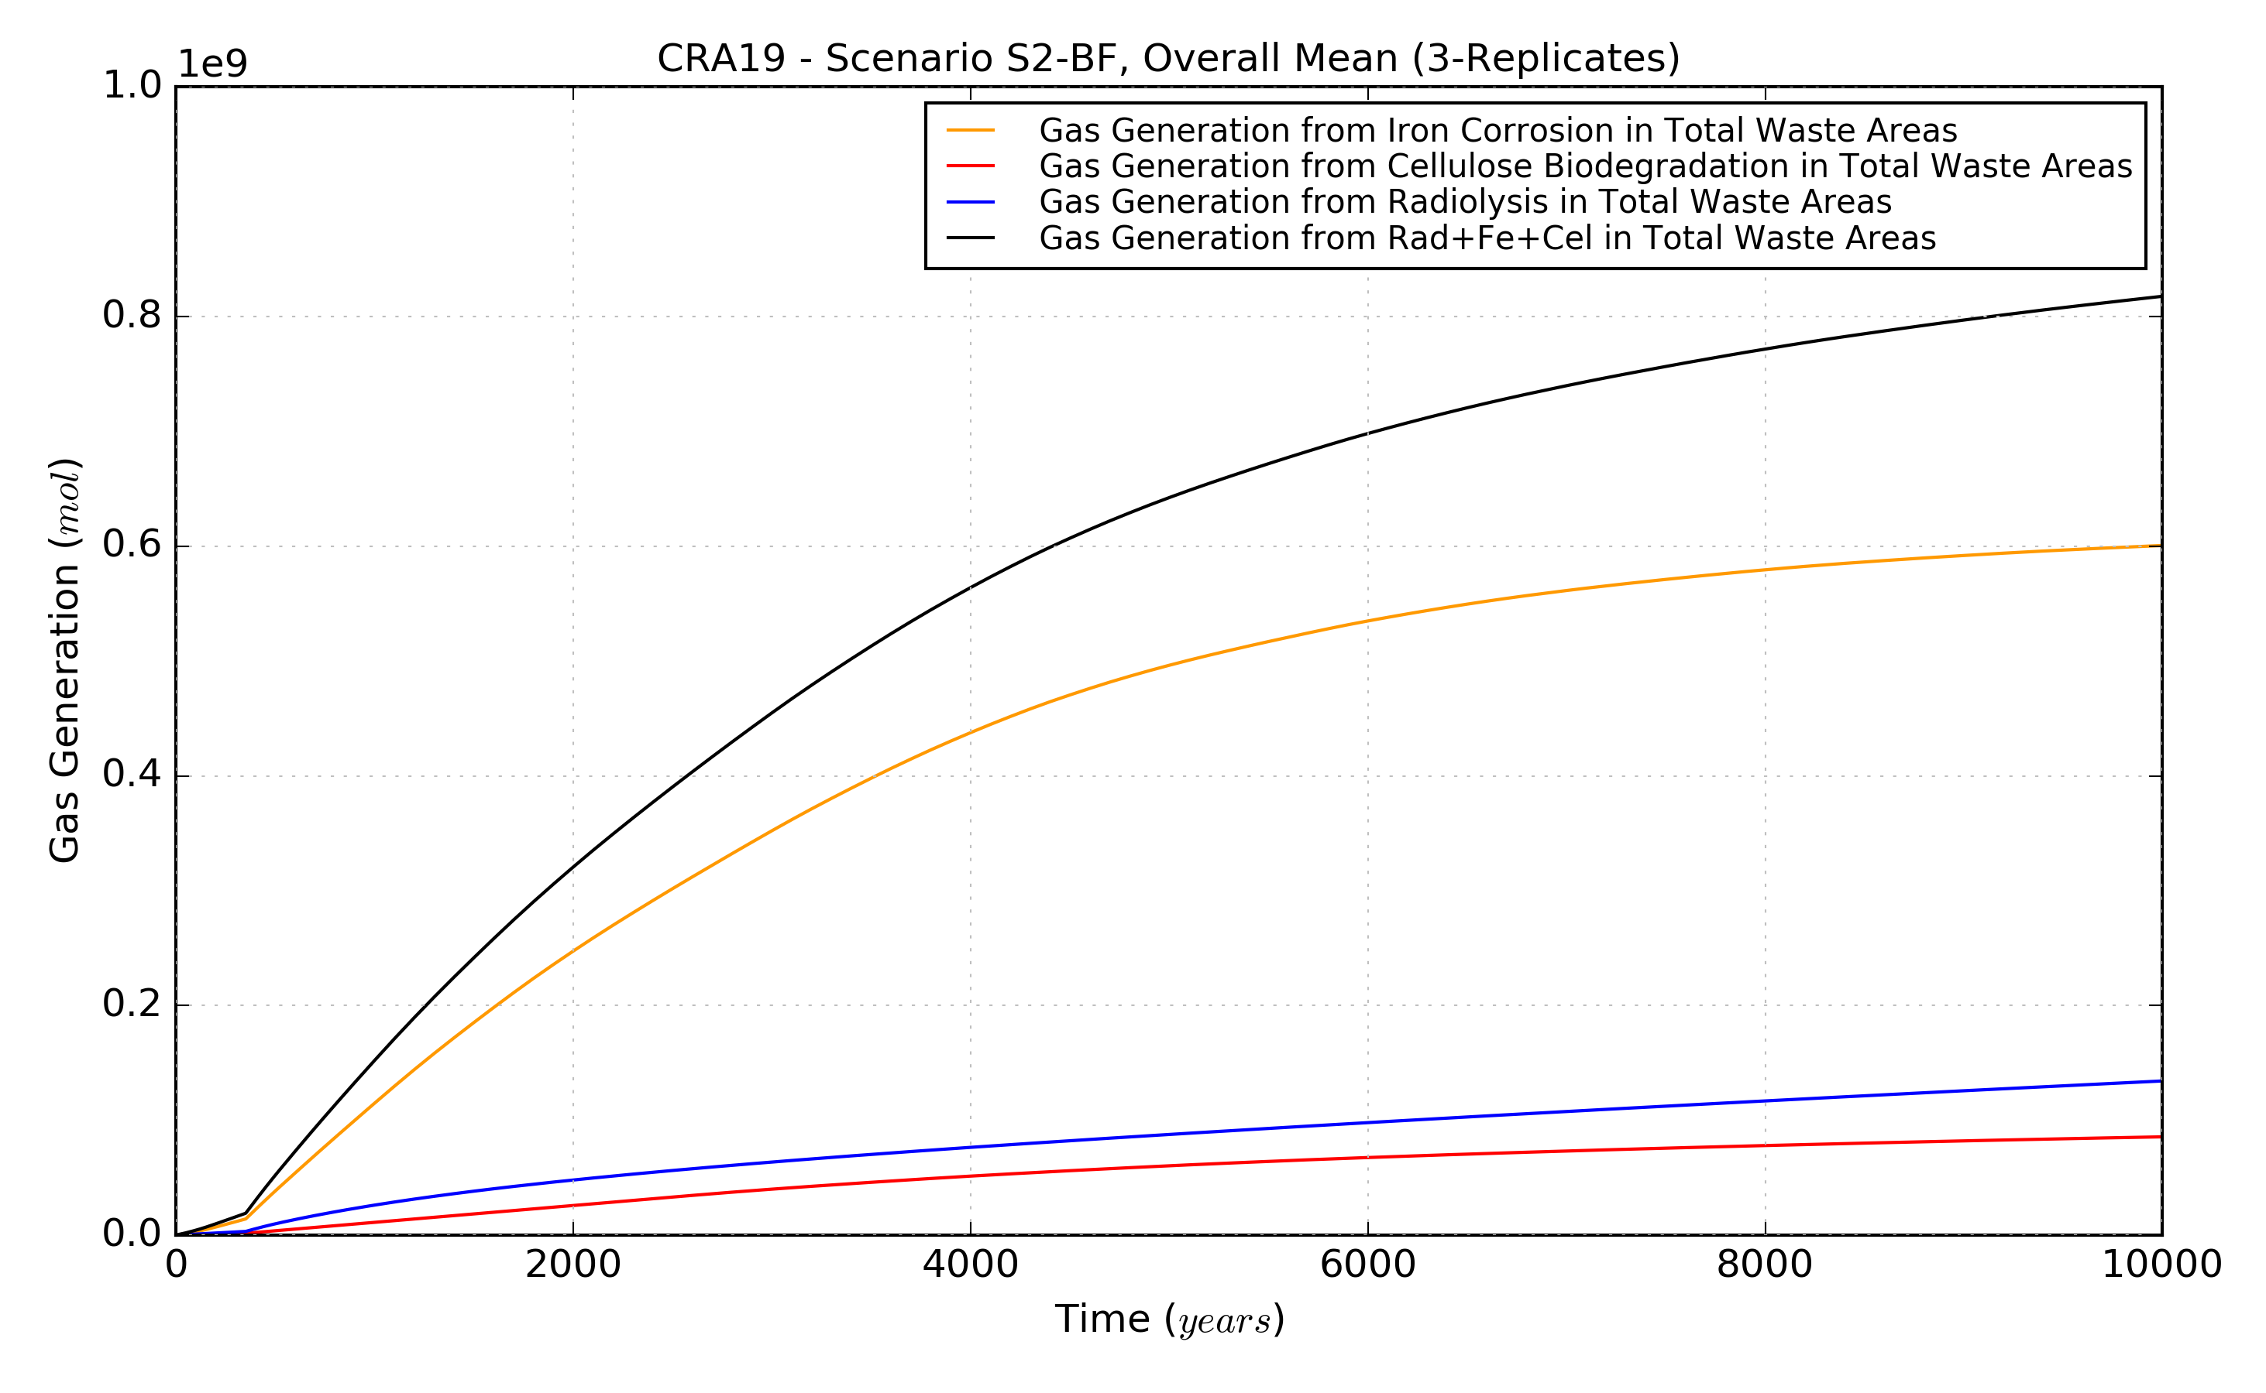
3. Brine Radiolysis as Part of Gas Generation Process Model
Earlier models of radiolytic gas generation showed negligible contribution.
Assumed radionuclide inventory has changed over time, prompting reevaluation of model.
Reevaluation of brine radiolysis showed that it should be included in gas generation process model.
CRA19 Gas Generation
(Steel Corrosion + Plastic Degradation + Radiolysis)
Total
Iron Corrosion
Radiolysis
Plastic Degradation
Gas Generation (mol)
Simulation Time (yrs)

Slide 14
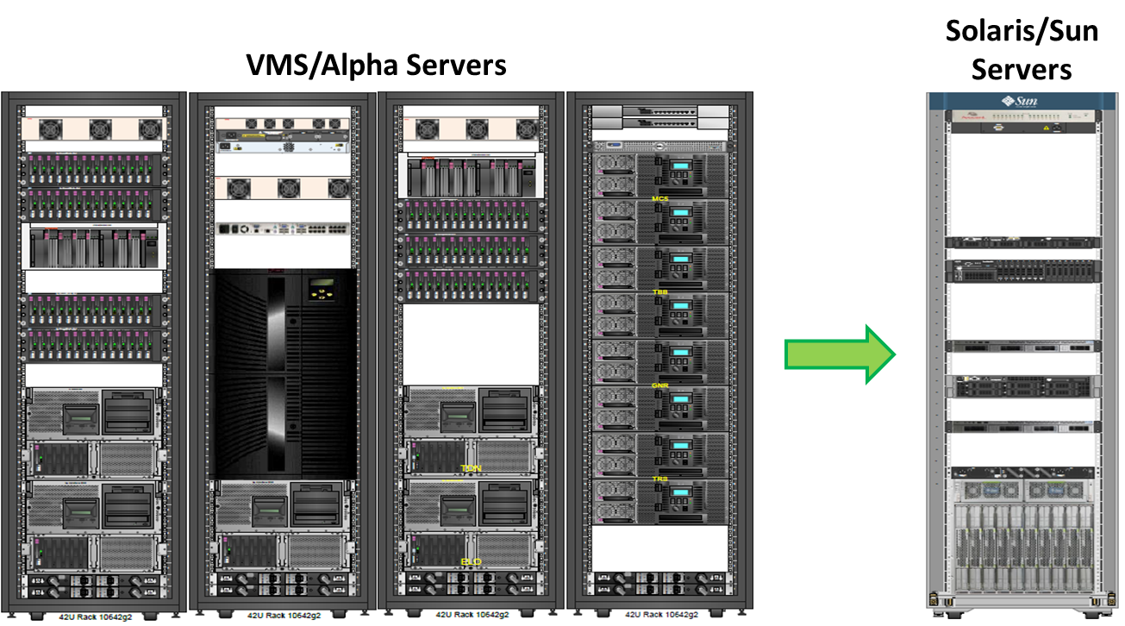
16. Hardware and Computational Code Updates
PA codes migrated to a modern Solaris Cluster
  Recompilation, retesting, requalification
Additional code changes since migration
  Bug fixes
  Added code functionality
Addition of two utility codes
32 CPUs
720 cores

Slide 15
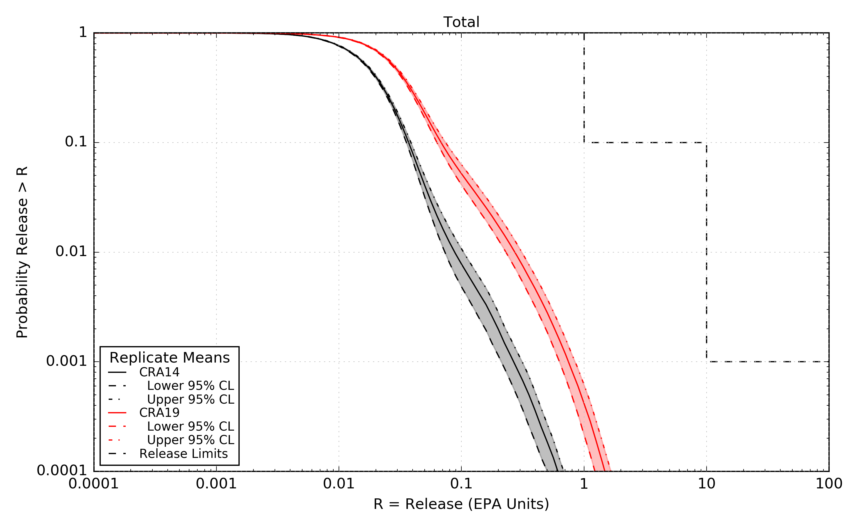
Latest Compliance Results: CRA-2019 PA
Total Releases
CRA-2014 PA
CRA-2019 PA
Regulatory Limits
Calculated releases have increased since 2014, but remain below regulatory limits
Mean Calculated Release Probabilities and 5%, 95% Confidence Limits
Probability | Analysis | Mean Total Release | Lower 95% CL | Upper 95% CL | Release Limit
0.1 | CRA14 | 0.0373 | 0.0355 | 0.0388 | 1
 | CRA19 | 0.0685 | 0.0631 | 0.0745
0.001 | CRA14 | 0.2677 | 0.2124 | 0.3132 | 10
 | CRA19 | 0.7505 | 0.6301 | 0.8501

Slide 16
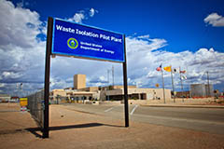

CRA-2019 PA – Conclusions
Total mean calculated remain below regulatory limits
Mean calculated releases increase at all probabilities
Mean releases increase for all release mechanisms
Solids releases continue to dominate at high probabilities
Solubilized radionuclides in direct brine releases continue to dominate at low probabilities

