Slide 1
Nonideal Electric Field Observed in the Separatrix
Region of a Magnetotail Reconnection Event
Xiancai Yu , Rongsheng Wang , Quanming Lu, Christopher T. Russell and Shui Wang
1 CAS Key Laboratory of Geospace Environment, Department of Geophysics and Planetary Science, University of Science and Technology of China, Hefei, China
2 CAS Center for Excellence in Comparative Planetology, Hefei, China
3 Earth Planetary and Space Sciences, University of California, Los Angeles, CA, USA
Reference: Yu et al., GRL 2019
https://doi.org/10.1029/2019GL082538

Slide 2
Introduction
In the separatrix region (SR), various instabilities and waves can be excited (Divin et al., 2012; Khotyaintsev et al., 2006; Lapenta et al., 2015), that is, the double layer (Wang et al., 2014), the electron holes (Cattell, 2005; Huang et al., 2014), lower hybrid waves (Graham et al., 2017), and whistler waves (Graham, Vaivads, et al., 2016).
Recently, the energetic electrons with energies up to 120 keV were observed to be injected toward the X line in the SRs, at both ion outflow regions of one reconnection event (Lapenta et al., 2016; Wang et al., 2013, 2014).
The parallel electric field directed away from the X‐line was simultaneously detected in the SRs. However, it remains unclear how this parallel electric field was created and whether the parallel electric field was the unique reason for the high-energy electron beam.
In this letter, we present a magnetic reconnection event encountered by MMS in the magnetotail. The nonideal electric field perpendicular to the local magnetic field was observed in the northern SR.

Slide 3
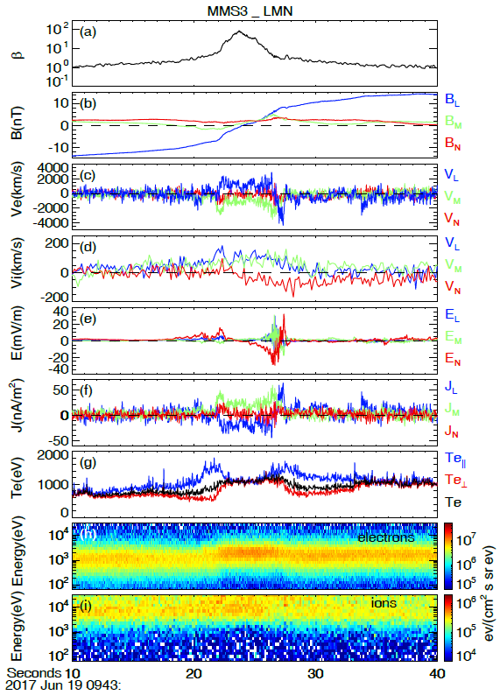
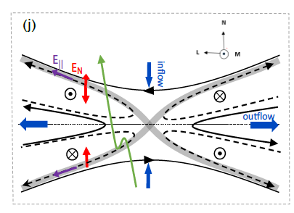
An Magnetotail Reconnection Event
Crossing the current sheet
The reversal of BL
The Ion/Electron flow ViL, VeL
Inflowing electrons----separatrix region (SR)
Separatrix region
Abnormal electric field
Electron temperature
Asymmetry between two sides of the current sheet.
The electron inflowing speed, the electric field intensity
Reasons: Spatial variation/Temporal evolution
The reconnection rate: Vin/Vout (~0.004 S, ~0.05 N)

Slide 4
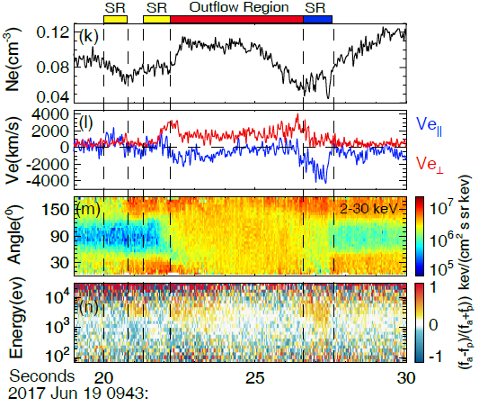
Energized Electrons in the SR
Separatrix region
Density cavity
Ve|| is large
electron field-aligned anisotropy: (fa-fp)/(fa+fp), where fa, fp are the energy fluxes antiparallel and parallel to B.
In both separatrix regions, the inflowing electrons were significantly accelerated to a few keV.

Slide 5
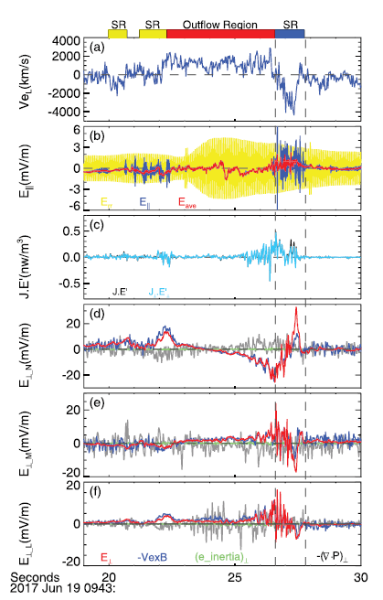
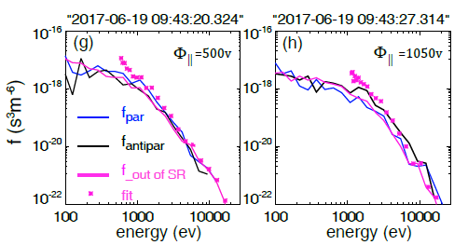
Electron Acceleration
Liouville’s theorem
Separatrix region
A net parallel electrostatic potential
An significant energy dissipation.
Non-ideal electric field
electron frozen-in condition was violated

Slide 6
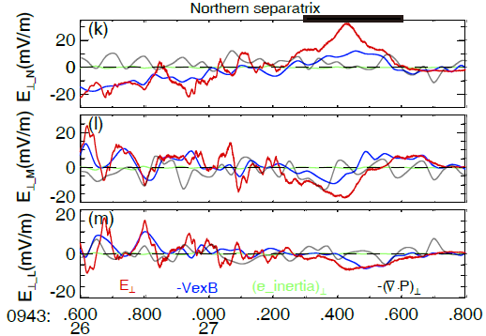
The Observation of Non-ideal electric field in NR
The generalized Ohm’s law:
$E+U×B=ηJ+\frac{J×B}{en}−\frac{∇⋅P_{e}}{en}−\frac{{{∇⋅(m}_{e}nu}_{e}u_{e})+∂m_{e}nu_{e}/∂t}{en}$ (1)
In the weakly collisional or collisionless plasma, non-ideal electric field Re contains resistivity, electron inertia and pressure.
${ R}_{e}≡E+U_{e}×B=ηJ−\frac{∇⋅P_{e}}{en}−\frac{{{∇⋅(m}_{e}nu}_{e}u_{e})+∂m_{e}nu_{e}/∂t}{en}$ (2)
The electron inertia term (green) was always close to zero.
The gradient of electron pressure tensor (gray) fluctuates largely.
39.4 km/s~2.5 de

Slide 7
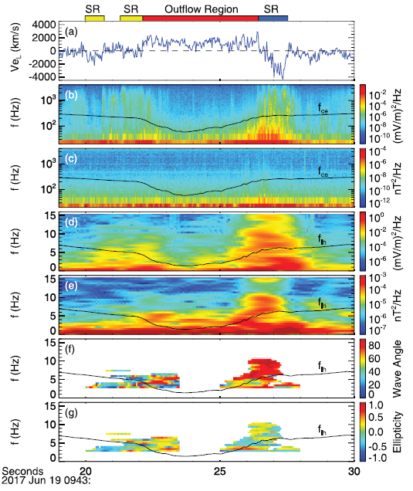
Wave analysis
SR
High frequency: Electrostatic waves
Low frequency: Lower hybrid drift wave
Near the low hybrid frequency
the wave normal angle was 90
the ellipticity was near zero
The anomalous resistivity term was less than 0.005mV/m
The non-ideal electric field was inferred to be caused by gradient of the electron pressure tensor.

Slide 8
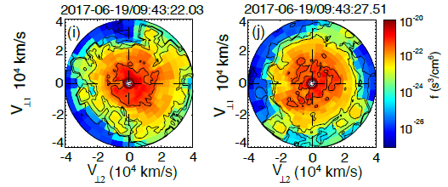
Non-gyrotropic distribution in SR
Southern SR
Northern SR
Non-gyrotropic distribution.
The observations indicate that the inner electron diffusion region can extend along the separatrices or some electron‐scale instability can be destabilized in the SR

Slide 9
Conclusion
Non-ideal electric field was observed in the separatrix region and inferred to be caused by gradient of the electron pressure tensor.
The non-gyrotropic electron distribution and substantial energy dissipation were observed in the separatrix region.
Asymmetry between two sides of the current sheet was observed in the symmetric reconnection.

Slide 10
Thank you for reading

