Slide 1
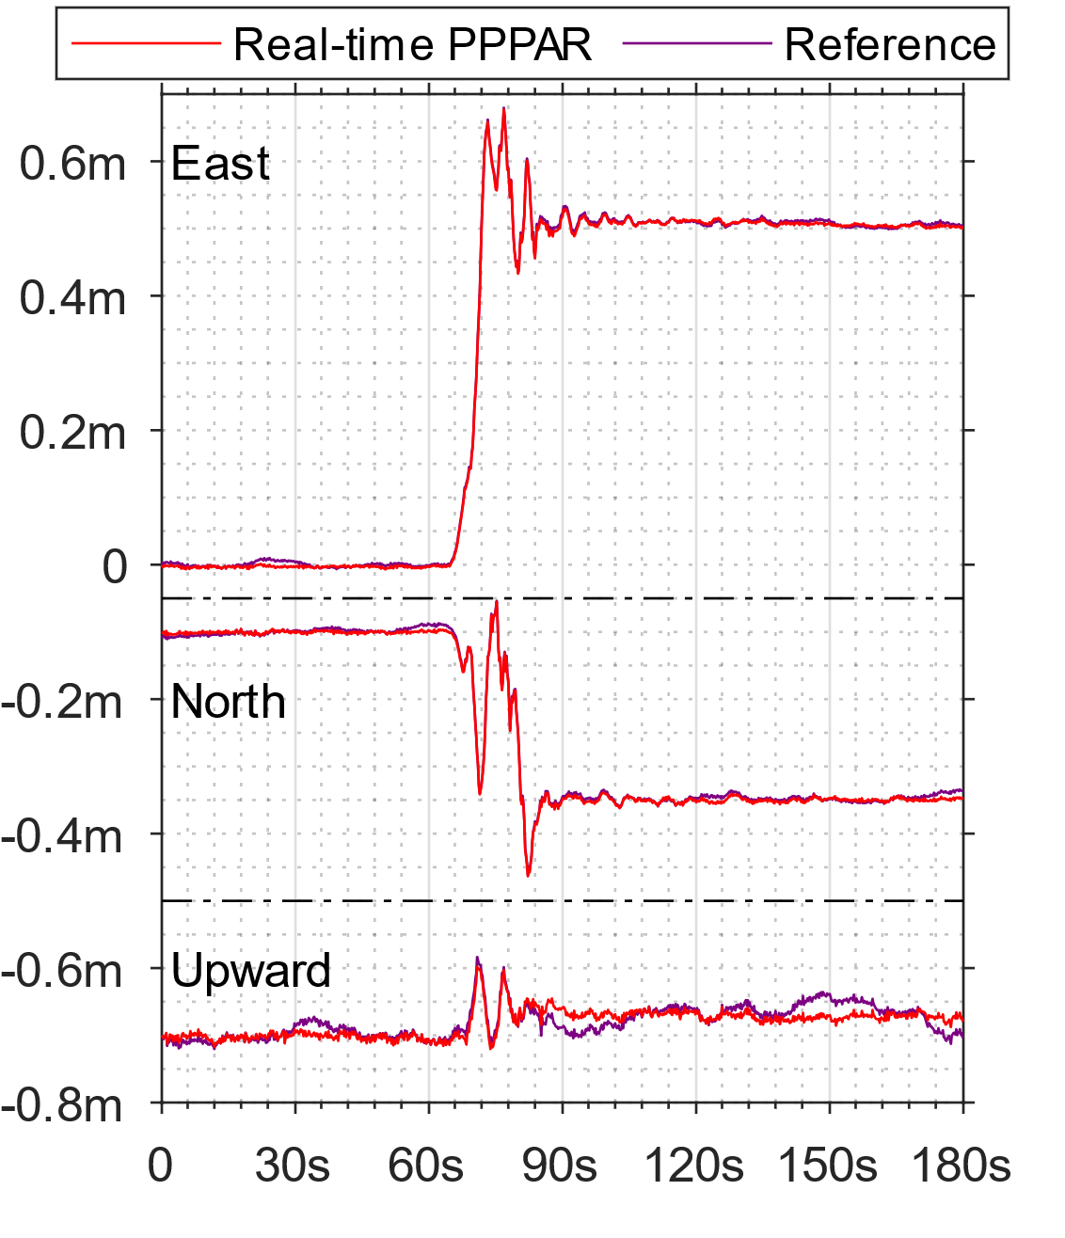
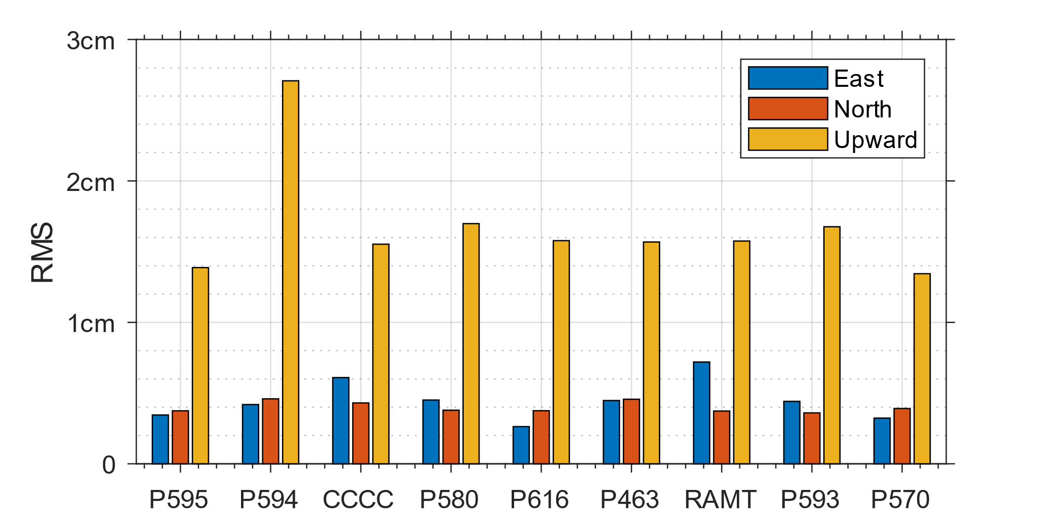
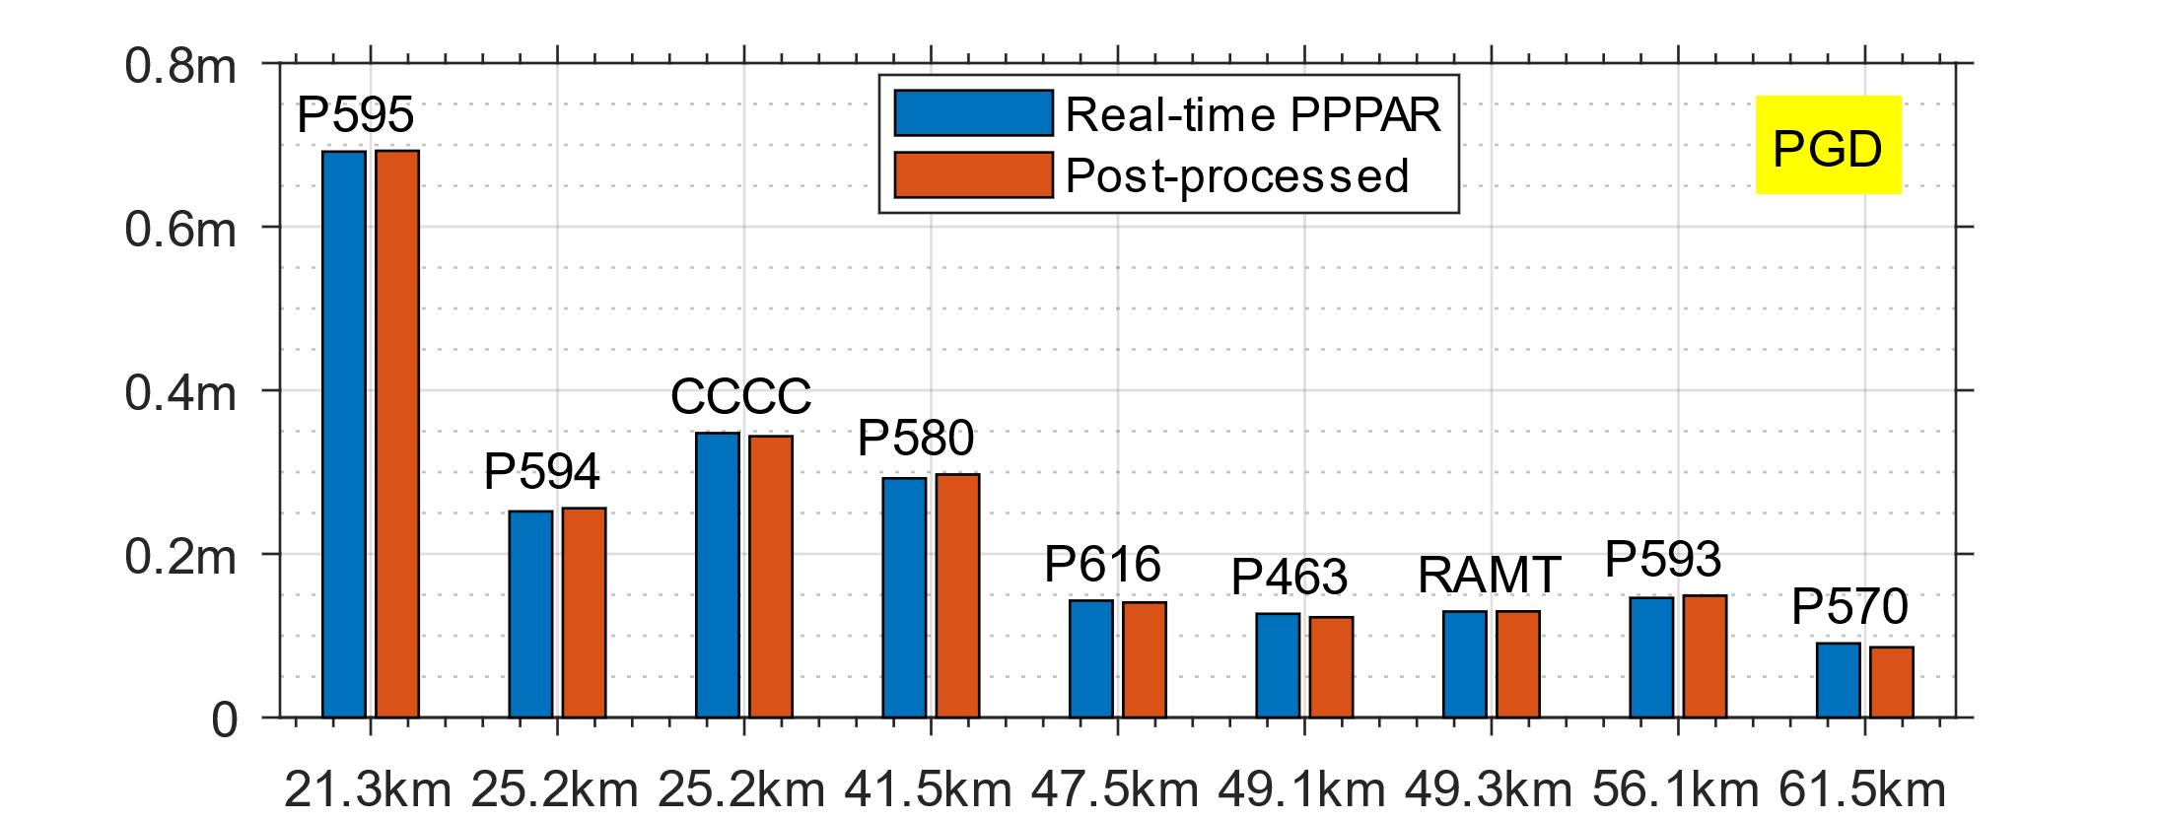
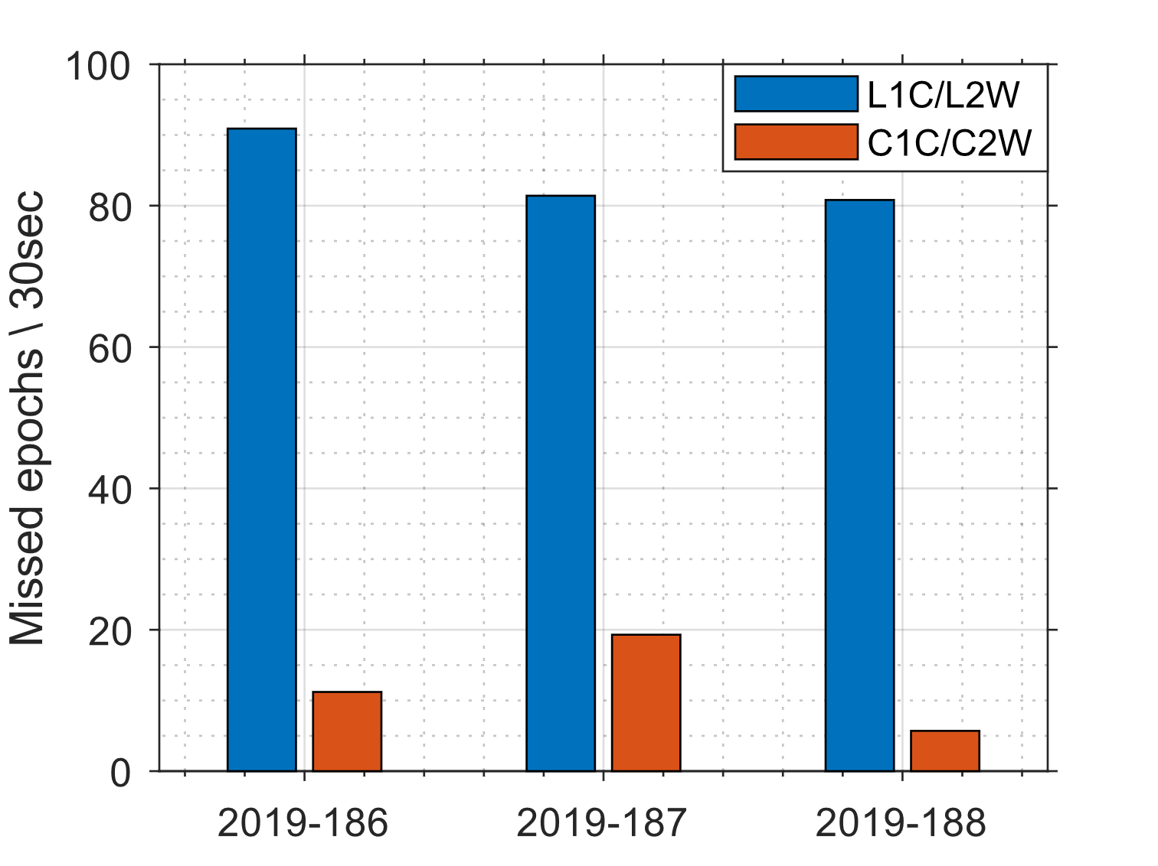
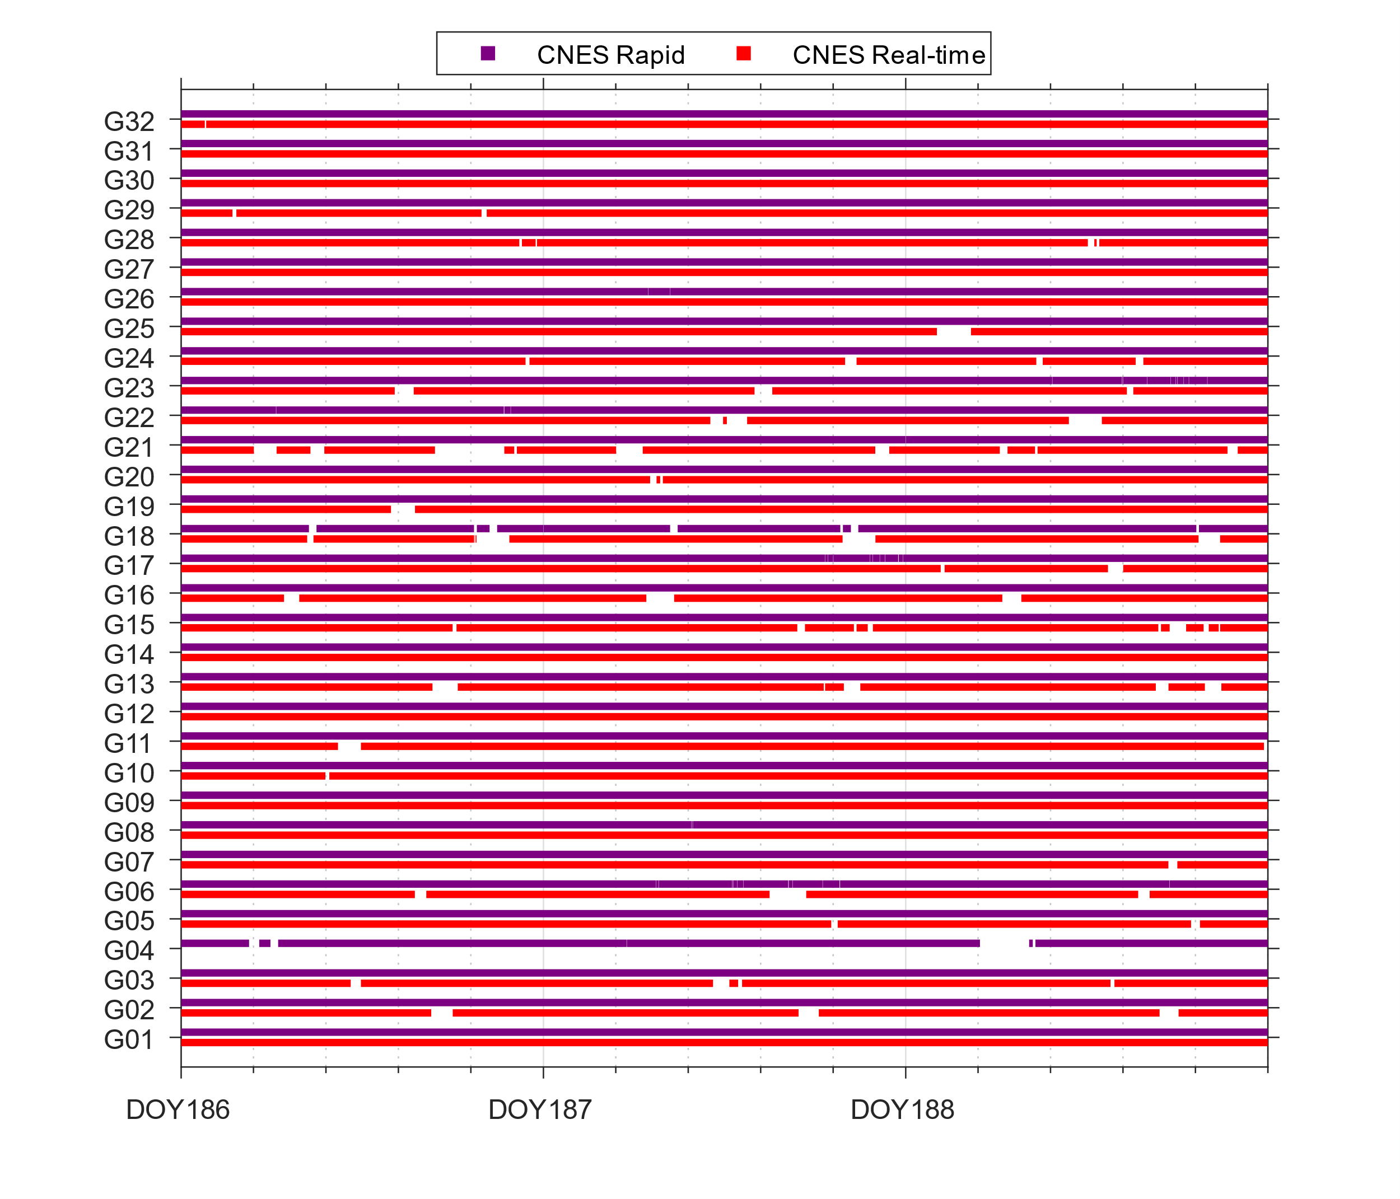
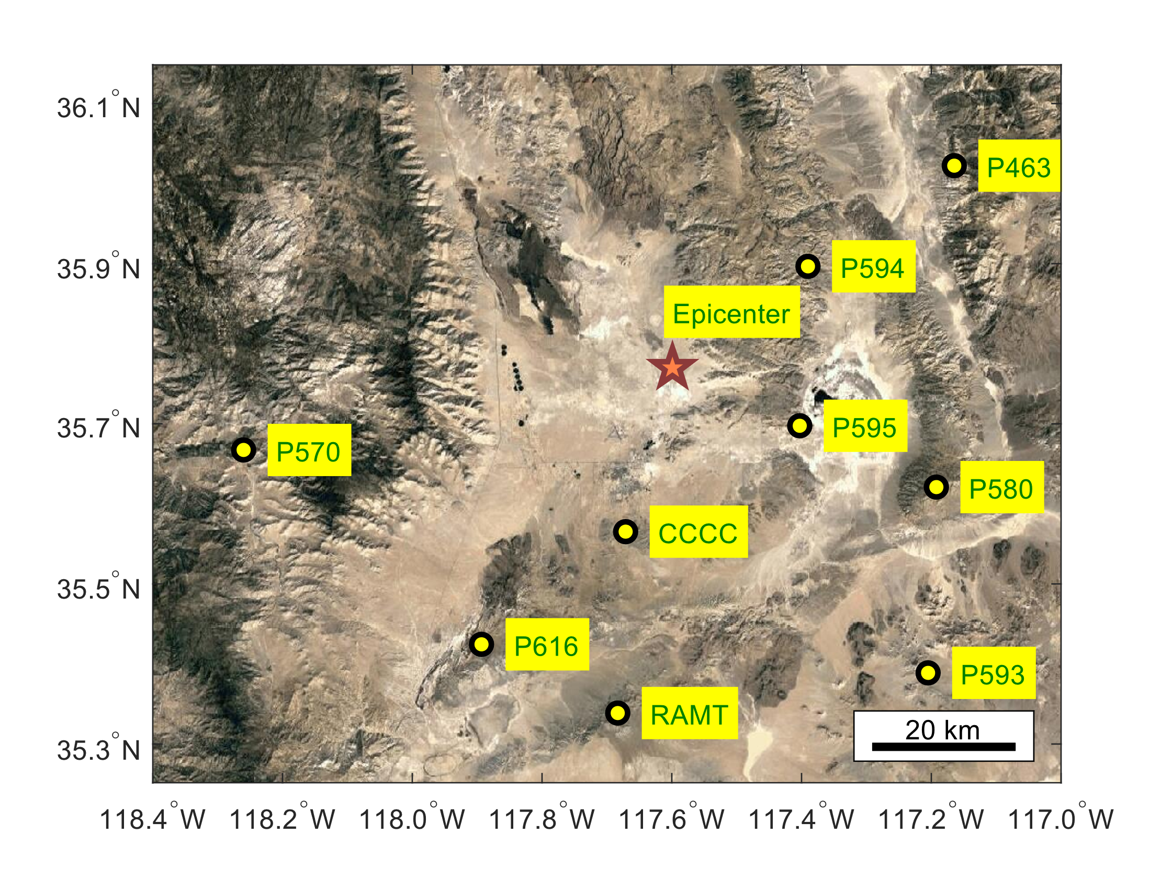
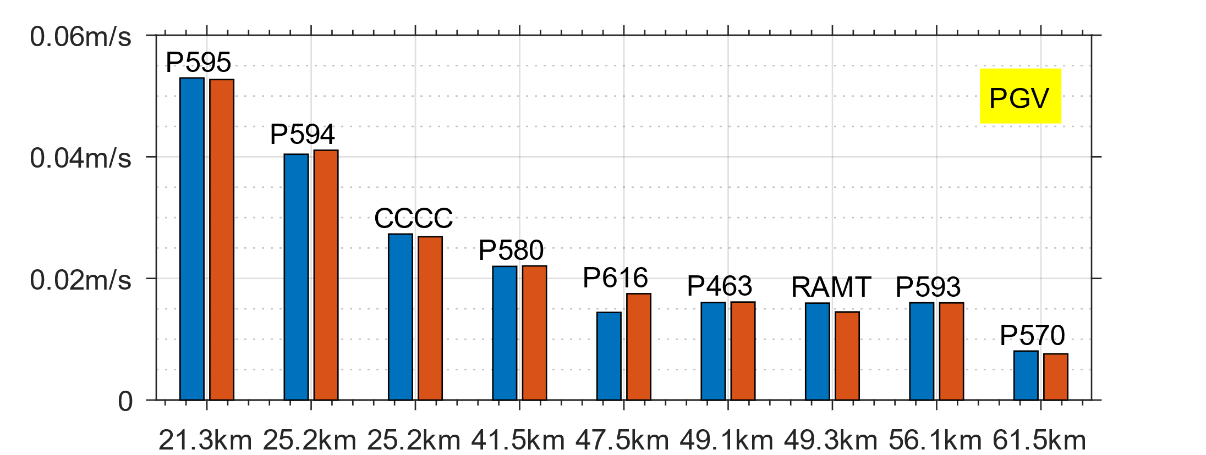
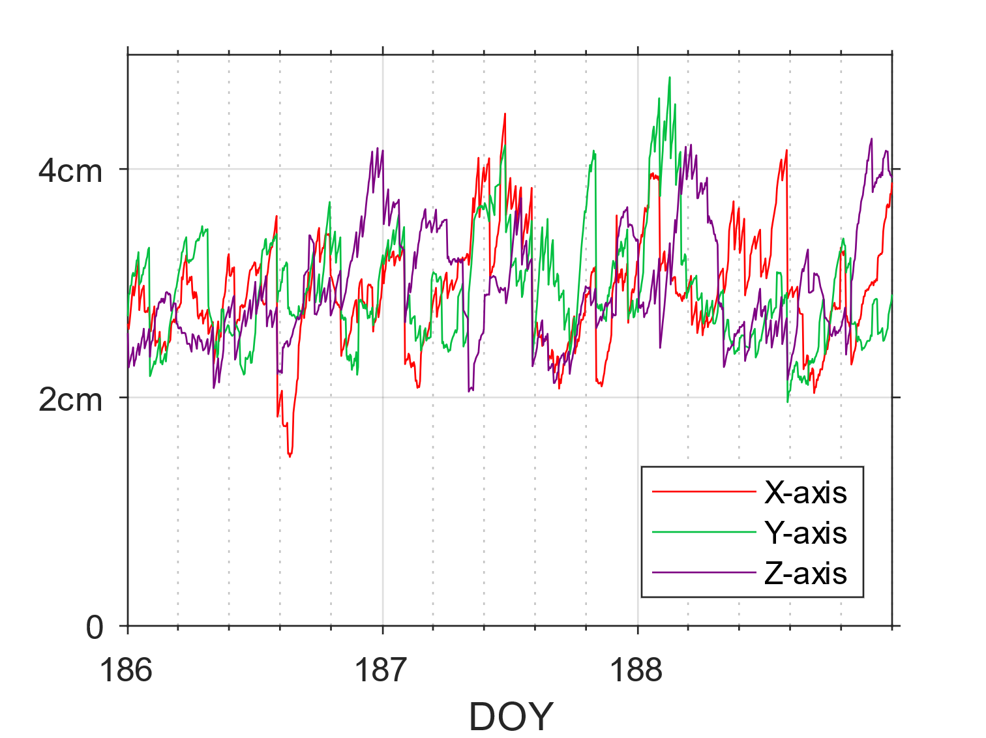
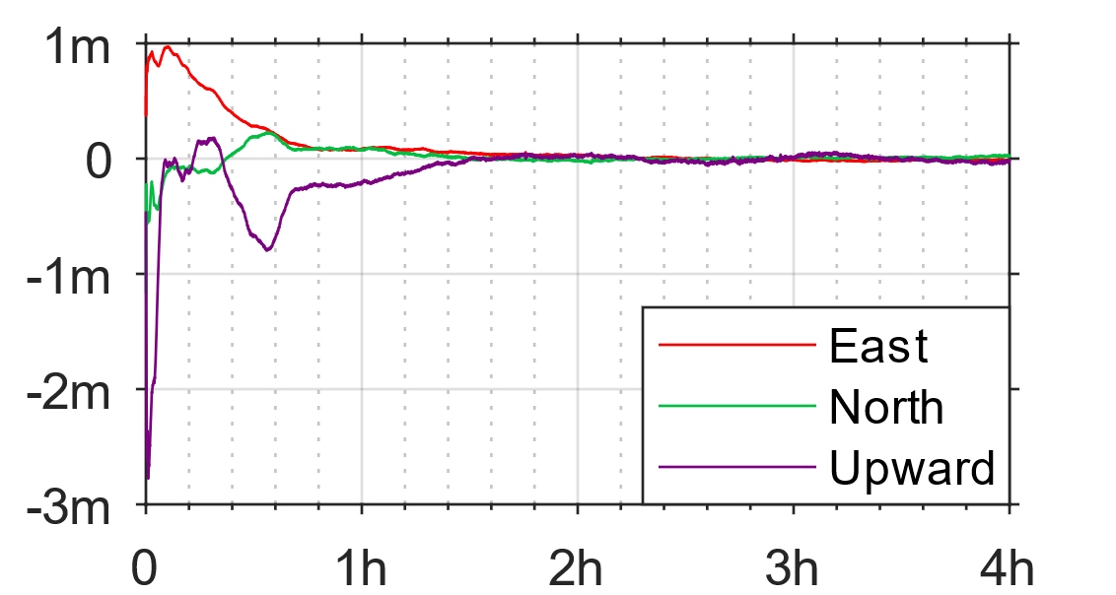
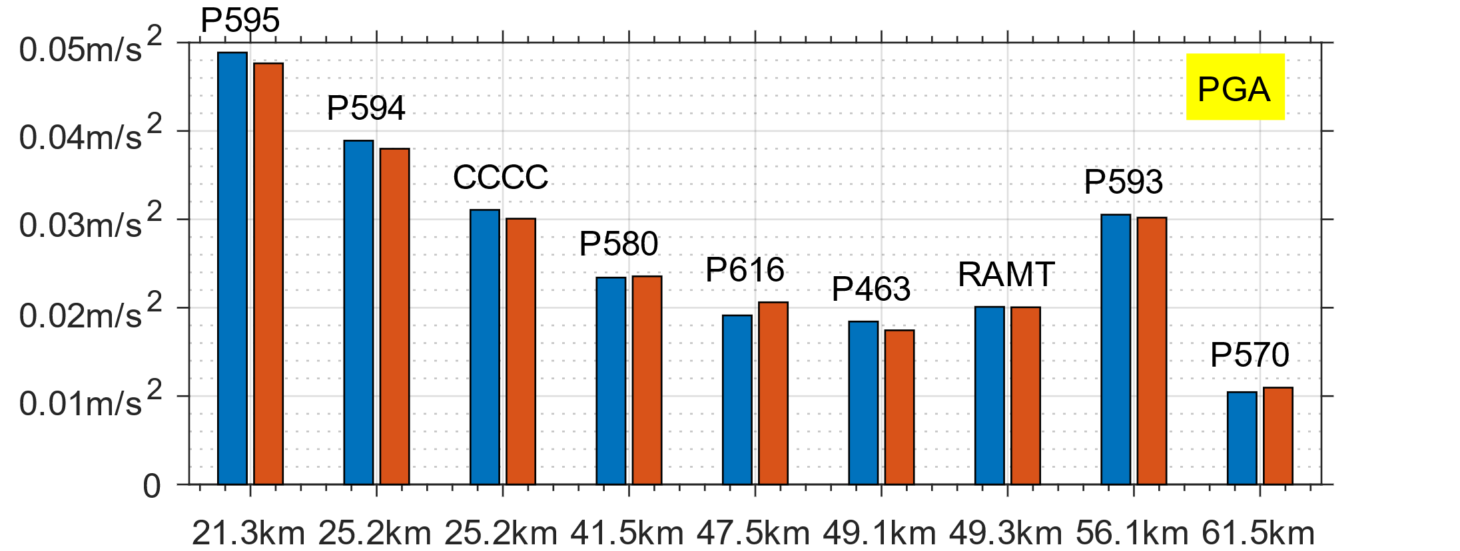
Real-time earthquake hazard assessment based on high-rate GNSS PPPAR
Yang Jiang, Yang Gao, and Michael G. Sideris
Department of Geomatics Engineering, Schulich School of Engineering, University of Calgary
Introduction
The Global Navigation Satellite Systems (GNSS) provide a powerful tool for earthquake hazard assessment, mitigation and response. Many GNSS positioning techniques have been developed, including processing data from GNSS networks at global, regional and local scales and from newly available multi-constellations. Precise point positioning (PPP) with ambiguity resolution (PPPAR) is a promising approach, which offers single-receiver based precise positioning capability at cm-level accuracy with the availability of precise GNSS correction products for satellite orbits, clocks and code/phase biases. Free access to real-time correction services such as the one from Centre National D’Etudes Spatiales (CNES), has enabled users to conduct PPPAR for earthquake hazard assessment by global users.
In this contribution, a new approach using PPPAR with the CNES correction product to process high-rate in-field GNSS measurements is proposed for real-time earthquake hazard assessment. A case study on the earthquake that occurred in Ridgecrest, California on July 6, 2019 is presented to analyze the performance of the proposed method by comparing the obtained waveforms to post-processing references from other studies. The results indicate that cm-level consistency has been obtained. The derived real-time displacements however are noisy due to the accuracy limitation of the CNES product. Overall, this research shows that high-rate GNSS data processing based on PPPAR and a freely accessible GNSS correction service like CNES’s can be utilized to support real-time seismic hazard assessment.
Results and Analysis: Seismic wave capturing
By implementing the real-time PPPAR method, the estimation on coseismal displacement for station P595 during the earthquake of Ridgecrest, California on July 6, 2019 is presented in Figure 5, which shows a significant seismic amplitude while real-time PPPAR remains consistent with the reference. Figure 6 depicts power spectral density (PSD) estimates of the seismic wave as evidence of frequency-domain accuracy, where the major difference is the low-frequency components of vertical direction. The error RMS values for the estimated displacement trajectories on all nearby GNSS monitoring stations are shown in Figure 7. In the horizontal directions of East and North, centimeter-level consistency is generally found between the real-time PPPAR solutions and the post-processed reference values. With an RMS error of at most 1-2 cm in the vertical direction and better than 1cm in the horizontal directions, the major components of the coseismal wave are well recovered. The locations of all GNSS sites are shown in Figure 8.
Methodology
In this study, a PPPAR epoch-by-epoch data processing approach has been developed which consists of three major steps.
Step 1: PPP ambiguity float positioning is conducted based on the following GNSS ionosphere-free (IF) pseudorange and carrier-phase observations
$$P_{r}^{s}=ρ+d_{orb}+c\left(t_{r}−t^{s}\right)+c(B_{r,IF}−B_{IF}^{s})+T_{r}^{s}+ε_{P}$$
$$Φ_{r}^{s}=ρ+d_{orb}+λ_{IF}\left(N_{IF}+b_{r,IF}−b_{IF}^{s}\right)+c\left(t_{r}−t^{s}\right)+T_{r}^{s}+ε_{Φ}$$
where $ε_{P}$ and $ε_{Φ}$ represent the measurement noises, $ρ$ is the satellite-to-receiver distance, $d_{orb}$ is the satellite orbital error, $T_{r}^{s}$ represents the tropospheric delay, $N_{IF}$represents the IF carrier-phase ambiguity, $λ_{IF}$ is the combined wavelength, $b_{r,IF}$ and $b_{IF}^{s}$ respectively represent the receiver’s and satellite’s phase bias, $B_{r,IF}$ and $B_{IF}^{s}$ is the code bias, $t_{r}$ and $t^{s}$ are the clock offsets of the receiver and satellite, respectively, and $c$ is the speed of light. To execute the float PPP, the CNES correction products for satellite orbit, clock and bias terms are applied, and the receiver position and clock offset, phase ambiguities and tropospheric delay are estimated.
Step 2: Ambiguity resolution of between-satellite single-difference ambiguities based on the float PPP solutions from Step 1.
Step 3: Ambiguity-resolved PPP is conducted based on GNSS IF pseudorange and carrier-phase observations in which the resolved between-satellite single-difference ambiguity terms from Step 2 are applied as constraints.
Figure 6: PSD estimates of the seismic wave and comparison between real-time PPPAR and post-processed solutions
Figure 5: Estimated three-dimensional seismic waveform displacement time series
Figure 7: RMS errors of three-dimensional seismic waveform displacement
Results and Analysis: GNSS correction product quality analysis
To verify the capability of the CNES correction product in providing consistent positioning functionality for seismic applications, the accessibility of the code/phase biases and accuracy of orbital correction are studied. Its regular positioning performance is provided hereafter.
The consistency of GNSS bias corrections during the seismic sequence period are examined in Figure 1. Data gaps of short duration affect the PPPAR performance by reducing the number of available GNSS observations. Statistically, the unavailability is 2.9% for phase bias and 0.4% for code bias.
Results and Analysis: Hazard assessment
After capturing the coseismal displacements, the hazard can be assessed to reveal the properties of the seismic wave. Specifically, the three-dimensional peak ground displacements (PGD), velocities (PGV) and accelerations (PGA) for nine nearby stations are estimated and the results are given in Figure 9 (the distances between sites and the epicenter are shown). Compared to the post-processed results, PGD estimates are consistent with a standard deviation of 0.34cm, where PGV and PGA are 0.12cm/s and 0.09cm/s2, respectively. In summery, the real-time PPPAR implementation can precisely identify the major properties of the seismic wave to be further studied by geo-science research.
Figure 1: Average occurrence count of missing GPS satellites in CNES bias product
Figure 2: Real-time CNES phase product availability time series for GPS L1C/L2W
Figure 3: Time series of root-mean-square (RMS) values of orbital correction errors
Figure 4: Real-time PPP time series with CNES product of P595 starting at DOY 186.00, 2019
Figure 8: Distribution of GNSS sites and the Epicenter
Conclusions
A real-time earthquake hazard assessment approach based on PPPAR with the CNES correction service is proposed and evaluated.
A case study based on the earthquake in Ridgecrest, California on July 6, 2019 is presented. Results indicate that 1-centimeter level consistency of displacement estimates can be obtained during the earthquake period.
The real-time PPPAR technique is able to provide seismic displacements with cm-level accuracy, enabling high quality hazard assessments in real-time.
To explore the phase bias product which is a major concern, Figure 2 shows the real-time availability of the phase bias corrections for different GPS satellites compared to the CNES rapid product. The outage of the phase bias corrections is at hour-level for half of the satellites except for G04 for which no phase bias correction is available due to an unknown cause.
Using the final product from the Center for Orbit Determination in Europe (CODE) as the reference, the accuracy of the real-time CNES orbital correction is assessed. Figure 3 shows the RMS values of the satellite orbital corrections in different axis components (X-axis, Y-axis and Z-axis) with an average value of 5.11 cm.
The position errors and convergence performance of the implemented PPPAR at a static site is given in Figure 4. As is revealed, the non-seismic GPS-only performance of PPP with the CNES correction product can reach 1.5cm and 2cm accuracy in the horizontal and vertical directions, respectively, within 2 hours of convergence time.
Figure 9: Estimates of PGD, PGV and PGA at the studied GNSS sites

