Slide 1
Mineral reservoirs and behaviors of hydrogen in Earth’s lower mantle
北京高压科学研究中心 （HPSTAR）
Center for High Pressure Science and Technology Advanced Research
Tsingtao quarantine lodging · 2020 EGU – May 4th, 2020
Speaker: Qingyang Hu

Slide 2
Collaborators
HPSTAR Ho-kwang Mao, Jin Liu, Duckyoung Kim, Yu He, Yukai, Zhuang, Mingqiang Hou, Li Zhang, Wenge Yang, Bingmin Yan, Ruilian Tang,.
Florida International Univ. Jiuhua Chen
Stanford University Wendy L. Mao, Chenxu Wang, Feng Ke
GL, Carnegie Institution Yanhao Lin, Michael Walter
University of Nevada Qiang Zhu (Computation)
University of Cambridge Chris J. Pickard, Richard J. Need (Computation)
Sun Yat-Sen University Shengcai Zhu (Computation)
Shenzhen University Liwei Deng (EC)
University of Hawaii Dongzhou Zhang
GSECARS, APS Eran Greenburg, Vitali B. Prakapenka
HPCAT, APS Yue Meng, Yuming Xiao, Paul Chow
SSRF, China Lili Zhang, Ke Yang

Slide 3
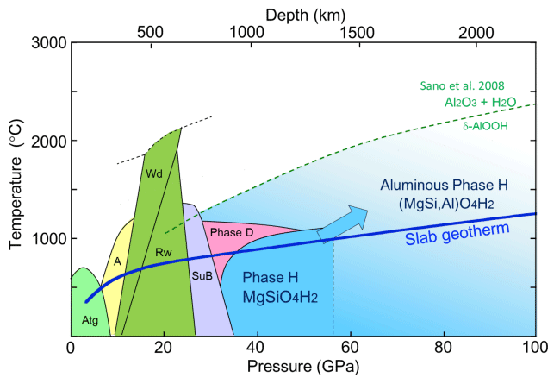
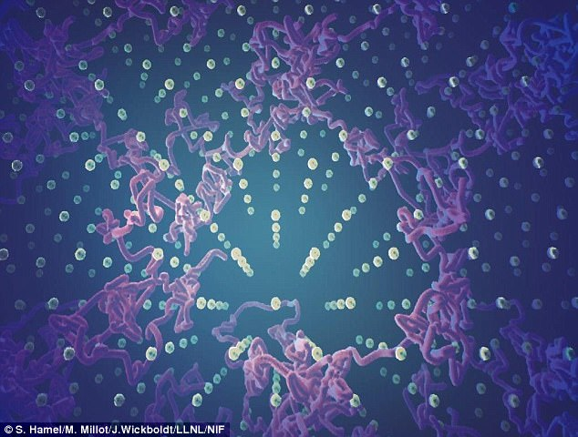
Water in Earth’s deep mantle
Thermal stability
dense hydrous phase
evolution of O-H bonding
highly stable hydrous phases that survives the P-T conditions of mantle geotherm
Hydrous phases that survive mantle geotherm?
Figure Credit: Nishi, M, 2014.
H in hydrous minerals
mobility and diffusion behaviors of H
seismic and conductivity features
Superionic H in ice. How about dense hydrous phase?
Figure Credit: Millot, M., LLNL, 2019

Slide 4
01
Superhydrous SiO₂
stable along the lower mantle geotherm
wt.% level of water
Lin et al., PNAS, 2020
Results
02
Superionic FeO₂Hx
O-H hydroxyl bonds break
H freely moves in the FeO₂ lattice
He et al., arXiv.1810.08766, 2018

Slide 5
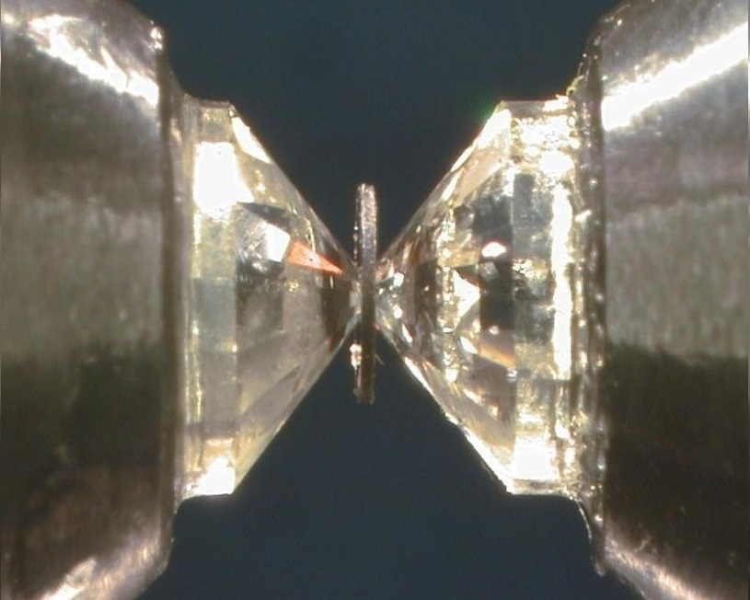
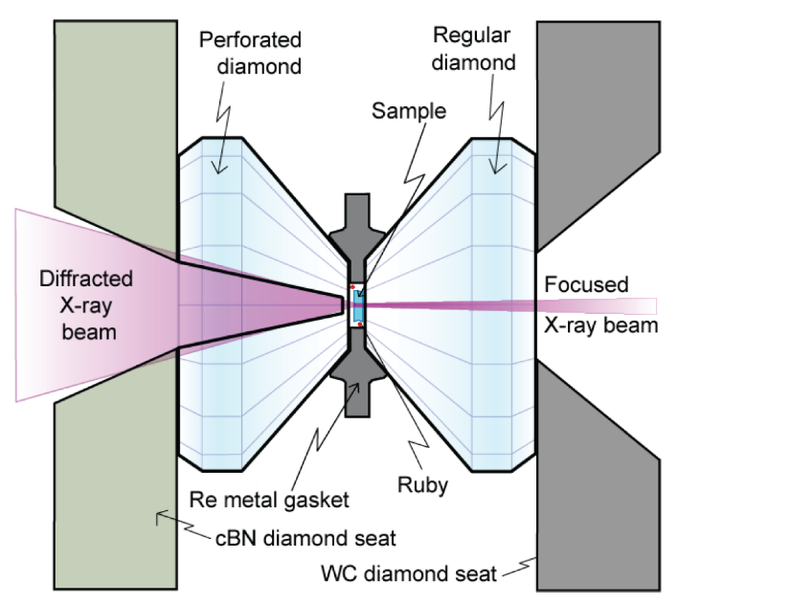
Diamond anvil cell
Why we have to use (DAC)?
Wide P-T range: 140 GPa, 3000 K.
Closed system: fully controllable
Small sample vs. nano probes
Drawbacks:
Rely on synchrotron x-ray.
Prone to contamination: reproducibility.
Strategy:
Pure sample, minimal composition.
Saturated condition: fast equilibrium.
Specialized high-pressure x-ray probes.

Slide 6
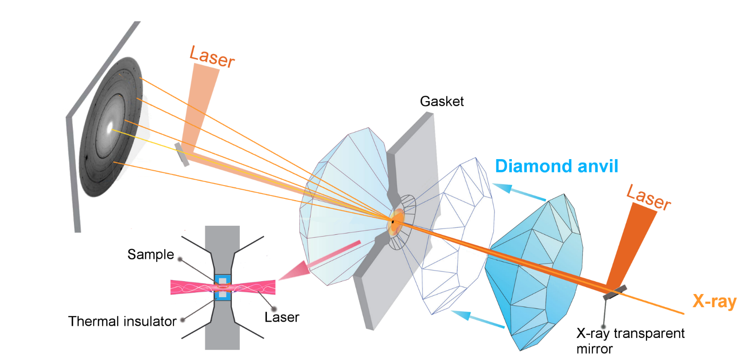
DAC + Laser heating
Sample assembly
SiO₂ + H₂O (saturated water)
Silicic acid (1-5 wt.% water)

Slide 7
Superhydrous SiO₂
Stishovite SiO₂ holds wt.% level of H₂O
Hydrous phase is stable at 30 GPa, ~1775 K and 54 GPa, ~1835 K.

Slide 8
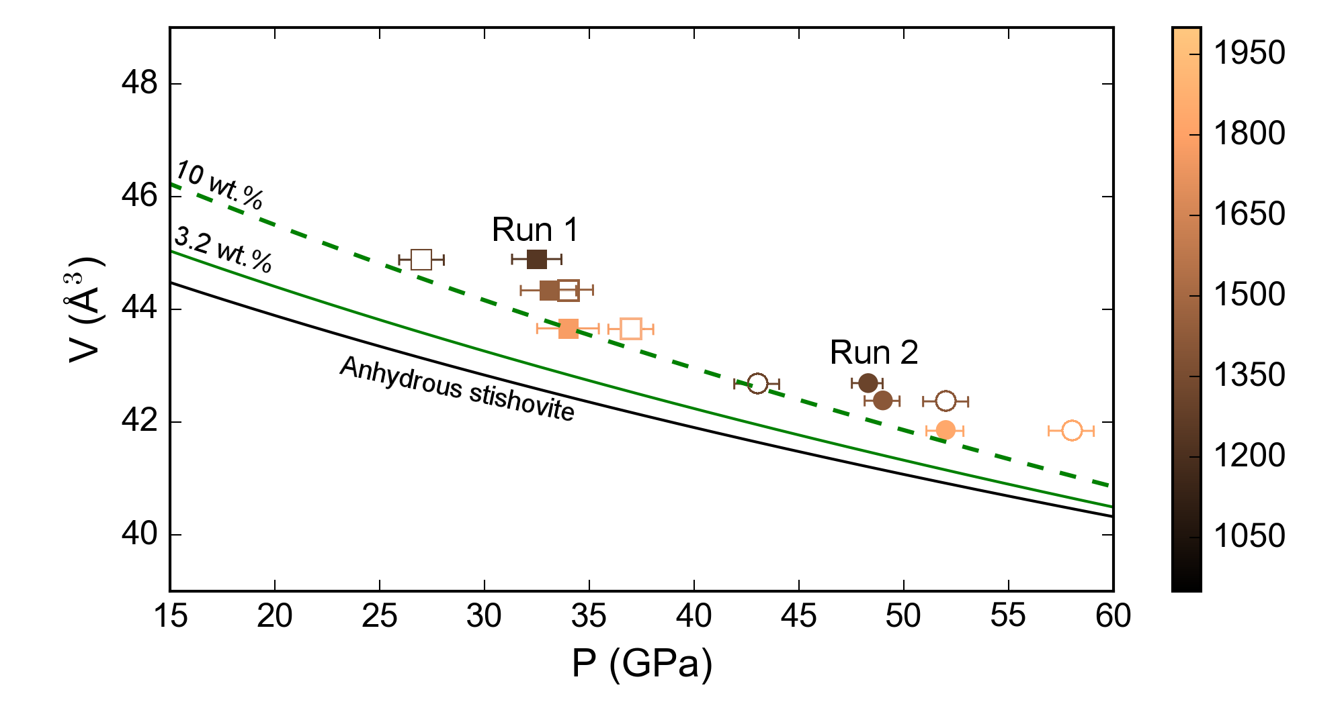
Volumes of superhydrous stishovite
2.4-5.0 % higher volume than dry SiO₂
Volume higher than the EOS of hydrous SiO₂ (3.3 wt.% of water, by Nisr. AM, 2018)
Curve of 10 wt. % water is propagated by volume.
Large uncertainty exists because the initial water amount is 5 wt.% at most.

Slide 9
Calibrating water
 | T (K) | P (GPa) | ΔV (%) | water wt.% by Nisr 2017* | water wt.% by H₂O**
Run 1
LH05 | 1240 | 32.5 | 5.0 | 6.2 | 1.5
LH08 | 1450 | 33.1 | 3.8 | 4.9 | 1.1
LH10 | 1775 | 34.0 | 2.4 | 3.3 | 0.73
Run 2
LH13 | 1310 | 48.3 | 3.6 | 4.6 | 1.1
LH15 | 1410 | 49.0 | 3.2 | 3.9 | 0.89
LH18 | 1835 | 52.0 | 3.0 | 3.3 | 0.71
*The V-water content relations by SIMS and TPS may fail at high pressure. error is ± 0.5 wt.%.
**water wt.% assume the expanded volume is contributed by Ice VII, following the equation:
SiO₂ + H₂O = SiO₂·xH₂O
we estimate 10% error.

Slide 10
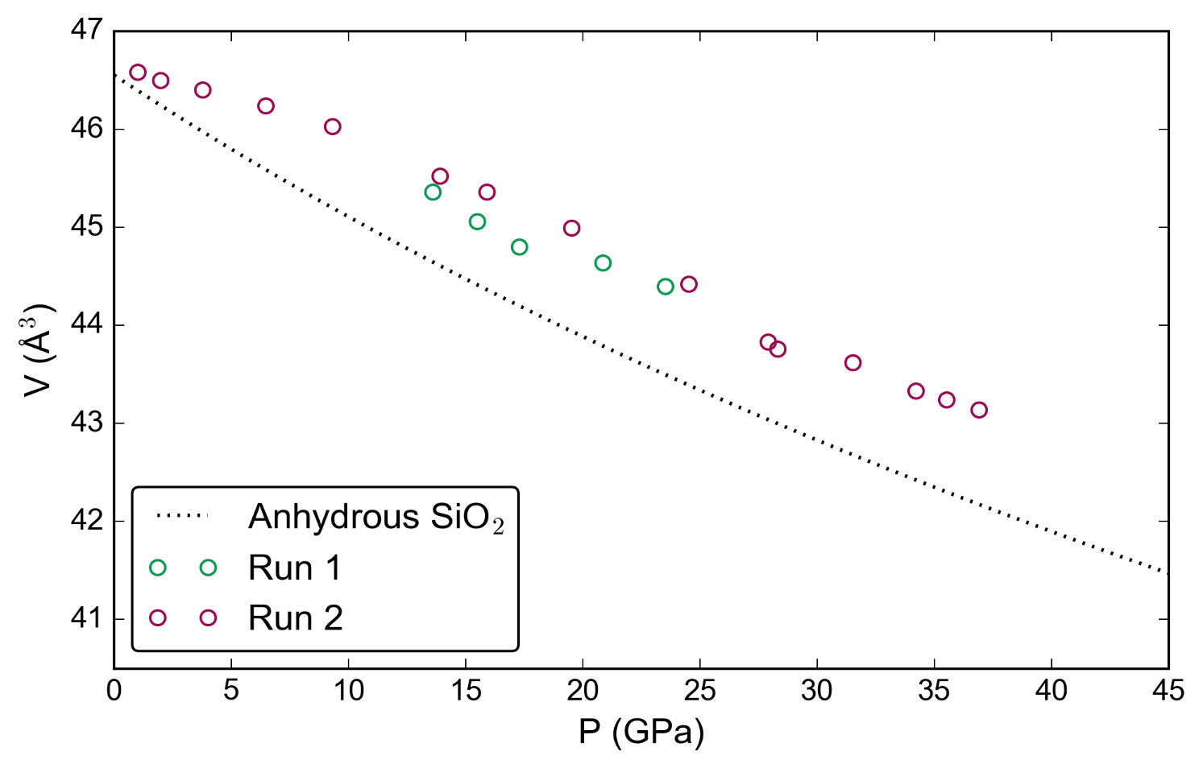
Dehydration upon decreasing pressure
Stishovite SiO₂ loses a significant amount of water during decompression.
Literature show large water solubility variations in synthesized samples (ppm level to 3%). Possible reasons are P, T, grain size (Litasov, 2007) and decompression rate (this work).

Slide 11
Water wt.% level in mantle minerals
References:
Wad.: Smyth, 1987; Inoue 1995
Rw.: Kohlstedt, 1996;
Kudoh, 2000; Fei, 2017
Brg: Kaminsky, 2012
Al-Brg: Kakizawam, JGU meeting 2019
Fp: Bolfan-Casanova 2002, 2003, 2006,
Litasov 2010
St: Litasov 2007, Spektor 2016
Minimum water wt. %
Maximum water wt. %
Our experiment suggests wt.% level of water under high pressure.

Slide 12
SiO₂ is capable of carrying wt.% level of water into the lower mantle.

Slide 13
Superionic FeO₂Hx
Ionic conduction by mobile proton
Superionic phase at 70-130 GPa, >1600-1800 K

Slide 14
Crystal structure search: Py-type FeO₂H_{0.75} is a stable phase.
The free energy pathway from FeO₂ to FeO₂H is shallow.
The O-H bonding is predicted to be softened upon heating.

Slide 15
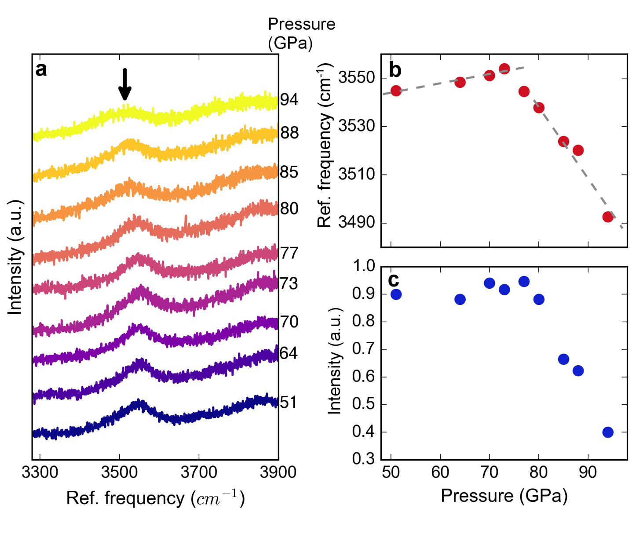
Raman spectroscopy:
Sample is synthesized at 94 GPa.
Collect Raman while we decompress sample at room temperature
O-H bonding is softened at high pressure.

Slide 16
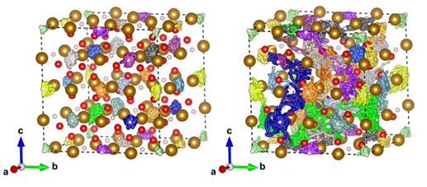
First-principles MD simulation:
Ordered crystal: all atoms are constrained in local vibration.
Superionic phase: H atoms behaves like fluid, FeO₂ lattice sustained in ordered crystal.
Mean squared displacement (MSD) of H skyrockets.

Slide 17
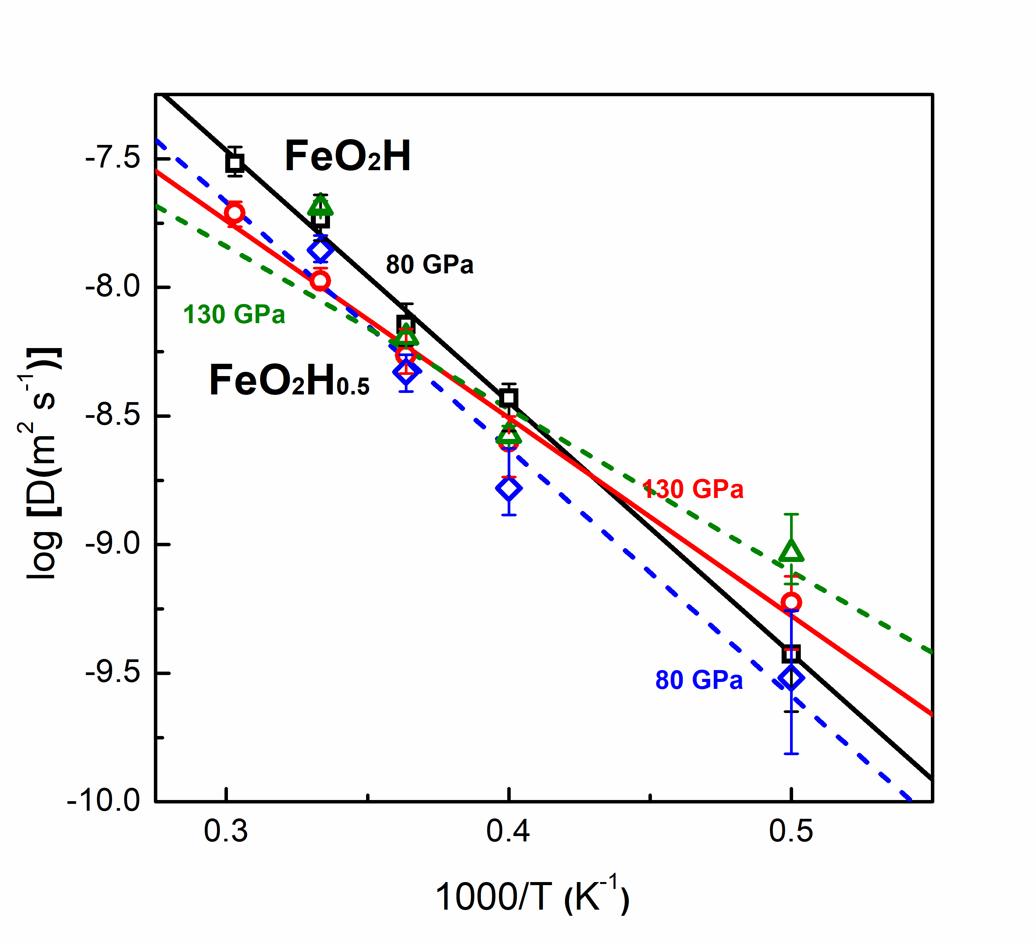
Ionic conductivity by Nernst-Einstein equation.
Very sensitive to temperature.
Mass transportation
Known to underestimate conductivity (Millot, Nat. Phys. 2018).

Slide 18
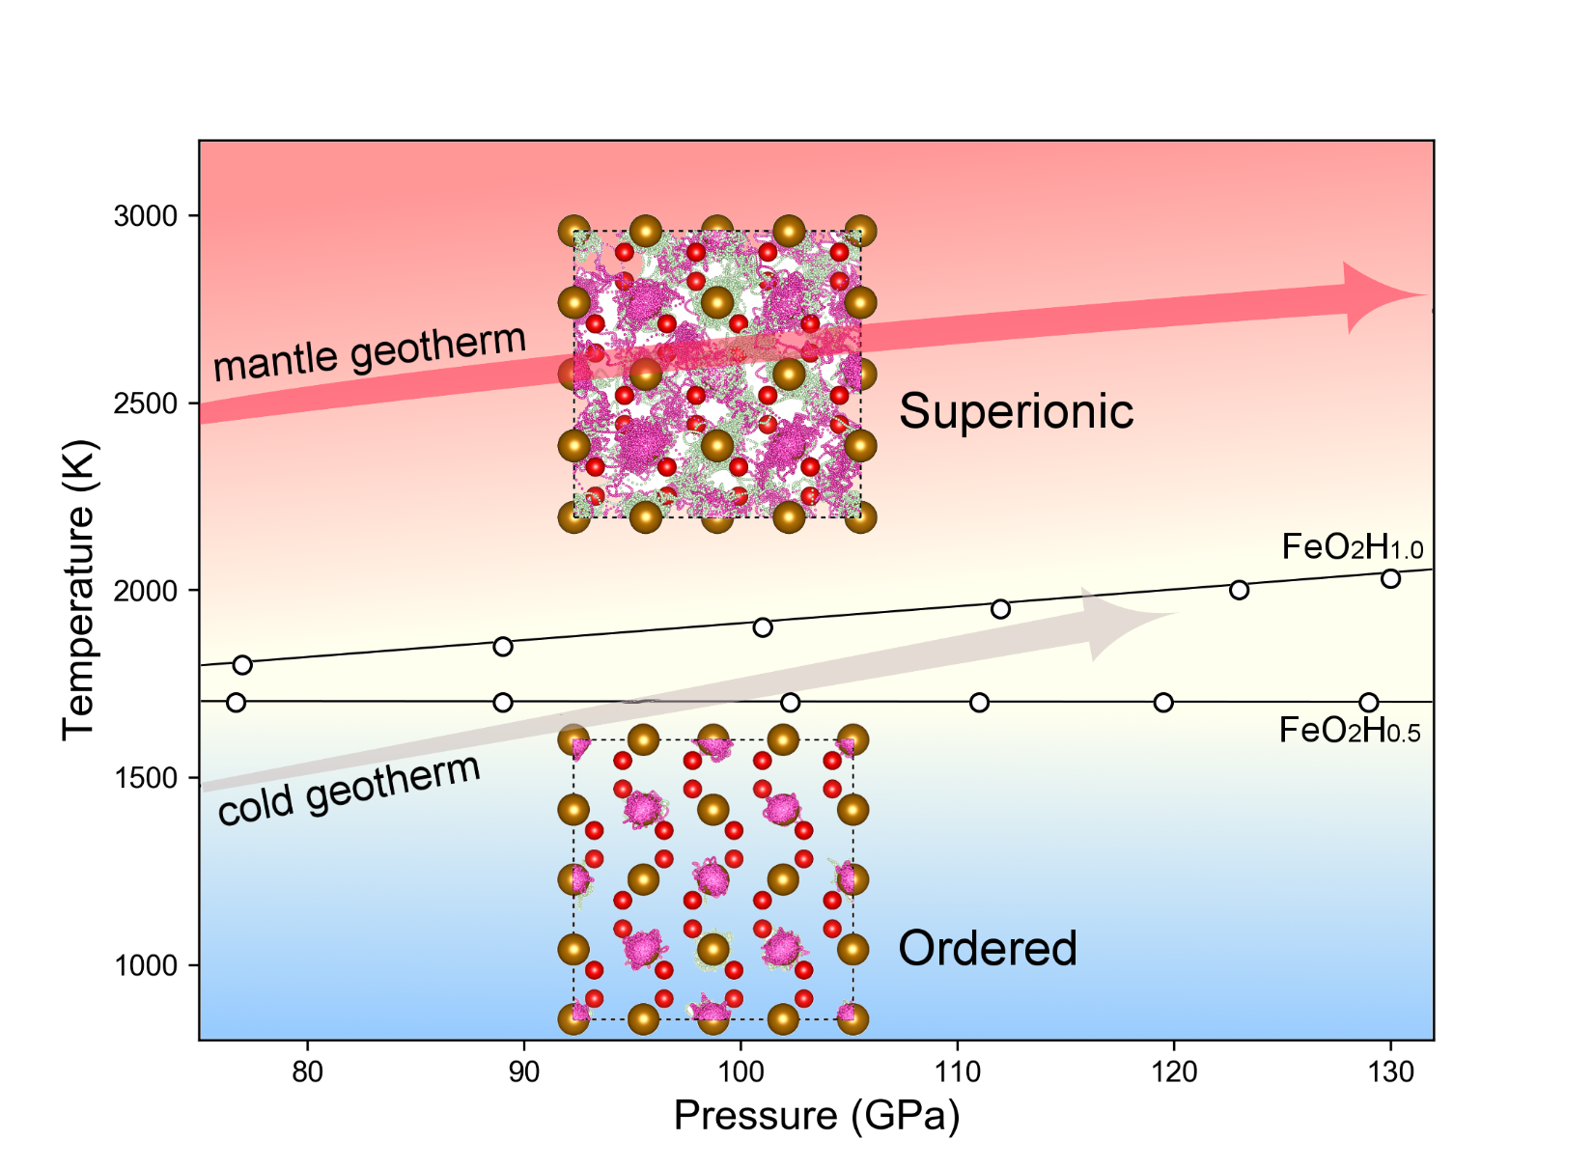
Cover the P-T condictiones of geotherms in the lower mantle.
Electrical conductivity and mass transport rate are higher than expected in localized regions.

Slide 19
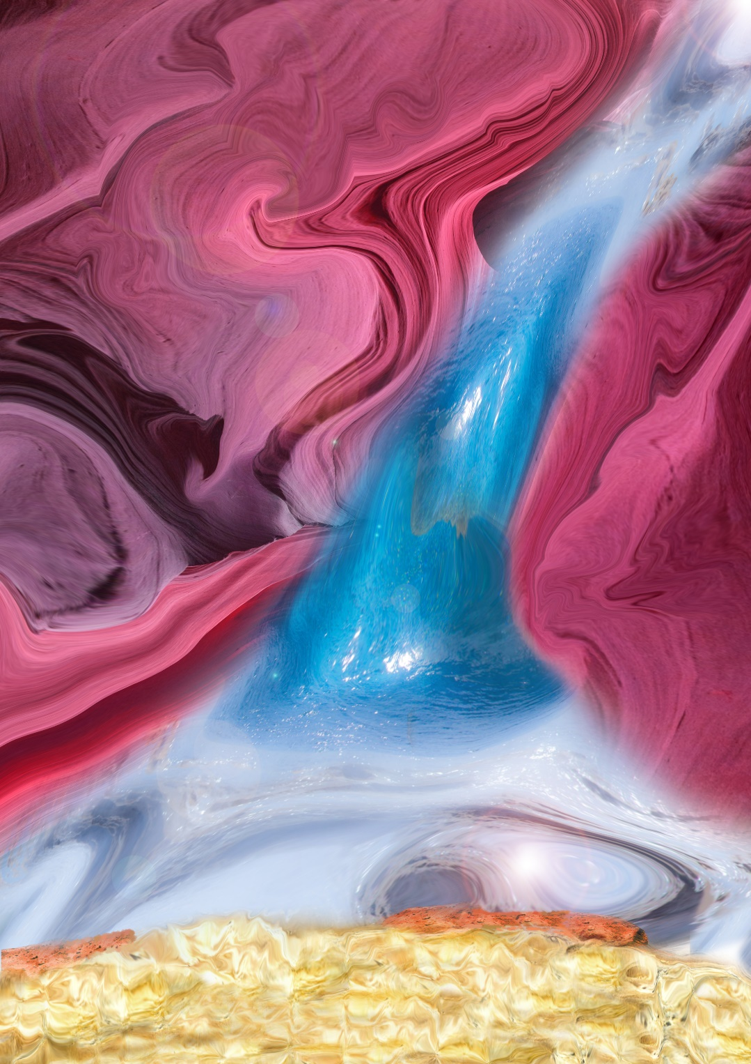
Take home messages
Water solubility in stishovite becomes increasingly higher with pressure
Hydroxyl bonding in some dense hydrous phase may become unstable, which creates a superionic phase.

