Slide 1
The behavior of gravity wave during the unusual QBO structure in 2015/2016
Haiyan Li^{1, 2} and Qingxiang Li^{1, 2}
¹School of Atmospheric Sciences and Guangdong Province Key Laboratory for Climate Change and Natural Disasters, SUN Yat-Sen University, Zhuhai, China
²Southern Laboratory of Ocean Science and Engineering (Zhuhai), Zhuhai, China

Slide 2
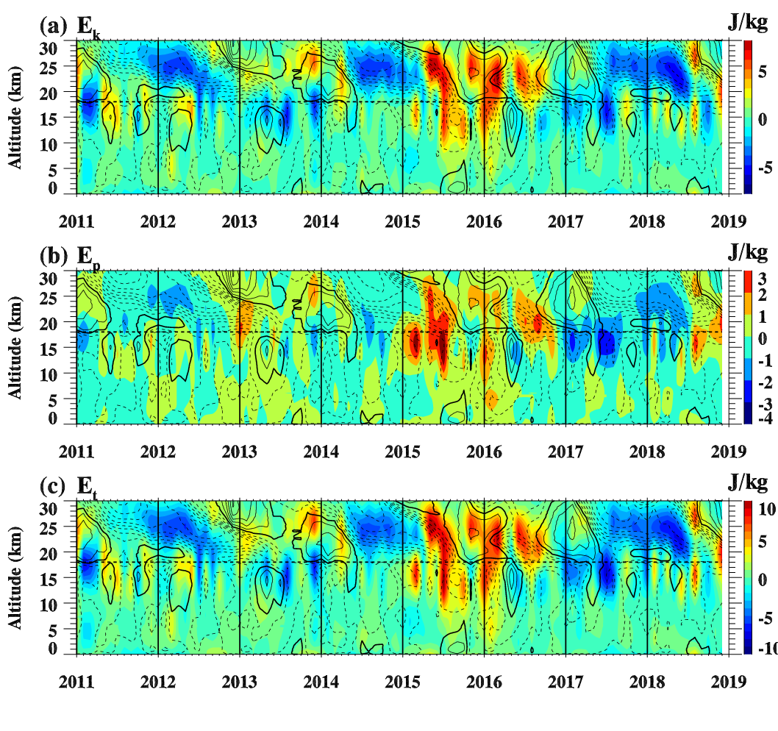
Data: U.S. Radiosonde data (2011-2018)
Method: abroad spectral Method
Results: The gravity wave energy densities significant enhanced during the periods of easterly phase turns to westerly phase, before westerly zonal wind interrupted and before westerly zonal wind recovery in stratosphere during 2015-2016.
The deviations of kinetic, potential and total energy densities from the monthly climatology.

Slide 3
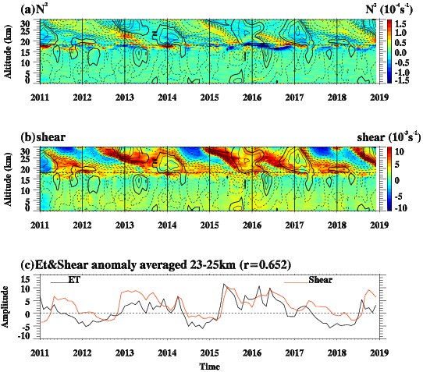
The enhanced gravity wave is corresponding to weak tropospheric convection in 2015/2016.
The stratospheric shear instability has high relationship with the gravity wave energy density in stratosphere.

Slide 4
Conclusions:
The gravity wave was significant enhanced during 2015-2016 period.
The enhanced gravity wave come from the tropospheric convection and stratospheric shear instability.

