Slide 1

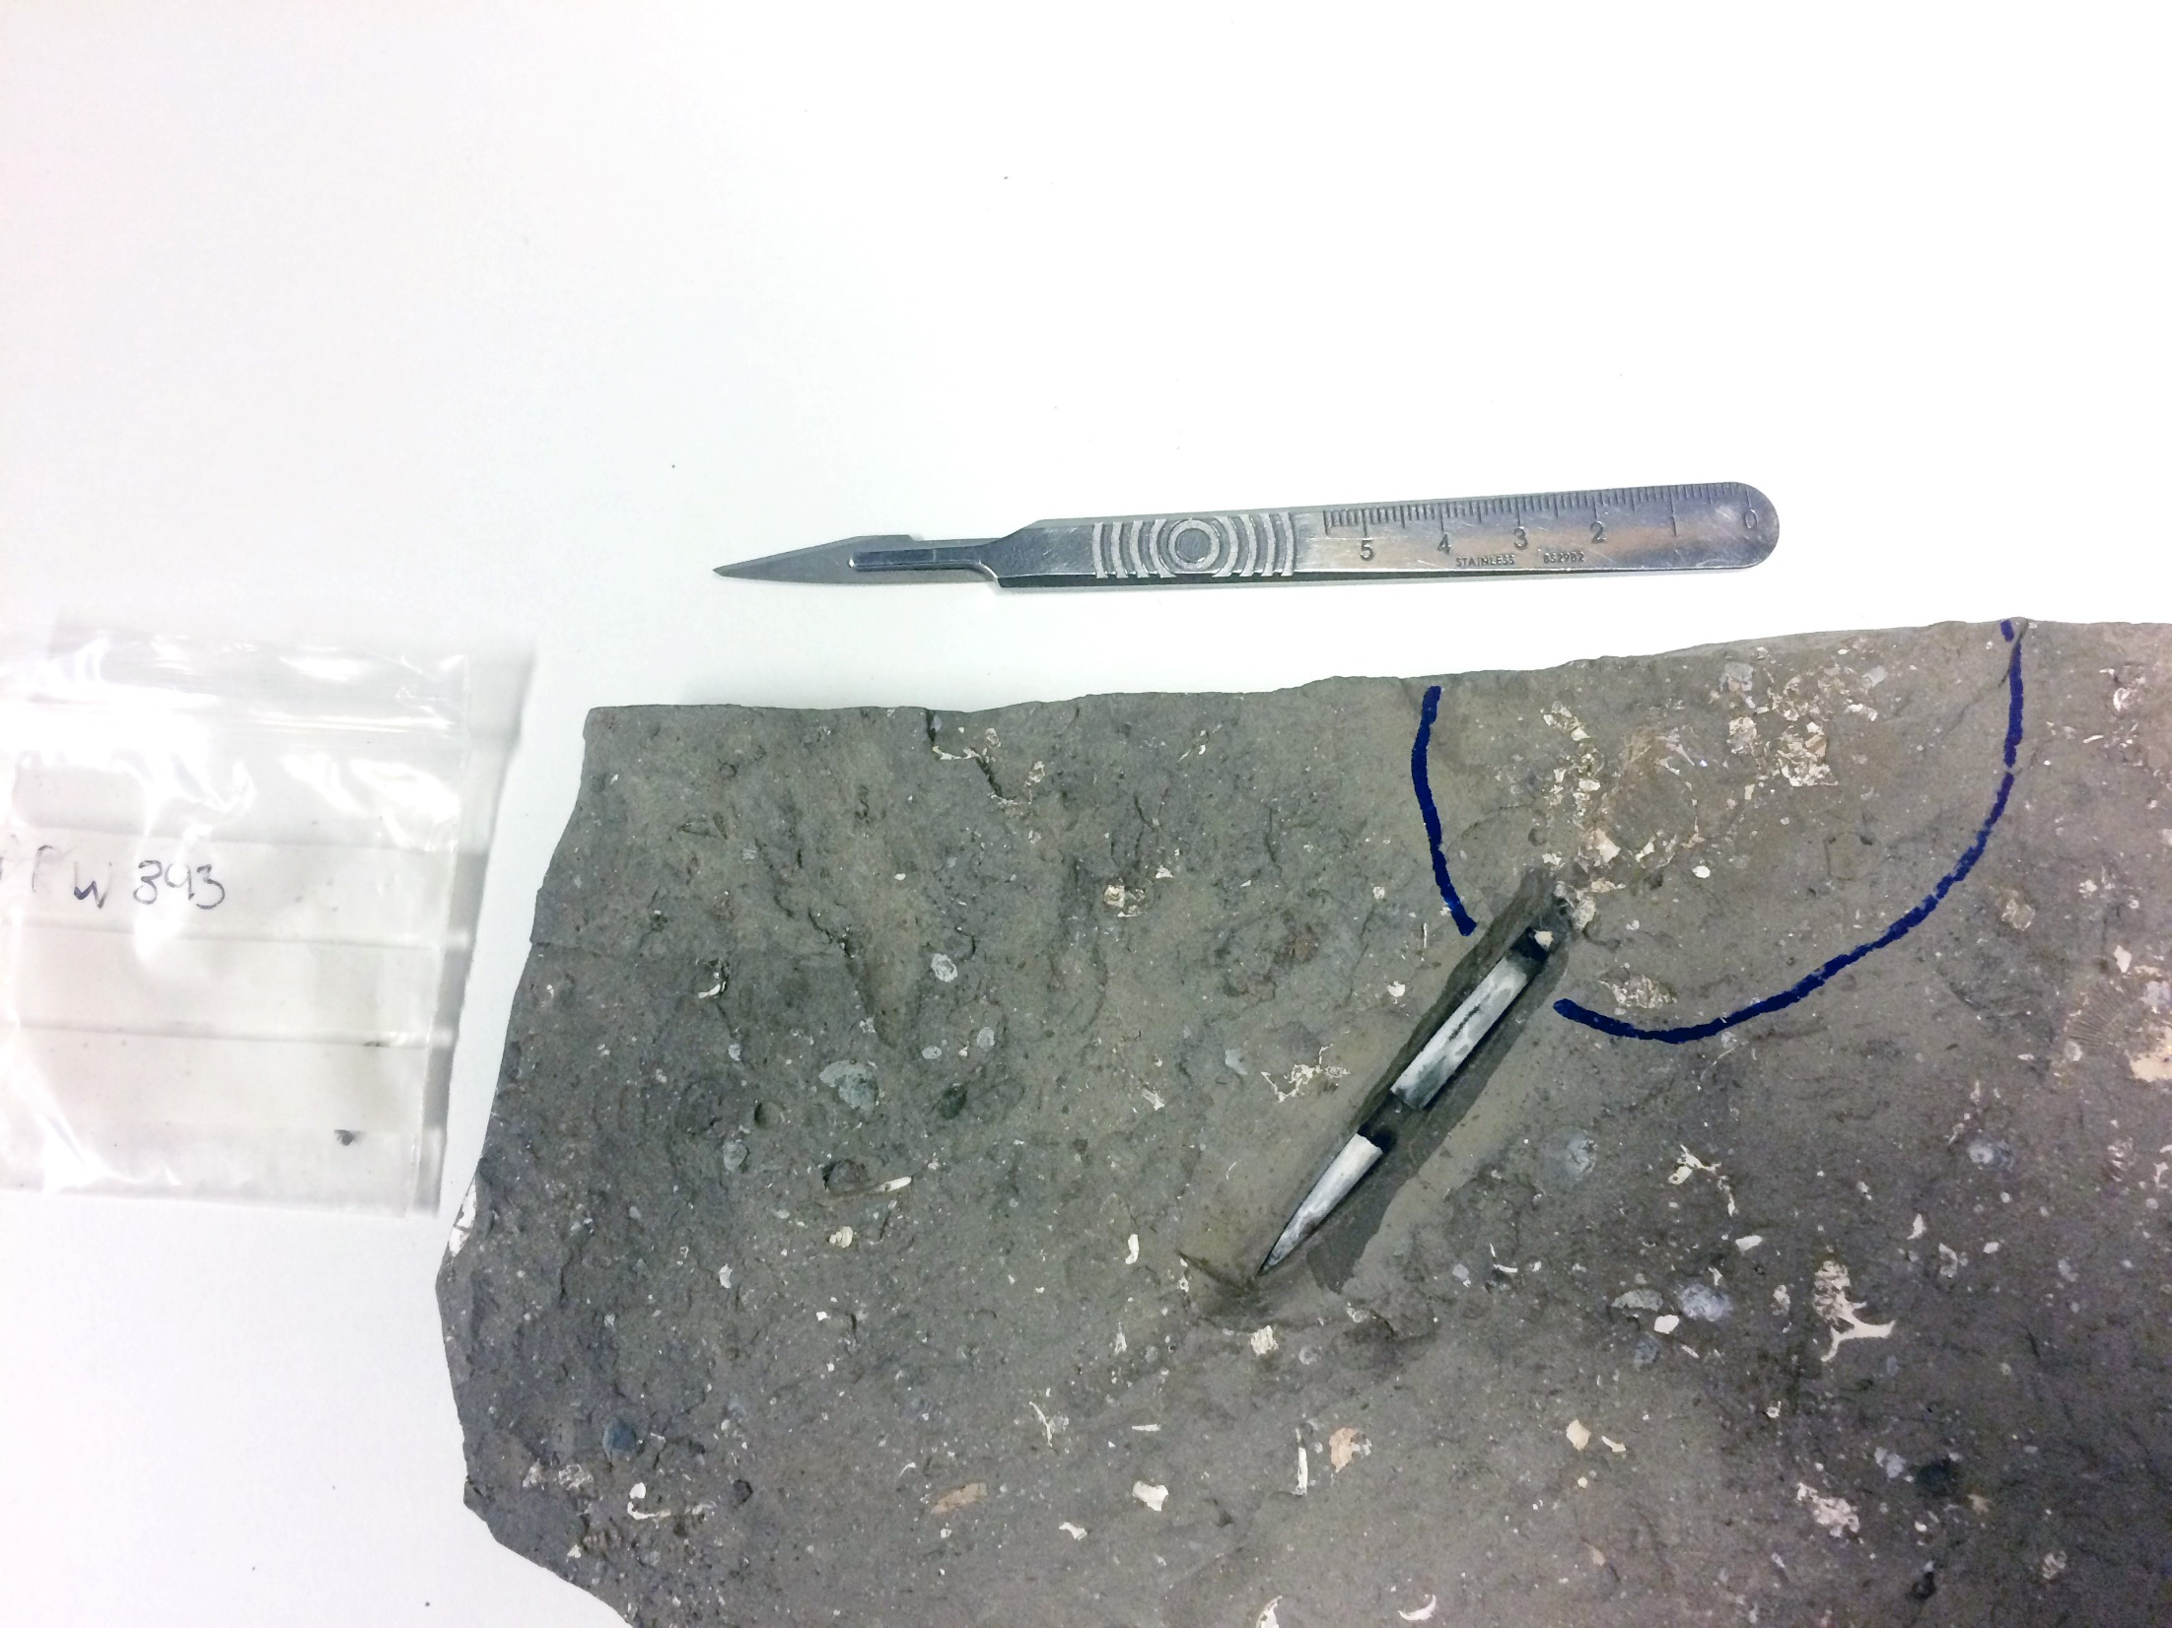

Belemnites, clumped isotopes and oxygen fractionation
Madeleine L. Vickers, Stefano M. Bernasconi, Clemens V. Ullmann, Stephen P. Hesselbo, Gregory D. Price, Christoph Korte

Slide 2
All samples are derived from the Middle Jurassic Peterborough Member of the Oxford Clay Formation, outcropping at Christian Malford.
Preservation exceptional: immature sedimentary organic material with T_{max} values of 411 °C and HI 694 mg HC/g TOC (Glass et al., 2012).
All samples are from the Callovian Athleta Zone (Phaeinum subzone).
All belemnites analysed are from the genus Cylindroteuthis.
Original aragonitic belemnite phragmocones preserved.
Ammonite (Kosmoceras) and bivalve (Mesosacella) aragonite present too.
© authors. All rights reserved

Slide 3
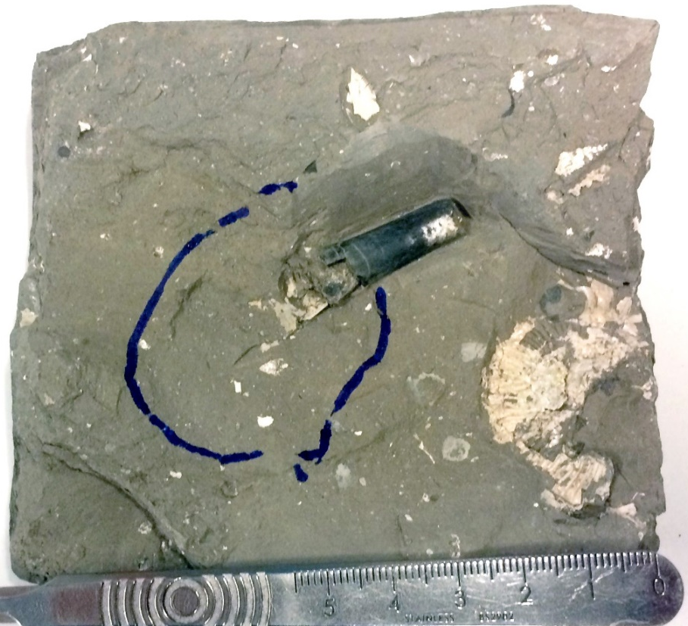
Clumped isotope temperature reconstructions
Belemnite rostrum-phragmocone pairs give clumped isotope temperatures within error of each other (one exception, PRW393).
PRW 720
phragmocone
rostrum
ammonite
© authors. All rights reserved

Slide 4
Stable isotopes
Rostrum calcite has higher δ¹³C and δ¹⁸O than phragmocone aragonite exception: PRW 393 (also anomalous T)
Rostrum calcite has much smaller spread for both δ¹³C and δ¹⁸O than aragonite (phragmocone and non-belemnite aragonite).
Rostrum calcite generally higher δ¹⁸O than phragmocone and other aragonite
Rostrum calcite higher δ¹³C than phragmocone, though within range similar range to other aragonite.
© authors. All rights reserved

Slide 5
Reconstructed δ¹⁸O_{sw}
Kim and O’Neil (1997) calcite thermometry equation returns more positive δ¹⁸O_{sw} than the aragonite equations give for the same belemnite.
Our data therefore suggests that the fractionation factor for oxygen isotopes in belemnite calcite from seawater is closer to that of slow-growing abiogenic calcites (e.g. Kele et al., 2015; Daëron et al., 2019) than rapidly-grown synthetic calcite (e.g. Kim and O’Neil, 1997) or other biogenic calcites (e.g. Craig, 1965; Brand et al., 2013).
© authors. All rights reserved

Slide 6
References
Brand, U., Azmy, K., Bitner, M., Logan, A., Zuschin, M., Came, R., Ruggiero, E., 2013. Oxygen isotopes and MgCO3 in brachiopod calcite and a new paleotemperature equation. Chemical Geology 359, 23-31.
Craig, H., 1965, The measurement of oxygen isotope palaeotemperatures, in Tongiorgi, E., ed., Stable isotopes in oceanographic studies and palaeotemperatures: Pisa, Italy, Consiglio Nazionale delle Richerche, Laboratorio di Geologia Nucleare, 161-182.
Daëron, M., Drysdale, R.N., Peral, M., Huyghe, D., Blamart, D., Coplen, T.B., Lartaud, F. and Zanchetta, G., 2019. Most Earth-surface calcites precipitate out of isotopic equilibrium. Nature Communications, 10, 1-7.
Glass, K., Ito, S., Wilby, P.R., Sota, T., Nakamura, A., Bowers, C.R., Vinther, J., Dutta, S., Summons, R., Briggs, D.E.G., Wakamatsu, K., Simon, J.D., 2012. Direct chemical evidence for eumelanin pigment from the Jurassic period. Proceedings of the National Academy of Sciences 109, 10218–10223.
Grossmann, E.L. and Ku, T.L., 1986. Stable oxygen and carbon isotope fractionation in biogenic aragonite: temperature effect. Chemical Geology, 59, 59-74.
Kele, S., Breitenbach, S.F., Capezzuoli, E., Meckler, A.N., Ziegler, M., Millan, I.M., Kluge, T., Deák, J., Hanselmann, K., John, C.M., 2015. Temperature dependence of oxygen-and clumped isotope fractionation in carbonates: a study of travertines and tufas in the 6–95 C temperature range. Geochimica et Cosmochimica Acta 168, 172-192.
Kim, S.-T., O'Neil, J.R., 1997. Equilibrium and nonequilibrium oxygen isotope effects in synthetic carbonates. Geochimica et Cosmochimica Acta 61, 3461-3475.
White, R.M.P., Dennis, P.F. and Atkinson, T.C., 1999. Experimental calibration and field investigation of the oxygen isotopic fractionation between biogenic aragonite and water. Rapid Communications in Mass Spectrometry, 13, 1242-1247.

