Slide 1
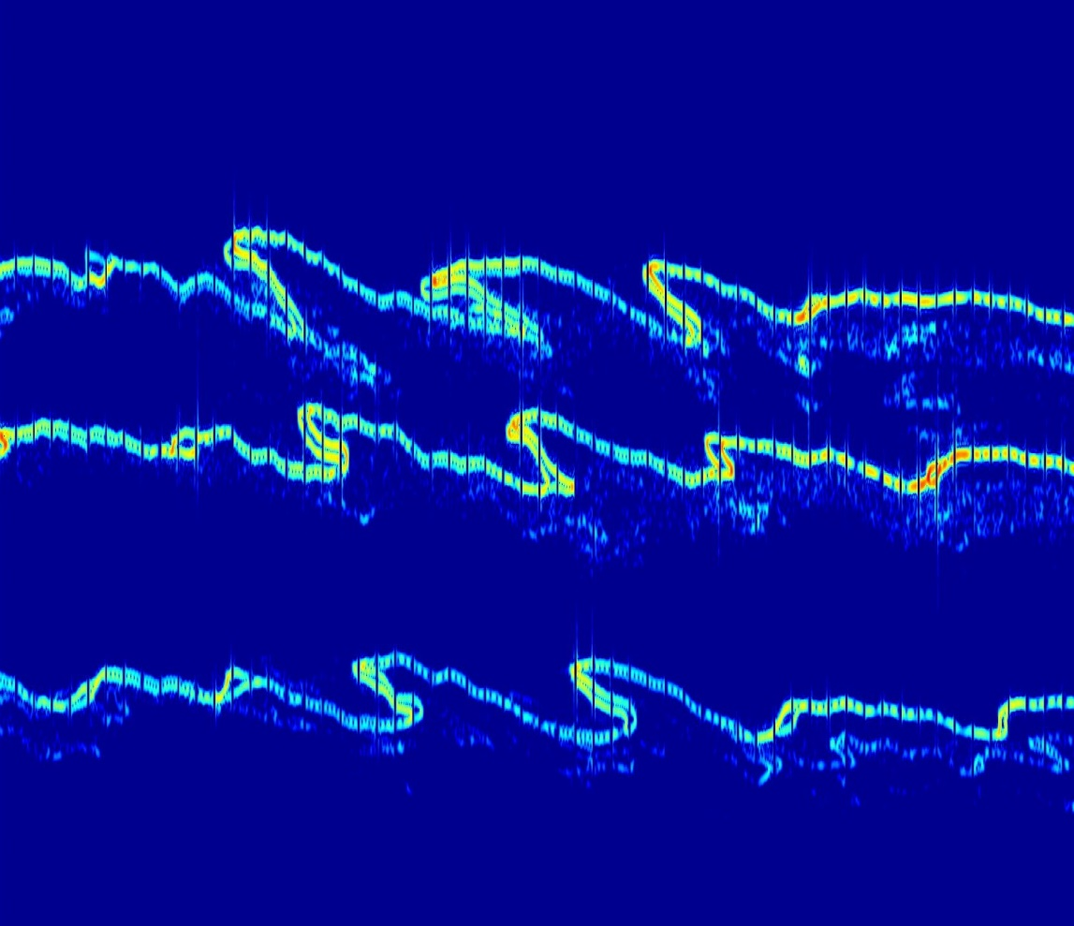
Statistical investigation of gravity wave propagation
in the Czech Republic and above
Jaroslav Chum (jachu@ufa.cas.cz),
K. Podolská, J. Rusz and Jiří Baše
Institute of the Atmospheric Physics of the Czech Academy of Sciences
Measurements and their locations
Analysis of 3D and 2D
propagation and attenuation
of GWs in the ionosphere
Analysis of GWs on ground
from microbarometer network
Summary
Notes:
1
Introduction: Motivation was the investigation of the velocity and direction of wave propagation, and investigation of a characteristic scale sizes of disturbances

Slide 2
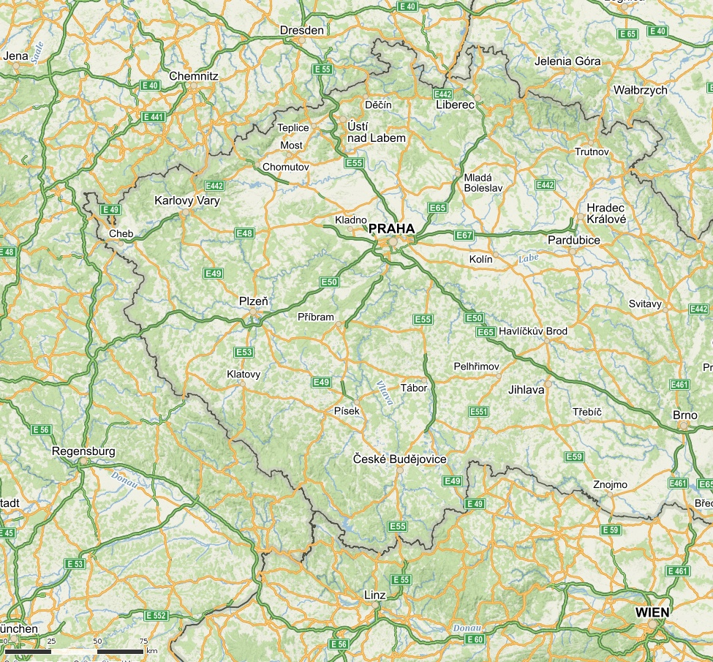
Continuous Doppler sounding of the ionosphere
Multi-frequency (different reflection heights) and multi-point continuous Doppler sounding is performed in the Czech Republic. Continuous, pure sine wave is transmitted and plasma motion (changes) are evaluated from the Doppler shift of the received signals.
Locations of Doppler transmitters in the Czech Republic
(at each location, frequency of
3.59, 4.65 and 7.04 MHz is transmitted)
Receiver Rx is at the Institute in Prague
Digital ionosonde is close to Tx2 and makes it possible to estimate reflection heights of the Doppler sounding signals.
Additional transmitters Tx4, Tx5 and receiver Rx2 installed in the southwest in autumn 2019; not shown as not used in this study.
Tx3
Tx1
Rx
Tx2
Notes:
2
Introduction: Motivation was the investigation of the velocity and direction of wave propagation, and investigation of a characteristic scale sizes of disturbances

Slide 3
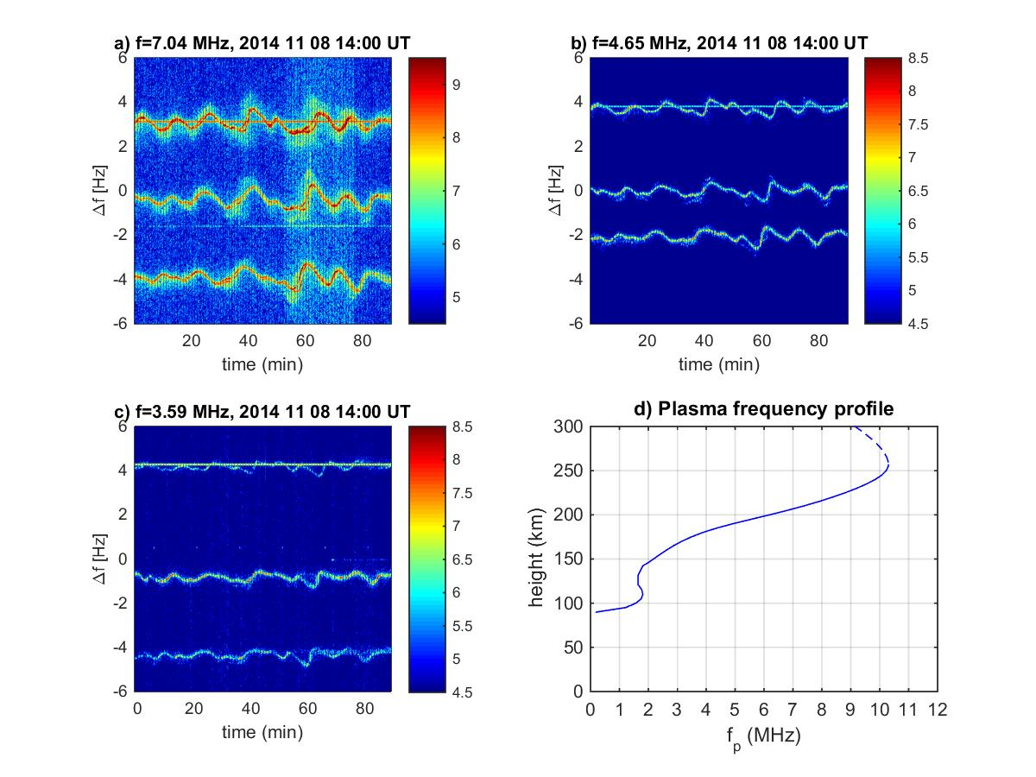
Example of Doppler shift spectrograms
Doppler shifts measured at 3 different frequencies on 8 November 2014 from 14:00 to 15:30 UT
Time (phase) shifts between fluctuations recorded for different Txi-Rx pairs are used to calculate propagation velocities (in 3D if signals are at more frequencies).
Measured plasma frequency f_{p} profile (true heights) is used to determine reflection heights h_{R.}
f (MHz) h_{RO}/ h_{RX} (km)
3.59 176/165
4.65 187/181
7.04 207/201
Tx2-Rx
Tx1-Rx
Tx3-Rx
Tx2-Rx
Tx1-Rx
Tx3-Rx
First, maxima of spectral intensities for each transmitter are evaluated to obtain Doppler shifts as single-valued functions of time.

Slide 4
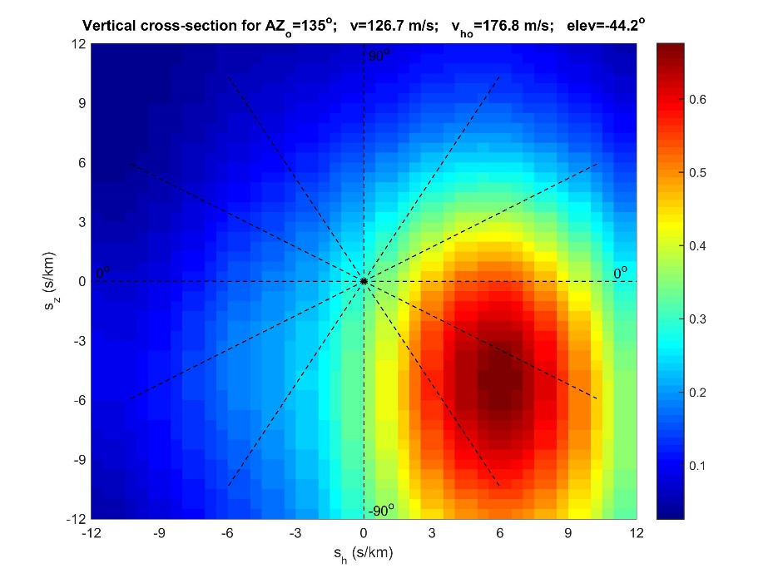
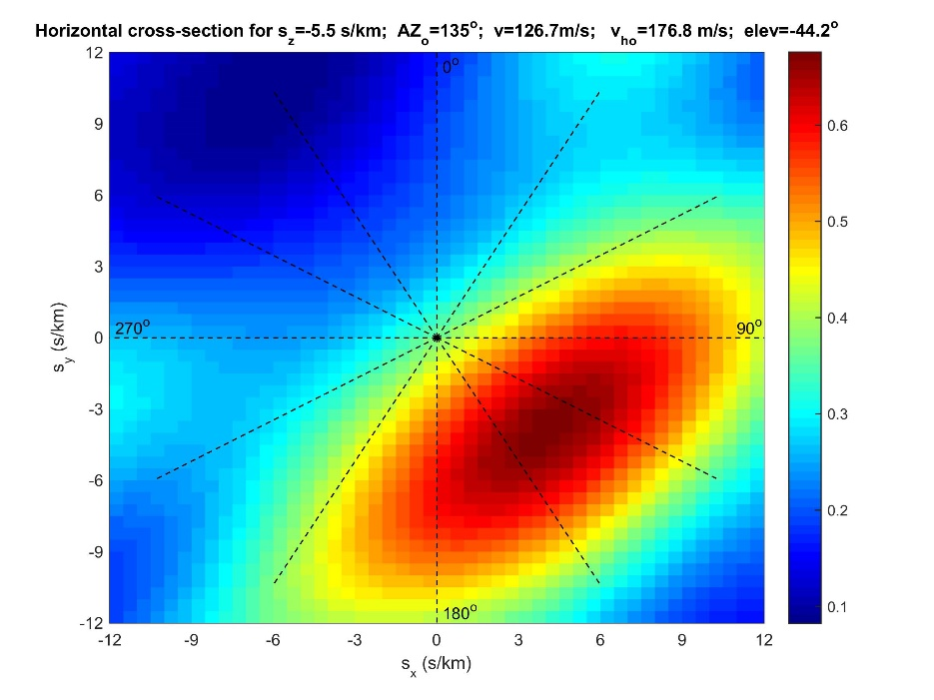
Calculating propagation velocities
* The velocity (slowness) vector is determined from the phase (time) delays between signals on different sounding paths (transmitter-receiver pairs) by three different methods (best beam slowness search, least square fitting based on weighted and unweighted cross-correlations of the signals) – see Chum and Podolská, GRL, 2018GL079695 or the next slide for more details.
* The uncertainties are estimated from the variance of the results obtained by three different methods. If the results differ significantly, they are discarded as unreliable.
* Slowness (the inverse of phase velocity) is used in calculations. The algebra is simpler using slowness than velocity as scalar products of slowness and spatial coordinates are in formulas.
Example of vertical cross-section (left) and horizontal cross-section
(right) of normalized energies for various slowness components (method 1)

Slide 5
Methods to calculate propagation velocities
Best beam slowness search
(summing shifted signals to reference point)
Slowness components s_{x},s_{y},s_{z} for which the best normalized signal - maximum of C(s_{x},s_{y},s_{z}) is obtained are searched .Δx_{n}, Δy_{n} and Δz_{n} are the coordinates of the individual reflection points with respect to their center, σ_{fDn} are the RMS values of the Doppler shifts calculated over the time interval of the analysis (90 min). M is the number of reflection points.
2. Least Squares fitting
Solution are slowness components s_{x},s_{y},s_{z} for which the residuum J is minimum. Δτ_{i} are time delays between Doppler shift time series found from cross-correlation functions (times at which the corresponding cross-correlation functions have maximum are considered), and Δξ_{i}, Δψ_{i}, and Δζ_{i} are corresponding mutual distances of reflection points along x, y, and z axes, respectively. N=M(M-1)/2 = 36 (3) different combinations exist for M=9 (3) reflection points. E.g., M=9 for 3D analysis, M=3 for 2D analysis based on one frequency (s_{z}=0 in 2D solution).
Weighted Least Squares fitting
The same as method 2. However, the equations (time delays) are considered with different weights that correspond to maxima of cross-correlation functions.

Slide 6
Notes to the results that follow in the next slides
Results of 3D analysis of GW propagation in the ionosphere are based on selected Doppler shift measurements during the last solar maximum (second half of 2014) when critical frequency of the ionosphere foF2 was sufficiently high to have reflection of signals at all 3 frequencies and significant waves were present. Attenuation of GWs was also studied. The Doppler sounder does not distinguish ordinary L-O and extraordinary R-X modes, therefore results are computed separately for both modes.
Statistical results of 2D analysis (horizontal) of GW propagation are based on recent data obtained during solar minimum from September 2018 to September 2019.
Statistical investigation of GW propagation in the ionosphere in 3D, based on 2 frequencies (M=6) is currently under work and will be presented later.
Statistical investigation of GW propagation in the troposphere, is based on the measurements by an array of sensitive micro-barometers (M=4) and covers period from September 2018 to September 2019.

Slide 7
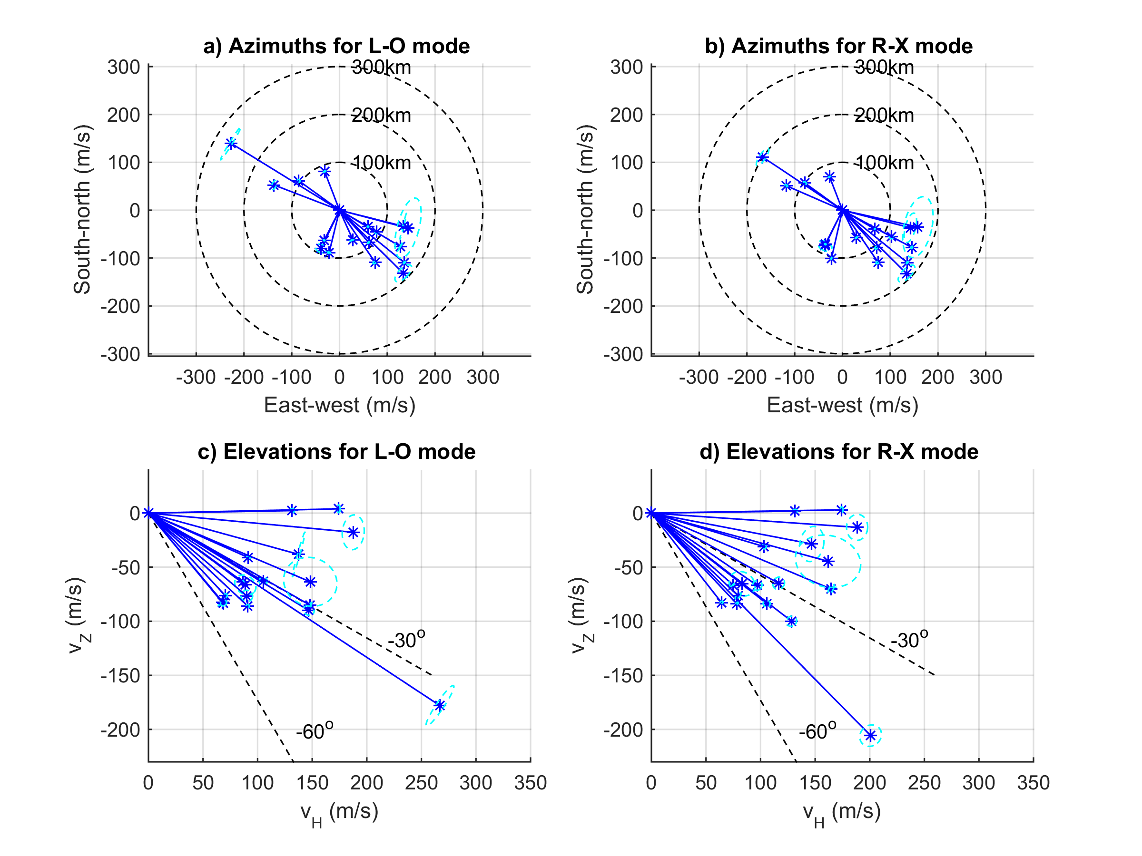
Observed 3D propagation in the ionosphere
Results for distinct events July-December 2014 (solar maximum)
Horizontal velocity
(here displayed)
Observed (apparent) horizontal velocity in the case of 2D observation (one frequency Doppler, GPS-TEC, airglow,..)
k is directed obliquely downward.
(energy propagates upward)

Slide 8
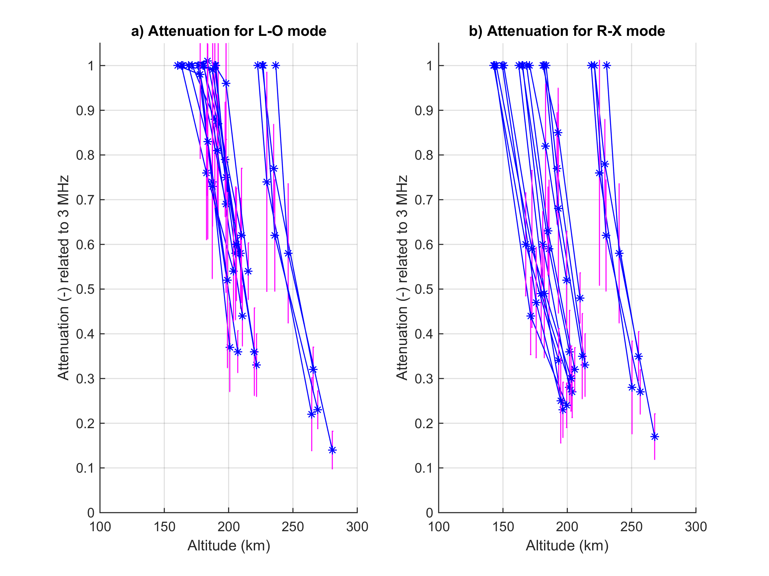
Attenuations for 4.65 and 7.04 MHz,
related to altitude z₀ at which 3.59 MHz reflects
Line-of-sight plasma velocity v_{p} is related to Doppler shift f_{D}
and its component along magnetic field line v_{p||} to oscillating velocity of neutrals v
β..angle between B and v.
Assuming that β and I (inclination) are ~constant at all reflection heights, attenuation A from kinetic energies is
Mass densities ρ are obtained from NRLMSISE-00 model at reflection heights
for specific frequencies and mode of propagation.

Slide 9
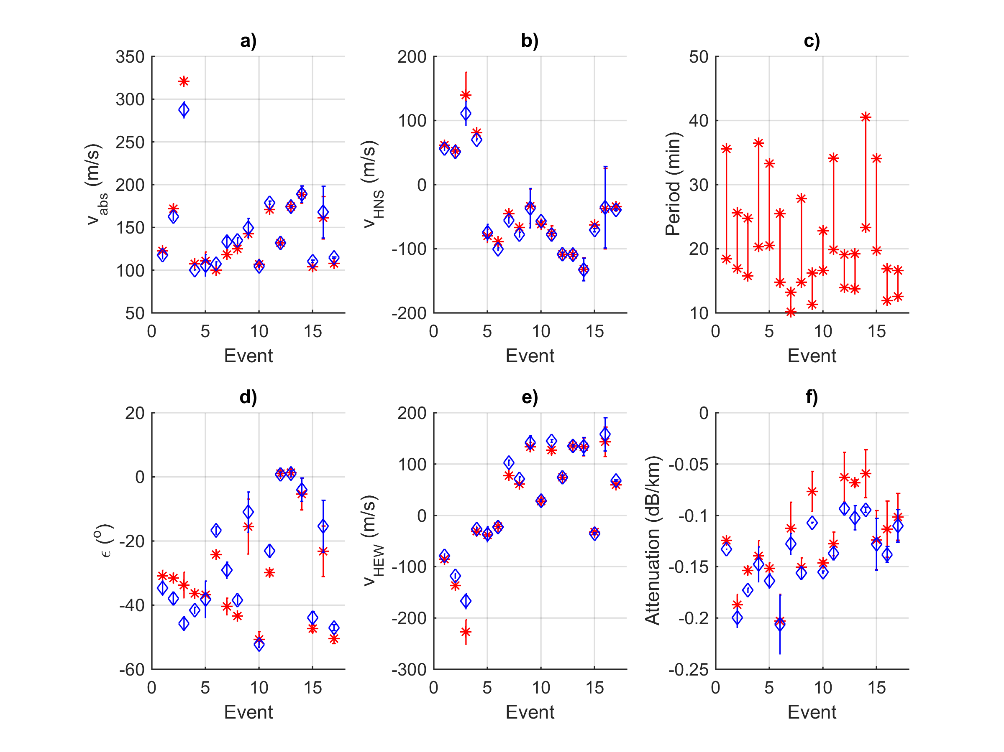
Results for the chronologically ordered events,
L-O mode by red, R-X mode by blue
Events 1-4 in July- September 2014
Events 5-17 in October-December 2014
Seasonal dependence
Attenuations from ~0.06 to 0.20 dB/km

Slide 10
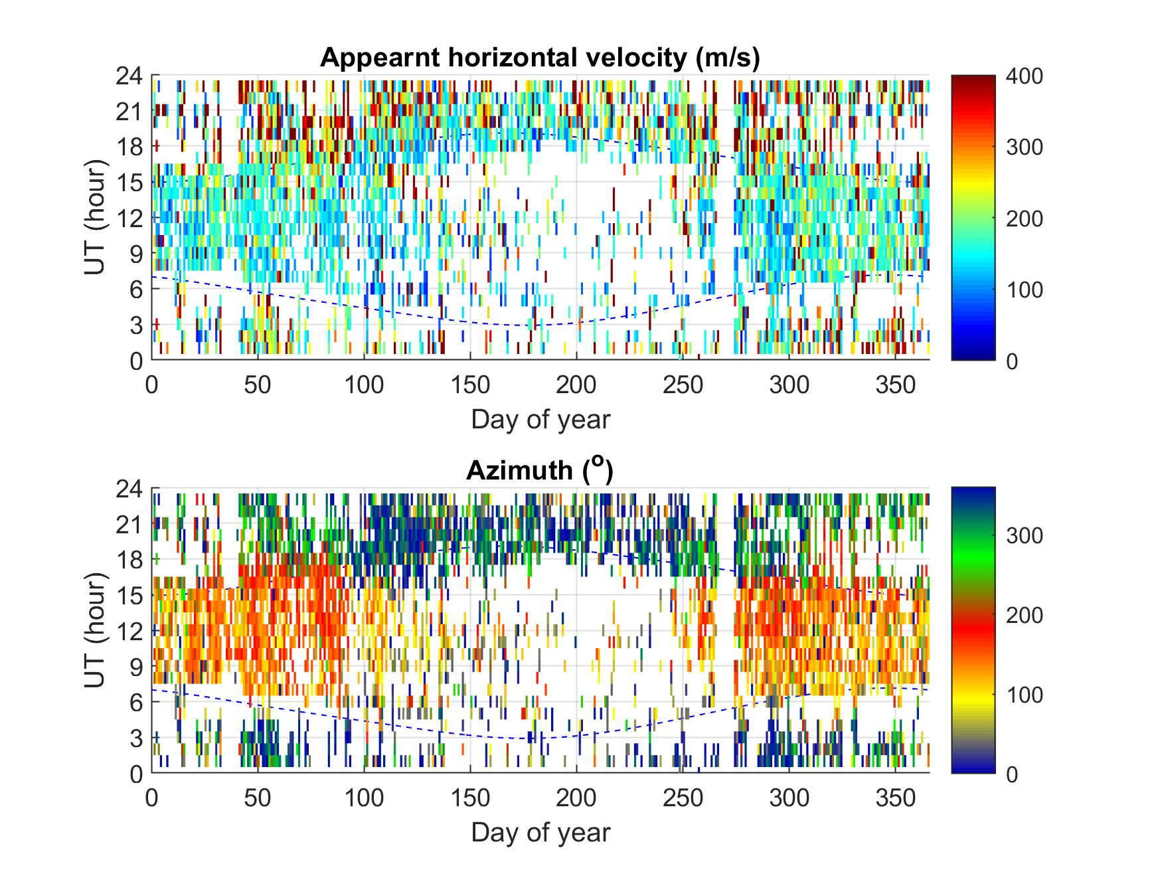
1-year analysis of horizontal (2D) propagation of GWs 1/2
Results for solar minimum from 1 September 2018 to 31 August 2019
Observed velocities are displayed
Seasonal and diurnal dependence of azimuths is observed
Effect of neutral winds at high altitudes on the observed azimuth
(next slide)

Slide 11
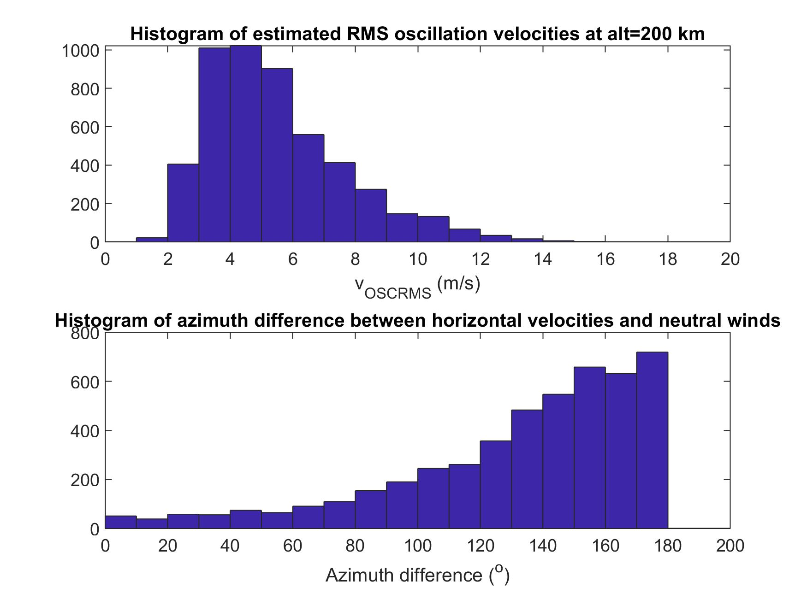
1-year analysis of horizontal (2D) propagation of GWs 2/2
Results for solar minimum from 1 September 2018 to 31 August 2019
Oscillation velocities
Were calculated from the observed Doppler shifts as
and recalculated
to 200 km assuming an average attenuation of 0.14 dB/km and neutral densities by
NRLMSISE-00 model
(see slide 8 and 9).
GWs propagated mainly against the neutral winds obtained by HWM 14 model at the height of observation.

Slide 12
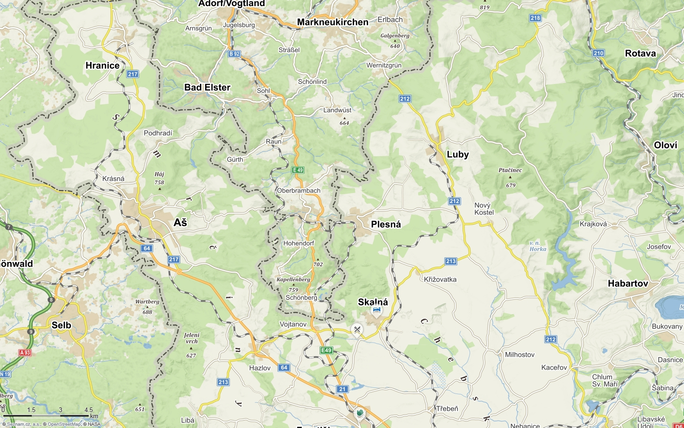
Large array of highly sensitive absolute micro-barometers
Location in the westernmost part of the Czech Republic
Model: 6000-16B-IS, Paroscientific, inc. , Measuring range: 500-1100 hPa
Distances ~4 to ~10 km
Mikrobarometer
ab3 is collocated
with Doppler transmitter Tx5 installed in late 2019
Own meteorological
station at location of ab4
ab5
ab4, meteo
Tx5, ab3
ab2
Notes:
12
Introduction: Motivation was the investigation of the velocity and direction of wave propagation, and investigation of a characteristic scale sizes of disturbances

Slide 13
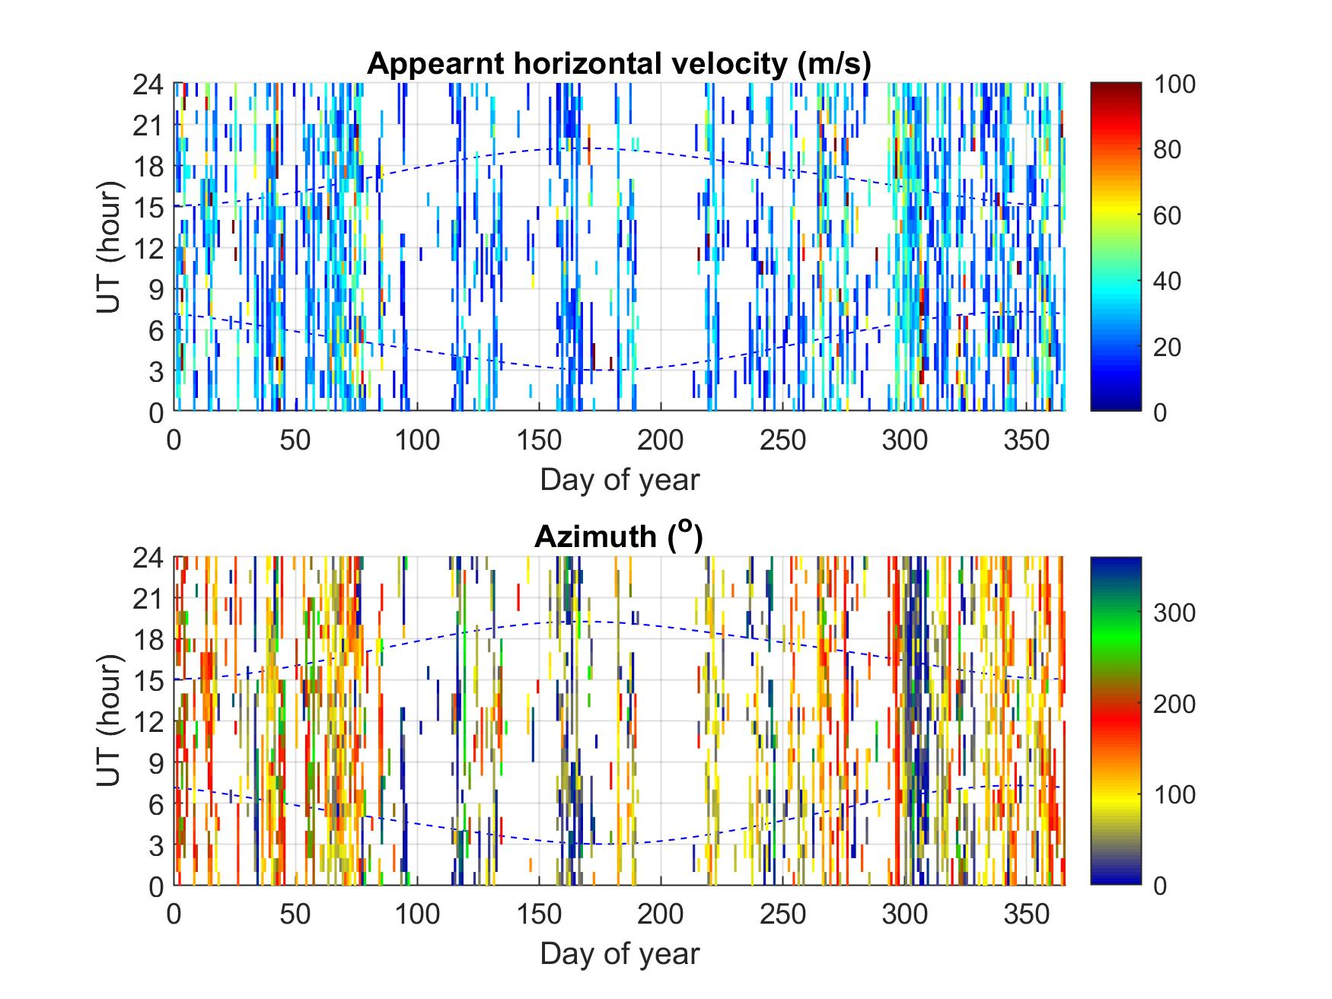
2-D GW analysis from micro-barometer network
Analysis over one year from August 2018 to July 2019
Results are only displayed for distinct waves.
Winds included
(not subtracted)
No obvious seasonal or diurnal dependence of azimuths (directions of propagation)

Slide 14
Summary
Observation and analysis of GWs in the ionosphere (~200 km) by continuous Doppler
sounding: velocities ~ 100-200 (300) m/s, phase vectors obliquely downward (energy upward), periods ~10-40 min, attenuation with height (around 0.14 dB/km), seasonal and diurnal dependence of propagation directions.
Chum and Podolská, GRL, 2018GL079695
Observation and analysis of GWs in the troposphere by array of sensitive μbarometers:
velocities several tens of m/s, periods tens of minutes or longer.
Future: statistics of elevation angles of wave vectors in the ionosphere from 3D analysis,
comparison of measurements in the troposphere, mesopause (collaboration with DLR), and ionosphere and focus on specific events (coupling studies) .
Thank you for your attention !
The supports under the Grant 18-01969S by the Czech Science Foundation is acknowledged.

