Slide 1
Sediment origins across the terrestrial-aquatic continuum: climate threat mitigation and promotion of water quality
Welcome to our project ➔
Katy Wiltshire
c.wiltshire@cranfield.ac.uk
Dr Toby Waine¹, Dr Robert Grabowski¹, Dr Miriam Glendell², Dr Jeroen Meersmans³, Dr Nikki Baggaley²,
Dr Steve Addy², Dr Barry Thornton², Fiona Napier⁴
¹ Cranfield University
² James Hutton Institute
³ University of Liege
⁴ SEPA
Partners ➔

Slide 2
This project is undertaken with the very gratefully received supervision, laboratory training, fieldwork guidance and support of the following institutions
Back

Slide 3
Accelerated soil erosion due to changes in climate and human activity results in the loss of soil, its nutrients and organic carbon (OC) from the land to the waterways ➔
Quantifying lateral flow of OC in our watersheds is vital to understand the driving mechanisms (natural or anthropogenic) and assess the possible impact on the exchange of CO₂ with the atmosphere and the global carbon budget.
Spatial distributed modelling can find areas at risk of soil erosion however:
areas with a high soil loss rate are not necessarily the regions contributing most sediment to the streams
areas contributing the most sediment to the streams may not be the regions contributing the most OC.
Aim to compare soil erosion and OC stocks modelling results to other, independent evidence of sediment source origin ➔
Back

Slide 4
Catchment Management ➔
Fluxes of Organic Carbon (OC) from land to freshwater ➔
Back

Slide 5
Sources of OC in rivers
One of the primary sources is soil erosion ➔
Fine material (<2mm in diameter) erodes from land surfaces and flows downslope to a river ➔
Back

Slide 6
Soil Erosion Impacts
On-site
Soil Loss
Off-site
Water Quality
Flooding
Sediments, OC and associated nutrients have significant impact on ecological status of waterbodies. Fine sediment is a major cause of water quality deterioration -impacts both the physical and biological components of river systems
Loss of fertile soil
Food security
Back

Slide 7
Continuous process of catchment-river sediment transfer
Erosion
Link between areas of erosion and the OC load in rivers ➔
Deposition
Transport
Back

Slide 8
Link between areas of erosion and the OC load in rivers is not simple
Areas with high soil loss rate may not contribute most sediment to the rivers
Complex interactions between erosion drivers ➔
Areas delivering the most sediment may not deliver the most OC
Back

Slide 9
OC fluxes change with time depending on complex interactions between erosion drivers
Landscape changes e.g. land-slides, wild-fires
Hydro-meteorological
e.g. climate, rainfall,
snowmelt
Sediment source changes
e.g. land-use,
crop-rotations
Anthropogenic disturbance
e.g. construction, dams, roads
Back

Slide 10
Catchment Management
Accelerated soil erosion due to human activity and/or changes in climate can result in a significant flux of soil, nutrients and OC from land to freshwater
Determine origin of OC in rivers to reduce fluxes at source
Trace transport and deposition within the catchment
To mitigate the impact of climate and/or anthropogenic induced sediment flows and improve water quality
AIM
Improved estimation of OC fluxes and drivers
Back

Slide 11
In this innovative study sediment fingerprinting studies of riverine OC is combined with OC loss modelling of the terrestrial catchment
Our Study
Back

Slide 12
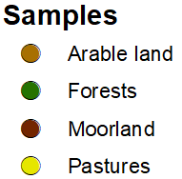
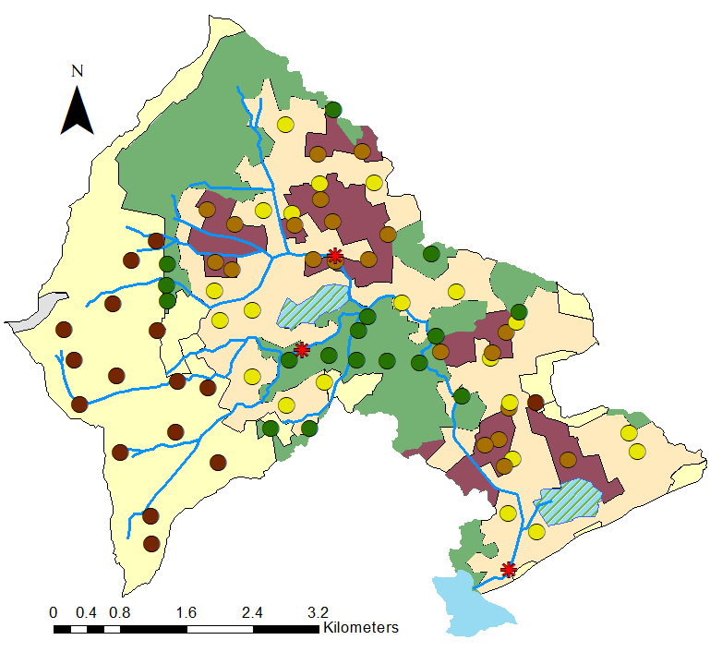
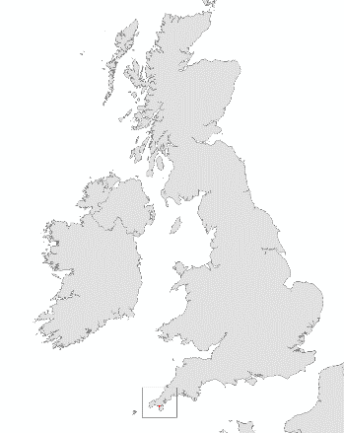
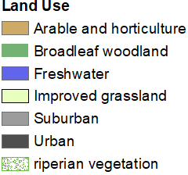
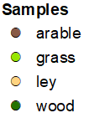
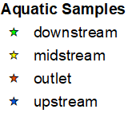
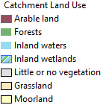
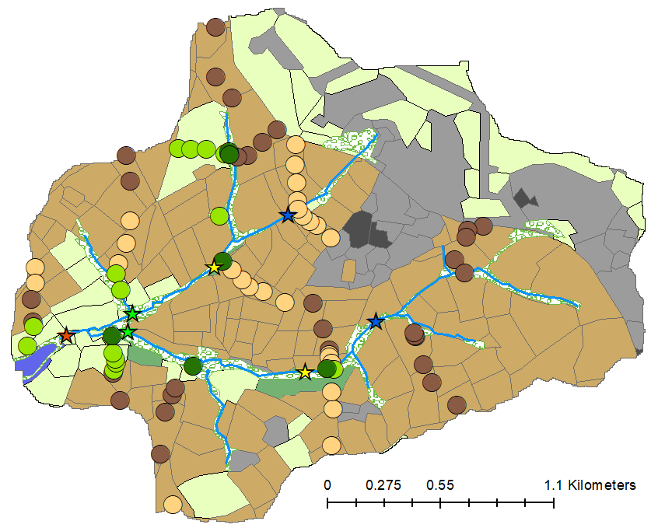
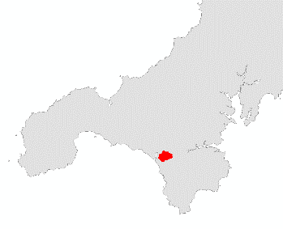
Two UK catchments with mixed land-uses
Back
Loe Pool and Carminowe Creek, Cornwall, UK ➔
Loch Davan and the Logie Burn, Aberdeenshire, UK ➔

Slide 13
Compare the results of a RUSLE soil erosion model and sediment fingerprinting technique when identifying sediment organic carbon origins based on land-use sources
RUSLE-based soil erosion models
Comparison of two sediment origin techniques ➔
Assess whether using the WaTEM/SEDEM model with its additional ability to model tillage erosion and sediment dynamics as a function of land use and topographical conditions reduces any disconnect between sediment fingerprinting and erosion model output
Assess the utility of using the distribution of land-use specific sources found via sediment fingerprinting techniques to validate the output of RUSLE-based soil erosion modelling
Sediment Fingerprinting
Back

Slide 14
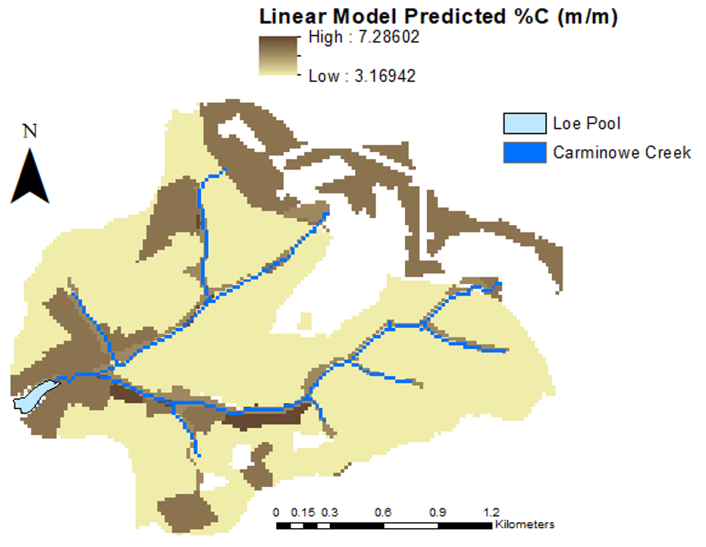
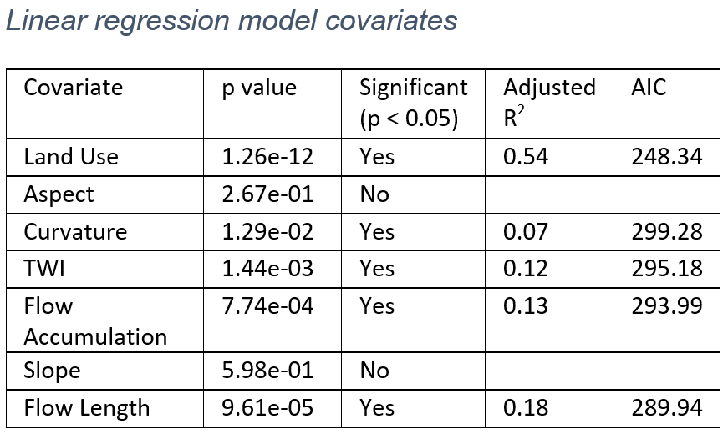
Catchment SOC Distribution
Error in interpolated values
RMSE = 1.35
R² = 0.43
Soil erosion and carbon dynamics
Back

Slide 15
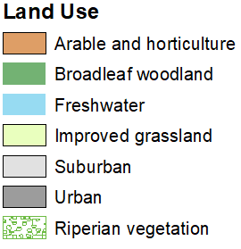
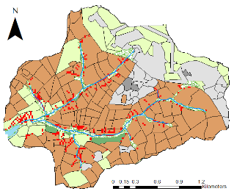
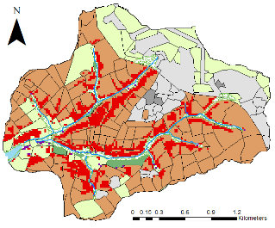
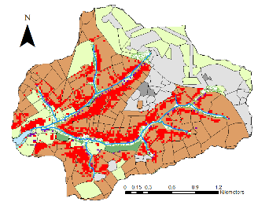
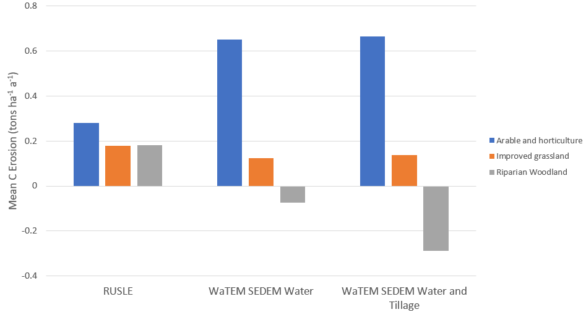
Soil erosion and carbon dynamics
Comparison with Sediment Fingerprinting
Back

Slide 16
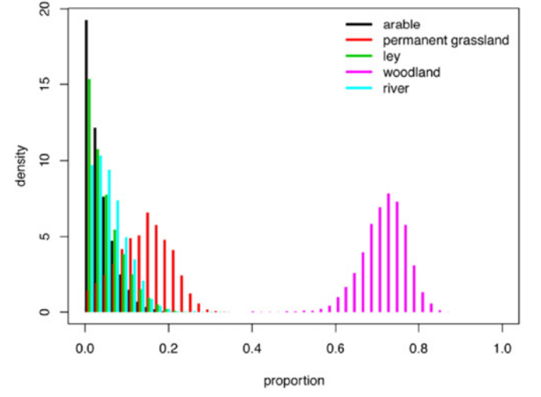
Sediment fingerprinting tracing techniques using plant-derived biomarkers (n-alkanes) with bulk stable isotopes (¹³C, ¹⁵N) were successfully used by (Glendell et al., 2017) to identify OC origins based on land-use sources.
It was found that OC from riparian woodland was a major contributor to the Loe Pool sediments with ~ 70% of the POC being of woodland origin.
Probability density function of sediment source apportionment (Glendell et al., 2017 (Fig 6a))
Back
Reference: Glendell, M., Jones, R., Dungait, J. A. J., Meusburger, K., Schwendel, A. C., Barclay, R., Barker, S., Haley, S., Quine, T. A. and Meersmans, J. (2017) ‘Tracing of particulate organic C sources across the terrestrial-aquatic continuum, a case study at the catchment scale (Carminowe Creek, southwest England)’, Science of the Total Environment, 616, pp. 1077–1088. doi: 10.1016/j.scitotenv.2017.10.211.

Slide 17
Comparison of two sediment origin techniques when identifying sediment OC origins based on land-use sources
Disconnect between RUSLE OC loss erosion model and sediment fingerprinting (SF) results
Riparian woodland forms effective barrier (disconnect) for OC inputs from agricultural land uses in upslope parts of study catchment
Use of WaTEM/SEDEM model (additional tillage erosion and sediment dynamics) did not reduce the disconnect between SF and the erosion model output
Using sediment fingerprinting output to validate output of RUSLE-based soil erosion modelling
Back

Slide 18
Utility of using the distribution of land-use specific sources found via sediment fingerprinting techniques to validate the output of RUSLE-based soil erosion modelling
Mismatch between erosion processes represented by the two sediment origin techniques
Bank erosion, overflow and other processes within the active river channel will be reflected in the sediment fingerprinting (SF) source attribution when included as sources but not in the RUSLE-based estimates considering only surface run-off inter-rill and rill erosion processes
Caution should be used when utilising using the distribution of land-use specific sources found via SF techniques to validate the output of RUSLE-based soil erosion modelling
Back

Slide 19
Loch Davan Catchment
16
Moorland
Riparian
21
Pasture
Suspended sediment
Bed Sediment
17
Forest
75 Terrestrial sites
3 aquatic sites
21
Arable
OC Fingerprinting
Loch Davan Core
(Autumn 2020)
OC Depth Profiling
Intra- and Inter- annual OC flux changes
C Loss Modelling ➔
Dominant source of OC within catchment streams
Back

Slide 20
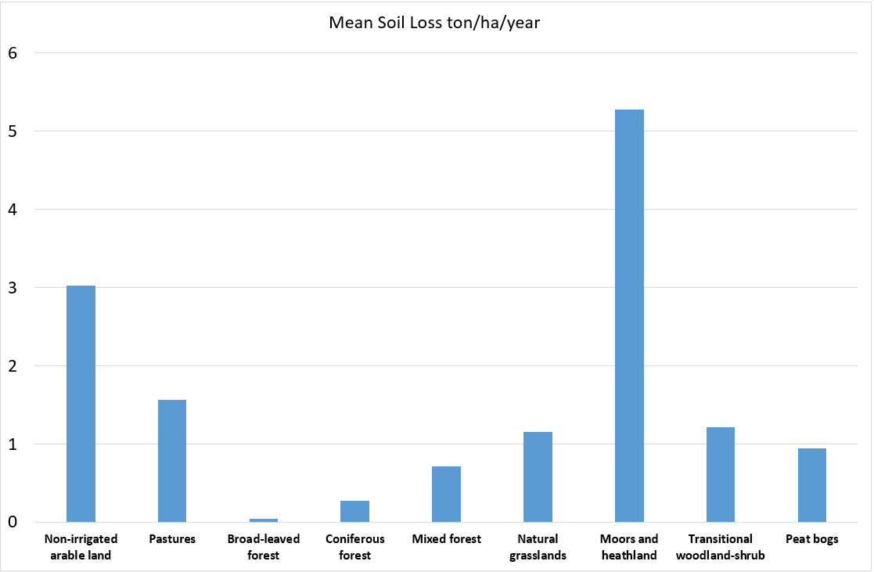
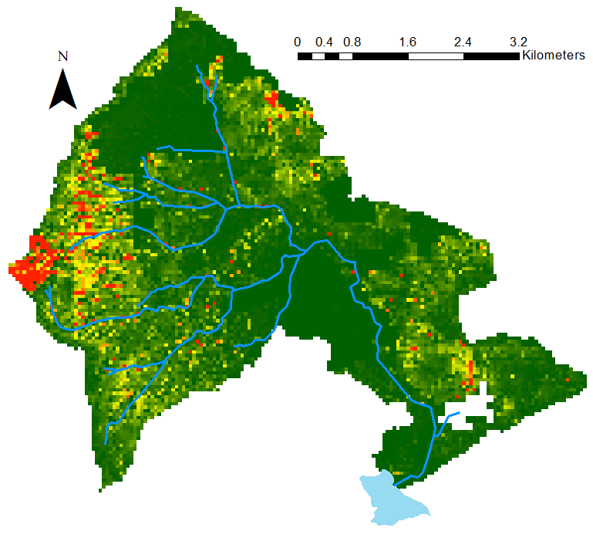
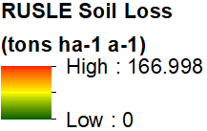
Preliminary catchment sediment erosion modelling
RUSLE model
RUSLE model predicts:
Highest soil losses from Moorland
Relatively high losses from arable land compared to grassland
Lowest rates of soil loss predicted for forested land
Back

Slide 21
Sediment Fingerprinting
Sediment fingerprinting techniques have been successfully employed to provide identification and relative contribution of different sources to the fine-grained sediment load in waterways
Unique sources within a catchment can be defined by their characteristics: Interactions between geology, climate, land use and management all influence the composition and structure of its sediment
These unique physical and/or biogeochemical characteristics are the “fingerprint” of each source
By assuming that the “fingerprint” properties (e.g. fallout radionuclides, geochemical, mineral magnetic properties, plant-specific biomarkers) behave conservatively, sediment fingerprinting can use statistical models to identify both the sediment sources and the amount of sediment contributed by each source within a catchment
Back

Slide 22
The RUSLE Model
Calculating long-term average annual soil loss
The Revised Universal Soil Loss Equation (RUSLE) calculates the long-term average annual soil loss according to the equation:
SL = R.K.L.S.C.P
where SL is the mean soil loss (tons ha⁻¹ yr⁻¹),
R is the rainfall intensity factor (MJ mm ha⁻¹ h⁻¹ yr⁻¹),
K is the soil erodibility factor (tons ha h ha⁻¹ MJ⁻¹ mm⁻¹)
S and L are the slope and slope-length factors,
C and P are the dimensionless cover-management factor and conservation support practice factor
Back

Slide 23
The WaTEM/SEDEM model has been widely employed to estimate net fluxes of sediments from landscape to continental scales. Its water erosion component uses the RUSLE to calculate the long-term average annual soil loss
The WaTEM-SEDEM Model
Calculating long-term average annual soil loss
The sediment generated is routed downslope making it possible to identify areas of the landscape in which substantial deposition takes place between the upslope areas of erosion and the catchment streams.
The WaTEM/SEDEM can also model tillage erosion. Tillage erosion is modelled as a diffusion-type process controlled by changes in slope gradient rather than by the slope gradient itself
References:
Van Oost, K., Govers, G. and Desmet, P. (2000) ‘Evaluating the effects of changes in landscape structure on soil erosion by water and tillage’, Landscape Ecology, 15(6), pp. 577–589. doi: 10.1023/A:1008198215674.
Van Oost, K., Van Rompaey, A., Poesen, J., Govers, G. and Verstraeten, G. (2002) ‘Evaluating an integrated approach to catchment management to reduce soil loss and sediment pollution through modelling’, Soil Use and Management, 18(4), pp. 386–394. doi: 10.1079/SUM2002150.
Rompaey, A. J. J. V. A. N., Verstraeten, G., Oost, K. V. A. N., Govers, G. and Poesen, J. (2001) ‘Modelling Mean Annual Sediment Yield Using a Distributed Approach’, Earth Surface Processes and Landforms, 1236, pp. 1221–1236. doi: 10.1002/esp.275.
Back

