Slide 1
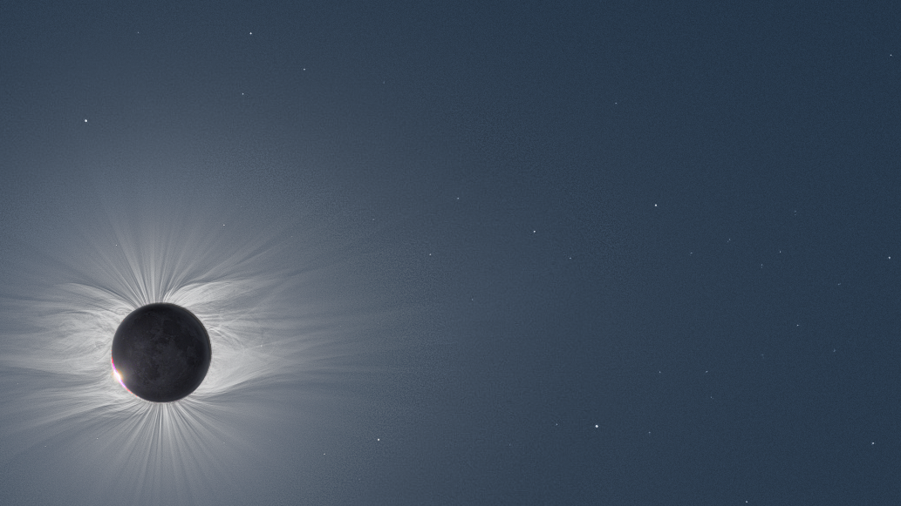
Connecting the dots: multi-point observations for science and forecasting (In 5 slides, so apologies for the lack of references and background)
Space and Atmospheric Electricity group
Department of Meteorology
Mathew Owens

Slide 2
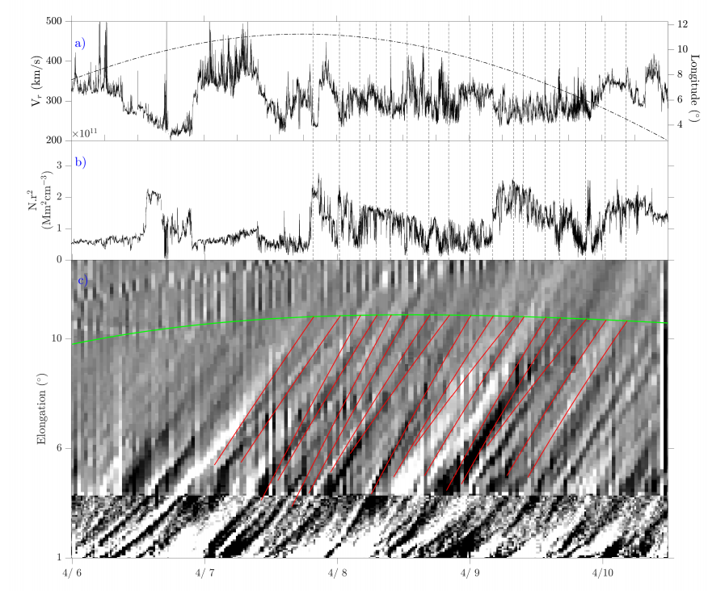
Linking in-situ and remote obs
Many outstanding problems in heliophysics require connecting remote and in situ observations
E.g., Source/release of the slow wind, coronal heating, etc
Best case, but rare: In situ spacecraft in field of view of imager (though even then, “depth” into image is ambiguous)
Rouillard et al., ApJS, 2020

Slide 3
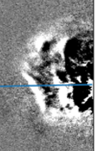
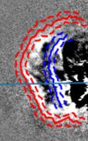
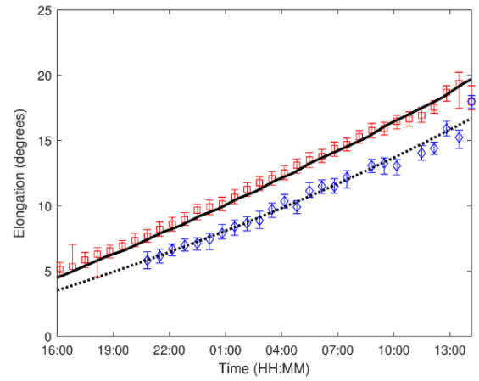
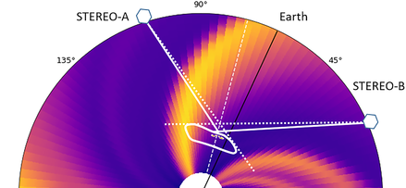
Interpreting images
Directly-imaged solar wind:
Line-of-sight integration: 2D projection of (complex) 3D structures
E.g., double “ghost” fronts in Heliospheric Imagers can result from different parts of the CME (the nose and the flank)
Ambient solar wind structure can be important
Scott et al., Space Weather, 2019

Slide 4
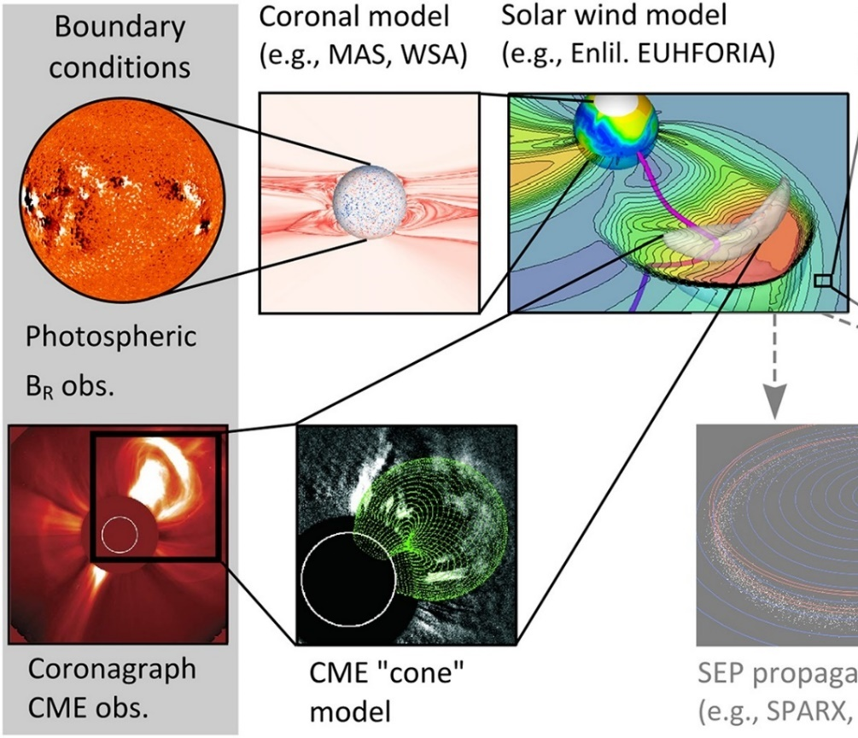
Filling in the gaps
Interpretation of images, or filling the gaps between imagers and in situ observations:
Models
Treat as two-step problem:
Corona (non-radial mapping)
Solar wind (mainly radial, but stream interaction, transients)
Can map out from corona, or in from solar wind
Lang et al., Space Weather, 2017

Slide 5
Solar wind mapping
Mapping out:
Magnetogram-derived solar wind structure is often incorrect.
But can drive solar wind models which account for stream interaction and solar wind acceleration in the heliosphere
Mapping in:
In situ solar wind speed is correct.
Can be ballistically mapped to corona, but doesn’t account for stream interaction or acceleration
Is there a way to combine the strengths of these approaches?

Slide 6
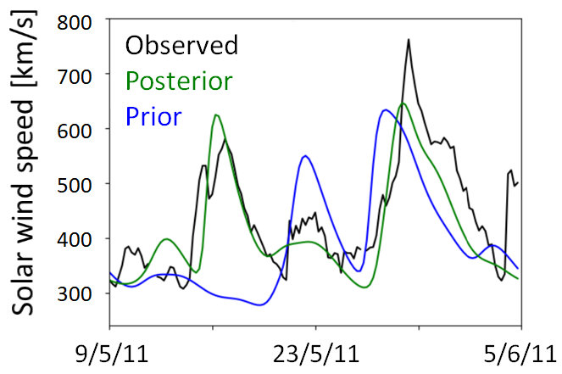
Data assimilation (DA)
Assimilating in situ obs improves reconstruction of solar wind structure, enabling more accurate mapping between in situ and remote obs
Models are free running from photosphere to 1 AU
Make use of available in situ observations
Data Assimilation – way to combine model and observations
Well used in meteorology, but there we have > 10k obs points
Solar wind: 4 or 5, at best.
Is this useful? (Yes)
Lang & Owens, Space Weather, 2019

