Slide 1
A new approach that utilizes the GNSS atmospheric delay gradient to monitor the heavy rains
caused by Front in Japan.
By : Syachrul Arief and Kosuke Heki Hokkaido University – Japan
EGU2020, May

Slide 2
Outline
Disastrous rainfalls in Japan
Heavy rain caused by a stationary front
Data and Methods
ZWD and tropospheric delay gradients
Inversion for sea-level ZWD
Water vapor convergence index (WVC index)
Discussion
2017, 2018, and 2019 heavy rain cases
Distribution of hourly ZWD/WVC
Time series analysis of ZWD/WVC/Rain
High time resolution (5 minutes)

Slide 3
Disastrous rainfall in July 2018 in SW Japan by stationary front activity
In June-July 2018, successive downpours in SW Japan caused widespread floods and mudflows known as 平成30年7月豪雨 "Heisei 30, July, heavy rain episode”
Flood in Mabi, Kurashiki, Okayama, SW Japan, 2018 July 8 10:07 AM (JST)
Deaths :
225 fatalities,
13 missing
Property damage :
US$9.86 billion
https://mainichi.jp/articles/20190706/k00/00m/040/077000c

Slide 4
Front often causes a heavy rain
Lackman 2011 in Utsumi et al, 2014,
Emphasized that the Front was the cause of heavy rain.

Slide 5
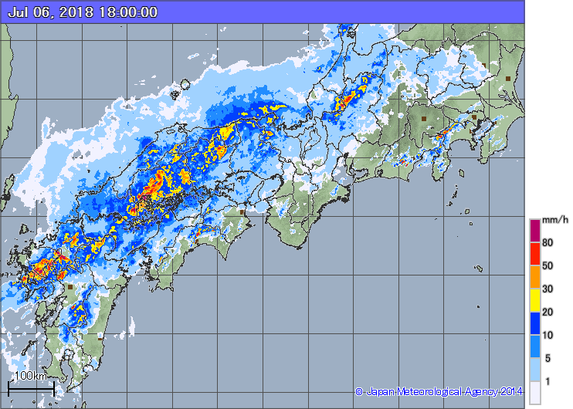
Weather charts on July 05 (0:00 UT) and July 06 (0:00 UT) from JMA
Baiu-front (stationary front) stagnant over SW Japan
Record-breaking heavy rains in SW Japan (rain radar at 2018 July 6, 09:00 UT)
https://www.data.jma.go.jp/fcd/yoho/hibiten/index.html

Slide 6
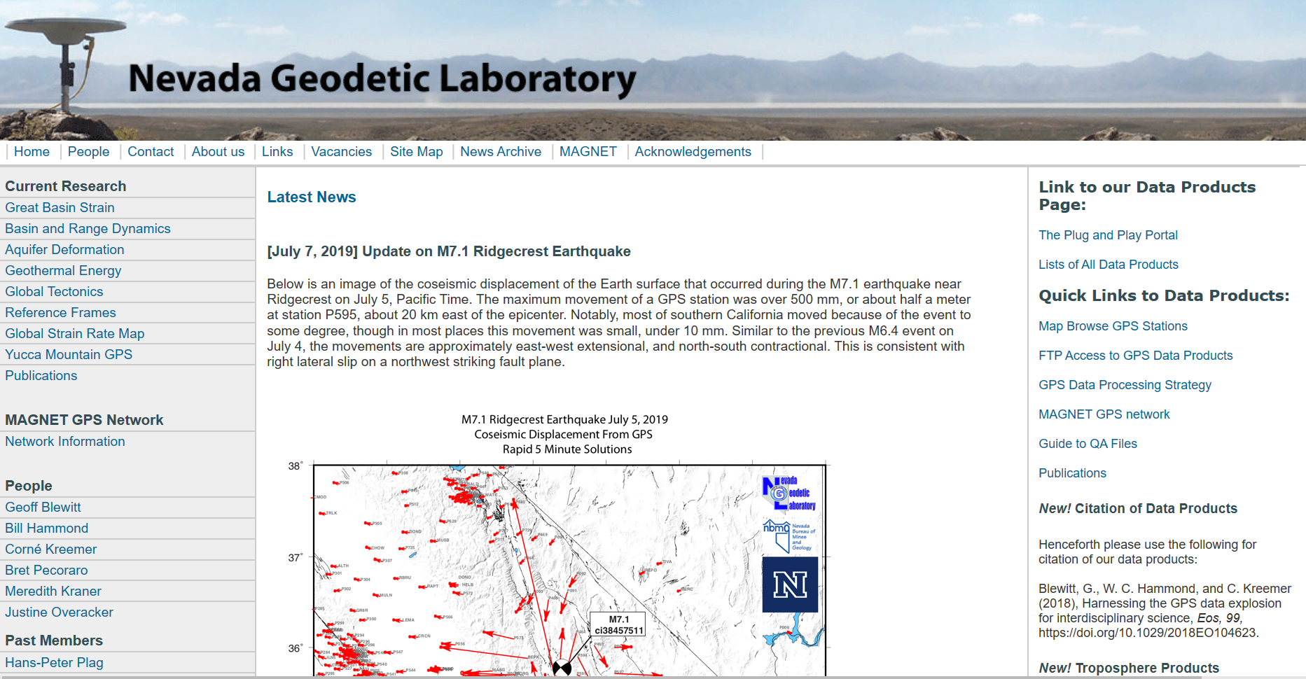
GEONET GNSS Data : ZTD and Gradient UNR/NGL
GEONET (GNSS Earth Observation NETwork)- GSI/Japan
About 20 km spacing
1,318 stations
Tracking GPS/GLONASS/Galileo/QZSS
RINEX data open to public (every 30 sec)
Gipsy-PPP
ZTD/Gradient every 5 min.
(also ZWD and PWV since 2019)
All GEONET stations

Slide 7
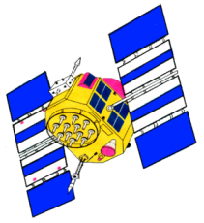
ZTD and tropospheric delay gradients
Atmospheric delay gradients (G_{n}, G_{e})
Δ τ = m(ε) cot ε [G_{n} cos ϕ + G_{e} sin ϕ]
(MacMillan, 1995)
Troposphere with gradient
cot ε (GN cos ϕ + GE sin ϕ)
Additional delay due to gradient (Δ τ)
ZTD
Troposphere
Delay without gradient
Elevation ε
Slant path delay ( ε, ϕ )= m(ε) * [ZTD + cot ε (Gn cos ϕ + Ge sin ϕ)] + μ

Slide 8
Two observables: Zenith Total Delay (ZTD) and Gradient (G)
ZWD = ZTD (observed) – ZHD (calculated from P)
In summer, wet gradient is dominant
Slant delay = m(θ) ZTD + ∂m(θ)/∂θ (G_{n} cos φ + G_{e} sin φ)
θ: elevation φ: azimuth m:mapping function (e.g. MacMillan, 1995)
ZWD has strong dependence on station height (drawback)
Gradient (G) is insensitive to station height (benefit)
G (gradient)

Slide 9
West
Drawback of ZWD and
Benefit of Gradient (G)
East
Dry air
Shoji (2013)
Eastward G well reflected in Ge
Eastward G not reflected in ZWD
Large ZWD
Medium ZWD
Small ZWD
Water vapor
G_{e}
Sea water

Slide 10
Two new key quantities used in this study
1. Sea-level ZWD
Estimated from coastal ZWD and gradient
2. Water vapor concentration (WVC) index (Shoji, 2013)
Calculated from gradient

Slide 11
Inversion of sea-level ZWD
Parameters x(i, j) i=1,2,…, m_{e}, j=1,2,…, m_{n} m_{n}= ~1600
ZWD at grid points (0.20 x 0.15 deg)
Ruffini et al. [1999]
G_{x} = h_{s} ∂ZWD/∂x
G_{y} = h_{s} ∂ZWD/∂y
h_{s}: scale height of water vapor
Data y(k) k=1,2, …, n_{y} n_{y}= ~100
G(k) k=1,2, …, n_{G} n_{G}= ~1200
1. ZWD at lowland GEONET stations (< 100 meters)
2. Gradient vectors (G ) at all GEONET stations
D_{e}
j+1
j
j-1
D_{n}
Observation equations
x (i, j) = y (k)
x (i+1, j) − x (i−1, j) = 2G_{e}(1, k)D_{e}/h_{s}
x (i, j+1) − x (i, j−1) = 2G_{n}(2, k)D_{n}/h_{s}
k'th station
i-1 i i+1

Slide 12
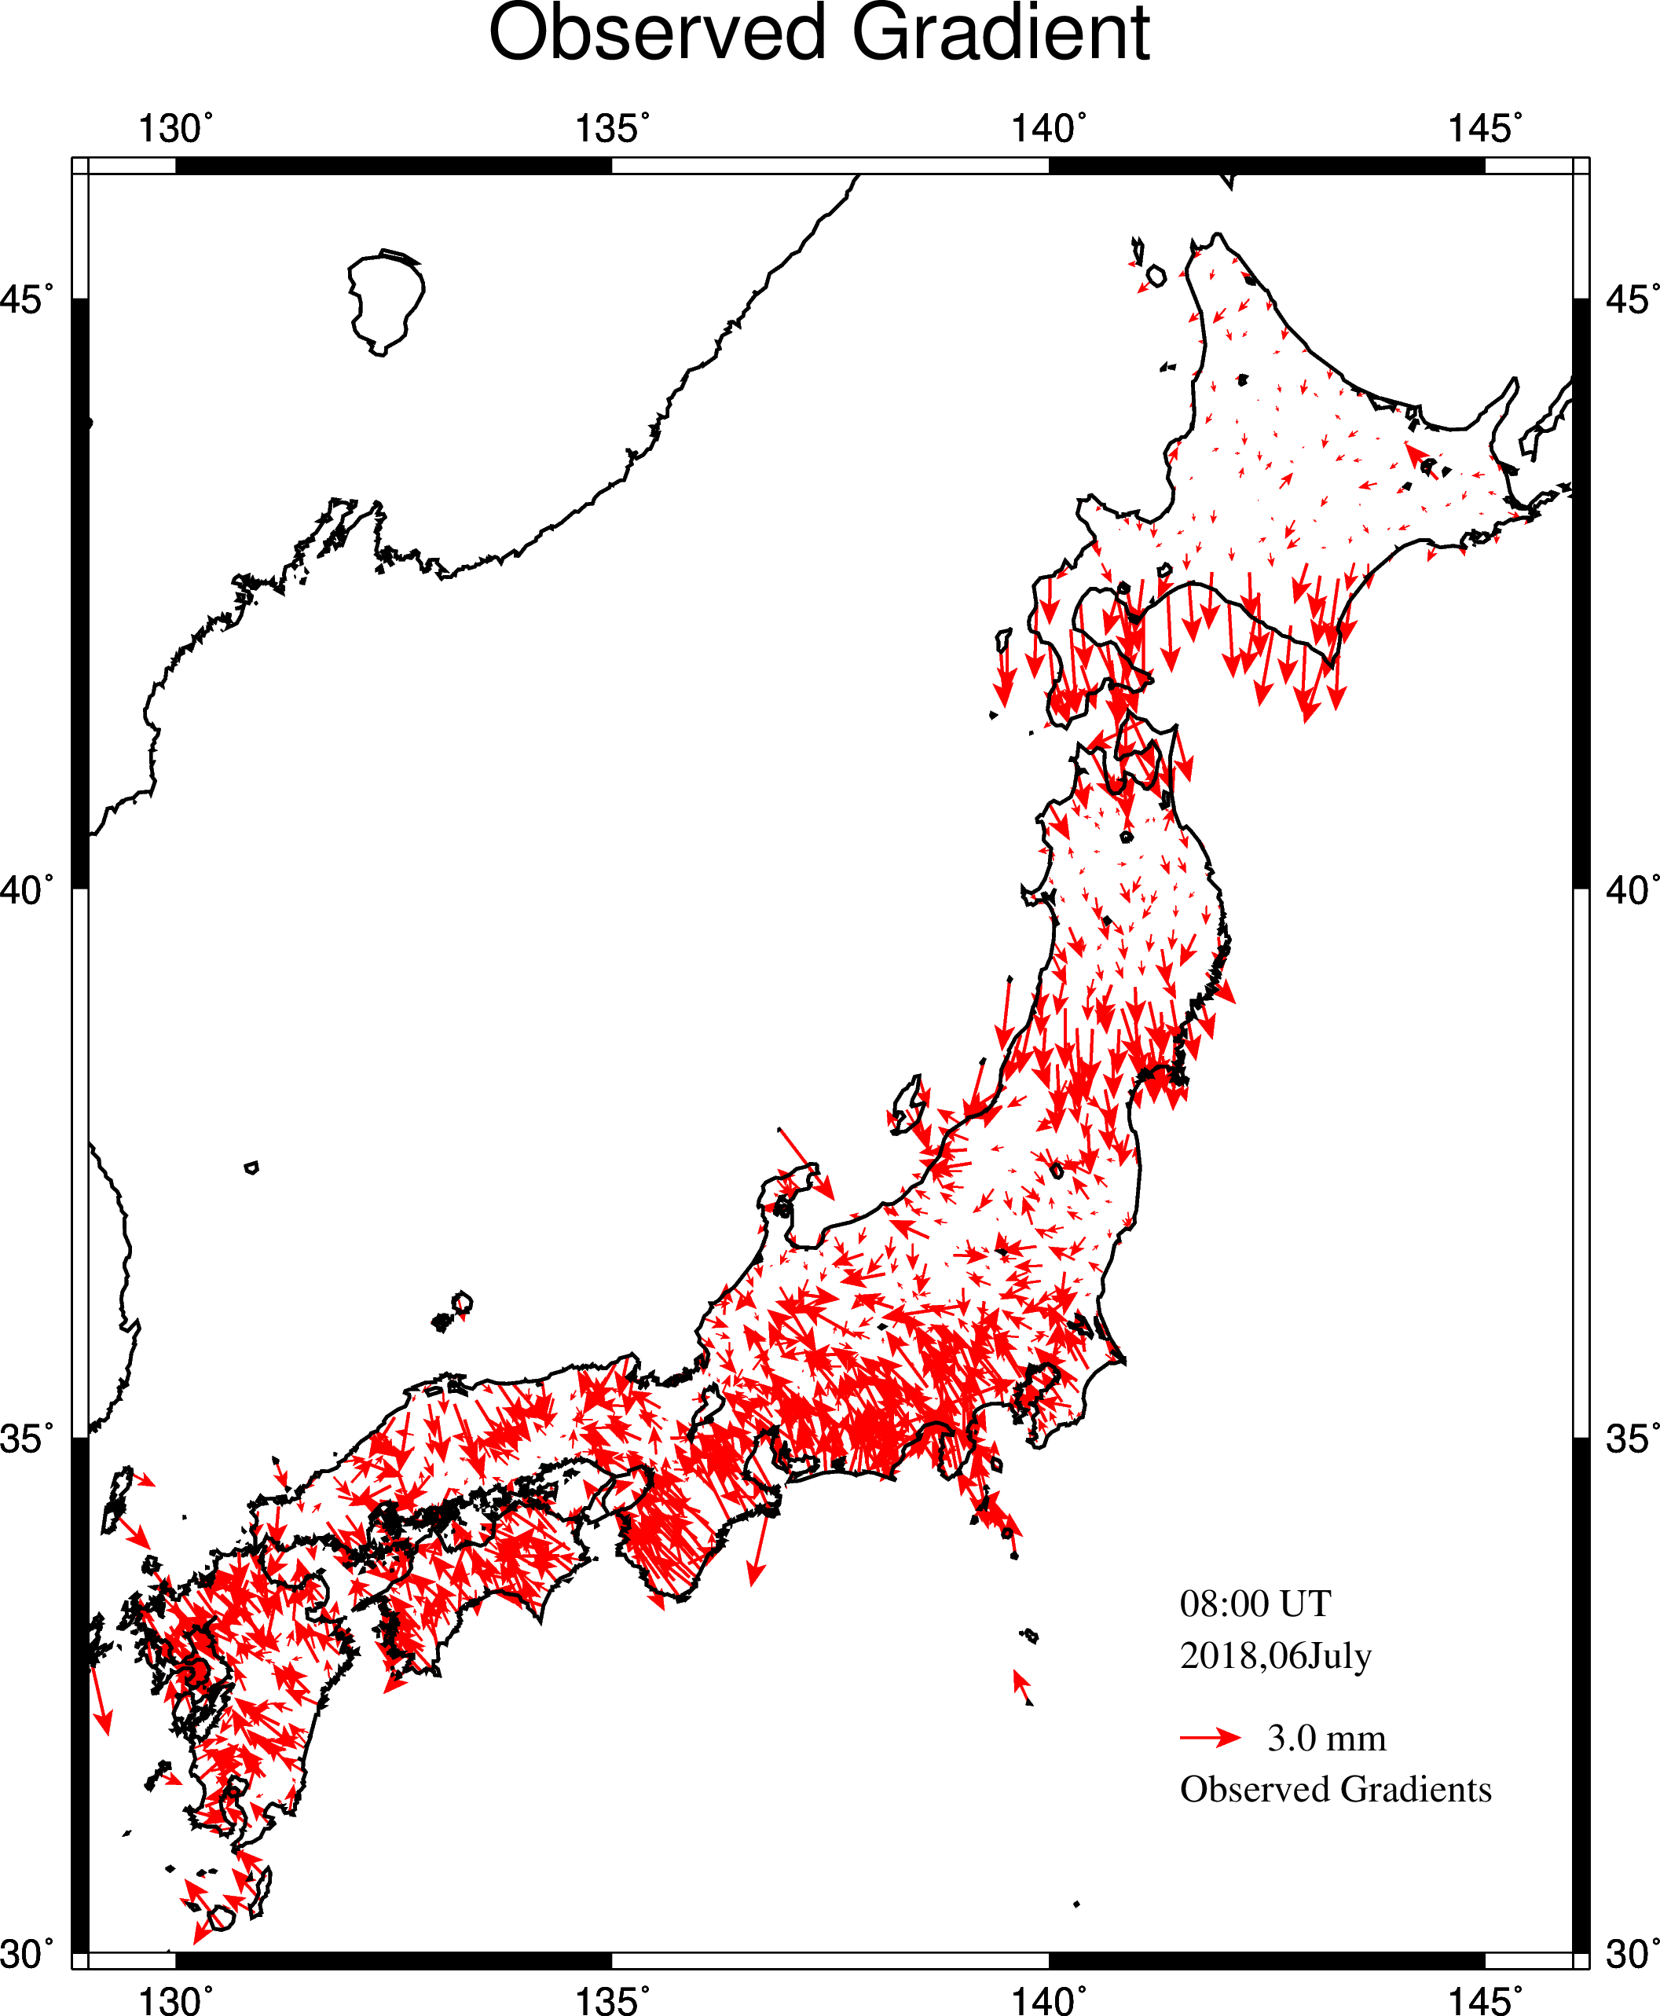
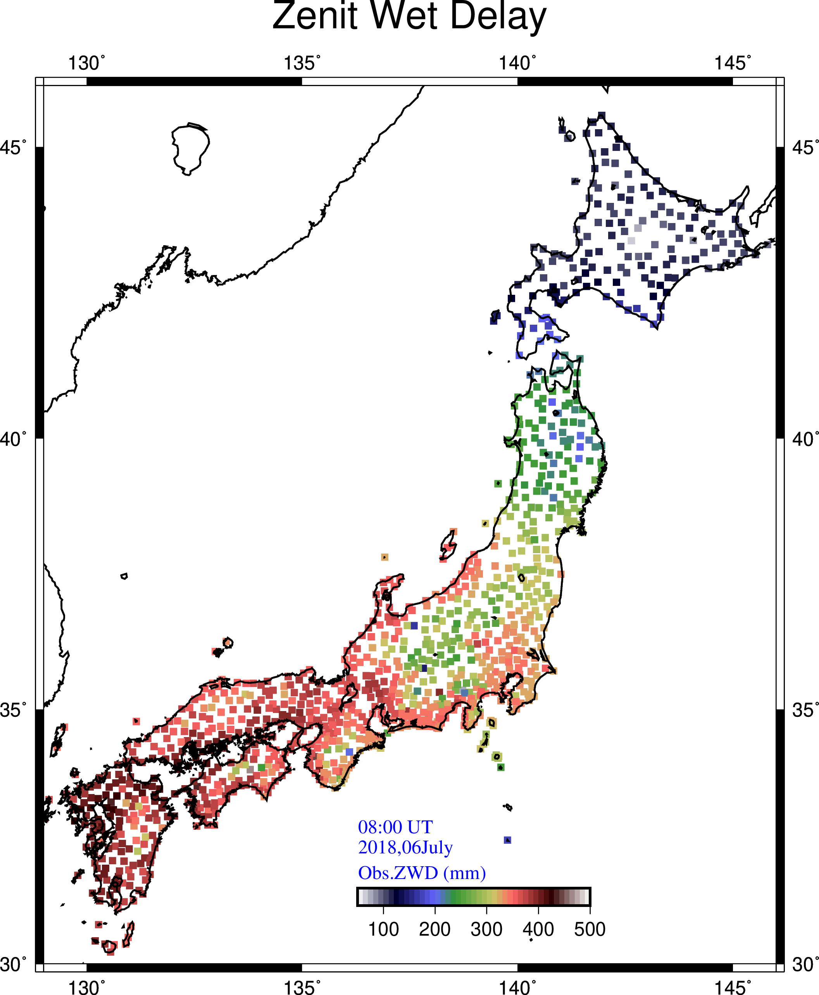
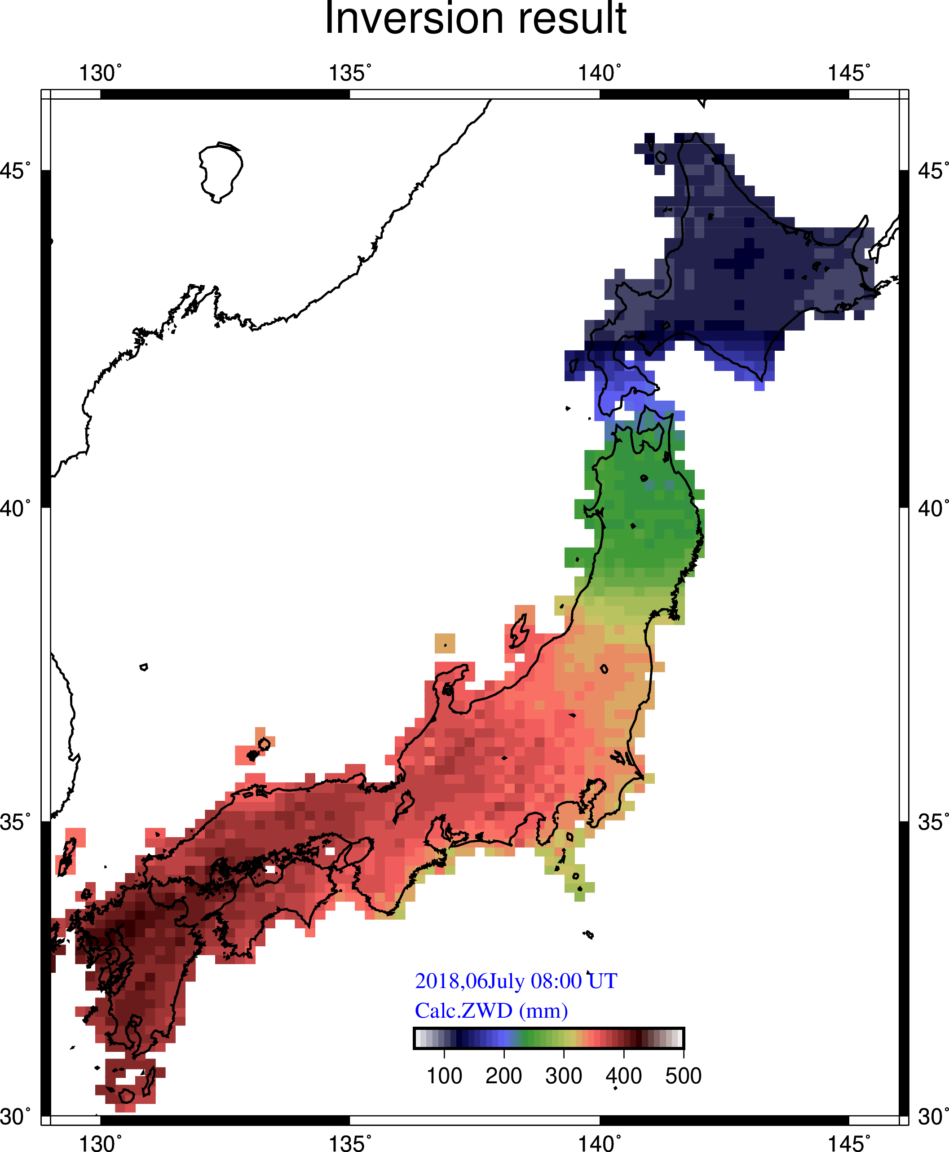
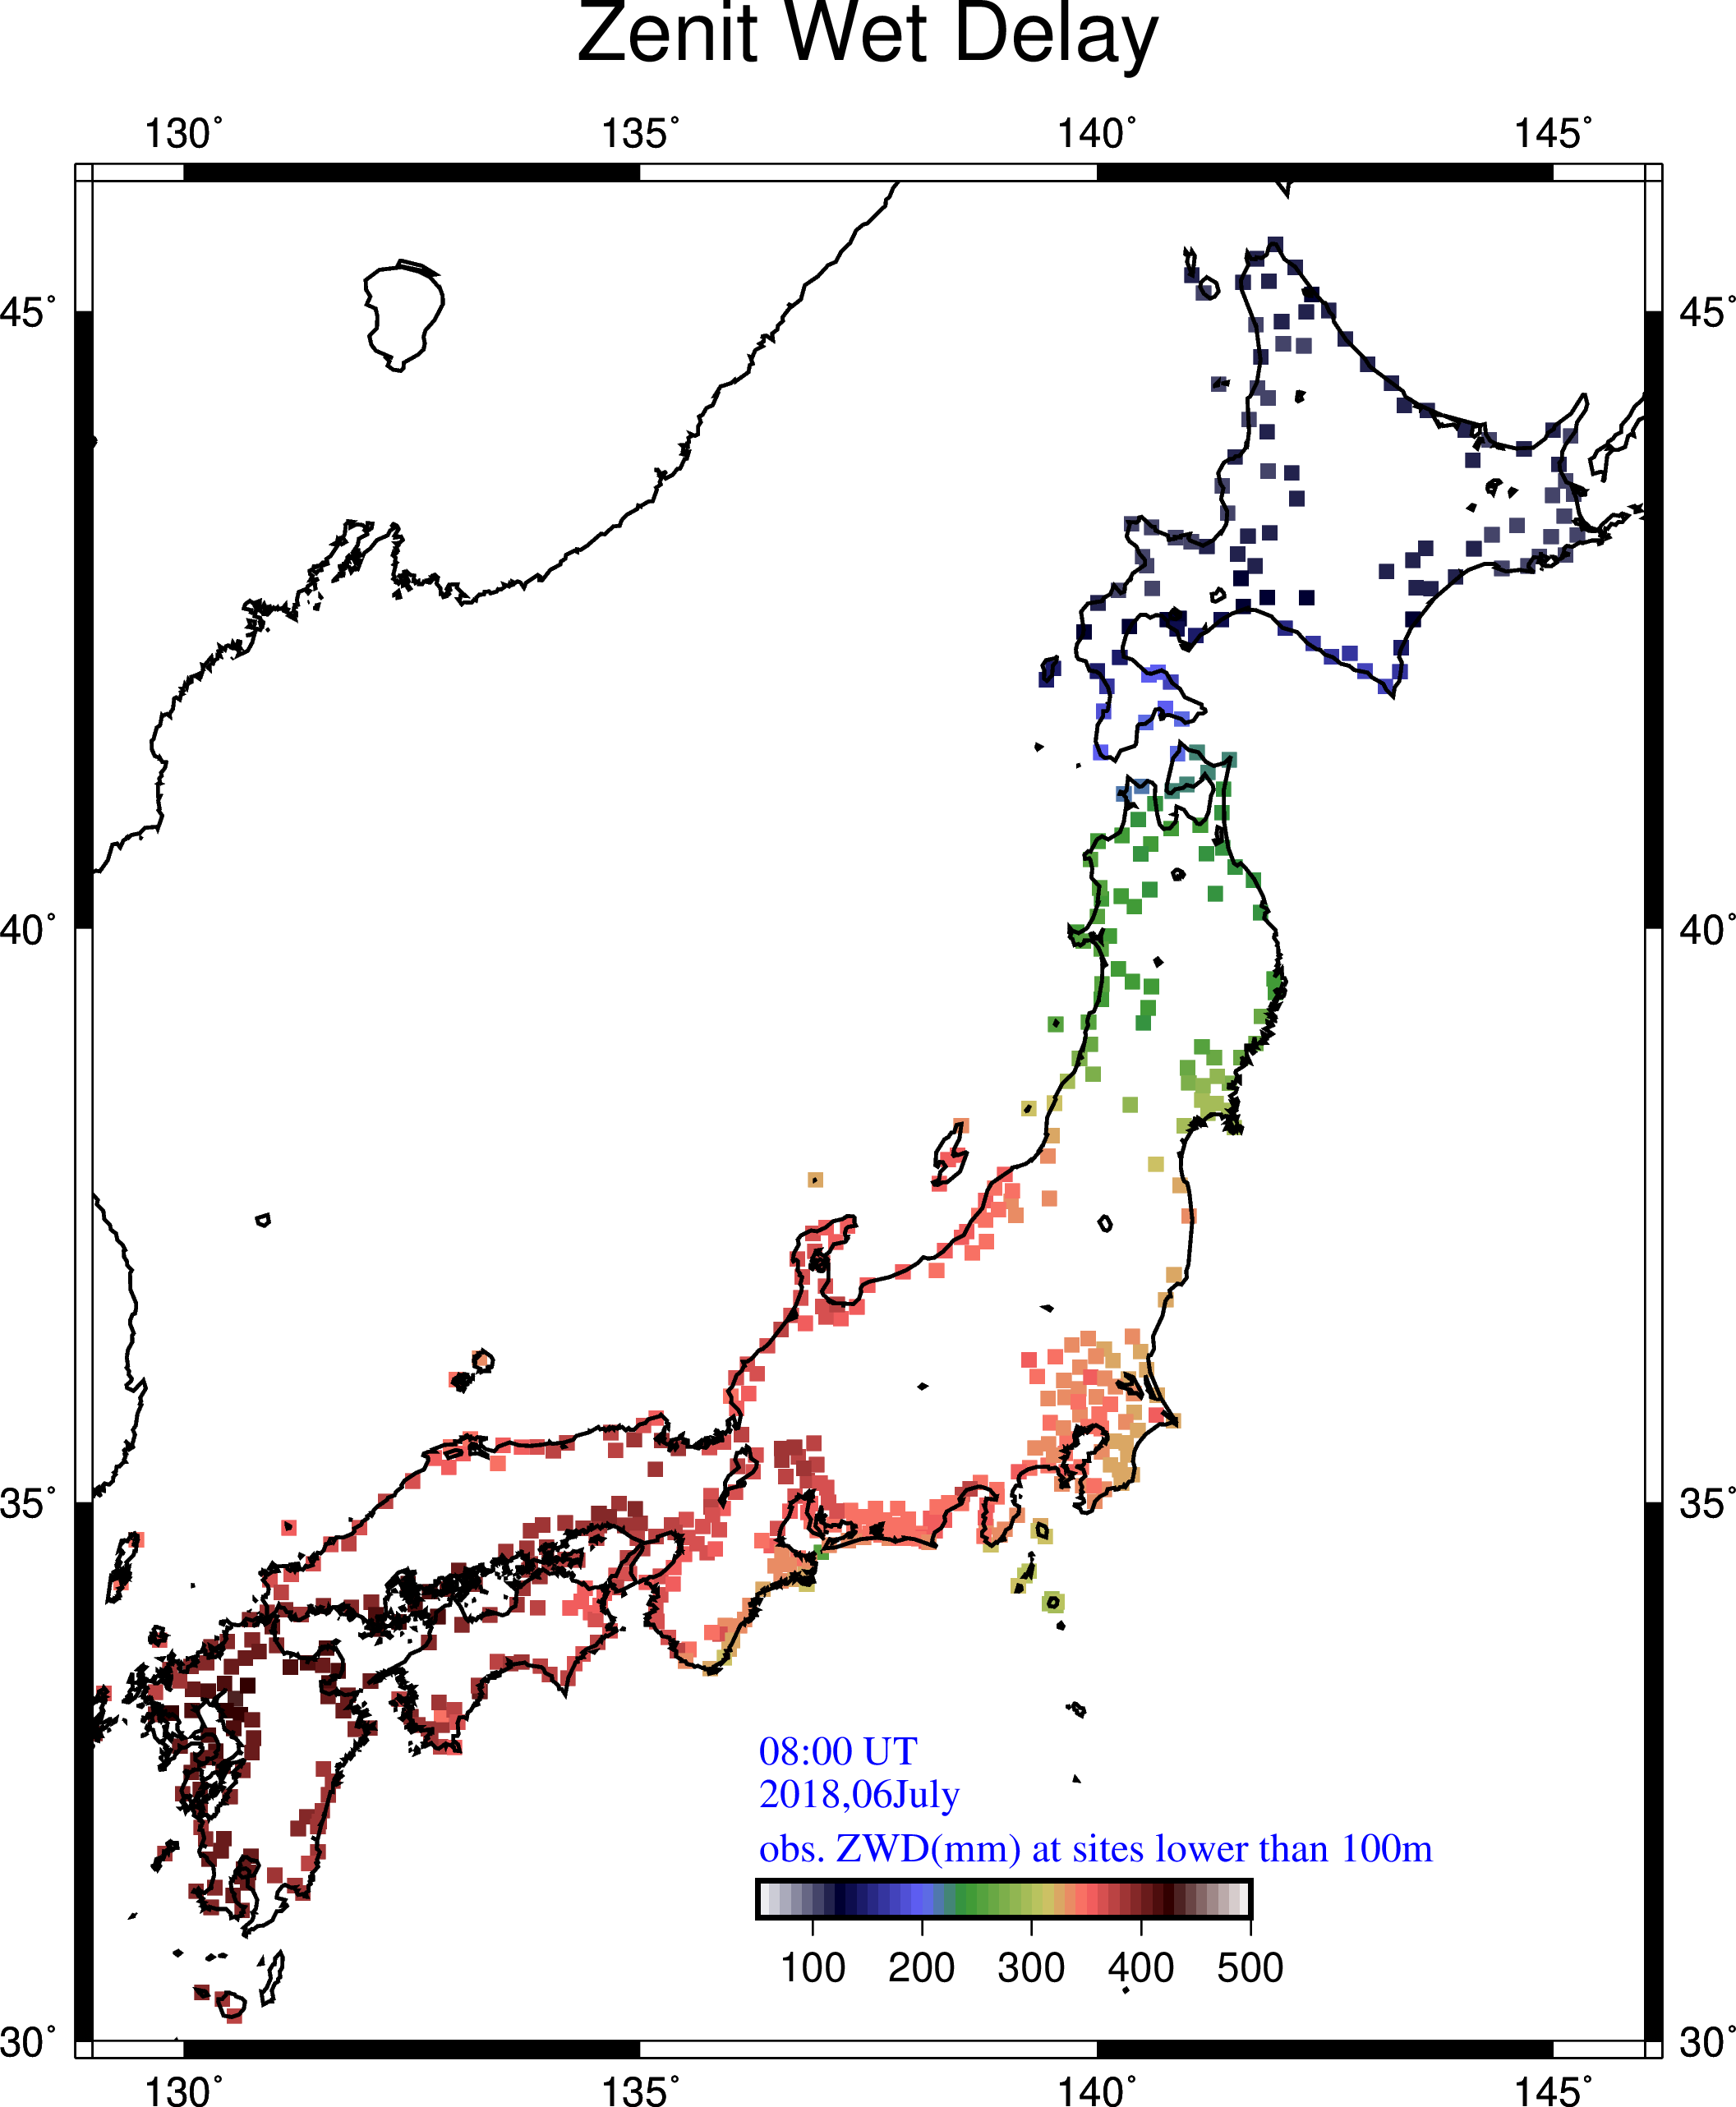
From Gradient to sea-level ZWD
+
→
Reconstructing sea-level ZWD
(all GEONET sites)
Input to the inversion
(Gradient vectors at all sites)
Believe only low stations
(ZWD at sites lower than 100 m)
ZWD does not show a large value
(because the altitude is high)
Low apparent ZWD in highland
Reconstruction of ZWD converted to sea-level zero

Slide 13
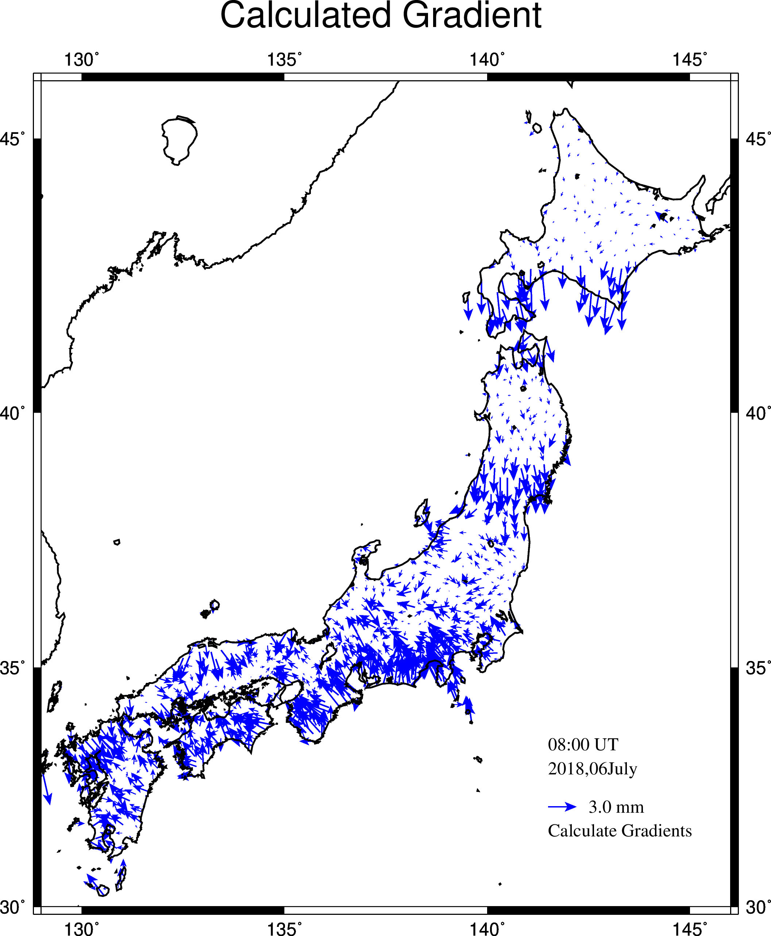
Gradient: Observed vs. Calculated
# Sites: 1124
# Blocks: 1825
WV Scale height: 3.5 km
Assumed ZWD error: 10.0 mm
Good coincidence (RMS: 0.654 mm)
Observed
Calculated
Recovered sea-level ZWD

Slide 14
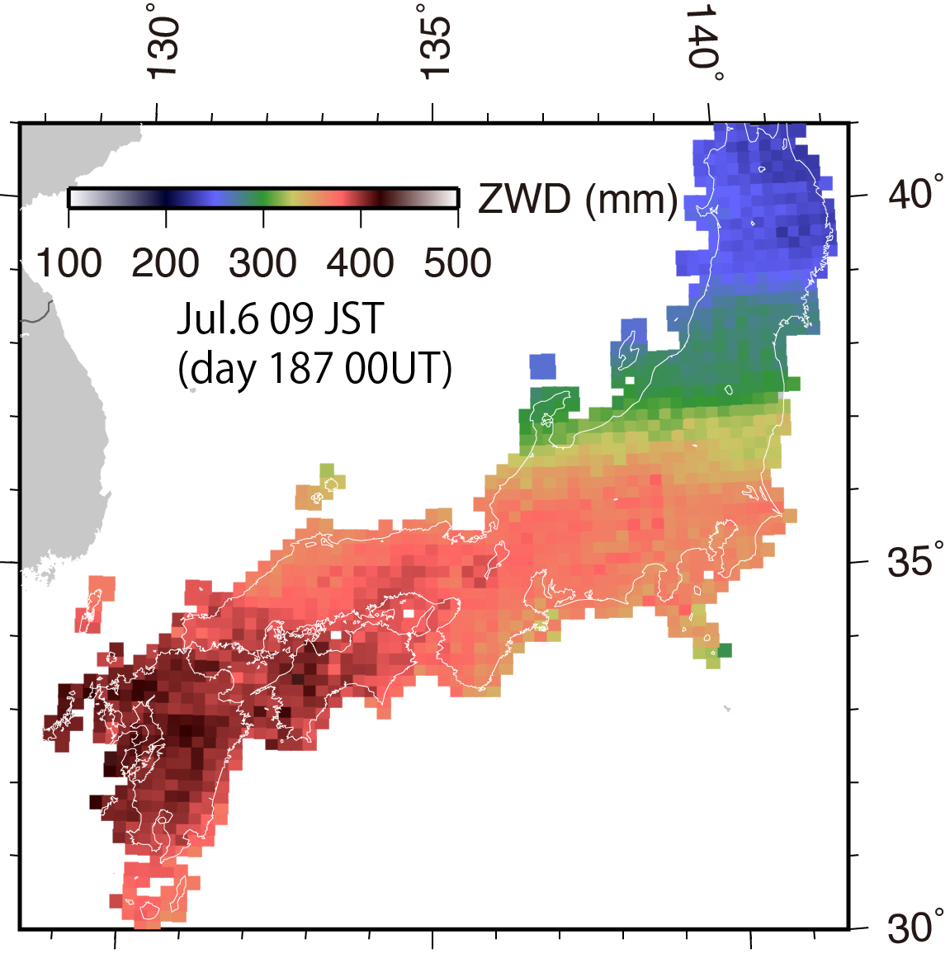
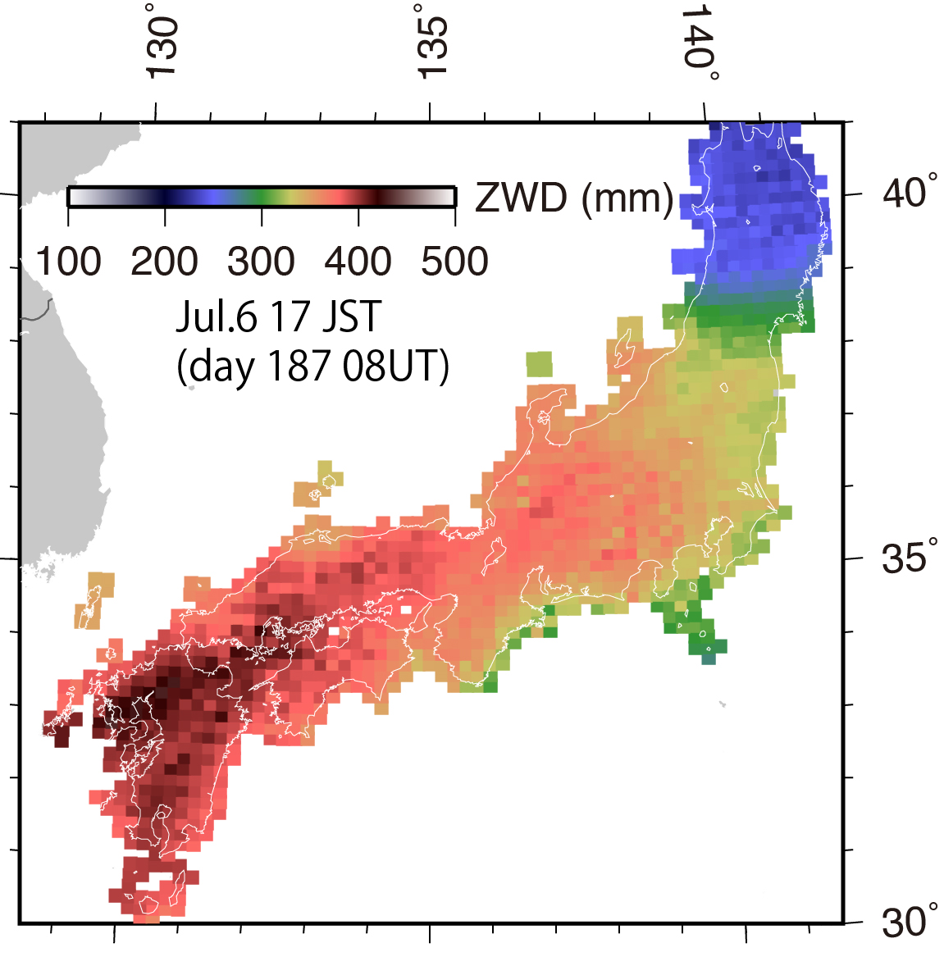
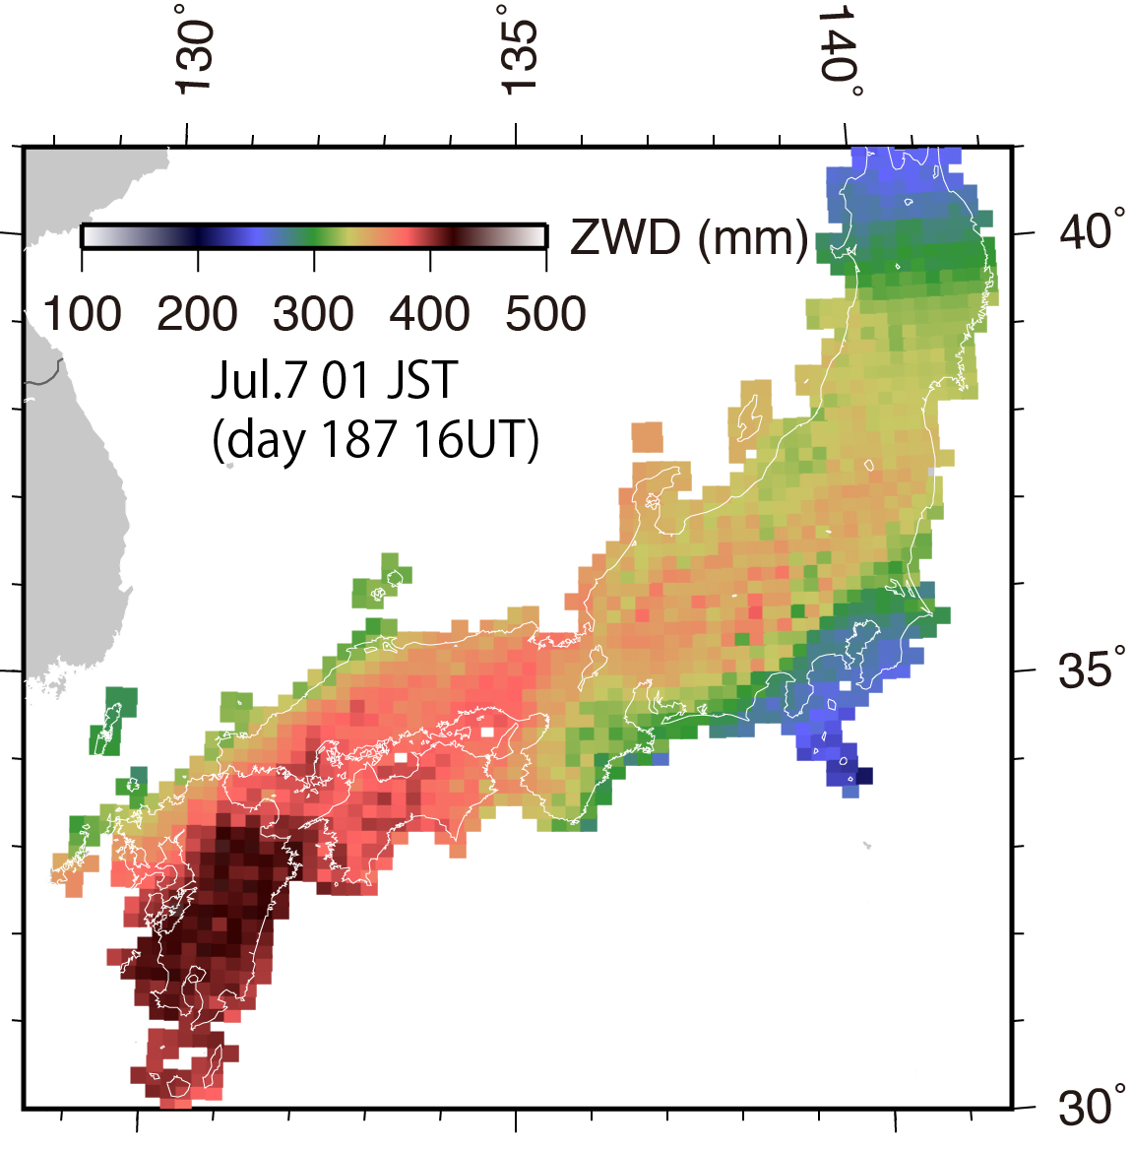
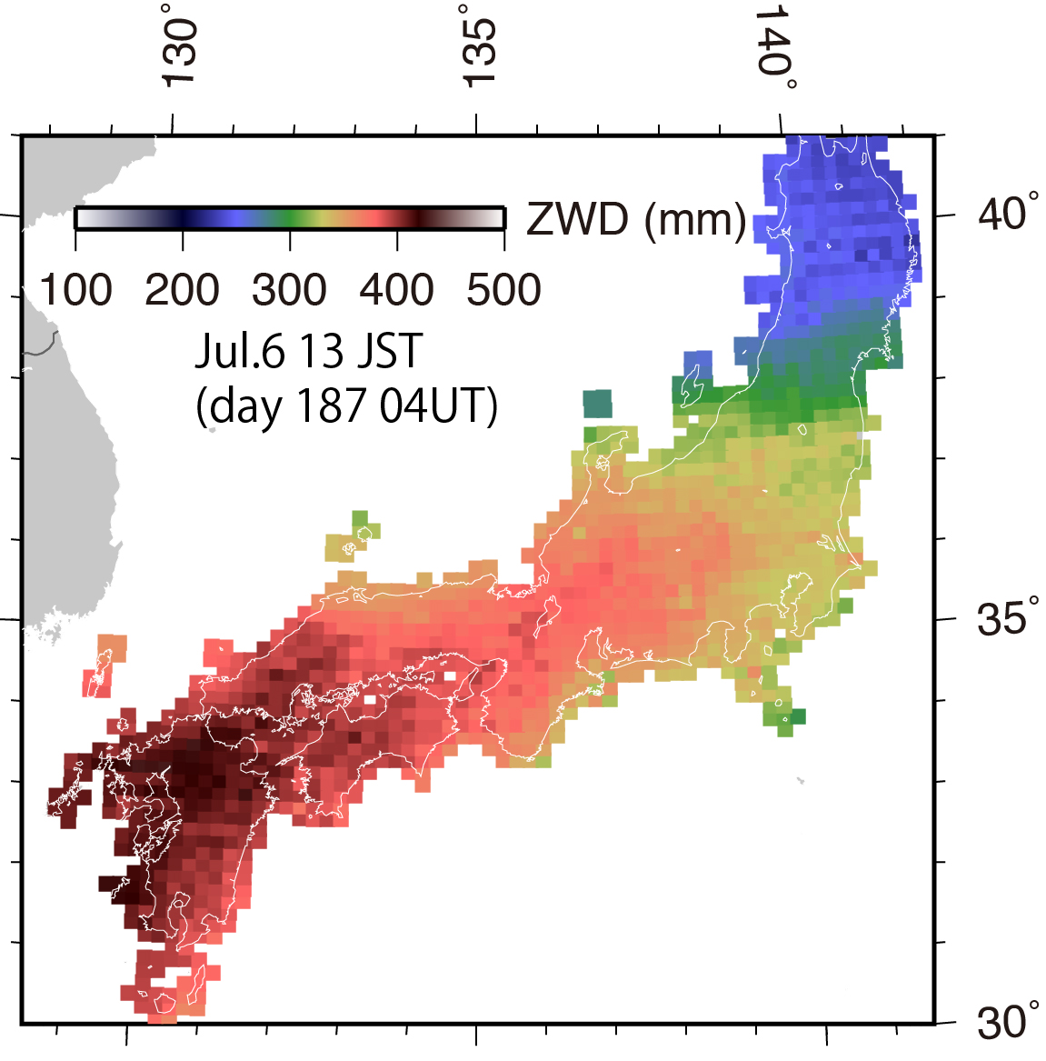
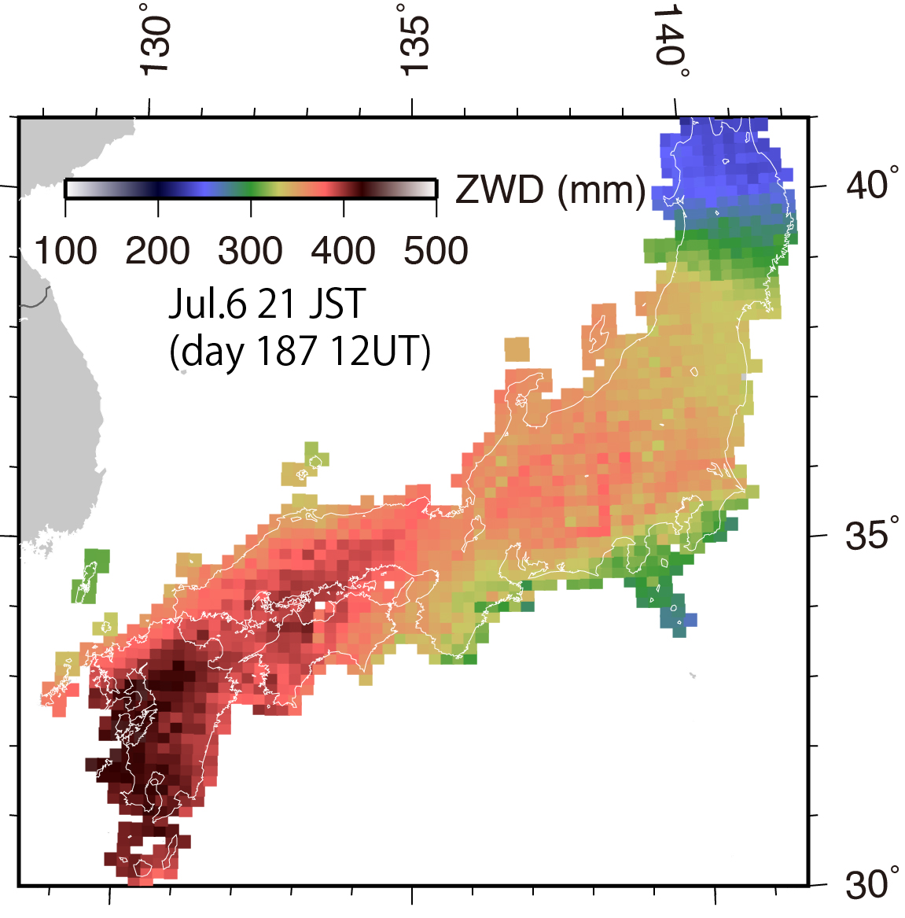
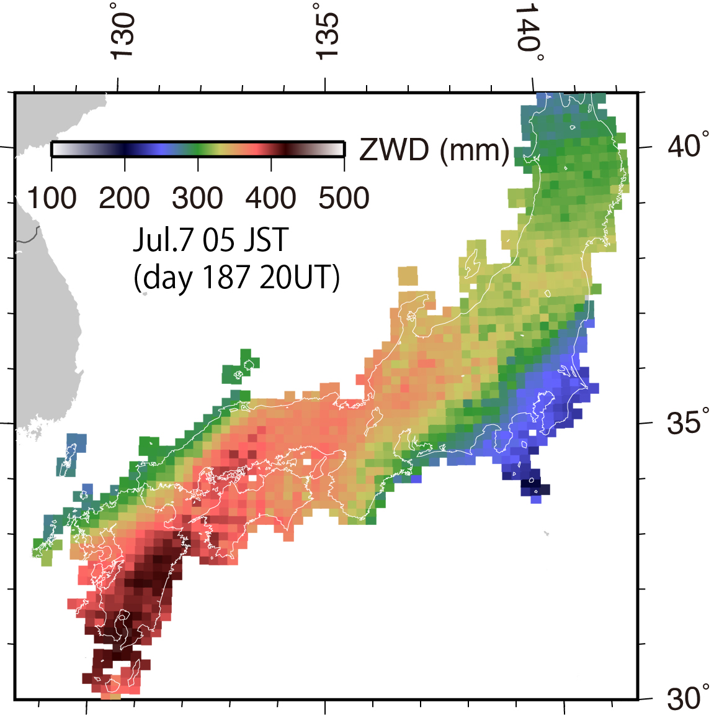
Sea-level ZWD at Peak Rainfall
Peak rainfall
Jul.6 17 JST
ZWD lacks spatial resolution
How to pinpoint heavy rain?

Slide 15
Two new key quantities used in this study
1. Sea-level ZWD
Estimated from coastal ZWD and gradient
2. Water vapor concentration (WVC) index (Shoji, 2013)
Calculated from gradient

Slide 16
Water vapor convergence index (WVC index) Shoji (2013)
convergence of gradient G
Definition
WVC index = −∇²ZWD(x, y) (originally, ZWD is PWV)
= −[∂²ZWD(x, y)/∂x² + ∂²ZWD(x, y)/∂y²]
Calculation
Method #1.
WVC index(i, j) = − [x(i+1,j) − 2x(i,j) + x(i−1,j)]/D_{e}²
− [x(i,j+1) − 2x(i,j) + x(i,j−1)]/D_{n}²
x : estimated sea-level ZWD
Method #2. (easier)
WVC index (i, j) = ∂(G_{x}/h_{s})/∂x + ∂(G_{y}/h_{s})/∂y
h_{s} : scale height of water vapor
D_{e}
j+1
j
j-1
D_{n}
(i, j)
i-1 i i+1

Slide 17
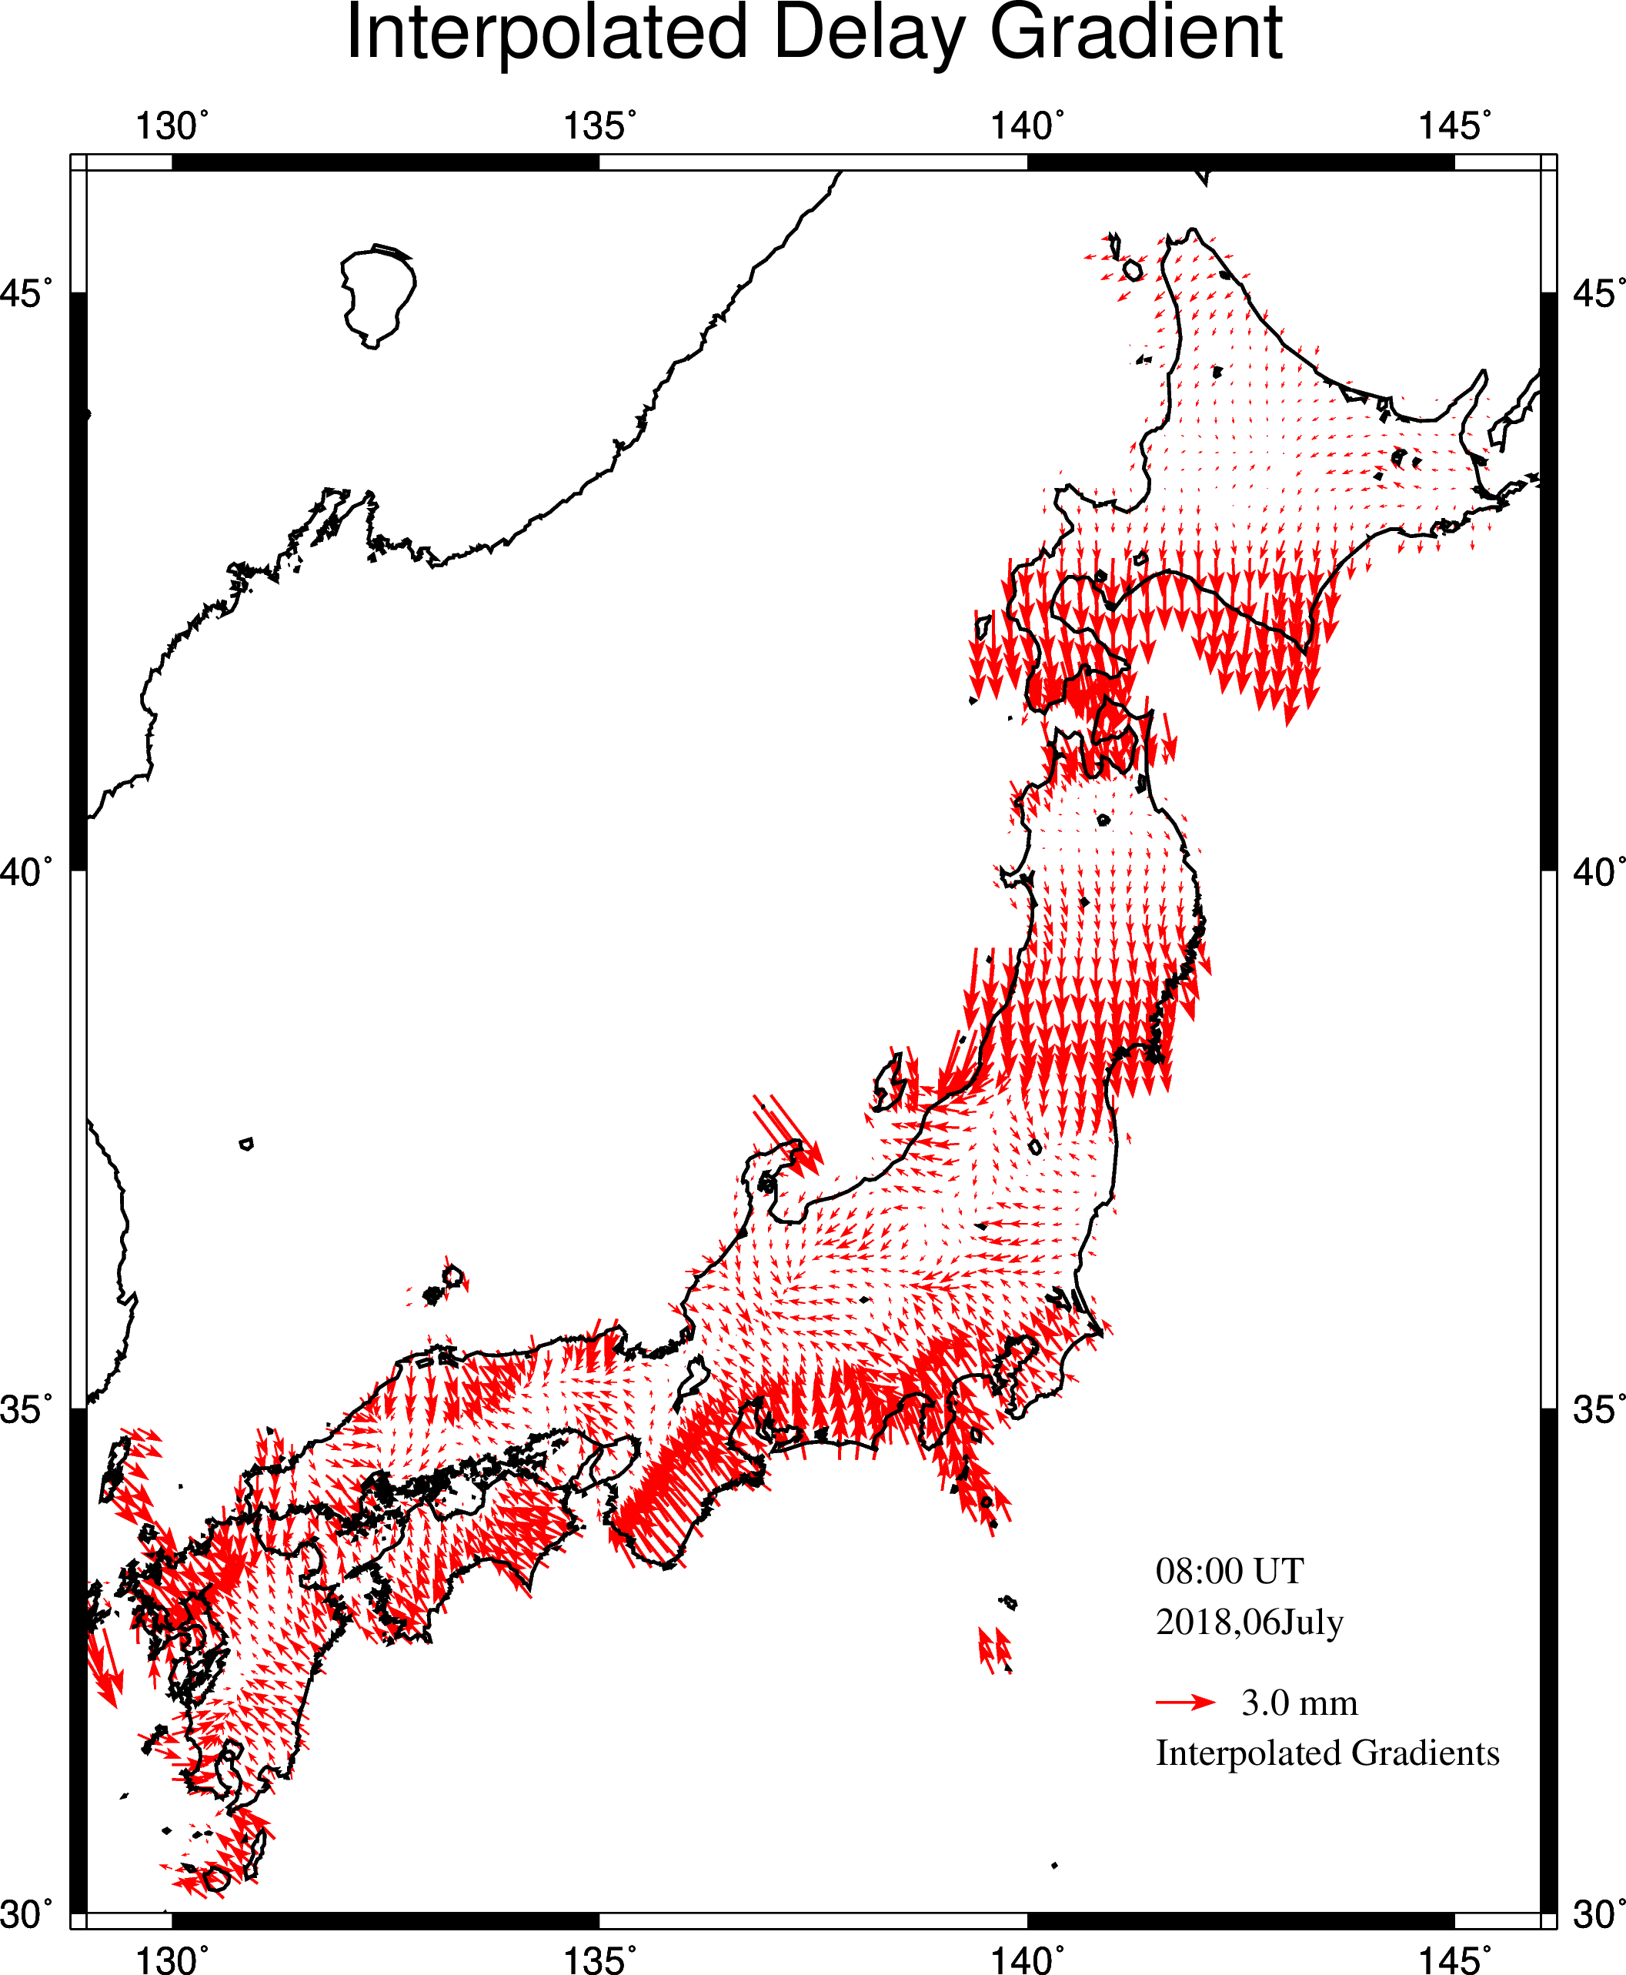
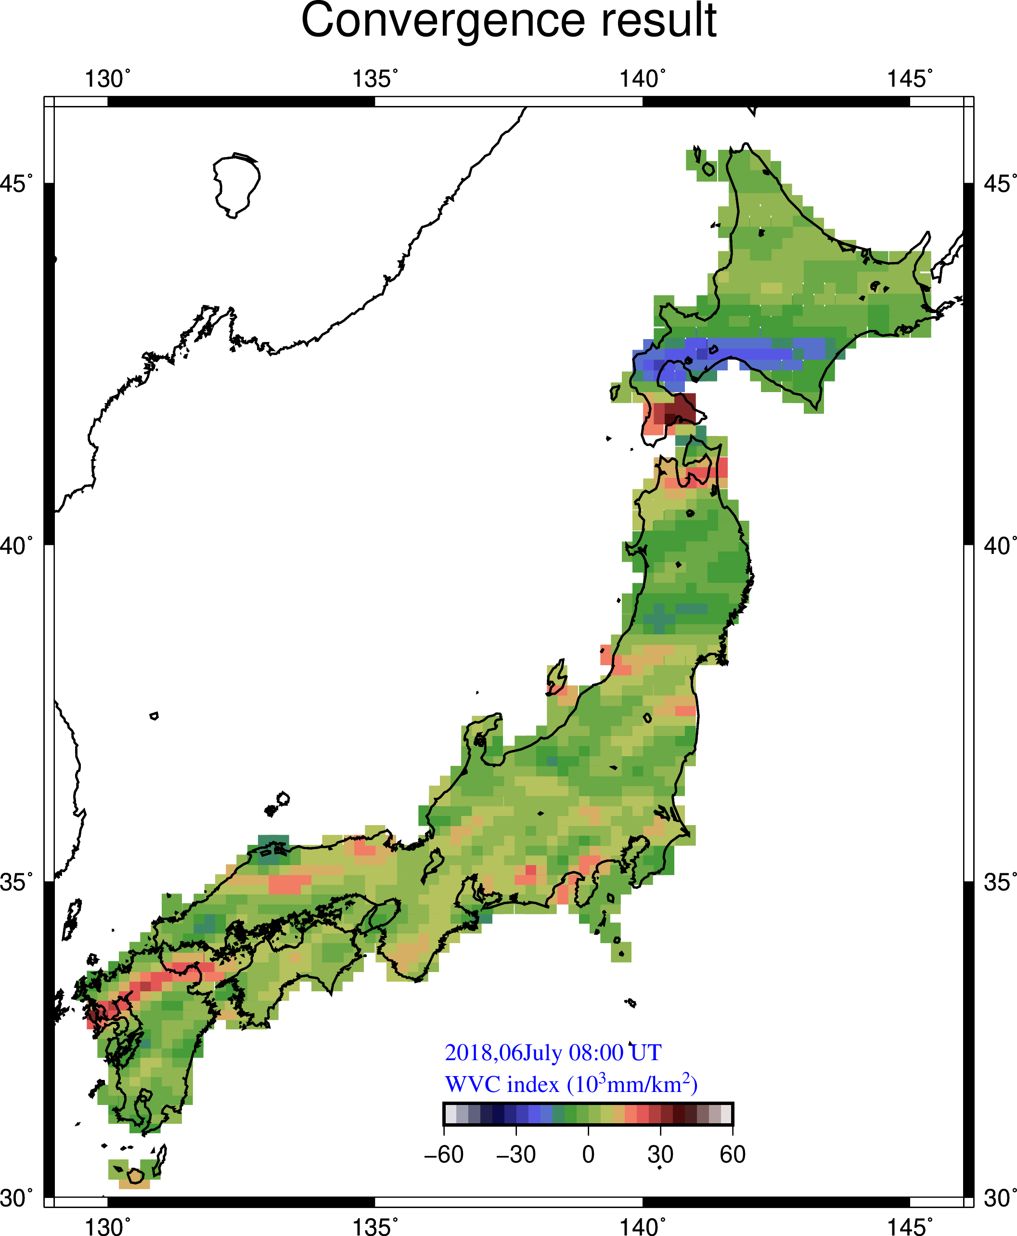
From Gradient to WVC index
Observed Gradient
Gradient at grid points
WVC index (∝ −∇⋅G)

Slide 18
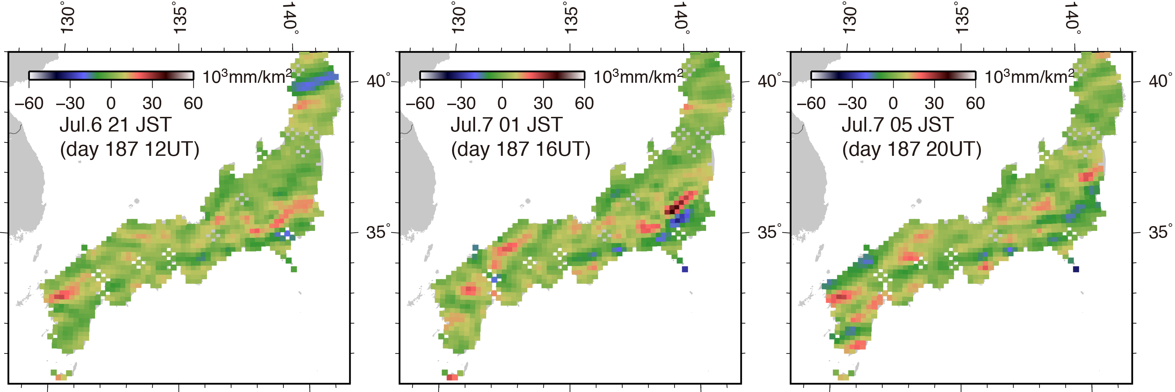
WVC index at Peak Rainfall
(day 187
(day 187
(day 187
WVC Index

Slide 19
Heavy rain occurs where both sea-level ZWD and WVC index are high
Case 1: 2018 Jul.6 Heavy Rain in SW Japan
WVC index pinpoints the heavy rain

Slide 20
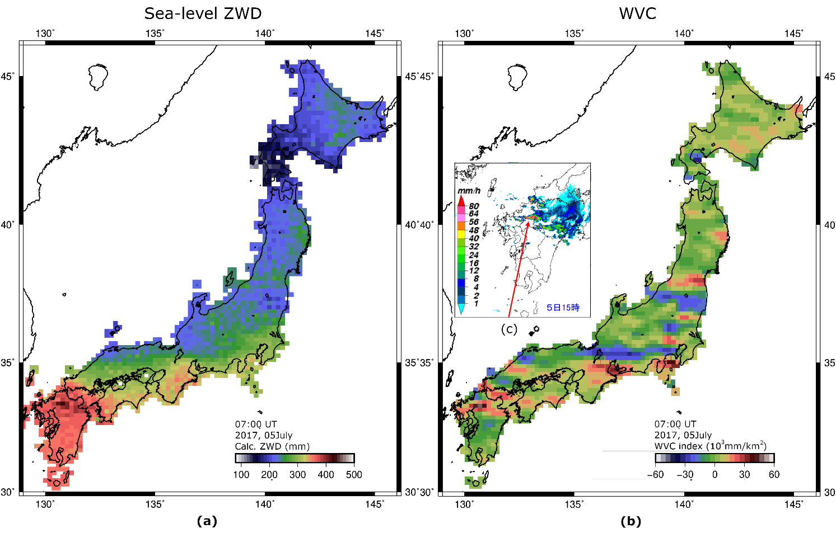
Case 2: 2017 Jul.5 Heavy Rain in SW Japan
Sea-level ZWD WVC index
2017 July 5
07 UT(16 JST)

Slide 21
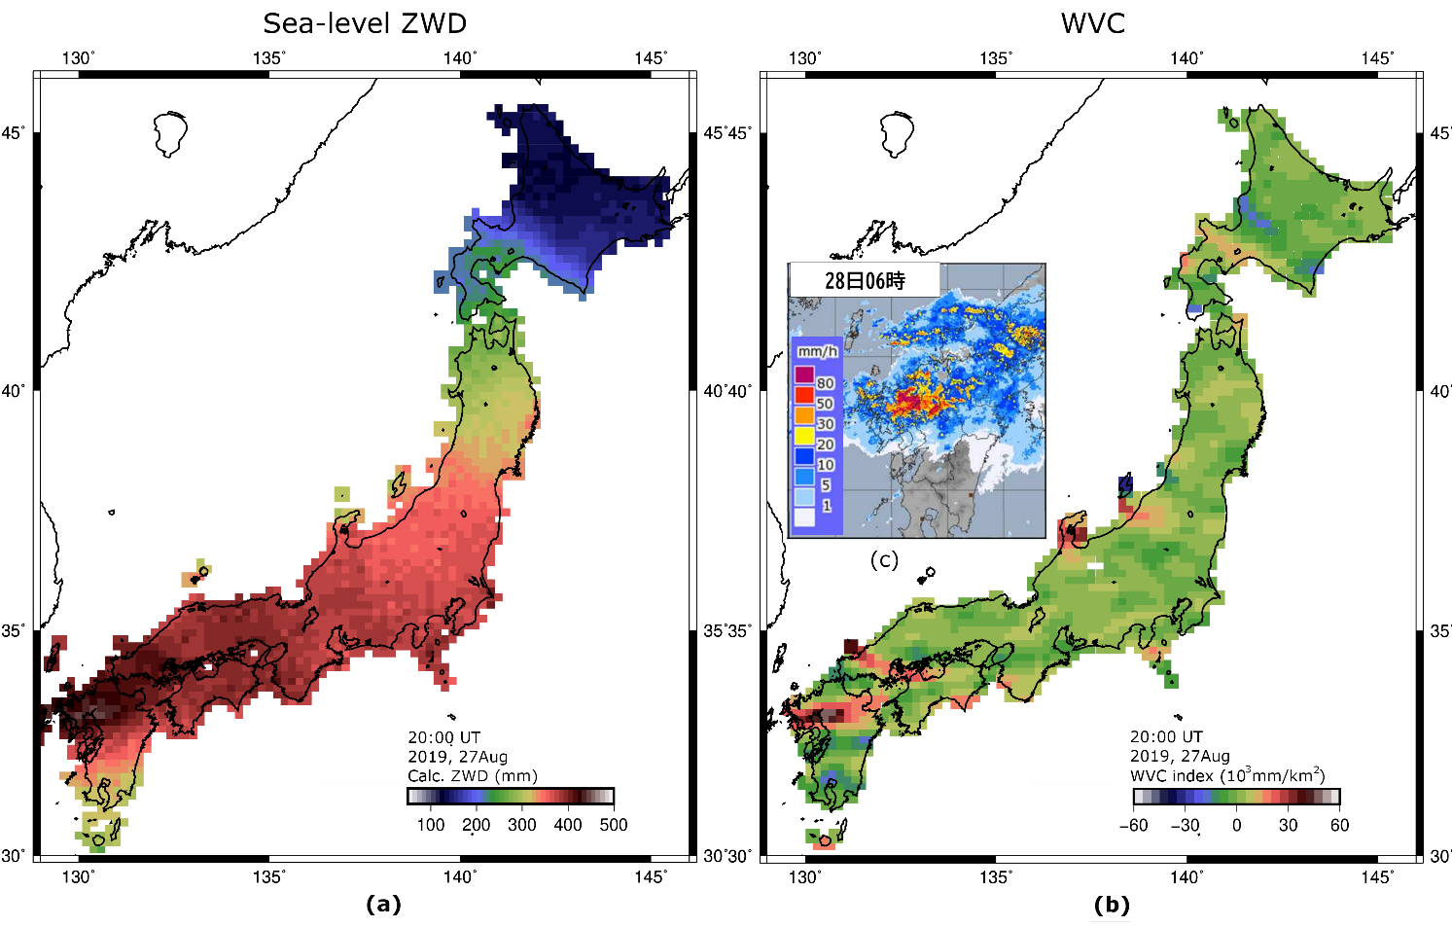
Case 3: 2019 Aug.27-28 Heavy Rain in SW Japan
Sea-level ZWD WVC index
2019 Aug 27 20UT
(Aug 28 05JST)

Slide 22
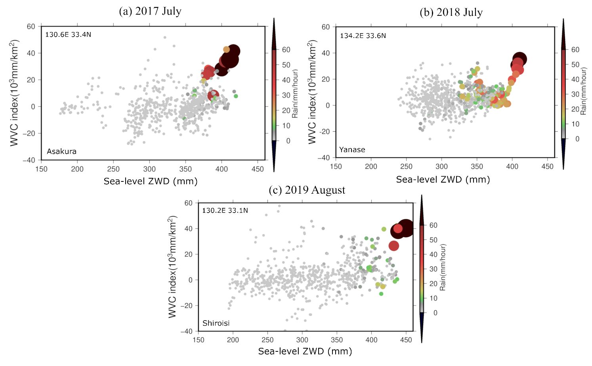
Higher possibility of heavy rain
WVC
Hourly plot
Sea-level ZWD
Heavy rain occurs when both sea-level ZWD and WVC index are high

Slide 23
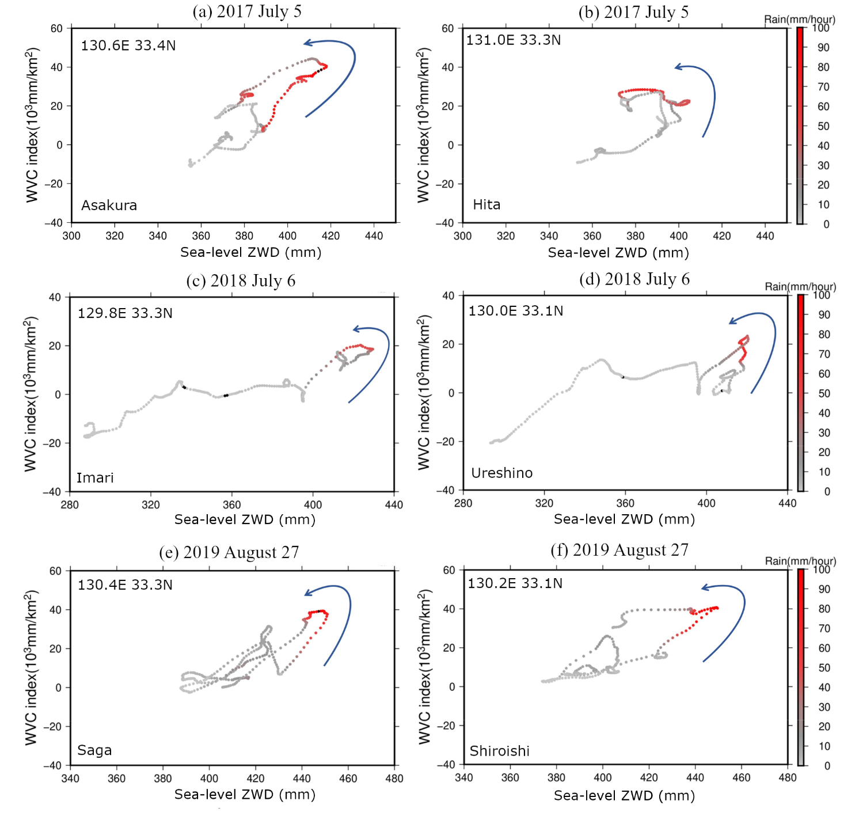
Every 5 minutes
Higher possibility of heavy rain
WVC
Sea-level ZWD
High time resolution plots

Slide 24
Summary
1. By using atmospheric delay gradients, we reconstruct sea-level ZWD, reflecting relative humidity of the air column above the GNSS station.
2. We studied heavy rain cases in SW Japan, 2017, 2018 and 2019
3. Heavy rain occurs when both sea-level ZWD and WVC index are high.
4. Monitoring these quantities is useful for the nowcast of heavy rains.

Slide 25
“The Sun after the rain is more beautiful than the Sun before the rain!”
― Mehmet Murat ildan

